Slide 1
Lesson 16.1
Mental Health Treatment: Past and Present

Slide 2

Mental Health Treatment: Past And Present₁
According to the Substance Abuse and Mental Health Services Administration (SAMHSA), in 2021, among the 57.8 million adults with any mental illness, 47.2% received treatment (NIMH, 2021).
Adults who received care in inpatient and outpatient settings and/or used prescription medication for psychological disorders
Children and adolescents also receive mental health services.
The Centers for Disease Control and Prevention's National Health and Nutrition Examination Survey (NHANES) found that approximately half (50.6%) of children with mental disorders had received treatment for their disorder within the past year (NIMH, n.d.-c).
Figure 2

Slide 3
Reflection Question₁
Can you think of some possible reasons for the differences in treatment rates between anxiety disorders and ADHD/conduct disorders?
What other disorders among children may have a higher rate of treatment?

Slide 4
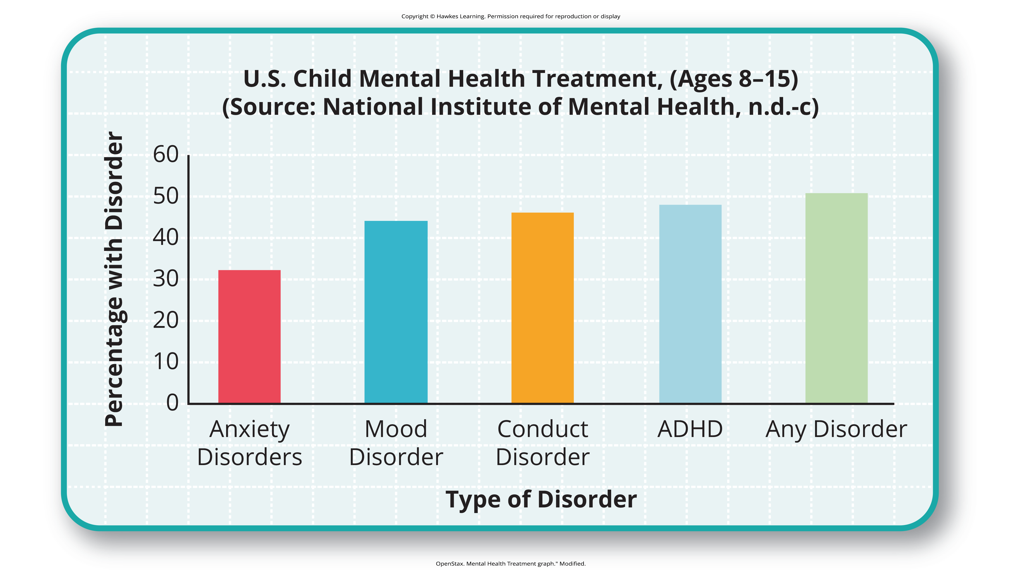
Lesson 16.1 Figure 3
Caption: About one third to one half of U.S. adolescents (ages 8 to 15) with mental disorders receive treatment, with behavior-related disorders more likely to be treated.

Slide 5
Treatment In The Past₁
Historically the mentally ill have been treated very poorly.
It was believed that mental illness was caused by demonic possession, witchcraft, or an angry god (Szasz, 1960).
Example: In medieval times, abnormal behaviors were viewed as a sign that a person was possessed by demons.
The most common treatment was exorcism, often conducted by priests or other religious figures: incantations and prayers were said over the person's body, and they may have been given some medicinal drinks.
Another form of treatment for extreme cases of mental illness was trephining: a small hole was made in the afflicted individual's skull to release spirits from the body.
Most people treated in this manner died.

Slide 6
Treatment In The Past₂
Other practices involved execution or imprisonment of people with psychological disorders.
From the late 1400s to the late 1600s, some religious organizations believed that people made pacts with the devil and committed horrible acts
Worldwide, it is estimated that tens of thousands of mentally ill people were killed after being accused of being witches or under the influence of witchcraft during this period.

Slide 7

Asylums
By the 18th century, people who were considered odd and unusual were placed in asylums (Figure 4).
Asylums were the first institutions created for the specific purpose of housing people with psychological disorders.
The focus was ostracizing them from society rather than treating their disorders.
People were kept in windowless dungeons, beaten, chained to their beds, and had little to no contact with caregivers
Figure 4

Slide 8
Group Activity₁
Discuss the pros and cons of the introduction of asylums.

Slide 9
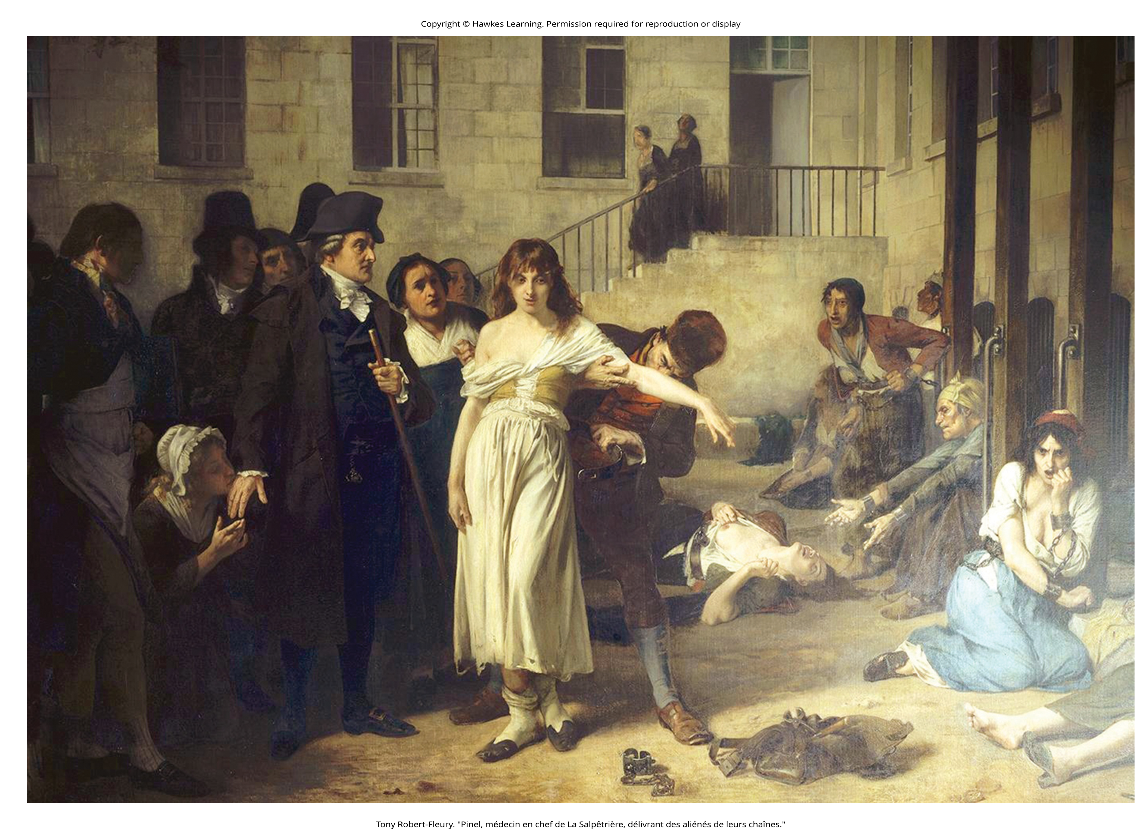
Treatment In The Past₃
In the late 1700s, a French physician, Philippe Pinel, argued for more humane treatment of the mentally ill.
Suggested that they be unchained and talked to
Applied this to patients at La Salpêtrière in Paris in 1795 (Figure 5)
Patients benefited from this more humane treatment, and many were able to leave the hospital.
Figure 5

Slide 10
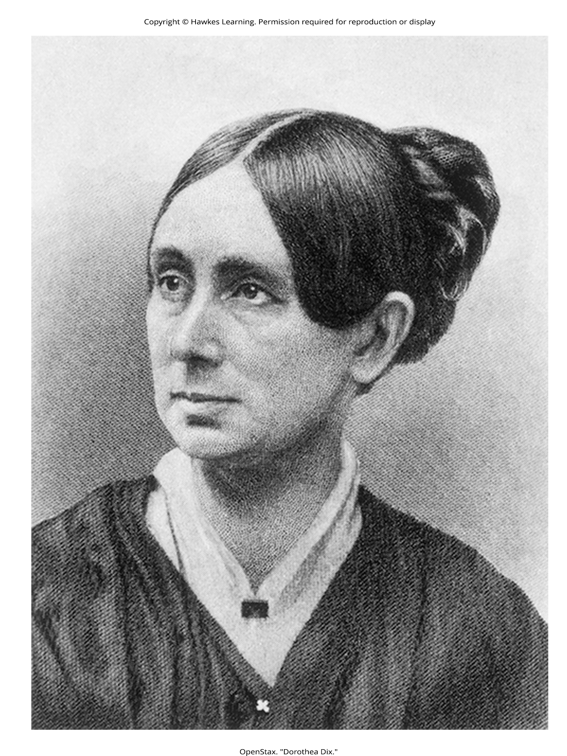
Treatment In The Past₄
In the 19th century, Dorothea Dix led reform efforts for mental health care in the United States (Figure 6).
Investigated how those who were mentally ill and poor were cared for
Discovered an underfunded and unregulated system that perpetuated abuse of this population (Tiffany, 1891)
Her effort led to the creation of the first mental asylums in the United States.
Despite efforts, a typical asylum was filthy, offered little treatment, and often kept people for decades.
Figure 6

Slide 11
Example: Willard Psychiatric Center in upstate New York
One treatment they used was to submerge patients in cold baths for long periods of time.
Electroshock treatment was also used, and the way the treatment was administered often broke patients' backs.
Electroshock is now called electroconvulsive treatment, and the therapy is still used, but with safeguards and under anesthesia.
Many of the wards and rooms were so cold that a glass of water would be frozen by morning (Willard Psychiatric Center, 2009).
Despite all of this, Willard's doors were not closed until 1995. Conditions like these remained commonplace until well into the 20th century.

Slide 12
Reflection Question₂
Why do you suppose that places like the Willard Psychiatric Center remained open into the 1990s?

Slide 13

Deinstitutionalization₁
Antipsychotic medications proved helpful in controlling the symptoms of certain psychological disorders, such as psychosis
Psychosis was often evidenced by symptoms like hallucinations and delusions, indicating a loss of contact with reality.
Common diagnosis of individuals in mental hospitals
The Mental Retardation Facilities and Community Mental Health Centers Construction Act provided federal support and funding for community mental health centers (National Institutes of Health, 2013).
Figure 7

Slide 14
Deinstitutionalization₂
This legislation started the process of deinstitutionalization by providing for people to stay in their communities and be treated locally.
Deinstitutionalization: process of closing large asylums and integrating people back into the community where they can be treated locally
In 1955, there were 558,239 severely mentally ill patients institutionalized at public hospitals (Torrey, 1997).
By 1994, by percentage of the population, there were 92% fewer hospitalized individuals (Torrey, 1997).

Slide 15

Mental Health Treatment Today₁
Community mental health centers can be found across the nation.
Located in neighborhoods near the homes of clients
Provide large numbers of people with mental health services of various kinds
After deinstitutionalization, those released from institutions were supposed to go to newly created centers, but the system was not set up effectively.
Research shows that consistent risk factors for homelessness are mental illness and drug addiction (Tsai & Rosenheck 2015; Thompson et al., 2013; Yamamoto et al., 2019).
Figure 8

Slide 16
Group Activity₂
Brainstorm some ways in which the current population of homeless individuals with mental illness could be reduced.

Slide 17
Mental Health Treatment Today₂
Another group of the mentally ill population is involved in the corrections system.
According to a 2006 special report by the Bureau of Justice Statistics (BJS), approximately 705,600 mentally ill adults were incarcerated in the state prison system, and another 78,800 were incarcerated in the federal prison system.
479,000 were in local jails.
The incarceration experience itself exacerbates existing issues, triggers disturbances, or leads to long-term effects such as PTSD, depression, or other disorders.
Instead of asylums there are psychiatric hospitals run by state governments and local community hospitals focused on short-term care.
Emphasis is on short-term stays
Insurance coverage often limits the length of time a person can be hospitalized for treatment.
Only if they are an imminent threat to themselves or others

Slide 18

Mental Health Treatment Today₃
Most people suffering from mental illnesses are not hospitalized.
If someone is feeling depressed, complains of hearing voices, or feels anxious all the time, they might seek psychological treatment.
Some people seek treatment because they are involved wit the state's child protective services.
Example: children have been removed from their care due to abuse or neglect
Figure 9

Slide 19
Involuntary Treatment
If an individual is mandated to attend therapy, they are seeking services involuntarily.
Involuntary treatment refers to therapy that is not the individual's choice.

Slide 20
Voluntary Treatment
Other individuals might voluntarily seek treatment.
Voluntary treatment means the person chooses to attend therapy to obtain relief from symptoms.

Slide 21
Reflection Question₃
Do you imagine that treatment success is influenced by whether the individual is there voluntarily or involuntarily?
How might success rates be increased for involuntary treatment?

Slide 22
Types Of Treatment
Psychological treatment can occur in a variety of places.
Community mental health center
Practitioner in a private or community practice
A child might see a school counselor, school psychologist, or school social worker.
An incarcerated person might receive group therapy in prison.
The following are individuals who can perform counseling and therapy services: psychologists, psychiatrists, clinical social workers, marriage and family therapists, and trained religious personnel

Slide 23
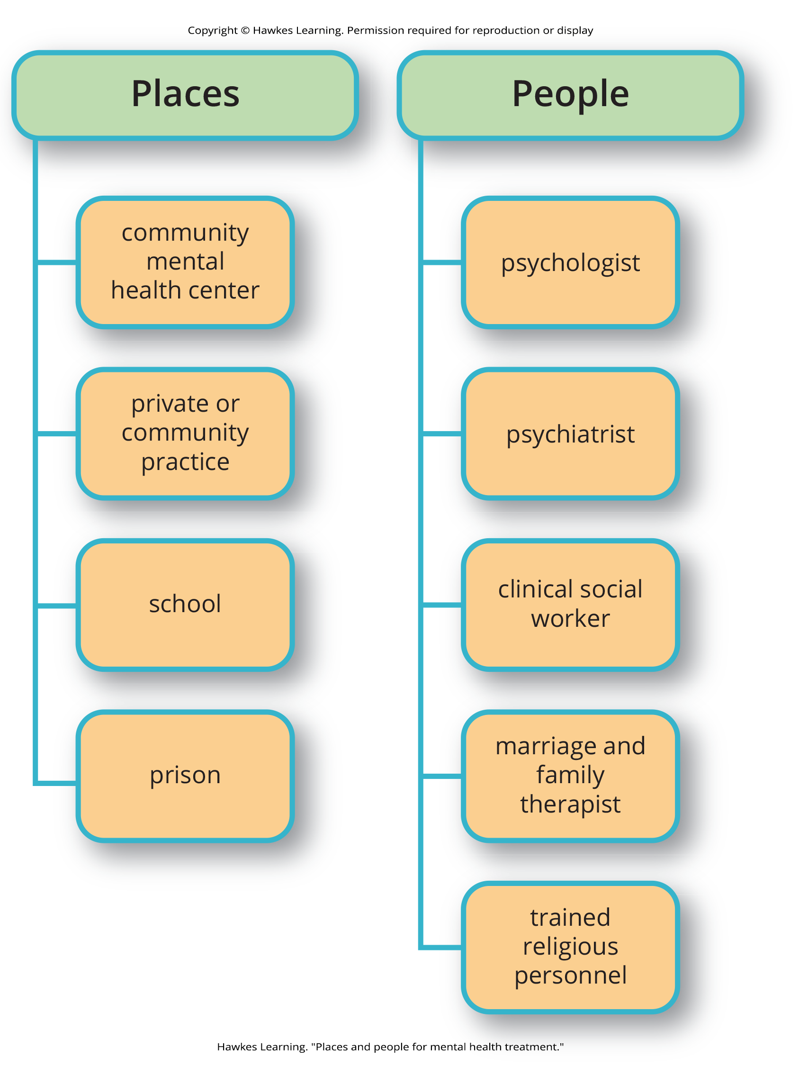
Lesson 16.1 Figure 10
Caption: There are several different places people can go and several different kinds of professionals people can see to seek mental health treatment.

Slide 24
Funding Mental Health Treatment
A range of funding sources pays for mental health treatment: health insurance, government funds, and private pay. +
The Mental Health Parity and Addiction Equity Act of 2008 which requires group health plans and insurers to make sure there is parity of mental health services (U.S. Department of Labor, n.d.).
In December of 2020, Congress enacted the Consolidated Appropriations Act (CAA).
Requires insurance companies to prove that they are complying with the Mental Health Parity and Addiction Equity Act of 2008 (APA, 2023)

Slide 25
Is It Easy To Find Treatment Sources?
Finding treatment sources is also not always easy for a variety of reasons, such as:
Limited options, especially in rural and low-income urban areas
Waiting lists
Poor quality of care available for indigent patients
Financial obstacles such as co-pays, deductibles, and time off work

Slide 26
Summary₁
In the past, people with psychological disorders or exhibiting strange behavior were believed to be possessed by demons and were subjected to exorcisms, imprisonment, or execution.
Asylums were later built to house the mentally ill, but patients received little to no treatment and faced cruel methods.
Philippe Pinel and Dorothea Dix advocated for more humane treatment of people with psychological disorders.

Slide 27
Summary₂
The deinstitutionalization movement in the mid-1960s led to the closure of asylums, enabling people with mental illnesses to return home or receive treatment in their communities, although many became homeless due to lack of resources.
Today, psychiatric hospitals run by state governments and local community hospitals emphasize short-term stays for mental illness treatment.
Most people suffering from mental illness are not hospitalized and can receive outpatient mental health services from various sources, including therapists, counselors, and social workers, covered through insurance, government funds, or private pay.

Slide 28
End of Hawkes Learning PowerPoint

