Slide 1
Lesson 16.2
Types of Treatment

Slide 2
Types Of Therapy
The two types of therapy are psychotherapy and biomedical therapy.
Both types of treatment help people with psychological disorders, such as depression, anxiety, and schizophrenia.
Psychotherapy is a psychological treatment that employs various methods to help someone overcome personal problems or attain personal growth.
Biomedical therapy involves medication and/or medical procedures to treat psychological disorders.

Slide 3
Various Psychotherapy Techniques
Psychodynamic psychotherapy
  Talk therapy based on belief that the unconscious and childhood conflicts impact behavior
Play therapy
  Psychoanalytical therapy wherein interaction with toys is used instead of talk; used in child therapy
Behavior therapy
  Principles of learning applied to change undesirable behaviors
Cognitive therapy
  Awareness of cognitive processes helps patients eliminate thought patterns that lead to distress
Cognitive-behavioral therapy
  Work to change cognitive distortions and self-defeating behaviors
Humanistic therapy
  Increase self-awareness and acceptance through focus on conscious thoughts

Slide 4
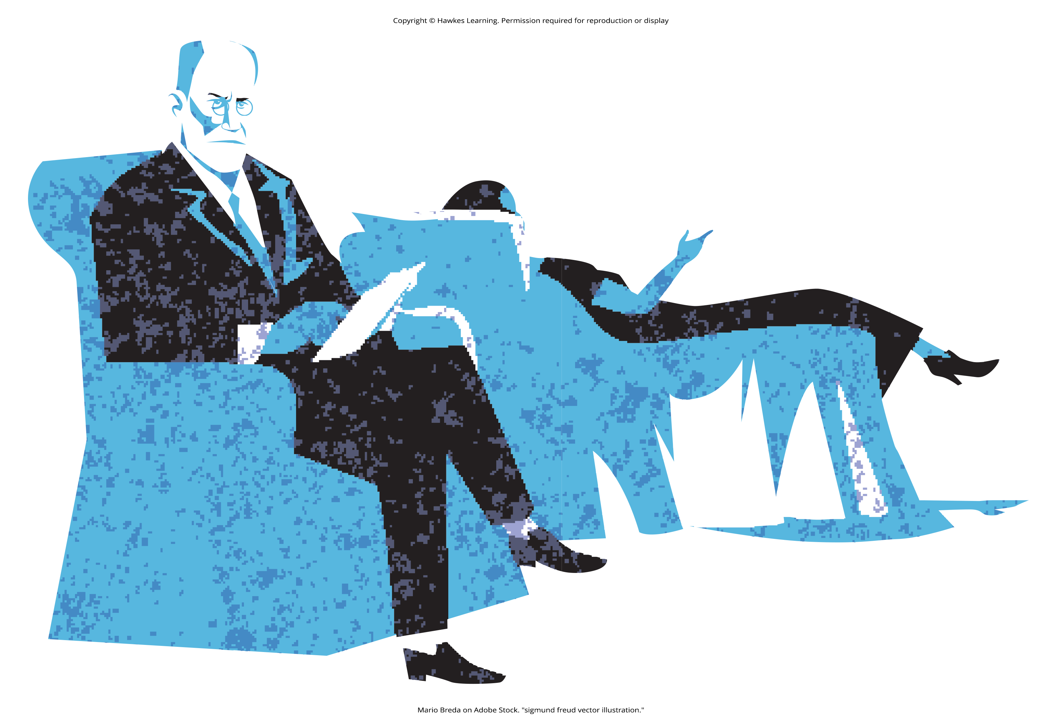
Psychotherapy: Psychoanalysis₁
Psychoanalysis was developed by Sigmund Freud and was the first form of psychotherapy.
  Dominant therapeutic technique in the early 20th century, but it has since waned significantly in popularity
Freud believed most of our psychological problems are the result of repressed impulses and trauma experienced in childhood.
He believed psychoanalysis would help uncover long-buried feelings
Freudian used methods such as free association and dream analysis.
  Free association: technique in psychoanalysis in which the patient says whatever comes to mind at the moment
  Dream analysis: technique in psychoanalysis in which patients recall their dreams and the psychoanalyst interprets them to reveal unconscious desires or struggles
Figure 1

Slide 5
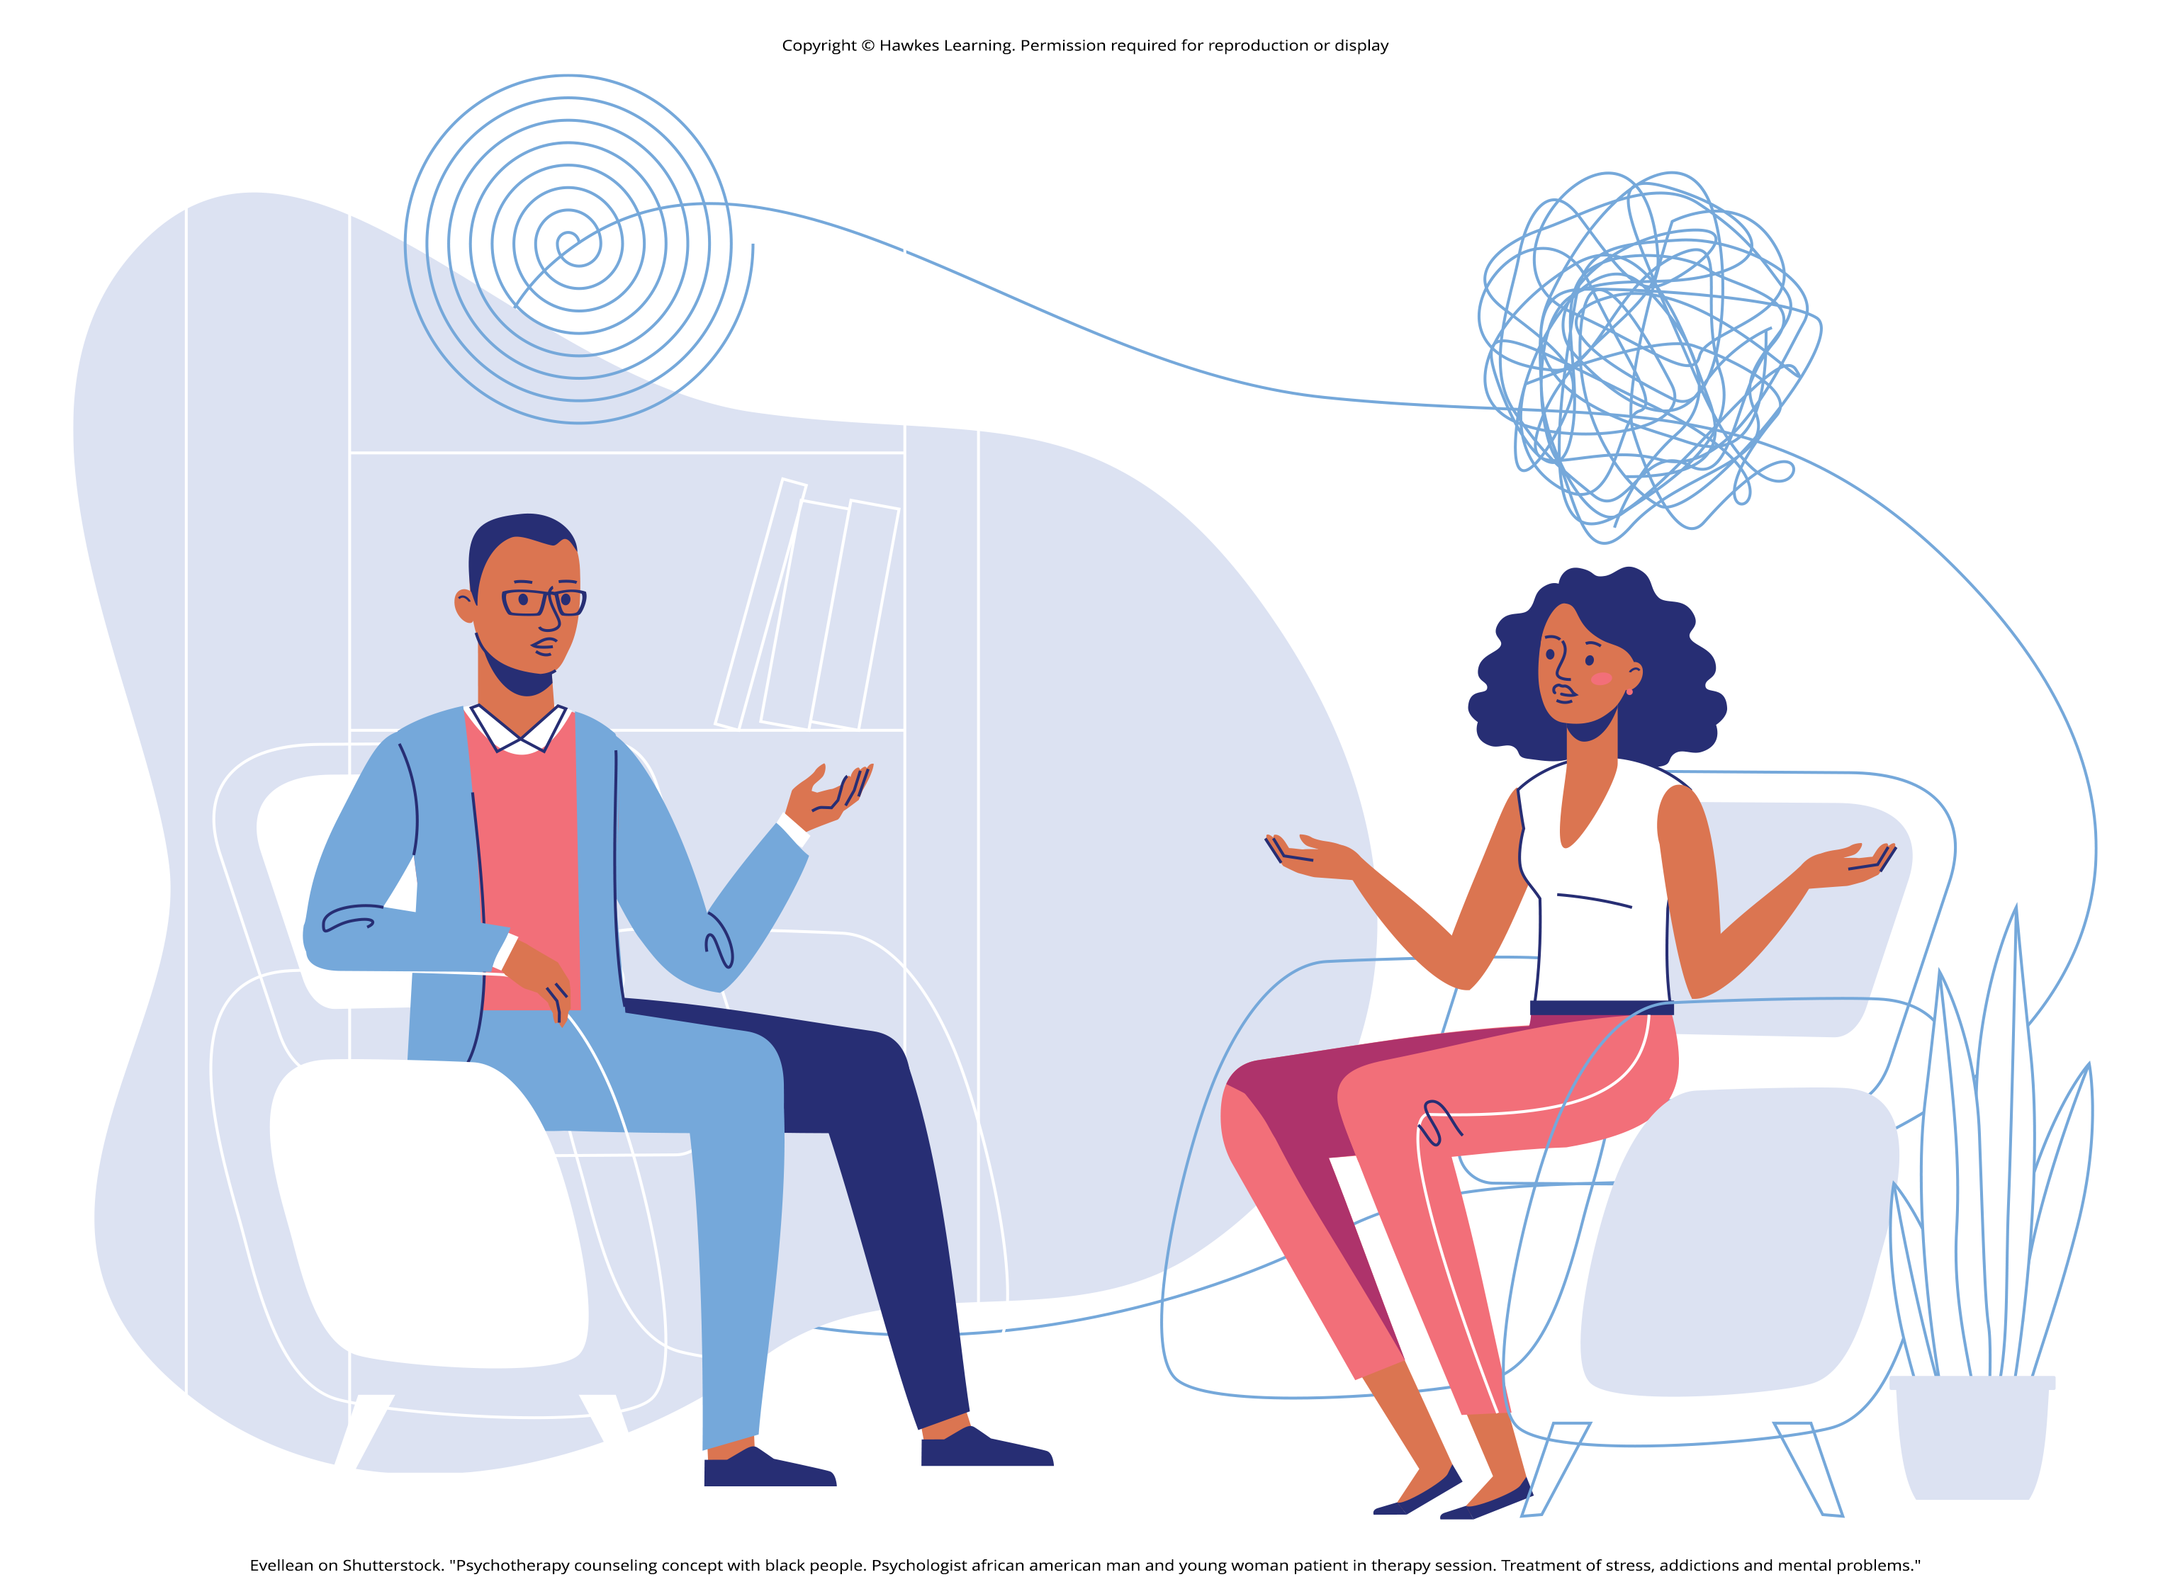
Psychotherapy: Psychoanalysis₂
Psychoanalysis is a therapy approach that typically takes years.
Freud suggested that during this patient-therapist relationship, the patient comes to develop strong feelings for the therapist.
  Transference: process in psychanalysis in which the patient transfers all of the positive or negative emotions associated with the patient’s other relationships to the psychoanalyst
Figure 2

Slide 6
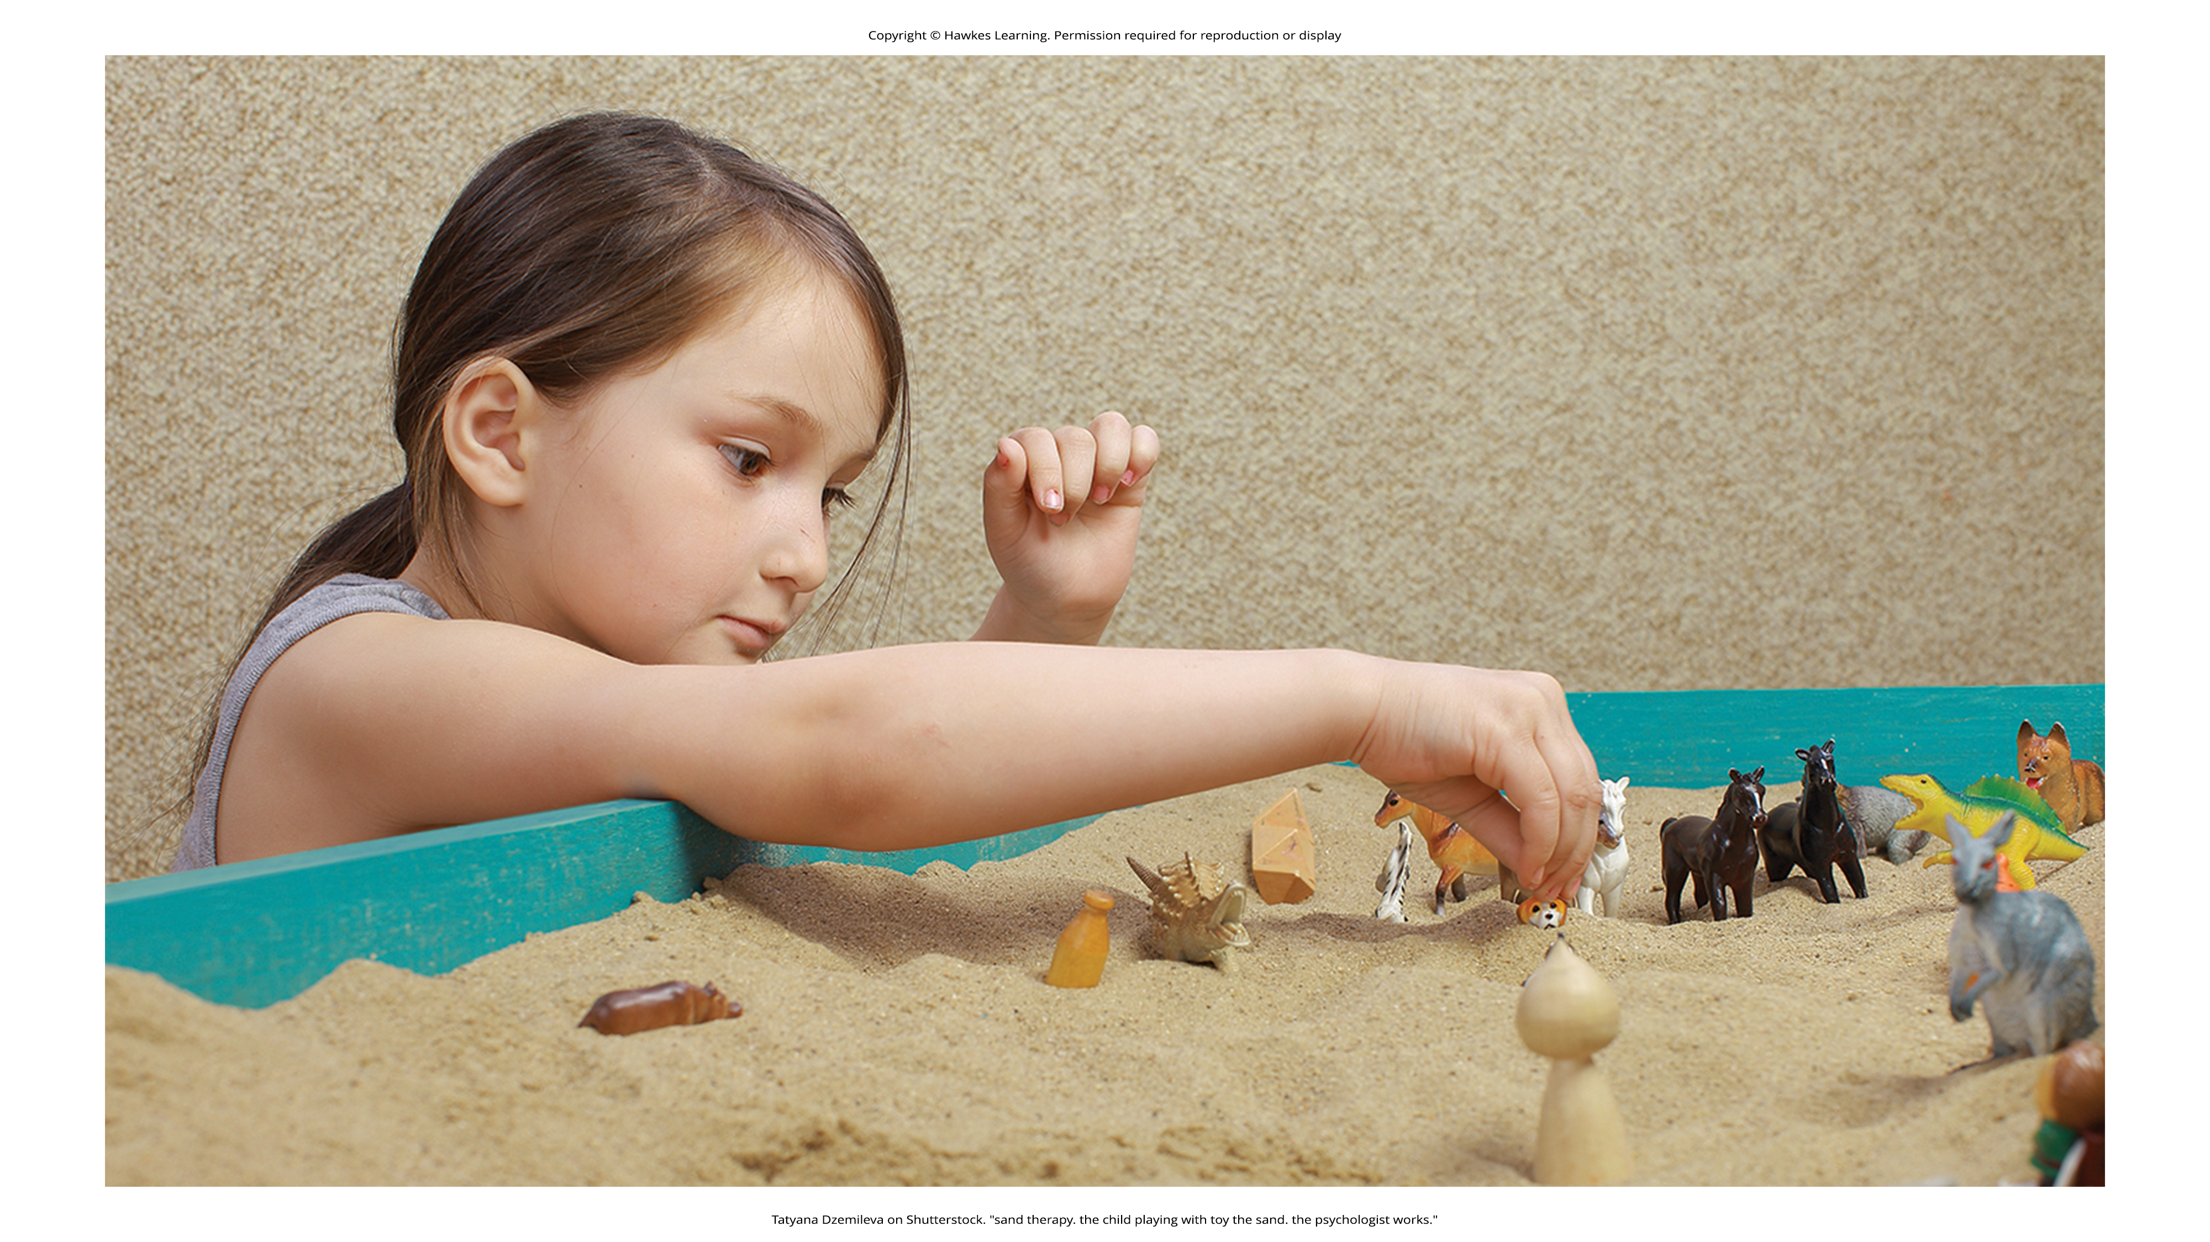
Psychotherapy: Play Therapy
Play therapy is often used with children since they are not likely to sit on a couch and recall their dreams or engage in traditional talk therapy.
  Uses a therapeutic process of play to "help clients prevent or resolve psychosocial difficulties and achieve optimal growth" (O'Connor, 2000, p. 7).
It can also be used to help a therapist make a diagnosis.
  Example: A therapist can observe how the child interacts with toys (e.g., dolls, animals, and home settings) in an effort to understand the roots of the child's disturbed behavior.
Play therapy can be nondirective or directive.
Figure 3

Slide 7
Psychotherapy: Behavior Therapy₁
In psychoanalysis, therapists help their patients look into their past to uncover repressed feelings.
In behavior therapy, a therapist employs principles of learning to help clients change undesirable behaviors—rather than digging deeply into one's unconscious.
Behavior therapy employs both classical and operant conditioning techniques to change behavior.
One type of behavior therapy utilizes classical conditioning techniques.
  Therapists using these techniques believe that dysfunctional behaviors are conditioned responses.

Slide 8

Psychotherapy: Behavior Therapy₂
One commonly used classical conditioning therapeutic technique is counterconditioning.
  Counterconditioning: classical conditioning therapeutic technique in which a client learns a new response to a stimulus that has previously elicited an undesirable behavior
Aversive conditioning uses an unpleasant stimulus to stop an undesirable behavior.
  Therapists apply this technique to eliminate addictive behaviors.
  Clients will typically engage in a specific behavior (such as nail biting) and at the same time are exposed to something unpleasant, such as a mild electric shock or a bad taste.
After repeated associations between the unpleasant stimulus and the behavior, the client can learn to stop the unwanted behavior.
Figure 4

Slide 9
Psychotherapy: Behavior Therapy₃
Aversion therapy has been used effectively for years in the treatment of alcoholism (Davidson, 1974; Elkins, 1991; Streeton & Whelan, 2001).
Antabuse is a chemically based substance.
  Results in nausea, vomiting, increased heart rate, heart palpitations, severe headache, and shortness of breath
Antabuse is repeatedly paired with alcohol until the client associates alcohol with unpleasant feelings, which decreases the client's desire to consume alcohol

Slide 10
Reflection Question₁
Do you, a friend, or a family member have an unhealthy habit that you would like to stop? How do you think aversive conditioning would work to eliminate the behavior in question? Do you think this strategy would be effective? Why or why not?

Slide 11
Psychotherapy: Behavior Therapy₄
In exposure therapy, a therapist seeks to treat clients' fears or anxiety by presenting them with the object or situation that causes their problem, with the idea that they will eventually get used to it.
Exposure therapy was first reported in 1924 by Mary Cover Jones.
  Considered the mother of behavior therapy
Jones worked with a boy named Peter who was afraid of rabbits, aiming to replace his fear with a conditioned response of relaxation.
Over 2 months, Jones gradually moved a caged rabbit closer to Peter while he ate snacks, until he could eventually hold and pet the rabbit while eating, overcoming his fear.

Slide 12
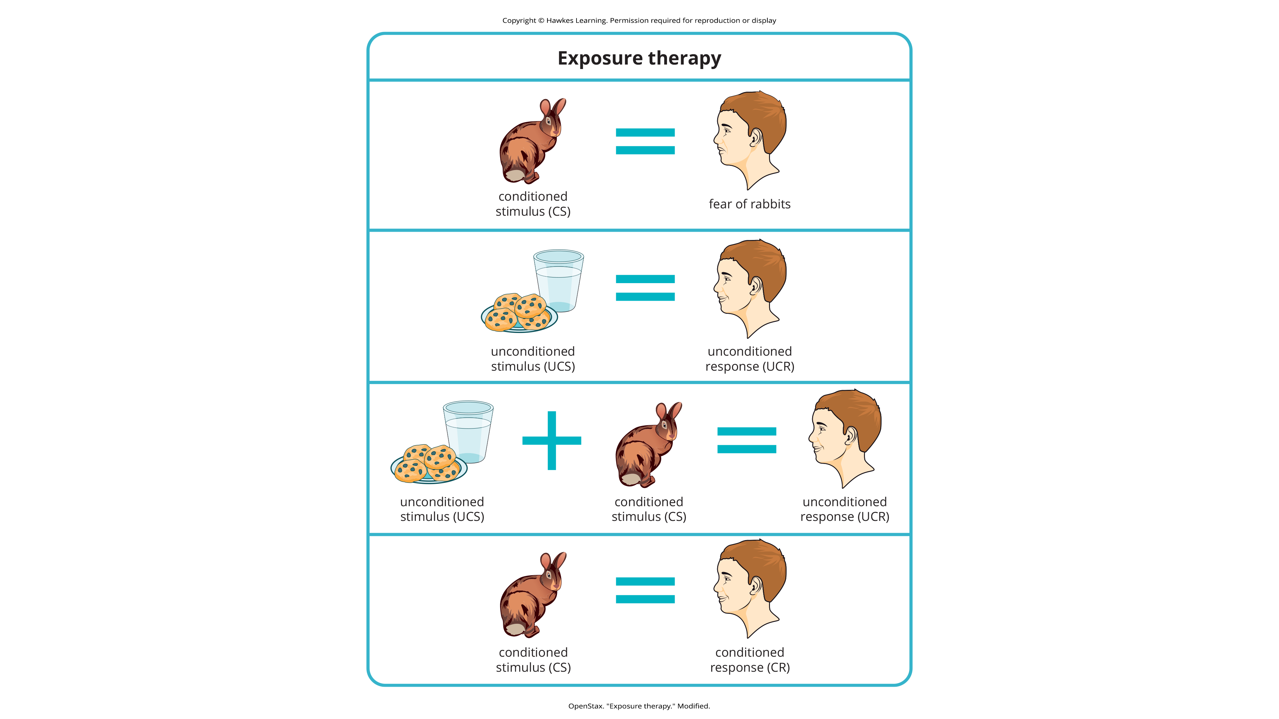
Lesson 16.2 Figure 5
Caption: Exposure therapy seeks to change the response to a conditioned stimulus (CS). An unconditioned stimulus is presented over and over just after the presentation of the conditioned stimulus. This figure shows conditioning as conducted in Mary Cover Jones's 1924 study.

Slide 13
Psychotherapy: Behavior Therapy₅
Thirty years later, Joseph Wolpe (1958) refined Jones's techniques, giving us systematic desensitization.
Using this method, a person creates a hierarchy of anxiety, ranging from the least-anxiety-producing stimulus to the feared object.
These activities are paired with relaxation techniques, which are taught to the client beforehand and used during the graduated exposures.
The idea is that a person cannot be nervous and relaxed at the same time.
If they can learn to relax when they are facing environmental stimuli that make them nervous or fearful, they can eventually eliminate the unwanted fear response.

Slide 14
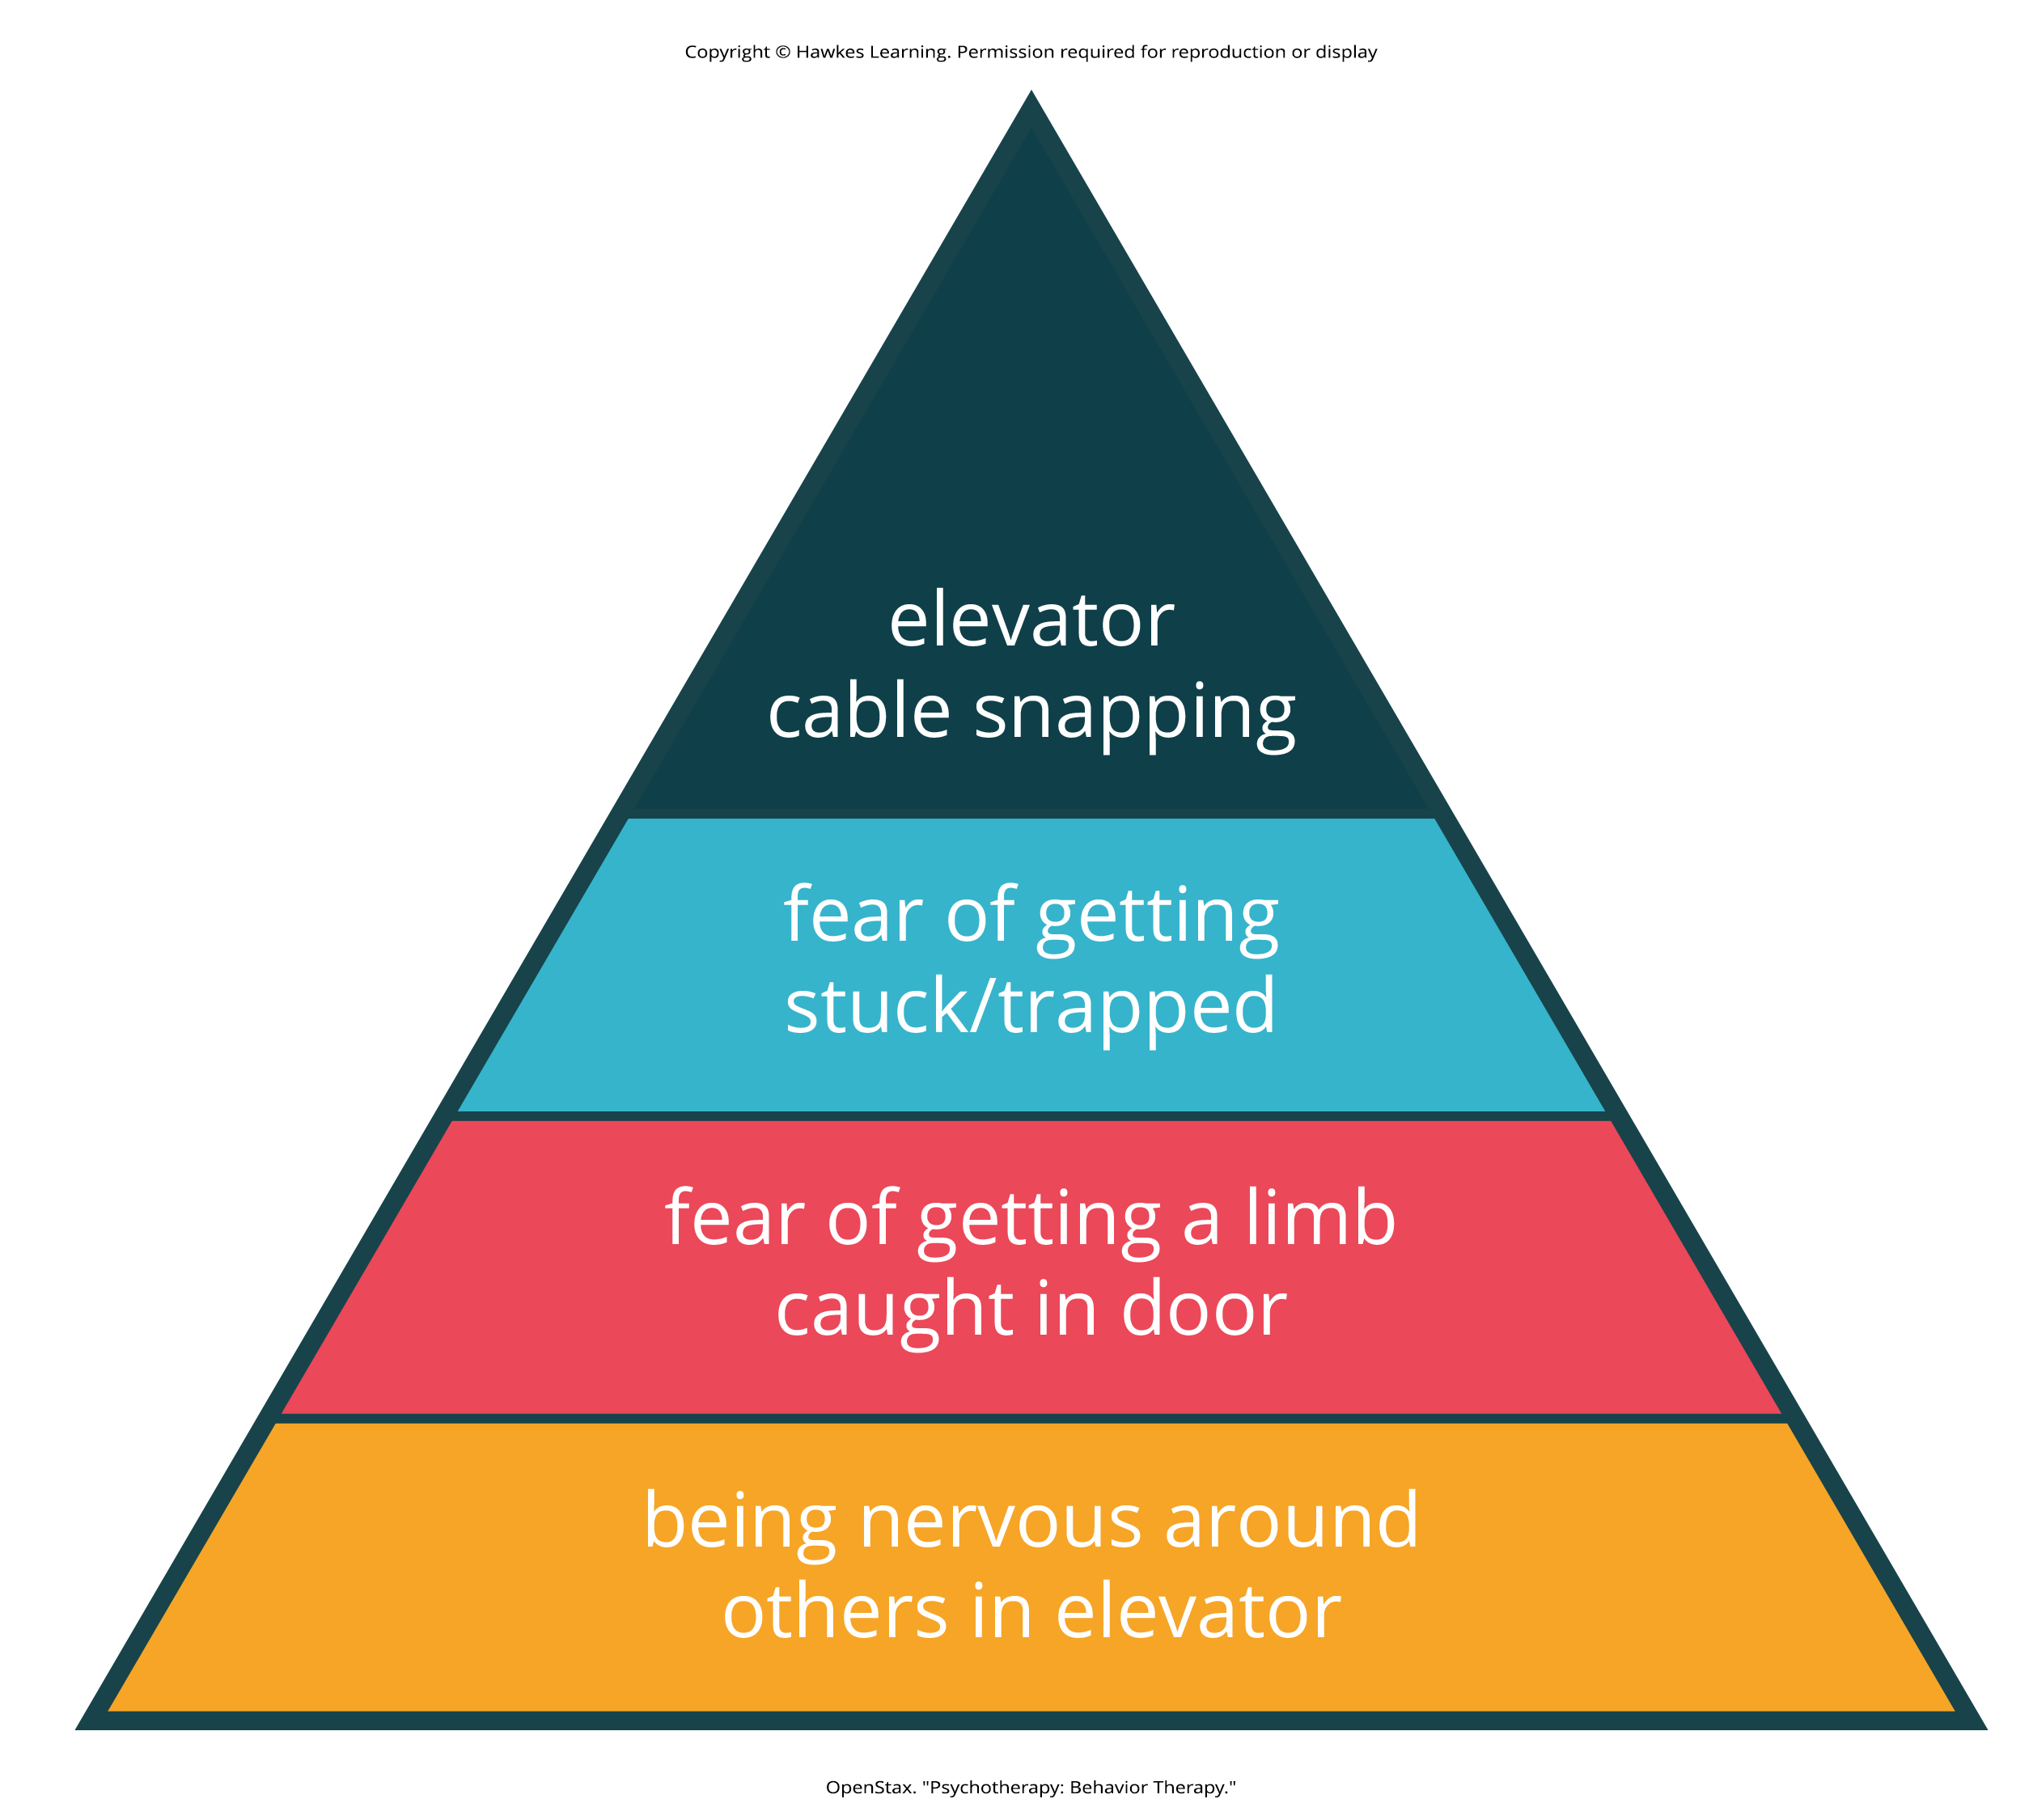
Lesson 16.2 Psychotherapy: Behavior Therapy

Slide 15
Reflection Question₂
Do you have any irrational fears that impact your daily life? How do you think the fears started? Do you think exposure therapy and systematic desensitization would work for you? Why or why not?

Slide 16
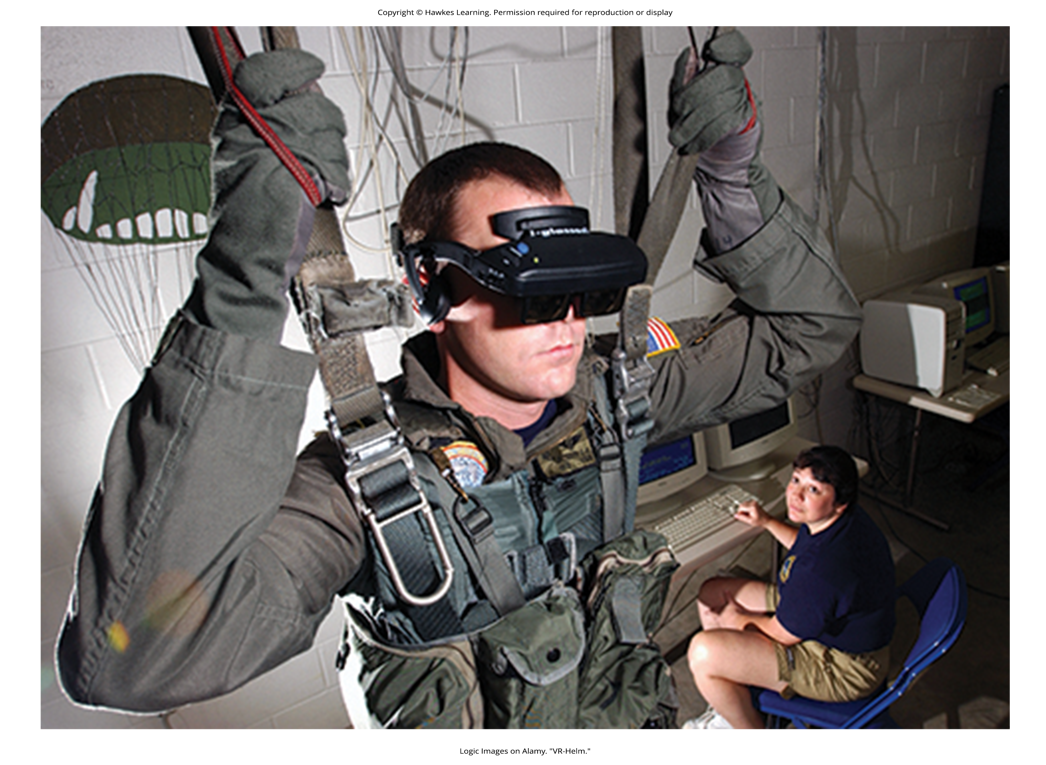
Psychotherapy: Behavior Therapy₆
A therapist might employ virtual reality exposure therapy by using a simulation to help conquer fears.
Virtual reality exposure therapy has been used effectively to treat numerous anxiety disorders.
  Fear of public speaking, claustrophobia (fear of enclosed spaces), aviophobia (fear of flying), and posttraumatic stress disorder (PTSD), a trauma-and-stressor-related disorder (Gerardi et al., 2010)
Figure 6

Slide 17
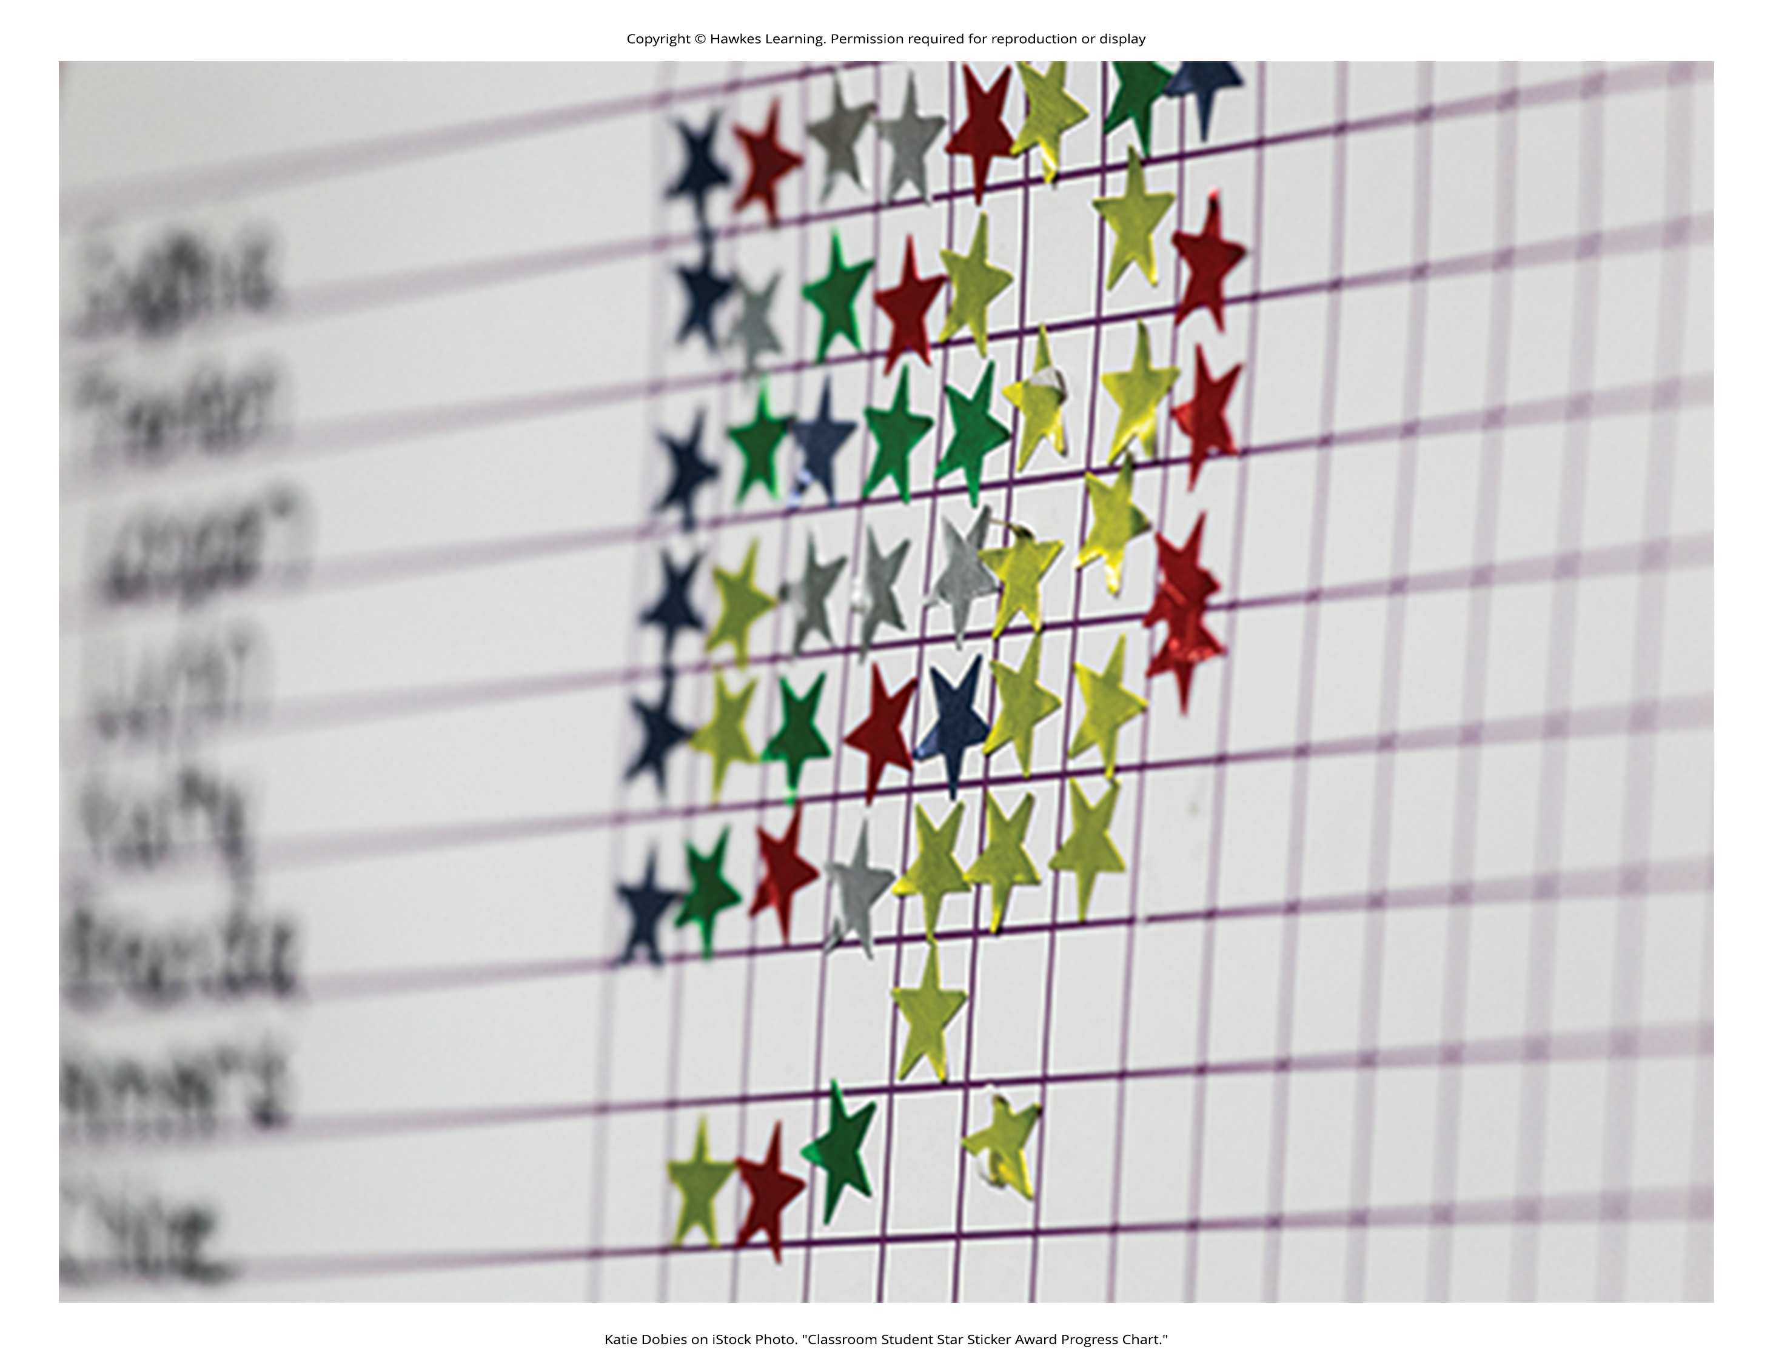
Psychotherapy: Behavior Therapy₇
Operant conditioning interventions reinforce desirable behavior and punish undesirable behavior.
  Example: Applied Behavior Analysis (ABA) is a treatment that uses reinforcement (stickers, praise, candy, etc.) to reward and motivate individuals with autism spectrum disorder when they demonstrate desired behaviors
Token economy is a popular operant conditioning intervention.
This involves a controlled setting where individuals are reinforced for desirable behaviors with tokens, such as poker chips, that can be exchanged for items or privileges.
Patients are rewarded with tokens when they engage in positive behaviors.
They can later exchange the tokens for extra TV time, private rooms, extended game time, and so on (Dickerson et al., 2005).
Figure 7

Slide 18
Psychotherapy: Cognitive Therapy
Cognitive therapy is a form of psychotherapy that focuses on how a person's thoughts lead to feelings of distress.
Psychiatrist Aaron Beck developed cognitive therapy in the 1960s.
  His initial focus was on depression and how a client's self-defeating attitude served to maintain a depression despite positive factors in their life (Beck et al., 1979) (Figure 8).
The idea behind cognitive therapy is that how you think determines how you feel and act.
Cognitive therapists help their clients change dysfunctional thoughts about themselves to help relieve stress and improve success toward their future goals.
They help a client see how they misinterpret a situation, which is called a cognitive distortion.

Slide 19
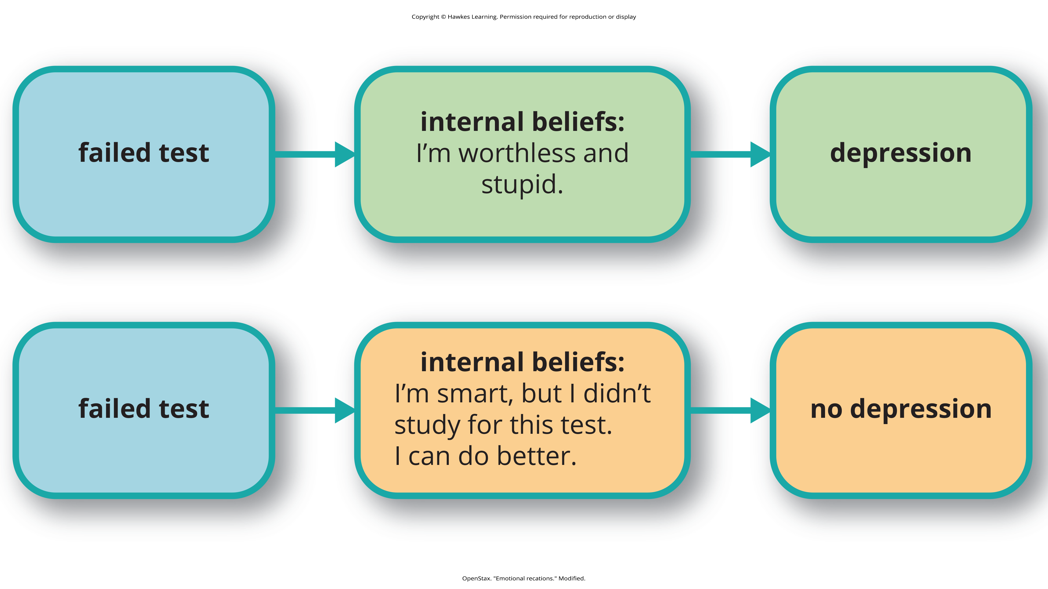
Lesson 16.2 Figure 8
Caption: Your emotional reactions are the result of your thoughts about the situation rather than the situation itself. For instance, if you consistently interpret events and emotions around the themes of loss and defeat, then you are likely to be depressed. Through therapy, you can learn more logical ways to interpret situations.

Slide 20
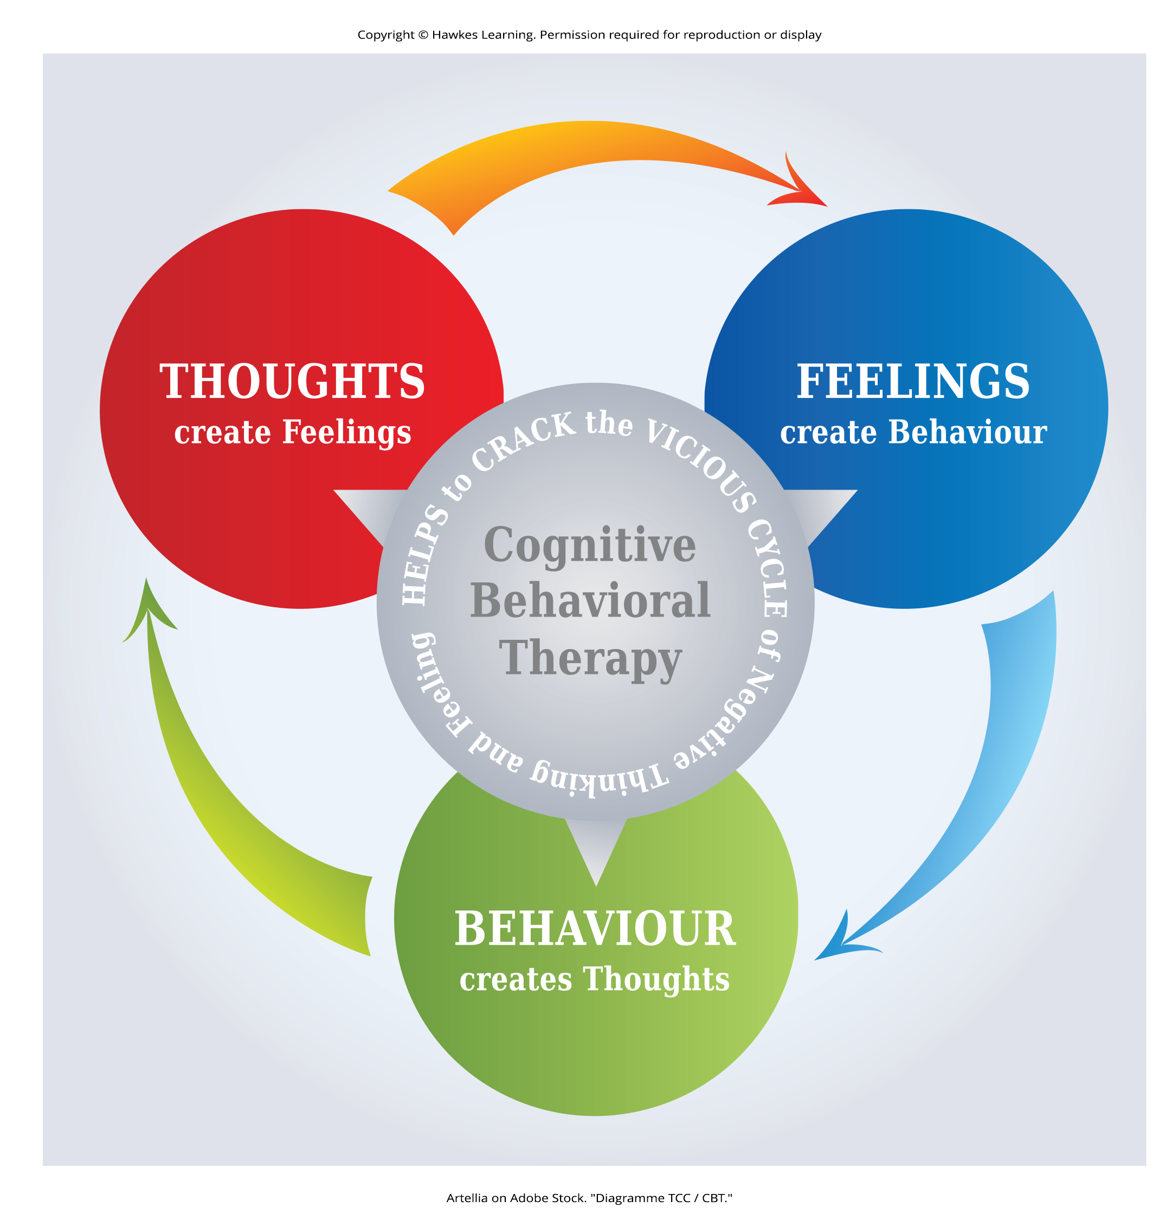
Psychotherapy: Cognitive-Behavioral Therapy₁
Cognitive-behavioral therapists focus much more on present issues than on a patient's childhood or past.
One of the first forms of cognitive-behavioral therapy was rational emotive therapy (RET), which was founded by Albert Ellis and grew out of his dislike of Freudian psychoanalysis (Daniel, n.d.).
Behaviorists such as Joseph Wolpe also influenced Ellis's therapeutic approach (National Association of Cognitive-Behavioral Therapists, 2009).
Figure 9

Slide 21
Psychotherapy: Cognitive-Behavioral Therapy₂
Cognitive-behavioral therapy (CBT) helps clients examine how their thoughts affect their behavior.
It aims to change cognitive distortions and self-defeating behaviors.
CBT attempts to make individuals aware of their irrational and negative thoughts and helps people replace them with new, more positive ways of thinking.
CBT teaches people how to practice and engage in more positive and healthy approaches to daily situations.
Research has shown the effectiveness of cognitive-behavioral therapy in the treatment of numerous psychological disorders.

Slide 22
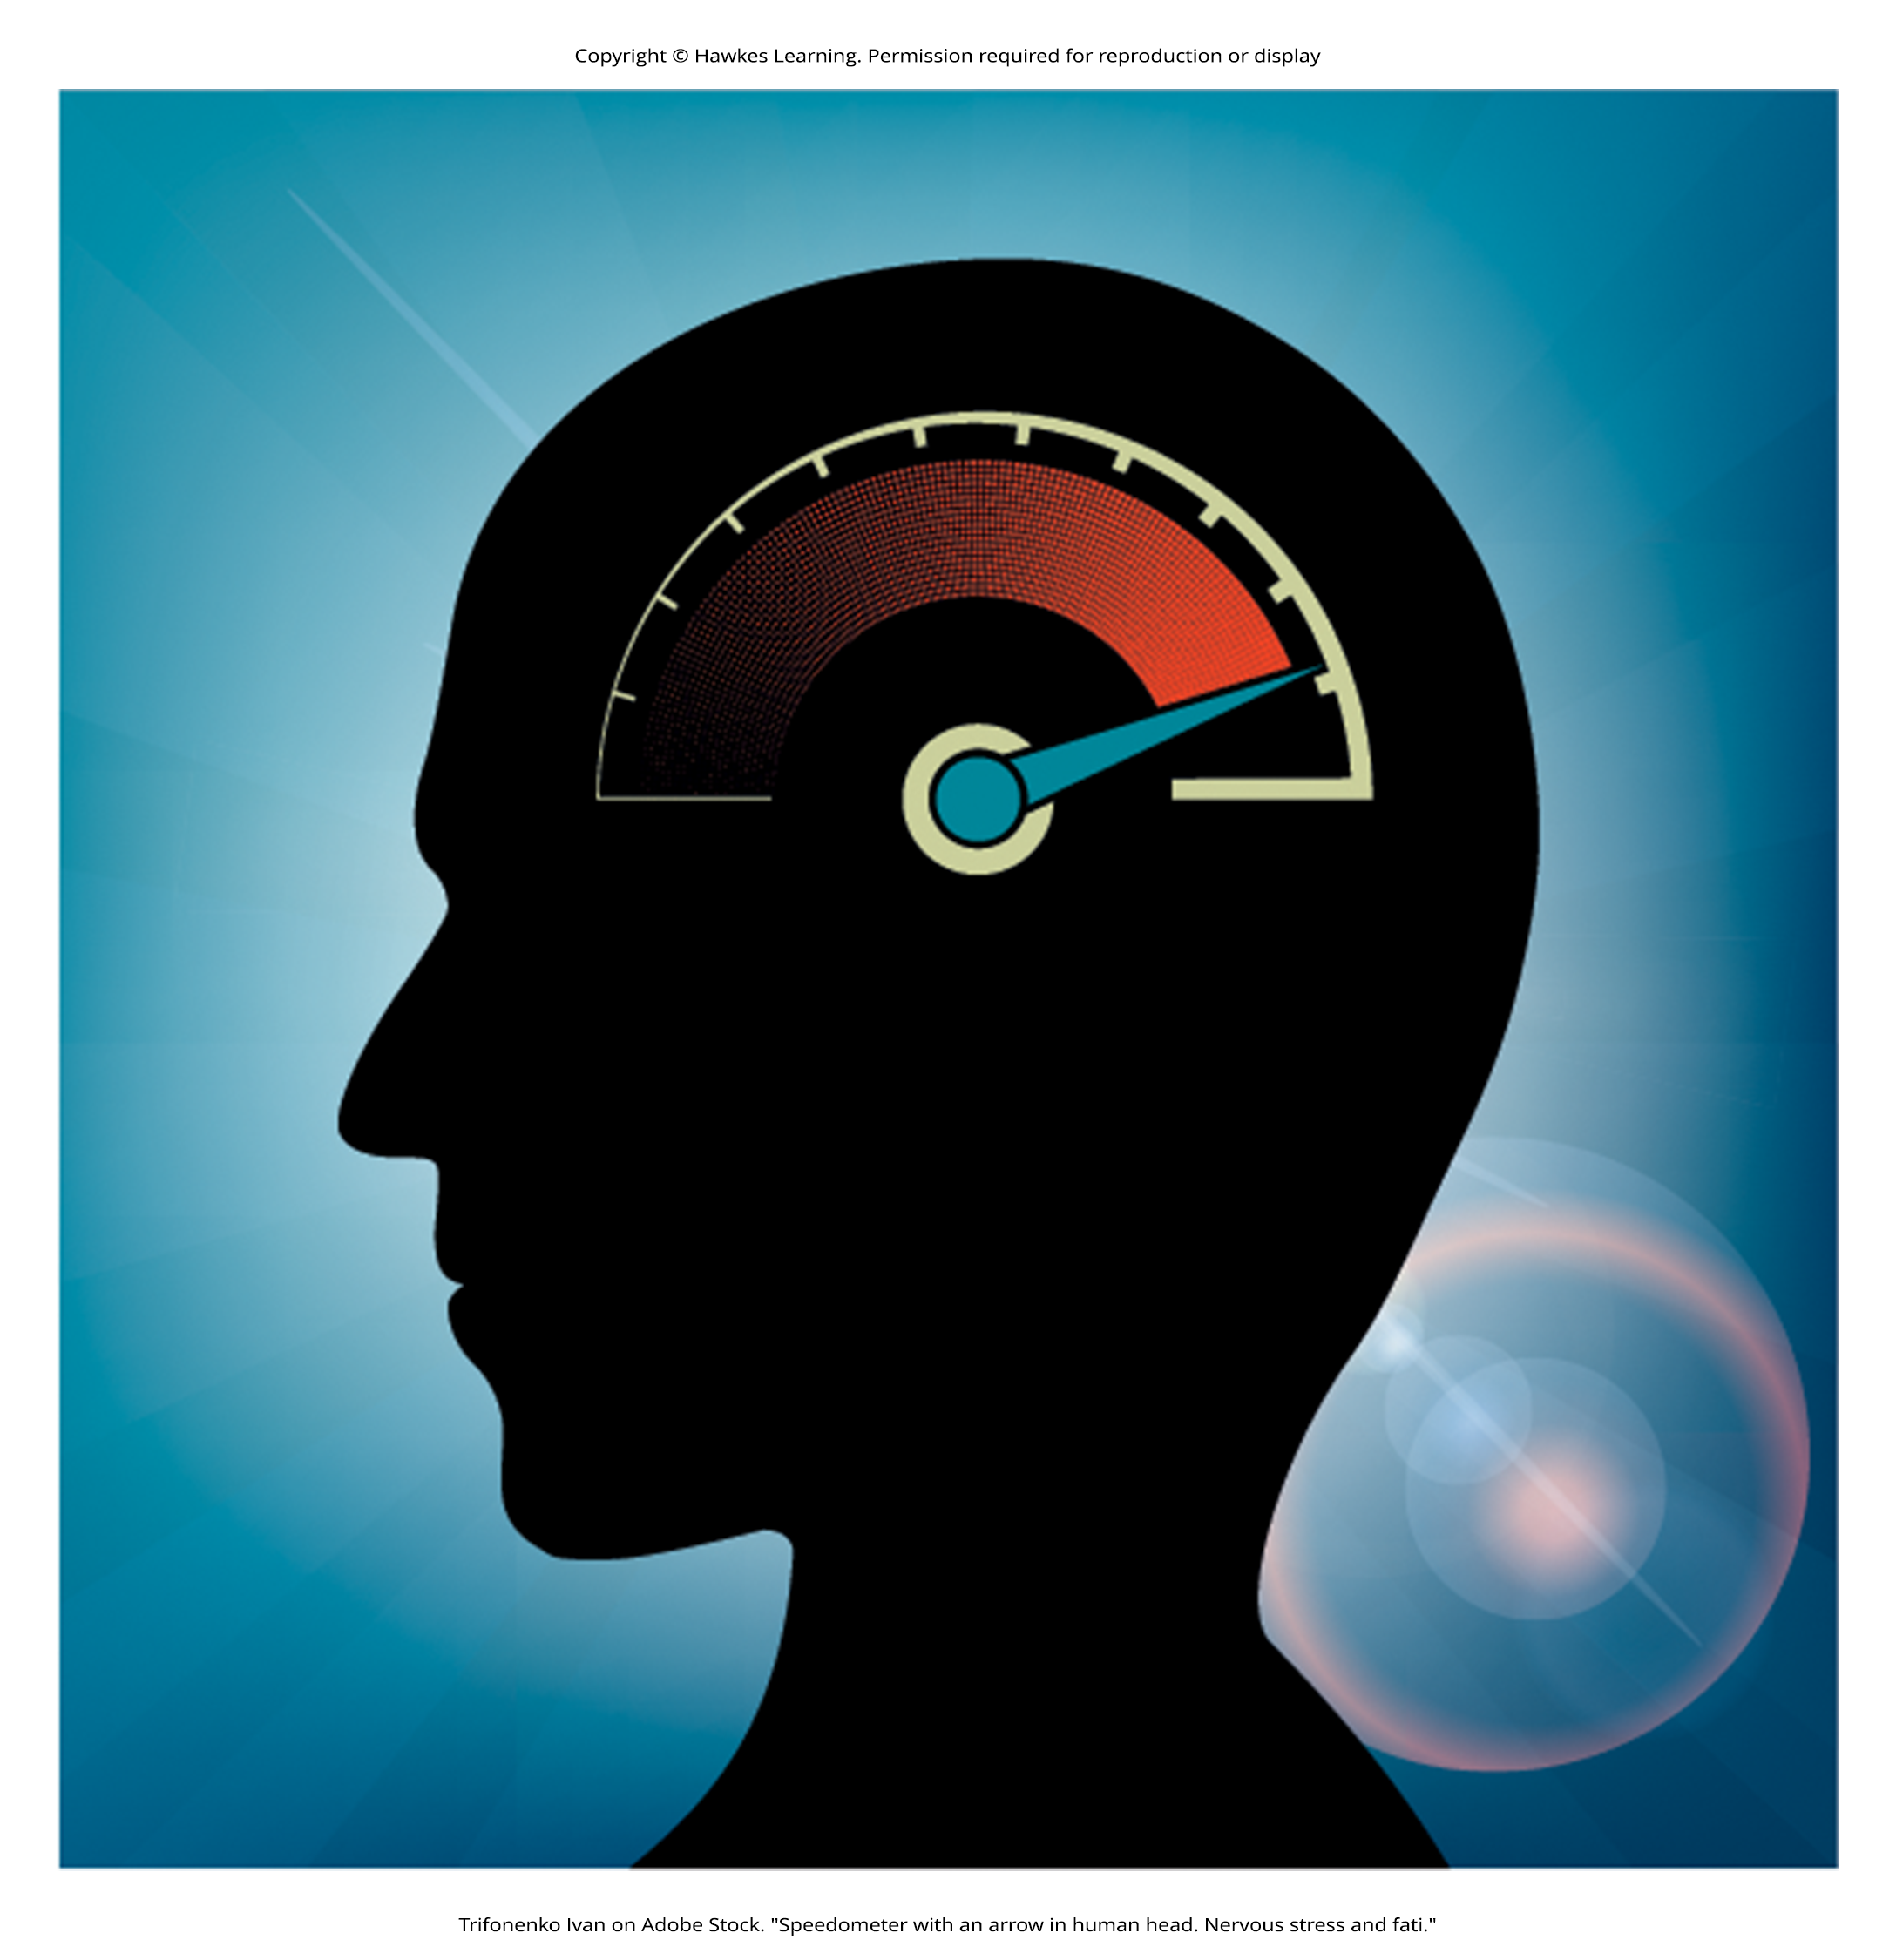
Psychotherapy: Cognitive-Behavioral Therapy₃
Cognitive-behavioral therapy uses techniques like the ABC model.
  Action (sometimes called an activating event)
  Belief about the event
  Consequences of this belief
All-or-nothing thinking, is a common type of cognitive distortion for people suffering from depression.
It reflects extremes.
  Everything is black or white
Figure 10

Slide 23
Psychotherapy: Cognitive-Behavioral Therapy₄
The third kind of distortion involves jumping to conclusions.
  Assuming that people are thinking negatively about you or reacting negatively to you even though there is no evidence

Slide 24
On Your Own
Think about an event where something negative happened to you, which led to a cognitive distortion. Explain this event, your belief, and the consequence of your belief on your behavior.

Slide 25
Psychotherapy: Humanistic Therapy₁
Humanistic psychology focuses on helping people achieve their potential.
The goal of humanistic therapy is to help people become more self-aware and accepting of themselves.
Humanistic therapists focus on conscious rather than unconscious thoughts.
They emphasize the patient's present and future, as opposed to exploring the patient's past.

Slide 26
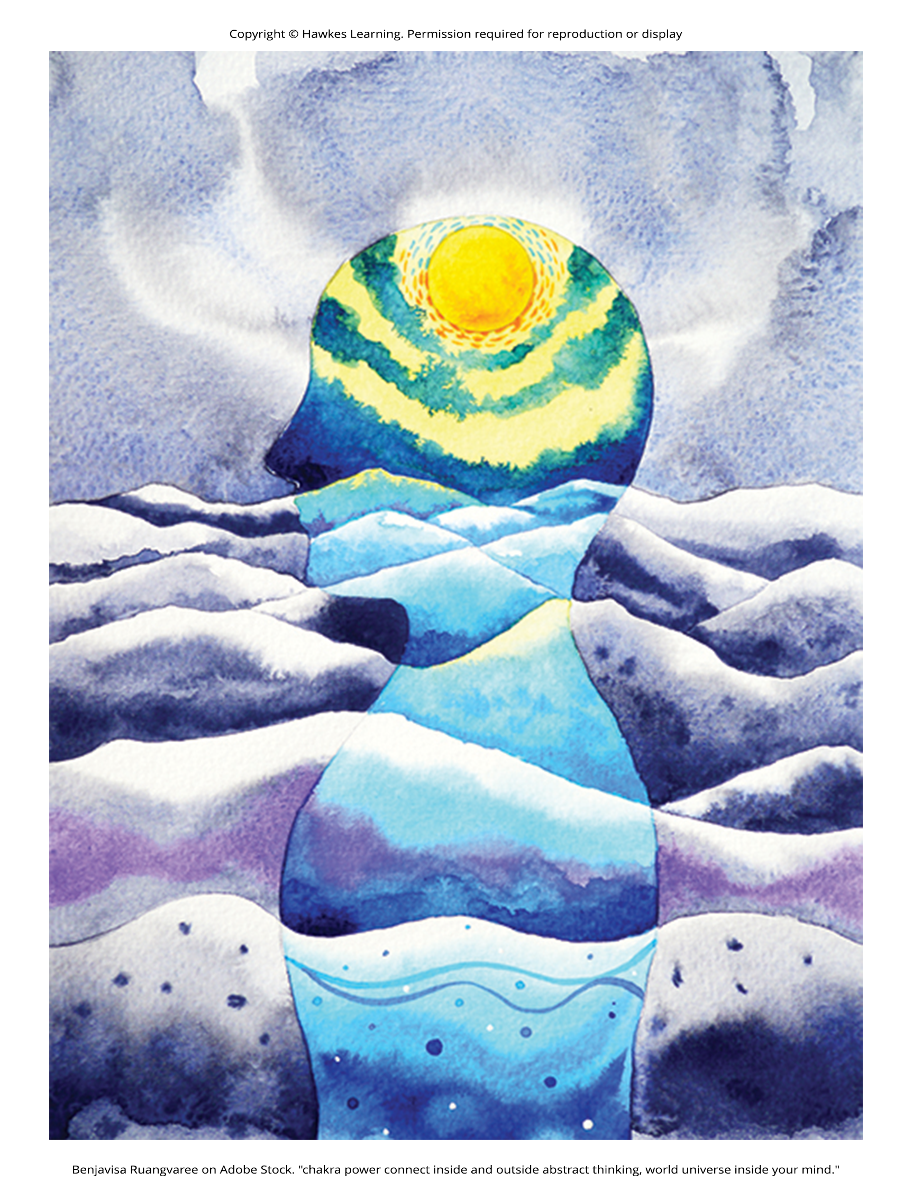
Psychotherapy: Humanistic Therapy₂
Psychologist Carl Rogers developed a therapeutic orientation known as Rogerian, or client-centered therapy. Note the change from patients to clients.
Rogers (1951) felt that the term patient suggested the person seeking help was sick and looking for a cure.
It is a form of nondirective therapy.
In client-centered therapy, the therapist uses the technique of active listening.
  The therapist acknowledges, restates, and clarifies what the client expresses
Therapists also practice what Rogers called unconditional positive regard, which involves not judging clients and simply accepting them for who they are.
Figure 11

Slide 27
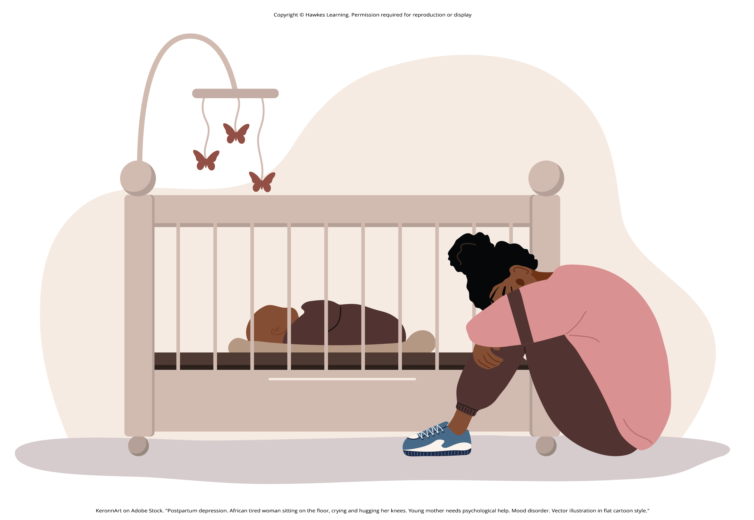
Evaluating Various Forms of Psychotherapy
According to the American Psychological Association, three factors work together to produce successful treatment.
  (1) The use of evidence-based treatment that is deemed appropriate for the client's problem
  (2) The clinical expertise of the psychologist or therapist
  (3) Your own characteristics, values, preferences, and culture
No studies have found one psychotherapeutic approach more effective than another (Abbass et al., 2009; Chorpita et al., 2011).
Regardless of the type of psychotherapy the success of treatment is determined by the person's relationship with the psychologist or therapist.
Figure 12

Slide 28
Reflection Question₃
Which type of therapy discussed in this lesson most appeals to you, and why?

Slide 29
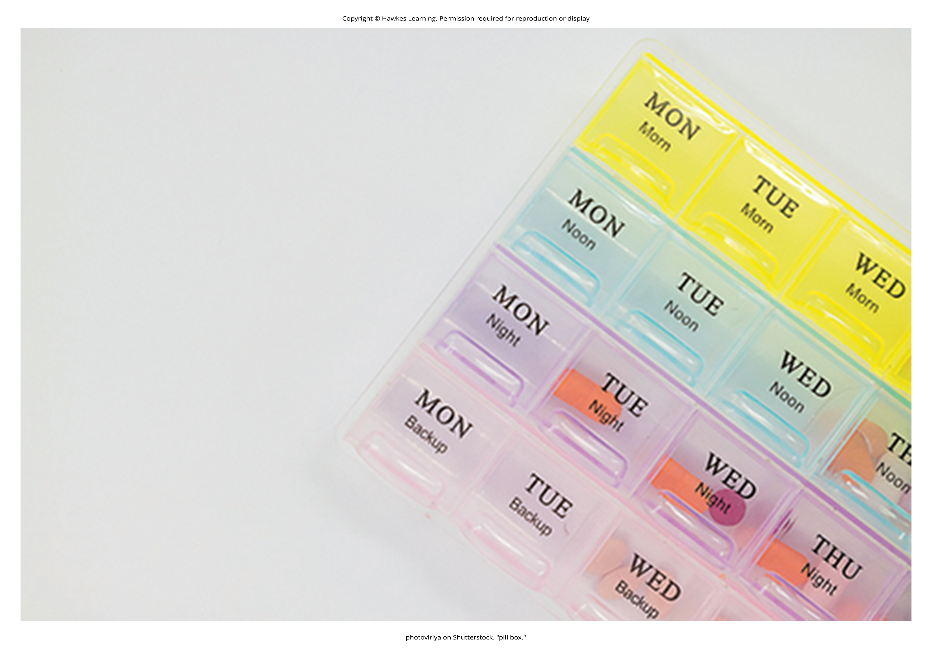
Biomedical Therapies₁
Individuals can be prescribed biologically based treatments or psychotropic medications.
  Can be taken in combination with psychotherapy or by individuals who are not in therapy
This is known as biomedical therapy.
Medications used to treat psychological disorders are called psychotropic medications.
  Prescribed by medical doctors, including psychiatrists
Different types and classes of medications are prescribed for different disorders.
  Example: A depressed person might be given an antidepressant, a bipolar individual might be given a mood stabilizer, and a schizophrenic individual might be given an antipsychotic.
These medications treat the symptoms of a psychological disorder.
Some people may only need to take a psychotropic medication for a short period of time, while others may take medication for a long time.
Figure 13

Slide 30
Commonly Prescribed Psychotropic Medications
Antipsychotics (developed in the 1950s)
  Used to treat schizophrenia and other types of severe thought disorders
Atypical antipsychotics (developed in the late 1980s)
  Used to treat schizophrenia and other types of severe thought disorders
Antidepressants
  Used to treat depression and increasingly for anxiety
Antianxiety agents
  Used to treat anxiety and agitation that occur in OCD, PTSD, panic disorder, and social phobia
Mood stabilizers
  Used to treat bipolar disorder
Stimulants
  Used to treat ADHD

Slide 31
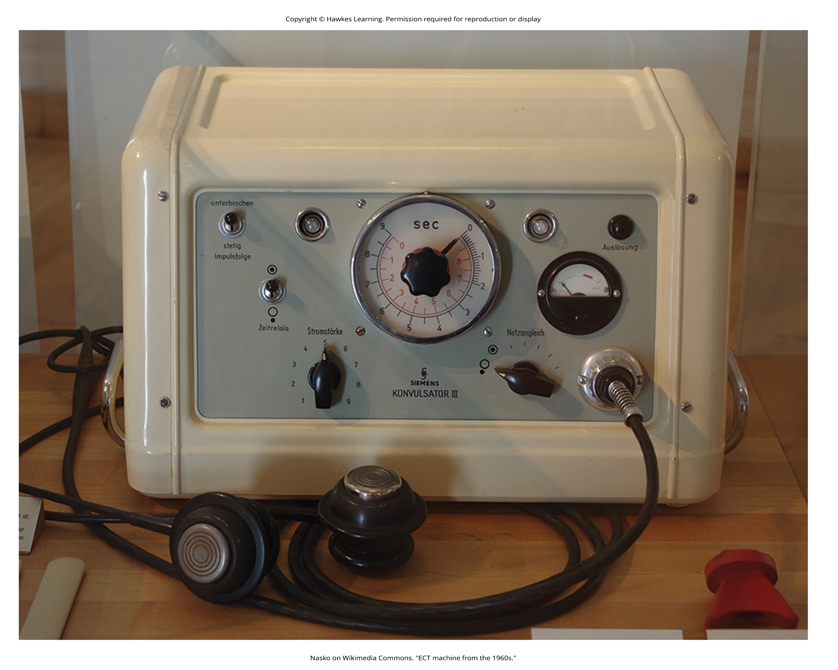
Biomedical Therapies₂
Electroconvulsive therapy (ECT) was formerly known as electroshock therapy.
  Still used today but not frequently
It involves using an electrical current to induce seizures to help alleviate the effects of severe depression.
About 85% of people treated with ECT improve (Reti, n.d.).
  Some suffer memory loss after repeated administrations
A more recent alternative is transcranial magnetic stimulation (TMS).
TMS is a procedure that was approved by the FDA in 2008 that uses magnetic fields to stimulate nerve cells in the brain to improve depression symptoms (Mayo Clinic, 2023).
Figure 14

Slide 32
Reflection Question₄
Do you think biomedical therapies are preferable to psychotherapies? Why or why not?

Slide 33
Dig Deeper: Evidence-Based Practice
Evidence-based practice aims to reduce treatment selection errors by making clinical decisions based on research.
Professional organizations like APA recommend specific evidence-based psychological treatments for certain psychological disorders (Chambless & Ollendick, 2001).
According to the APA (2021), "Evidence-based practice in psychology (EBPP) is the integration of best research evidence with clinical expertise and patient values" (p.1).
Evidence-based treatment compares various forms of treatment to determine best practices, which are then operationalized in treatment manuals followed by trained therapists.
Critics argue that results of randomized control trials cannot be applied to individuals and that treatment should be based on therapist's judgment.

Slide 34
Summary₁
Psychoanalysis was developed by Sigmund Freud.
Freud's theory is that a person's psychological problems are the result of repressed impulses or childhood trauma.
Play therapy is a psychodynamic therapy technique often used with children.
In behavior therapy, a therapist employs principles of learning from classical and operant conditioning to help clients change undesirable behaviors.
Counterconditioning is a commonly used therapeutic technique in which a client learns a new response to a stimulus that has previously elicited an undesirable behavior via classical conditioning.

Slide 35
Summary₂
Principles of operant conditioning can be applied to help people deal with a wide range of psychological problems.
Cognitive therapy is a technique that focuses on how thoughts lead to feelings of distress.
Cognitive-behavioral therapy explores how our thoughts affect our behavior. It aims to change cognitive distortions and self-defeating behaviors.
Humanistic therapy focuses on helping people achieve their potential.
One form of humanistic therapy developed by Carl Rogers is known as client-centered or Rogerian therapy.
Often in combination with psychotherapy, people can be prescribed biologically based treatments, such as psychotropic medications, and/or other medical.

Slide 36
End of Hawkes Learning PowerPoint

