Slide 1
Lesson 16.4
Substance-Related and Addictive Disorders: A Special Case

Slide 2
Addiction
Addiction is often viewed as a chronic disease.
The choice to use a substance is initially voluntary.
Chronic substance use can permanently alter the neural structure in the prefrontal cortex, a person becomes driven to use drugs and/or alcohol (Muñoz-Cuevas, et al., 2013; National Institute on Drug Abuse [NIDA], 2018).
This helps explain why relapse rates tend to be high. About 40% to 60% of individuals relapse.
Relapse: repeated drug use and/or alcohol use after a period of improvement from substance abuse

Slide 3
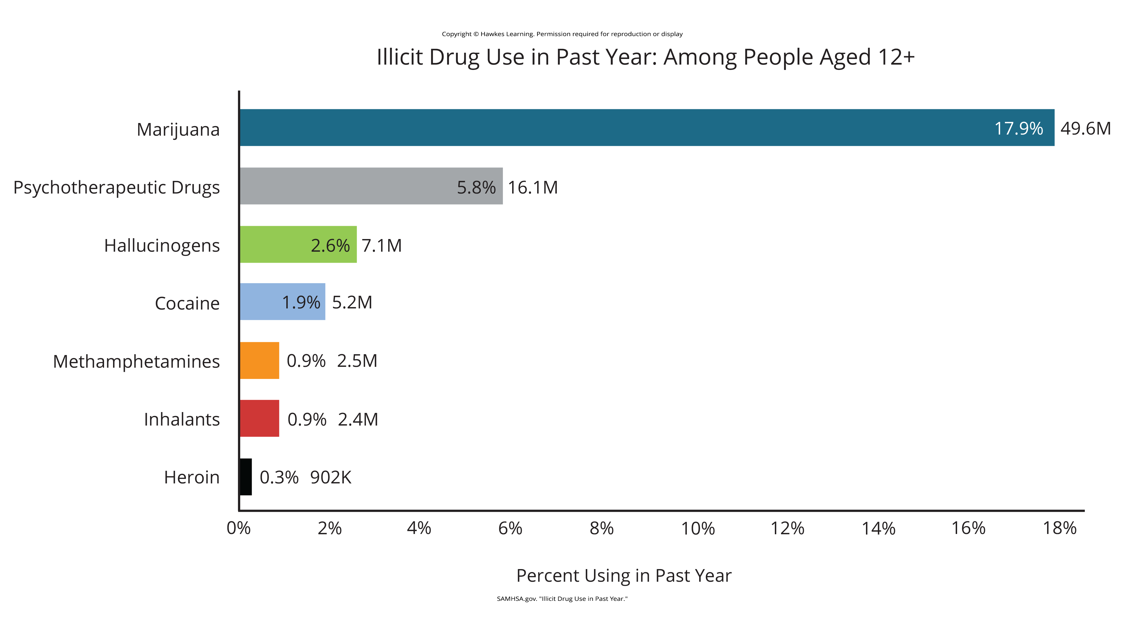
Lesson 16.4 Figure 1
Caption: The National Survey on Drug Use and Health shows trends in prevalence of various drugs for ages 12 and older (SAMHSA, 2020).

Slide 4

Substance-Related Treatment
The goal of substance-related treatment is to help an addicted person stop compulsive drug-seeking behaviors (NIDA, 2012; Miller, 2022).
An addicted person will need long-term treatment.
Treatment usually includes behavioral therapy and/or medication, depending on the individual (NIDA, 2012; Snyder, 2023).
Substance-related treatment is considered much more cost-effective than incarceration or not treating those with addictions (NIDA, 2012).
Figure 2

Slide 5
Reflection Question₁
What is your reaction to the idea that treatment for substance abuse is actually more cost effective than incarceration for these individuals?

Slide 6
What Makes Treatment Effective?₁
One factor is duration of treatment.
Generally, the addict needs to be in treatment for at least 3 months to achieve a positive outcome (Simpson, 1981; Simpson et al., 1982; NIDA, 2012; American Addiction Centers, 2023).
Addict might also receive behavior therapy.
Can help motivate the addict to participate in the treatment program
Can teach strategies for dealing with cravings and how to prevent relapse
Treatment needs to be holistic and address multiple needs, not just the drug addiction.

Slide 7
What Makes Treatment Effective?₂
Group therapy is the most widespread treatment modality (Weiss et al., 2004; Substance Abuse and Mental Health Services Administration [SAMHSA], 2021b).
The rationale behind using group therapy for addiction treatment is that addicts are much more likely to maintain sobriety in a group format.
For teenagers, the whole family often needs to participate in treatment to address issues such as family dynamics, communication, and relapse prevention.
However, neither individual nor group therapy has been found to be more effective than the other (Weiss et al., 2004).
Regardless of the type of treatment service, the primary focus is on abstinence or at the very least a significant reduction in use (McGovern & Carroll, 2003; SAMHSA, 2021a).

Slide 8
Medications For Treatment
Treatment also usually involves medications.
Medications may be used in the following ways:
To detox the addict safely after an overdose
To prevent seizures and agitation that often occur in detox
To prevent reuse of the drug
To manage withdrawal symptoms
Getting off drugs often involves the use of drugs; some of which can be just as addictive.

Slide 9
Comorbid Disorders₁
Saying a person has comorbid disorders means the individual has two or more diagnoses (NIDA, 2020a).
Example: A substance-related diagnosis and another psychiatric diagnosis, such as depression, bipolar disorder, or schizophrenia
Approximately 9.2 million adults with substance use disorder have a comorbid disorder (SAMHSA, 2021b).
These individuals fall into the category of mentally ill and chemically addicted (MICA).
Compared with the overall population, substance abusers are twice as likely to have a mood or anxiety disorder.
Drug abuse can cause symptoms of mood and anxiety disorders, and the reverse is also true; people with debilitating symptoms of a psychiatric disorder may self-medicate and abuse substances.

Slide 10
Reflection Question₂
What additional challenges would be present in treating a person who has both a mental disorder and is addicted to heroin?

Slide 11
Comorbid Disorders₂
In cases of comorbidity, the best treatment addresses both (or multiple) disorders simultaneously (NIDA, 2012).
Behavior therapies are used to treat comorbid conditions.
Psychotropic medications are used along with psychotherapy.
Example: Evidence suggests that bupropion (trade names: Wellbutrin and Zyban), approved for treating depression and nicotine dependence, might also help reduce craving and use of the drug methamphetamine (NIDA, 2011).
More research is needed to better understand how these medications work—particularly when combined in patients with comorbidities.

Slide 12
Summary
Addiction is often viewed as a chronic disease that rewires the brain.
The goal of treatment is to help an addict stop compulsive drug-seeking behaviors.
Treatment usually includes behavioral therapy, which can take place individually or in a group setting.
Treatment may also include medication.
Sometimes a person has comorbid disorders, which usually means that they have a substance-related disorder diagnosis and another psychiatric diagnosis, such as depression, bipolar disorder, or schizophrenia.
The best treatment would address both problems simultaneously.

Slide 13
End of Hawkes Learning PowerPoint

