Slide 1
Lesson 16.5
The Sociocultural Model and Therapy Utilization

Slide 2
Sociocultural Perspective
The sociocultural perspective examines you, your behaviors, and your symptoms in the context of your culture and background.

Slide 3
Sociocultural Perspective Example
Mateo is an 18-year-old Hispanic male from a traditional family.
Mateo comes to treatment because of depression.
During the intake session, he reveals that he is gay and is nervous about telling his family.
He also discloses that he is concerned because his religious background has taught him that homosexuality is wrong.
How does his religious and cultural background affect him?
How might his cultural background affect how his family reacts if Mateo were to tell them he is gay?

Slide 4
Cultural Competence
Mental health professionals must develop cultural competence.
Cultural competence: therapist’s understanding and attention to issues of race, culture, and ethnicity in providing treatment
They must also develop strategies to effectively address the needs of various populations.
Example: A counselor whose treatment focuses on individual decision-making may be ineffective at helping a Chinese client with a collectivist approach to problem-solving (Sue, 2004).

Slide 5
Reflection Question₁
How culturally competent are you? Which diverse groups do you have knowledge about?

Slide 6
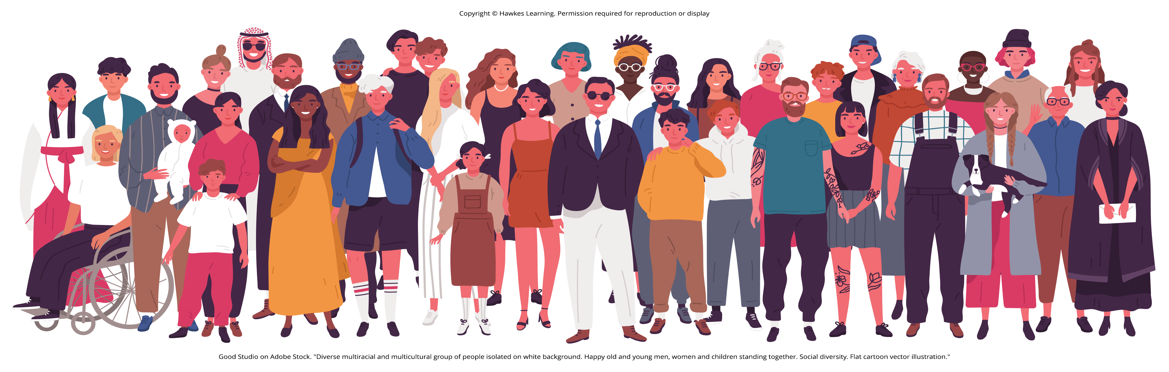
Multicultural Counseling And Therapy
Multicultural counseling and therapy aim to:
Offer a helping role
Offer a process that uses modalities and defines goals consistent with the life experiences and cultural values of clients
Recognize client identities to include individual, group, and universal dimensions
Advocate the use of universal and culture-specific strategies and roles in the healing process
Balance the importance of individualism and collectivism in the assessment, diagnosis, and treatment of the client and client systems (Sue, 2001; American Counseling Association, 2019).
Figure 1

Slide 7
Barriers To Treatment₁
Statistically, ethnic minorities tend to utilize mental health services less frequently than White, middle-class Americans (Alegría et al., 2008; Richman et al., 2007; Green et al., 2020).
Ethnic minorities and individuals of low socioeconomic status (SES) report that barriers to services include lack of:
Insurance
Transportation
Time
(Thomas & Snowden, 2002; American Psychiatric Association [APA], 2017)

Slide 8
Group Activity
In small groups, brainstorm some reasons why ethnic minorities are less likely to utilize mental health services.

Slide 9
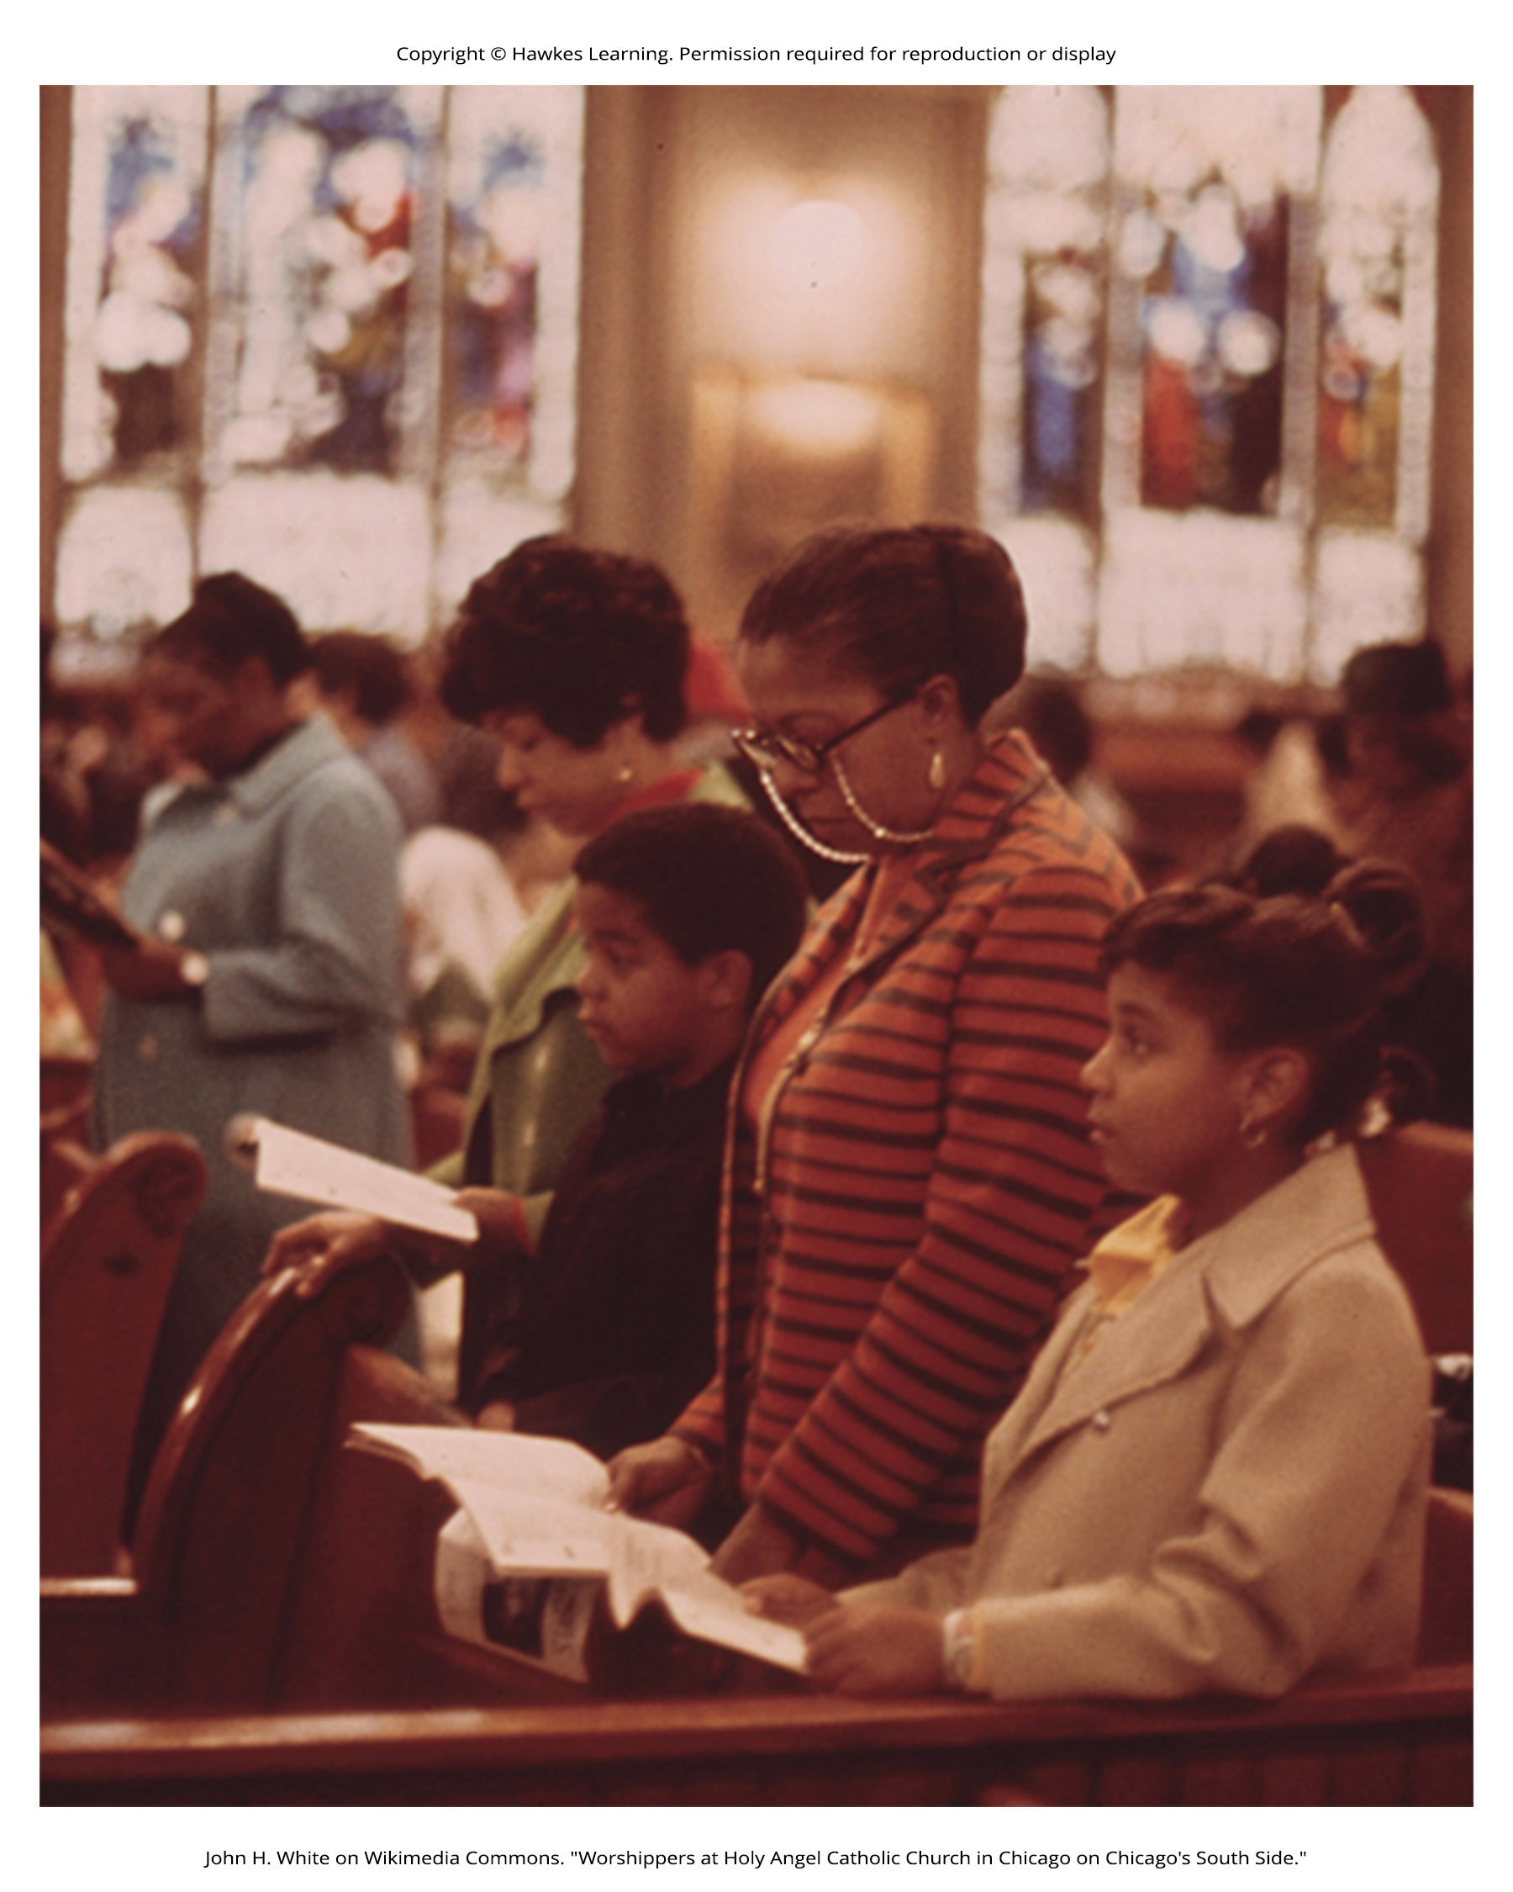
Barriers To Treatment₂
Perceptions and attitudes toward mental health services may also contribute to this imbalance.
A study at King's College, London, found many complex reasons why people do not seek treatment:
Self-sufficiency and not seeing the need for help
Not thinking therapy is effective
Concerns about confidentiality
The many effects of stigma and shame
(Clement et al., 2014; American Psychological Association, 2020)
Figure 2

Slide 10
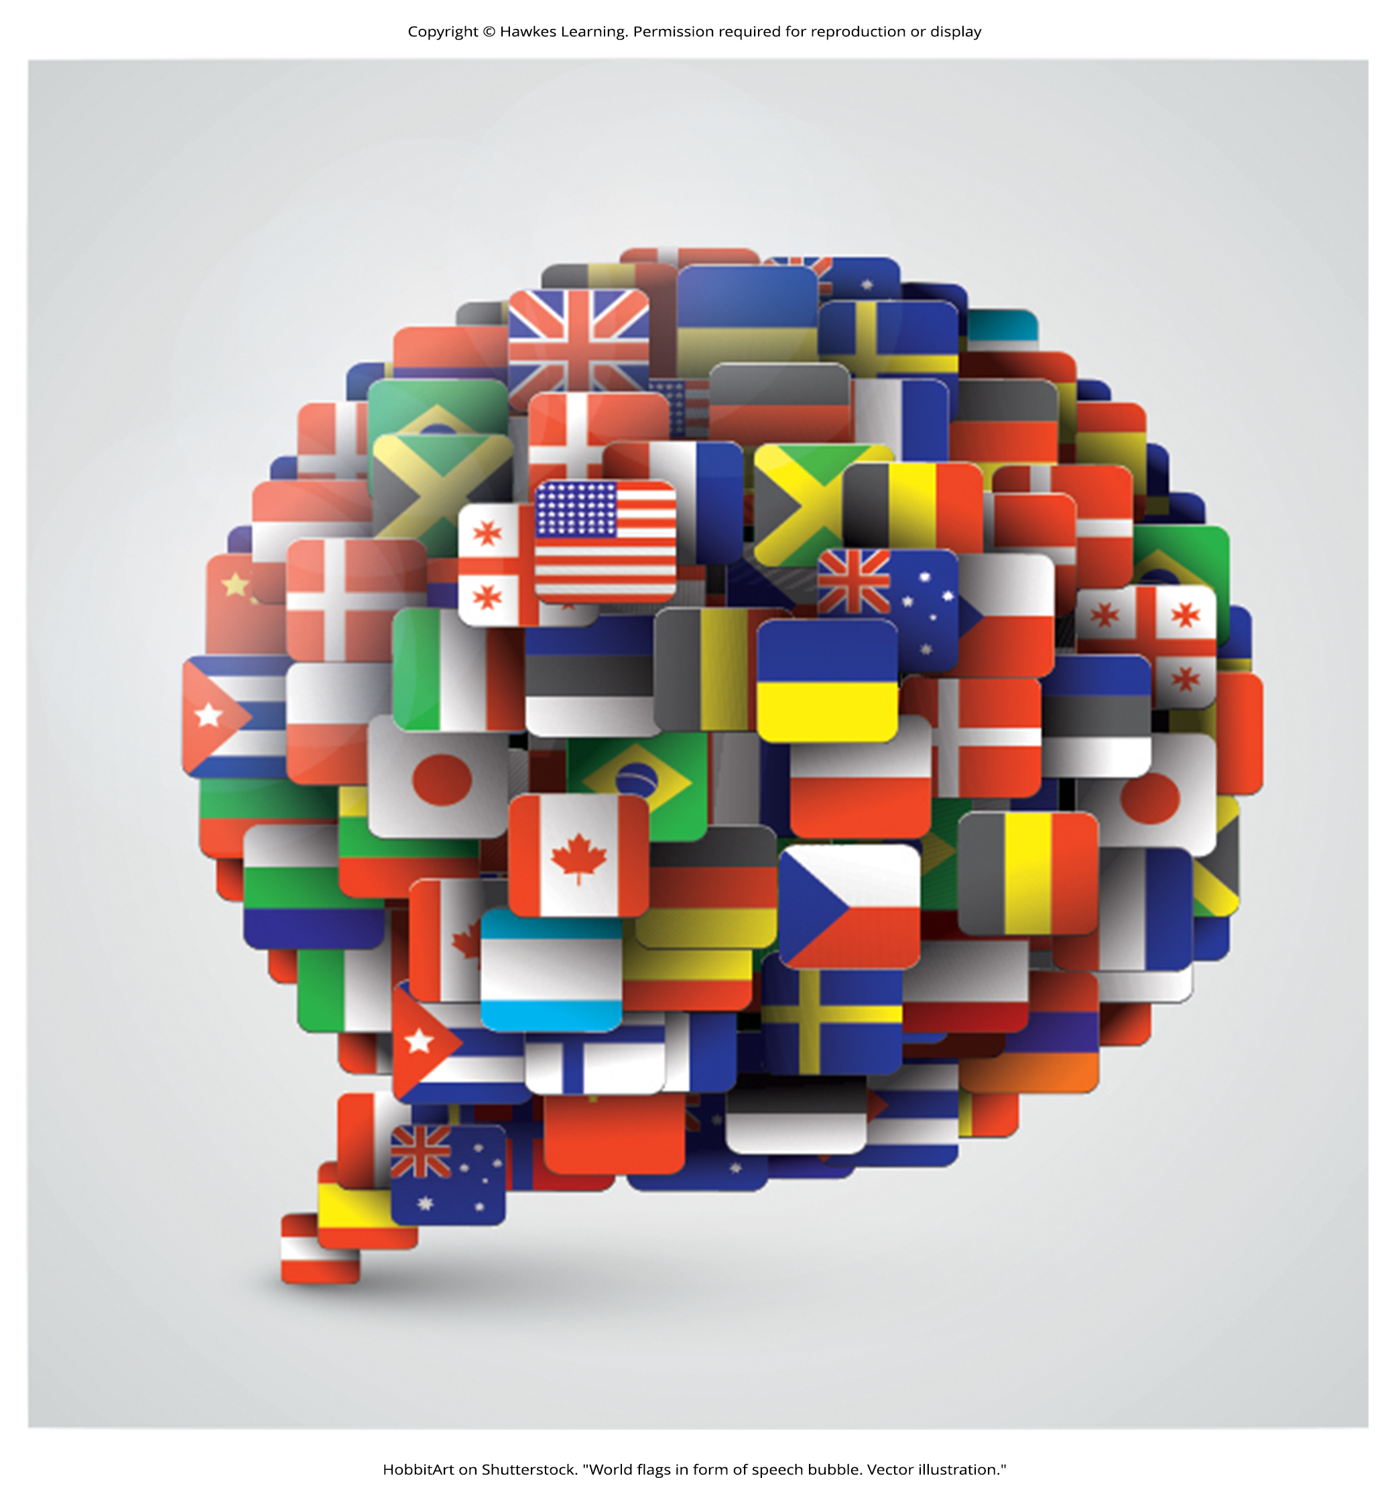
Barriers To Treatment₃
People belonging to ethnic groups that already report concerns about prejudice and discrimination are less likely to seek services for a mental illness because they view it as an additional stigma (Gary, 2005; Townes et al., 2009; Scott et al., 2011; Wong et al., 2017).
Language differences are a further barrier to treatment.
Figure 3

Slide 11
Reflection Question
How can we change the belief that having a mental illness means the individual is weak?

Slide 12
Dig Deeper: Treatment Perceptions₁
One in seven children ages 10–19 will experience at least one mental health condition, and suicide is the fourth leading cause of death for adolescents (World Health Organization, 2021).
Less than 25% of classmates experiencing mental disorders recognized they needed help, and even fewer will receive professional help (U.S. Public Health Service, 2000; van den Toren et al., 2019).
The public has a negative perception of children and teens with mental health disorders, believing they are prone to violence and more likely to be rejected by peers at school.

Slide 13
Dig Deeper: Treatment Perceptions₂
Stigmatization of psychological disorders is one of the main reasons why young people do not get the help they need when they are having difficulties.
The tragic shootings at Sandy Hook Elementary in 2012 highlight the consequences of children not receiving needed mental health treatment, and the importance of looking at mental illness with compassion (DeYoung, 2013).
Campaigns related to the destigmatization of mental illness and an increase in public education and awareness are growing, with organizations like the National Alliance on Mental Illness (NAMI) leading the effort.

Slide 14
Summary
The sociocultural perspective examines you, your behaviors, and your symptoms in the context of your culture and background.
Clinicians using this approach integrate cultural and religious beliefs into the therapeutic process.
Barriers to treatment include lack of insurance, transportation, and time; cultural views that mental illness is a stigma; fears about treatment; and language barriers.

Slide 15
End of Hawkes Learning PowerPoint

