Slide 1
Lesson 2.2
Cells of the Nervous System

Slide 2

The Nervous System
The nervous system is composed of two basic cell types: glial cells and neurons.
Glial cells outnumber neurons, providing support and protecting neurons by insulation, transport, and immune response.
Neurons are the interconnected information processors essential for all nervous system functions.
Figure 1

Slide 3
Neuron Structure
Neurons have a semipermeable membrane that allows some molecules to pass through.
The soma or cell body contains the nucleus.
Dendrites are branching extensions that receive signals as input from other neurons.
The axon extends from the soma and transmits signals via electrical impulses.
Terminal buttons at the axon ends contain synaptic vesicles housing chemical neurotransmitters.
The myelin sheath formed by glial cells insulates axons, increasing signal transmission speed.

Slide 4
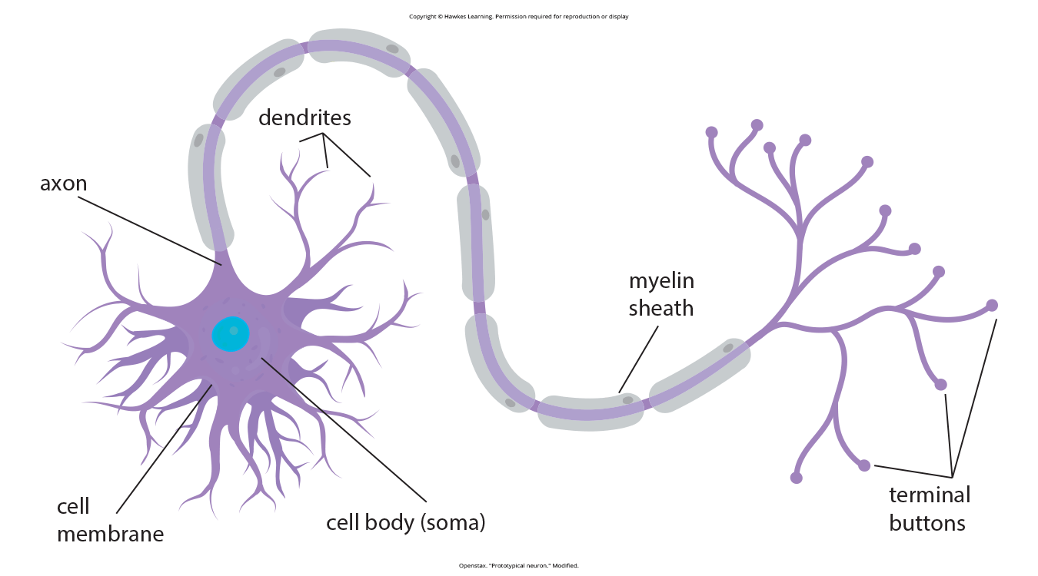
Lesson 2.2 Figure 2
Caption: This illustration shows a prototypical neuron.

Slide 5
Functions Of The Parts Of The Neuron
Dendrite: receives information (neurotransmitters) from other neurons that excite or inhibit the stimulation of the rest of the neuron
Soma: contains the nucleus and produces neurotransmitters
Axon: carries the vesicle full of neurotransmitters from the soma to the terminal buttons
Terminal button: releases the neurotransmitters into the synaptic gap; has receptors to regulate neurotransmitters in the gap; recycles unused neurotransmitters
Synaptic vesicle: contains the neurotransmitters in transport from the soma, through the axon, and empties contents into synaptic gap

Slide 6
Multiple Sclerosis (MS) Example
Multiple sclerosis (MS) is an autoimmune disorder involving large-scale loss of the myelin sheath on axons.
The loss of myelin sheath insulation interferes with the electrical signal transmission by neurons.
This impaired neuronal communication can lead to symptoms like dizziness, fatigue, loss of motor control, and sexual dysfunction.
While treatments may help modify the disease course and manage symptoms, there is currently no known cure for MS.
The example highlights the crucial role of the myelin sheath in facilitating normal neuronal function and nervous system operation.

Slide 7
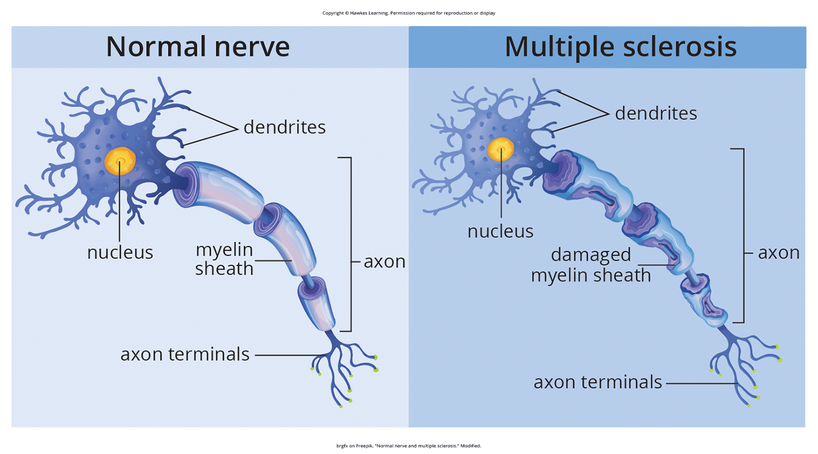
Lesson 2.2 Figure 3
Caption: In people who suffer from multiple sclerosis, the myelin sheaths on some of their neurons are destroyed by the body's own immune cells.

Slide 8
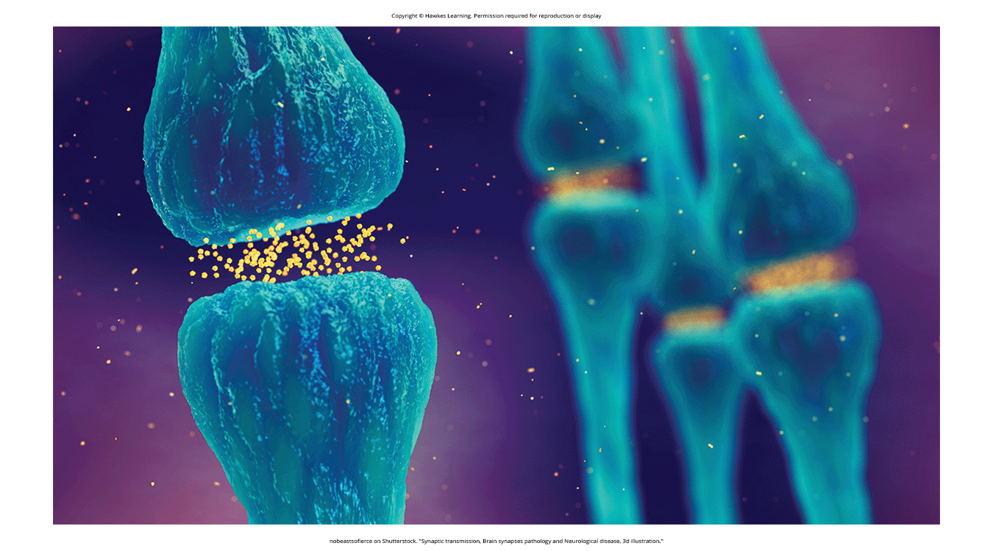
Neuronal Signal
The neuronal signal moves rapidly down the axon to the terminal buttons.
At the terminals, synaptic vesicles release neurotransmitters into the synapse - the small space between neurons.
Neurotransmitters bind to corresponding receptors on the dendrite of the adjacent neuron based on a "lock-and-key" fit.
Figure 4

Slide 9
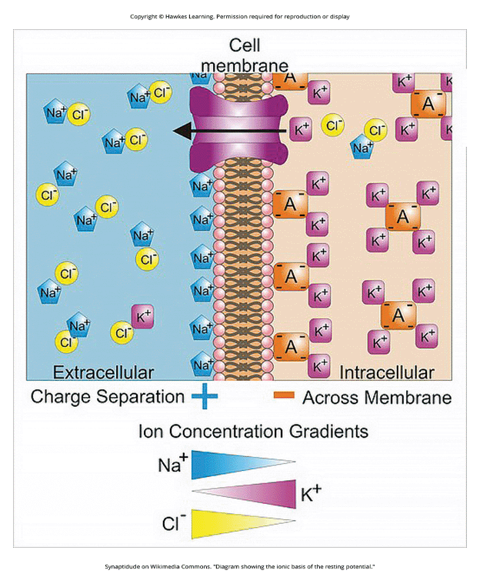
Neuronal Communication₁
Neurons are surrounded by extracellular and intracellular fluids separated by the membrane.
The difference in charge across this membrane is the membrane potential.
Ions like sodium (Na+) and potassium (K+) have different concentrations inside vs. outside the cell.
Figure 5

Slide 10
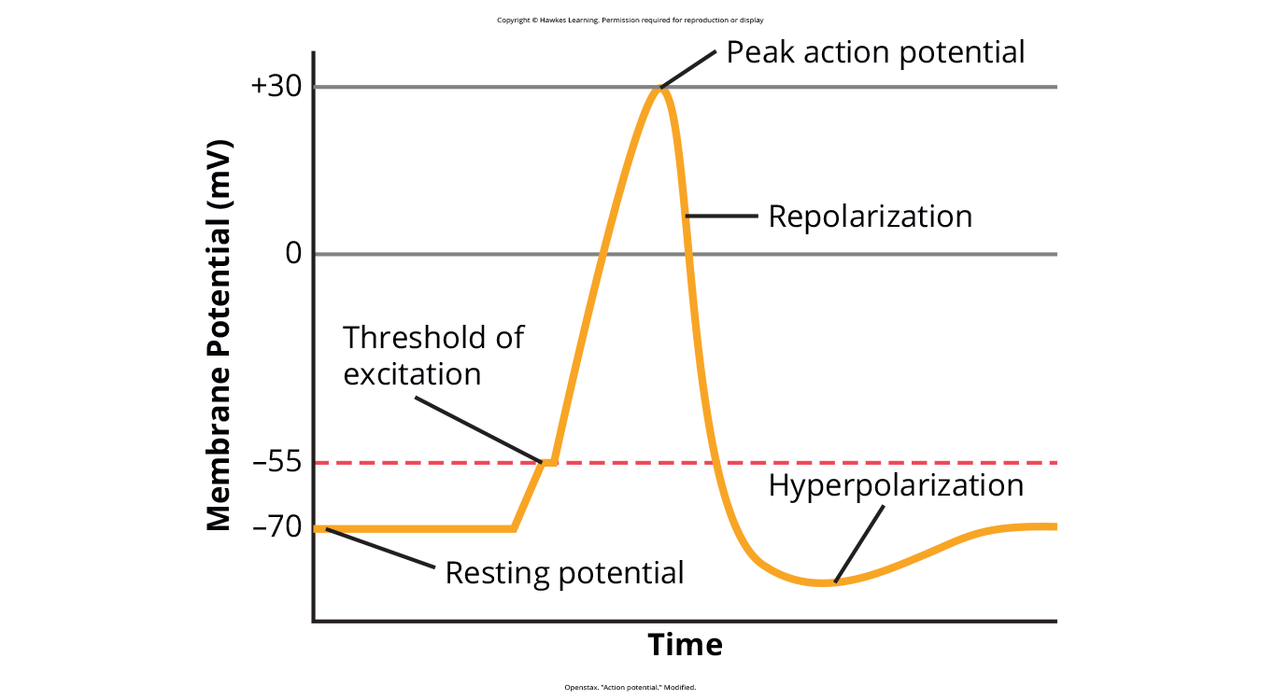
Neuronal Communication₂
In the resting potential state, ions are lined up ready to move based on charge/concentration differences.
An incoming signal opens sodium gates, allowing Na+ influx, making the internal charge more positive.
If it reaches the threshold of excitation, the neuron becomes active and the action potential begins.
Figure 6

Slide 11
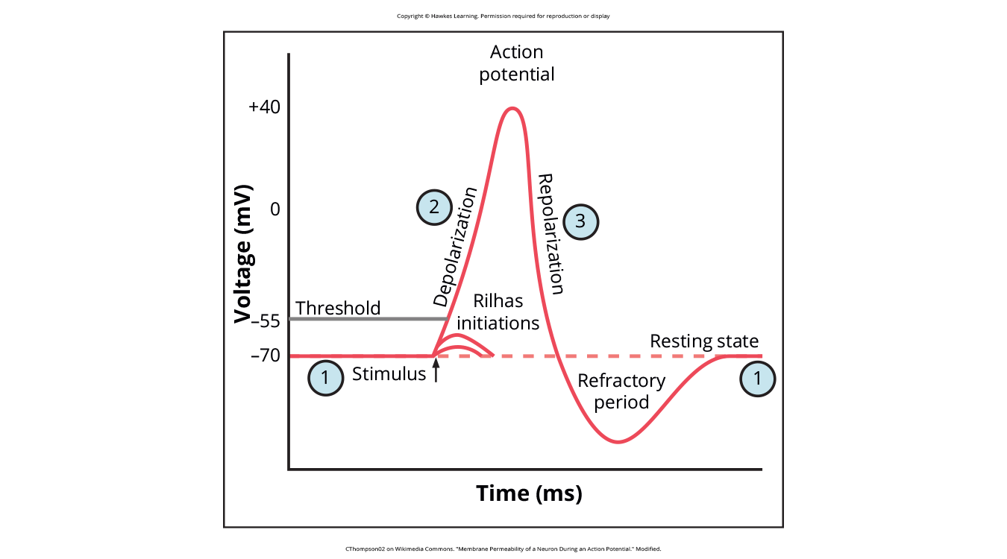
Lesson 2.2 Figure 7a
Caption: Reference the graph for the order of steps in an action potential.

Slide 12
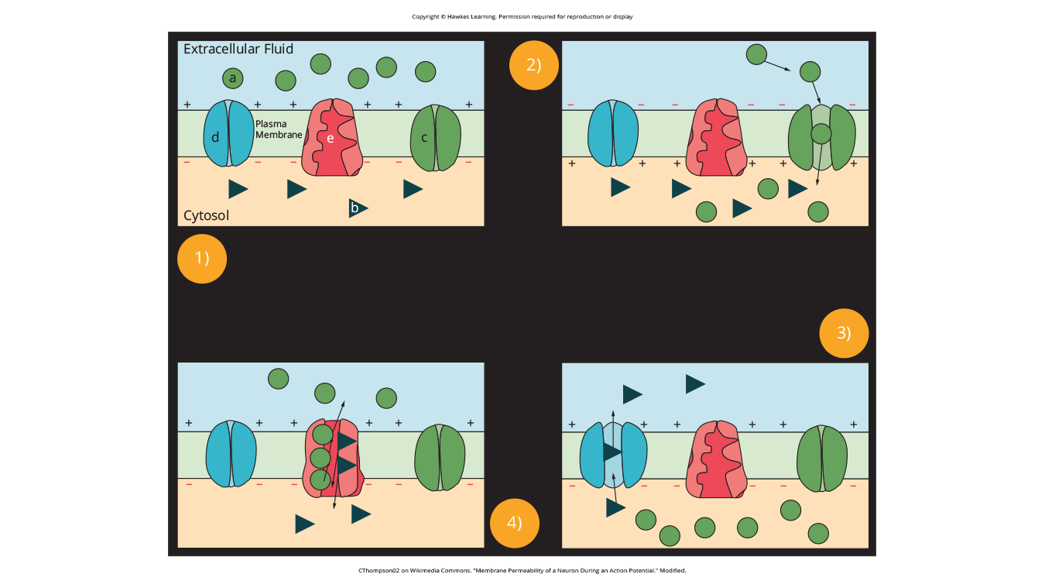
Lesson 2.2 Figure 7b
Caption: The membrane permeability of a neuron during an action potential

Slide 13
Neuronal Communication₃
More sodium gates open, causing a large positive spike - the peak action potential.
Potassium gates then open, allowing K+ efflux and repolarization back to the resting potential.
This positive spike, the action potential, propagates down the axon in an all-or-none manner.

Slide 14
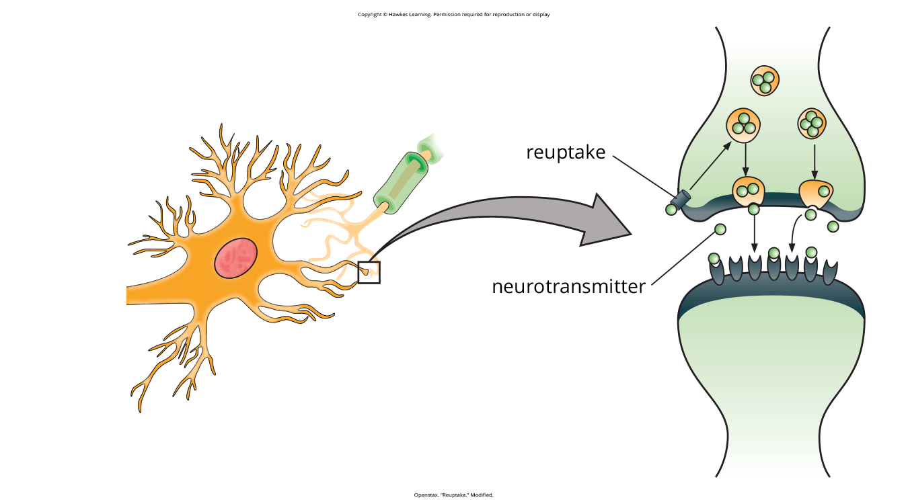
Lesson 2.2 Figure 8
Caption: Reuptake involves moving a neurotransmitter from the synapse back into the axon terminal from which it was released.

Slide 15
Neuronal Communication₄
At terminals, neurotransmitters are released into the synapse when the action potential arrives.
Neurotransmitters bind to receptors on the next neuron, and the process repeats.
Reuptake clears excess neurotransmitters from the synapse to provide clear "on/off" signaling.

Slide 16
Neurotransmitters And Drugs
Neurotransmitters are chemical messengers released by neurons to transmit signals and influence behavior.
Psychotropic medications treat psychiatric symptoms by restoring neurotransmitter balance.
Research on drugs helps understand neurotransmitter functions and their impact on psychological disorders.
The biological perspective links psychological disorders like depression to neurotransmitter imbalances.
Drug treatments for disorders have improved due to insights into neurotransmitter roles.

Slide 17
Agonist
Agonists are chemicals that mimic neurotransmitters at receptor sites, strengthening the neurotransmitter's effects.
Example: Parkinson's disease is treated with dopamine agonists to mimic dopamine and alleviate symptoms due to low dopamine levels.
Dopamine agonists bind to dopamine receptors, helping manage conditions like Parkinson's by imitating dopamine's function.
Agonists are used in treatments where neurotransmitter activity needs to be increased to address certain conditions.

Slide 18
Antagonist
Antagonists block or impede the activity of neurotransmitters by binding to their receptors without activating them.
Example: Schizophrenia treatment often involves dopamine antagonists to block dopamine's overactive neurotransmission.
Antipsychotic drugs are dopamine antagonists that prevent dopamine from signaling information between neurons.
Antagonists are prescribed to reduce excessive neurotransmitter activity that contributes to disorders like schizophrenia.

Slide 19
Psychotropic Drugs
Psychotropic drugs treat psychiatric symptoms by correcting neurotransmitter imbalances in the brain.
Reuptake inhibitors prevent unused neurotransmitters from being reabsorbed, increasing their effects in the synapse.
SSRIs, such as Prozac and Zoloft, treat depression by preventing serotonin reuptake, enhancing serotonin's availability and effects.
Combining drug therapy with psychological or behavioral therapies is often more effective than using medication alone.

Slide 20
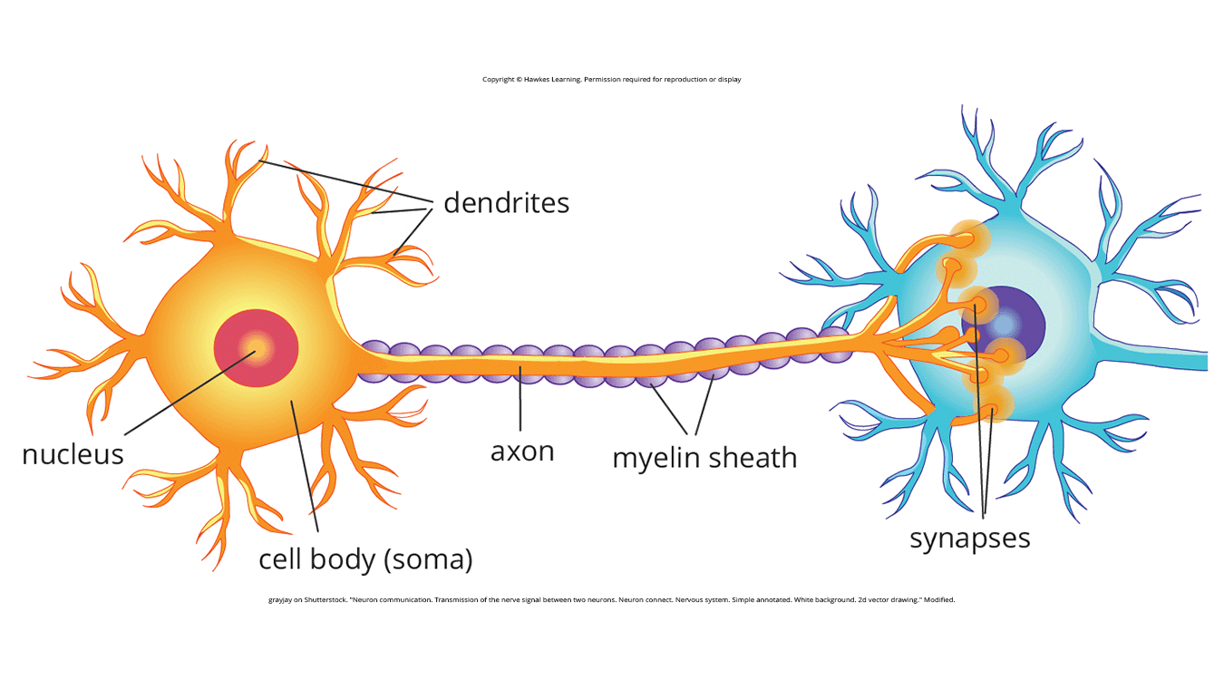
Lesson 2.2 Figure 9
Caption: Neuronal communication is essential to functions related to the nervous system.

Slide 21
Summary
Glia and neurons are the primary cell types in the nervous system, with glia providing support and neurons handling communication.
Neuronal communication relies on specialized structures: soma (cell nucleus), dendrites (receive signals), axon (transmits impulses), and terminal buttons (release neurotransmitters).
The myelin sheath on axons increases the speed of neural impulse transmission, enhancing communication efficiency.
Action potentials are electrochemical events triggered by signals strong enough to cause the release of neurotransmitters, operating on the all-or-none principle.
Neurotransmitter imbalances are often linked to psychological disorders, leading to the use of psychotropic drugs to restore balance by acting as agonists or antagonists.

Slide 22
End of Hawkes Learning PowerPoint

