Slide 1
Lesson 2.3
Parts of the Nervous System

Slide 2
Parts Of The Nervous System
Can be divided into two major subdivisions (Figure 1)
Central nervous system (CNS)
Consists of the brain and spinal cord
Peripheral nervous system (PNS)
Connects the CNS to the rest of the body

Slide 3
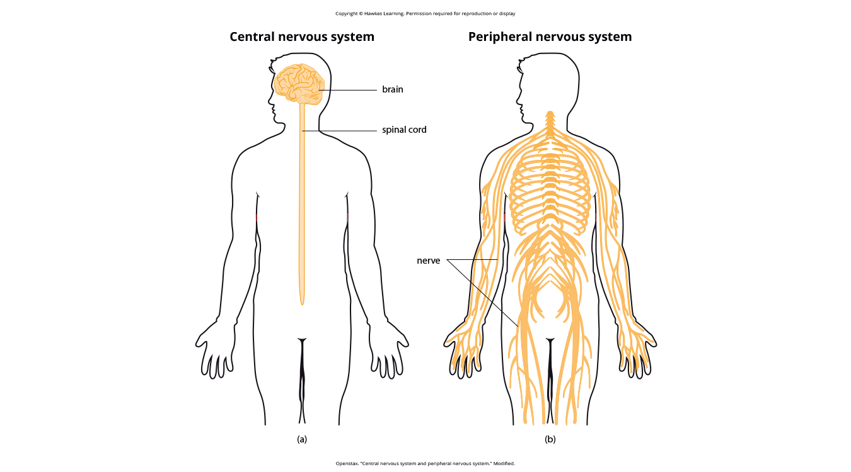
Lesson 2.3 Figure 1
Caption: The nervous system is divided into two major parts: (a) the central nervous system and (b) the peripheral nervous system.

Slide 4
Peripheral Nervous System (PNS)
The PNS is made up of thick bundles of axons (called nerves).
Nerves carry messages back and forth between the brain, the spinal cord, muscles, organs, and senses in the periphery of the body
It consists of two major subdivisions
Somatic nervous system
Autonomic nervous system

Slide 5
Somatic Nervous System
The somatic nervous system relays sensory and motor information to and from the brain using motor and sensory neurons.
Motor neurons (efferent fibers) carry instructions from the brain to the muscles.
Sensory neurons (afferent fibers) transmit sensory information to the CNS.
Nerves function as two-way highways, containing both efferent and afferent axons to coordinate bodily actions.

Slide 6
Autonomic Nervous System
The autonomic nervous system controls internal organs and glands, operating largely outside voluntary control.
It consists of two main divisions:
Sympathetic nervous system
Parasympathetic nervous system
Homeostasis is maintained through the complementary functions of these two divisions.
Homeostasis: tendency to maintain a balance, or optional level, within a biological system

Slide 7
Parasympathetic Nervous System
The parasympathetic nervous system returns the body to routine operations after a stress response, promoting relaxation.
This system counterbalances the sympathetic nervous system, ensuring bodily functions return to a state of calm and stability.

Slide 8
Sympathetic Nervous System
Sympathetic nervous system prepares the body for stress-related activities, activating the fight-or-flight response.
It is activated when we are faced with stressful or high-arousal situations.
It was adaptive for our ancestors and increased their chances of survival.
Example: our ancestors out hunting small game that suddenly disturbs a bear and her cub
At this moment, the person′s body undergoes a series of changes – a direct function of sympathetic activation
Pupils dilate, heart rate increases, blood pressure increases, bladder relaxes, liver releases glucose

Slide 9
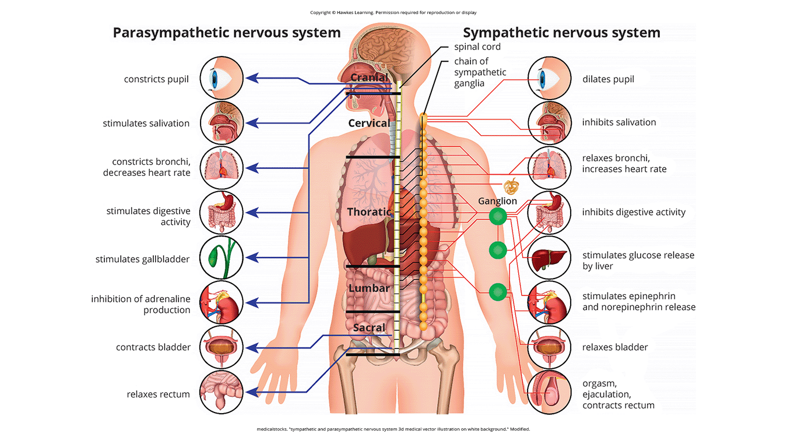
Lesson 2.3 Figure 2
Caption: The sympathetic and parasympathetic divisions of the autonomic nervous system have the opposite effects on various systems.

Slide 10
Fight-Or-Flight Response₁
Fight-or-flight response: set of physiological responses that occur when an individual encounters a perceived threat
Allows the body access to energy reserves and heightened sensory capacity so it can fight a threat or run away to safety

Slide 11
Fight-Or-Flight Response₂
Modern humans experience increased sympathetic activity from psychological threats like giving a presentation, taking an important test, or dealing with COVID-19 stressors.
Chronic stress can increase susceptibility to heart disease and impair immune function (Chandola et al., 2006)
Once the threat is resolved, the parasympathetic nervous system restores bodily functions to a relaxed state.
Heart rate and blood pressure return to normal, pupils constrict, bladder control is regained, and the liver stores glucose as glycogen.

Slide 12
Reflection Question
What are some ways you can increase parasympathetic nervous system activity?

Slide 13
Summary
The peripheral nervous system includes the somatic and autonomic nervous systems.
The somatic nervous system transmits sensory and motor signals to and from the central nervous system.
The autonomic nervous system controls organ and gland functions and is divided into the sympathetic and parasympathetic divisions.
Sympathetic activation prepares for fight-or-flight response, while parasympathetic activation is associated with normal functioning under relaxed conditions.

Slide 14
End of Hawkes Learning PowerPoint

