Slide 1
Lesson 2.4
The Brain and Spinal Cord

Slide 2
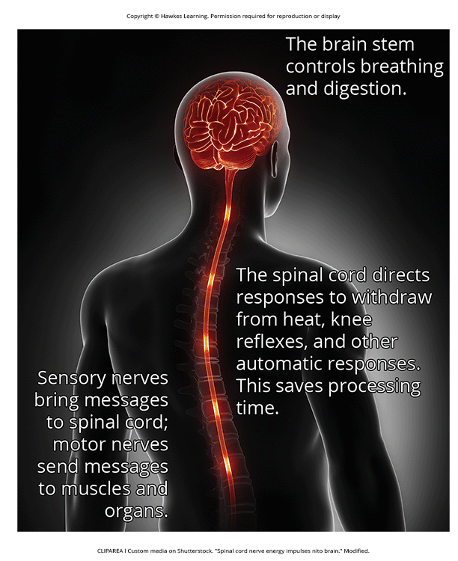
The Spinal Cord
It connects the brain to the outside world, enabling brain function and action
It acts as a relay station routing messages to/from the brain and has its own system of automatic processes called reflexes
The top of the spinal cord merges with the brain stem.
Controls basic processes like breathing and digestion
It ends just below the ribs, with 30 segments corresponding to vertebrae, connecting to specific body parts via the peripheral nervous system.
Sensory nerves bring messages in; motor nerves send messages out; reflexes initiated in spinal cord allow rapid responses without brain processing.
The spinal cord is protected by bony vertebrae and cushioned in cerebrospinal fluid.
Figure 1

Slide 3
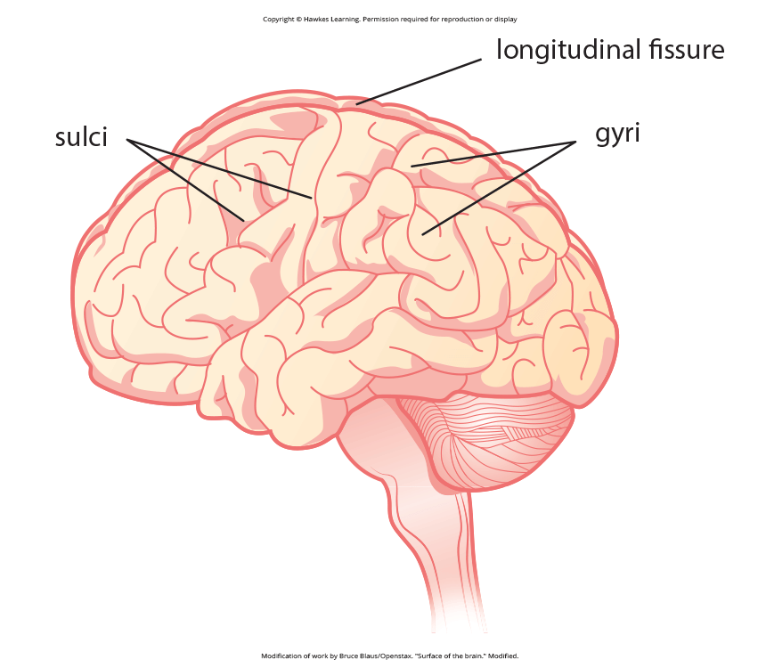
The Two Hemispheres₁
The cerebral cortex is the uneven surface of the brain with distinctive patterns of gyri (bumps) and sulci (grooves).
The most prominent sulcus is the longitudinal fissure, which separates the brain into two hemispheres: left and right.
There is evidence of lateralization, or specialization of function, in each hemisphere, mainly regarding language ability.
The left hemisphere controls the right half of the body, and the right hemisphere controls the left half.
The brain has flexibility to rewire pathways in case of injury, showing its plasticity.
Figure 2

Slide 4
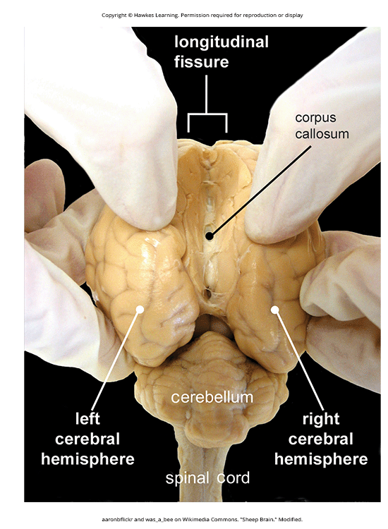
The Two Hemispheres₂
The two hemispheres are connected by the corpus callosum.
Corpus callosum: thick band of neural fibers connecting the brain's two hemispheres
In cases of severe epilepsy, the corpus callosum may be severed, resulting in "split-brain" patients.
Split-brain patients show interesting behaviors.
Like the inability to name a picture shown in the left visual field (right hemisphere)
They can recreate the picture with their left hand, controlled by the right hemisphere
When the left hemisphere sees the drawing, the patient can identify the picture, due to its verbal abilities
Figure 3

Slide 5
Brain Damage And Localization Of Function
Studying changes in behavior after brain damage helps understand functions of different brain areas.
Strokes, caused by interrupted blood flow, can damage specific brain regions and cause localized deficits.
Damage to the frontal lobe's motor centers can cause movement deficits, like difficulty moving a limb.
Damage to the prefrontal cortex can impair judgment, reasoning, and impulse control, leading to socially inappropriate behavior.

Slide 6
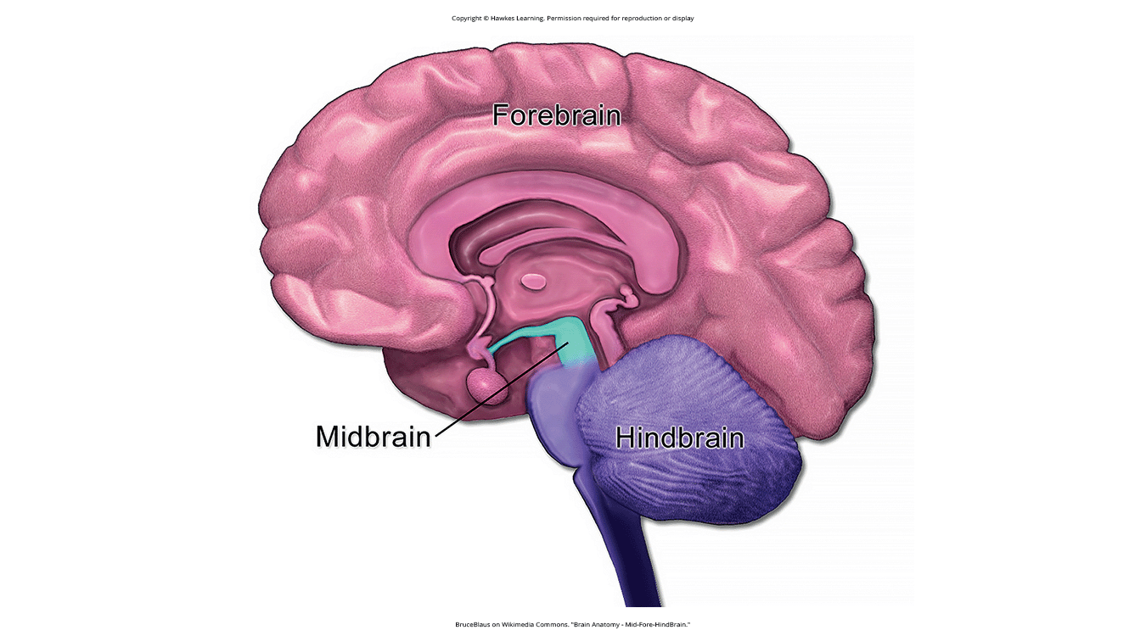
Lesson 2.4 Figure 4
Caption: The brain and its parts can be divided into three main categories: the forebrain, midbrain, and hindbrain.

Slide 7
Forebrain Structures
Cerebral cortex: surface of the brain that is associated with our highest mental capabilities
Higher level processes include consciousness, thought, emotion, reasoning, language, and memory
Subcortical structures
Thalamus
Hypothalamus
Pituitary gland
Limbic system

Slide 8
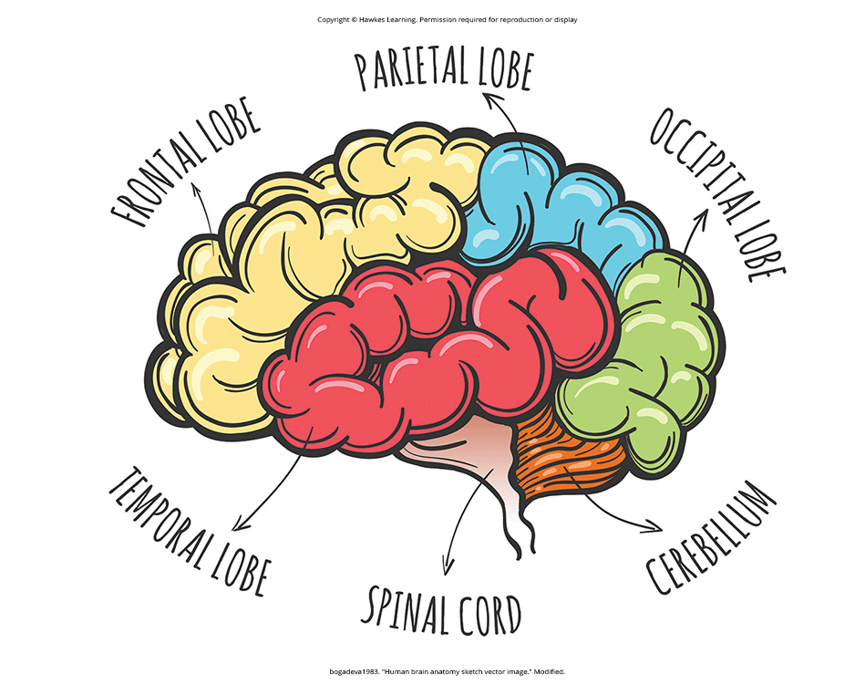
Lobes Of The Brain
Frontal lobe
Parietal lobe
Temporal lobe
Occipital lobe
Figure 5

Slide 9
Fontal Lobe
Located in the forward part of the brain
Contains the motor cortex for planning and coordinating movement
Prefrontal cortex responsible for higher-level cognitive functioning
Broca's area is essential for language production
People with damage to Broca's area have great difficulty producing any form of language
Example: An individual lost the ability to speak/write after damage to Broca's area from car accident

Slide 10
Parietal Lobe
Contains the somatosensory cortex
Somatosensory cortex: essential for processing sensory information from across the body, such as touch, temperature, and pain
Different areas of somatosensory cortex process sensations from different body parts
Larger body areas with more nerves have larger representational space in the cortex
Example: fingers have much more cortical space than toes due to their sensitivity

Slide 11
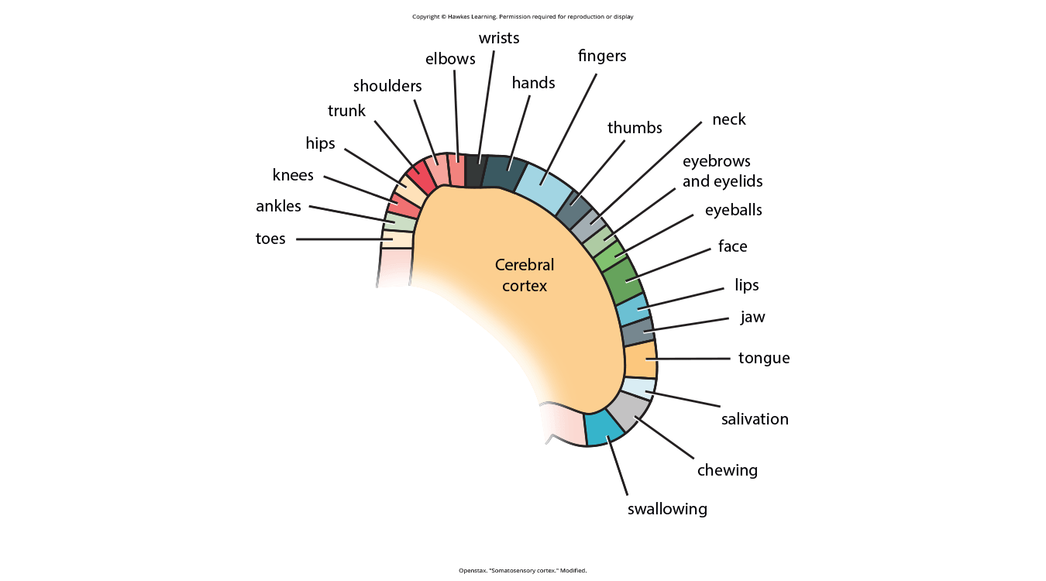
Lesson 2.4 Figure 6
Caption: Spatial relationships in the body are mirrored in the organization of the somatosensory cortex.

Slide 12
Temporal Lobe
Located on the side of the head
Associated with hearing, memory, emotion, and aspects of language
Contains the auditory cortex
Auditory cortex: strip of cortex in the temporal lobe that is responsible for processing auditory information
Wernicke's area in the temporal lobe is important for speech comprehension
Damage to Wernicke's area impairs ability to understand language while allowing language production

Slide 13
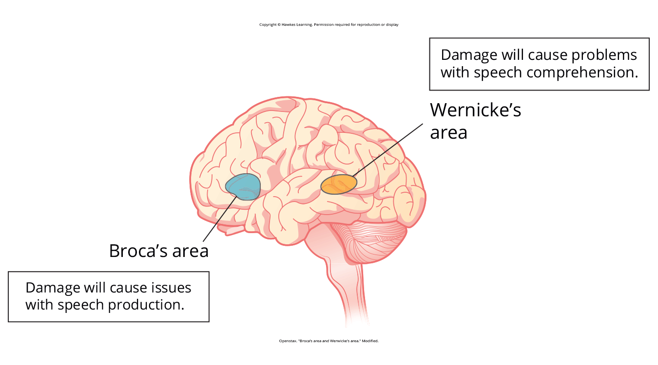
Lesson 2.4 Figure 7
Caption: Damage to either Broca's area or Wernicke's area can result in language deficits. The types of deficits are very different, however, depending on which area is affected.

Slide 14
Occipital Lobe
Located at the very back of the brain
Contains the primary visual cortex for interpreting incoming visual information
Organized retinotopically
Close relationship between the position of an object in a person's visual field and the position of that object's representation on the cortex

Slide 15
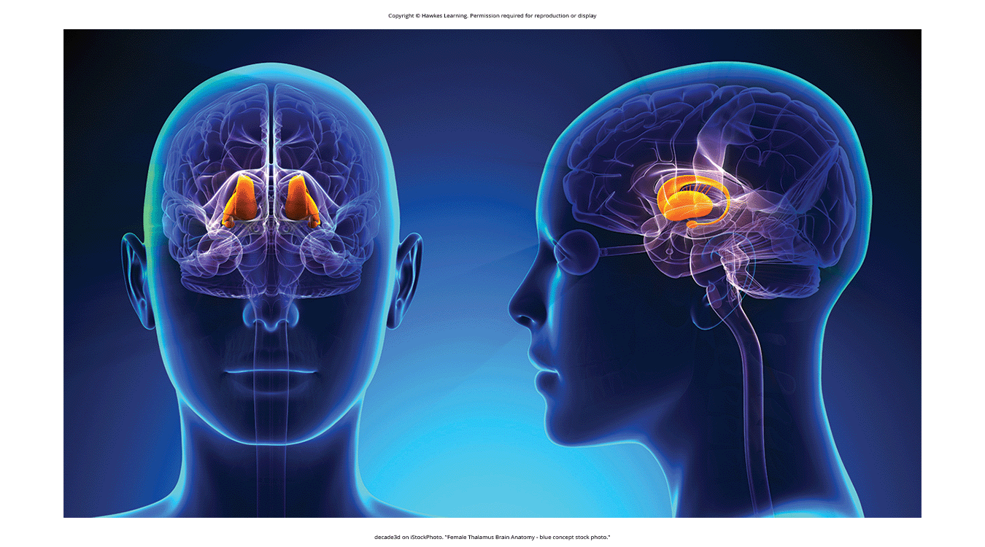
Other Areas Of The Forebrain
Located beneath the cerebral cortex and includes the thalamus and the limbic system.
Thalamus: sensory relay for the brain (Figure 8)
Limbic system: collection of structures involved in processing emotion and memory
Hippocampus: structure in the temporal lobe associated with learning and memory
Amygdala: structure in the limbic system involved in our experience of emotion and tying emotional meaning to our memories
Hypothalamus: forebrain structure that regulates sexual motivation and behavior and a number of homeostatic processes
Figure 8

Slide 16
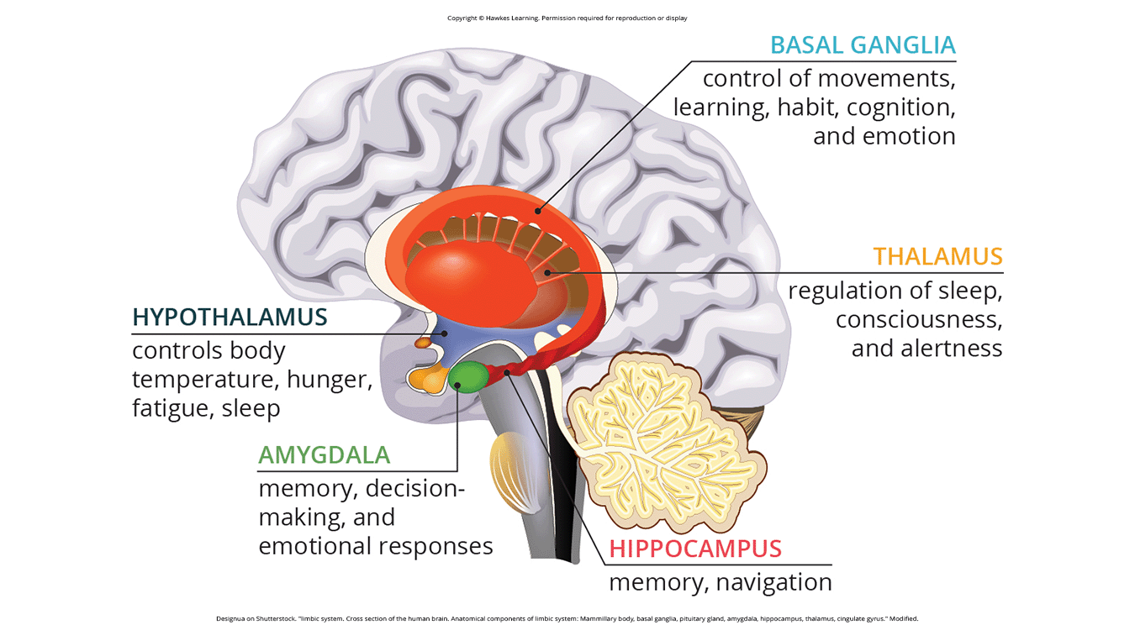
Lesson 2.4 Figure 9
Caption: The limbic system is involved in mediating emotional response and memory.

Slide 17
The Case Of Henry Molaison (H. M.)
In 1953, Henry Molaison (H.M.) was 27 years old and suffered from severe seizures.
He underwent brain surgery to remove his hippocampus and amygdala to control seizures.
After surgery, his seizures reduced but he lost ability to form many new memories.
He could learn new skills but had no recollection of learning them.
He could not remember new faces or events, even immediately after they occurred.
He is considered one of the most studied cases in medical and psychological history (Hardt et al.,2010; Squire, 2009).

Slide 18
Midbrain Structures
Comprised of structures located deep within the brain, between the forebrain and the hindbrain.
Reticular formation (extends up into the forebrain and down into the hindbrain)
Regulates sleep/wake cycle
Regulates arousal
Regulates alertness
Regulates motor activity
Substantia nigra (Latin for "black substance") and ventral tegmental area (VTA)
Produce dopamine
Involved in Parkinson's disease
Involved in mood, reward, and addiction
(Berridge & Robinson, 1998; Gardner, 2011; George et al., 2012)

Slide 19
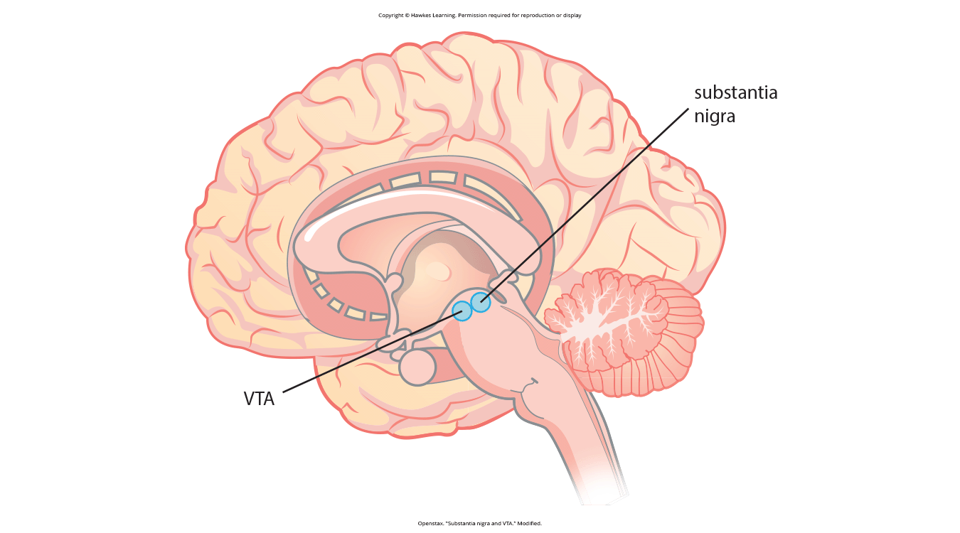
Lesson 2.4 Figure 10
Caption: The substantia nigra and ventral tegmental area (VTA) are located in the midbrain.

Slide 20
Hindbrain Structures
Located at the back of the head
Looks like an extension of the spinal cord
Contains the medulla, pons, and cerebellum (Figure 11)
Medulla, pons, and cerebellum together are known as the brainstem

Slide 21
Medulla
Controls the automatic processes of the autonomic nervous system
Breathing
Blood pressure
Heart rate

Slide 22
Pons
Means "bridge"
Connects brain and spinal cord
Regulates brain activity during sleep

Slide 23
Cerebellum
Latin for "little brain"
Receives messages from muscles, tendons, joints, and structures in our ear to control balance, coordination, movement, and motor skills
Believed to be involved in processing some memories, such as procedural memory or memory involved in learning and remembering how to perform tasks

Slide 24
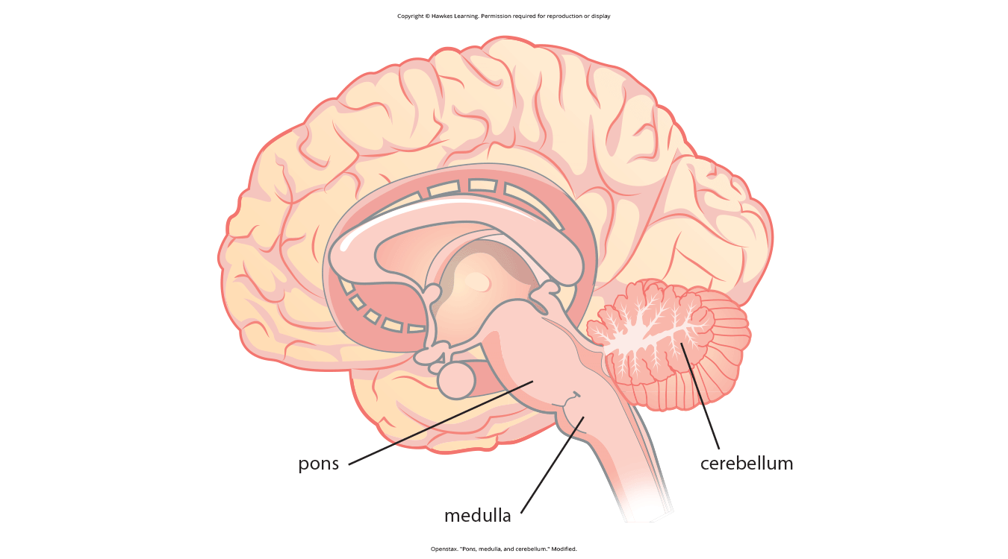
Lesson 2.4 Figure 11
Caption: The pons, medulla, and cerebellum make up the hindbrain.

Slide 25
Reflection Question
What would you do if you were told that a family member is brain-dead, and there is no hope for recovery of brain function?
Would you continue or discontinue life support?
What if your family member had a living will that specified that life support be discontinued in these circumstances?
Would you honor their wishes?

Slide 26
Brain Imaging
We are able to obtain information about the brain using images techniques.
These types of techniques include
Radiation (CT/PET scans)
Magnetic Fields (MRI/fMRI)
Electrical Activity (EEGs)

Slide 27
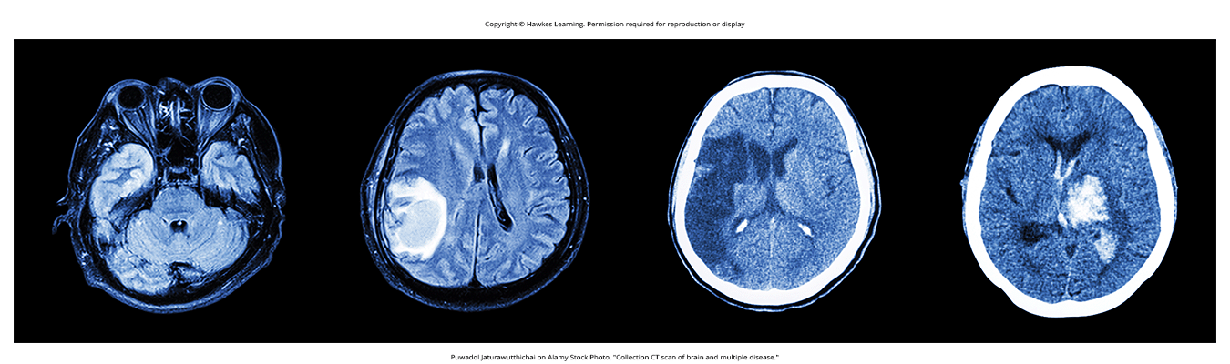
Computerized Tomography (CT) Scan
It is a technique involving radiation.
Is an imaging technique in which a computer coordinates and integrates multiple X-rays of a given area (Figure 13).
It is often used to determine whether someone has a tumor or significant brain atrophy.
Figure 13

Slide 28
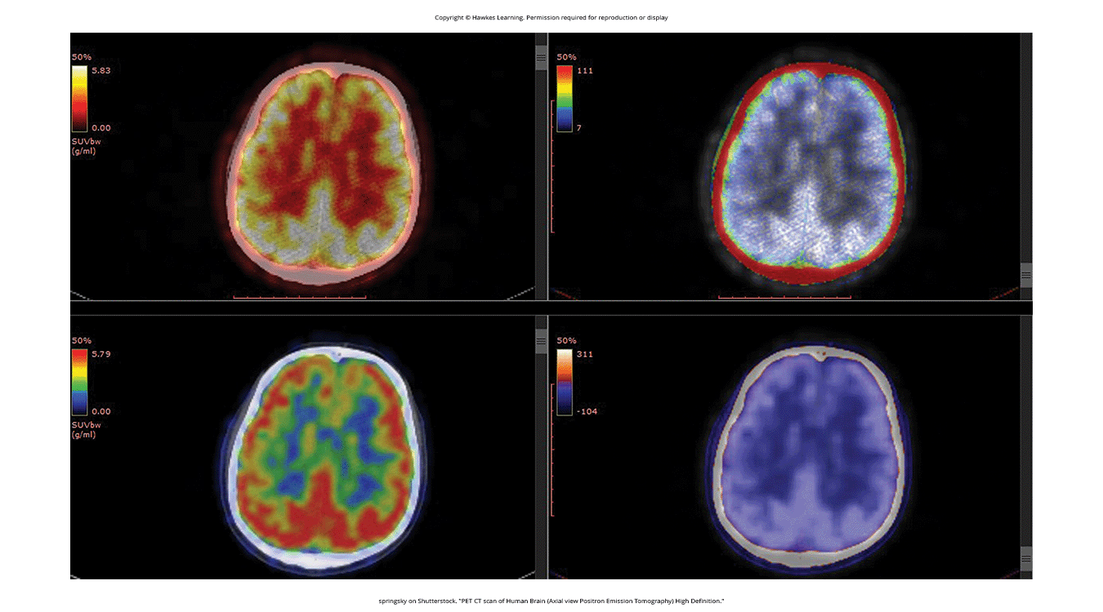
Positron Emission Tomography (PET)
A PET scan involves injecting individuals with a mildly radioactive substance and monitoring changes in the blood flow to different regions of the brain.
It is a technique that relies on radiation.
PET scans show little detail, are unable to pinpoint events precisely in time, and require that a brain be exposed to radiation.
Allows for better imaging of the activity of neurotransmitter receptors
Figure 14

Slide 29
Magnetic Resonance Imaging (MRI)
In magnetic resonance imaging (MRI), a person is placed in a strong magnetic field.
MRI: magnetic fields used to produce a picture of the tissue being imaged
The magnetic field causes hydrogen atoms in body cells to move.
When field is turned off, hydrogen atoms emit signals based on tissue density.
A computer interprets these signals and displays them as an image.

Slide 30
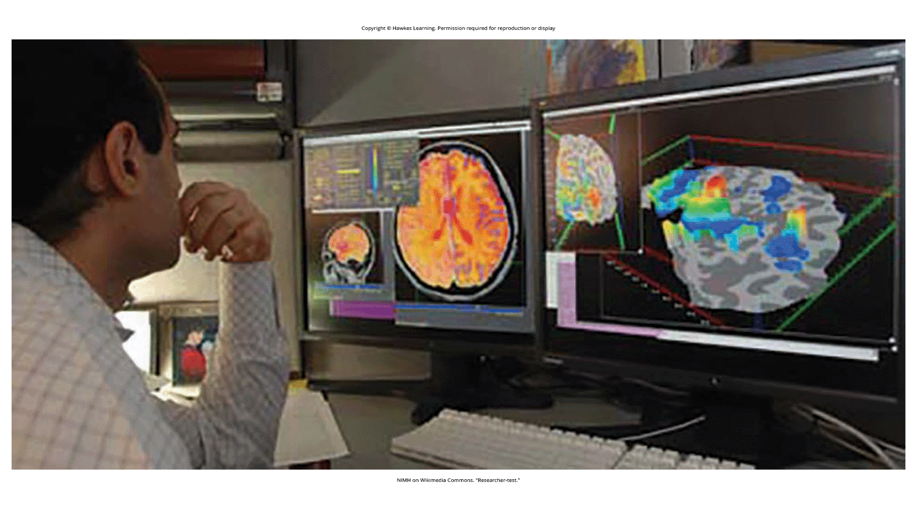
Functional Magnetic Resonance Imaging (fMRI)
Functional MRI (fMRI) operates on the same principles as an MRI.
But it shows changes in brain activity over time by tracking blood flow and oxygen levels.
fMRI provides detailed images of brain structure and accurate timing information.
fMRI is used to compare brains of healthy vs. disordered individuals
Figure 15

Slide 31

Electroencephalography (EEG)
Electroencephalography (EEG) measures overall electrical activity of the brain without location information.
An array of electrodes is placed around the person's head.
The EEG shows brainwave frequency (waves per second) and amplitude (wave height).
An EEG is helpful for studying sleep patterns and sleep disorders.
Figure 16

Slide 32
On Your Own
Summarize the functions of the brain tests listed below:
CT scan
PET scan
MRI
fMRI
EEG

Slide 33
Summary
The brain consists of two hemispheres, each controlling the opposite side of the body.
Each hemisphere can be subdivided into lobes: frontal, parietal, temporal, and occipital.
The forebrain includes the thalamus (sensory relay) and limbic system (emotion and memory circuit).
The midbrain has the reticular formation (sleep/arousal), substantia nigra and VTA (movement, reward, addiction).
The hindbrain contains the brainstem controlling automatic functions like breathing/blood pressure, and the cerebellum for movement/memory.
Studying brain-damaged individuals provides insights into brain area functions.
Neuroimaging techniques like CT, PET, MRI, fMRI, EEG allow visualizing brain structure/activity.

Slide 34
End of Hawkes Learning PowerPoint

