Slide 1
Lesson 2.5
The Endocrine System

Slide 2
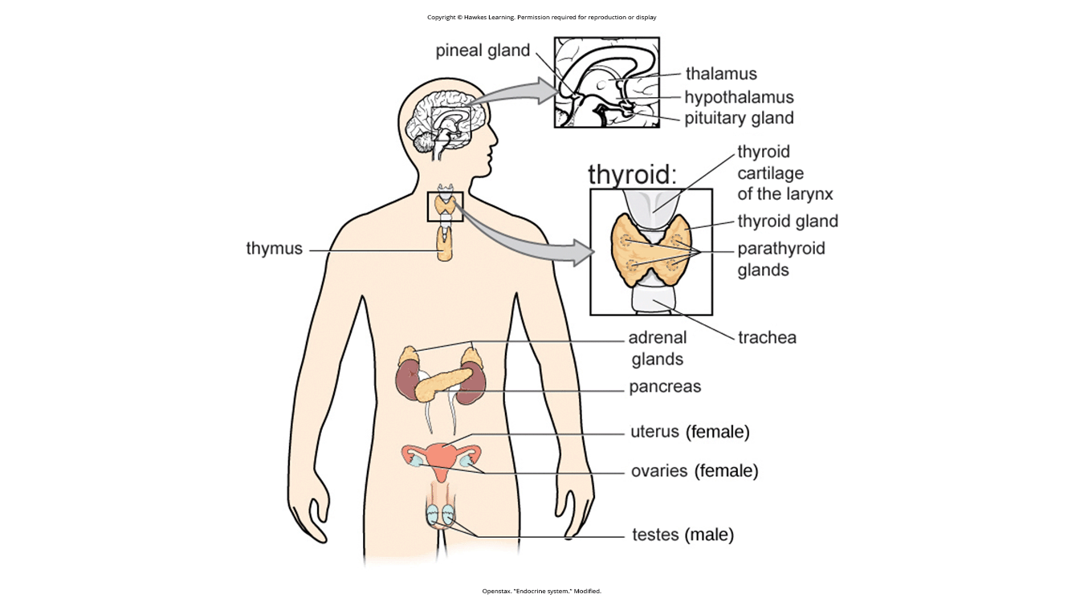
The Endocrine System
Consists of a series of glands that product chemical substances known as hormones. (Figure 1)
Figure 1

Slide 3
Hormones
Hormones: chemical messengers released by endocrine glands
Secreted into the bloodstream and travel through the body
Affect any cells that contain receptors for them
Effects are widespread
Slower than neurotransmitters to take affect
Longer lasting than neurotransmitters
Involved in regulating many bodily functions
Ultimately controlled through interactions between the hypothalamus and pituitary gland

Slide 4
Reflection Question
How is it evolutionarily advantageous for our neurotransmitters to be fast-acting and our hormones to be released and act more slowly?

Slide 5
Pituitary Gland
Descends from the hypothalamus at the base of the brain
"Master gland"—messenger hormones control all endocrine glands
Carries out instructions from hypothalamus
Secretes growth hormone
Secretes endorphins for pain relief
Secretes hormones that regulate fluid levels

Slide 6
Thyroid Gland
Located in the neck
Releases hormones that regulate growth, metabolism, and appetite
Hyperthyroidism:
  Secretes too much thyroxine
  Causes agitation, bulging eyes, weight loss
Hypothyroidism:
  Secretes too little thyroxine
  Causes tiredness and feeling cold

Slide 7
Adrenal Gland
Sits on top of the kidneys
Secrete hormones involved in stress response:
  Epinephrine (adrenaline)
  Norepinephrine (noradrenaline)

Slide 8
Pancreas
Organ that secretes hormones that regulate blood sugar
  Insulin (lower blood sugar)
  Glucagon (increase blood sugar)

Slide 9
Diabetes
Individuals with diabetes must take medications that stimulate or replace insulin production.
  Diabetes: disease related to insufficient insulin production
They also must closely control the amount of sugars and carbohydrates they consume.

Slide 10
Group Activity
The percentage of Americans who are overweight continues to increase. As a result, Type II diabetes diagnoses are increasing in children and teenagers. As a group, research the average weight for adult men and women in the 1970s, 1990s, 2010s, and 2020.
Has it increased or decreased?
If so, by how much?
Come up with some possible explanations for your findings.

Slide 11
Gonads
Secrete sexual hormones, which are important in reproduction:
  Female ovaries secrete estrogens and progesterone.
  Male testes secrete androgens (e.g., testosterone).
Mediate sexual motivation and behavior

Slide 12
Dig Deeper: Athletes And Anabolic Steroids
Anabolic steroids are drugs that mimic effects of body's steroid hormones like testosterone.
They are used by some athletes to potentially increase muscle mass, strength, and endurance.
Their use is banned by many professional sports organizations due to health risks.
Negative effects of anabolic steroids range from cosmetic issues like acne to life-threatening heart attacks.
Steroid use can also cause mood changes and increase aggressive behavior.
  Example: Baseball player Alex Rodriguez (A-Rod) was suspended for steroid use costing over $20 million.
  His performance was enhanced by illegal PEDs helping negotiate a record-high player contract.
  Though he denied recent use, the suspension suggested continued doping for competitive advantage.
  (Gaines, 2013)

Slide 13
Summary
The endocrine system's glands secrete hormones to regulate normal body functions.
The hypothalamus connects the nervous and endocrine systems, controlling pituitary secretions.
The pituitary is the master gland, controlling secretions of all other endocrine glands.
The thyroid secretes thyroxine for metabolism and growth; adrenals secrete stress hormones.
The pancreas regulates blood sugar; and ovaries/testes produce sex hormones for sexual motivation/behavior.

Slide 14
End of Hawkes Learning PowerPoint

