Slide 1
Lesson 3.1
What Is Consciousness?

Slide 2
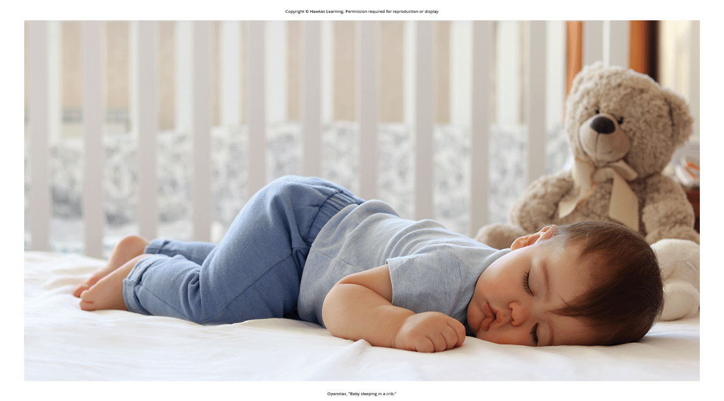
What Is Consciousness?
Consciousness: describes our awareness of internal and external stimuli
Internal stimuli: pain, hunger, and emotions
External stimuli: sight, sound, touch, taste, and smell
Different states and levels of consciousness, from full awareness to deep sleep
Figure 1

Slide 3
States Of Consciousness
Sleep: a state marked by low physical activity and reduced sensory awareness
Wakefulness: characterized by high sensory awareness, thought, and behavior
Other states: daydreaming, intoxication, meditation, hypnosis, and sleep deprivation
May experience unconscious states through drug-induced anesthesia
Not always fully aware even when awake
Example: daydreaming while driving

Slide 4
Biological Rhythms
Biological rhythms: internal rhythms of biological activity
Example: a woman's menstrual cycle (28-day recurring pattern)
Cyclically fluctuating body temperature over a 24-hour period (Figure 2)
Higher temperatures: associated with alertness
Lower temperatures: associated with sleepiness

Slide 5
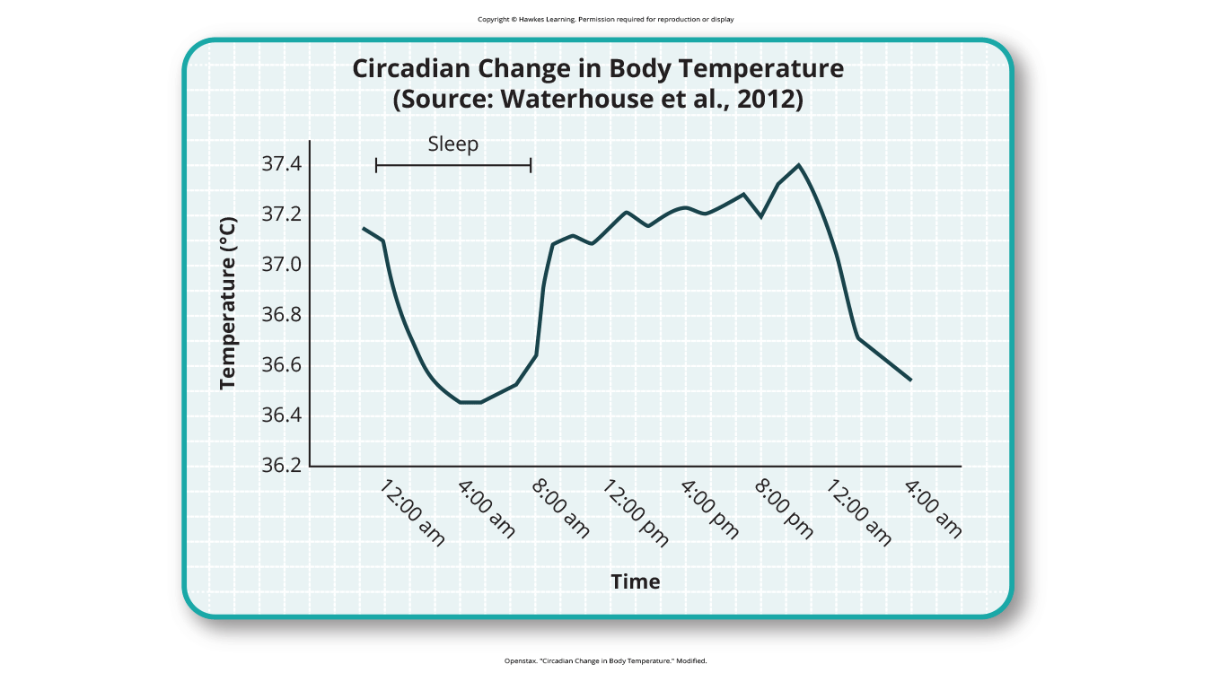
Lesson 3.1 Figure 2
Caption: This chart illustrates the circadian change in body temperature over 28 hours in a group of eight young men. Body temperature rises throughout the waking day, peaks in the afternoon, and falls during sleep with the lowest point occurring during the very early morning hours.

Slide 6
Circadian Rhythms
Circadian rhythm: a biological rhythm of about 24 hours
Example: the sleep-wake cycle, which is linked to nature's light-dark cycle
Other examples: our daily fluctuations in heart rate, blood pressure, blood sugar, and body temperature
Can influence changes in states of consciousness

Slide 7
The Biological Clock
The hypothalamus in the brain is a main homeostasis center.
Homeostasis is the maintenance of a balance/optimal level in a biological system.
The suprachiasmatic nucleus (SCN) is the brain's clock mechanism in the hypothalamus.
Light-sensitive neurons provide light information to sync the SCN internally and externally (Klein et al., 1991; Welsh et al., 2010; Foster, 2020) (Figure 3).

Slide 8
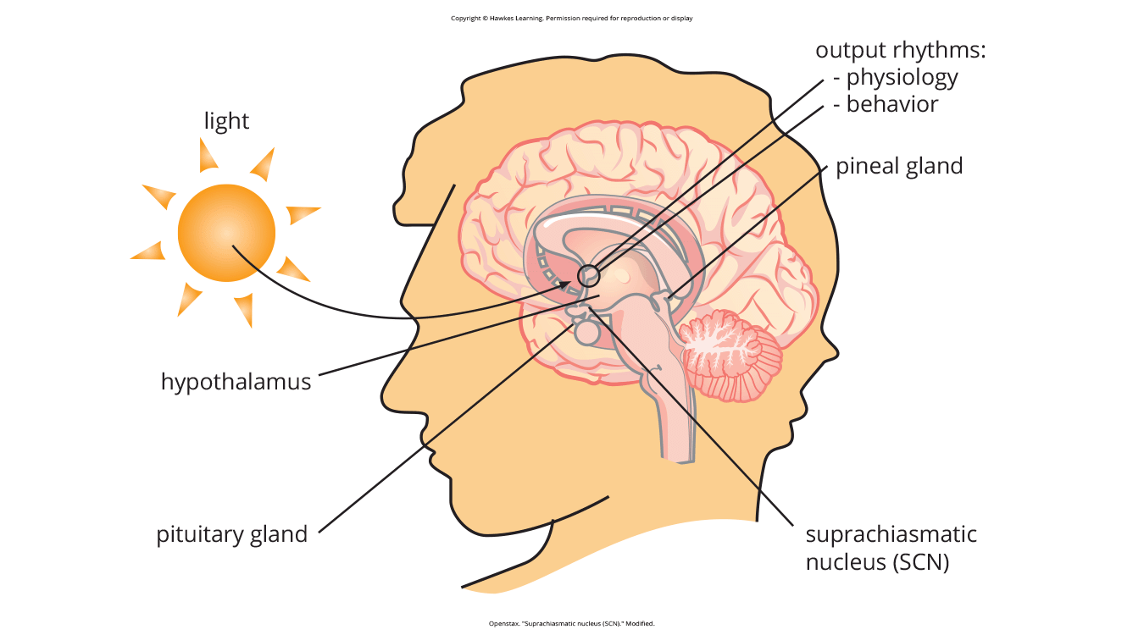
Lesson 3.1 Figure 3
Caption: The suprachiasmatic nucleus (SCN) serves as the brain's clock mechanism. The clock sets itself with light information received through projections from the retina.

Slide 9
Problems With Circadian Rhythms
Our circadian cycles are generally aligned with the outside world.
Example: Most people sleep at night and are awake during the day.
The hormone melatonin is an important regulator of sleep-wake cycles.
Melatonin release is stimulated by darkness and inhibited by light.

Slide 10
Individual Differences In Sleep-Wake Cycles
There are individual differences in our sleep-wake cycles.
A person's chronotype refers to their circadian activity patterns.
Morning larks and night owls differ in sleep regulation.

Slide 11
Sleep Regulation
Sleep regulation: the brain's control of sleep and wakefulness cycles
Coordinates this cycle with the external day-night cycle
Disruptions to sleep regulation can occur due to:
Jet lag from traveling across time zones
Working night/rotating shift schedules
Poor vision causing misalignment of light/dark cues

Slide 12
Disruptions Of Normal Sleep
There are situations where the circadian clock is out of sync with the environment.
Jet lag is a collection of symptoms from mismatched internal/external cycles.
Symptoms: fatigue, irritability, and insomnia (recurring sleep difficulty) (Roth, 2007; National Institutes of Health, 2022a)
Occurs when traveling across multiple time zones.

Slide 13
Rotating Shift Work
Rotating shift work: changing from early to late schedules frequently
Makes it difficult for a normal circadian rhythm to develop
Can result in sleep problems, depression, anxiety, memory issues
Tired workers more likely to make mistakes on the job (Gold et al., 1992; Presser, 1995; Lazzari et al., 2018)

Slide 14
Reflection Question₁
What are some factors in your life that have disrupted your circadian rhythm?

Slide 15
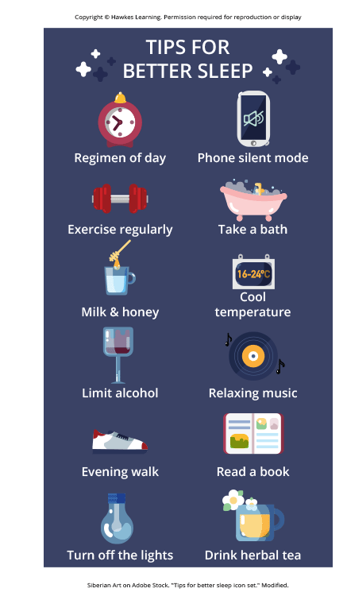
Insufficient Sleep
Sleep debt occurs when you are not getting enough sleep chronically.
Consequences: decreased alertness and mental efficiency
Since electric lighting, amount of sleep people get has declined.
Many sleep less than the recommended 7–8 hours and accrue a debt.
Figure 4

Slide 16
Sleep Needs At Different Ages
Sleep needs vary across ages and individuals.
Newborns require the most sleep at 14–17 hours per night.
This declines to 7–9 hours for adults (National Sleep Foundation, n.d.).
By age 65, average sleep is typically less than 7 hours (Ohayon et al., 2004).

Slide 17
Consequences Of Sleep Deprivation
Sleep debt and deprivation have major negative effects (Figure 5).
Can lead to depression-like symptoms and cognitive/motor impairments
Sleep deprivation impairs functioning as much as alcohol intoxication.
Those with health issues like obesity are more prone to sleep debt (Banks & Dinges, 2007; Gupta & Sood, 2023).

Slide 18
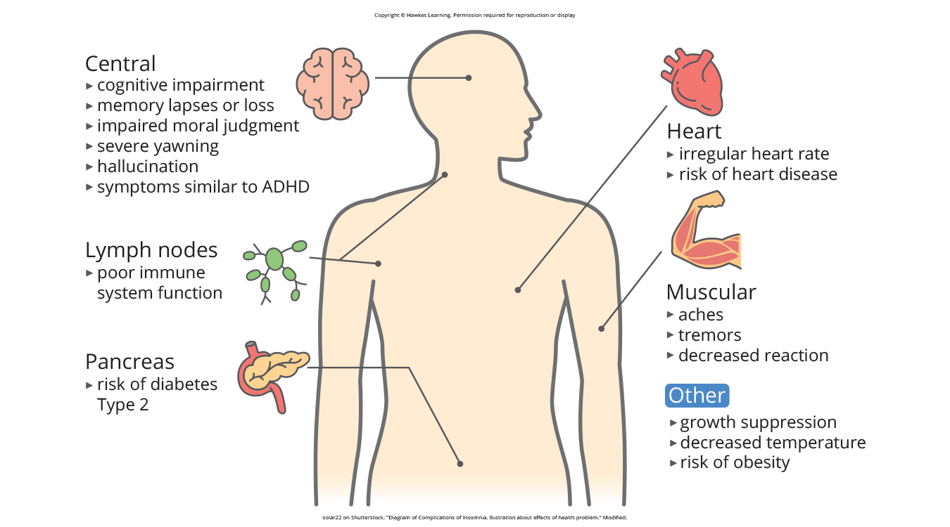
Lesson 3.1 Figure 5
Caption: This figure illustrates some of the negative consequences of sleep deprivation. While cognitive deficits may be the most obvious, many body systems are negatively impacted by lack of sleep.

Slide 19
Reflection Question₂
Have you noticed changes in your circadian rhythm before? Describe what the experience was like.

Slide 20
Summary
States of consciousness vary daily and across the lifespan.
Key factors are biological rhythms, especially circadian rhythms from the suprachiasmatic nucleus (SCN).
Our biological clocks typically align with the external light-dark cycle.
Traveling across time zones or rotating shift work disrupts these cycles.
This can lead to insomnia, sleepiness, and decreased alertness.

Slide 21
End of Hawkes Learning PowerPoint

