Slide 1
Lesson 3.2
Sleep and Why We Sleep

Slide 2
Sleep And Why We Sleep
We spend around one-third of our lives sleeping, equating to ~25 years for average U.S. life expectancy.
Different species exhibit varied sleep patterns and needs.
Understanding the functions and mechanisms of sleep is crucial.

Slide 3
Reflection Question
Are you impacted by getting too little sleep? Too much sleep? How does sleep quantity and quality affect your body and mind?

Slide 4
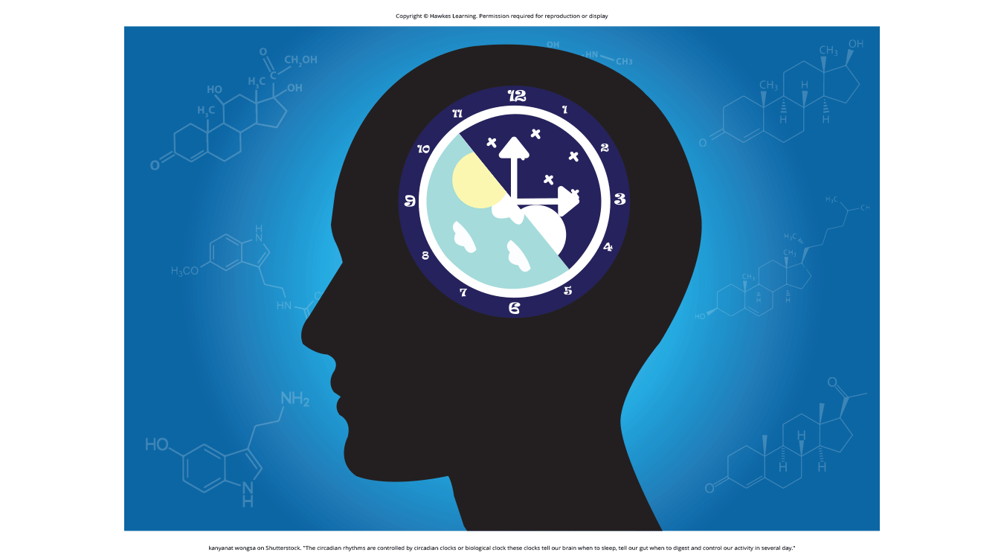
What Is Sleep?₁
State of low physical activity and reduced sensory awareness
Regulated by circadian rhythms (biological clock) and homeostatic mechanisms like sleep rebound
Figure 1

Slide 5
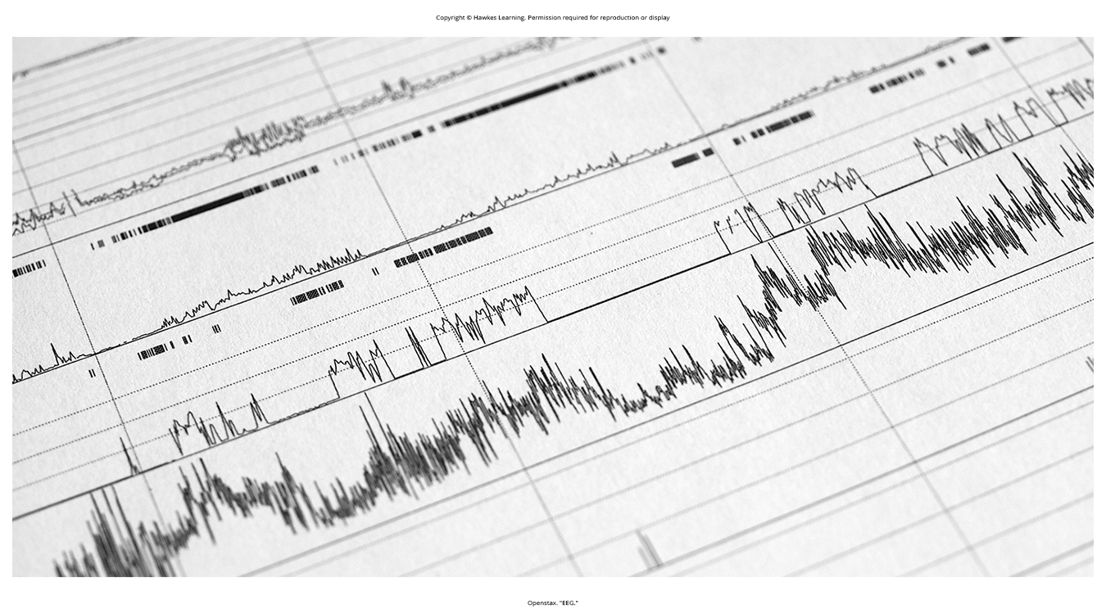
What Is Sleep?₂
Characterized by distinct brain activity patterns captured by electroencephalography (EEG) (Figure 2)
Figure 2

Slide 6
What Is Sleep?₃
Controlled by brain areas like the thalamus, hypothalamus, and pons
Thalamus: works with the hypothalamus to regulate slow-wave sleep
Hypothalamus: contains the SCN and other nuclei
Pons: regulates REM sleep (National Institutes of Health, n.d.)
Tied to release of hormones like melatonin, FSH, LH, and growth hormone (National Institutes of Health, n.d.)
Melatonin: released during sleep by pineal gland (Figure 3)

Slide 7
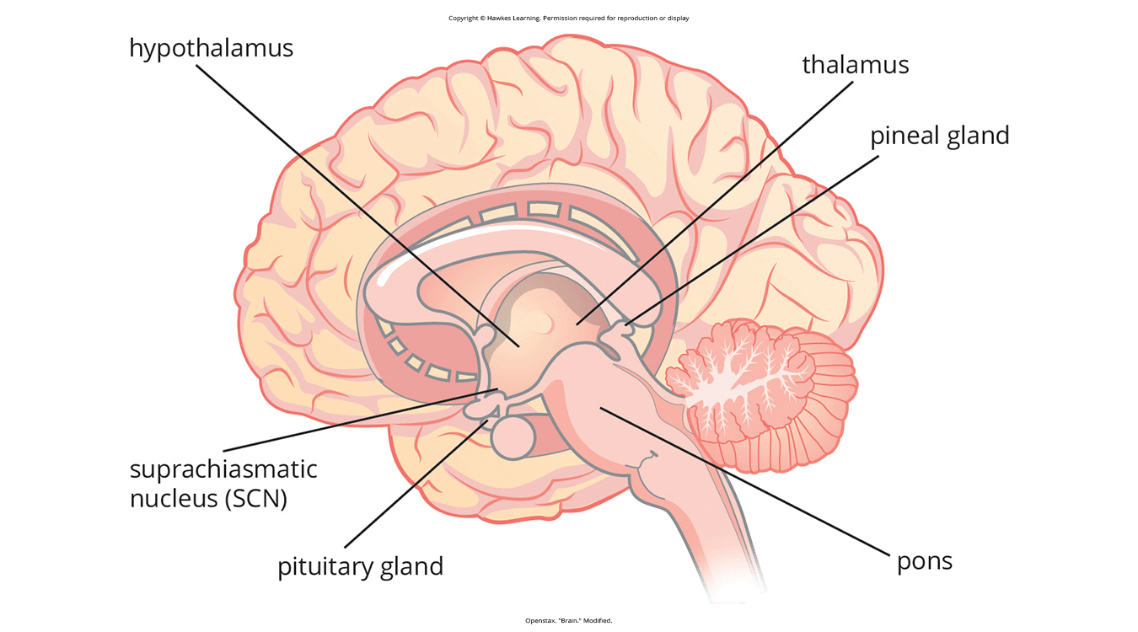
Lesson 3.2 Figure 3
Caption: The pineal and pituitary glands secrete a number of hormones during sleep.

Slide 8
Why Do We Sleep?
No definitive explanation, but several proposed hypotheses
Adaptive function: involves evolutionary psychology
Cognitive function: importance of sleep to cognitive function and memory formation (Rattenborg et al., 2007; The Sleep Foundation, 2023; Whitehurst et al., 2022)

Slide 9
Adaptive Function of Sleep₁
Evolutionary psychology is the idea that sleep evolved from natural selection.
One hypothesis argues that sleep restores resources expended during the day, like hibernation.
Another hypothesis suggests a complex, equivocal link between predation risk and sleep patterns.
Species with higher risk may sleep less, but no clear relationship to deep sleep.

Slide 10
Group Activity
As a group, brainstorm all of the ways in which you expend energy throughout the day. Based on this list, do you feel that this perspective on why we sleep makes sense?

Slide 11

Adaptive Function Of Sleep₂
There are two main arguments:
Species that face higher predatory risks sleep fewer hours than other species (Capellini et al., 2008; Nunn et al., 2016; Svensson et al., 2018).
There is no relationship between the amount of time a given species spends in deep sleep and its predation risk (Lesku et al., 2006).
Figure 4

Slide 12
On Your Own
Reflect on which argument you agree with more. Does it make sense to you that creatures facing high risks of survival sleep more or less than others? Or do you feel that there is likely no comparison?

Slide 13

Adaptive Function Of Sleep₃
Sleep may serve different adaptive functions across species' evolutionary pressures.
Many benefits are associated with adequate amounts of sleep:
Maintaining a healthy weight
Lowering stress levels
Improving your mood
Increasing motor coordination
Benefiting cognition and memory formation
Figure 5

Slide 14
Cognitive Function of Sleep
Sleep is important for cognition, memory formation and consolidation (Rattenborg et al., 2007; The Sleep Foundation, 2023; Whitehurst et al., 2022).
Sleep deprivation impairs attention, decision-making (Whitehurst et al., 2022), and recall (Brown, 2012).
Slow-wave sleep aids learning (Huber et al., 2004) and memory encoding (Stickgold, 2005).
Adequate sleep may boost creative thinking (Cai et al., 2009; Wagner et al., 2004), language skills (Fenn et al., 2003; Gómez et al., 2006), and emotional processing (Walker, 2009; Denis et al., 2023).

Slide 15
Summary
Complex systems regulate sleep stages and cycles.
Sleep is seemingly vital for cognitive processing and development.
More research is needed to fully understand sleep's core functions.

Slide 16
End of Hawkes Learning PowerPoint

