Slide 1
Lesson 3.3
Stages of Sleep

Slide 2
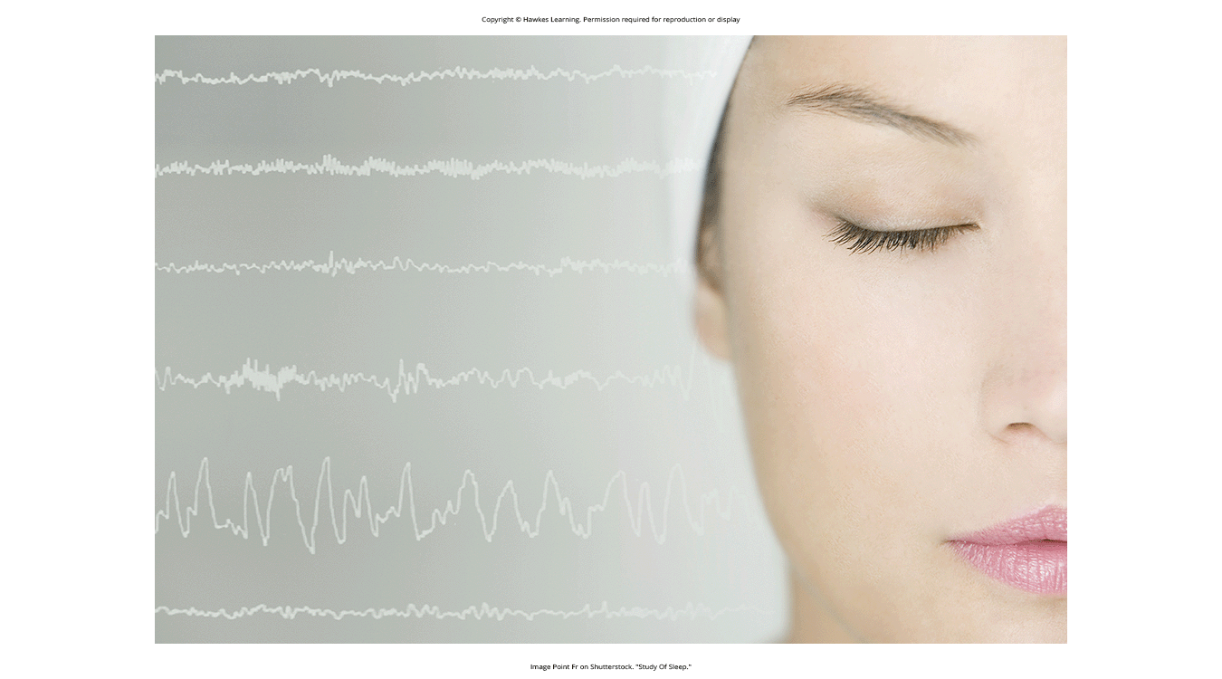
Stages Of Sleep
Different stages exhibit distinct patterns of brain waves.
These stages can be visualized using EEG.
Distinguished by both frequency and amplitude of brain waves (Figure 1)
Sleep is composed of several stages distinguished by brain wave activity: non-REM (NREM) sleep (first 3 stages) and REM sleep (final stage).
Figure 1

Slide 3
NREM Stages Of Sleep: Stage 1
Stage 1 sleep: transitional phase between wakefulness and sleep
Reduction in rates of respiration and heart rate
Marked decrease in overall muscle tension
Decrease in core body temperature
Relatively easy to wake someone up from stage 1

Slide 4
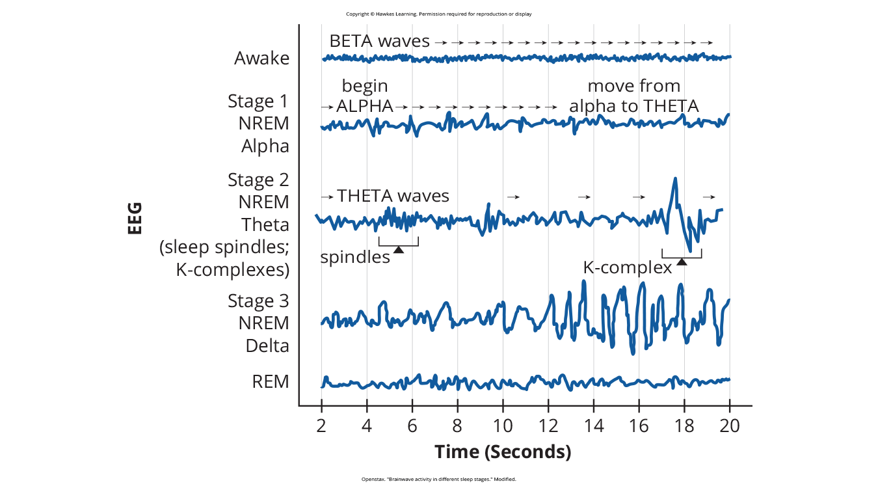
Brain Wave Activity: Stage 1
Alpha waves: produced during stage 1 sleep; low frequency (8–13 Hz), high amplitude patterns of electrical activity (Figure 2)
Resembles someone who is relaxed yet awake
Theta waves: lower frequency (4–7 Hz), higher amplitude brain waves than alpha waves
Figure 2

Slide 5
NREM Stages Of Sleep: Stage 2
Stage 2 sleep: body enters a state of deep relaxation
Dominated by theta waves
Interruption by sleep spindles (Figure 3)
Sleep spindle: rapid burst of higher frequency brain waves that may be important for learning and memory (Fogel & Smith, 2011; Poe et al., 2010)
K-complex: high amplitude pattern of brain activity that may occur in response to environmental stimuli
Might serve as a bridge to higher levels of arousal (Halász, 1993; Steriade & Amzica, 1998; Gandhi & Emmady, 2022)

Slide 6
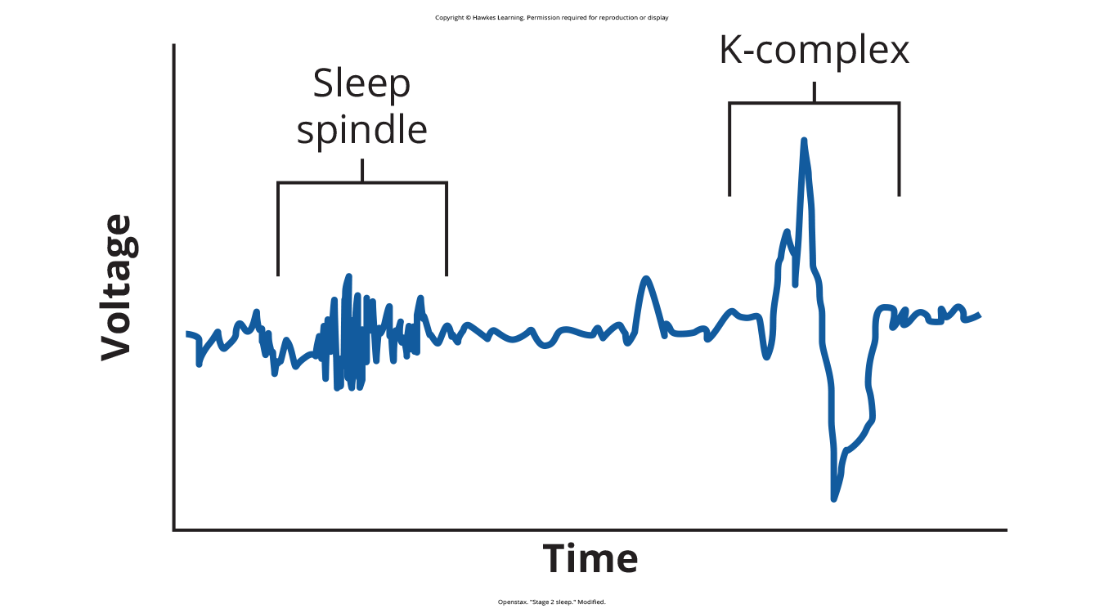
Lesson 3.3 Figure 3
Caption: Stage 2 sleep is characterized by the appearance of both sleep spindles and K-complexes.

Slide 7
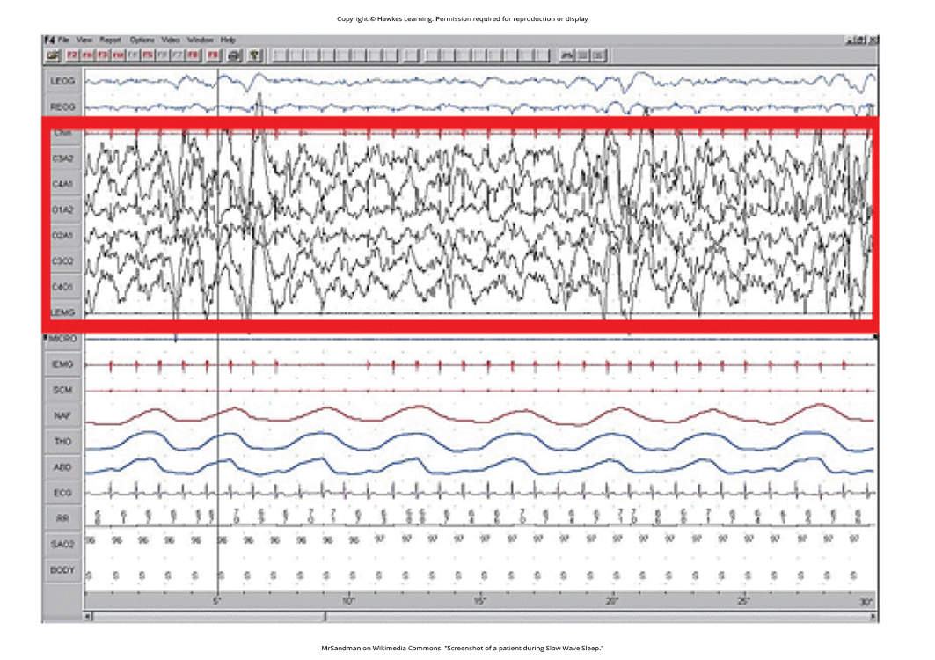
NREM Stages Of Sleep: Stage 3
Stage 3 sleep: characterized by slow-wave sleep with low frequency (up to 4 Hz), high amplitude delta waves (Figure 4)
Dramatic slowing of physiological functions like heart rate and respiration
Difficulty arousing or awakening the individual
Presence of alpha waves, associated with wakefulness, can lead to feeling unrefreshed despite duration of sleep (Stone et al., 2008)
Figure 4

Slide 8
REM Sleep
REM sleep: characterized by rapid eye movement
Brain wave activity like patterns seen during wakefulness (Figure 5)
Stage when most vivid dreaming occurs
Muscle systems paralyzed, except circulation and respiration
High brain activity and lack of muscle tone
Proposed roles in learning, memory consolidation, and emotional processing (Wagner et al., 2001; Aime et al., 2022), though functions still debated (Siegel, 2001)

Slide 9
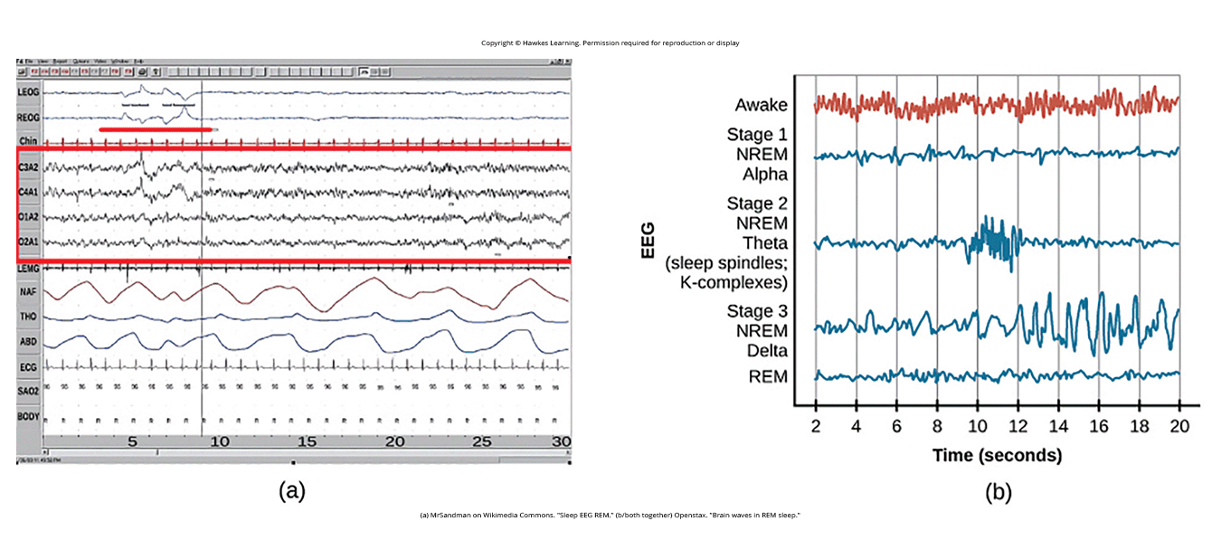
Lesson 3.3 Figure 5
Caption: (a) A period of rapid eye movement is marked by the short red line segment. The brain waves associated with REM sleep, outlined in the red box in (a), look very similar to those seen (b) during wakefulness.

Slide 10
REM Rebound
REM rebound occurs after REM deprivation to compensate for lost time.
Existence of rebound suggests REM is biologically regulated to maintain balance in sleep cycle.
REM rebound may facilitate emotional regulation by suppressing/processing negative emotions from prior wake period (Suchecki et al., 2012; Steiger & Pawlowski, 2019).

Slide 11
On Your Own
For each stage of sleep, indicate which waveforms are happening in each. For some stages, more than one waveform is associated.

Slide 12
Sleep Deprivation & REM Sleep
General sleep deprivation linked to numerous negative consequences (Brown, 2012).
Selective REM sleep deprivation appears to have less profound impact (Siegel, 2001).
REM deprivation shown to improve symptoms in some patients with major depressive disorder.
Many effective antidepressant medications are known to suppress or reduce REM sleep (Riemann et al., 2001; Vogel, 1975; Riemann et al., 2020).
Some reviews challenge this finding, suggesting non-REM sleep deprivation may be equally or more beneficial for depression.

Slide 13
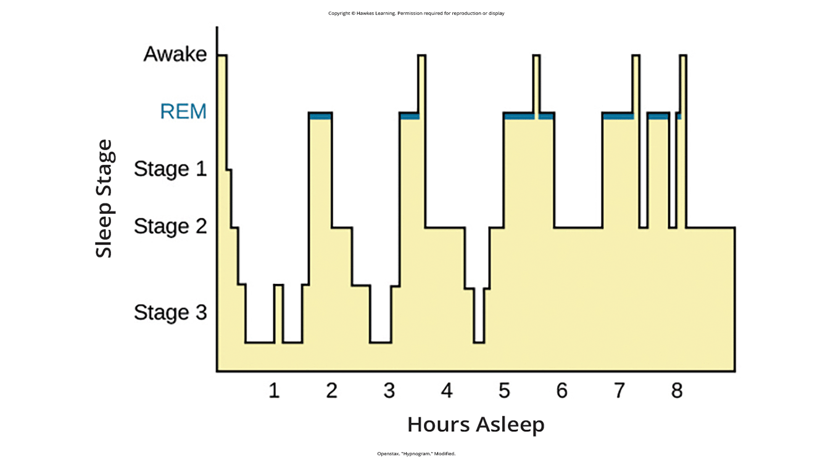
Lesson 3.3 Figure 6
Caption: A hypnogram is a diagram of the stages of sleep as they occur during a period of sleep. This hypnogram illustrates how an individual moves through the various stages of sleep.

Slide 14
Dreams: Sigmund Freud
Meaning of dreams varies across cultures and time periods
Sigmund Freud's view: dreams provide access to the unconscious mind and reveal desires or conflicts
Manifest content: actual events occurring in the dream
Latent content: hidden, symbolic meaning behind the dream
Example: snakes representing male genitalia

Slide 15
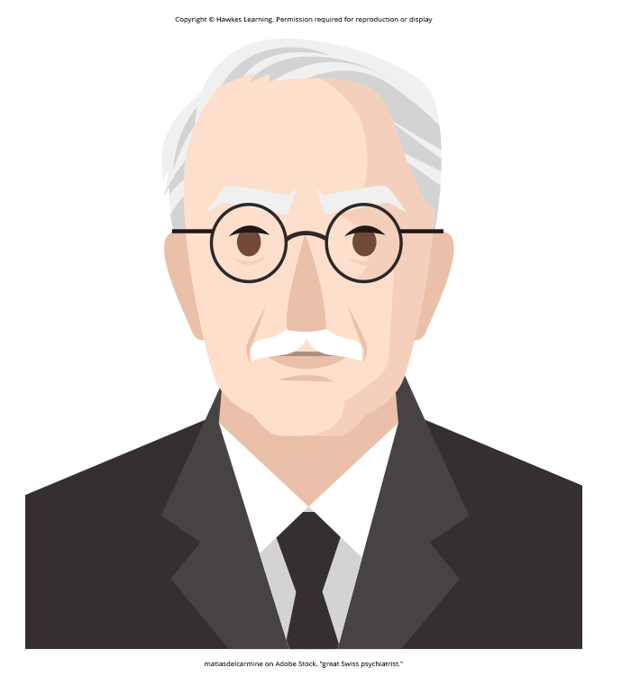
Dreams: Carl Jung
Carl Jung's view: dreams tap into the collective unconscious, a universal reservoir of knowledge/meanings
Contain archetypical symbols with meanings shared across all cultures
Figure 7

Slide 16
Dreams: Rosalind Cartwright
Rosalind Cartwright's view: dreams reflect live events important to the dreamer
Example: Cartwright's study on women going through a divorce and their dream content
New techniques to detect visual images during dreams using fMRI (Horikawa et al., 2013)

Slide 17
Why Do We Dream?
John Hobson's theory: dreaming constructs a virtual reality simulation to help with waking functions
Evidence from lucid dreaming, where aspects of wakefulness occur, and dreamers can control content (LaBerge, 1990)
Deirdre Barrett's research: potential role in creativity and problem-solving
Contended that dreaming is "thinking in a different state" (Barrett, 2007)
Ongoing debate, but dreaming seen as serving cognitive purposes beyond mere byproduct of sleep

Slide 18
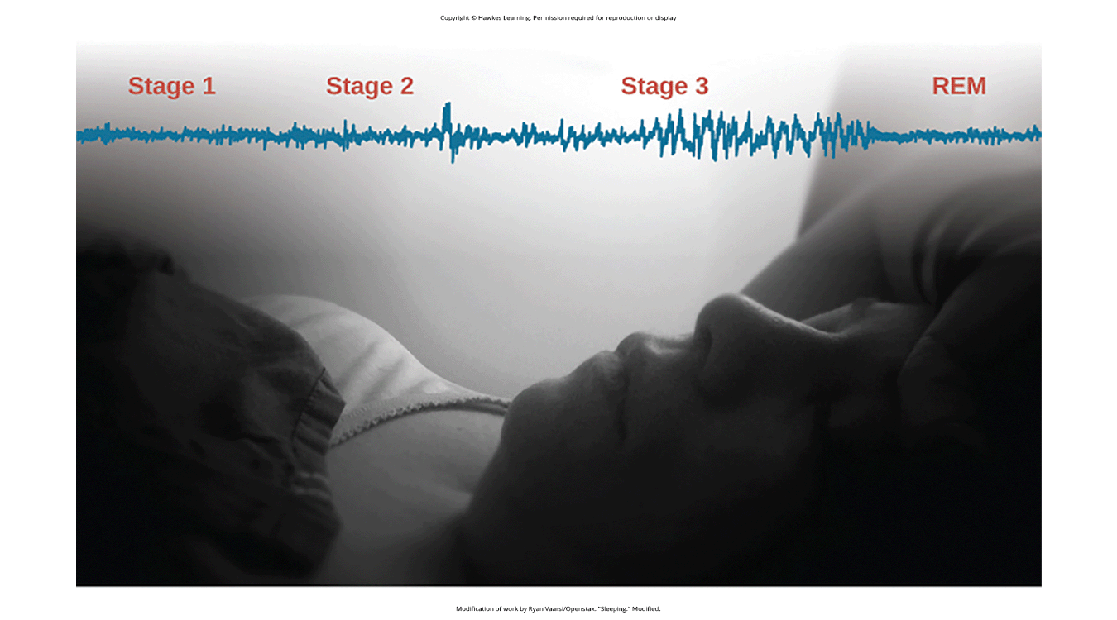
Summary
Sleep stages are characterized by distinct brain wave patterns.
Both NREM and REM sleep play roles in learning and memory.
Various theories propose different functions and interpretations of dreams.
Figure 8

Slide 19
End of Hawkes Learning PowerPoint

