Slide 1
Lesson 3.4
Sleep Problems and Disorders

Slide 2
Sleep Problems And Disorders
Many people struggle to get good quality sleep for various reasons.
Sleep disturbances can impact the person experiencing them and others around them.

Slide 3
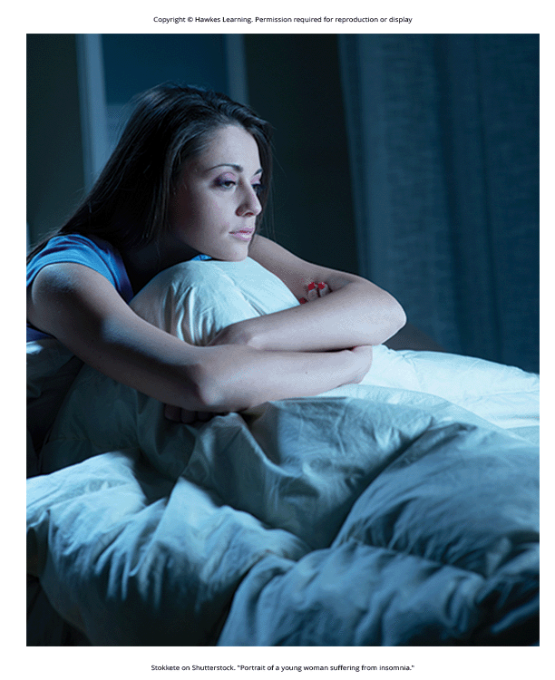
Insomnia
Insomnia is the consistent difficulty in falling or staying asleep.
Most common of the sleep disorders
Individuals with insomnia spend significant time awake in bed.
Factors include age, drug use, exercise, mental status, and bedtime routines.
Figure 1

Slide 4
Reflection Question₁
Have you ever experienced insomnia? Describe what it was like and why you think you were unable to sleep.

Slide 5
Insomnia And CBT
Cognitive-behavioral therapy (CBT): type of psychotherapy effective in treating insomnia
Focuses on changing sleep-related behaviors and improving sleep hygiene
Example: only going to bed when tired to promote sleep hygiene
Helps clients develop effective strategies for managing insomnia

Slide 6
Parasomnias
Parasomnia: group of sleep disorders involving unwanted/disruptive motor activity or experiences
Can occur during REM or NREM sleep phases
Examples: sleepwalking, RBD, restless legs syndrome, and night terrors

Slide 7
Sleepwalking
Sleepwalking (somnambulism): parasomnia characterized by engaging in relatively complex behaviors during sleep
Includes activities such as wandering about or even driving
Eyes open but unresponsive during sleepwalking episodes (Mahowald & Schenck, 2000; Cleveland Clinic, 2020)
Historically treated with pharmacotherapies like benzodiazepines or antidepressants
Holistic treatment options recommended alongside medication for managing sleepwalking (Guilleminault et al., 2005; Mayo Clinic, 2017)

Slide 8
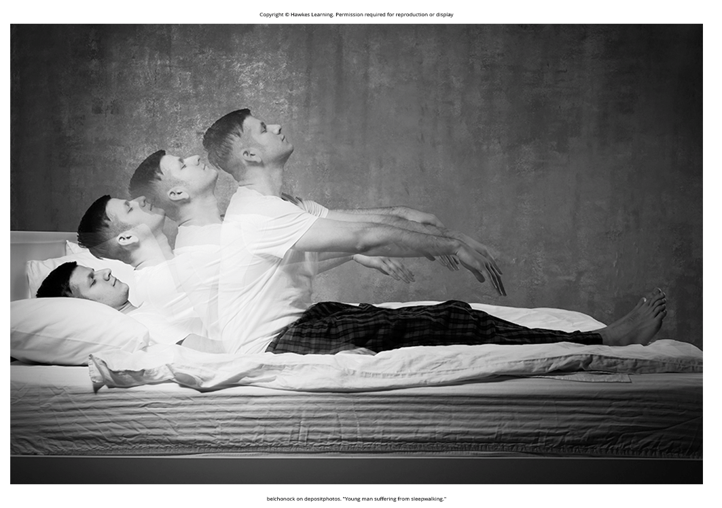
Dig Deeper: A Sleepwalking Defense?
Scott Falater's case illustrates the potential for homicidal acts during sleepwalking episodes.
The defense argued that Falater killed his wife unconsciously, emphasizing the lack of free will during sleepwalking.
Research suggests that individuals with certain sleep disorders may be prone to violent behaviors during sleep (Broughton et al., 1994; Cartwright, 2004; Kantha, 2021; Mahowald et al., 2005; Pressman, 2007).
Figure 2

Slide 9
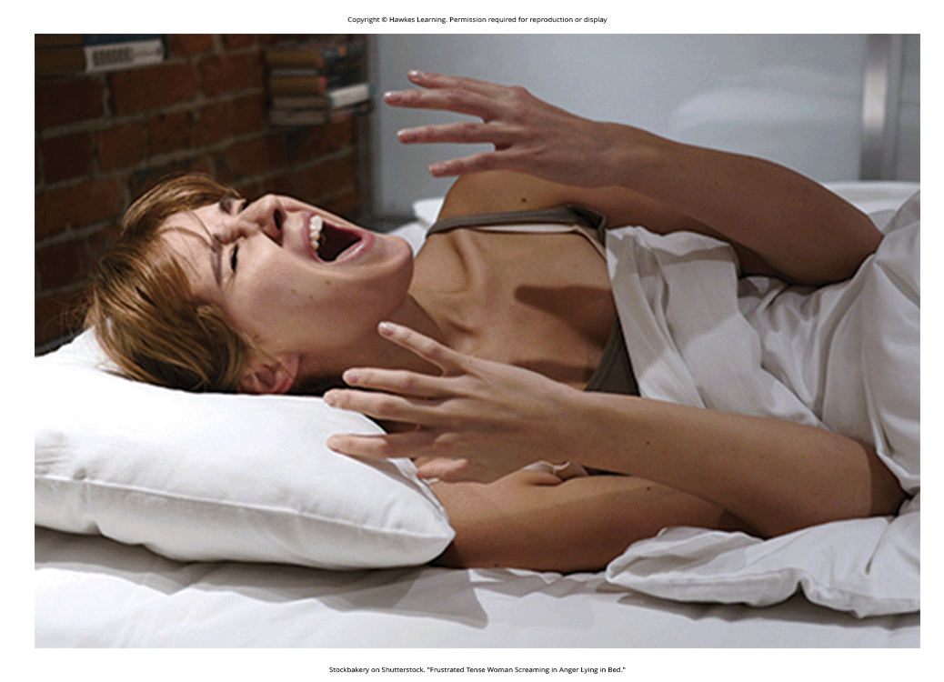
REM Sleep Behavior Disorder (RBD)
RBD: lack of muscle paralysis during REM sleep
Results in physical acting out of dreams (kicking, yelling, etc.)
More common in those with neurodegenerative disorders like Parkinson's disease (Ferini-Strambi, 2011; Rolinski et al., 2016)
Can lead to injuries for the individual or their sleeping partners, despite no memory of the events (Arnulf, 2012)
Often treated with medications and modifications to the sleeping environment for safety (Zangini et al., 2011; Howell & Schenck, 2023)
Figure 3

Slide 10
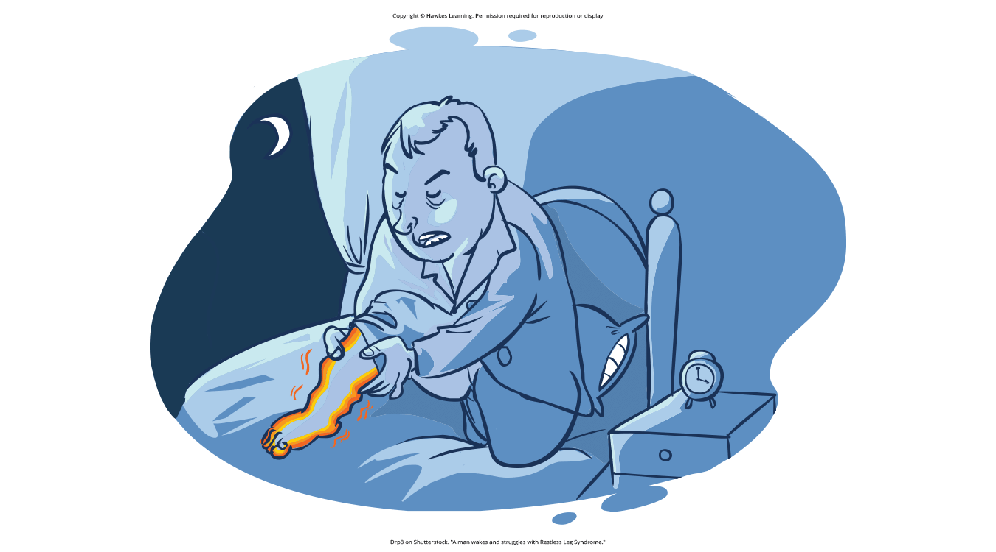
Restless Legs Syndrome
Restless legs syndrome: uncomfortable sensations in the legs during inactivity or when trying to sleep
Relieved by deliberately moving legs, disrupting sleep (National Institute of Neurological Disorders and Stroke, 2023)
Can be associated with chronic kidney disease, diabetes (Mahowald & Schenck, 2000)
Treated with medications such as benzodiazepines, opiates, and anticonvulsants (Restless Legs Syndrome Foundation, n.d.)
Figure 4

Slide 11
Night Terrors
Night terrors characterized by a sense of panic and screaming during NREM sleep (Idir et al., 2022; Provini et al., 2011; Mahowald & Schenck, 2000).
Sufferers often appear awake but have no memory of the events.
Attempts to console them are ineffective.
Night terrors usually resolve on their own without need for treatment.
Except if there is an underlying medical or psychological condition (Mayo Clinic, n.d.)

Slide 12
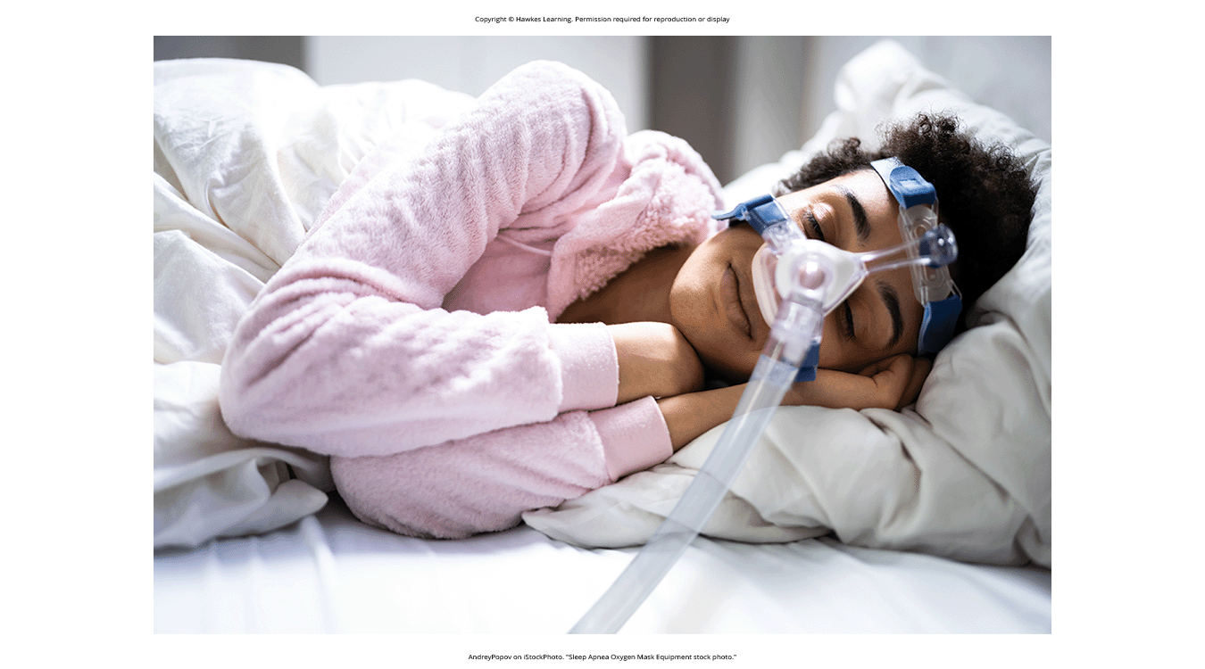
Sleep Apnea
Sleep apnea: inability to breathe properly during sleep
Obstructive (blocked airway) or central (disrupted brain signals) (White, 2005; Mayo Clinic, 2021)
Often unaware but can severely impact sleep quality, daytime functioning
Continuous positive airway pressure (CPAP) device: common treatment, includes a mask (Figure 5)
Forces air into airways to keep them open during sleep
Alternative expiratory positive air pressure (EPAP) device showing promise
Figure 5

Slide 13
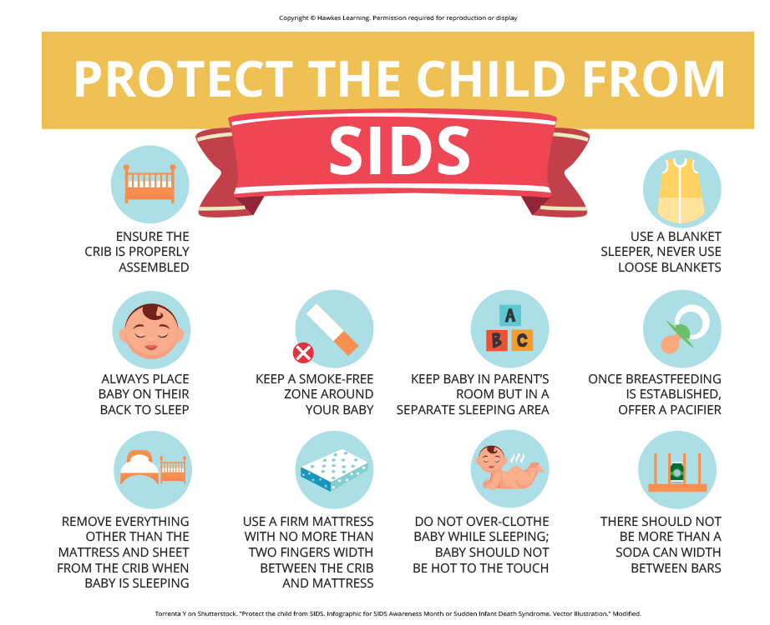
SIDS
Sudden infant death syndrome (SIDS): when an infant stops breathing during sleep and dies
Risks: premature birth, smoking exposure, overheating, low BChE enzyme levels (Harrington et al., 2022)
BChE major in producing neurotransmitter that wakes the baby up to breathe
Preventive measures: back sleeping position, removing hazards from crib
Figure 6

Slide 14
Narcolepsy
Narcolepsy: inability to resist falling asleep unexpectedly
Often triggered by stress/arousal, can involve muscle weakness/paralysis (cataplexy)
Associated with reduced hypocretin levels in brain (De la Herrán-Arita & Drucker-Colín, 2012; Han, 2012)
Treated with stimulant medications to increase neural activity (Mignot, 2012; NIH, 2023a)

Slide 15
Reflection Question₂
Have you ever fallen asleep during a task where you were supposed to be awake? What was that experience like?

Slide 16
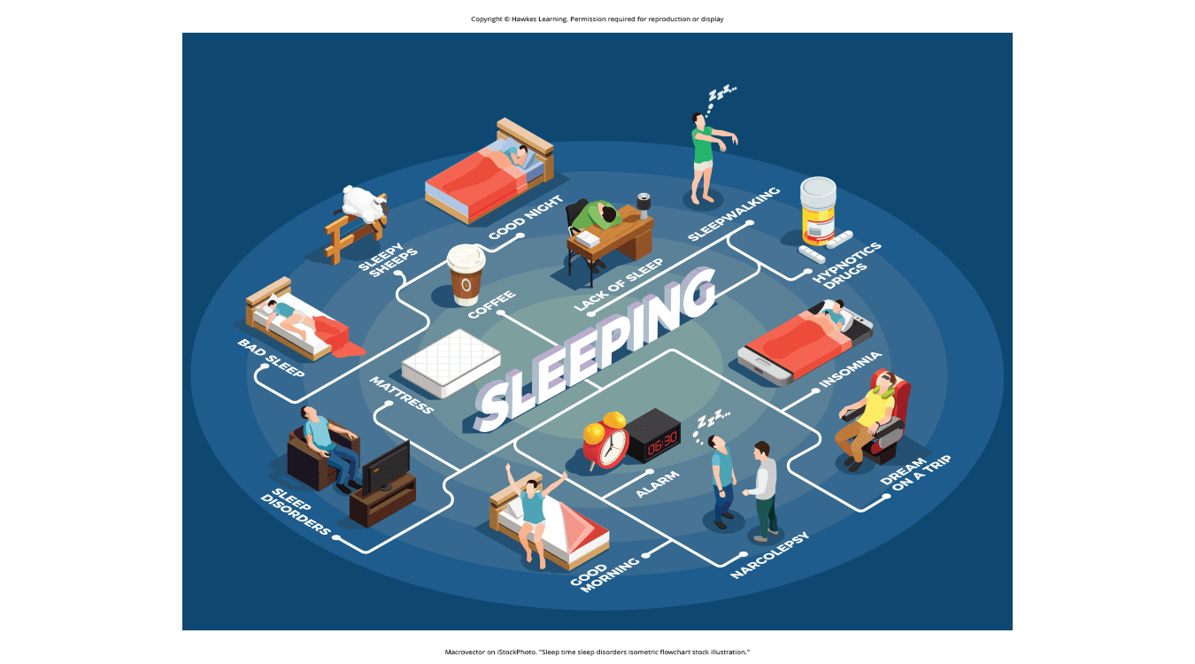
Summary
Insomnia: common experience; difficulty falling or staying asleep
Parasomnias: involve unwanted experiences during sleep; include RBD, sleepwalking, restless legs syndrome, and night terrors
Sleep apnea: breathing interruptions during sleep
SIDS: when infants stop breathing during sleep and die
Narcolepsy: irresistible urge to fall asleep during waking hours, often associated with cataplexy and hallucinations
Figure 7

Slide 17
On Your Own
For each of the following sleep disorders, provide a definition and the recommended treatment.
Insomnia
Parasomnia
Sleep apnea
Narcolepsy

Slide 18
End of Hawkes Learning PowerPoint

