Slide 1
Lesson 3.5
Substance Use and Abuse

Slide 2

Substance Use And Abuse
Altered states of consciousness beyond sleep
  Can be mirrored by drugs and other substances
Use of psychoactive drugs and problems associated
Brief descriptions of effects
Well-known drugs commonly used
Figure 1

Slide 3
Substance Use Disorders
Addictive disorders described in the DSM-5-TR (APA, 2022)
Criteria: using more than intended, continued use despite consequences, compulsive use patterns
  Also involves physical and psychological dependence on the substance
Physical dependence: changes in bodily functions and withdrawal upon cessation
Psychological dependence: an emotional need for the drug, relieving distress

Slide 4
On Your Own₁
For the following situations, determine if the scenario describes a physical or psychological dependence.
James, a usual coffee drinker, feels sluggish and out of touch when he misses his normal two cups of coffee in the morning.
When Anni, an ex-smoker, sits at the bar, she looks longingly at the person next to her who is smoking. She feels that old familiar urge to smoke.
When Julianne stops using heroin, she feels ill, as if she will vomit at any moment. She also starts to experience chills and a general feeling of unease.

Slide 5
Dependence And Tolerance
Tolerance: when higher doses are needed for the same effect
  Can lead to dangerous levels of use or overdose
Withdrawal: produces unpleasant symptoms opposite of the drug's effects
New diagnostic criteria in DSM-5-TR: psychological dependence (drug craving)
Physical dependence limited in diagnosing substance use disorder

Slide 6
Group Activity
In a group of two or three classmates, generate a list of drugs that individuals develop tolerance to or experience withdrawal from but that are not generally drugs of abuse.

Slide 7
Drug Categories
Psychoactive drugs interact with the body's neurotransmitter systems.
Drugs can act as agonists that facilitate neurotransmitter activity.
  Drugs can also act as antagonists that impede neurotransmitter activity.
Many drug categories and relationships are shown in Figure 2.
Categories interact with different neurotransmitter systems in various ways.

Slide 8
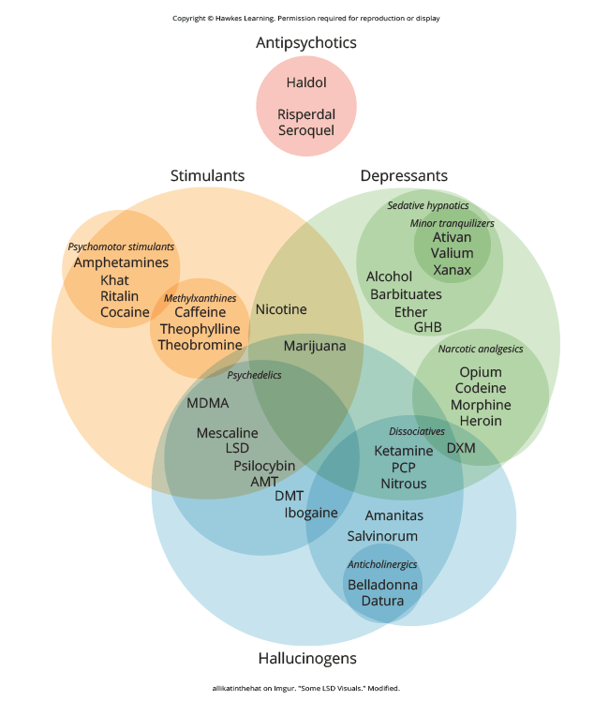
Lesson 3.5 Figure 2
Caption: This figure illustrates various drug categories and overlap among them.

Slide 9
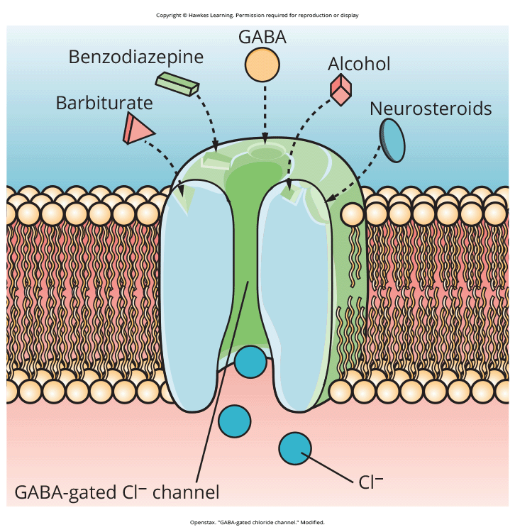
Alcohol And Other Depressants
Depressants: drugs that suppress central nervous system activity
Examples: alcohol (ethanol; Figure 3), barbiturates, benzodiazepines (Department of Justice/Drug Enforcement Administration, 2020; National Institutes of Health, 2018)
Act as agonists of GABA neurotransmitter system, producing quieting effects
Prescribed to treat anxiety and insomnia
Figure 3

Slide 10
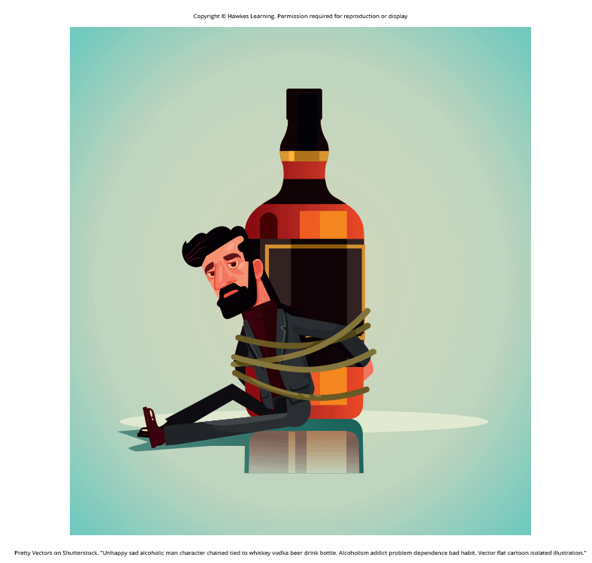
Common Effects Of Alcohol
Can cause fetal alcohol spectrum disorder (FASD) if consumed during pregnancy (CDC, 2022a)
Low doses: sedation, decreased reaction time/alertness, reduced behavioral control
Excessive doses: loss of consciousness, memory impairment
With repeated use, leads to physical and psychological dependence, tolerance and withdrawal symptoms
Withdrawal life-threatening for those with heavy, long-term use (American Addiction Centers, 2023)
  Medical supervision recommended
Figure 4

Slide 11
Stimulants
Stimulants: increase overall neural activity; often act as dopamine agonists
Associated with reward/craving, leading to abuse liability
Types of stimulants: cocaine, amphetamines, cathinones, MDMA, nicotine, caffeine
  Cocaine: blocks dopamine reuptake; can be snorted, injected, or smoked (crack)

Slide 12
Dig Deeper: Methamphetamines
"Crystal meth": highly addictive, smokable form resembling rock crystals
  Produces intense but brief euphoria, prompting continued use
Multi-day binges ("runs") without food/sleep
Potent, inexpensive, lower overdose risk than opiates
  Contributes to its rising popularity among drug users (NIDA, 2019)
Long-term effects: dental problems ("meth mouth"), skin sores, memory loss, sleep issues, violent behavior
  Also paranoia, hallucinations, and difficult-to-treat intense cravings

Slide 13
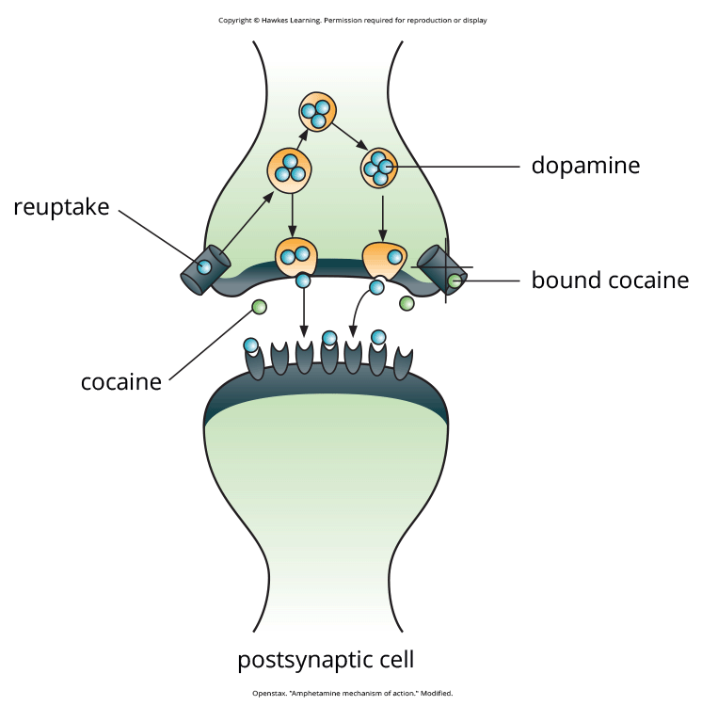
Stimulants: Amphetamines
Also block dopamine reuptake and stimulate release
Prescribed for ADHD due to effects on impulse control
Methamphetamine: potent, inexpensive amphetamine
  Easily accessible and relatively inexpensive (Shukla et al., 2012)
Figure 5

Slide 14
Effects Of Stimulants
Users seek euphoric high, intense pleasure/elation.
Repeated use leads to adverse effects like nausea, hypertension, anxiety, hallucinations, and paranoia.
Repeated use causes depletion of monoamines (dopamine, norepinephrine, serotonin).
Compulsive use may try to re-establish normal neurotransmitter levels (Jayanthi & Ramamoorthy, 2005; Rothman et al., 2007).

Slide 15
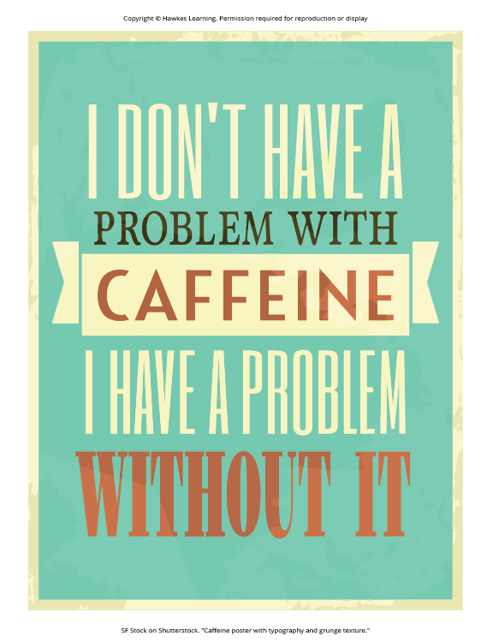
Stimulants: Caffeine
Milder stimulant affecting alertness/arousal
Found in many common medicines, beverages, food, cosmetics (Herman & Herman, 2013)
Acts as an adenosine antagonist rather than dopamine (Porkka-Heiskanen, 2011)
Can cause insomnia, agitation, and irregular heartbeat in high doses (Reissig et al., 2009; Wolk et al., 2012; FDA, 2018)
Figure 6

Slide 16
Reflection Question₁
Think about your own experience with caffeine. Do you feel it has an impact on you? If so, what has that impact been?

Slide 17
Stimulants: Nicotine
Highly addictive, increases disease risks
Interacts with acetylcholine receptors involved in arousal/reward
Most commonly used in tobacco products
Smoking cessation programs to address nicotine dependence
  New programs developed annually (Altendorf et al., 2022; Villarosa, 2022); utilize telemedicine since COVID-19 in 2020

Slide 18
On Your Own₂
Which neurotransmitter system does each drug impact?
Depressants
Cocaine
Amphetamines
Caffeine

Slide 19
Opioids
Decrease pain (analgesic property) by mimicking endogenous opioid system
Have extremely high potential for abuse
Opiates: natural opioids derived from opium (found in poppy plants)
Synthetic opioids potent painkillers, often abused
  Example: misuse/abuse of hydrocodone and oxycodone (Maxwell, 2006; NIDA, 2019b)
Types of opioids: heroin, morphine, methadone, codeine

Slide 20
Prescription Opioid Crisis
Tighter prescription controls led some addicted patients to use cheaper heroin.
  Dealers adding potent synthetic opioids like fentanyl to heroin increases overdose risks.
Public health campaigns aim to increase treatment access and overdose prevention (NIDA, 2019b).

Slide 21
Opioids: Heroin
Can be snorted, smoked or injected intravenously
Causes euphoria followed by agitation
Risk of HIV/tuberculosis from needle use
Users increasingly exposed to other potent opioids (e.g., fentanyl)
Figure 7

Slide 22
Reflection Question₂
Did you know that heroin was made by Bayer pharmaceuticals and was marketed as a cough suppressant during the days of rampant tuberculosis? What are your thoughts on the origins of this drug of abuse?

Slide 23
Opioid Withdrawal
Opioid withdrawal resembles severe flu; it is extremely unpleasant but not life-threatening.
Methadone is a synthetic opioid that is less euphorigenic.
  Methadone clinics help former addicts manage withdrawal symptoms.
  It is used with buprenorphine to alleviate withdrawal symptoms.

Slide 24
Opioids: Codeine
Codeine: low-potency opioid prescribed for minor pain; available over-the-counter in some countries
Still has potential for abuse, like other prescription opioids
Abuse of prescription opioid medications major concern worldwide (Aquina et al., 2009; Casati et al., 2012)

Slide 25
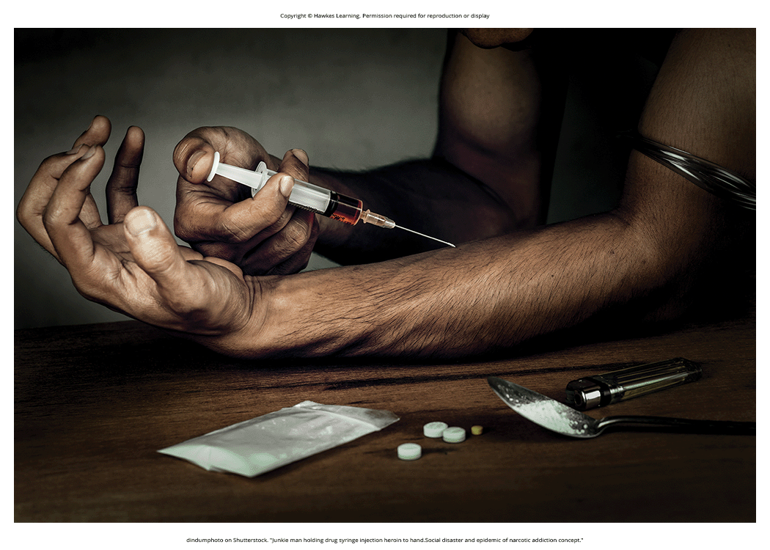
Hallucinogens
Hallucinogen: causes profound alterations in sensory/perceptual experiences (Figure 8)
May cause vivid visual hallucinations, altered body sensations, and perception of time passage
Affect various neurotransmitter systems
Generally not considered as addictive as other drug classes
Examples: mescaline, LSD, PCP, ketamine
Figure 8

Slide 26
Dig Deeper: Medical Marijuana
Medical marijuana: marijuana prescribed to treat health conditions
  Legal for medical use in 37 states and 3 territories
  May have promise in treating various medical conditions (Mather, et al., 2013; National Conference of State Legislatures, 2022; Robson, 2014; Schicho & Storr, 2014)
Lack of large-scale, controlled research due to federal illegal classification (Bostwick, 2012)
Reclassification urged to facilitate more study (Aggarwal et al., 2009; Bostwick, 2012; Kogan & Mechoulam, 2007)
Cole Memo (2013) indicated federal non-interference with state medical laws, rescinded in 2018
  Highlights lag of politics behind science/public opinion on the issue and wider societal impact of drug policies like marijuana laws

Slide 27
Summary
Substance use disorder is compulsive drug use despite negative consequences.
Physical and psychological dependence are important parts of this disorder.
Depressants (alcohol, barbiturates, benzodiazepines) affect GABA.
Stimulants (cocaine, amphetamines, MDMA) agonize dopamine neurotransmission.
Nicotine acts on acetylcholine, and caffeine acts on adenosine.
Opioids are powerful analgesics acting on the endogenous opioid system.
Hallucinogens profoundly alter sensory/perceptual experiences.

Slide 28
End of Hawkes Learning PowerPoint

