Slide 1
Lesson 3.6
Other States of Consciousness

Slide 2
Other States Of Consciousness
Our consciousness changes from wakefulness to sleep states.
Consciousness can be altered through use of various psychoactive drugs.
Hypnotic and meditative states are additional examples of altered consciousness experienced by some.

Slide 3
Hypnosis
Hypnosis: state of extreme self-focus and attention with minimal attention to external stimuli
  Used to alter thoughts and perceptions, draw out deeply buried memories
  An effective therapeutic treatment tool for those open to suggestion
Associated with global changes in brain functioning across entire brain (Del Casale et al., 2012; Guldenmund et al., 2012; Wolf et al., 2022)

Slide 4
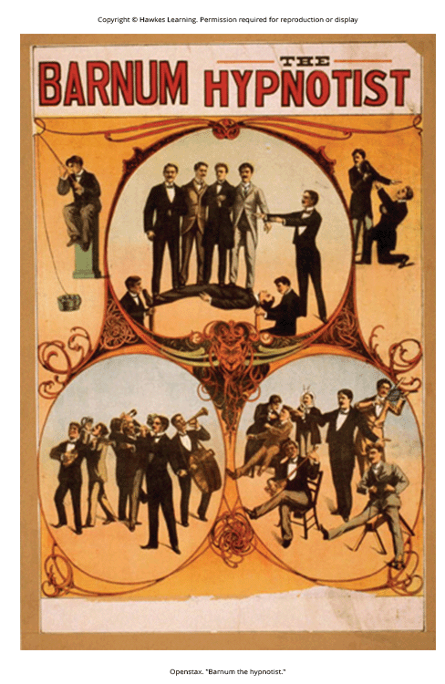
Hypnosis: Myths And Truths
Myth: People can be made to do embarrassing things.
Truth: People are aware of what they do under hypnosis.
Myth: The hypnotist can control the participant's mind.
Truth: Participants remain in control under hypnosis.
Figure 1

Slide 5
Hypnosis: Participant Experience
There are variations, but four parts are consistent (National Research Council, 1994; Williamson, 2019):
  Participant focuses on one thing (e.g., hypnotist's words).
  Participant is made comfortable and directed to relax and feel sleepy.
  Participant is told to be open, trust the hypnotist, and let go.
  Participant is encouraged to use their imagination.
Most people are at least moderately hypnotizable (Kihlstrom, 2013).
Hypnosis is used for therapeutic purposes like pain management, treating depression/anxiety, smoking cessation, and weight loss (Alladin, 2012; Beevi et al., 2019; Elkins et al., 2012; Golden, 2012; Montgomery et al., 2012).

Slide 6
Group Activity
With your group, discuss any experiences you've had or seen relating to hypnosis. Do you feel the previously described steps would be effective on you? Do you feel you would be open to the idea?

Slide 7
How Hypnotism Works
Some use hypnosis to affect cognitive processes like learning in educational settings (Wark, 2011; Drigas et al., 2021).
Hypnosis can alter processes once thought to be automatic outside voluntary control like reading (Lifshitz et al., 2013; Raz et al., 2002).
  Others suggest these processes remain intact (Augustinova & Ferrand, 2012).
Dissociation theory: Hypnosis is a dissociated state of consciousness separate from normal awareness.
Social-cognitive theory: Hypnotized people are performing the expected social role, not an altered state.

Slide 8
Reflection Question
There are some who believe that practices like hypnosis are immoral. Why do you think people would make this argument? Do you see any merit in this perspective? Why or why not?

Slide 9
Meditation₁
Meditation: act of focusing on a single target like breath or repeated sound
Increases awareness of the present moment through clearing the mind
Achieved alone, though training in techniques is often received initially
Not an altered state of consciousness, but expert meditators show unique brain wave patterns (Fell et al., 2010; Pandey et al., 2021)

Slide 10
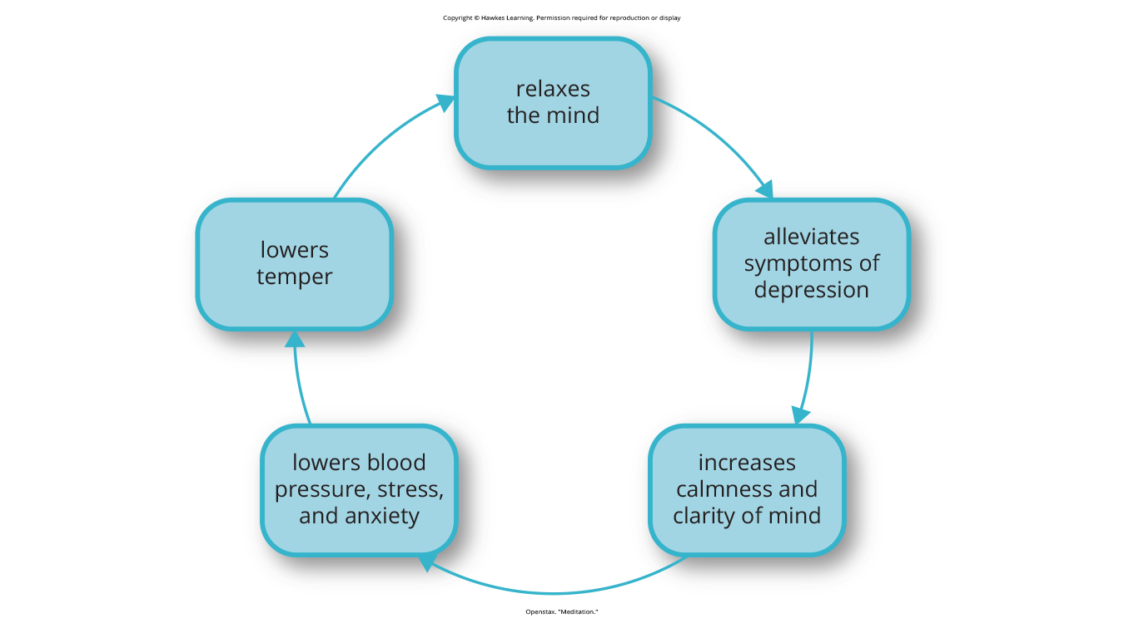
Meditation₂
Central feature is clearing mind to achieve relaxed awareness and focus (Chen et al., 2012; Lang et al., 2012)
Mindfulness meditation: variation where attention is focused on internal processes or external objects (Zeidan et al., 2012; Feruglio et al., 2021)
Health benefits (Figure 2):
Figure 2

Slide 11
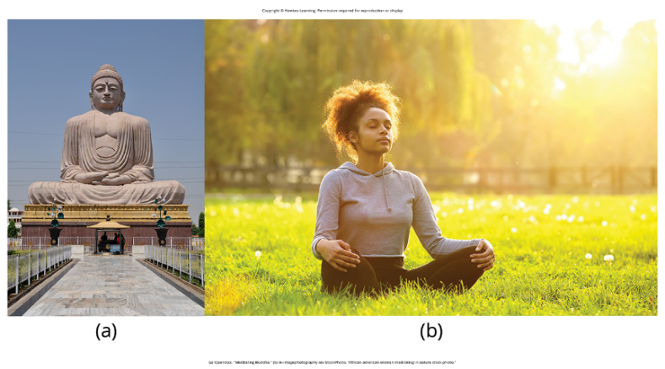
Applications Of Meditation
Roots in religious practices (Figure 3), but grew popular in alternative medicine
May help reduce blood pressure as complementary treatment for hypertension (Elkins, 2022)
Shows promise for stress management, improving sleep quality (Elkins, 2022; Slonena & Elkins, 2020), mood/anxiety disorders (Shamblaw & Zindel, 2022; Vancampfort et al., 2021), pain management (McKernan et al., 2021)
Figure 3

Slide 12
Summary
Hypnosis is a focus on the self involving suggested changes in behavior and experience.
Meditation involves relaxed yet focused awareness on the present moment.
Both hypnotic and meditative states may involve altered states of consciousness.
There are potential therapeutic applications for various physical and psychological disorders.

Slide 13
End of Hawkes Learning PowerPoint

