Slide 1
Lesson 4.1
Sensation Versus Perception

Slide 2
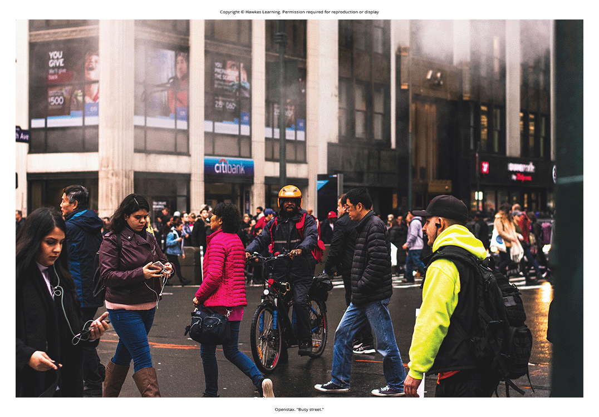
Sensation Versus Perception
Importance of sensory systems:
Navigation and interaction with environment
Finding nourishment, seeking shelter, maintaining social relationships
Avoiding potentially dangerous situations
Figure 1

Slide 3

Sensation
Sensory receptors are specialized neurons that respond to specific types of stimuli.
When sensory information is detected by a sensory receptor, sensation has occurred.
Example: Light causes chemical changes in cells lining the back of the eye.
These cells relay messages as action potentials to the central nervous system.
The conversion from sensory stimulus to action potential is called transduction.
Figure 2

Slide 4
The Senses
We have five traditional senses:
Vision, hearing (audition), smell (olfaction), taste (gustation), and touch (somatosensation)
We also have sensory systems:
For balance (vestibular sense)
Body position and movement (proprioception and kinesthesia)
Pain (nociception)
Temperature (thermoception)

Slide 5
Absolute Threshold
Absolute threshold is the minimum amount of stimulus energy for stimulus detection 50% of the time.
Example: Most sensitive eye cells can detect a candle flame 30 miles away (Okawa & Sampath, 2007).
Example: Inner ear cells can detect a clock tick 20 feet away (Galanter, 1962; National Institute on Deafness and Other Communication Disorders, 2022).

Slide 6
Subliminal Messaging
Subliminal messages are presented below the threshold for conscious awareness.
A stimulus reaches the physiological threshold when strong enough to excite receptors and send nerve impulses (absolute threshold).
Below this threshold is subliminal—received but not consciously aware.
Research shows people can process and respond to subliminal information (Bargh, 2016; Loersch et al., 2013; Sutil-Martin & Rienda-Gomez, 2020).

Slide 7
Just Noticeable Difference
The just noticeable difference (difference threshold) is how much stimulus difference is required to detect a change.
The difference threshold changes depending on the stimulus intensity.
Weber's law: The difference threshold is a constant fraction of the original stimulus.

Slide 8
Perception
Perception: how sensory information is organized, interpreted, and consciously experienced
Involves bottom-up processing built from sensory input
Also involves top-down processing influenced by knowledge/experiences
Sensation: physical process; perception: psychological
Example: smelling cinnamon rolls (sensation) vs. associating it with a memory (perception)

Slide 9

Sensory Adaption
Sensory adaption: when we don't perceive stimuli that remain relatively constant over periods of time
Example: no longer perceiving a ticking clock sound you first heard
Figure 3

Slide 10
Reflection Question₁
If someone lost one of their senses, do you think their perceptions would alter? An example might be losing a sense of smell and no longer being able to equate cinnamon with Grandma's baked goods. Would another sense take over, and how would it work?

Slide 11

Influences On Perception: Attention
Plays a significant role in what is sensed vs perceived
Inattentional blindness: failure to notice fully visible things due to lack of attention
Example: failing to see a gorilla in a video when focusing on counting ball passes (Simons & Chabris, 1999)
Example: failing to notice a red shape when focusing on black and white shapes (Figure 4) (Most et al., 2000)
Figure 4

Slide 12
Influences On Perception: Motivation
Can shift our ability to discriminate between a sensory stimulus and background noise
Signal detection theory: ability to identify stimulus when it's embedded in a distracting background
Example: increasing air traffic controller accuracy
Developed to improve the sensitivity of air traffic controllers to plane blips (Swets, 1964)

Slide 13
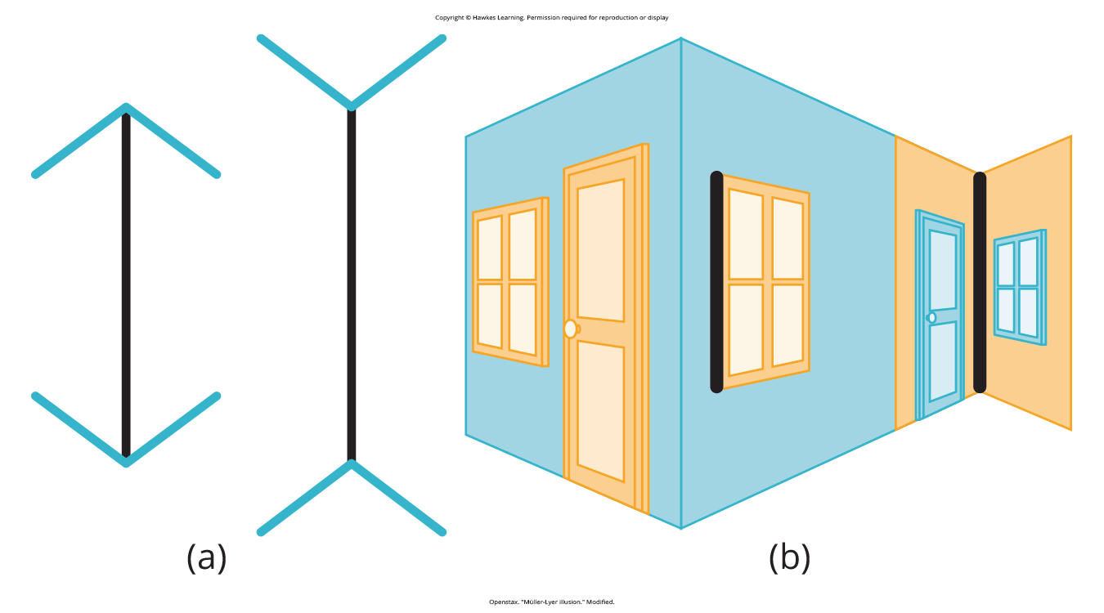
Other Influences On Perception₁
Can be affected by beliefs, values, prejudices, expectations, and experiences
Example: visual depth perception impaired by lack of binocular vision development (Fawcett et al., 2005)
Cultural differences in perception
Westerners more susceptible to certain illusions than those from non-Western cultures (Segall et al., 1963)
Example: Müller-Lyer illusion (Figure 5)
Figure 5

Slide 14
Other Influences On Perception₂
Other influences: personality and attitude
"Thrill-seeker" children and preference for intense sour flavors (Liem et al., 2004)
Suggests basic aspects of personality may affect perception
Positive attitude towards low-fat foods in relation to increased taste ratings (Aaron et al., 1994)

Slide 15
Reflection Question₂
Do you enjoy intense sour flavors? If yes, do you consider yourself a thrill seeker? Do agree with the findings of Liem and colleagues?

Slide 16
Summary
Sensation occurs when sensory receptors detect sensory stimuli.
Perception involves organization, interpretation and conscious experience of sensations.
All sensory systems have absolute thresholds and difference thresholds.
Sensory adaptation, selective attention, and signal detection theory explain what is/isn't perceived.
Perceptions affected by beliefs, values, prejudices, culture, and life experiences.

Slide 17
End of Hawkes Learning PowerPoint

