Slide 1
Lesson 4.2
Waves and Wavelengths

Slide 2
Waves And Wavelengths
Visual and auditory stimuli both occur as waves.
They are different in composition, but similar in characteristics.
These characteristics are important to our visual and auditory perceptions.

Slide 3
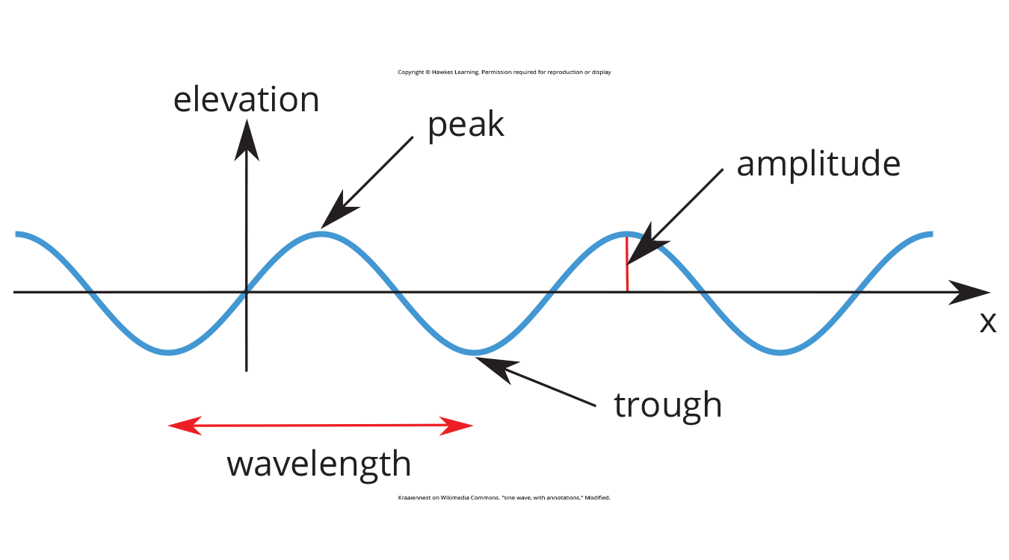
Amplitude And Wavelength₁
Amplitude: the distance from the center line to the top point of the crest or the bottom point of the trough
Wavelength: the length of a wave from one peak to the next
Figure 1

Slide 4
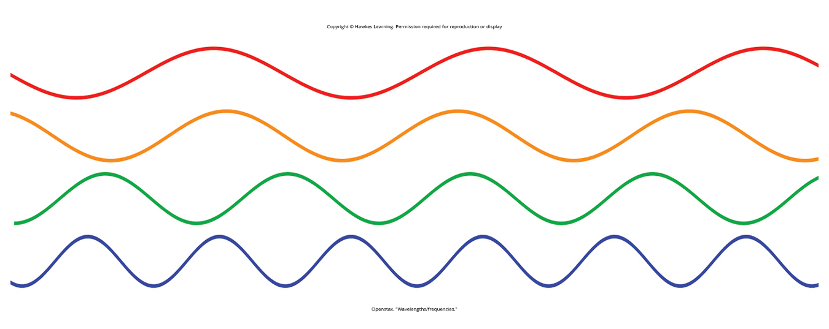
Amplitude And Wavelength₂
Wavelength is directly related to the frequency of a given wave form.
Frequency: number of waves that pass a given point in a particular time, often expressed in hertz (Hz), or cycles per second
Longer wavelengths have lower frequencies, and shorter wavelengths have higher frequencies (Figure 2).
Figure 2

Slide 5
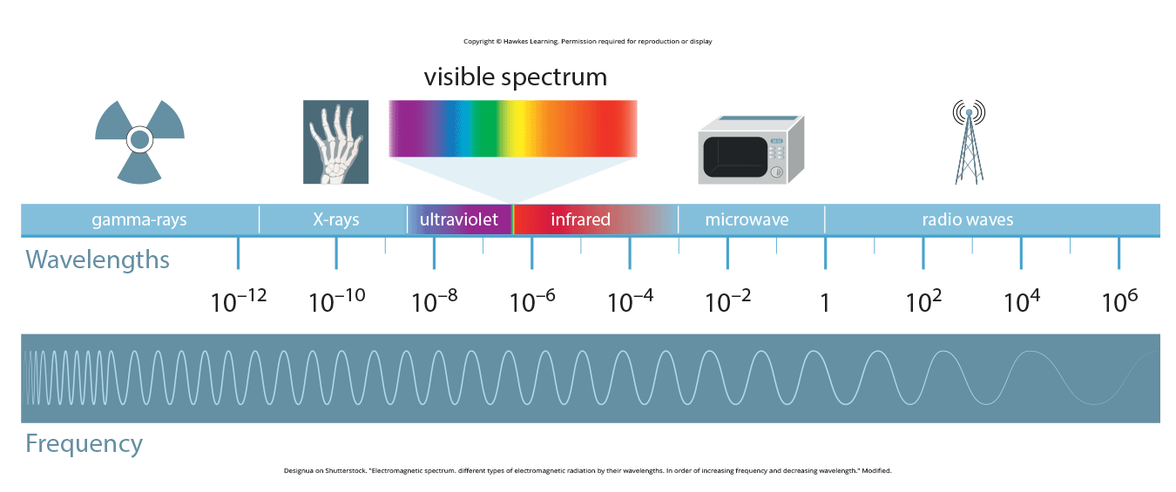
Light Waves₁
Figure 3
Electromagnetic spectrum: gamma rays, X-rays, ultraviolet, visible, infrared, microwaves, and radio waves
Visible spectrum: what we can see of the electromagnetic spectrum
Humans: wavelengths 380–740 nanometers (nm)
Honeybees: ultraviolet (Wakukuwa et al., 2007)
Snakes: infrared (Chen et al., 2012; Hartline et al., 1978)

Slide 6
Reflection Question₁
People have often assumed that dogs are color-blind. Instead, their ability to see color is slightly different from that of humans. Specifically, they see the world in yellows and blues (without the ability to perceive green). Given that information, how is a dog's experience of the world different from your own?

Slide 7
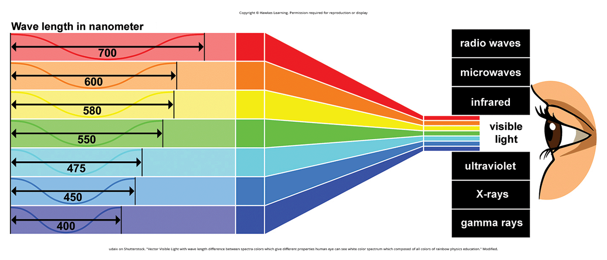
Light Waves₂
Figure 4
Wavelength is associated with color perception (Figure 4).
Red (longer), green (intermediate), blue/violet (shorter)
Amplitude is associated with brightness/color intensity; larger amplitudes appear brighter.

Slide 8
Reflection Question₂
How would your life differ if you could see beyond the visible spectrum that humans are able to perceive?
Notes:
Originally an On Your Own

Slide 9
Sound Waves
Frequency associated with pitch perception
High-frequency = high-pitch
Low-frequency = low-pitch
Audible ranges:
Humans: 20–20,000 Hz
Chickens: 125–2,000 Hz
Mice: 1,000–91,000 Hz
Beluga whale: 1,000–123,000 Hz
Dogs/cats: 70–45,000 Hz, 45–64,000 respectively (Strain, 2003)

Slide 10
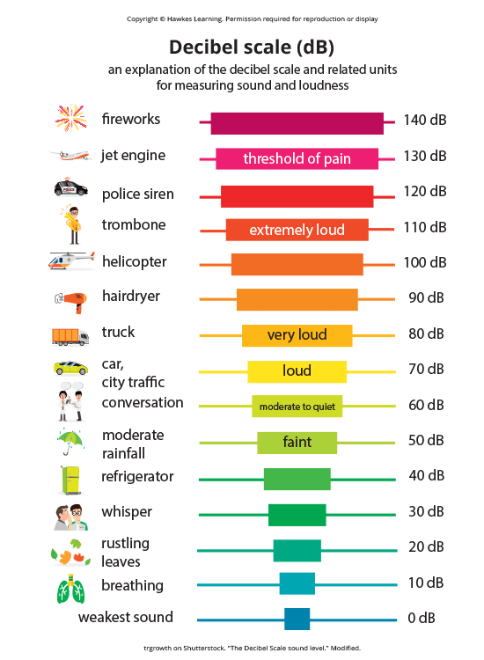
Sound Amplitude and Loudness₁
Amplitude associated with loudness
Higher amplitudes perceived as louder sounds
Loudness measured in decibels (dB)
Decibels: logarithmic unit of sound intensity
Potential for hearing damage from 80–130 dB
Examples: food processor, lawnmower, live rock music
Figure 5

Slide 11
Reflection Question₃
How likely do you think it is that you have already suffered some level of hearing loss? What have you experienced in your life that may have caused damage?
Notes:
Originally an On Your Own

Slide 12
Sound Amplitude And Loudness₂
Some interaction between frequency and amplitude in our perception of loudness
Example: 10 Hz sound wave inaudible no matter the amplitude; 1,000 Hz sound varies dramatically
Timbre: sound purity, affected by complex interplay of frequency, amplitude, and timing
Example: musical instruments sounding different even at same level of loudness

Slide 13
Summary
Both light and sound described as wave forms with characteristics like amplitude, wavelength, timbre
Wavelength and frequency inversely related: longer waves (lower frequencies), shorter waves (higher frequencies)
Visual system: wavelength associated with color, amplitude with brightness
Auditory system: frequency associated with pitch, amplitude with loudness

Slide 14
End of Hawkes Learning PowerPoint

