Slide 1
Lesson 4.3
Vision

Slide 2
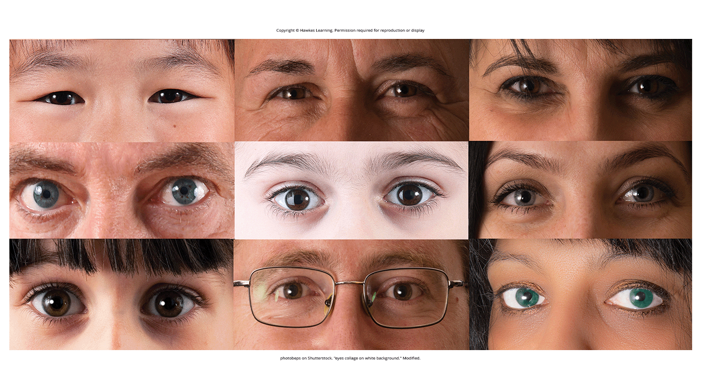
Vision
Mental representations of the world around us (Figure 1)
Helps us find our way, interact with people and objects
Figure 1

Slide 3
Anatomy Of The Visual System₁
The eye is the major sensory organ involved in vision (Figure 2).
  Cornea: transparent covering over the eye; serves as barrier and focuses light waves
  Pupil: controlled by the iris; small opening that allows light to enter the eye
    Low light levels = pupil dilates
    High light levels = pupil constricts
    Size controlled by muscles connected to the iris
  Iris: colored portion of the eye

Slide 4
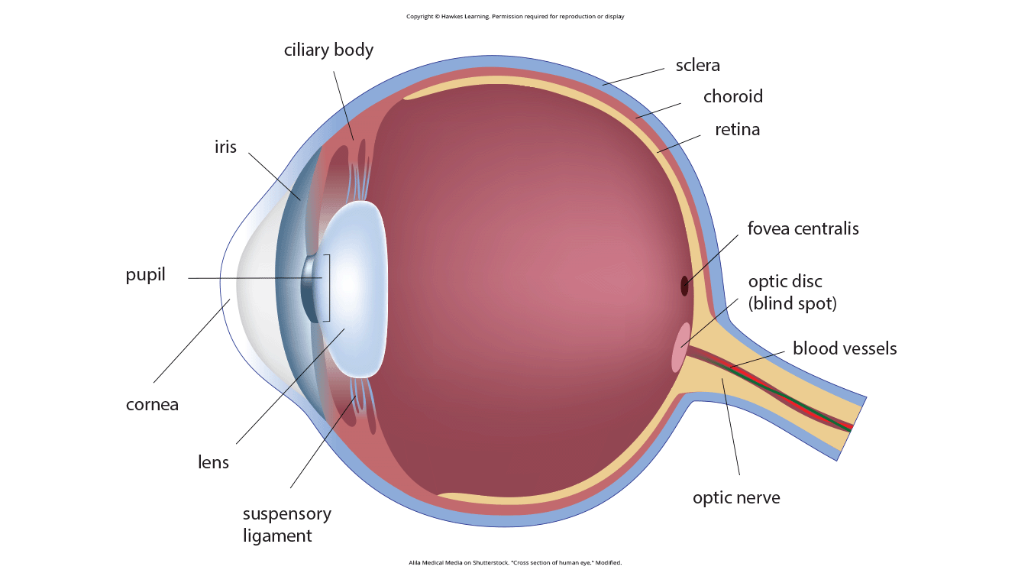
Lesson 4.3 Figure 2
Caption: The anatomy of the eye is illustrated in this diagram.

Slide 5
Anatomy Of The Visual System₂
Lens: curved, transparent structure; aids in focusing light from near or far objects onto the fovea
Fovea: small indentation in the retina; contains densely packed cone photoreceptor cells for acute detail and color perception
Retina: light-sensitive lining of the eye
Photoreceptor cells: light-detecting cells (Figure 3)
  Cones: specialized photoreceptors for bright light conditions
    Sensitive to acute detail
    Provide spatial resolution and color vision
  Rods: specialized photoreceptors for low light conditions
    Lack special resolution
    Involved in peripheral and dim-light vision
Example: transitioning from a bright environment to a dimly lit one

Slide 6
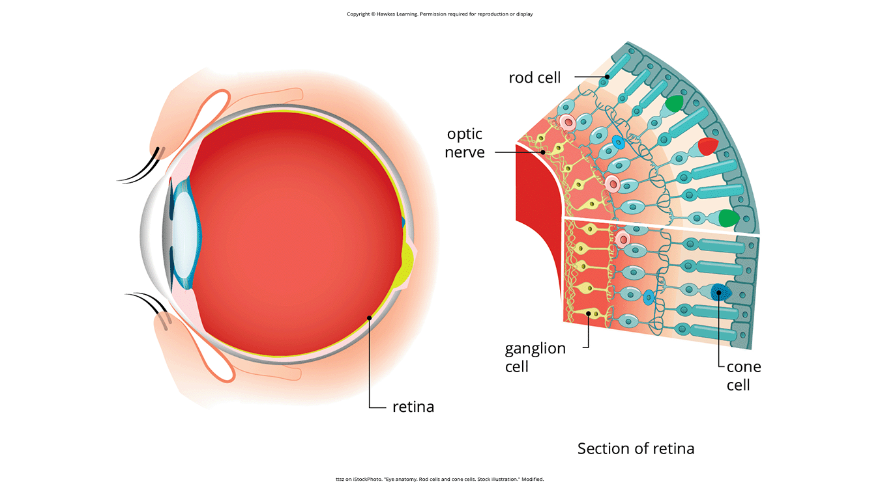
Lesson 4.3 Figure 3
Caption: The two types of photoreceptors are shown.

Slide 7
Group Activity
Form groups of two.
Take five different pieces of colored paper (all the same size, all different colors).
Lower the lights to the point of just being able to see.
Wait 10 minutes, and then have one partner hold up a piece of paper while the other partner states what they think the color is.
The partner holding the paper up should record this perceived color on the back of the sheet.
Repeat this for each sheet and then switch roles.
Compare results with your partner and then with the rest of the class.
  Were there any similarities in your perceived colors?
  Notable differences?
  Why do you think the results ended up this way?
  What do you know about our vision in low light conditions that helps explain this?

Slide 8
Processing Visual Information
Retinal ganglion cells receive input from rods and cones (via interneurons).
  Optic nerve: carries visual information from retina to brain
The blind spot is a point in the visual field where light is not perceived due to the optic nerve's exit point.
At the optic chiasm, visual info from the right visual field goes to the left brain and left visual field to the right brain.
Visual information is processed in parallel "what" and "where/how" pathways in the occipital lobe of the brain.
  "What pathway": involved in object recognition and identification
  "Where/how pathway": location and interaction with visual stimuli

Slide 9
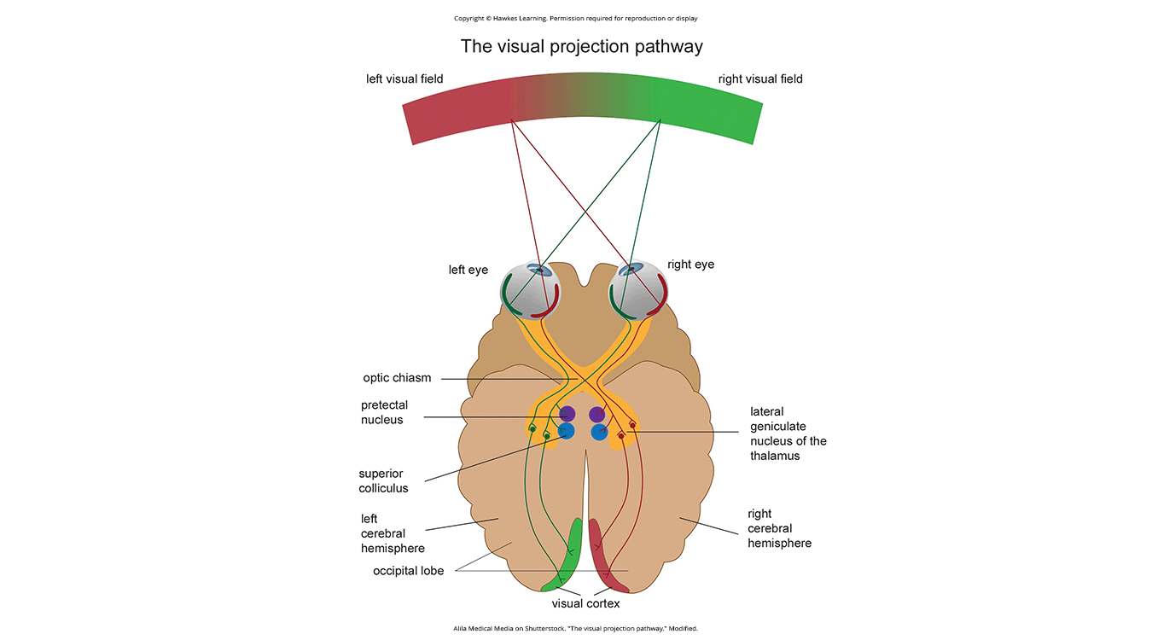
Lesson 4.3 Figure 4
Caption: This illustration shows the optic chiasm at the front of the brain and the pathways to the occipital lobe at the back of the brain, where visual sensations are processed into meaningful perceptions.

Slide 10
Color And Depth Perception
We do not see the world in black or white, nor do we see it in 2-D or flat.
How does color vision work?
How do we perceive three dimensions?

Slide 11
Reflection Question
What do you think the world would look like if we could only view it in two dimensions?

Slide 12
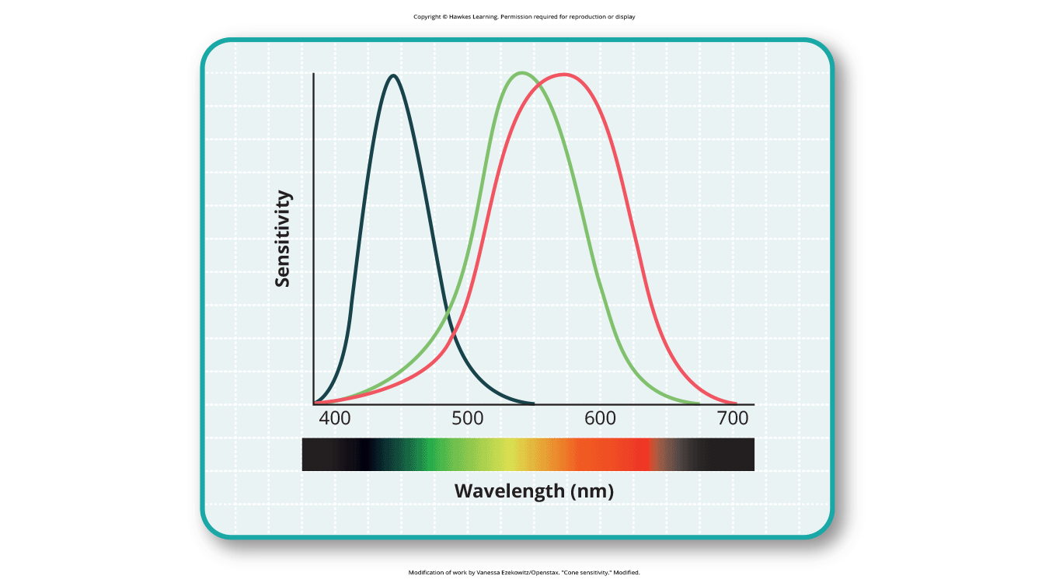
Color Vision: Trichromatic Theory
Three different cone types to mediate color vision
  Each maximally sensitive to different wavelengths
Trichromatic theory of color vision: all colors produced by combining red, green, blue wavelengths (Figure 5)
Figure 5

Slide 13
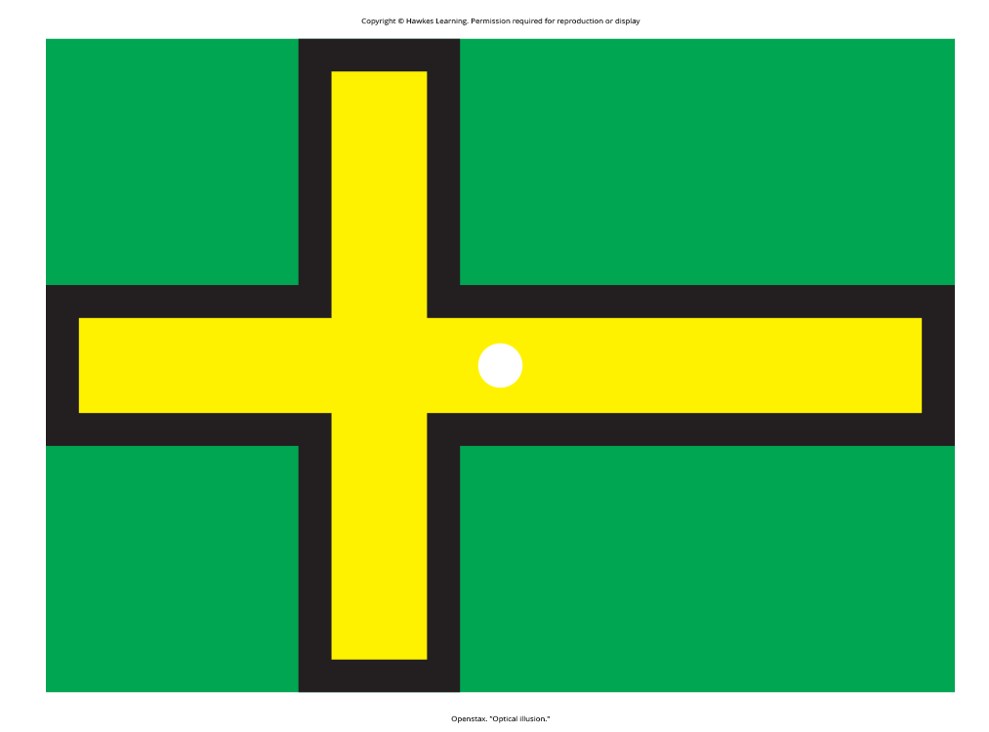
Color Vision: Opponent-Process Theory
Opponent-process theory: colors coded in opponent pairs (black-white, yellow-blue, green-red)
  Explains inability to perceive certain color combinations like greenish-reds
  Cause negative afterimages of complementary colors
    Afterimage: continuation of visual sensation after stimulus is removed
Figure 6

Slide 14
Color Vision: Theories in Comparison
Both theories not mutually exclusive, just apply to different levels of the nervous system
Trichromatic theory: applies at retinal level with cone wavelength sensitivity
Opponent-process theory: applies beyond retina as signals transmit to brain (Land, 1959; Kaiser, 1997)

Slide 15
Depth Perception
Depth perception: ability to perceive spatial relationships in 3-D space
  Enables us to describe things as being in front of, behind, above, below, or to the side things
Use a variety of cues to establish a sense of depth
Perceive depth in both 3-D (binocular cues) and 2-D (monocular cues)

Slide 16
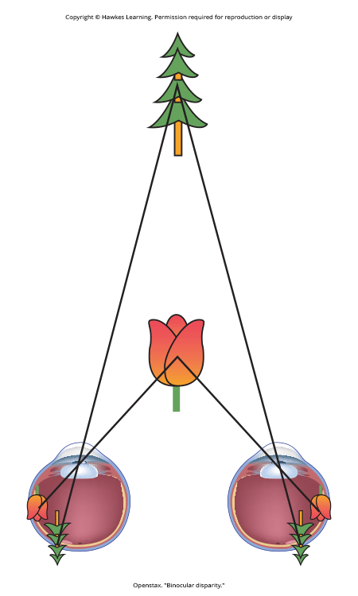
Binocular Cues
Binocular cues: rely on the use of both eyes
  Binocular disparity: slightly different view each eye receives
    Example: special glasses for 3-D movies, where each eye sees slightly different images
Exercise: extend your arm, focus on a finger, close one eye, then switch eyes without moving your head, noticing the perceived shift in your finger's position
Figure 7

Slide 17

Monocular Cues₁
Monocular cues: require only one eye
  Allow us to perceive depth in two-dimensional images through various visual cues
    Example: paintings and photographs
Linear perspective: perception of depth when we see two parallel lines that seem to converge in an image (Figure 8)
  Gives the illusion of three-dimensionality
Figure 8

Slide 18
Monocular Cues₂
Other examples include:
  Interposition: partial overlap of objects, with the partially covered object perceived as farther away
  Relative size and closeness to the horizon: larger objects perceived as closer; those near the horizon line appear farther away

Slide 19
Dig Deeper: Stereoblindness
Bruce Bridgeman was stereoblind from extreme lazy eye and relied on monocular depth cues.
At age 70, he watched a 3-D movie with specialized glasses and experienced binocular depth perception.
This ability persisted after leaving the movie theater, allowing Bridgeman to appreciate the 3-D world.
  Suggests his cells tuned to binocular cues were activated by the 3-D movie experience
The mystery is why it took 70 years for his cells to be activated (Peck, 2012).

Slide 20
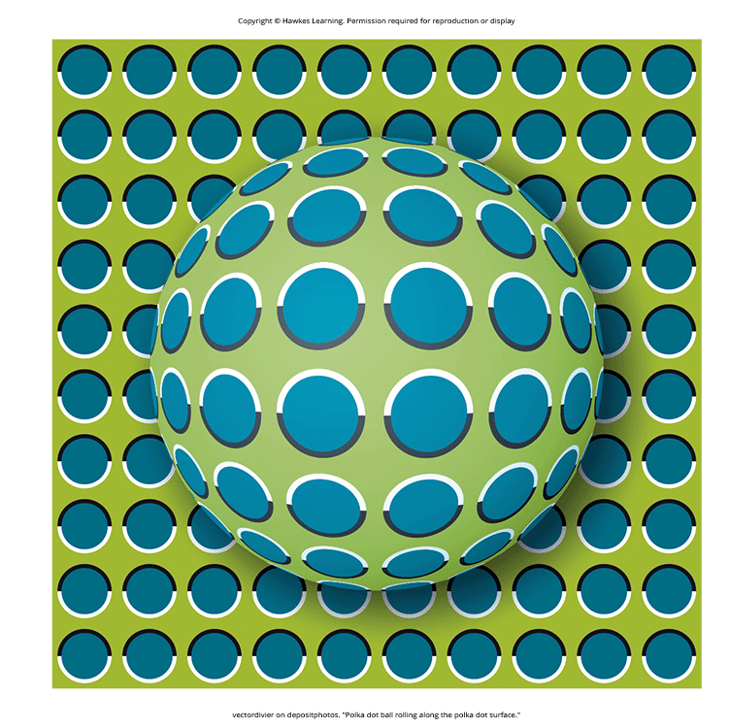
Summary
Light waves enter the eye through the cornea and pupil, the lens focuses light onto the fovea, and visual information exits the eye via the optic nerve.
Cones function best in bright light, and rods function best in dim light.
Each visual field's information crosses to the brain's opposite side at the optic chiasm.
Visual processing occurs through multiple brain areas, culminating in the occipital lobe.
There are two theories for color perception: trichromatic and opponent-process.
Depth perception utilizes monocular and binocular cues.
Figure 9

Slide 21
End of Hawkes Learning PowerPoint

