Slide 1
Lesson 4.4
Hearing

Slide 2
Hearing
The auditory system converts pressure waves into meaningful sounds.
  Translates to hearing nature, music, and speech
How are sensory stimuli translated into neural impulses?
How do we perceive pitch?
How do we know where sound is coming from?

Slide 3
Anatomy Of The Auditory System
The ear is divided into outer, middle, inner sections.
  Outer ear: pinna, auditory canal, tympanic membrane
  Middle ear: ossicles (malleus, incus, stapes)
  Inner ear: canals, cochlea

Slide 4
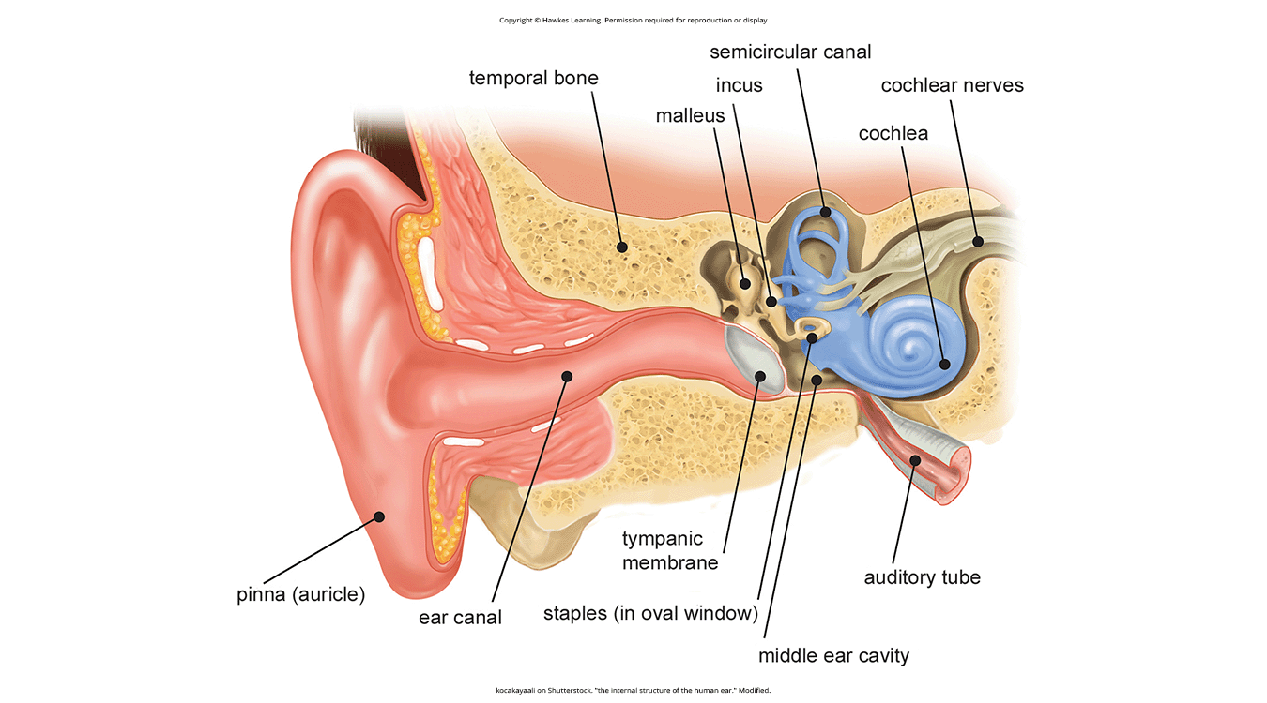
Lesson 4.4 Figure 1
Caption: The ear is divided into outer, middle, and inner sections.

Slide 5
Outer Ear
Pinna: visible part of the ear that interacts with sound waves
Auditory canal: sound waves travel through to the eardrum
Tympanic membrane: eardrum; vibrates when struck by sound waves, initiating ossicle movement

Slide 6
Middle Ear
Ossicles: three tiny bones that transfer eardrum vibrations
  Malleus: hammer
  Incus: anvil
  Stapes: stirrup; presses into oval window of cochlea, moving inner ear fluid

Slide 7
Inner Ear
Contains semicircular canals involved in balance and movement
Cochlea: fluid-filled, snail-shaped structure containing hair cells for hearing
  Hair cells: auditory receptors on basilar membrane
  Basilar membrane: thin strip of tissue in the cochlea

Slide 8
Inner Ear: Hair Cells
Activation of hair cells is mechanical and leads to activation of the cell.
  Generates neural impulses along auditory nerve to brain's auditory cortex
Auditory information is shuttled to inferior colliculus, medial geniculate nucleus of the thalamus, and the auditory cortex.
There is evidence that auditory recognition and localization is processed in parallel streams (Rauschecker & Tian, 2000; Renier et al., 2009).

Slide 9
On Your Own₁
Using the information learned so far in this lesson, recreate the auditory pathway, starting from the auditory canal and ending in the auditory cortex.

Slide 10
Pitch Perception
Different sound frequencies perceived as different pitches (low=low pitch, high=high pitch)
Several theories proposed for pitch perception:
  Temporal theory: frequency coded by activity level/firing rate of sensory neuron
  Place theory: different basilar membrane regions detect different frequencies
Different aspects explained by both theories

Slide 11
Pitch Perception: Temporal Theory
Frequency coded by activity level/firing rate of sensory neuron
Action potentials related to the frequency of a sound wave fired by hair cells
Broad range of frequencies detected (20–20,000 Hz)
  Entire range not accounted for by action potentials fired by hair cells
  Point where cells cannot fire any faster due to properties related to sodium channels on the neuronal membrane (Huspeth, 2009; Shamma, 2001)

Slide 12
On Your Own₂
Explain the temporal theory of pitch perception in your own words.
If a sound were roughly 20 Hz compared to 20,000 Hz, how would this information be coded according to the temporal theory?

Slide 13
Pitch Perception: Place Theory
Different basilar membrane regions detect different frequencies.
  Base of the basilar membrane: high frequencies
  Tip of the basilar membrane: low frequencies
Hair cells in the base are labeled as high-pitch receptors; those in the tip are low-pitch receptors (Shamma, 2001).

Slide 14
Reflection Question₁
For individuals who experience hearing loss, they often lose the ability to hear the highest pitches.
How would both the temporal theory and place theory of pitch perception explain these losses?

Slide 15
Sound Localization
Ability to locate sound sources, like visual depth perception
Uses monaural cues (one ear) for elevation and front/back
Uses binaural cues for horizontal location: interaural level, timing differences

Slide 16
Monaural Cues
Pinna interaction with incoming sound waves provides a monaural cue.
  Helps locate sounds above or below, in front of or behind
Monaural cues are essential because sound waves are identical for sounds above, below, in front of, or behind you (Grothe et al., 2010).

Slide 17
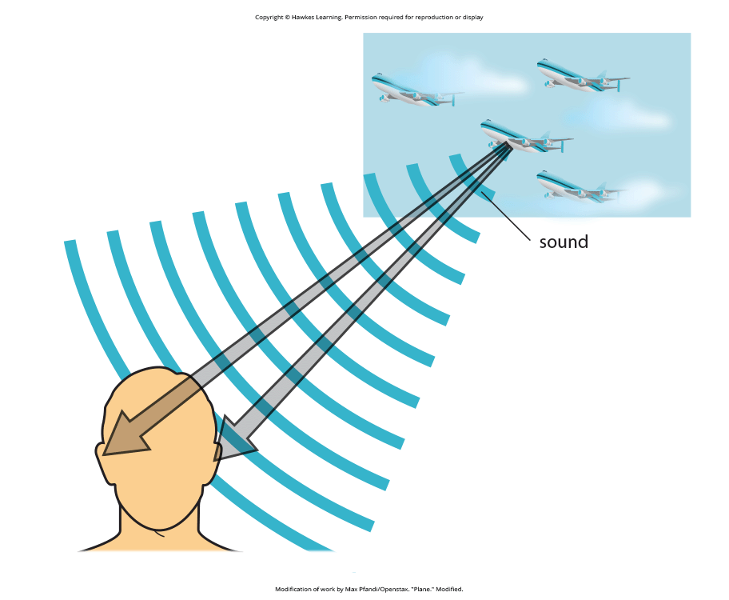
Binaural Cues
Provide information on the location of a sound along a horizontal axis
  Rely on differences in vibration patterns
If sound comes from off-center location, two types are created:
  Interaural level difference: a sound coming from the right side is more intense at the right ear than left
  Interaural timing difference: small difference in time when a sound wave arrives at each ear (Figure 2)
Figure 2

Slide 18
On Your Own₃
If you are sitting with your eyes closed, and your left ear and your right ear both receive a sound that is 15 dB at the same time, where is the sound coming from?
If you are sitting with your eyes closed, and your left ear receives a sound that is 20 dB 500 milliseconds earlier than a 15 dB sound that is received by your right ear, where is the sound coming from? How do you know?

Slide 19
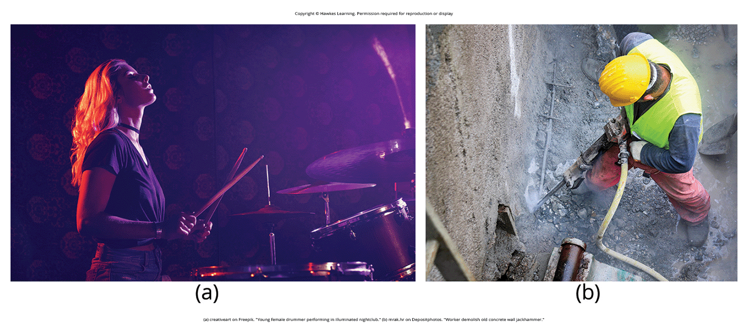
Hearing Loss₁
Deafness: partial or complete inability to hear
  Congenital deafness: born deaf
Conductive hearing loss: failure of eardrum vibration or ossicle movement
  Caused by age, genetics, extreme noise exposure, illness, toxin damage
  Treated with hearing aids
Figure 3

Slide 20
Reflection Question₂
Which do you think would be a more difficult situation for you: congenital deafness or total conductive hearing loss in your 20s? Why?

Slide 21
Hearing Loss₂
Sensorineural hearing loss: failure to transmit neural signals from cochlea to brain
Ménière's disease: results in degeneration of inner ear structures
  Can lead to hearing loss, tinnitus, vertigo, increase in inner ear pressure (Semaan & Megerian, 2011)
  Vertigo: sense of spinning
  Treated with cochlear implants instead of hearing aids
  Cochlear implants: use a microphone, speech processor, and electrode array to stimulate the auditory nerve

Slide 22
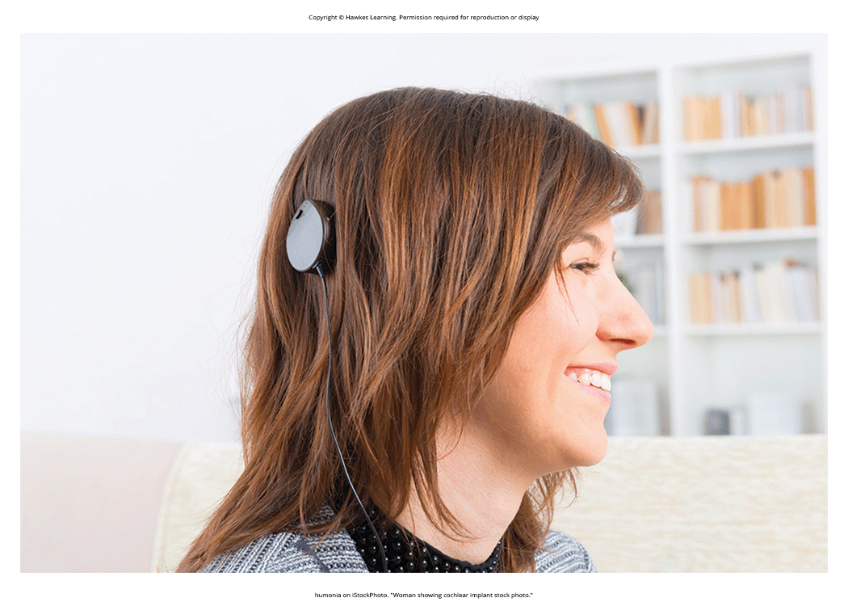
What Do You Think?: Deaf Culture
Individuals with hearing impairments have their own language, schools, and customs.
  United States: American Sign Language (ASL)
One value of deaf culture is to use sign language over speaking, reading lips, or having surgery.
  Parents decide whether to send children to mainstream schooling or deaf schools teaching ASL.
  This poses a decision between verbalizing/reading lips and learning ASL/exposure to deaf culture.
Figure 4

Slide 23
Summary
Sound waves > eardrum > ossicles > cochlear fluid > hair cells
Hair cell activation: neural impulses to brain's auditory cortex
Pitch perception based on firing rates and hair cell location
Sound localization: monaural (elevation) and binaural (horizontal) cues
Hearing loss: conductive (vibration failure) or sensorineural (neural signal failure)

Slide 24
End of Hawkes Learning PowerPoint

