Slide 1
Lesson 4.5
The Other Senses

Slide 2
The Other Senses
Vision and hearing have been extensively studied, but other senses are less understood.
Less is known about our chemical senses (taste and smell) and body senses (touch, temperature, pain, balance, and body position).
Exploration of these senses reveals how they contribute to our perception of the environment.

Slide 3
The Chemical Senses
Taste (gustation) and smell (olfaction) are chemical senses that detect molecules in food/air.
The combination of taste and smell information enhances our perception of flavors.
  Play a crucial role in our experience and enjoyment of food

Slide 4
Taste (Gustation)₁
There are at least six taste groupings: sweet, salty, sour, bitter, umami, and fatty taste.
  Umami: Japanese word that roughly translates to "yummy," associated with taste for MSG (Kinnamon & Vandenbeuch, 2009)
  Growing research that we possess a taste for the fatty content of a given food (Degrace-Passilly, 2012; Mizushige et al., 2007; Sobek et al., 2020)
Taste buds have taste receptor cells that bind taste molecules
Taste information travels to medulla, thalamus, limbic system, and gustatory cortex.

Slide 5

On Your Own₁
Examine the following image and write what taste bud groupings might be activated by the different ingredients.
Figure 1

Slide 6
Taste (Gustation)₂
Molecules from food and drink dissolve in our saliva and interact with taste receptors on our tongue, mouth, and throat.
  Taste buds: formed by groupings of taste receptor cells with hairlike extensions (Figure 2)
Taste information travels to medulla, thalamus, limbic system, and gustatory cortex (Maffei et al., 2012; Roper, 2013).

Slide 7
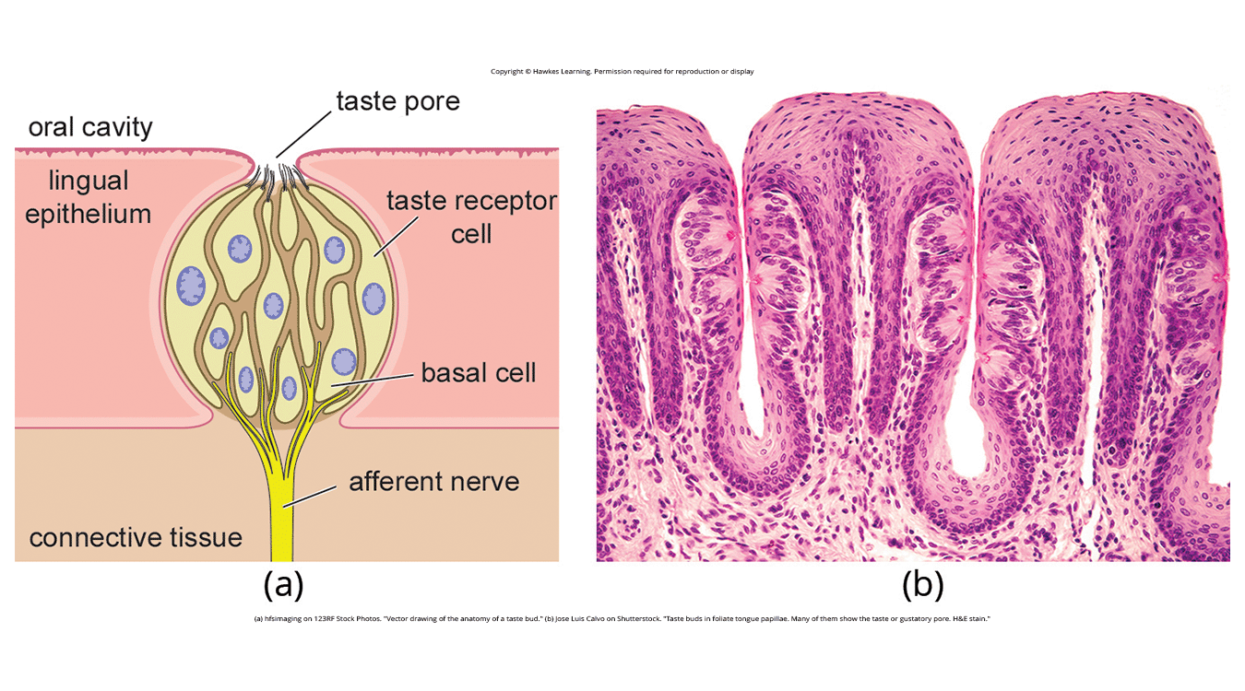
Lesson 4.5 Figure 2
Caption: (a) Taste buds are composed of a number of individual taste receptor cells that transmit information to nerves. (b) This micrograph shows a close-up view of the tongue's surface.

Slide 8
On Your Own₂
Recreate the gustatory pathway in the table, starting from the taste receptors and ending in the gustatory cortex.

Slide 9
Smell (Olfaction)₁
Olfactory receptors are located in the nasal mucous membrane and bind odor molecules.
  Hairlike extensions for odor molecules to interact with chemical receptors (Figure 3)
Signals travel to olfactory bulb, limbic system, and olfactory cortex (Lodovichi & Belluscio, 2012; Spors et al., 2012).
  Olfactory bulb: bulblike structure at the tip of the frontal lobe where olfactory nerves begin

Slide 10
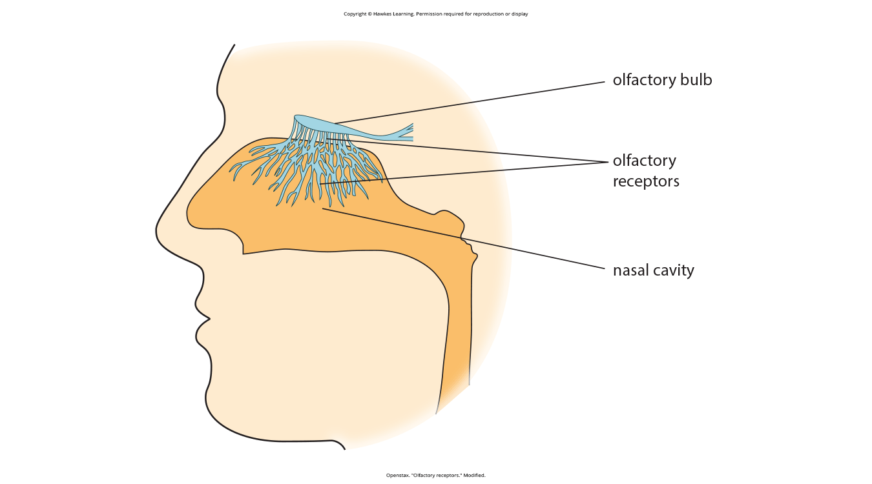
Lesson 4.5 Figure 3
Caption: Olfactory receptors are the hairlike parts that extend from the olfactory bulb into the mucous membrane of the nasal cavity.

Slide 11
Smell (Olfaction)₂
Variation in the sensitivity of the olfactory systems of different species
  Example: superior smell in dogs due to increased olfactory receptor genes (800–1,200 compared to fewer than 400 in humans) (Niimura & Nei, 2007)
Pheromones: chemical signals often about reproductive status
  Example: pheromonal activation important to eliciting sexual behavior in the male rat (Furlow, 1996, 2016; Purvis & Haynes, 1972; Sachs, 1997; Zhang et al., 2008)

Slide 12
Reflection Question₁
How might your life differ if you had the olfactory system of a dog? What would be the benefits? Challenges?

Slide 13
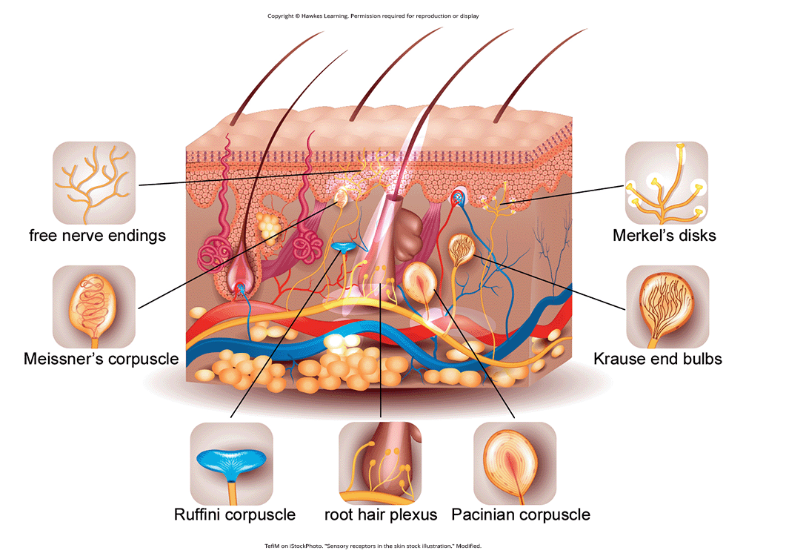
Touch, Thermoception, And Nociception₁
Skin receptors detect touch-related stimuli (Figure 4).
  Meissner's corpuscles: respond to pressure and lower frequency vibrations
  Pacinian corpuscles: detect transient pressure and higher frequency vibrations
  Merkel's disks: respond to light pressure
  Ruffini corpuscles: detect stretch
Figure 4

Slide 14
Touch, Thermoception, And Nociception₂
Free nerve endings detect temperature (thermoception) and potential harm (nociception) (Garland, 2012; Petho & Reeh, 2012; Spray, 1986).
  Also respond to a variety of different touch-related stimuli
Sensory signals travel to the medulla, thalamus, and somatosensory cortex.

Slide 15
On Your Own₃
Using the information learned so far in this lesson, recreate the sensory pathway in the table, starting from the sensory receptors and ending in the somatosensory cortex.

Slide 16
Pain Perception
Pain: unpleasant experience with physical and psychological components
  Adaptive for signaling injury
  Treatments: relaxation, medication, and brain stimulation
Inflammatory pain: signals tissue damage
Neuropathic pain: exaggerated pain signals to the brain due to nerve damage
Congenital insensitivity to pain: rare disorder causing the inability to feel pain; also called congenital analgesia
  Can detect differences in temperature and pressure, but not pain
  Can have shorter life expectancy (U.S. National Library of Medicine, n.d.)

Slide 17
Reflection Question₂
How might your life be improved if you were unable to feel pain? Would there be drawbacks?

Slide 18
The Vestibular Sense
Vestibular sense: contributes to our ability to maintain balance and body posture
Major sensory organs located next to the cochlea
  Utricle, saccule, three semicircular canals
Vestibular organs: fluid-filled structures with hair cells that respond to head movement and gravitational forces
Vestibular system important when experiencing motion sickness and/or dizziness related to inner ear (Khan & Chang, 2013)
Collects critical information for controlling movement and reflexes

Slide 19
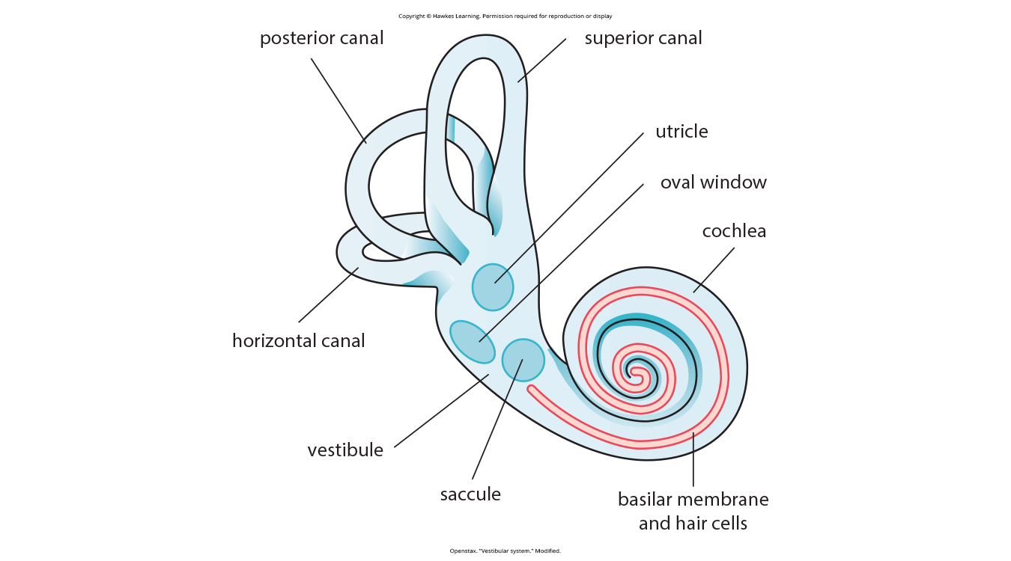
Lesson 4.5 Figure 5
Caption: The major sensory organs of the vestibular system are located next to the cochlea in the inner ear. These include the utricle, saccule, and the three semicircular canals (posterior, superior, and horizontal).

Slide 20
Proprioception And Kinesthesia
Proprioception and kinesthesia interact with information provided by the vestibular system.
  Proprioception: perception of body position
  Kinesthesia: perception of body movement
Muscle/joint receptors provide proprioceptive and kinesthetic information to the brain.
Receptors respond to stretch and tension in muscles, joints, skin, and tendons (Lackner & DiZio, 2005; Proske, 2006; Proske & Gandevia, 2012).
  Send information to the brain via the spinal column

Slide 21
Summary
Taste and smell employ receptors that bind with molecules to transmit sensory information to the brain.
Touch perception is mediated by various receptors and free nerve endings throughout the body.
Pain perception involves both physical and psychological components, signaling injury and prompting protective behaviors.
Vestibular sense maintains balance through hair cells in inner ear organs responding to head movement and gravity.
Proprioception and kinesthesia provide information about body position and movement.
Specialized receptors detect stimuli and send signals to respective brain regions.

Slide 22
End of Hawkes Learning PowerPoint

