Slide 1
Lesson 4.6
Gestalt Principles of Perception

Slide 2
Gestalt Principles Of Perception
Gestalt psychology: belief that perception involves more than combining sensory stimuli
Proposed by Max Wertheimer, Wolfgang Köhler, and Kurt Koffka
Gestalt = "form or pattern"
Reflects the idea that the whole is different from the sum of its parts
Shows how we organize sensory information into meaningful perceptions

Slide 3
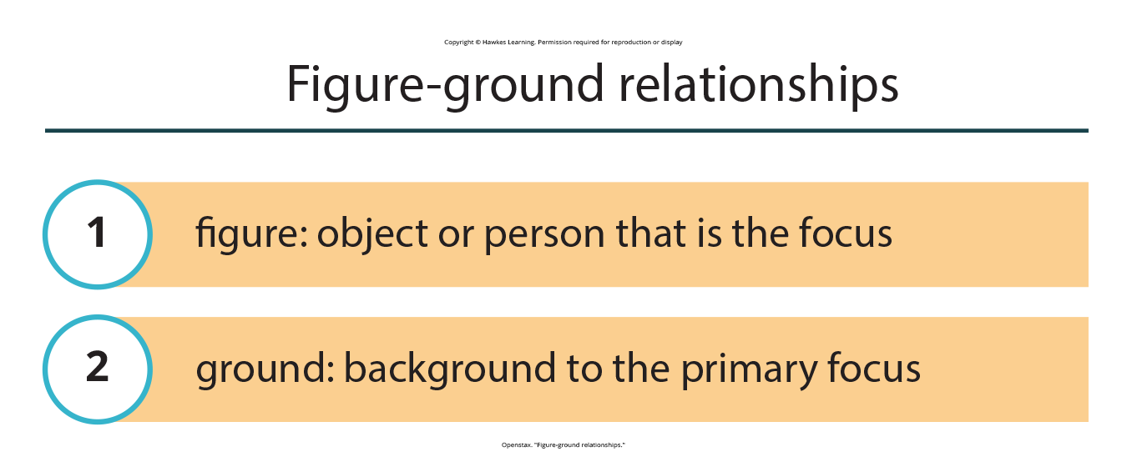
Figure-Ground Relationship₁
Figure-ground relationship is our tendency to segment the visual world into figure and ground.
Figure: object or person that is the focus
Ground: background to the primary focus
Figure 1

Slide 4
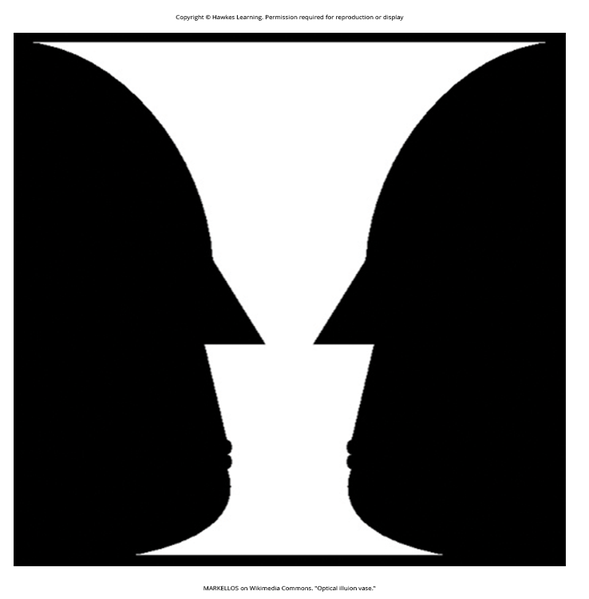
Figure-Ground Relationship₂
Perception varies based on what is labeled figure vs. ground (Figure 2).
Our ability to interpret sensory information may also depend on our labeling of figure vs. ground, though that has been questioned (Mashour et al., 2020; Peterson & Skow-Grant, 2003; Peterson & Gibson, 1994; Vecera & O'Reilly, 1998).
Figure 2

Slide 5
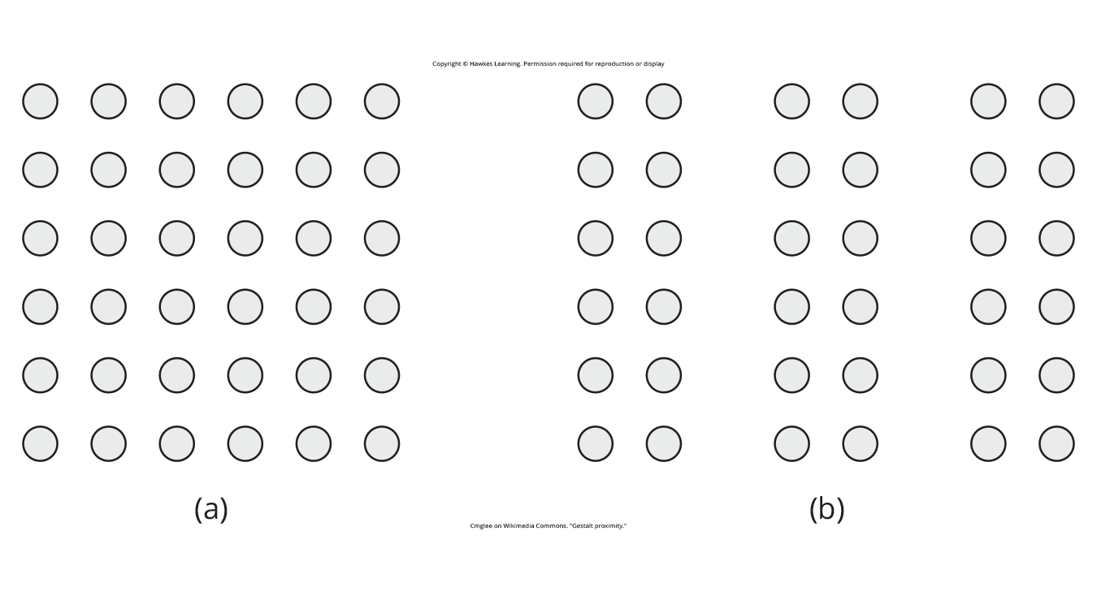
Proximity
Proximity: objects/elements close together tend to be grouped together visually (Figure 3)
Also illustrated by how we read words grouped by letter proximity
Figure 3

Slide 6
Group Activity
In a small group, discuss examples of times when you have grouped items based on their proximity to each other.

Slide 7
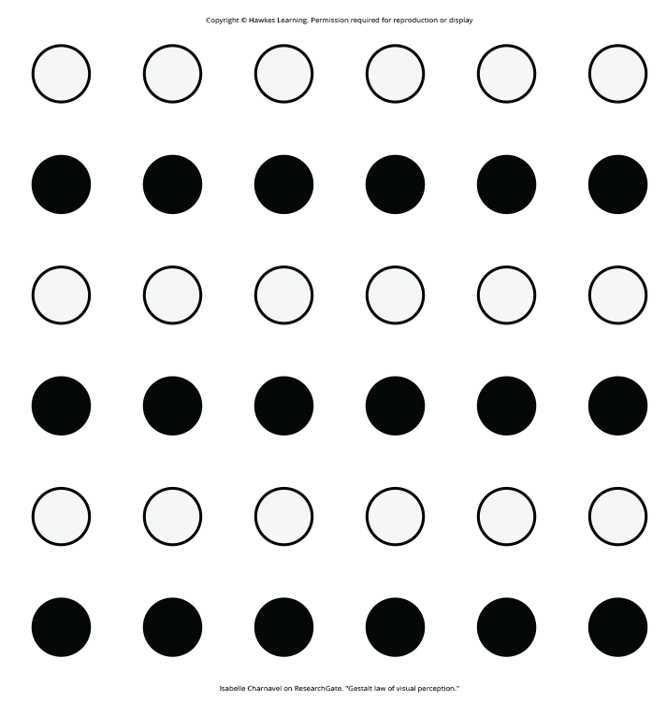
Similarity
Similarity: things that are alike/similar tend to be visually grouped together (Figure 4)
Example: grouping football players by uniform color
Figure 4

Slide 8
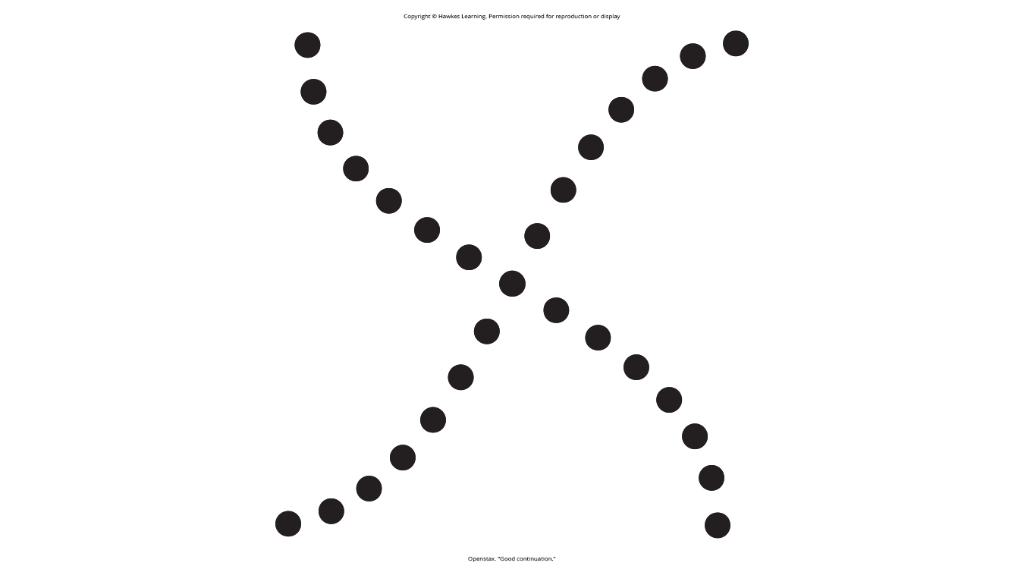
Continuity
Continuity: we perceive continuous, smooth flowing lines rather than jagged lines (Figure 5)
Also called good continuation
Figure 5

Slide 9
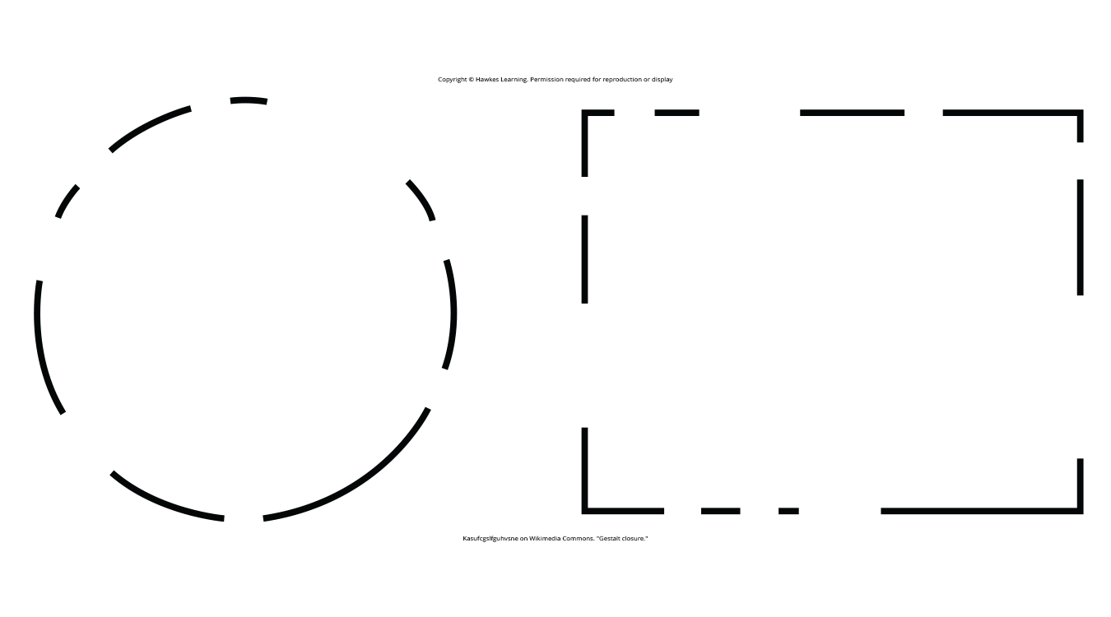
Closure
Closure: we organize perceptions into complete, whole objects rather than parts (Figure 6)
Figure 6

Slide 10
Pattern Perception
Pattern perception is our ability to discriminate figures/shapes by applying Gestalt principles of grouping.
We may think that our perceptions of the real world are accurate, but that is not always the case.

Slide 11
Perceptual Hypotheses
Perceptions are based on perceptual hypotheses influenced by experience/expectations.
Perceptual hypotheses: educated guesses that we make while interpreting sensory information
We use hypotheses to generate our perceptual set.
Those given verbal priming produce a biased interpretation of complex ambiguous figures (Goolkasian & Woodbury, 2010).

Slide 12
Dig Deeper: The Depths of Perception: Bias, Prejudice, And Cultural Factors
Perception is a complex process influenced by experiences, biases, and prejudices.
Research shows that implicit racial biases affect our perception of weapons/threats.
Example #1: Non-Black participants identify weapons faster when paired with images of a Black person (Payne, 2001; Payne et al., 2005).
Example #2: White individuals shoot an armed target in video games more quickly when the target is Black (Correll et al., 2002; Correll et al., 2006).

Slide 13
Summary
Gestalt principles explain how we organize sensory input into perceptions.
Figure-ground, proximity, similarity, continuity, closure are key principles.
Perceptions can be shaped by biases, prejudices, and cultural factors.

Slide 14
End of Hawkes Learning PowerPoint

