Slide 1
Lesson 5.1
What is Learning?

Slide 2
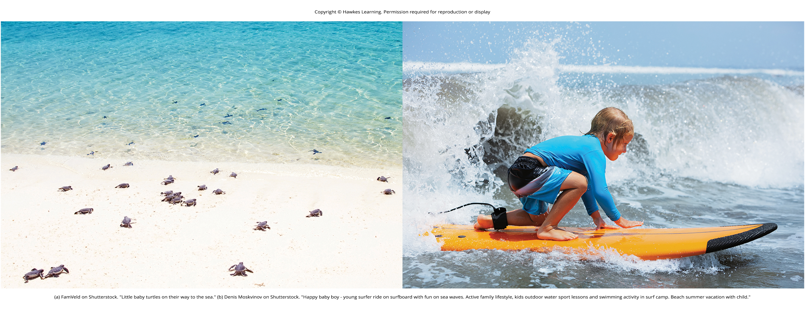
What Is Learning?
Humans an animals have a number of unlearned behaviors that often start at birth.
Example: birds build nests and migrate during winter
Learning: a change in behavior or knowledge that is the result of an experience
Figure 1

Slide 3
Reflexes
Reflex: unlearned, automatic response by an organism to a stimulus in the environment
Innate behavior
Simpler than instincts
Involve the activity of specific body parts and systems
Example: knee-jerk flex
Example: the contraction of the pupil in bright light

Slide 4
Instincts
Instinct: unlearned knowledge, involving complex patterns of behavior
Innate behavior
Triggered by a broad range of events
Involve the movement of the organism as a whole
Example: the aging process
Example: the desire to survive
Involve higher brain centers

Slide 5
Reflexes And Instincts
Help an organism to adapt to its environment
Do not have to be learned
Example: every healthy human baby has a sucking reflex (present at birth)

Slide 6
Learning
Unlike instincts and reflexes, learned behaviors involve change and experience.
In contrast to innate behaviors, learning involves acquiring knowledge and skills through experience.
Example: Julian will have to train extensively before learning to surf like his father.
Complex learning involves the interaction of conscious and unconscious processes.
Learning is traditionally studied in terms of simplest components - associations mind makes automatically.
Associative learning occurs when connections are made between stimuli/events in the environment.

Slide 7
Group Activity
As a group, discuss why you feel humans and other species are born with instincts and reflexes. Other than the ability to adapt to one's environment, what other benefits come with unlearned behaviors?

Slide 8
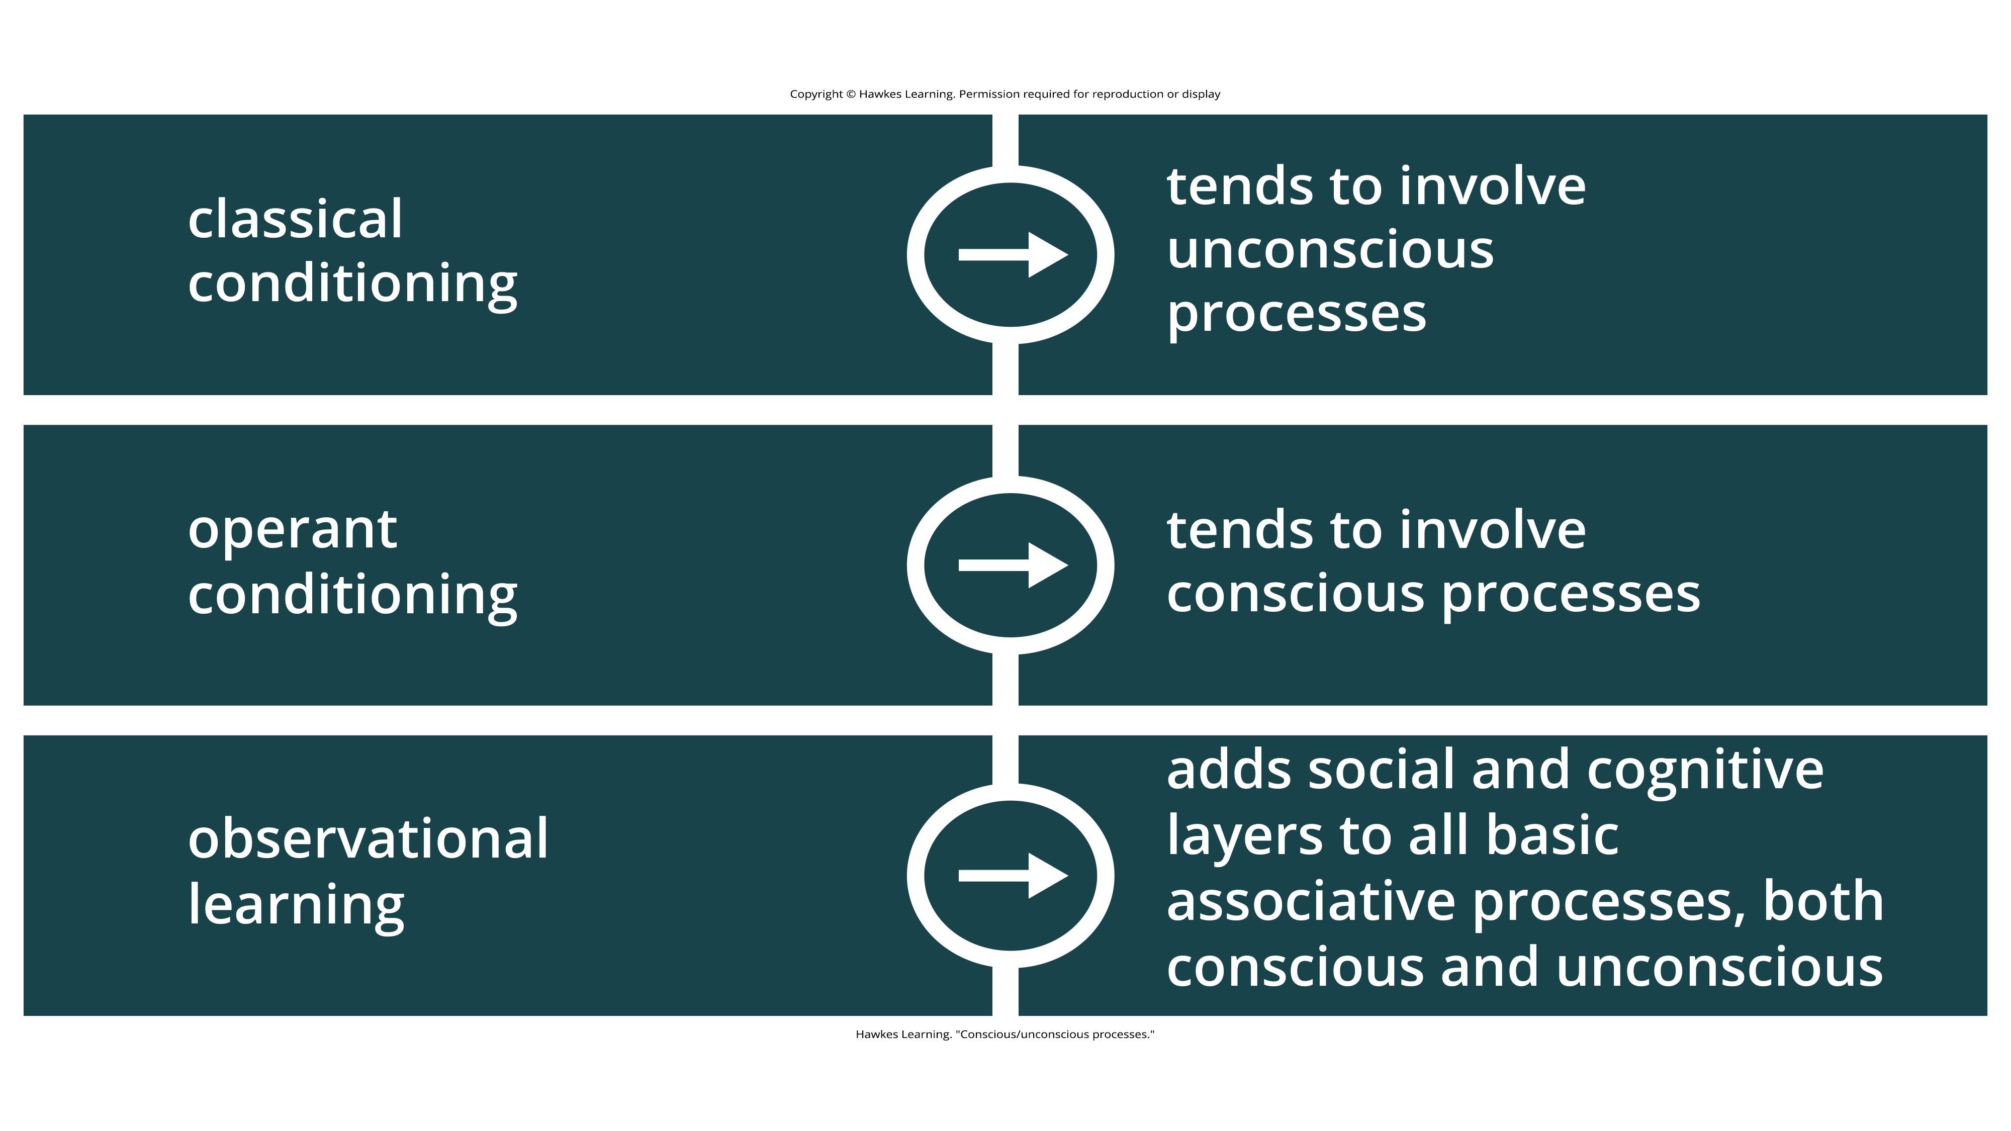
Lesson 5.1 Figure 2
Caption: Different types of learning can involve conscious or unconscious processes.

Slide 9
Classical Conditioning
In classical conditioning (or Pavlovian conditioning), organisms learn to associate events/stimuli that repeatedly happen together.
We experience this associative process in daily life.
Example: lightning and thunder
Lightning naturally predicts the impending boom of thunder, making us jump (reflex)
Psychological researchers study this by focusing on observable, measurable behaviors.

Slide 10
Operant Conditioning
In operant conditioning, organisms learn to associate a behavior with its consequence (reinforcement or punishment).
A pleasant consequence encourages that behavior in the future, while punishment deters the behavior.
Positive reinforcement refers to giving something to encourage a behavior.
Positive punishment refers to giving something to deter or decrease a behavior.

Slide 11
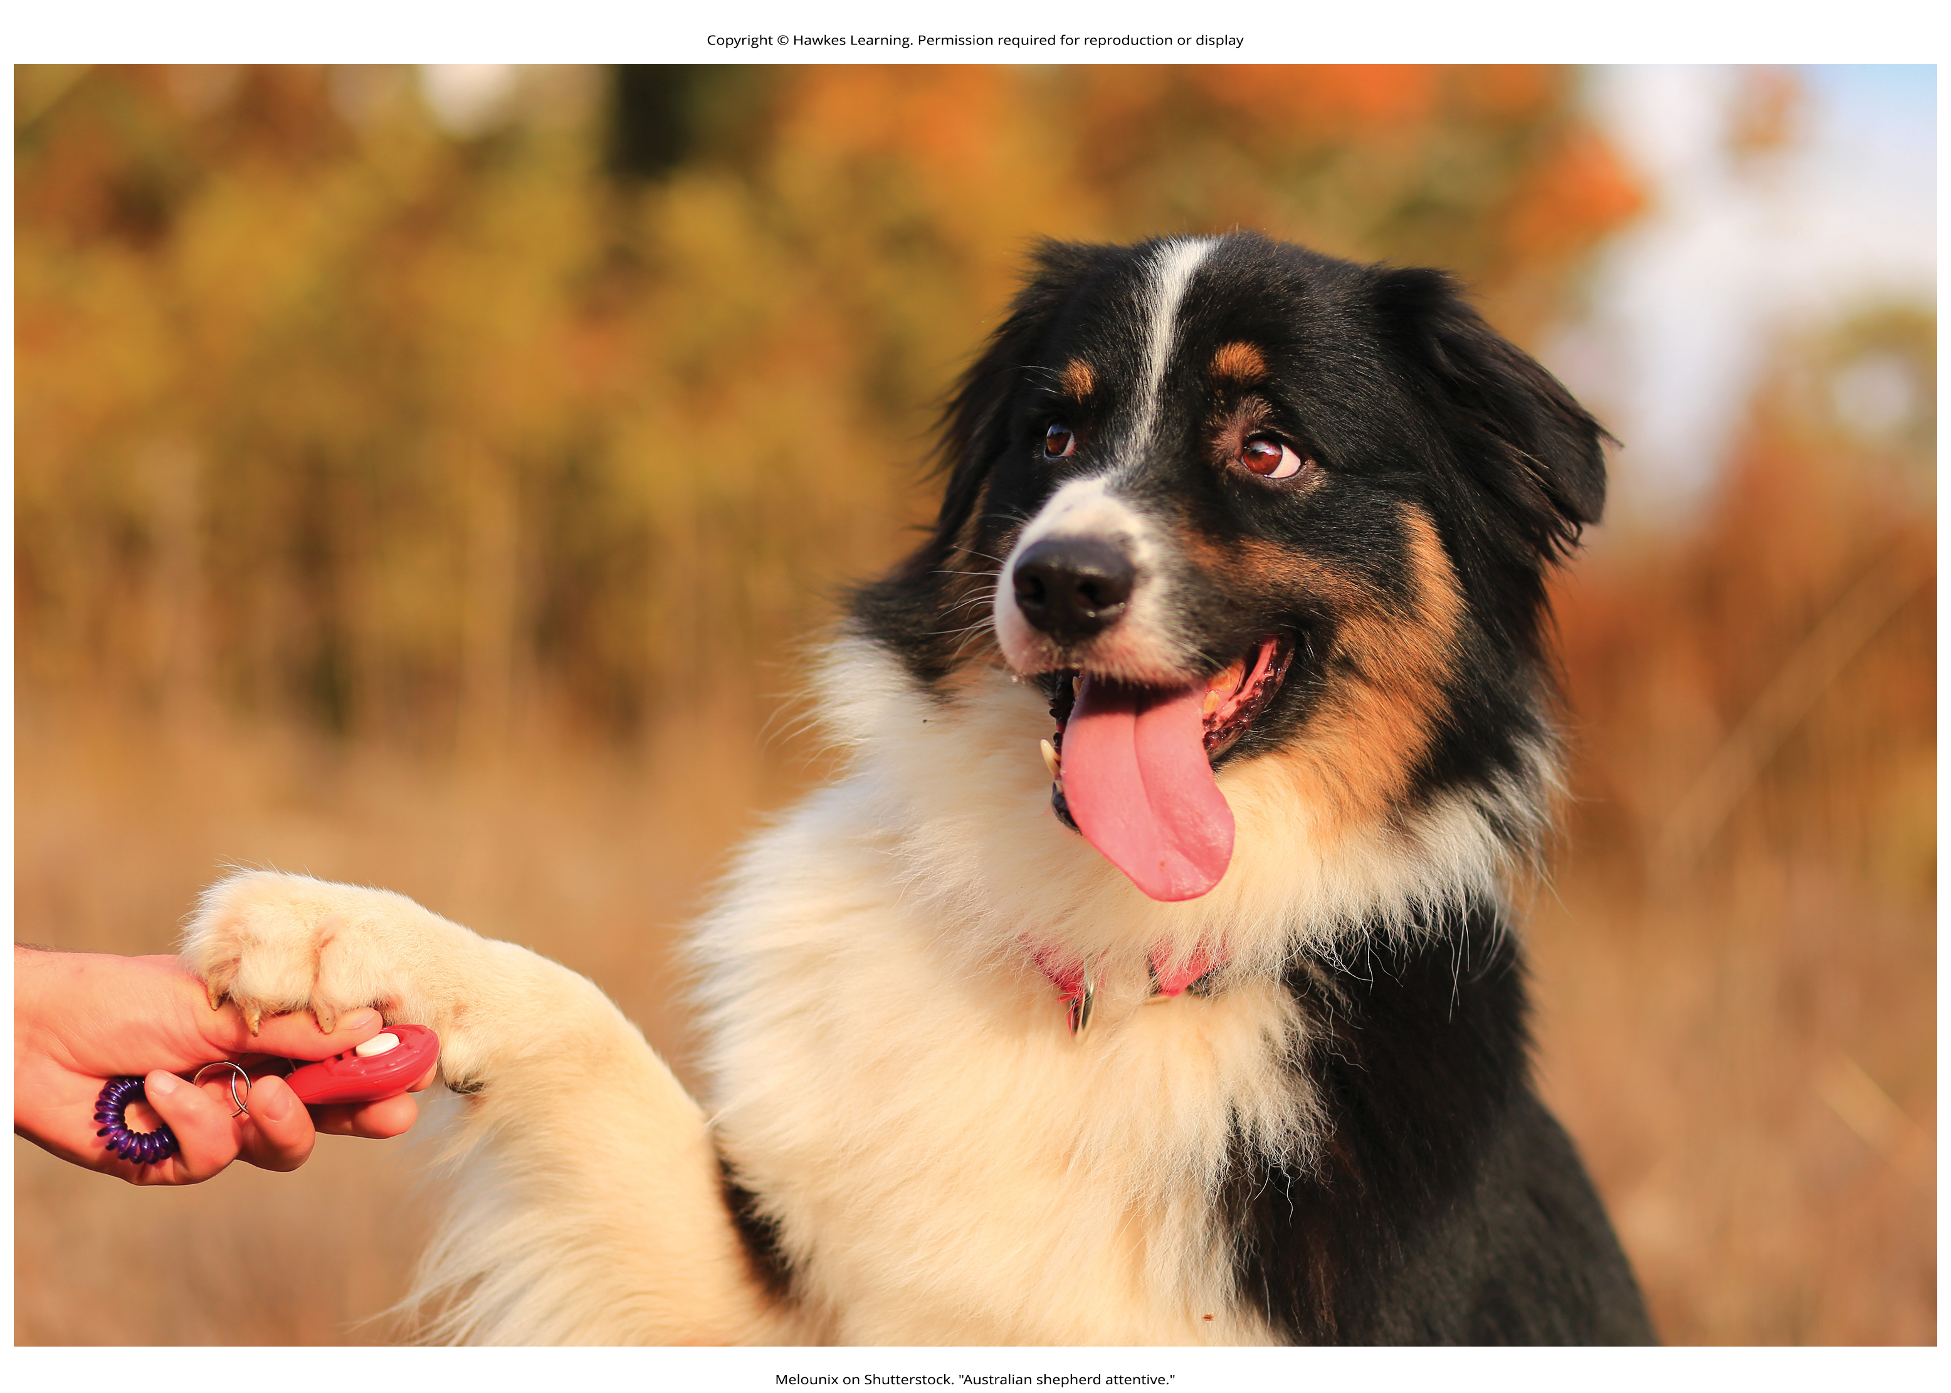
Positive Reinforcement Vs. Positive Punishment
Positive reinforcement
Example: You tell your dog Leroy to sit and give him a treat when he does. After repeated experiences, Leroy begins to associate the act of sitting with receiving a treat. He learns that the consequence of sitting is that he gets a biscuit (Figure 3).
Positive punishment
Example: You want Leroy to be in your yard when you aren't with him, so he receives a small shock when crossing the boundary of an invisible electric fence. If Leroy is punished when trying to exceed the fence, he becomes conditioned to avoid that behavior.
Figure 3

Slide 12
Observational Learning
Observational learning extends classical and operant conditioning's effective range.
Unlike conditioning from direct experience, observational learning occurs by watching others and imitating.
A lot of human and animal learning comes from observational learning processes.
Example: By watching his father surf, Julian can imitate successful moves and avoid failed ones.
This allows learning without sole trial-and-error, expanding what can be effectively learned.

Slide 13
Reflection Question
Can you think of something you have learned to do simply by watching someone else?

Slide 14
Summary
Instincts and reflexes are innate, unlearned behaviors that occur naturally.
Learning is a change in behavior or knowledge resulting from experience.
The three main types of learning are classical conditioning, operant conditioning, and observational learning.
Classical and operant conditioning involve making associations between events that co-occur (associative learning).
Observational learning occurs by watching and imitating others' behaviors.

Slide 15
End of Hawkes Learning PowerPoint

