Slide 1
Lesson 5.2
Classical Conditioning

Slide 2
Classical Conditioning
Classical conditioning: learning in which the stimulus or experience occurs before the behavior and then gets paired or associated with the behavior
Ivan Pavlov
Russian scientist
Performed extensive research on dogs
Best known for classical conditioning

Slide 3
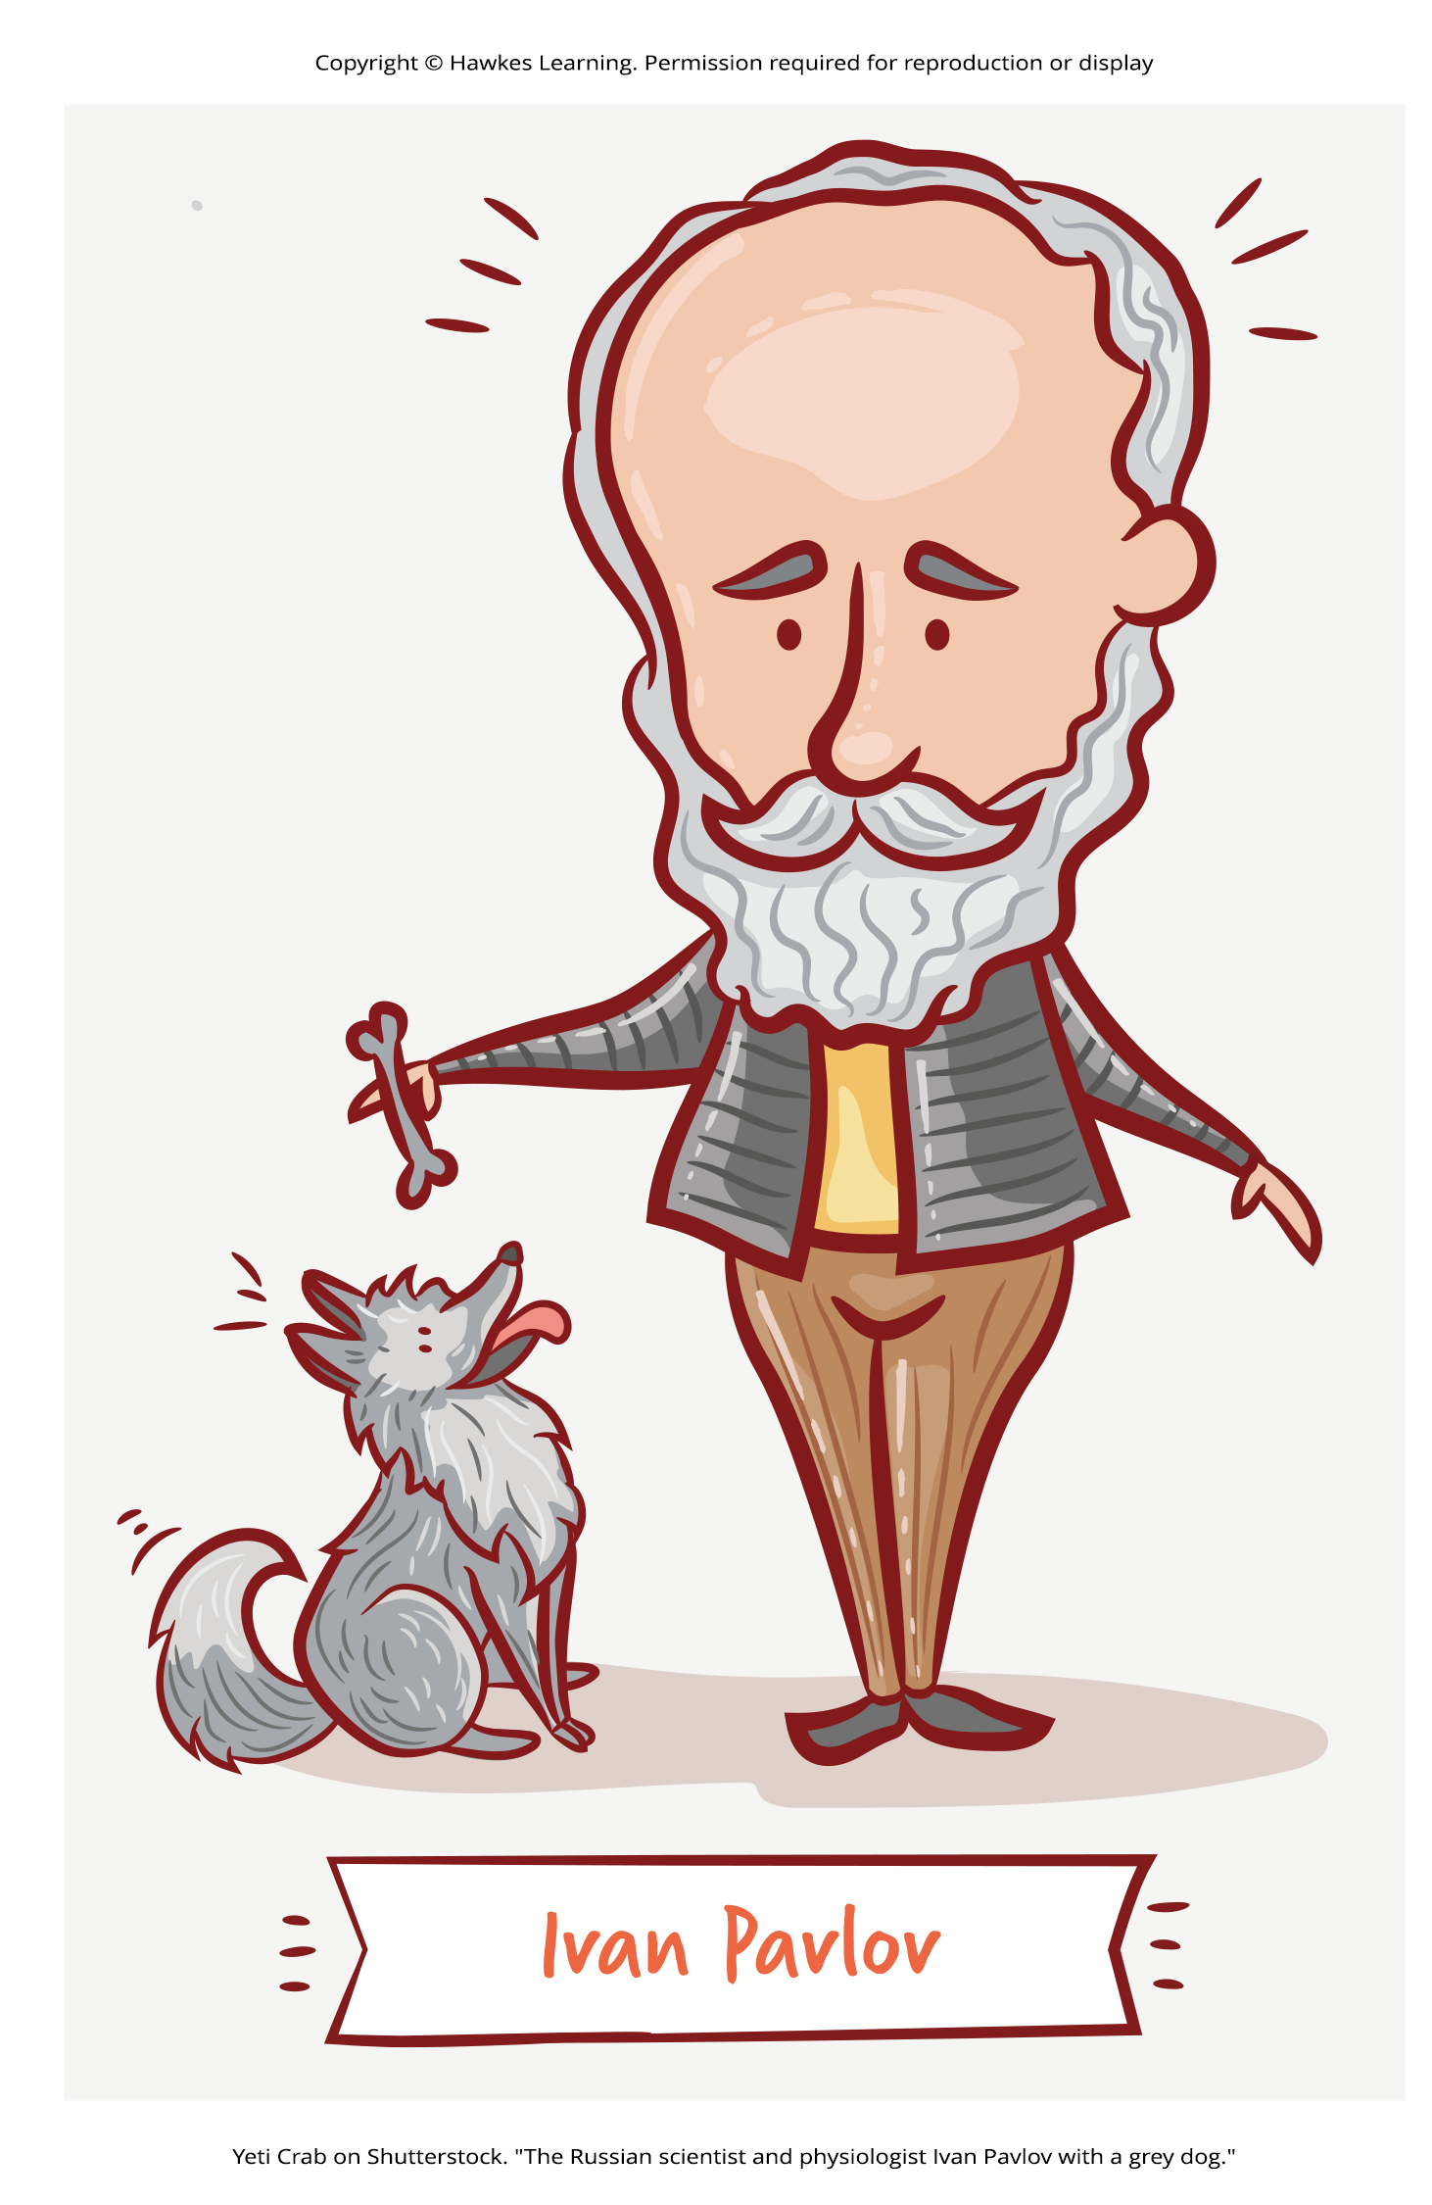
Pavlov's Work
In studies with dogs, Pavlov surgically implanted tubes to collect saliva.
He measured saliva produced in response to various foods (unconditioned stimulus).
Over time, dogs began salivating at sights/sounds associated with food (e.g. footsteps).
Pavlov trained dogs to salivate in response to neutral stimuli like metronome sounds.
Through experiments, Pavlov realized organisms have two types of responses:
Unconditioned (unlearned) responses or reflexes
Conditioned (learned) responses
Figure 1

Slide 4
Unconditioned Stimulus (UCS)
Unconditioned stimulus (UCS): stimulus that elicits a reflexive response
Example: In Pavlov's experiments the UCS was the meat powder

Slide 5
Unconditioned Response (UCR)
Unconditioned response (UCR): natural (unlearned) behavior to a given stimulus
Example: In Pavlov's experiments the UCR was the dog's salivation

Slide 6
Neutral Stimulus (NS)
Neutral stimulus (NS): stimulus that does not initially elicit a response
Presented immediately before an unconditioned stimulus
Example: In Pavlov's experiments the NS was the tone sounded before the meat powder (Figure 2)

Slide 7
Conditioned Stimulus (CS)
Conditioned stimulus (CS): stimulus that elicits a response do to its being paired with an unconditioned stimulus
Example: When Pavlov paired the tone with the meat powder repeatedly, the previously neutral stimulus (the tone) also began to elicit salivation from the dogs.

Slide 8
Conditioned Response (CR)
Conditioned response (CR): response caused by the conditioned stimulus
Example: In Pavlov's experiment the dogs began to salivate at the sound of the tone alone

Slide 9
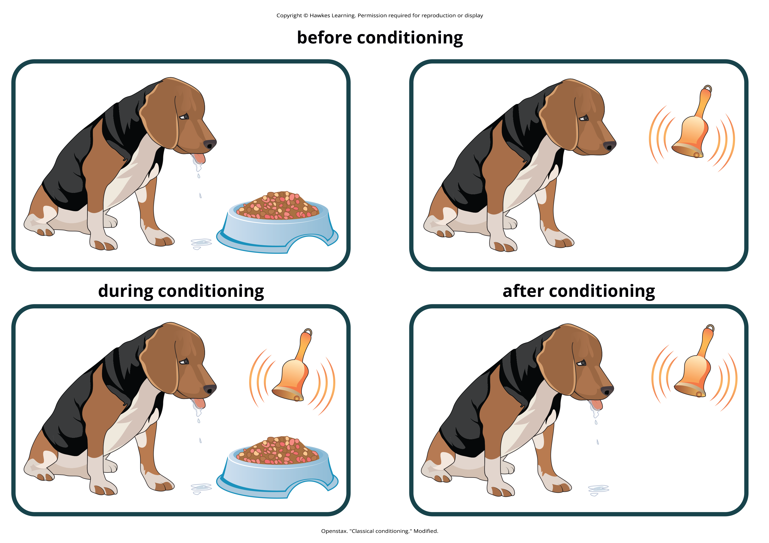
Lesson 5.2 Figure 2
Caption: Before conditioning, an unconditioned stimulus (food) produces an unconditioned response (salivation), and a neutral stimulus (bell) does not produce a response. During conditioning, the unconditioned stimulus (food) is presented repeatedly just after the presentation of the neutral stimulus (bell). After conditioning, the neutral stimulus alone produces a conditioned response (salivation), thus becoming a conditioned stimulus.

Slide 10
Real World Application Of Classical Conditioning
If you use an electric can opener, your cat may associate its sound with food (conditioned stimulus).
If the can opener is stored in a cabinet that squeaks, the cat associates that noise with the can opener/food.
The pairing of a new neutral stimulus (cabinet noise) with a conditioned stimulus (can opener) is higher-order conditioning.
This means using the conditioned stimulus to condition another stimulus (squeaky cabinet).
It is difficult to achieve conditioning above second-order, like a bell preceding the cabinet/can opener/food.

Slide 11
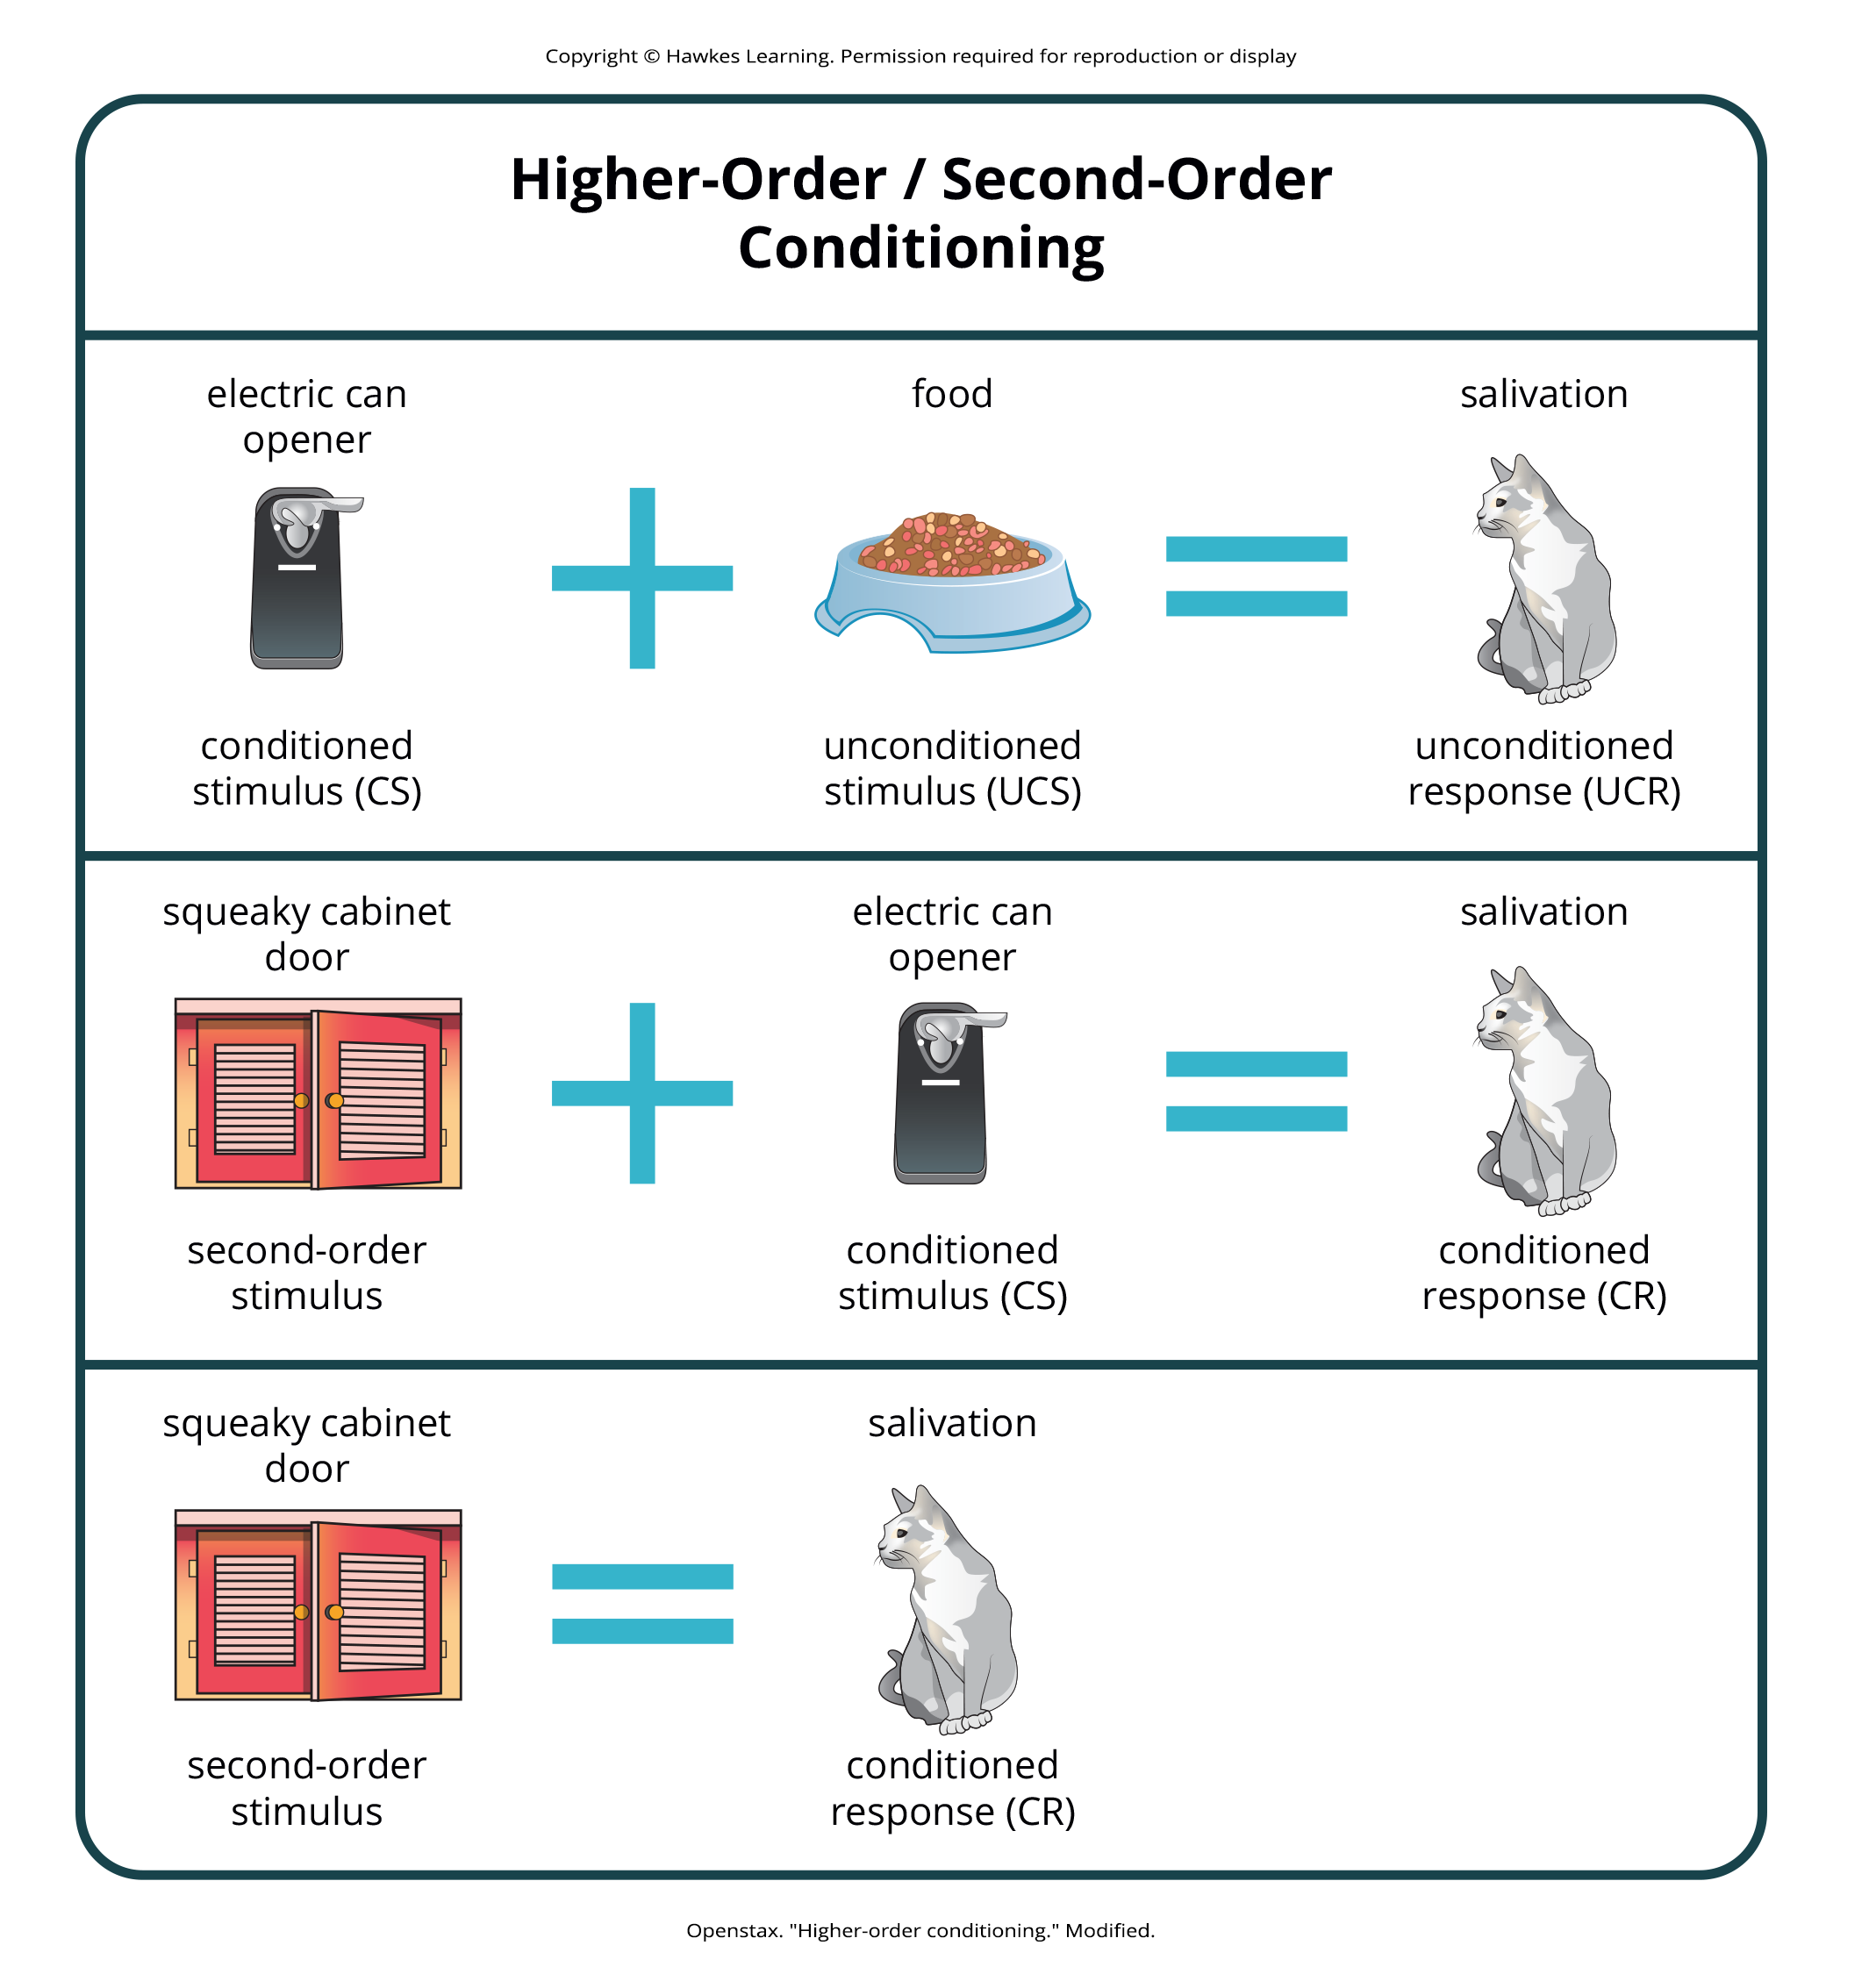
Lesson 5.2 Figure 3
Caption: In higher-order conditioning, an established conditioned stimulus is paired with a new neutral stimulus (the second-order stimulus) so that eventually the new stimulus also elicits the conditioned response, without the initial conditioned stimulus being presented.

Slide 12
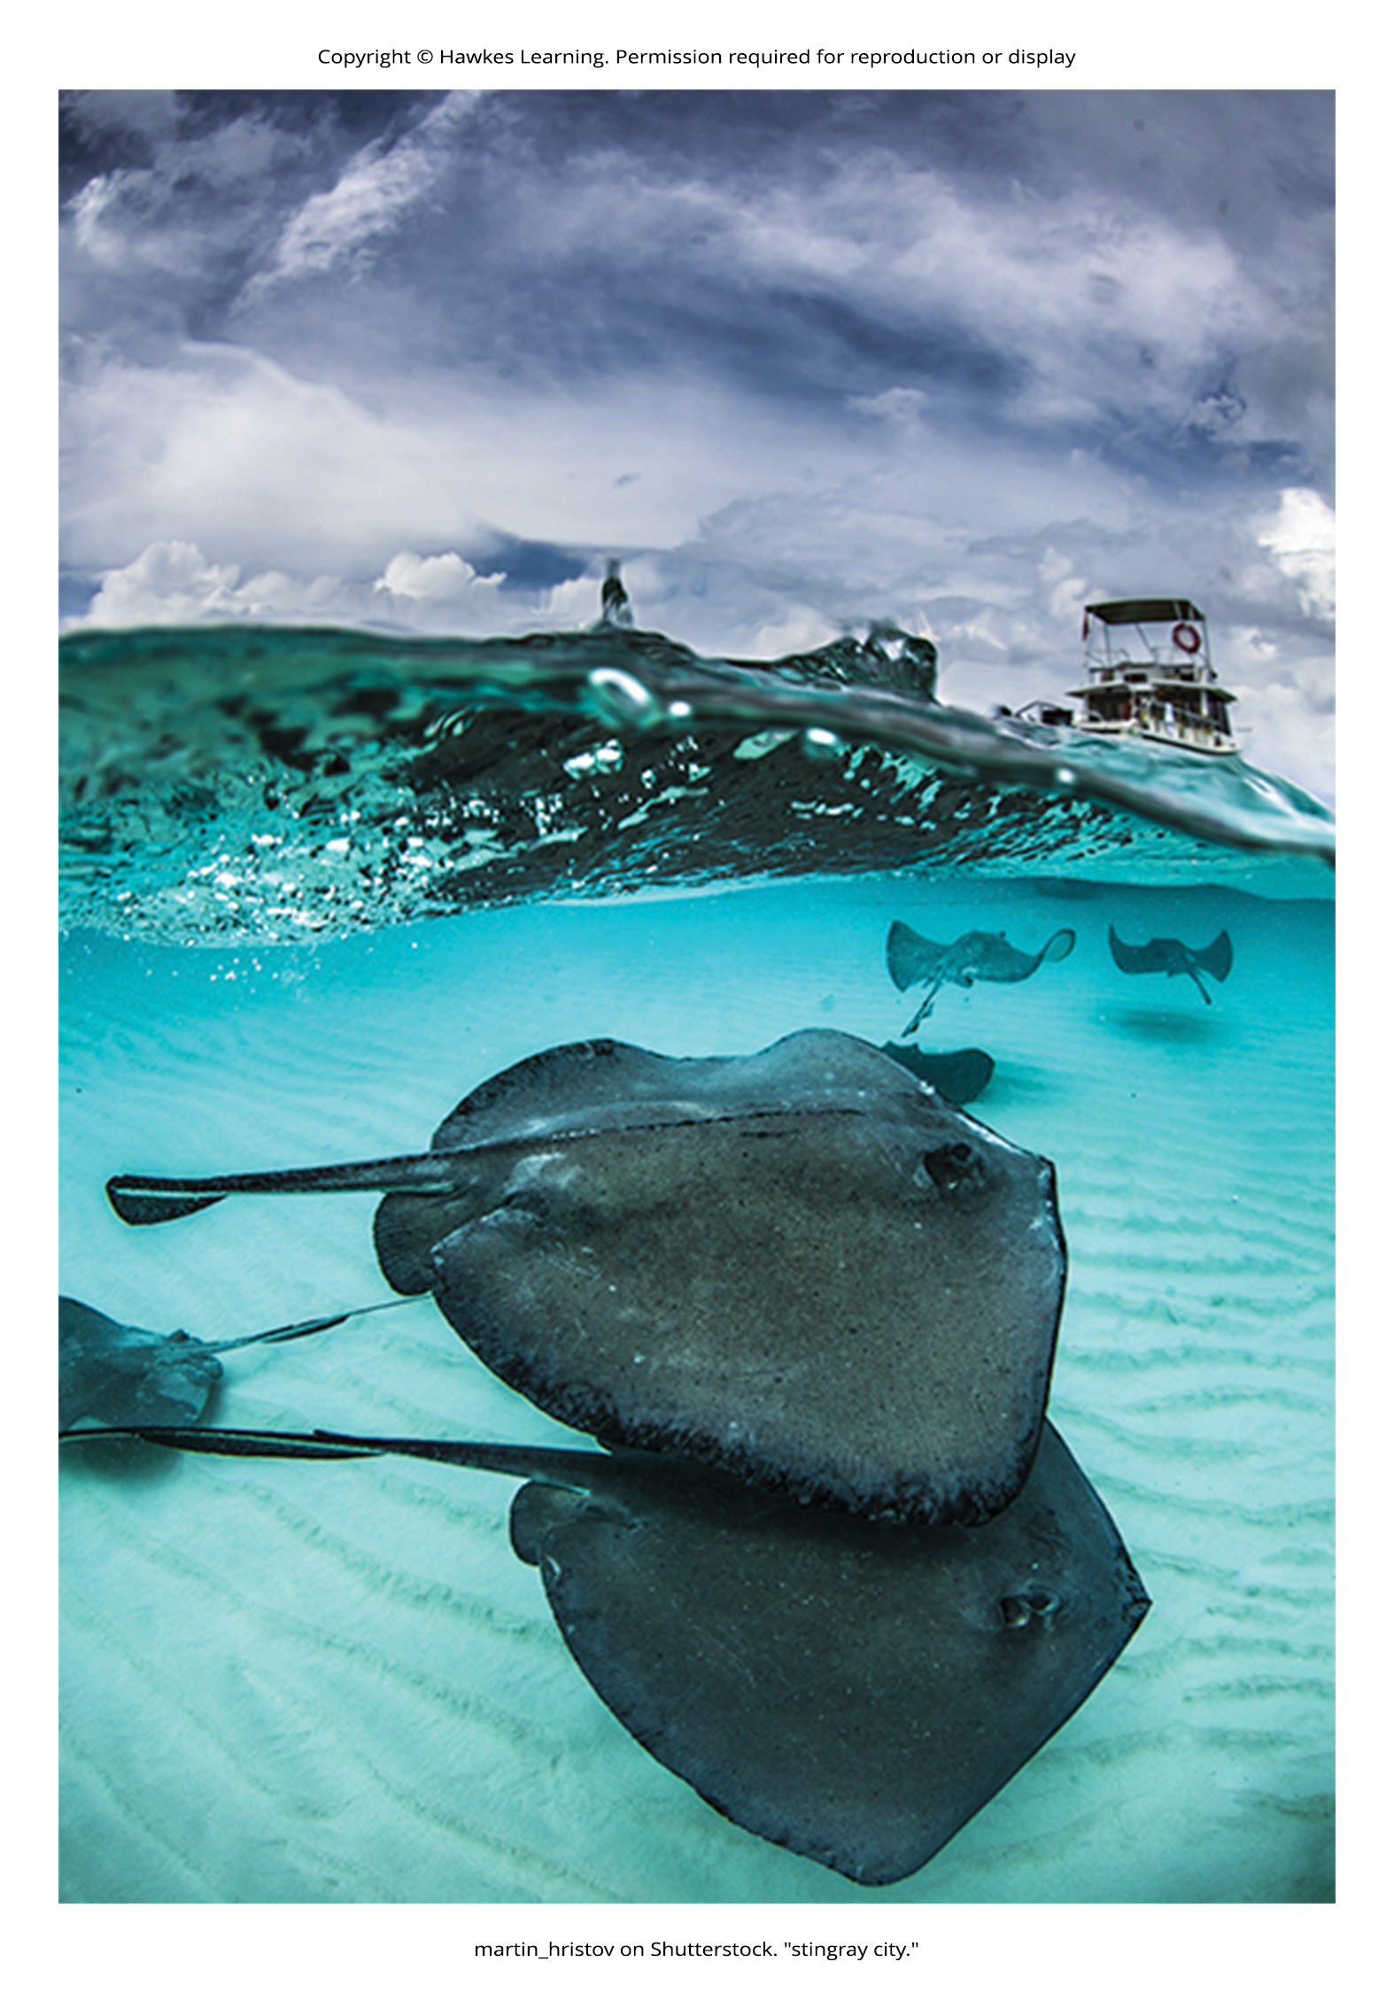
General Processes In Classical Conditioning₁
Acquisition: period of initial learning in classical conditioning in which a human or animal begins to connect a neutral stimulus and an unconditioned stimulus so that the neutral stimulus will begin to elicit the condition response
Extinction: decrease in the conditioned response when the unconditioned stimulus is no longer paired with the conditioned stimulus
Example: Pavlov's dogs stopped salivating to the bell (conditioned stimulus) when not paired with meat powder (unconditioned stimulus).
Spontaneous recovery: return of a previously extinguished conditioned response
Example: a cat's excitement for the can opener sound after a break in usage
Figure 4

Slide 13
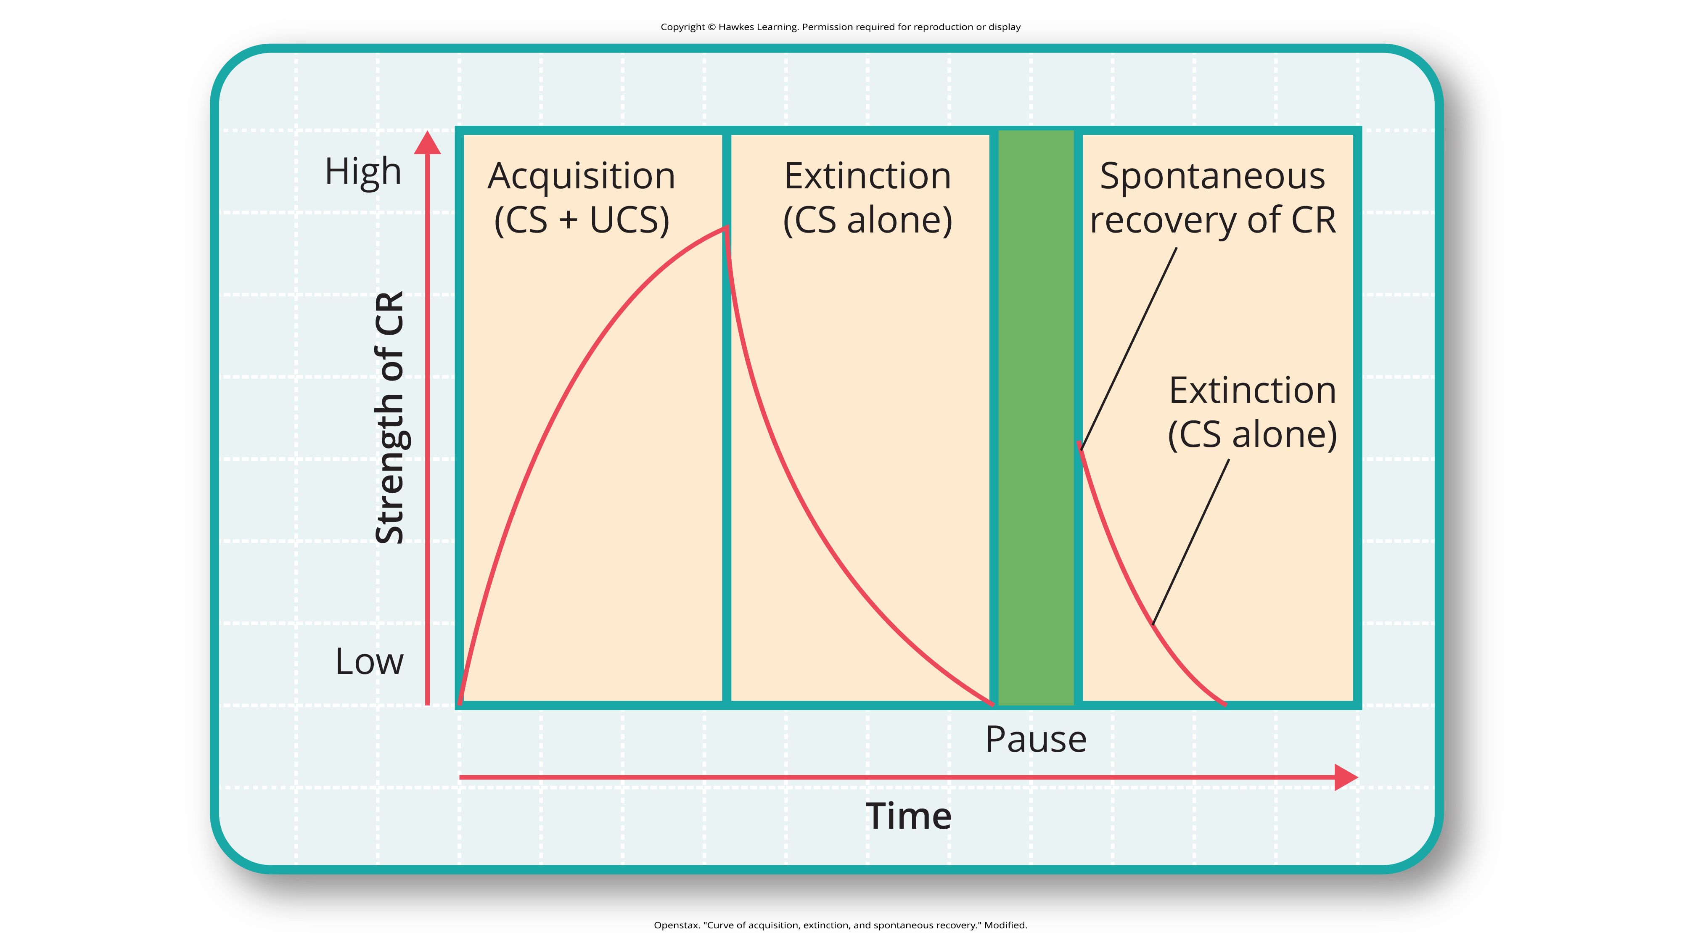
Lesson 5.2 Figure 5
Caption: This is the curve of acquisition, extinction, and spontaneous recovery. The rising curve shows the conditioned response quickly getting stronger through the repeated pairing of the conditioned stimulus and the unconditioned stimulus (acquisition). Then the curve decreases, which shows how the conditioned response weakens when only the conditioned stimulus is presented (extinction). After a break or pause from conditioning, the conditioned response reappears (spontaneous recovery).

Slide 14
General Processes In Classical Conditioning₂
Stimulus discrimination: ability to respond differently to similar stimuli
Stimulus generalization: demonstrating the conditioned response to stimuli that are similar to the conditioned stimulus
Habituation: when we learn not to respond to a stimulus that is presented repeatedly without change
Over time, we ignore a stimulus that occurs repeatedly without any change.
Classical conditioning involves both the strengthening and weakening of learned associations.

Slide 15
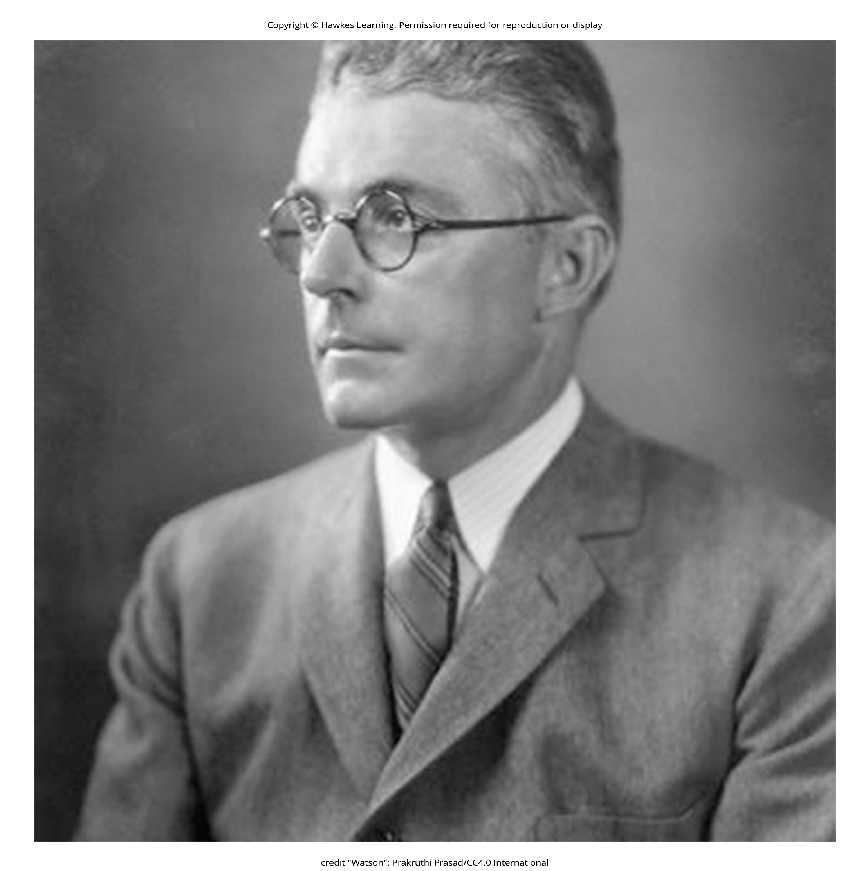
Behaviorism₁
John B. Watson founded behaviorism, focusing on observable behavior and stimulus-response reactions.
Behaviorism arose during the first part of the 20th century, which incorporates elements of Pavlov's classical conditioning (Hunt, 2007).
Watson believed human behavior results from conditioned responses, similar to animal behavior.
Figure 6

Slide 16
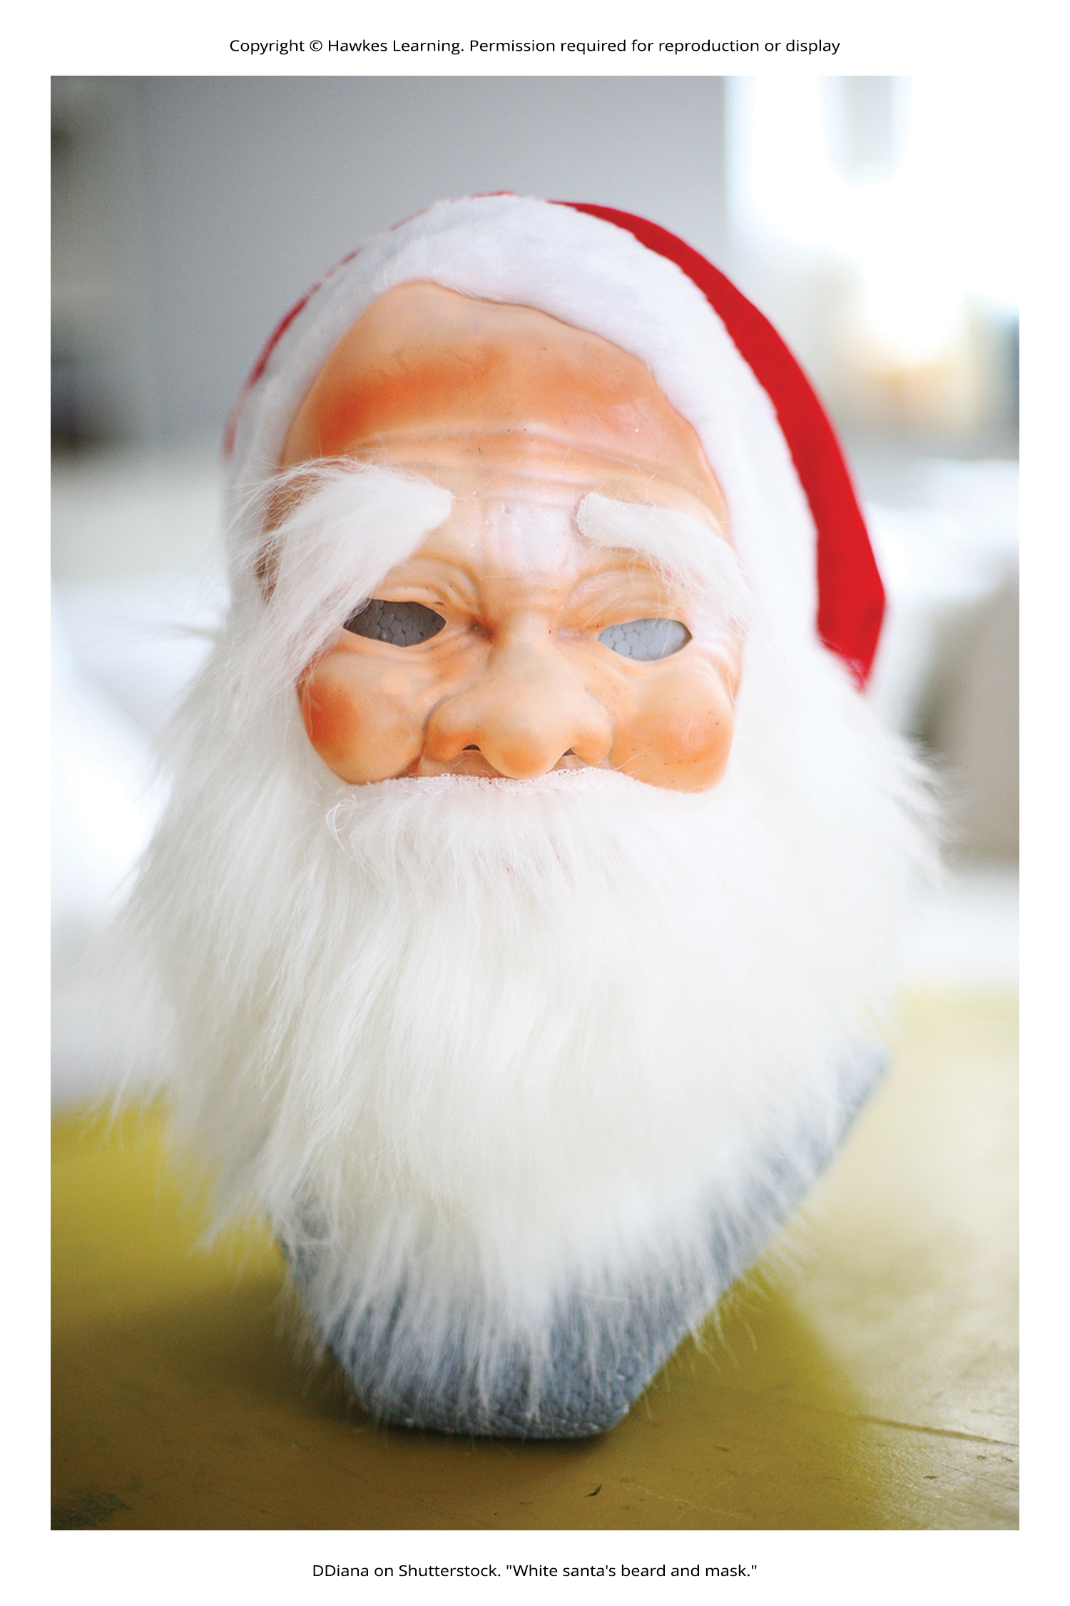
Behaviorism₂
In collaboration with Rosalie Rayner, Watson conducted the Little Albert experiment to condition fear.
Little Albert initially showed no fear of neutral stimuli like a rabbit, dog, monkey, masks, cotton wool, and a white rat.
Watson and Rayner paired the white rat with a loud, frightening noise, causing Little Albert to associate the rat with fear.
After conditioning, Little Albert also became afraid of similar furry objects, demonstrating stimulus generalization.
The experiment showed that emotions could be conditioned responses, aiming to create a phobia through conditioning.
Figure 7

Slide 17
Everyday Connection: Advertising And Associative Learning
Advertisers use principles of associative learning to promote products.
They cancel contracts with celebrities involved in scandals.
Scandals make celebrities lose their association with positive feelings.
Without positive associations, celebrities can't condition the public to feel positively about the product.
Now that you are aware of how associative learning works, will you be able to identify examples of these types of advertisements on television, social media, or YouTube?

Slide 18
Group Activity
Watson's experiment is considered unethical by today's standards. As a group, identify the modern standards that would be violated by this experiment today.

Slide 19
Summary
Pavlov's experiments with dogs explored classical conditioning.
Classical conditioning involves learning to associate events that repeatedly occur together.
Pavlov demonstrated how stimulus-response bonds are formed.
Watson, influenced by Pavlov, conditioned fear in an infant known as Little Albert.
Watson's findings suggest classical conditioning can explain the development of some fears.

Slide 20
End of Hawkes Learning PowerPoint

