Slide 1
Lesson 5.3
Operant Conditioning

Slide 2
Operant Conditioning
Operant conditioning: form of learning in which the stimulus/experience happens after the behavior is demonstrated
Organisms learn to associate behavior and its consequence.
A pleasant consequence makes that behavior more likely to be repeated in the future.

Slide 3
Classical Conditioning Vs. Operant Conditioning
Classical conditioning
Conditioning approach: An unconditioned stimulus (such as food) is paired with a neutral stimulus (such as a bell). The neutral stimulus eventually becomes the conditioned stimulus, which brings about the conditioned response (salivation).
Stimulus timing: The stimulus occurs immediately before the response.
Operant conditioning
Conditioning approach: The target behavior is followed by reinforcement or punishment to either strengthen or weaken it so that the learner is more or less likely to exhibit the behavior in the future.
Stimulus timing: The stimulus (either reinforcement or punishment) occurs soon after the response.

Slide 4
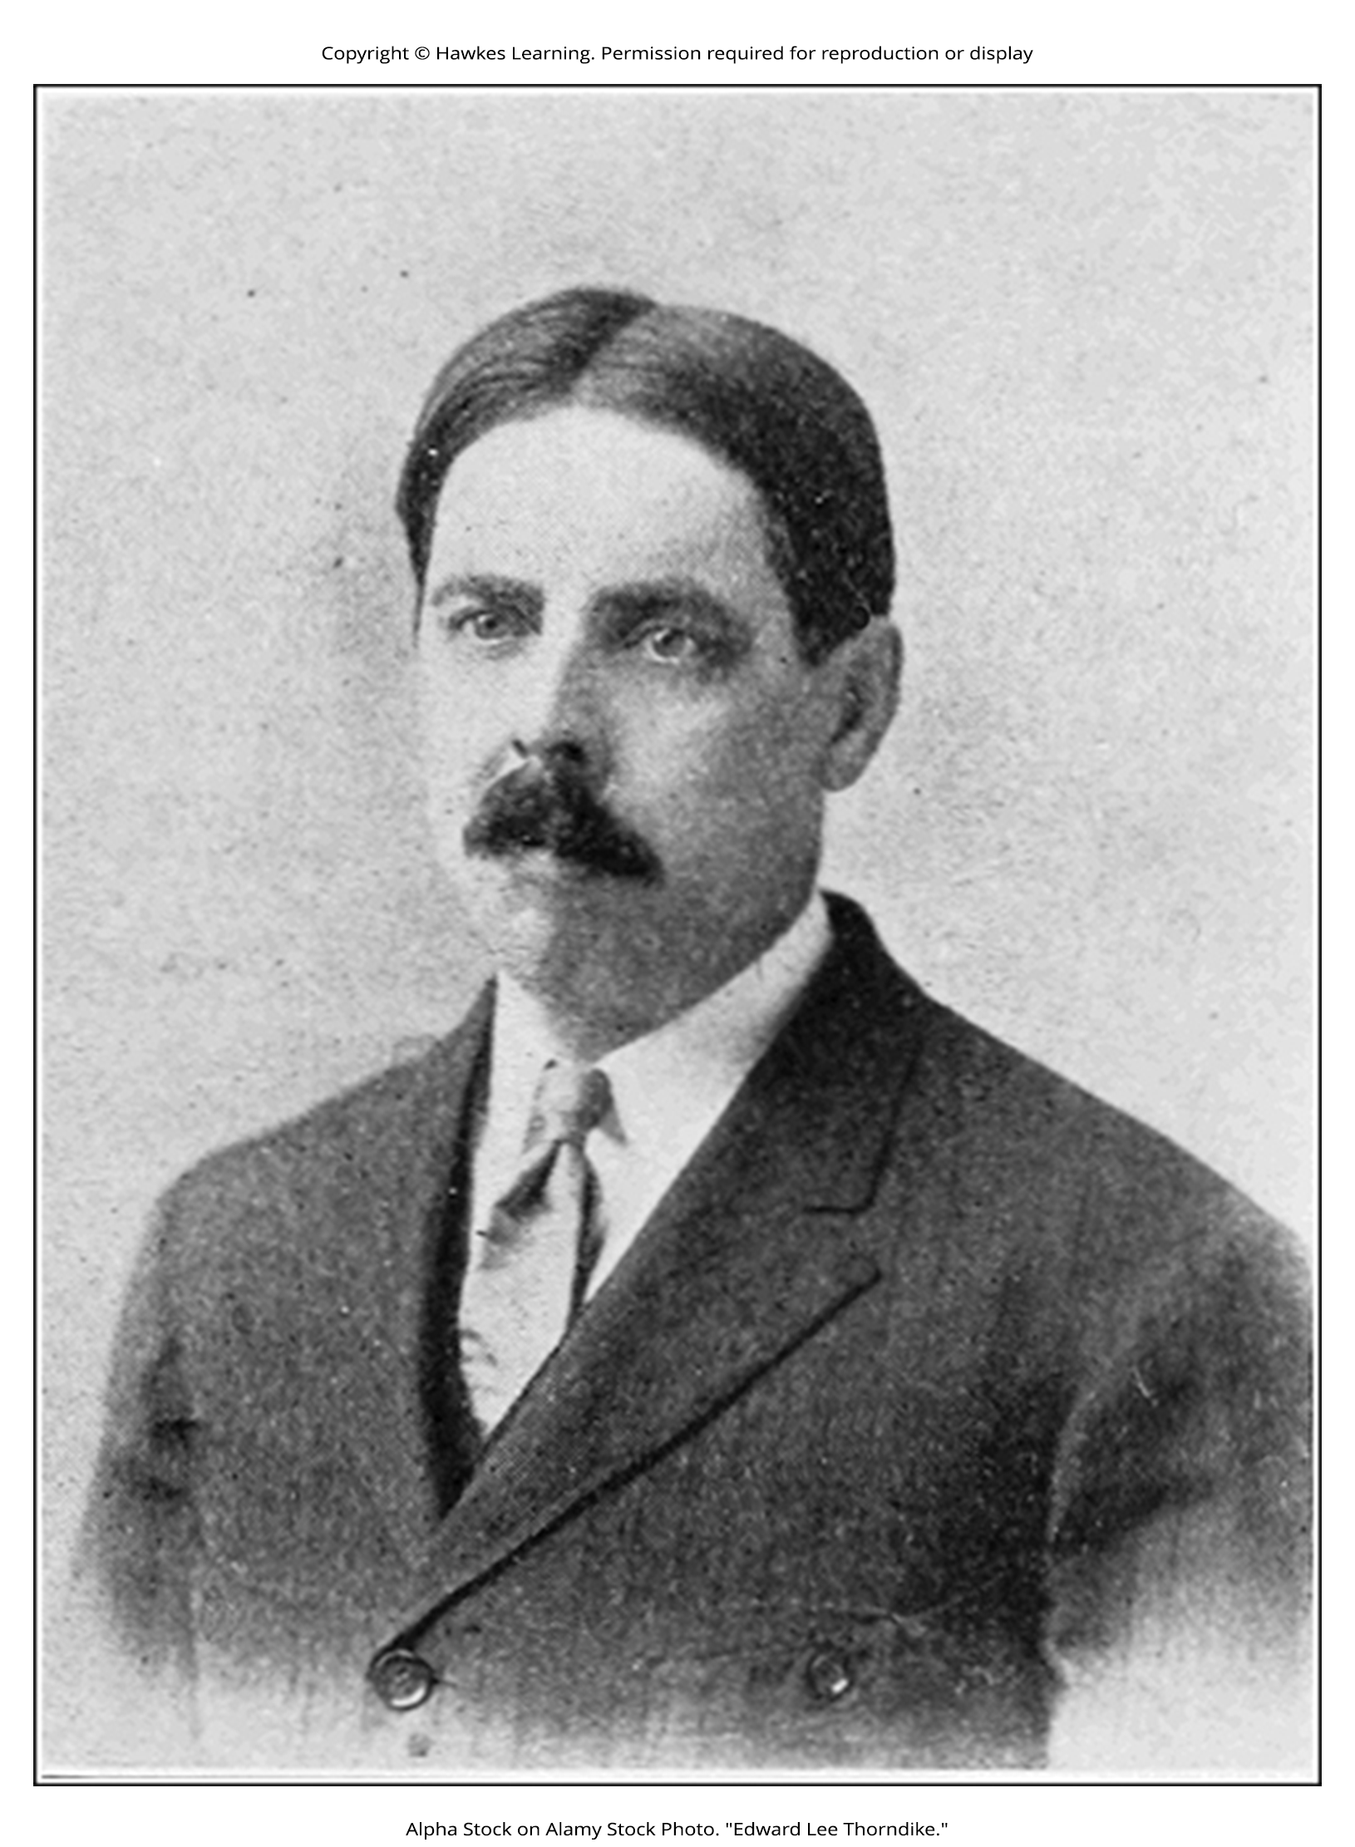
Law Of Effect₁
Skinner believed that behavior is motivated by the consequences we receive for the behavior: the reinforcements and punishments.
His idea that learning is the result of consequences is based on the law of effect, which was first proposed by psychologist Edward Thorndike.
Law of effect: behavior that is followed by consequences satisfying to the organism will be repeated, and behaviors that are followed by unpleasant consequences will be discouraged
Figure 1

Slide 5
Law Of Effect₂
Behaviors that are followed by consequences that are satisfying to the organism are more likely to be repeated.
If an organism does something that brings about a desired result, the organism is more likely to do it again.
If an organism does something that does not bring about a desired result, the organism is less likely to do it again.

Slide 6
Reflection Question₁
Edward Thorndike (1898) tested the law of effect by placing cats in puzzle boxes that had to be manipulated in order for the cat to escape. How do you think the cats' behaviors differed from the first time in the box, to the fifth, to the final trial?

Slide 7
"Skinner Box"
Skinner began conducting scientific experiments on animals (mainly rats and pigeons) to determine how organisms learn through operant conditioning (Skinner, 1938).
He placed these animals inside an operant conditioning chamber, which has come to be known as a "Skinner box" (Figure 2).
A Skinner box contains a lever (for rats) or disk (for pigeons) that the animal can press or peck for a food reward via the dispenser.
Speakers and lights can be associated with certain behaviors.
A recorder counts the number of responses made by the animal.

Slide 8
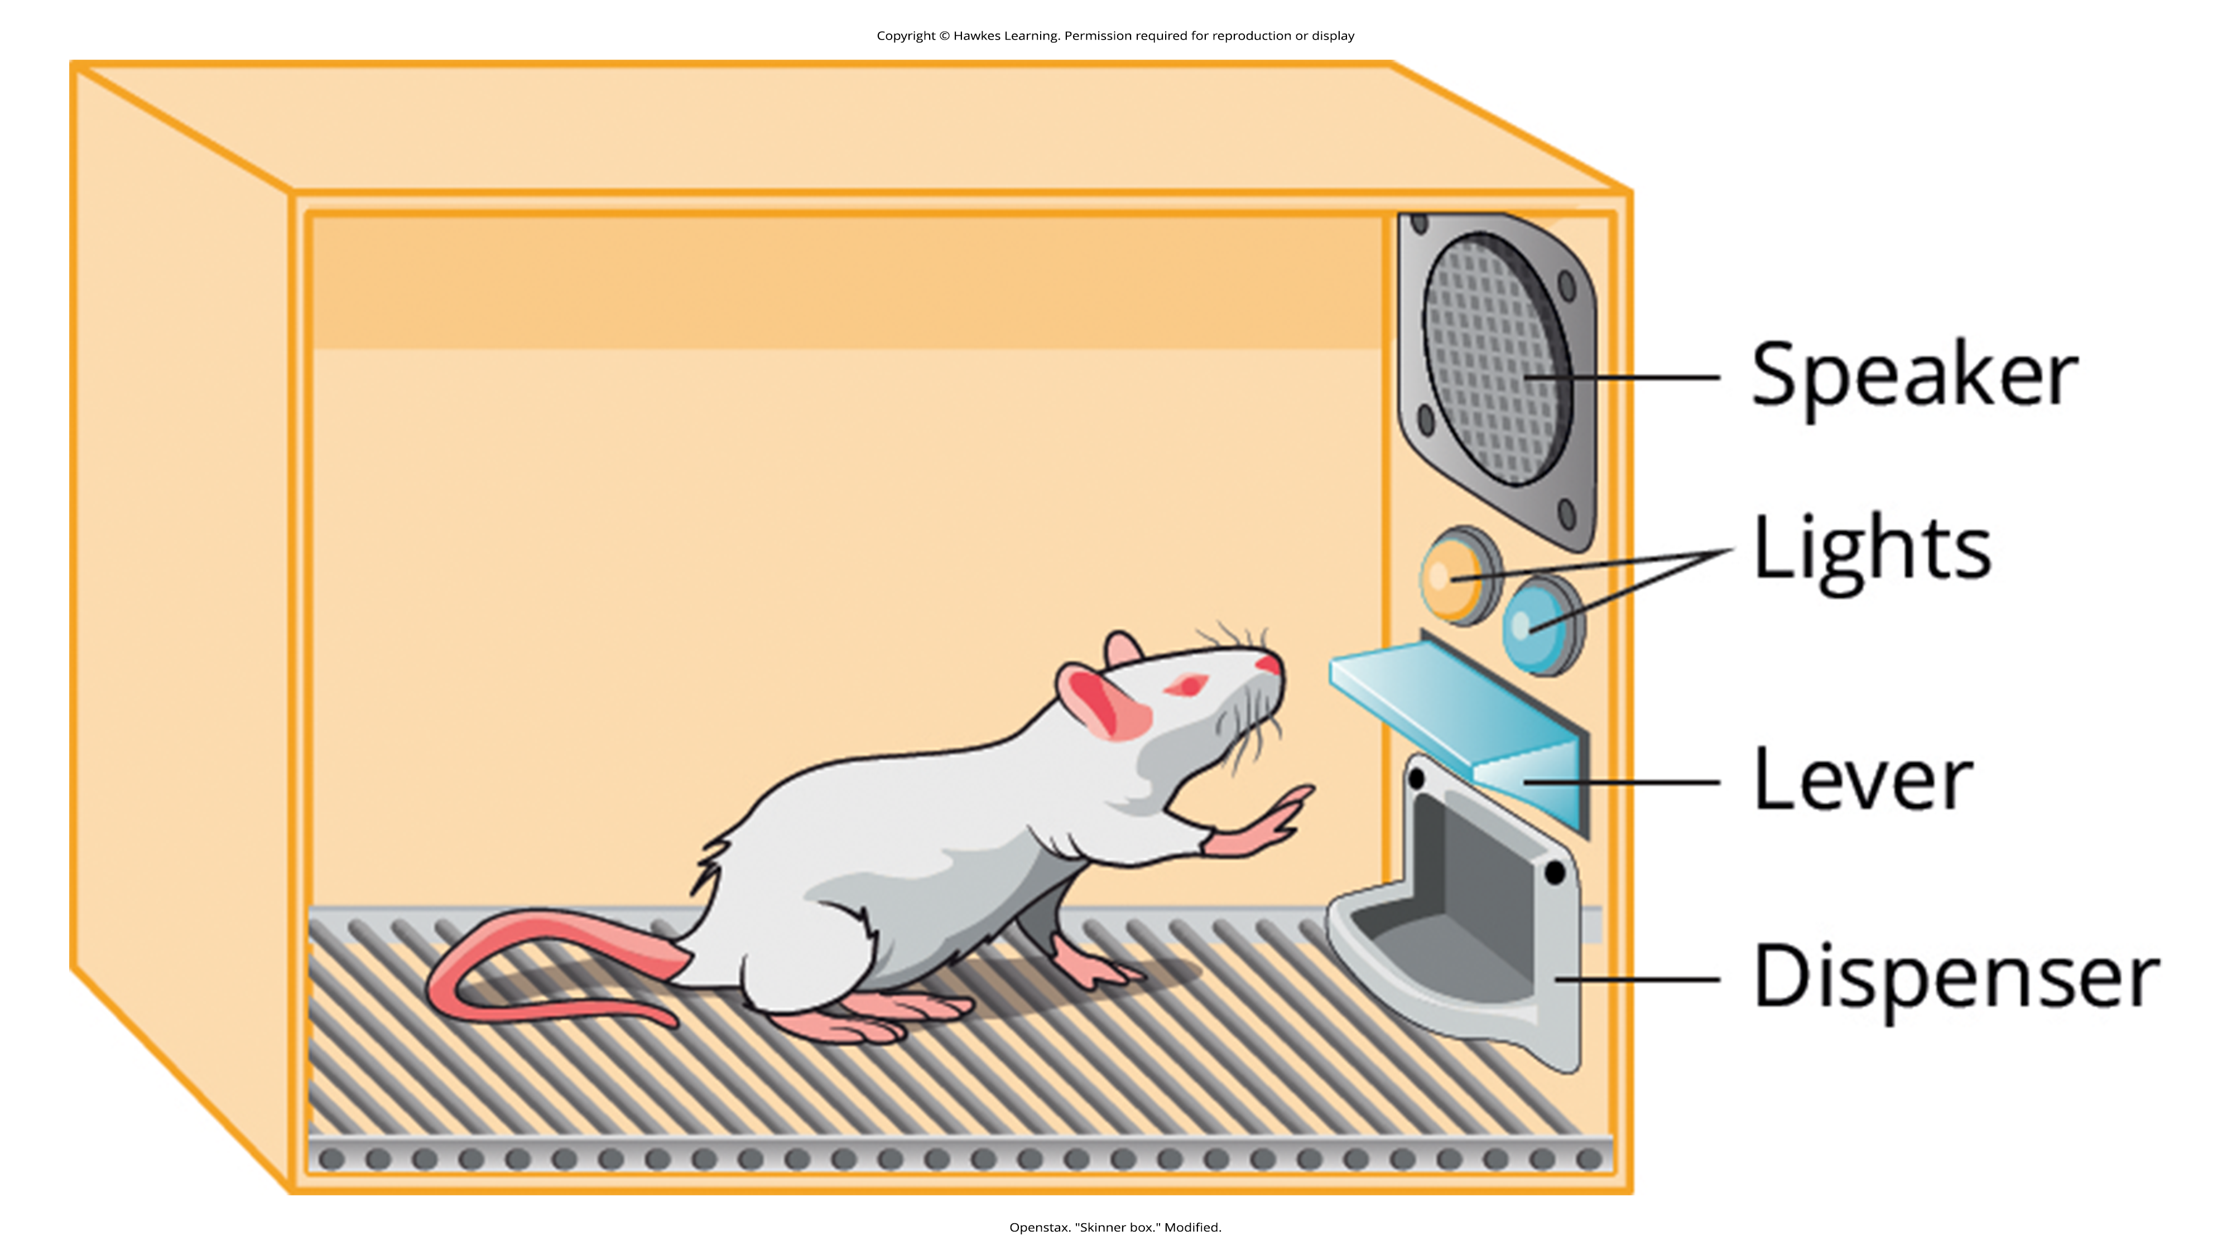
Lesson 5.3 Figure 2
Caption: B. F. Skinner developed operant conditioning for the systematic study of how behaviors are strengthened or weakened according to their consequences. In a Skinner box, a rat presses a lever in an operant conditioning chamber to receive a food reward.

Slide 9
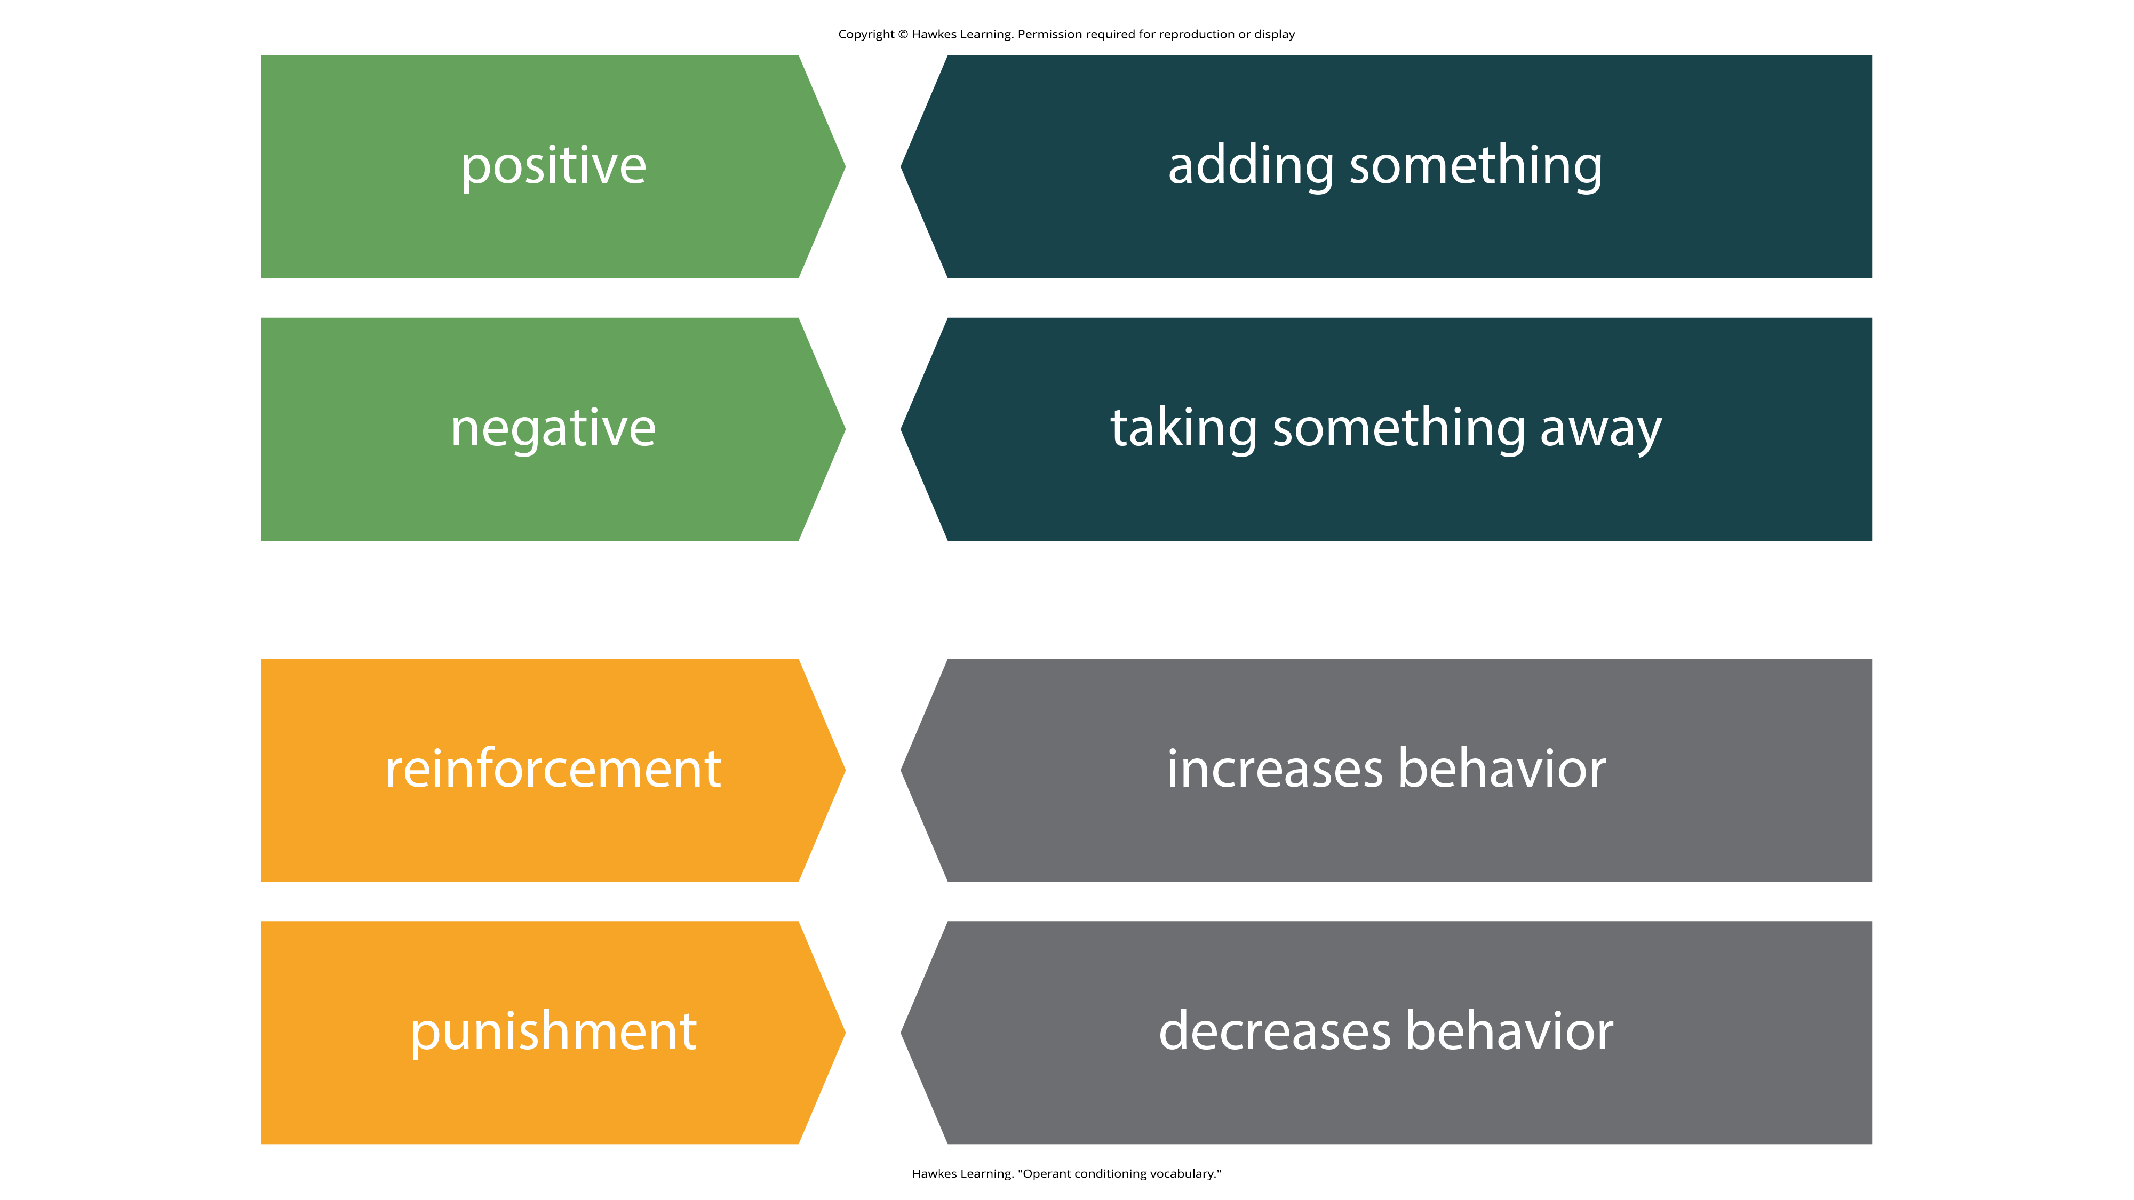
Lesson 5.3 Figure 3
Caption: It's important to grasp the specific vocabulary used in reference to operant conditioning.

Slide 10
Reinforcement Vs. Punishment
Reinforcement can be positive or negative.
Punishment can be positive or negative.
All reinforcers (positive or negative) increase the likelihood of a behavioral response.
All punishers (positive or negative) decrease the likelihood of a behavioral response.

Slide 11
Positive And Negative Reinforcement
Positive:
Something is added to increase the likelihood of a behavior.
Negative:
Something is removed to increase the likelihood of a behavior.

Slide 12
Positive And Negative Punishment
Positive
Something is added to decrease the likelihood of a behavior.
Negative
Something is removed to decrease the likelihood of a behavior.

Slide 13
Reinforcement
The most effective way to teach a person or animal a new behavior is with positive reinforcement.
There are two types of reinforcement: positive and negative.
Reinforcement: implementation of a consequence in order to increase behavior

Slide 14

Positive Reinforcement
A desirable stimulus is added to increase behavior.
Example: If he cleans his room, 5-year-old Jerome gets a toy.
Example: Janine gets paid $5 for each A she earns on her report card.
Positive reinforcement as a learning tool is extremely effective.
Figure 4

Slide 15
Reflection Question₂
In 1998, a book about the Nurtured Heart approach hit shelves. Within the book, the authors described a method by which parents should notice each time their children acted in non-disruptive ways and to reward that behavior by commenting or actively seeing the child in those times of good (or neutral) behavior. What would Skinner think about this program?

Slide 16
Negative Reinforcement
In negative reinforcement, an undesirable stimulus is removed to increase a behavior.
Example: Car manufacturers use the principles of negative reinforcement in their seatbelt systems, which beep loudly and repeatedly until you fasten your seatbelt.

Slide 17
On Your Own
Provide examples of positive and negative reinforcement that you've experienced or used in your own life.

Slide 18
Punishment
Negative reinforcement is different than punishment.
Even when reinforcement is negative, it always increases behavior.
Punishment always decreases a behavior.
Punishment: implementation of a consequence in order to decrease behavior
Punishment can be positive or negative.

Slide 19
Positive Punishment
Positive punishment: adding an undesirable stimulus to stop or decrease a behavior
Example: scolding a student to get the student to stop texting in class
A stimulus (the reprimand) is added in order to decrease the behavior (texting in class).

Slide 20
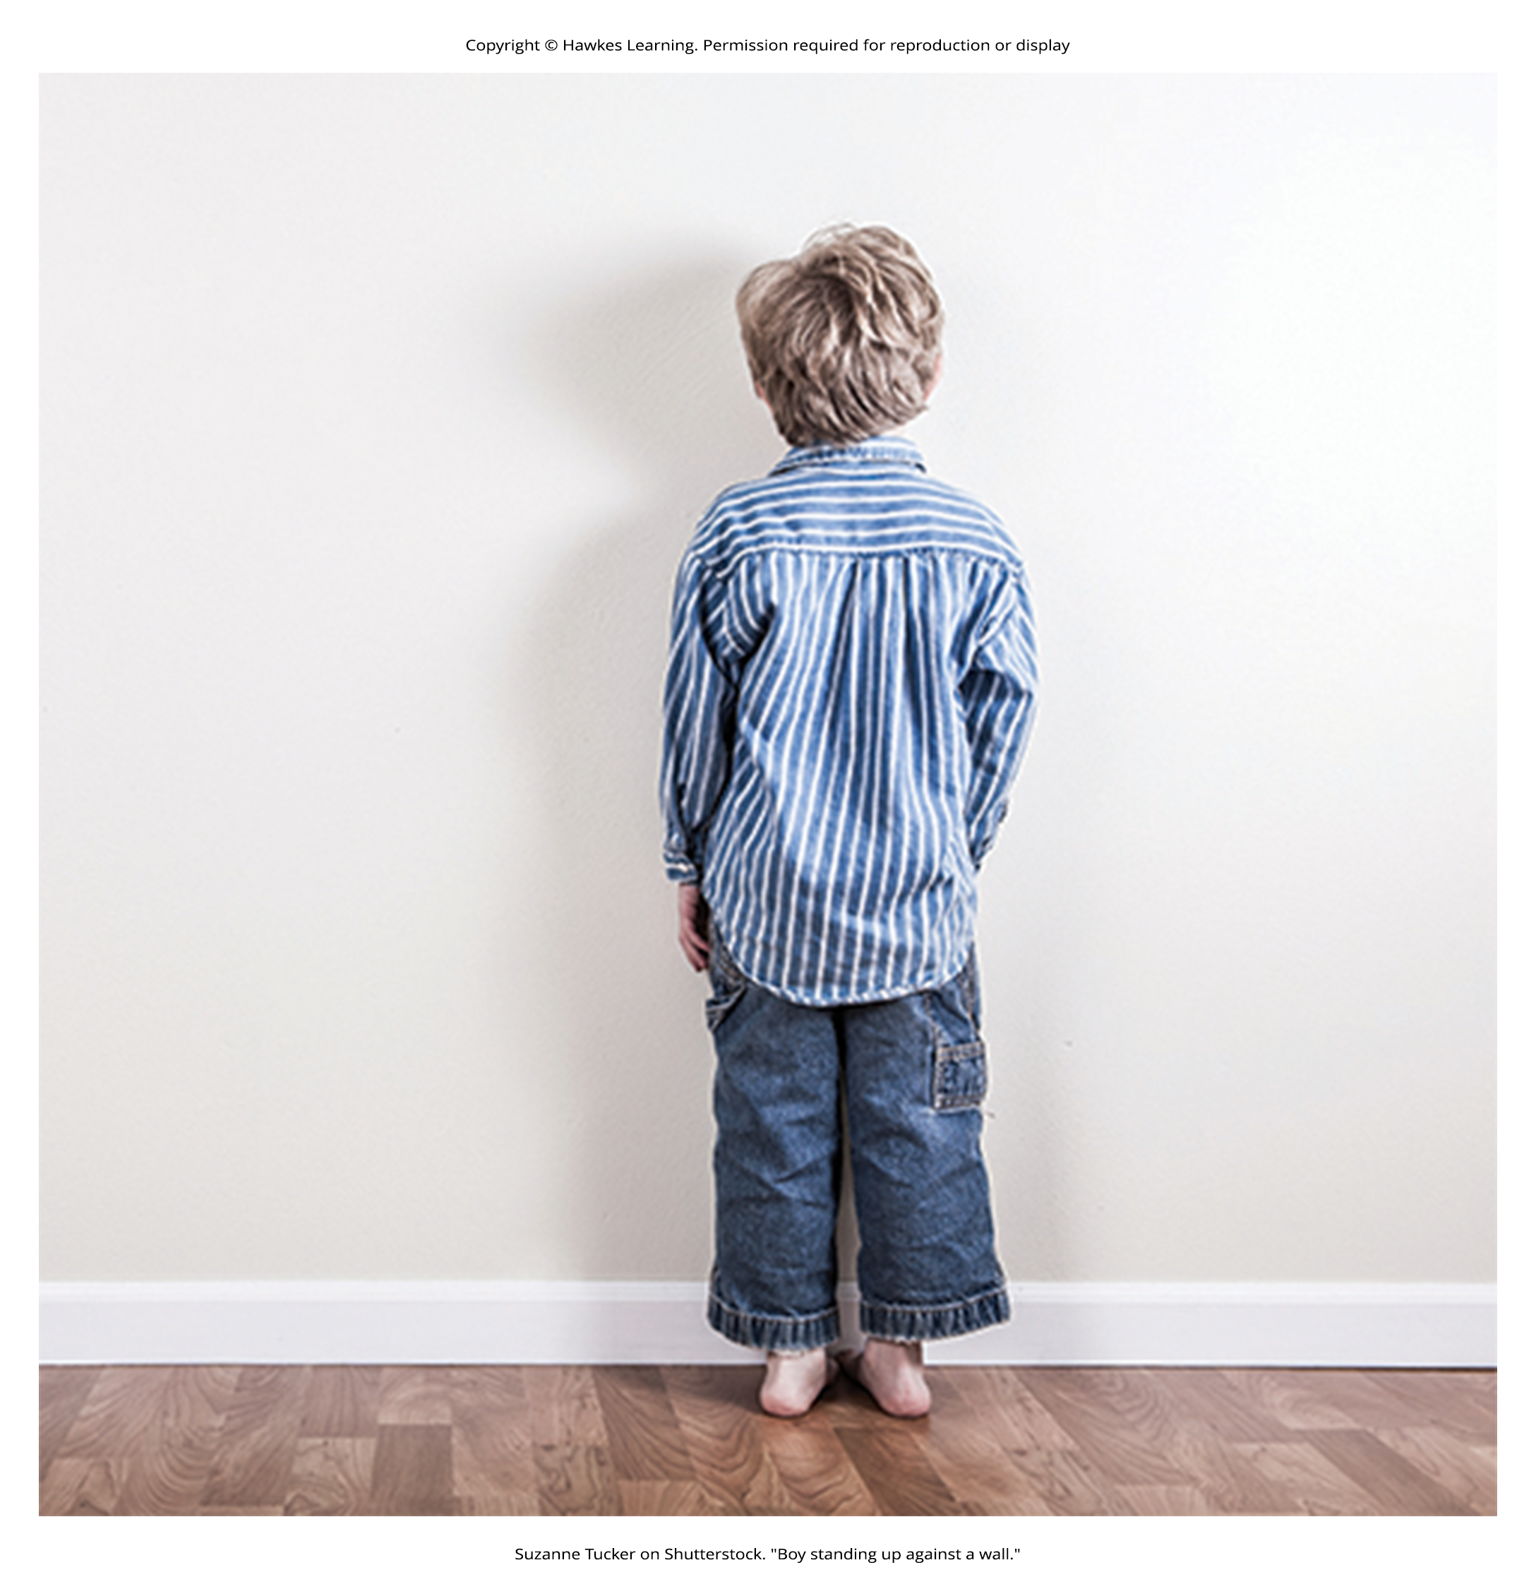
Negative Punishment
Negative punishment: taking away a pleasant stimulus to decrease or stop a behavior
Example: a child misbehaves and a parent takes away a favorite toy
A stimulus (the toy) is removed in order to decrease the behavior.
Figure 5

Slide 21
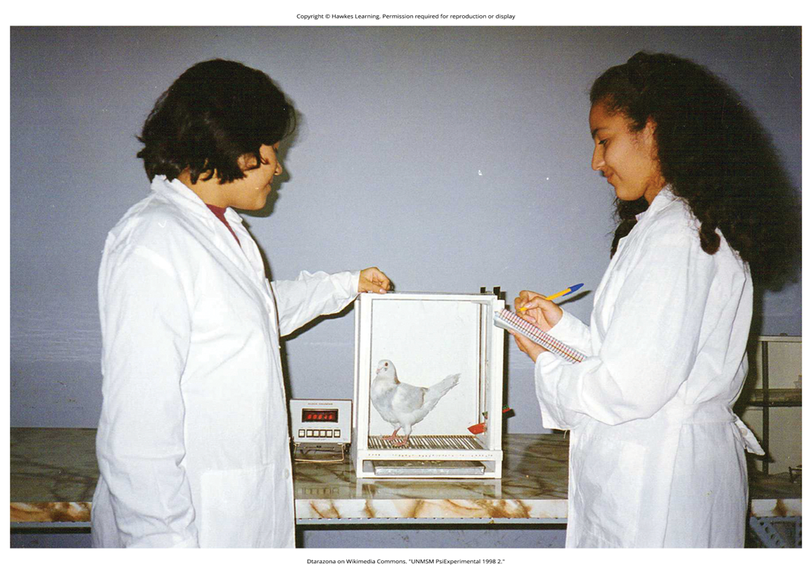
Shaping
Shaping was an approach used by Skinner.
Shaping: rewarding successive approximations toward a target behavior
Shaping is needed because it is extremely unlikely that an organism will display anything but the simplest of behaviors spontaneously.
In shaping, behaviors are broken down into many small, achievable steps.
Shaping is often used in teaching a complex behavior or chain of behaviors.
An important part of shaping is stimulus discrimination.
Figure 6

Slide 22
Process Of Shaping
Reinforce any response that resembles the desired behavior.
Then reinforce the response that more closely resembles the desired behavior. You will no longer reinforce the previously reinforced response.
Next, begin to reinforce the response that even more closely resembles the desired behavior.
Continue to reinforce closer and closer approximations of the desired behavior.
Finally, only reinforce the desired behavior.

Slide 23
Group Activity
Brainstorm how you would use shaping to train a dog to fetch a newspaper from the curb and bring it back into the house.

Slide 24
Reflection Question₃
How could shaping be applied to humans? For example, let's say you wanted to shape your roommate to clean up after themselves. How would you do this?

Slide 25
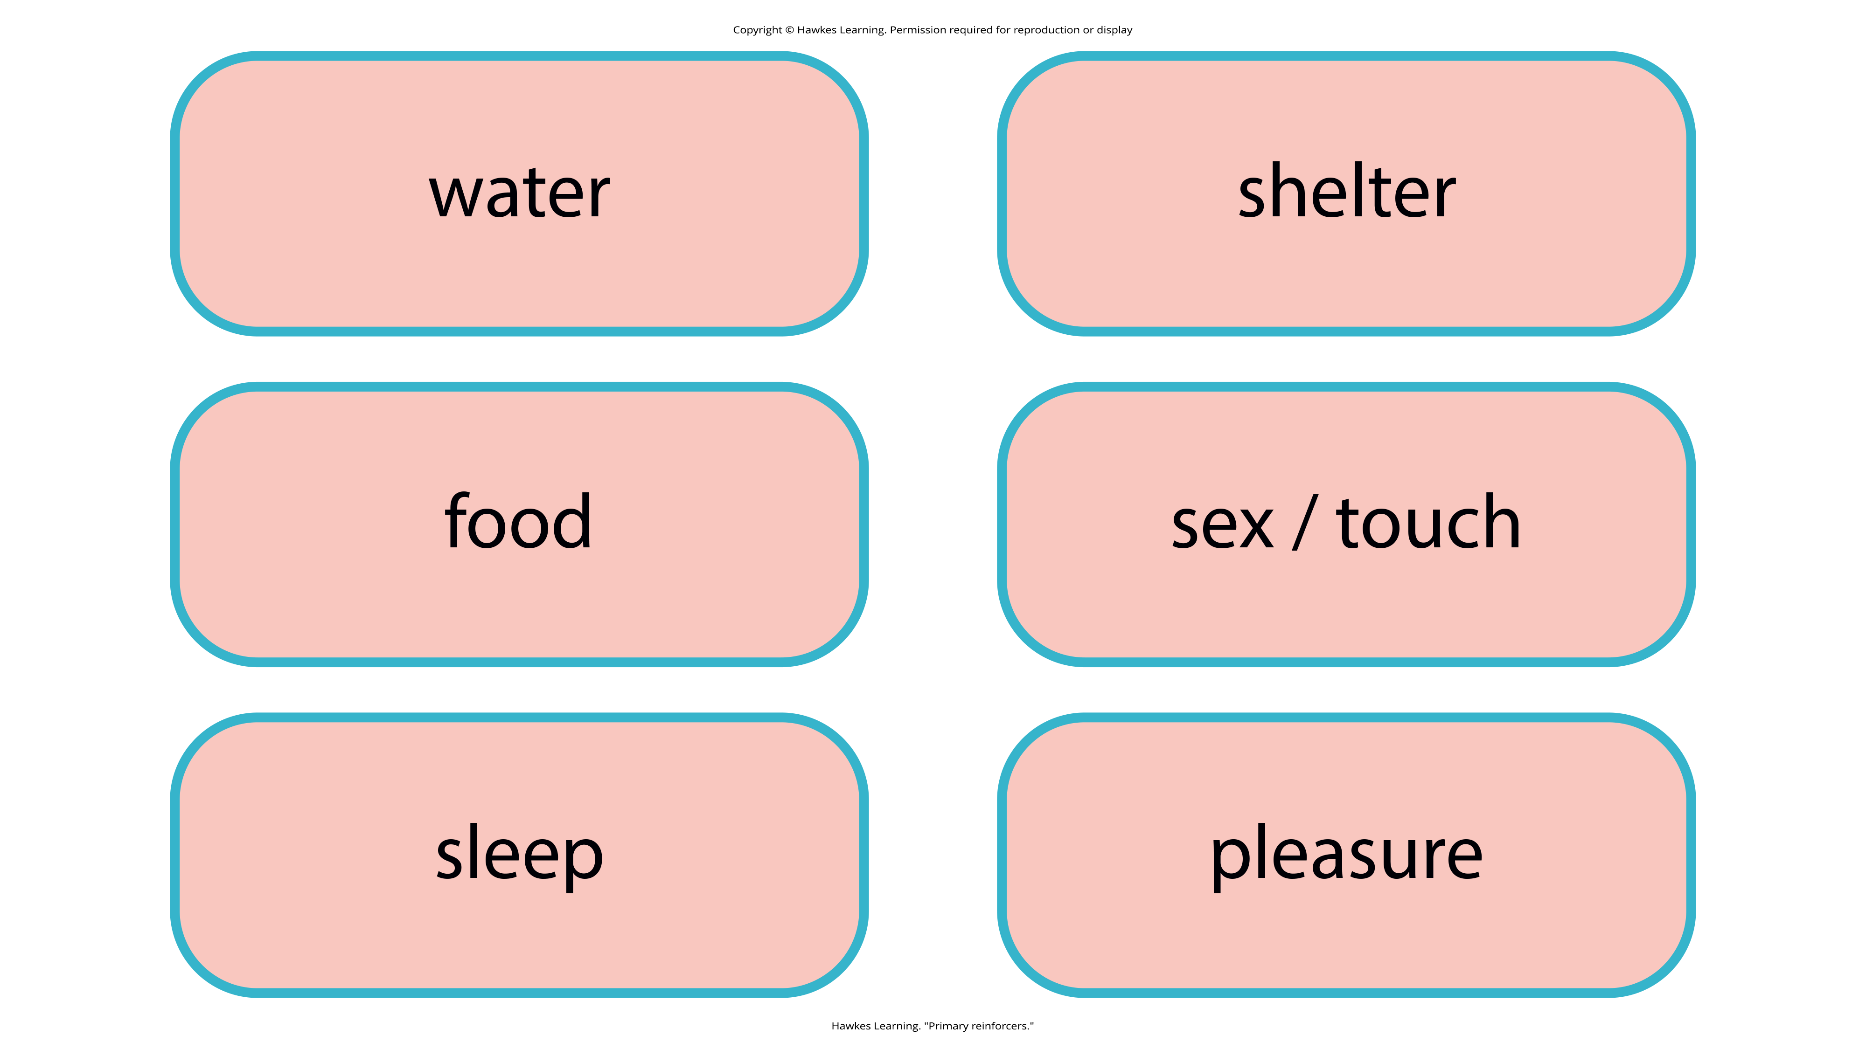
Primary Reinforcers₁
Primary reinforcers are reinforcers that have innate reinforcing qualities.
Primary reinforcers are not learned.
Figure 7

Slide 26
Primary Reinforcers₂
Organisms do not lose their drive for these primary reinforcers.
Example: For most people, jumping in a cool lake on a very hot day would be reinforcing, and the cool lake would be innately reinforcing; the water would cool the person off (a physical need), as well as provide pleasure.

Slide 27

Secondary Reinforcers
A secondary reinforcer has no inherent value and only has reinforcing qualities when linked with a primary reinforcer.
Example: Money, is only worth something when you can use it to buy other things—either things that satisfy basic needs (food, water, shelter—all primary reinforcers) or other secondary reinforcers.
Figure 8

Slide 28
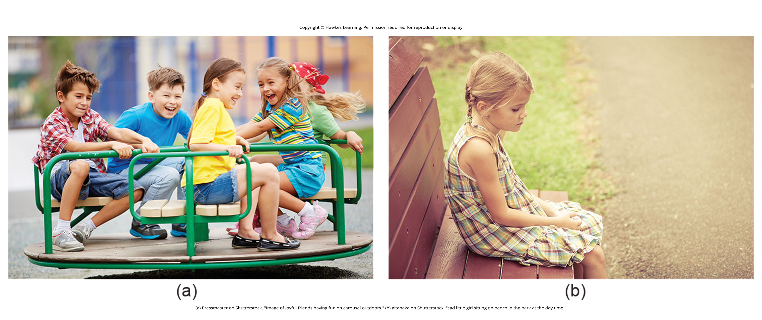
Everyday Connection: Behavior Modification In Children
Parents and teachers use behavior modification to change a child's behavior.
Behavior modification uses operant conditioning principles to replace undesirable behaviors with more acceptable ones.
Sticker charts are a form of token economies used to reinforce desired behaviors.
Time-out operates on the principle of negative punishment by removing the child from a desirable activity.
Guidelines for effective time-out include removing the child from a desirable activity, timing it appropriately, and remaining calm.
Figure 9

Slide 29
Reinforcement Schedules
The best way to teach a person or animal a behavior is to use positive reinforcement.
Example: Skinner used positive reinforcement to teach rats to press a lever in a Skinner box.
Types of reinforcement schedules include:
Continuous reinforcement
Partial reinforcement
Fixed interval reinforcement schedule
Variable interval reinforcement schedule
Fixed ratio reinforcement schedule
Variable ratio reinforcement schedule

Slide 30
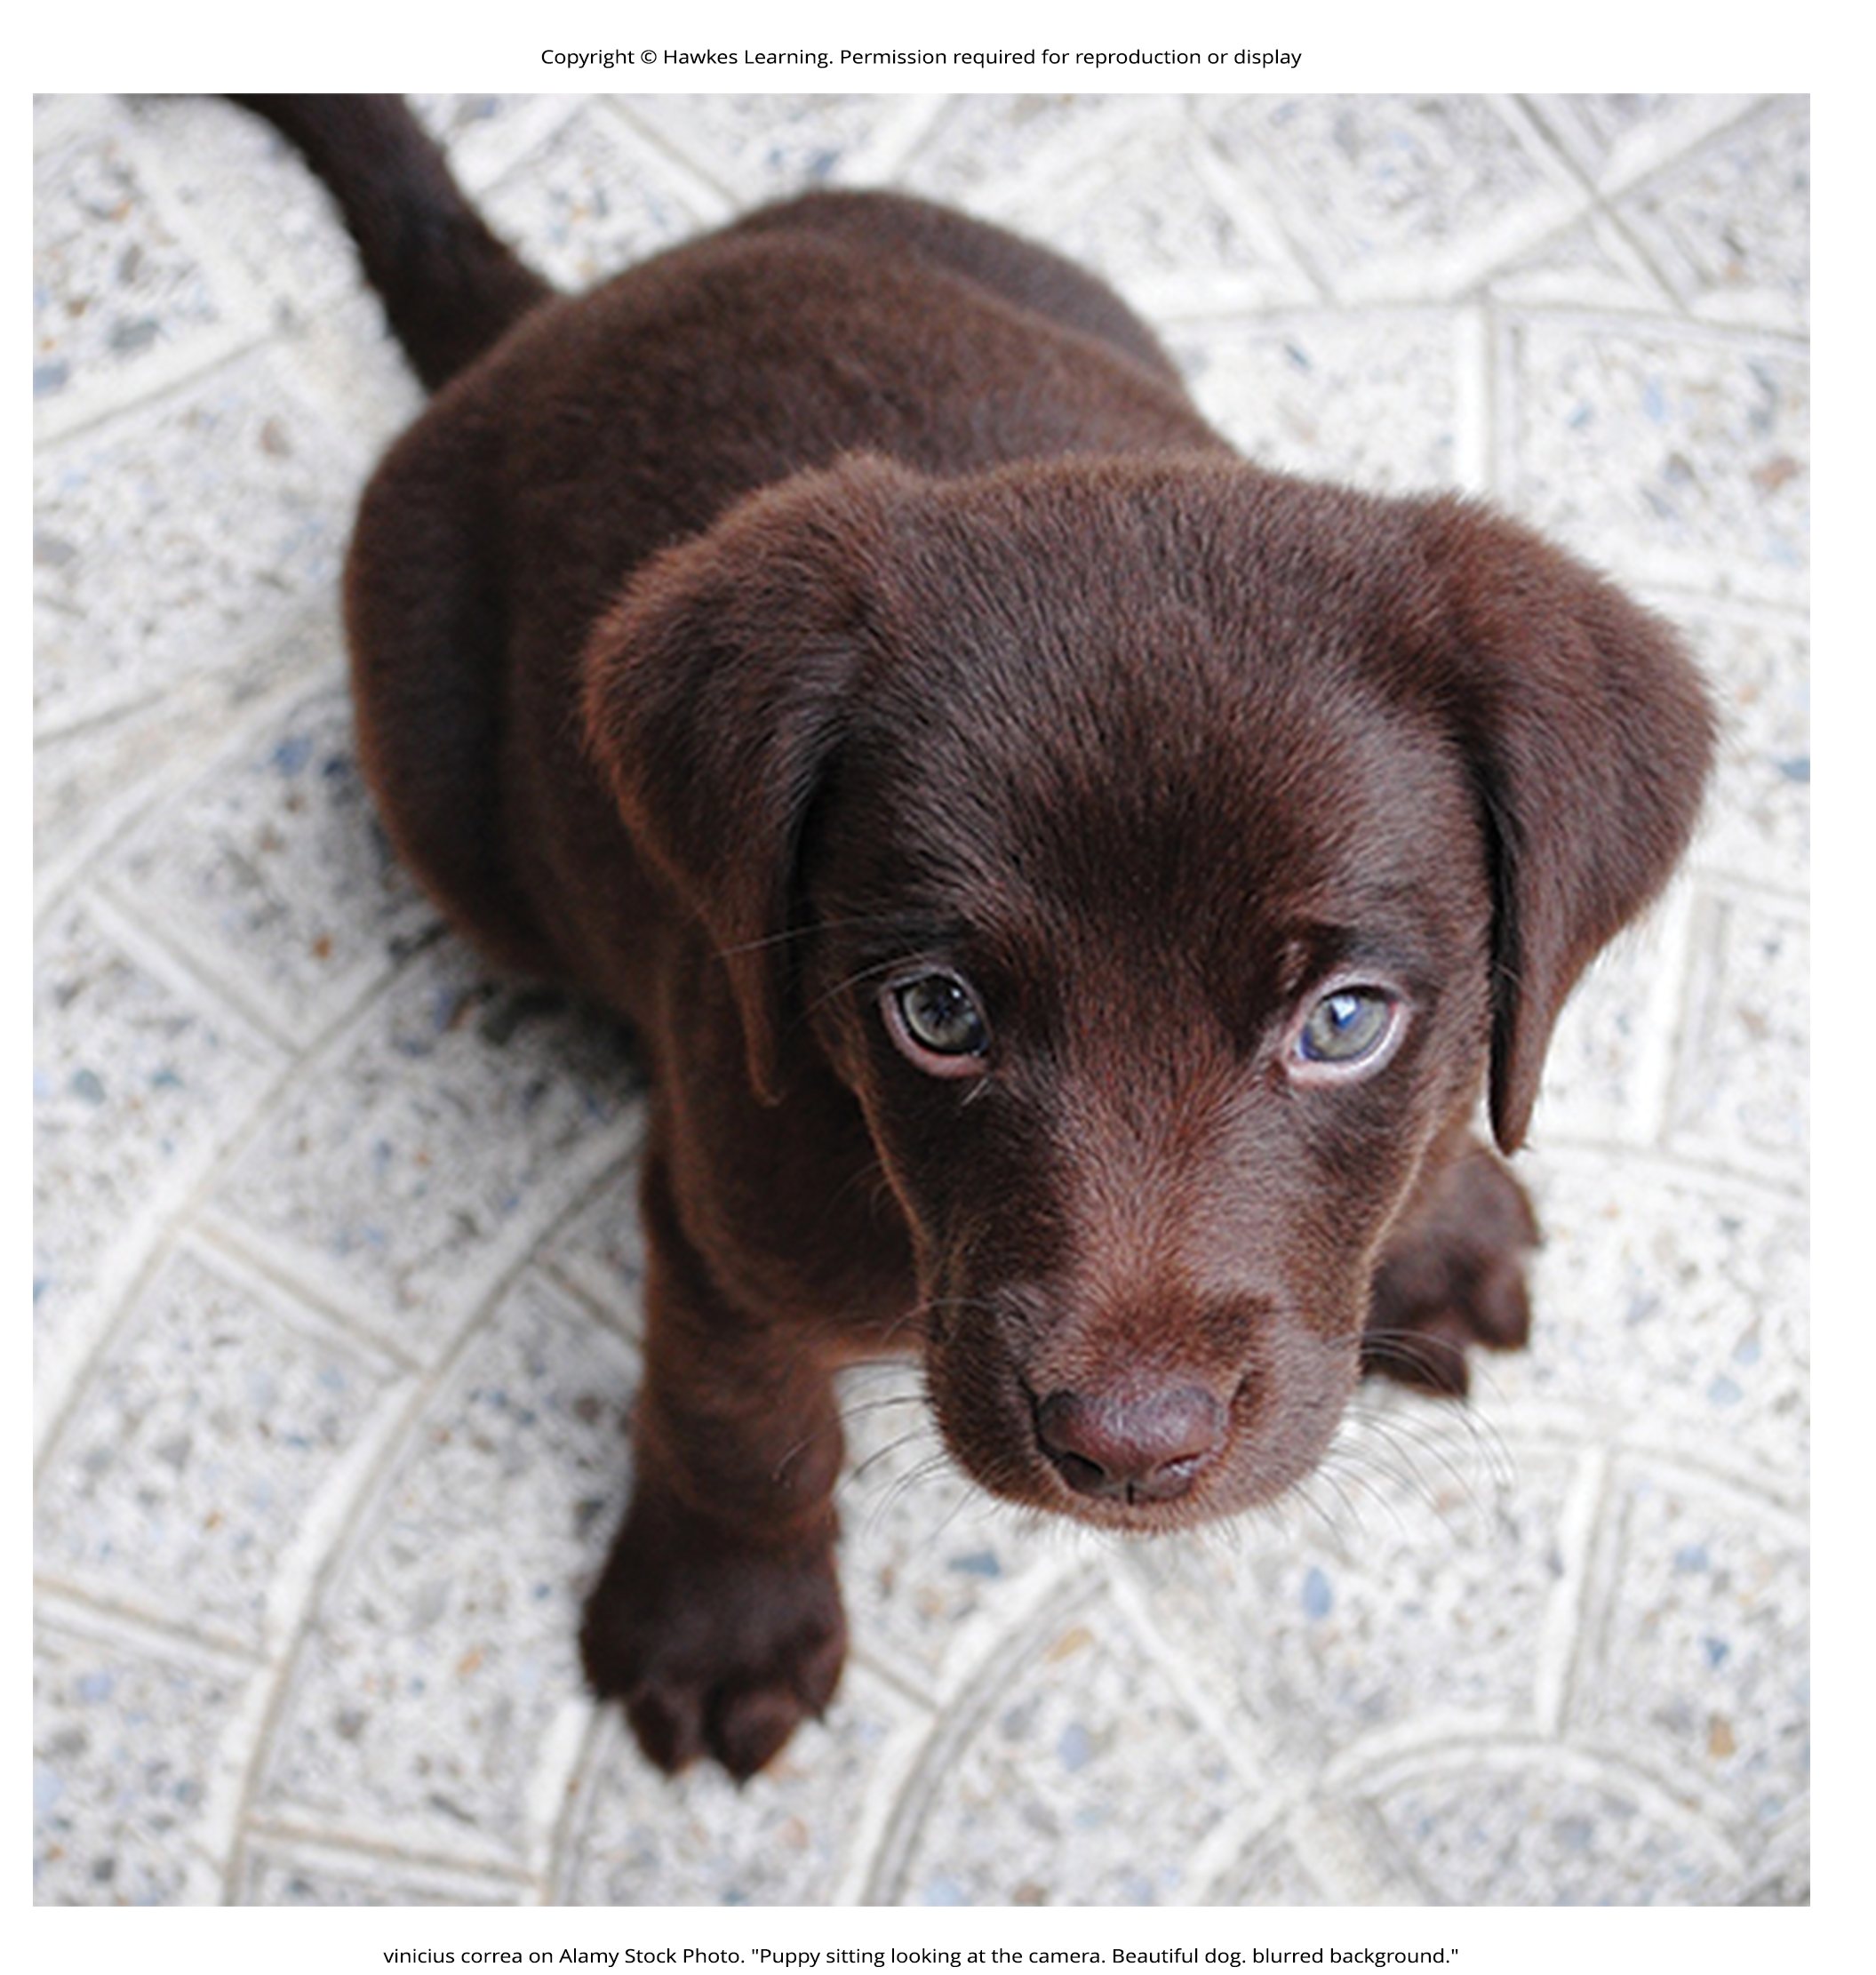
Continuous Reinforcement
Continuous reinforcement: rewarding a behavior every time it occurs
Quickest way to teach someone a behavior
Effective in training a new behavior
Example: a dog learning to sit and each time he sits, you give him a treat
Timing is important, you will be most successful if you present the reinforcer immediately after he sits, so that he can make an association between the target behavior (sitting) and the consequence (getting a treat)
Figure 10

Slide 31
Partial Reinforcement
Partial reinforcement: rewarding behavior only some of the time
Also referred to as intermittent reinforcement
Several types of partial reinforcement
Fixed: refers to the number of responses between reinforcements or the amount of time between reinforcements
Variable: refers to the number of responses or amount of time between reinforcements, which varies or changes
Interval: the schedule is based on the time between reinforcements
Ratio: the schedule is based on the number of responses between reinforcements

Slide 32
Fixed Interval Reinforcement Schedule
Fixed interval reinforcement schedule: behavior is rewarded after a set amount of time
Example: June undergoes major surgery in a hospital.
During recovery, she is expected to experience pain and will require prescription medications for pain relief.
June is given an IV drip with a patient-controlled painkiller.
Her doctor sets a limit: one dose per hour.
June pushes a button when pain becomes difficult, and she receives a dose of medication.
Since the reward (pain relief) only occurs on a fixed interval, there is no point in exhibiting the behavior when it will not be rewarded.

Slide 33
Variable Interval Reinforcement Schedule
Variable interval reinforcement schedule: behavior is rewarded after unpredictable amounts of time have passed
Example: Manuel is the manager at a fast-food restaurant.
Every once in a while, someone from the quality control division comes to Manuel's restaurant.
If the restaurant is clean and the service is fast, everyone on that shift earns a $20 bonus.
Manuel never knows when the quality control person will show up, so he always tries to keep the restaurant clean and ensures that his employees provide prompt and courteous service.
His productivity regarding prompt service and keeping a clean restaurant are steady because he wants his crew to earn the bonus.

Slide 34
Fixed Ratio Reinforcement Schedule
Fixed ratios are better suited to optimize the quantity of output, whereas a fixed interval, in which the reward is not quantity based, can lead to a higher quality of output.
Fixed ratio reinforcement schedule: set number of responses must occur before a behavior is rewarded
Example: Carla sells glasses at an eyeglass store, and she earns a commission every time she sells a pair of glasses.
She always tries to sell people more pairs of glasses, including prescription sunglasses or a backup pair, so she can increase her commission.
She does not care if the person really needs the prescription sunglasses; Carla just wants her bonus.
The quality of what Carla sells does not matter because her commission is not based on quality; it's only based on the number of pairs sold.

Slide 35
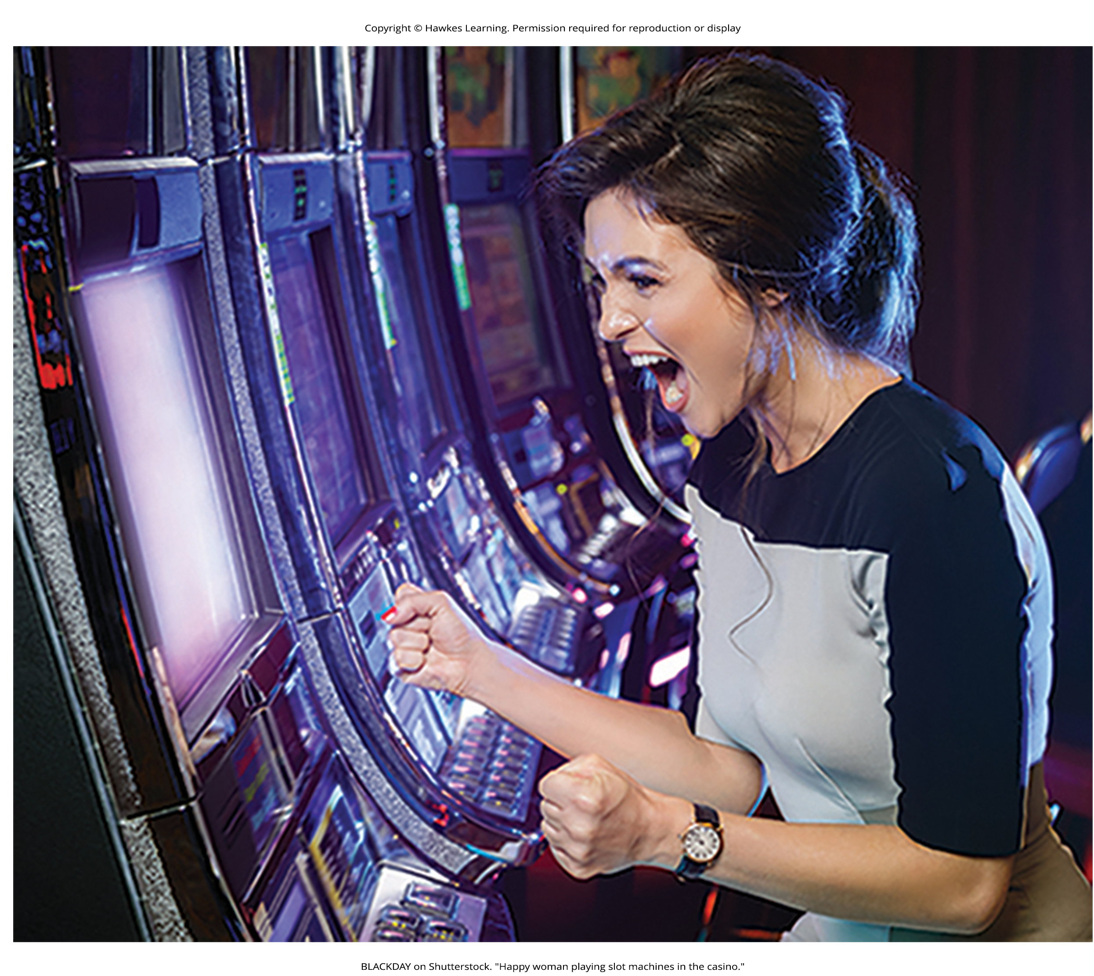
Variable Ratio Reinforcement Schedule
Variable ratio reinforcement schedule: number of responses differ before behavior is rewarded
This is the most powerful partial reinforcement schedule.
Example: gambling
Gabriela puts quarters into a slot machine out of curiosity.
The machine eventually pays out, reinforcing her behavior.
Despite losses, she continues gambling in hopes of a big win.
Gambling uses a variable ratio reinforcement schedule, which resists extinction.
The unpredictable payout schedule contributes to gambling's addictive nature.
Figure 11

Slide 36
Reinforcement Schedule Summary
In operant conditioning, extinction occurs when reinforcement stops.
The speed of extinction depends on the reinforcement schedule.
With a variable ratio schedule, extinction occurs very slowly.
With other schedules like fixed interval, extinction occurs quickly.
Variable ratio is most resistant to extinction, while fixed interval is easiest to extinguish.

Slide 37
Latent Learning
Experiments by Edward C. Tolman showed organisms can learn without immediate reinforcement
Conflicted with the idea that reinforcement must be immediate for learning to occur
Suggested a cognitive aspect to learning

Slide 38
Cognitive Maps
In Tolman's experiments, unreinforced rats developed a cognitive map, a mental picture of the maze layout.
After 10 sessions with no reinforcement, rats given food could quickly navigate the maze.
This demonstrated latent learning.
Learning that occurs but is not observable until there is a reason to demonstrate it

Slide 39
Latent Learning In Humans
Children may learn by watching parents but only demonstrate it later when needed.
Example: Ravi learns the route to school by being driven, then demonstrates knowledge by biking the same route.
Ravi had learned the route but had no need to demonstrate the knowledge earlier.

Slide 40
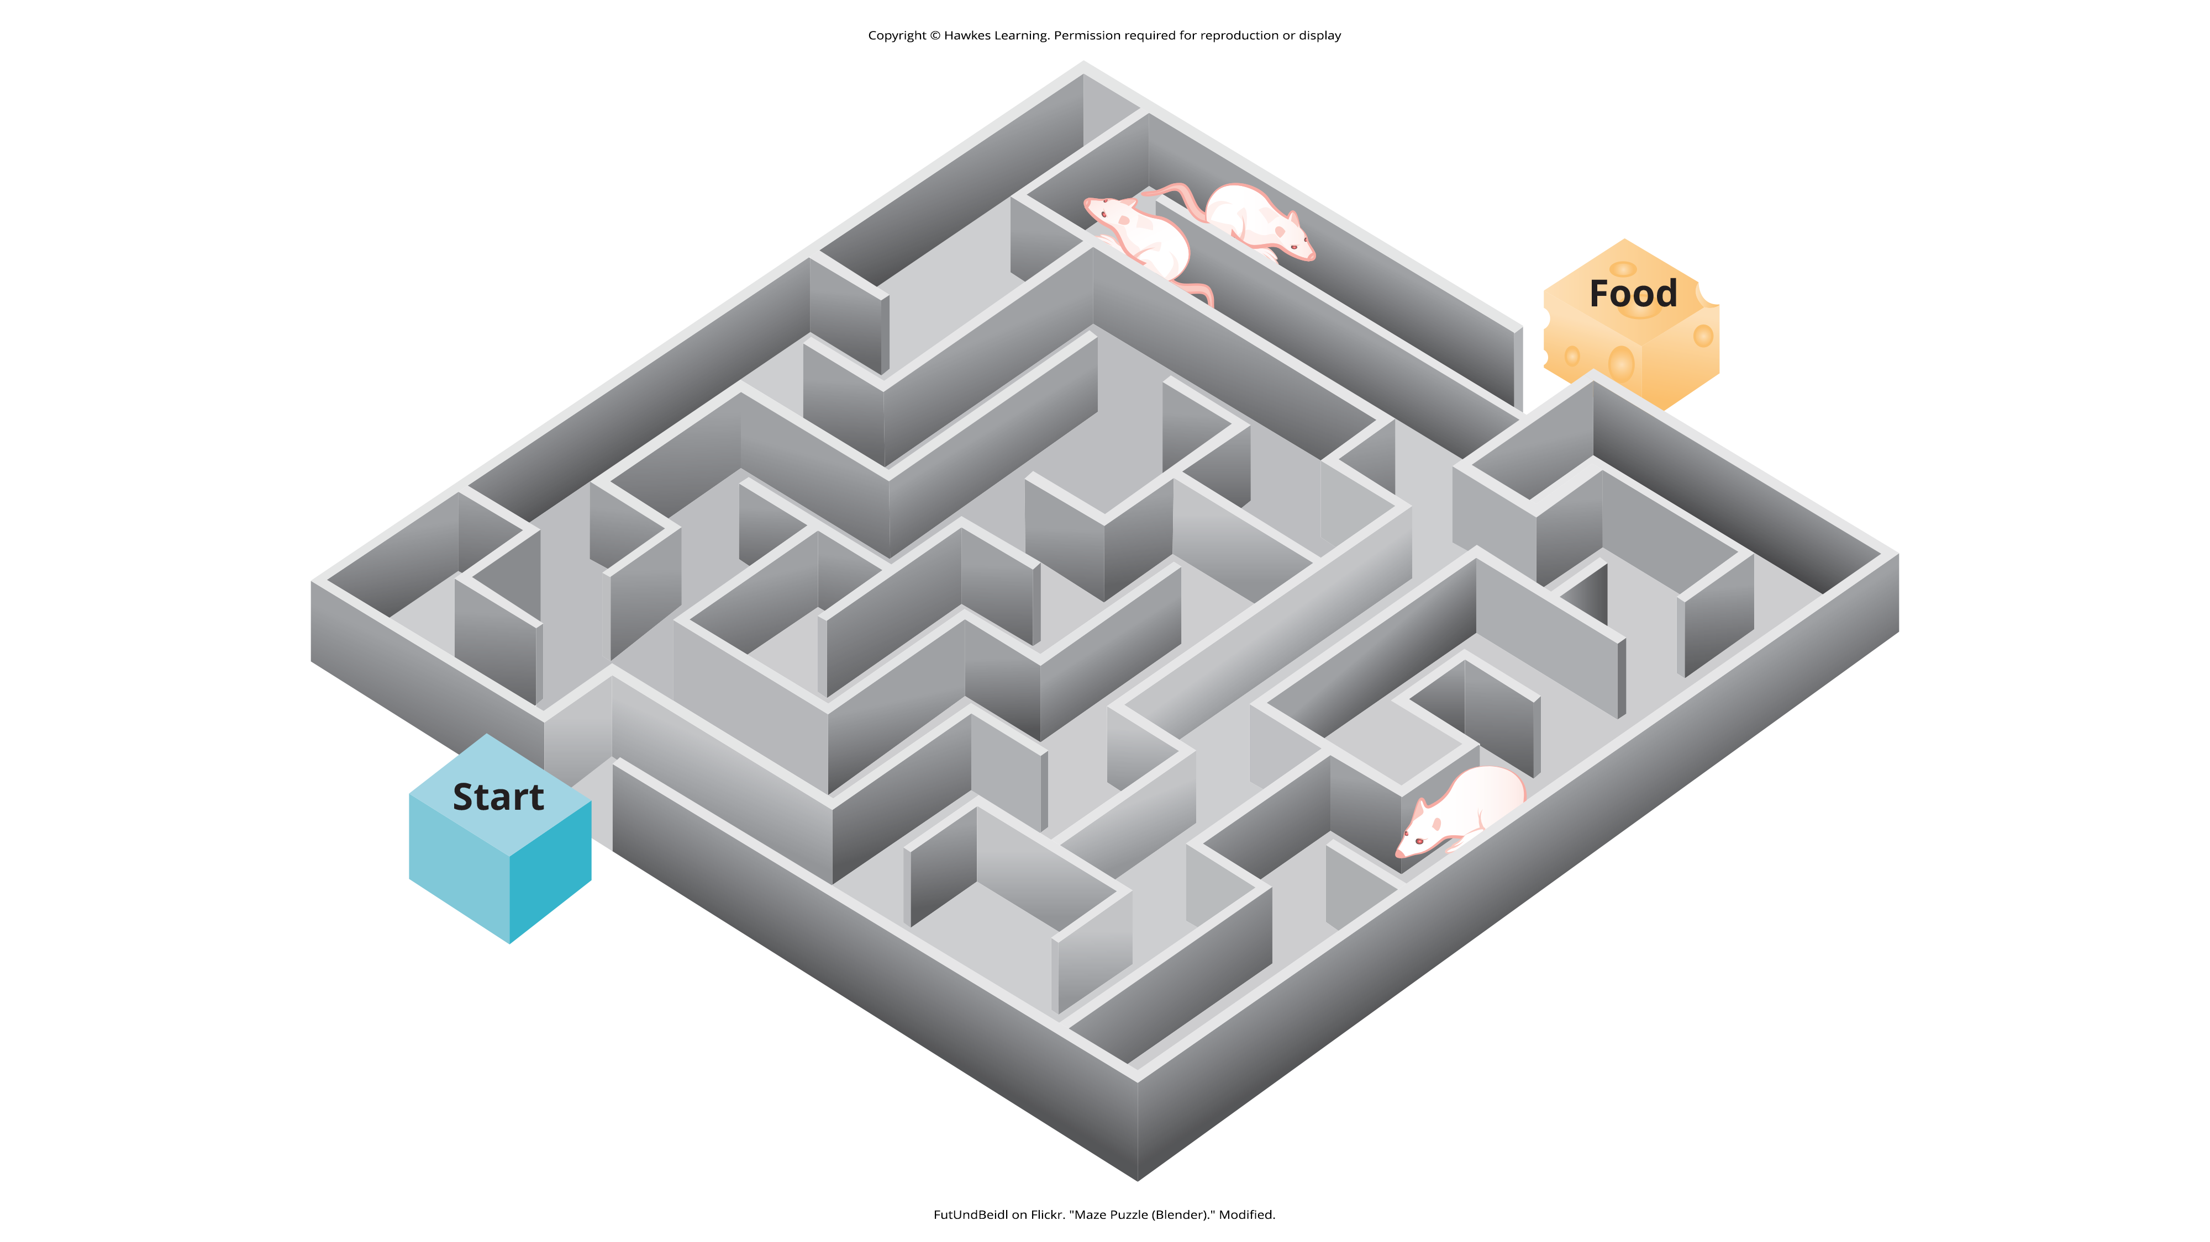
Figure 13
Caption: Psychologist Edward Tolman found that rats use cognitive maps to navigate through a maze. Have you ever worked your way through various levels on a video game? You learned when to turn left or right, move up or down. In that case, you were relying on a cognitive map, just like the rats in a maze.

Slide 41
Summary
Operant conditioning is based on B. F. Skinner's work.
It involves consequences (reinforcers or punishers) occurring after a behavior is demonstrated.
Reinforcement (positive or negative) increases the likelihood of a behavioral response.
Punishment (positive or negative) decreases the likelihood of a behavioral response.
Reinforcement schedules (set or variable) are used to reward behavior.

Slide 42
End of Hawkes Learning PowerPoint

