Slide 1
Lesson 5.4
Observational Learning (Modeling)

Slide 2
Observational Learning
Form of learning by watching others and imitating/modeling their behaviors
Example: Going to YouTube to learn how to do something
Involves a specific type of neuron called mirror neurons

Slide 3
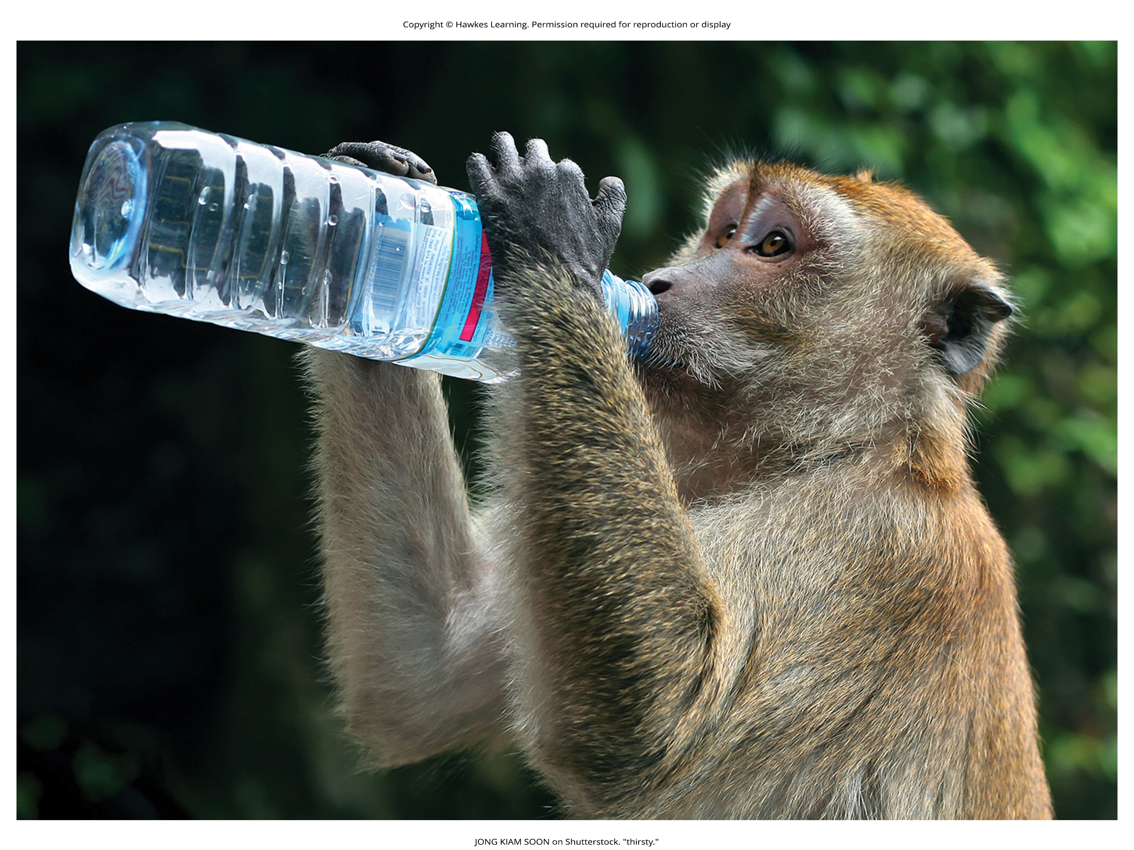
Models
The individuals performing the imitated behavior are called models.
Humans and other animals are capable of observational learning.
Example: chimpanzees learning efficient juice drinking by observing other chimps
Figure 1

Slide 4
Imitation
Imitation is more obvious in humans than animals.
Example: Claire's child Anna imitated the spanking of a teddy bear after seeing Claire spank Jay.
This made Claire realize she wanted to discipline her children differently.

Slide 5
Albert Bandura
He proposed social learning theory, accounting for cognitive processes in learning.
Pure behaviorism could not explain learning without external reinforcement.
Observational learning involves more than just imitation.
He identified three kinds of models: live, verbal, and symbolic.

Slide 6
On Your Own
List three examples of observational learning.

Slide 7
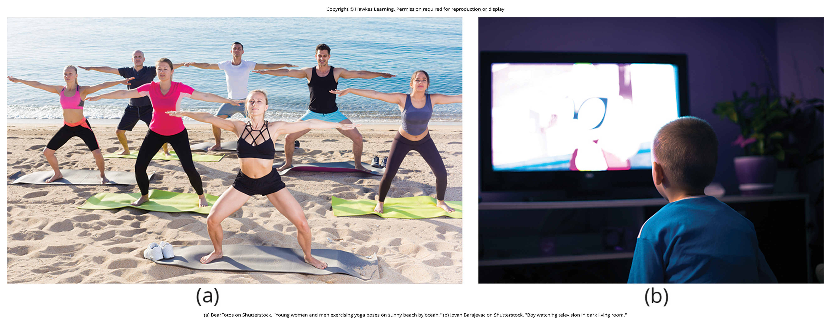
Three Kinds Of Models
Live model: demonstrates the behavior in person (e.g. surfing)
Verbal instructional model: explains/describes the behavior (e.g. soccer coach)
Symbolic model: models from media like books, movies, TV shows (fictional or real)
Figure 2

Slide 8
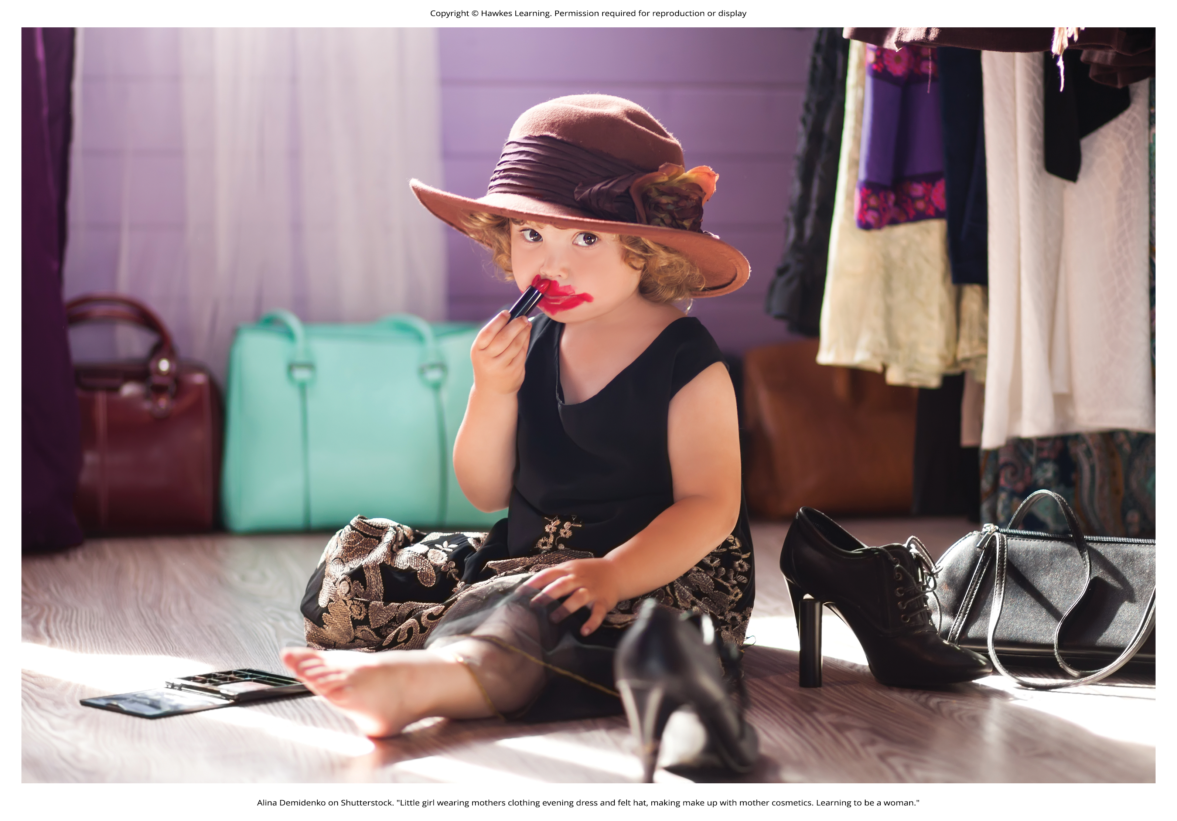
Steps In The Modeling Process
Bandura argued that in order to learn the behavior you need to pay attention to the model, remember what the model did, and be motivated to copy the model.
Steps in the modeling process include:
Attention
Retention
Reproduction
Motivation
Figure 3

Slide 9
Vicarious Reinforcement
Vicarious reinforcement: process where the observer sees the model rewarded, making the observer more likely to imitate the model's behavior

Slide 10
Vicarious Punishment
Vicarious punishment: process where the observer sees the model punished, making the observer less likely to imitate the model's behavior

Slide 11
Modeling Behavior₁
Bandura researched children's modeling of adults' aggressive/violent behaviors.
He conducted an experiment with a 5-foot inflatable Bobo doll.
Children's aggression was influenced by whether the teacher punished the behavior.
When the teacher punished, children decreased their aggressive tendency.
When the teacher praised or ignored, the children imitated the aggressive acts and language.

Slide 12
Modeling Behavior₂
Bandura concluded that we watch and learn, with prosocial and antisocial effects.
Prosocial models can encourage socially acceptable behavior.
Example: If you want children to read, read to them and have books.
Example: If you want siblings healthy, let them see you eat healthy and exercise.

Slide 13
Reflection Question
Who has been a prosocial model in your life? What kinds of behaviors did they model for you?

Slide 14
Modeling Behavior₃
The antisocial effects of observational learning are also important.
Research suggests that this may explain why abused children often grow up to be abusers themselves (Murrell et al., 2007).
About 51% of abused children are more likely to experience domestic abuse as adults (Office for National Statistics, 2017).
This demonstrates a vicious cycle of witnessing/learning violent behavior.

Slide 15
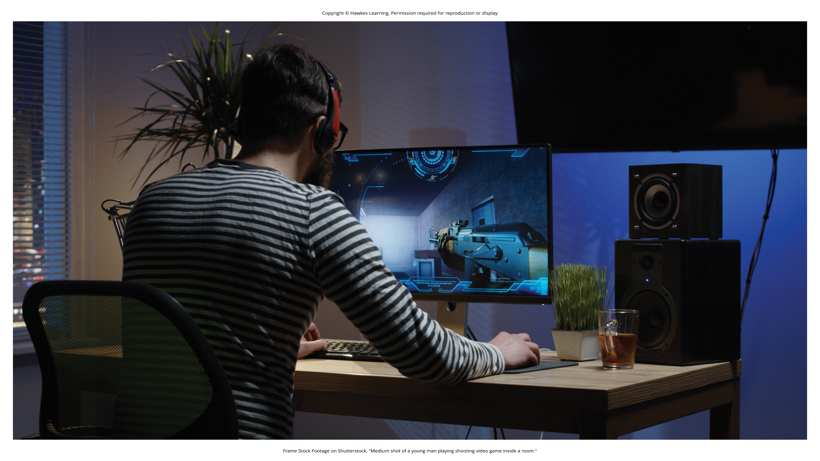
Potential Media Violence Effects
Studies suggest violent TV/movies/games may have antisocial effects.
The viewing of violence is linked to increased aggression in some children.
Repeated exposure may desensitize people to violent acts.
This is a complicated area needing more research by psychologists/organizations.
Figure 4

Slide 16
Summary
According to Bandura, learning can occur by watching others and then modeling what they do or say.
This is known as observational learning.
There are specific steps in the process of modeling that must be followed if learning is to be successful.
These steps include attention, retention, reproduction, and motivation.
Through modeling, Bandura has shown that children learn many things both good and bad simply by watching their parents, siblings, and others.

Slide 17
End of Hawkes Learning PowerPoint

