Slide 1
Lesson 6.1
What Is Cognition?

Slide 2
What Is Cognition?
Cognition is thinking; it encompasses the processes associated with perception, knowledge, problem solving, judgement, language, and memory.
Scientists who study cognition are searching for ways to understand how we integrate, organize, and utilize our conscious cognitive experiences without being aware of all of the unconscious work that our brains are doing (Kahneman, 2011; APA, 2022).

Slide 3
Cognition
Exceptionally complex, cognition is an essential feature of human consciousness, yet not all aspects of cognition are consciously experienced.
  Example: Upon waking each morning, you begin contemplating the tasks you must complete that day. In what order should you run your errands? Should you go to the gym, the grocery store, or the library first? Can you get these things done before class, or will they need to wait? These thoughts are one example of cognition at work.

Slide 4
Cognitive Psychology
Cognitive psychology is the field of psychology dedicated to examining how people think.
  It attempts to explain how and why we think the way we do by studying the interactions among human thinking, emotion, creativity, language, and problem solving, in addition to other cognitive processes.
  Cognitive psychologists strive to determine and measure different types of intelligence, why some people are better at problem solving than others, how emotional intelligence affects success in the workplace, and how we organize information gathered from our environments into meaningful categories of thought.

Slide 5
Sensations, Emotions, Memories, And Thoughts
The human senses serve as the interface between the mind and the external environment, receiving stimuli and translating it into nervous impulses that are processed in the brain.
  The brain uses the relevant pieces to create sensory memory, which can lead to thoughts.
  Thoughts can be expressed or stored in memory for future use.
  When thoughts are formed, the brain also pulls information from emotions and memories to bring into consciousness.

Slide 6
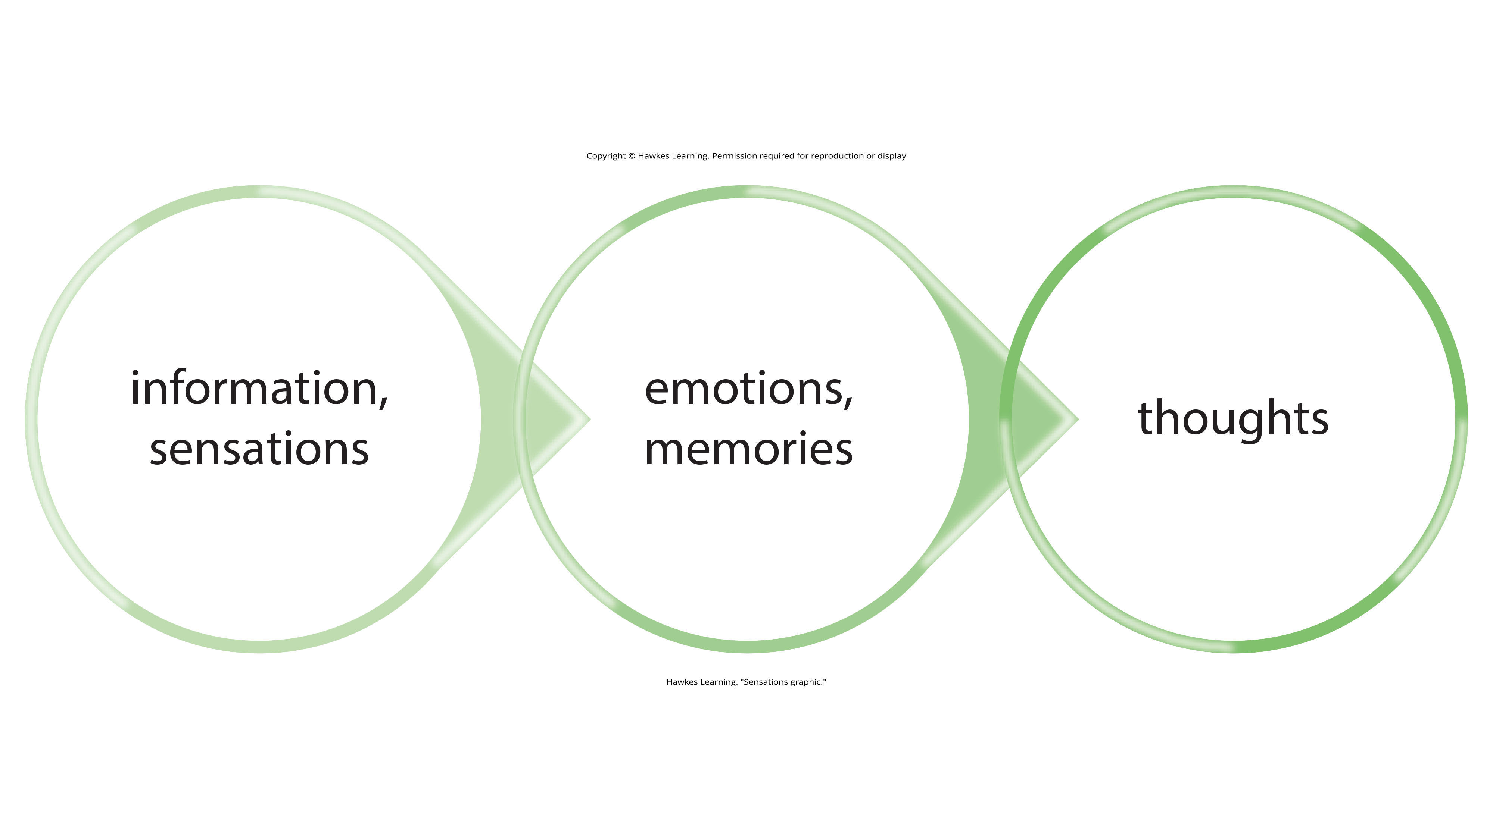
Lesson 6.1 Figure 2
Caption: Sensations and information are received by our brains, filtered through emotions and memories, and processed to become thoughts.

Slide 7
Concepts
Concepts are categories or groupings of linguistic information, images, ideas, or memories, such as life experiences.
  Like "big ideas," we use concepts to see relationships among different elements of our experiences and keep the information organized and accessible in our minds.
  Example: Mammals are a group of animals that have fur, produce milk, and the females carry the species.

Slide 8
Concepts And Semantic Memory
Concepts are informed by our semantic memory and are present in every aspect of our lives. They are discussed explicitly in the classroom.
  Example: When you study U.S. history, you learn about more than just individual events that occurred in the past; you absorb a large quantity of information by listening to and participating in discussions, examining maps, and reading first-hand accounts of people's lives.
    In the process, your brain gathers details that inform and refine your understanding of related concepts, like democracy, power, and freedom.

Slide 9
Concept Types And Prevalence
Concepts can be complex and abstract or more concrete.
  Complex/abstract: justice; Piaget's stages of development
  Concrete: types of birds
Some concepts are agreed upon by many people; others are personal and individualized.
  Collective agreement: tolerance
  Individual: characteristics of your ideal friend, or your family's birthday traditions
Concepts touch every aspect of our lives, from daily routines to guiding principles behind how governments function.

Slide 10
Prototypes
A prototype is the best example or representation of a concept.
  Example: For the category of civil disobedience, your prototype could be Rosa Parks.
  Parks' peaceful resistance to segregation on a city bus in Montgomery, Alabama, is a recognizable example of civil disobedience.

Slide 11
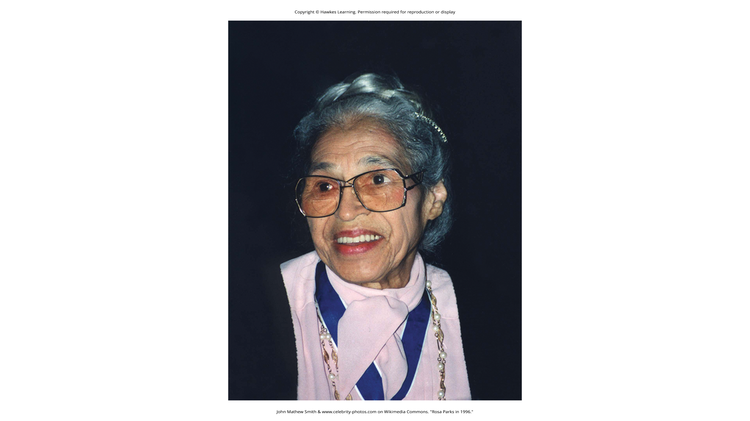
Lesson 6.1 Figure 3
Caption: Rosa Parks and her peaceful resistance to segregation on a city bus could be understood as a prototype for civil disobedience.

Slide 12
Natural Concepts
In psychology, concepts can be divided into two categories: natural and artificial.
Natural concepts are created "naturally" through your experiences and can be developed from either direct or indirect experiences (Mareschal et al., 2010).
  Example: Snow is a natural concept because you can construct an understanding of it through direct observations or experiences of snow, whether you grew up in a snowy climate and have direct experience with it or grew up in a warm climate but understand snow through what you’ve seen depicted in movies, images, or stories.

Slide 13
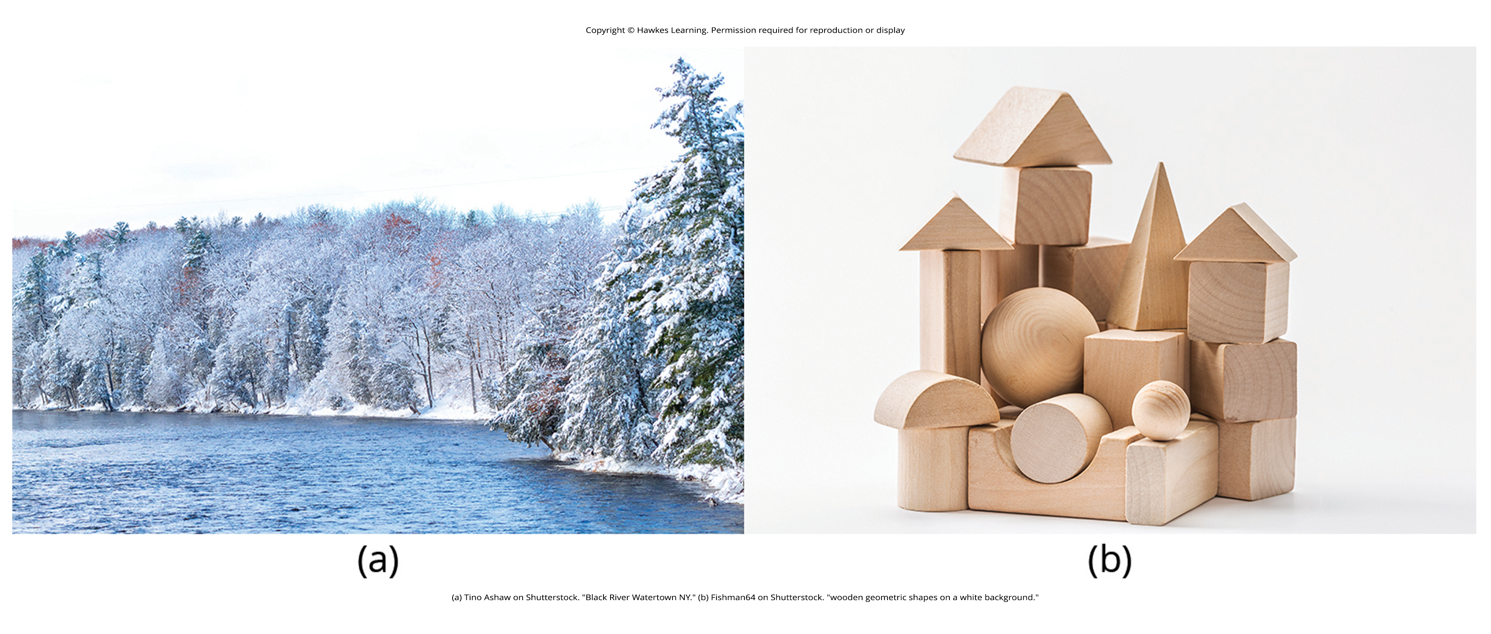
Figure 5
Caption: (a) Our concept of snow is an example of a natural concept—one that we understand through direct observation and experience. (b) In contrast, artificial concepts are ones that we know by a specific set of characteristics that they always exhibit, such as what defines different basic shapes.

Slide 14
Artificial Concepts₁
An artificial concept, on the other hand, is a concept that is defined by a specific set of characteristics.
  Examples: Various properties of geometric shapes, like squares and triangles; mathematical formulas, like the equation for area (length x width)
    These are artificial concepts defined by specific sets of characteristics that are always the same.

Slide 15
Artificial Concepts₂
Artificial concepts can enhance the understanding of a topic by building on one another.
  Example: Before learning the concept of "area of a square" and the formula to find it, you must understand what a square is.
The use of artificial concepts to define an idea is crucial to communicating with others and engaging in complex thought.

Slide 16
Schema
A schema is a mental construct consisting of a cluster or collection of related concepts.
When a schema is activated, you are more likely to recall or think about concepts, memories, and emotions that are related to that schema (Canevello, 2020).

Slide 17
Role Schema
A role schema makes assumptions about how individuals in certain roles will behave.
  Example: When you meet someone who introduces themselves as a firefighter, your brain automatically activates the "firefighter schema" and begins making assumptions based on your past encounters and experiences with information related to firefighters.
  However, this may not always be accurate or attributable to the person you’ve just met.

Slide 18
Event Schema₁
An event schema, also known as a cognitive script, is a set of behaviors that often go in a specific order and can feel like a routine.
  Example: Think about what you do when you walk into an elevator. First, the doors open, and you wait for exiting passengers to leave. Then, you step into the elevator, turn around to face the doors, and find the correct button to push. Since you expect the behaviors to go in this order, this is your cognitive script for getting on an elevator.

Slide 19
Event Schema₂
Because event schemata are automatic, they can be difficult to change.
  Example: While you are driving, you hear your phone’s notification sound. Typically, the event schema for hearing your phone ring involves finding and opening your phone. Without thinking, you may reach for your phone to do this, even though it is unsafe and inadvisable based on the context of you driving a car.

Slide 20
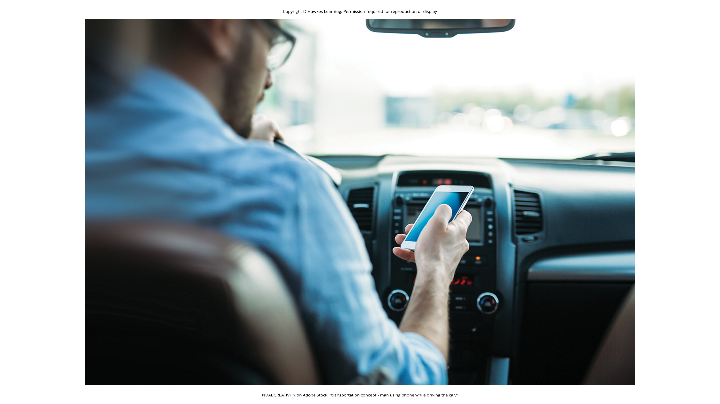
Lesson 6.1 Figure 7
Caption: Using your phone while driving is dangerous, but it is a difficult event schema for some people to resist.

Slide 21
On Your Own
Which of the following best represents an event schema/cognitive script?
Jonte knows that a lizard is a reptile.
Homer thinks that a man he meets is not going to be talkative because he is an accountant.
Juan knows that he leaves for work after he finishes pouring his coffee.

Slide 22
Summary
Cognitive psychology is the study of cognition, or the brain's ability to think, perceive, plan, analyze, and remember.
Concepts and their corresponding prototypes help us quickly organize our thinking by creating categories into which we can sort new information.
Schemata are clusters of related concepts; some involve routines of thought and behavior that help us function properly in various situations without having to actively think about them.
Schemata also show up in social situations and routines of daily behavior.

Slide 23
End of Hawkes Learning PowerPoint

