Slide 1
Lesson 6.2
Language

Slide 2

Language₁
Language is a communication system that involves using words and systematic rules to organize those words to transmit information from one individual to another.
Lexicon refers to the words of a given language or its vocabulary.
Grammar refers to the set of rules that are used to convey meaning by use of the lexicon.
Figure 1

Slide 3
Language₂
A phoneme (e.g., the sounds "ah" vs. "eh") is a basic sound unit of a given language, and different languages have different sets of phonemes.
Phonemes are combined to form morphemes, which are the smallest units of language that convey some type of meaning (e.g. "I" is both a phoneme and a morpheme).
Semantics refers to the process by which we derive meaning from morphemes and words.
Syntax refers to the way words are organized into sentences.

Slide 4
Theories Of Language Development
B. F. Skinner (1957) proposed that language is learned through reinforcement.
Noam Chomsky (1965) criticized this behaviorist approach, asserting instead that the mechanisms underlying language acquisition are biologically determined.
One of Chomsky 's arguments is that regardless of culture or the type of language spoken, it is more easily learned in early childhood than at any other point in the lifespan.

Slide 5

Language Development
Babies are born being able to discriminate sounds of all human languages.
However, by the time they are 1 year old, they can only discriminate among the phonemes that are used in the languages that they are exposed to.
The use of language develops in the absence of formal instruction and appears to follow a very similar pattern in children from vastly different cultures and backgrounds.
It would seem, therefore, that we are born with a biological predisposition to acquire a language.
Figure 2

Slide 6
Language Development In Babies
Children begin to learn about language from a very early age. In fact, it appears that this is occurring even before we are born (Adam-Darque et al., 2020).
Newborns show preference for their mothers' voice.
Babies are also attuned to the languages being used around them and show preferences for videos of faces that are moving in synchrony with the audio of spoken language.

Slide 7
Stages Of Language Development₁
After the first few months of life, babies enter the babbling stage.
Tend to produce single syllables that are repeated over and over
As time passes, more variation appears in the syllables, and in many cases a child’s first word is uttered some time between the ages of 1 year to 18 months.

Slide 8
Stages Of Language Development₂
Around age 18 to 36 months, 75% of children are able to use simple sentences of two or three words.
After age three, many children are able to speak in complex sentences and have regular everyday conversations
During this time, children often commit an error called overgeneralization, which is an extension of a language rule to an exception to the rule.
We add an –s to the end of most animals to indicate more than one. A child may refer to more than one mouse as mouses instead of mice.

Slide 9
Sound Discrimination In Babies
Babies can discriminate among the sounds that make up a language.
Example: They can tell the difference between the s in vision and the ss in fission.
Early on, they can differentiate between the sounds of all human languages, even those that do not occur in the languages that are used in their environments.
However, by the time they are about 1 year old, they can only discriminate among those phonemes that are used in the language or languages they hear most often.

Slide 10
Language And Thought
When we speak one language, we agree that words are representations of ideas, people, places, and events.
The given language that children learn is connected to their culture and surroundings.
But can words themselves shape the way we think about things?

Slide 11
Reflection Question
What are your thoughts on if language can limit thought?
Do you think this is possible? Why or why not?

Slide 12
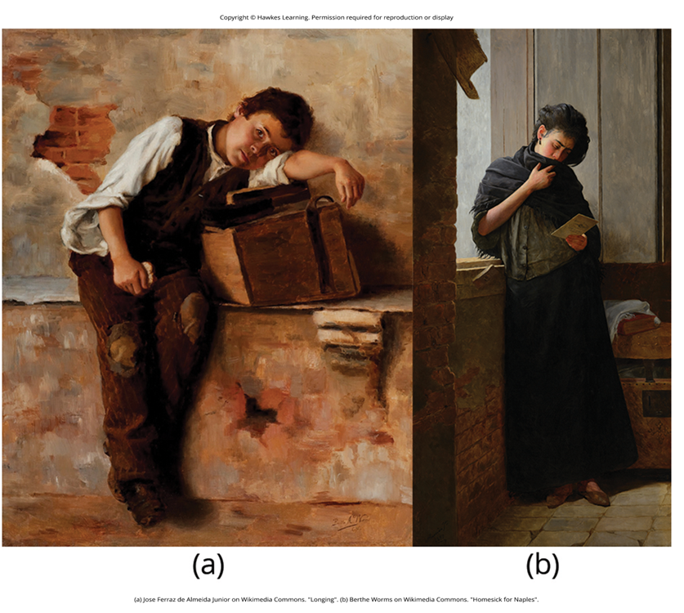
What Do You Think?
Think about what you know of other languages; perhaps you even speak multiple languages. You may know a few words that are not translatable from their original language into English.
For example, the Japanese word age-otori: to look worse after a haircut. The word expresses many meanings/feelings, including regret, sadness, yearning, and self-doubt. There is no single word in English that includes all of those emotions in a single description.
What do you think? Do words such as age-otori indicate that different languages produce different patterns of thought in people?
Figure 3

Slide 13
Edward Sapir and Benjamin Lee
Edward Sapir and Benjamin Lee wanted to understand how the language habits of a community encourage members of that community to interpret language in a particular manner.
They proposed that language determines thought, suggesting, for example, that a person whose community language did not have past-tense verbs would have difficulty thinking about the past (Whorf, 1956).
Researchers have since identified this view as too absolute, pointing out a lack of empiricism (Abler, 2013; Boroditsky, 2011; van Troyer, 1994).

Slide 14
Linguistic Determinism₁
Language may indeed influence the way that we think, an idea known as linguistic determinism.
One recent demonstration of this phenomenon involved differences in the way that English and Mandarin Chinese speakers talk and think about time.
English speakers tend to use terms that describe changes along a horizontal dimension ("I'm running behind"; "Don't get ahead of yourself").
Mandarin Chinese speakers also describe time in horizontal terms, but it is not uncommon to also use terms associated with a vertical arrangement (the past might be described as being "up" and the future as being "down").

Slide 15
Linguistic Determinism₂
It turns out that these differences in language translate into differences in performance on cognitive tests designed to measure how quickly an individual can recognize temporal relationships.
Specifically, when given a series of tasks with vertical priming, Mandarin Chinese speakers were faster at recognizing temporal relationships between months.
Indeed, Boroditsky (2001) sees these results as suggesting that "habits in language encourage habits in thought" (p. 12).

Slide 16
How Language Influences Thought: The Dani
The Dani language of the people of Papua New Guinea differentiates only two basic colors: mili for cool/dark shades such as blue, green, and black, and mola for warm/light colors such as red, yellow, and white.
Researchers hypothesized that the number of color terms could limit the ways that the Dani people conceptualized color. However, the Dani were able to distinguish colors with the same ability as English speakers despite having fewer words at their disposal (Berlin & Kay, 1969).

Slide 17
How Language Influences Perception
A review of research aimed at determining how language might affect something like color perception suggested that language can influence perceptual phenomena, especially in the left hemisphere of the brain (He et al., 2019)
The left hemisphere is associated with language for most people. However, the right (less linguistic hemisphere) of the brain is less affected by linguistic influences on perception (Regier & Kay, 2009).

Slide 18
Summary
Language is a communication system that has both a lexicon and a system of grammar.
Language acquisition occurs naturally and effortlessly during the early stages of life, and this acquisition occurs in a predictable sequence for individuals around the world.
Language has a strong influence on thought, and the concept of how language may influence cognition remains an area of study and debate in psychology.

Slide 19
End of Hawkes Learning PowerPoint

