Slide 1
Lesson 6.3
Problem Solving

Slide 2
Problems
In life, some problems are easy to solve, and some are harder.
No matter what the problem is, you first need to identify it—and potentially its many parts—and then apply a strategy for solving the problem.

Slide 3
Problem-Solving Strategies
A problem-solving strategy is a plan of action used to find a solution. Different strategies have different action plans associated with them.
Example: A well-known strategy is trial and error, which means to continue trying different solutions until the problem is solved.

Slide 4
Algorithms
An algorithm is a problem-solving formula that provides you with step-by-step instructions used to achieve a desired outcome (Kahneman, 2011; Kovari, 2020).
Example: a recipe with highly detailed instructions that produces the same results every time it is performed

Slide 5

Heuristics₁
A heuristic is a mental shortcut that is used to help us solve problems. Although heuristics may help us save time, they are not always the best for making rational decisions.
Working backwards is a useful heuristic in which you begin solving the problem by focusing on the result.
Example: when doing your math homework, you may look up the answer in the back of the book and use that to help you figure out how the problem was solved
Figure 1

Slide 6
Heuristics₂
Different types of heuristics are used in different types of situations, but the impulse to use a heuristic occurs when one of five conditions is met (Pratkanis, 1989):
When one is faced with too much information
When the time is limited
When the decision to be made isn’t important
When there is access to very little information to use in making the decision
When an appropriate heuristic happens to come to mind in the same moment

Slide 7
On Your Own₁
Keisha has a leak in her kitchen sink. She finds and watches a YouTube video that demonstrates the instructions for how to fix the leak.
This best exemplifies which of the following?
algorithm
trial and error
heuristic

Slide 8
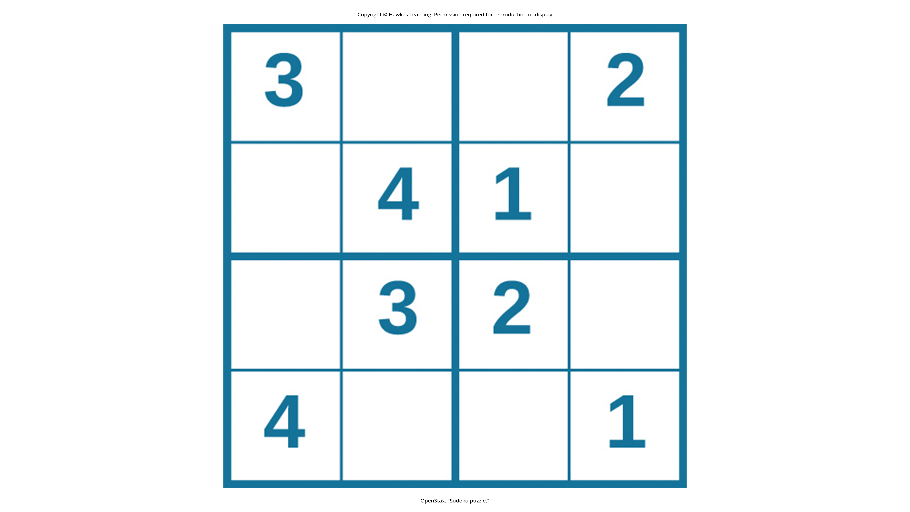
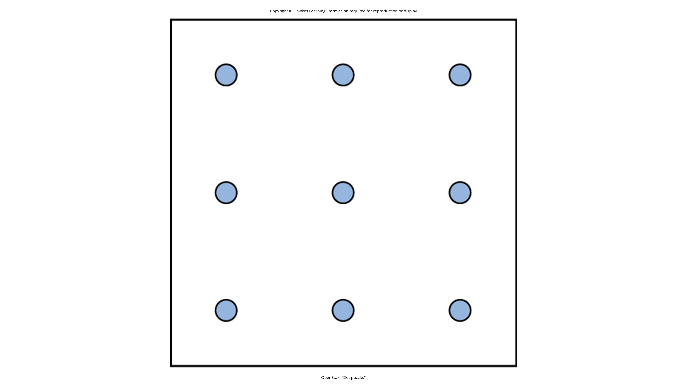
Puzzles Increasing Problem-Solving Ability
Problem-solving abilities can improve with practice.
Many people challenge themselves every day with puzzles and other mental exercises to sharpen their problem-solving skills, such as Sudoku or word puzzles.
Figure 2
Figure 3

Slide 9
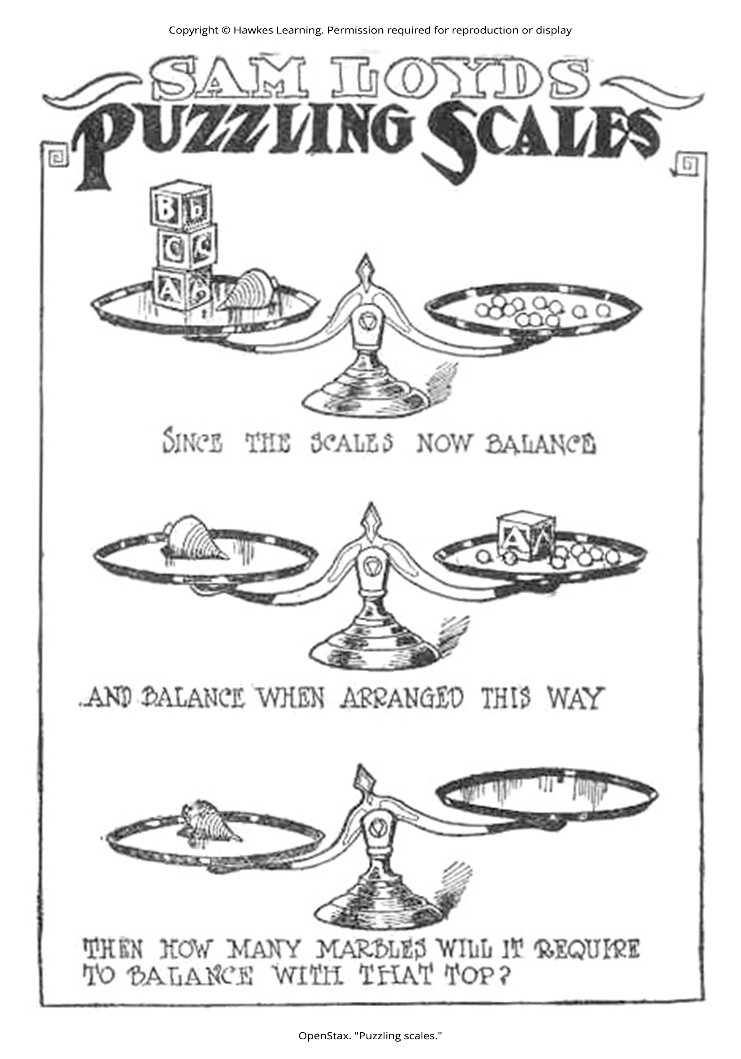
Pitfalls to Problem Solving
A mental set is where you persist in approaching a problem in a way that has worked in the past but is clearly not working now.
Functional fixedness is a type of mental set where you cannot perceive an object being used for something other than what it was designed for.
During the Apollo 13 mission to the moon, NASA engineers had to overcome functional fixedness to save the lives of the astronauts aboard the spacecraft.
The astronauts were in danger of being poisoned by rising levels of carbon dioxide because of problems with the carbon dioxide filters.
The engineers found a way for the astronauts to use spare plastic bags, tape, and air hoses to create a makeshift air filter, which saved the lives of the astronauts.
Figure 4

Slide 10
On Your Own₂
Which of the following is not an example of a mental set that causes functional fixedness?
only using a water bottle to store water that you drink
only using a hammer to drive a nail into a surface
using water from a water bottle to clean a stain on a shirt

Slide 11
Decision-Making and Anchoring Bias
In order to make good decisions, we use our knowledge and our reasoning.
Often, this knowledge and reasoning is sound and solid.
Sometimes we are swayed by biases or by others manipulating a situation.
An anchoring bias occurs when you focus on one piece of information when making a decision or solving a problem.
If you first see a t-shirt that costs $400—then see a second one that costs $100—you’re prone to see the second shirt as "cheap" even though you would normally consider $100 a high price for a t-shirt.

Slide 12
Reflection Question₁
In your opinion, how can salespeople use the anchoring bias to their advantage?

Slide 13
Confirmation Bias
Confirmation bias is the tendency to focus on information that confirms your existing beliefs.
Example: A medical practitioner may prematurely focus on a particular disorder early in a diagnostic session, and then seek only confirming evidence.
If you are trying to prove that Michael Jordan was the greatest basketball player of all time (over Lebron James), you may only reference statistical categories where Jordan outperformed James (vs. vice versa).

Slide 14
Reflection Question₂
Think of a time when you or someone you know committed confirmation bias.
What was the situation, and why do you think you or the other person ignored the other facts of the argument?

Slide 15
Hindsight Bias
Hindsight bias leads you to believe that the event you just experienced was predictable even though it really wasn’t (sometimes called the "knew-it-all-along" effect).
Example: A spectator claiming, "I knew they were going to win!" after the game was over.
Example: An investor thinking, "I knew that stock was going to go up!" after the stock had already increased in value.
Example: A person stating, "I knew that relationship wasn't going to work out!" after a couple breaks up.

Slide 16

Representative Bias
Representative bias is when you unintentionally stereotype someone or something without a valid basis.
Example: You assume someone is a hockey fan because they live in Canada (and hockey is popular in Canada).
Figure 5

Slide 17
Availability Heuristic
The availability heuristic is a heuristic in which you make a decision based on information that is readily available (Aronson, 1994; Kahneman, 2011; Redelmeier & Ng, 2020).
Example: If you consume a lot of media about home break-ins, you may think the odds of your house getting broken into are much higher than they really are.
The reason is that you can easily recall many examples of when people's homes have been broken into.

Slide 18
On Your Own₃
Describe each of the following biases in your own words.
Confirmation
Hindsight
Representative
Availability
Anchoring

Slide 19
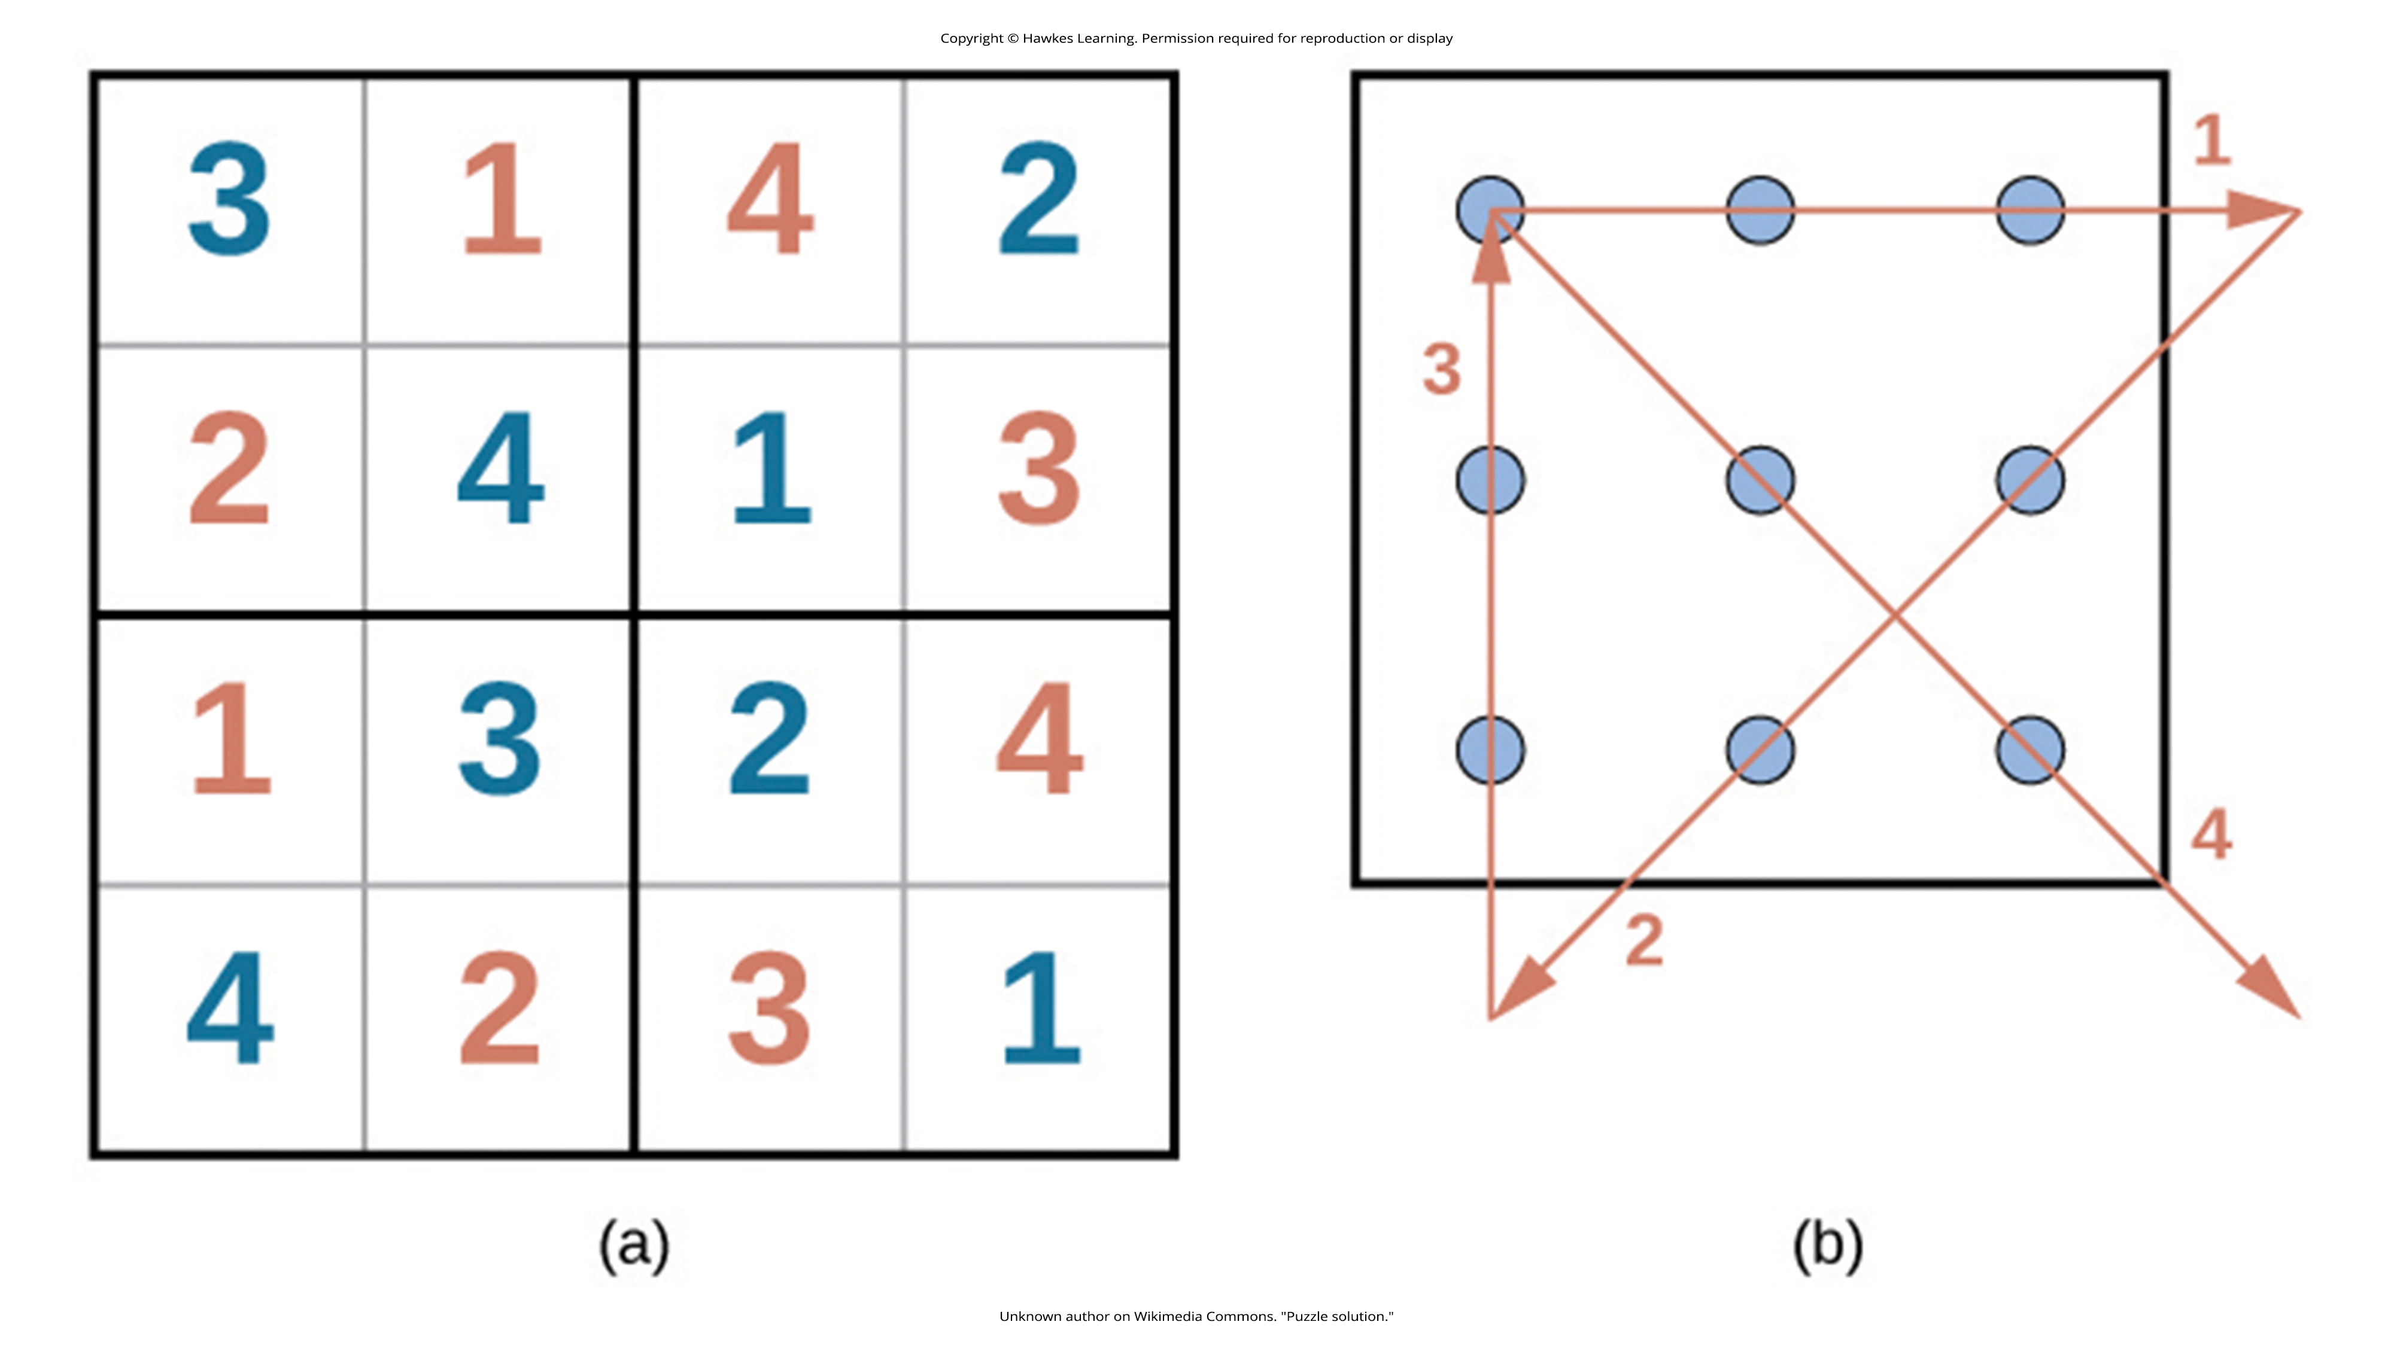
Lesson 6.3 Figure 6
Caption: Here are the solutions to the puzzles in Figure 2 and Figure 3.

Slide 20
Summary
Many different strategies exist for solving problems.
Typical strategies include trial and error, applying algorithms, and using heuristics.
To solve a large, complicated problem, it often helps to break the problem into smaller steps that can be accomplished individually, leading to an overall solution.
Roadblocks to problem solving include mental sets, functional fixedness, and various biases that can cloud decision-making skills.

Slide 21
End of Hawkes Learning PowerPoint

