Slide 1
Lesson 6.4
What Are Intelligence and Creativity?

Slide 2
What Constitutes Intelligence?
Psychologists have long wondered what constitutes intelligence and how it can be measured.
The way that researchers have defined the concept of intelligence has been modified many times since the birth of psychology.

Slide 3
Spearman And The g Factor
British psychologist Charles Spearman believed intelligence consisted of one general factor, called g, which could be measured and compared among individuals.
  Spearman focused on the commonalities among various intellectual abilities and deemphasized what made each unique.
Long before modern psychology developed, however, ancient philosophers, such as Aristotle, held a similar view (Cianciolo & Sternberg, 2004).

Slide 4
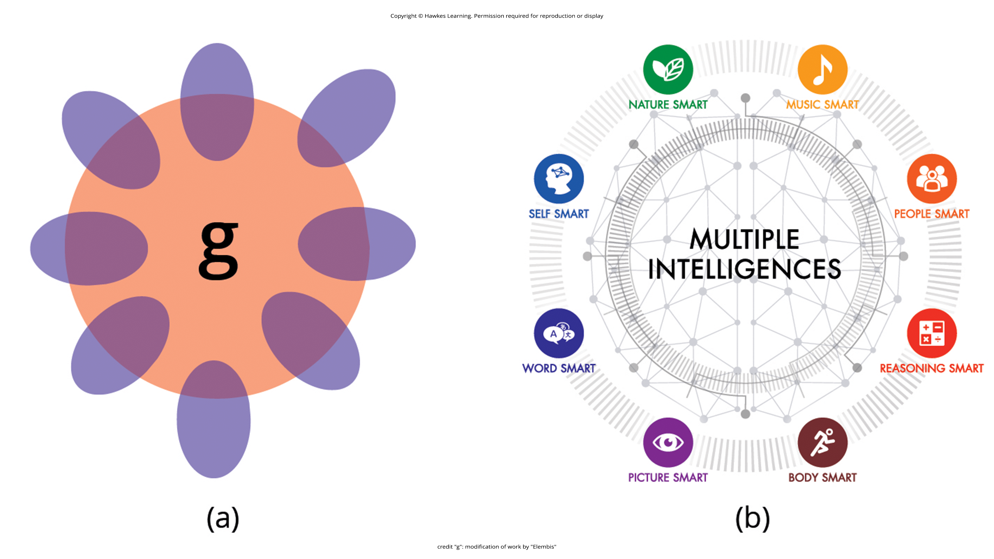
Lesson 6.4 Figure 1
Caption: (a) This is a representation of Spearman's g factor of intelligence. Each purple oval represents a factor related to intelligence, such as verbal fluency. (b) Gardener's multiple intelligence theory argues that each individual has strengths and weaknesses in at least eight types of intelligence.

Slide 5
Cattell's Theory Of Intelligence
Other psychologists believe that instead of a single factor, intelligence is a collection of distinct abilities.
In the 1940s, Raymond Cattell proposed a theory of intelligence that divided general intelligence into two components: crystallized intelligence and fluid intelligence (Cattell, 1963).

Slide 6
Crystallized Intelligence
Crystallized intelligence:
Acquired knowledge and the ability to retrieve it
Used when learning, remembering, and recalling information
Helps us overcome concrete, straightforward problems
  Example: demonstrating that you have mastered the information covered in this course

Slide 7
Fluid Intelligence
Fluid intelligence:
Ability to see complex relationships and solve problems
Used when tackling complex, abstract challenges in your daily life
  Example: navigating using a complicated subway system in a new city

Slide 8
Sternberg's Triarchic Theory Of Intelligence
Robert Sternberg developed another theory of intelligence.
He titled it the triarchic theory of intelligence because it sees intelligence as comprised of three parts: practical, creative, and analytical intelligence (Sternberg, 1988).

Slide 9
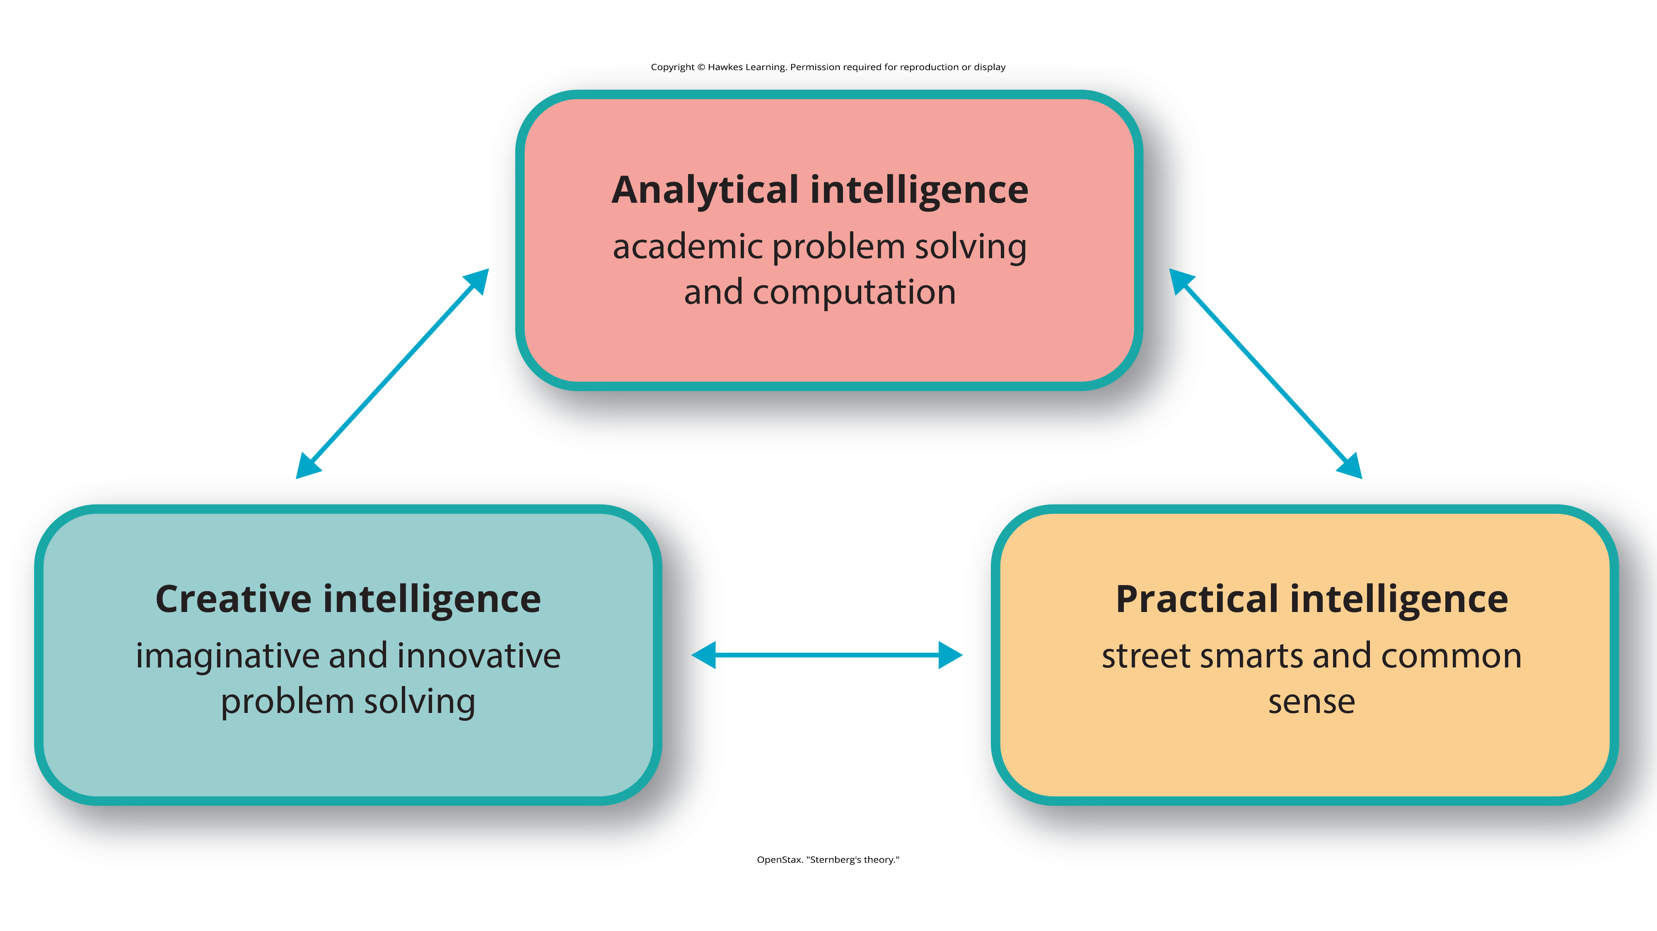
Lesson 6.4 Figure Number 2
Caption: Sternberg's theory identifies three types of intelligence: practical, creative, and analytical.

Slide 10
Practical Intelligence
Practical intelligence:
Sometimes compared to "street smarts"
Finding solutions that work in your everyday life by applying knowledge based on your experiences
Appears to be separate from traditional understanding of IQ; individuals who score high in practical intelligence may or may not have comparable scores in creative and analytical intelligence (Sternberg, 1988)
  When your friends want to find something to eat in a new city, you use an app to find locations and reviews for restaurants closest to you.

Slide 11
Analytical Intelligence
Analytical intelligence:
Closely aligned with academic problem solving and computations
Demonstrated by an ability to analyze, evaluate, judge, compare, and contrast
  When solving a challenging math problem, you analyze different aspects of the problem and then solve it section by section.

Slide 12
Creative Intelligence
Creative intelligence:
marked by inventing or imagining a solution to a problem or situation
can include finding a novel solution to an unexpected problem or producing a beautiful work of art or a well-developed short story
  When camping, you figure out a way to brew coffee even though your friend forgot to bring the coffee pot.

Slide 13
Multiple Intelligences Theory₁
Multiple intelligences theory was developed by Howard Gardner, a Harvard psychologist and former student of Erik Erikson.
Gardner's theory, which has been refined for more than thirty years, is a more recent development among theories of intelligence (Morgan, 2021).
In Gardner's theory, each person possesses at least eight intelligences. Among these eight intelligences, a person typically excels in some and falters in others (Gardner, 1983).

Slide 14
Multiple Intelligences Theory₂
Linguistic intelligence
  Perceives different functions of language, different sounds and meanings of words; may easily learn multiple languages
Logical-mathematical intelligence
  Capable of seeing numerical patterns; strong ability to use reason and logic
Musical intelligence
  Understands and appreciates rhythm, pitch, and tone; may play multiple instruments or perform as a vocalist
Bodily kinesthetic intelligence
  High ability to control the movements of the body and use the body to perform various physical tasks

Slide 15
Multiple Intelligences Theory₃
Spatial intelligence
  Ability to perceive the relationship between objects and how they move in space
Interpersonal intelligence
  Ability to understand and be sensitive to the various emotional states of others
Intrapersonal intelligence
  Ability to access personal feelings and motivations and use them to direct behavior and reach personal goals
Naturalist intelligence
  High capacity to appreciate the natural world and interact with the species within it

Slide 16
Multiple Intelligences Theory₄
Gardner's theory is relatively new and needs additional research to better establish empirical support.
Developing traditional measures of Gardner's intelligences is extremely difficult (Furnham, 2009; Gardner & Moran, 2006; Klein, 1997).

Slide 17
Reflection Question
How do you define intelligence?
Can you think of ways that you would measure intelligence as you define it?

Slide 18
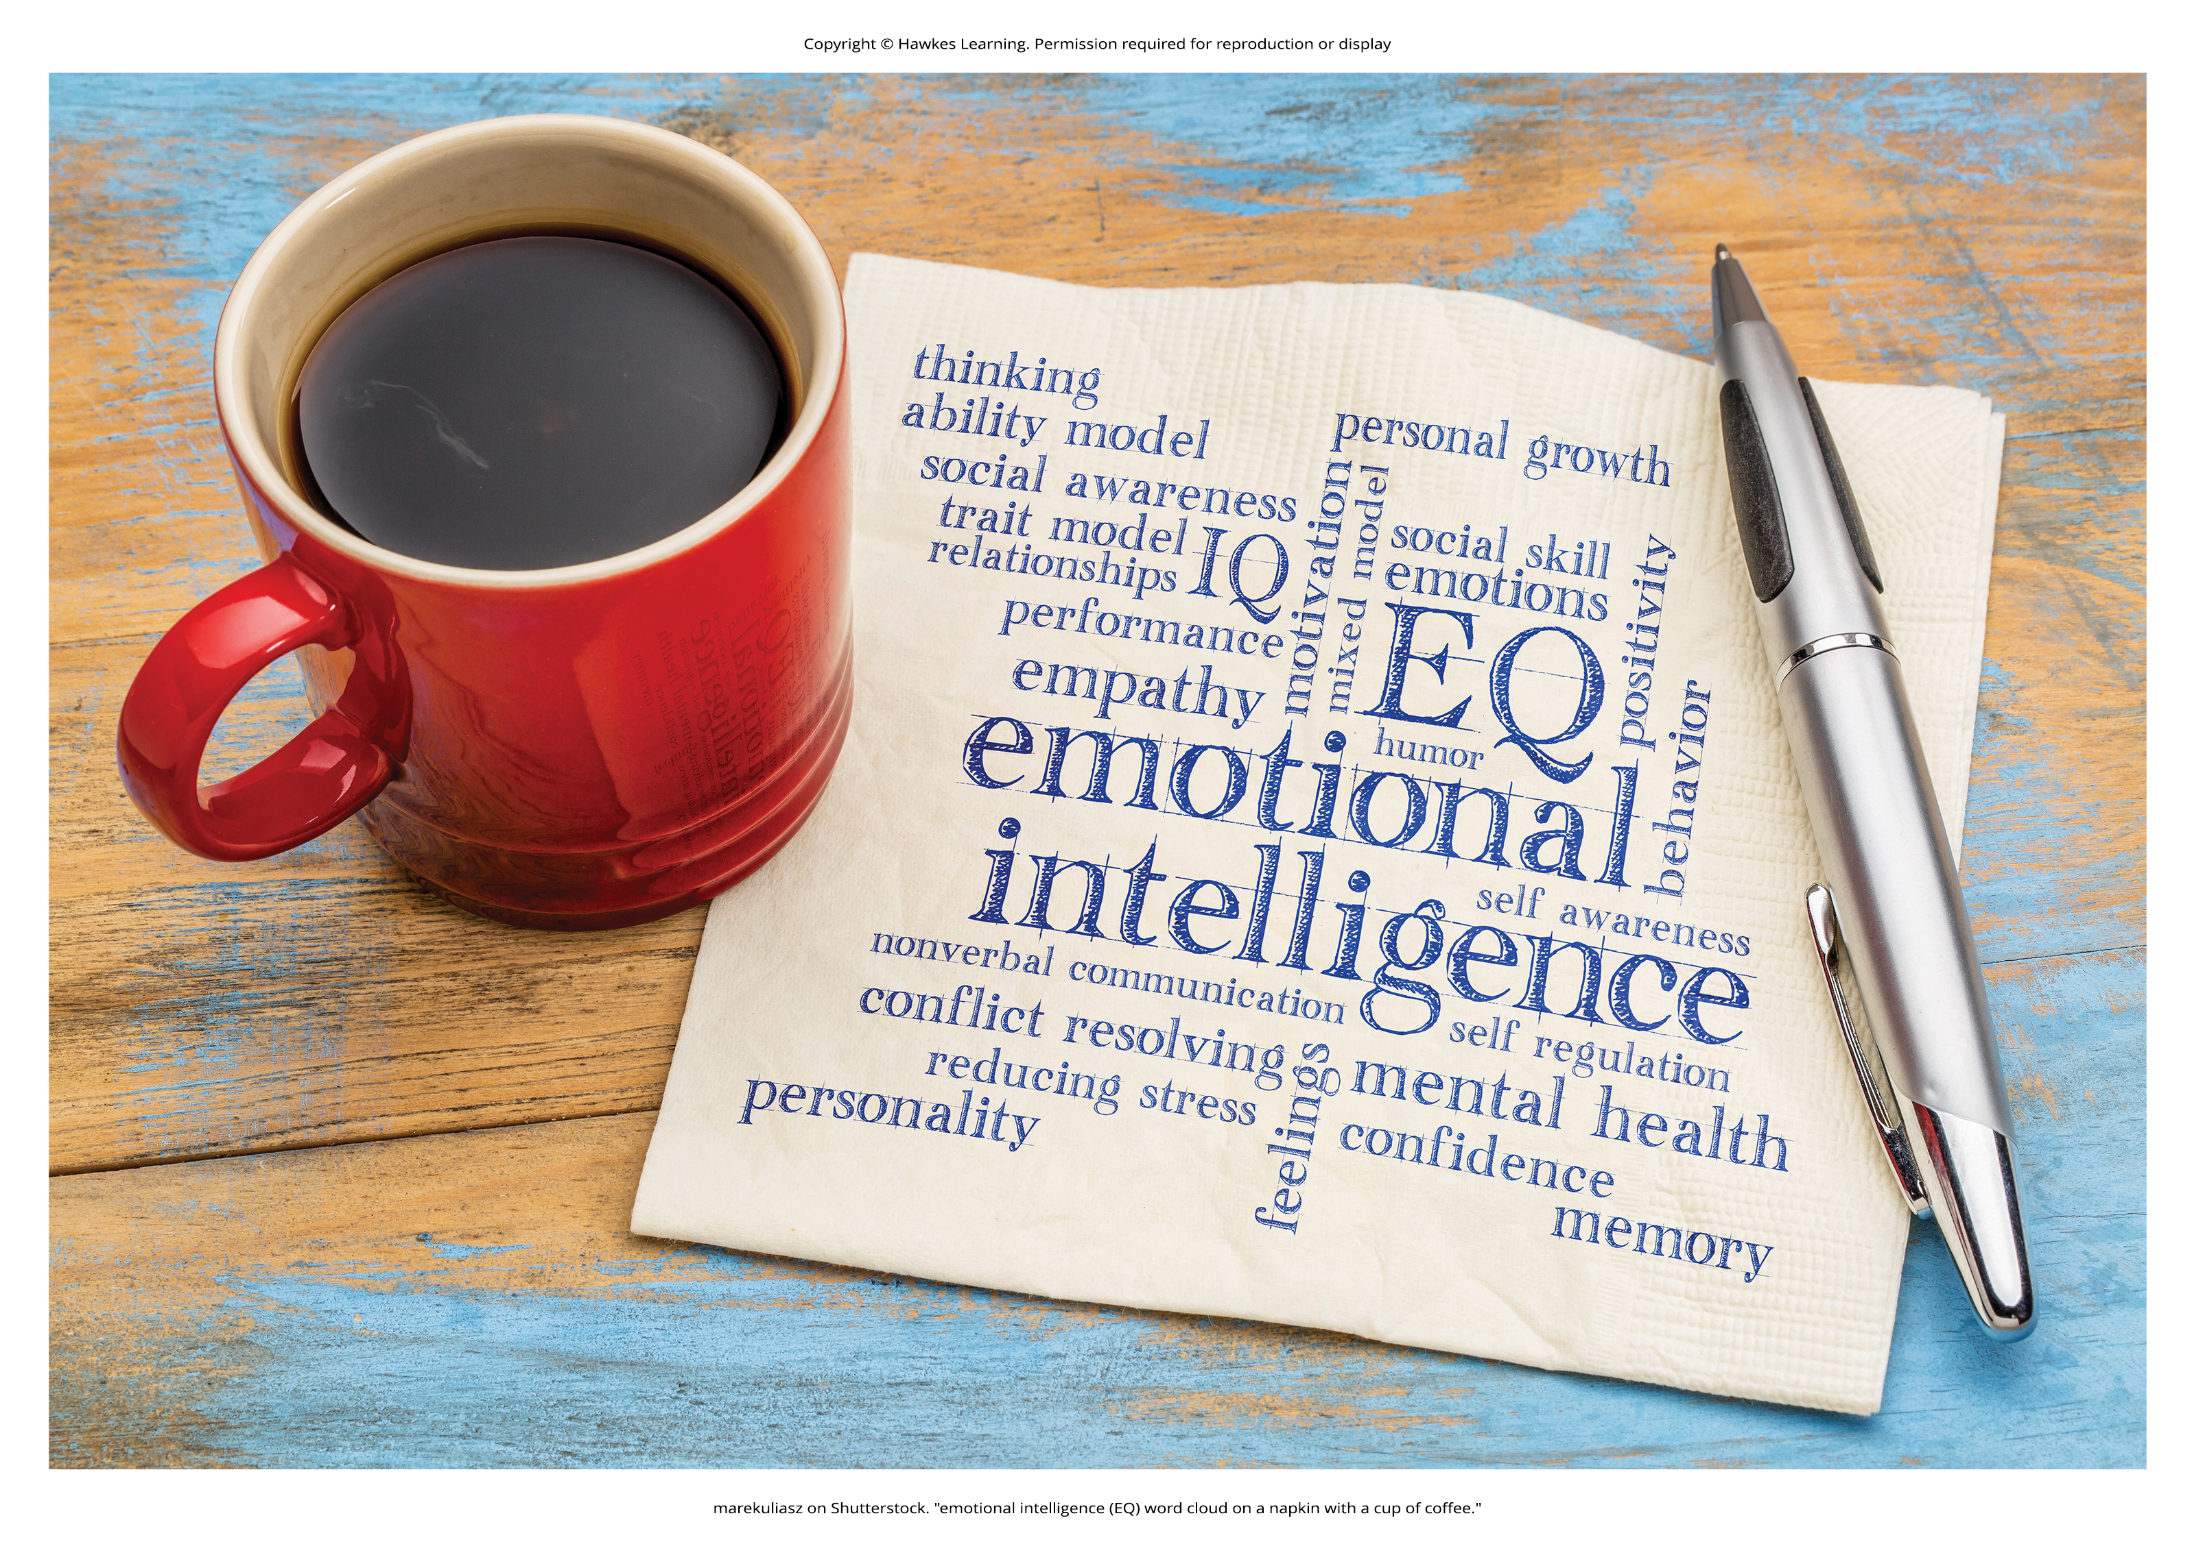
Emotional Intelligence
Emotional intelligence encompasses the ability to understand the emotions of yourself and others, show empathy, understand social relationships and cues, regulate your own emotions, and respond in culturally appropriate ways (Parker et al., 2009).
  People with high emotional intelligence typically have well-developed social skills.
  Some researchers argue that emotional intelligence is a better predictor of success than traditional intelligence (Goleman, 1995).
  In the wake of the COVID-19 pandemic, researchers and clinicians have promoted emotional intelligence to reduce stress (Drigas & Papoutsi, 2020).
Figure 3

Slide 19
Cultural Differences In Meaning Of Intelligence
Intelligence can also have different meanings and values in different cultures.
  Example: If you live on a small island where most people get their food by fishing from boats, it would be important to know how to fish and how to repair a boat.
Some cultures place a high value on working together as a collective.
In these cultures, the importance of the group supersedes the importance of individual achievement.
  When you visit such a culture, how well you relate to the values of that culture exemplifies your cultural intelligence, sometimes referred to as cultural competence.

Slide 20
Cultural Competence
In a study of graduate students, researchers found that cultural competency training programs not only improve cultural intelligence capabilities but also improve work behavior and resilience (Azevedo & Shane, 2019).
With the ever-increasing globalization of the modern-day workforce, the reliance on understanding and valuing culture differences is becoming exceedingly more important.

Slide 21
Creativity
Creativity is the ability to generate, create, or discover new ideas, solutions, and possibilities.
  Very creative people often have intense knowledge about something, work on it for years, look at novel solutions, seek out the advice and help of other experts, and take risks.
Although creativity is often associated with the arts, it is actually a vital form of intelligence that drives people in many disciplines to discover something new.
  Creativity can be found in every area of life; from the way you decorate your residence to a new way of understanding how a cell works.

Slide 22
Divergent and Convergent Thinking
Creativity is often assessed as a function of one's ability to engage in divergent thinking.
Divergent thinking can be described as thinking "outside the box"; it allows an individual to arrive at unique, multiple solutions to a given problem.
In contrast, convergent thinking describes the ability to provide a correct or well-established answer or solution to a problem (Cropley, 2006; Gilford, 1967; Wigert et al., 2022).

Slide 23
Summary
Intelligence is a complex characteristic of cognition.
Many theories have been developed to explain what intelligence is and how it works.
  Sternberg generated his triarchic theory of intelligence, whereas Gardner posited that intelligence is comprised of many factors.
  Still others focus on the importance of emotional intelligence.
Finally, creativity seems to be a facet of intelligence, but it is extremely difficult to measure objectively.

Slide 24
End of Hawkes Learning PowerPoint

