Slide 1
Lesson 6.5
Measures of Intelligence

Slide 2
Intelligence Quotient (IQ)
Although you're likely familiar with the term IQ and associate it with the idea of intelligence, what does it really mean?
IQ stands for intelligence quotient and describes a score earned on a test designed to measure intelligence.
There are many ways psychologists describe intelligence (or more aptly, intelligences).
Similarly, IQ tests—the tools designed to measure intelligence—have been the subject of debate throughout their development and use.

Slide 3
IQ Tests
IQ tests are expensive to administer and must be given by a licensed psychologist.
Intelligence testing has been considered useful for education and social policy.

Slide 4
Reflection Question₁
When might an IQ test be used?
Have you ever taken an IQ test?
What do we learn from the results, and how might people use this information?

Slide 5
Measuring Intelligence
The IQ test has been synonymous with intelligence for over a century.
In the late 1800s, Sir Francis Galton developed the first broad test of intelligence (Flanagan & Kaufman, 2004).
Intelligence testing began in earnest during the early 1900s with a researcher named Alfred Binet.
Binet was asked by the French government to develop an intelligence test to use on children to determine which ones might have difficulty in school; it included many verbally based tasks.
American researchers soon realized the value of such testing.

Slide 6
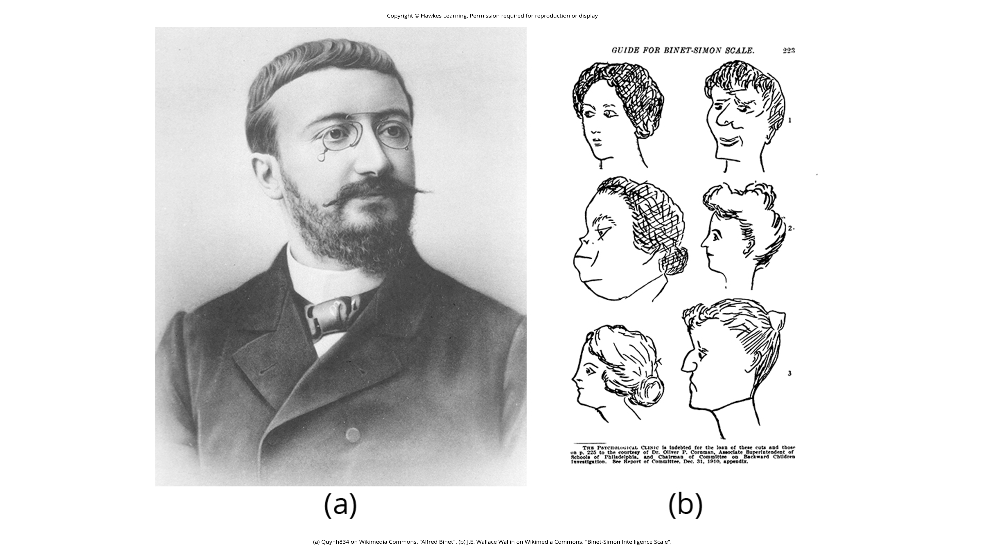
Lesson 6.5 Figure 1
Caption: (a) French psychologist Alfred Binet helped to develop intelligence testing. (b) This page is from a 1908 version of the Binet-Simon Intelligence Scale. Children being tested were asked which face, of each pair, was prettier.

Slide 7
Standardizing And Norming The IQ Test₁
Louis Terman, a Stanford professor, modified Binet's work by standardizing the administration of the test and tested thousands of different-aged children to establish an average score for each age.
As a result, the test was normed and standardized, which means that it was administered consistently to a large enough representative sample of the population that the range of scores resulted in a bell curve.

Slide 8
Standardizing And Norming The IQ Test₂
The resulting data provide norms, or referential scores, by which to interpret future scores. Norms are not expectations of what a given group should know but a demonstration of what that group does know.
Norming and standardizing the test ensures that new scores are reliable. This new version of the test was called the Stanford-Binet Intelligence Scale (Terman, 1916).
An updated version of this test is still widely used today.

Slide 9
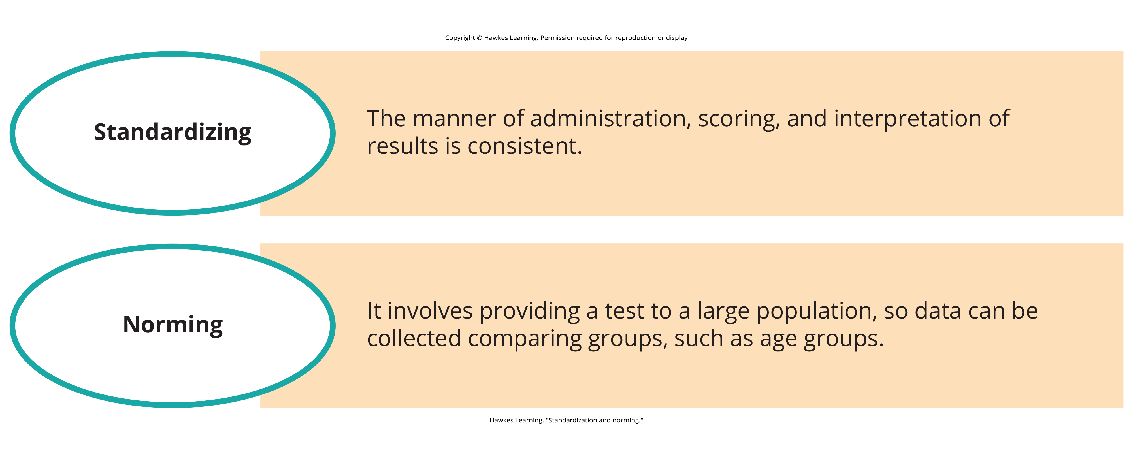
Lesson 6.5 Figure 2
Caption: Standardization and norming are two concepts that IQ testing seeks to fulfill.

Slide 10
Wechsler-Bellevue Intelligence Scale₁
In 1939 psychologist David Wechsler developed a new IQ test in the United States by combining several subtests from other intelligence tests used between 1880 and World War I.
These subtests tapped into a variety of verbal and nonverbal skills because Wechsler believed that intelligence encompassed "the global capacity of a person to act purposefully, to think rationally, and to deal effectively with his environment" (Wechsler, 1958, p. 7).
He named the test the Wechsler- Bellevue Intelligence Scale.

Slide 11
On Your Own₁
Describe why you agree or disagree with Wechsler's definition of what encompasses intelligence.
What do you think reflects signs of intelligence?

Slide 12
Wechsler-Bellevue Intelligence Scale²
This combination of subtests became one of the most extensively used intelligence tests in the history of psychology.
Although its name was later changed to the Wechsler Adult Intelligence Scale (WAIS) and has been revised several times, the aims of the test remain virtually unchanged since its inception (Boake, 2002).
It is still widely criticized for being culturally biased (Miezah, 2015).

Slide 13
Intelligence Tests Credited to Wechsler
Today, there are three intelligence tests credited to Wechsler:
1. The Wechsler Adult Intelligence Scale—fourth edition (WAIS-IV)
2. The Wechsler Intelligence Scale for Children (WISC-V)
3. The Wechsler Preschool and Primary Scale of Intelligence—IV (WPPSI-IV) (Wechsler, 2012)
These tests are used widely in schools and communities throughout the United States, and they are periodically normed and standardized as a means of recalibration.
The periodic recalibrations have led to an interesting observation known as the Flynn effect.

Slide 14
The Flynn Effect
The Flynn effect—named after James Flynn who was among the first to describe this trend—refers to the observation that each generation has a significantly higher IQ than the last.
Flynn himself argues, however, that increased IQ scores do not necessarily mean that younger generations are more intelligent, per se (Flynn et al., 2012).

Slide 15
Reflection Question₂
What do you think causes the Flynn effect?
If younger generations aren't necessarily more intelligent, what are some possible explanations for higher IQ scores than the generation that comes before?

Slide 16
The WISC-V
As a part of the recalibration process, the WISC-V was given to thousands of children across the country, and children taking the test today are compared with their same-age peers.
The WISC-V is composed of 14 subtests comprised of five categories that then render an IQ score. The five categories are:
Verbal comprehension
Visual spatial
Fluid reasoning
Working memory
Processing speed

Slide 17
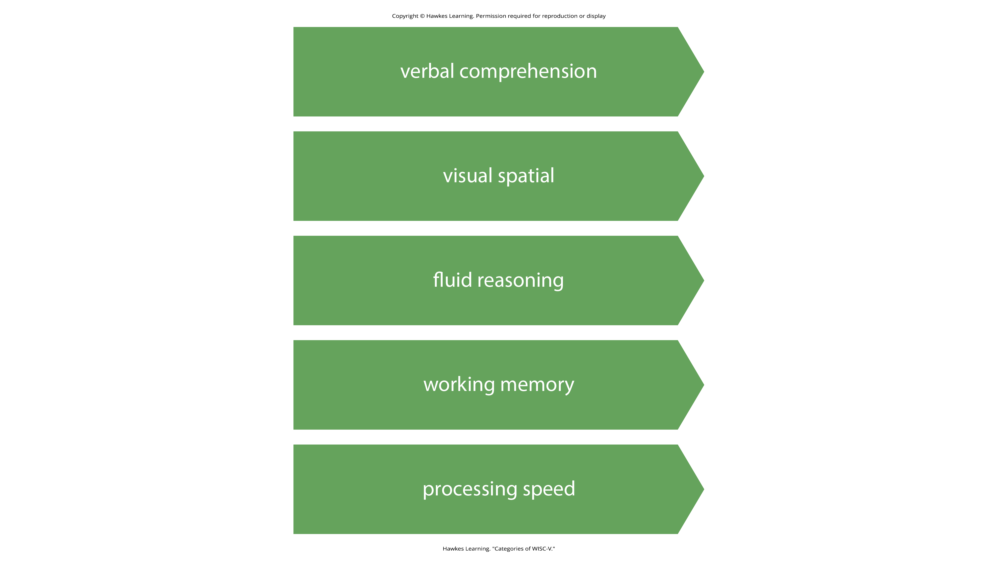
Lesson 6.5 Figure 3
Caption: These categories comprise the 14 subtests of the WISC-V.

Slide 18
WISC-V Scoring
Individuals receive a score for each of the five indices and a Full-Scale IQ score.
The method of scoring reflects the understanding that intelligence is comprised of multiple abilities in several cognitive realms and focuses on the mental processes that the child used to arrive at their answers to each test item.

Slide 19
Debate Around Validity
Ultimately, we are still left with the question of how valid intelligence tests are.
The most modern versions of these tests tap into more than verbal competencies, yet the specific skills that should be assessed in IQ testing, the degree to which any test can truly measure an individual’s intelligence, and the use of the results of IQ tests are still issues of debate (Flynn et al., 2012; Ganuthula & Sinha, 2019; Gresham & Witt, 1997; Richardson, 2002; Schlinger, 2003).

Slide 20
On Your Own₂
In your own words, explain each psychologist’s contributions to IQ testing.
Sir Francis Galton
Alfred Binet
Louis Terman
David Weschler

Slide 21
The Bell Curve
The results of intelligence tests follow the bell curve, a graph in the general shape of a bell.
When the bell curve is used in psychological testing, the graph demonstrates a normal distribution of a trait—in this case, intelligence—in the human population.
Many human traits naturally follow the bell curve.
Example: If you lined up all your female schoolmates according to height, it is likely that a large cluster of them would be the average height for an American woman: 5'4" to 5'6".
This cluster would fall in the center of the bell curve, representing the average height for American women.

Slide 22
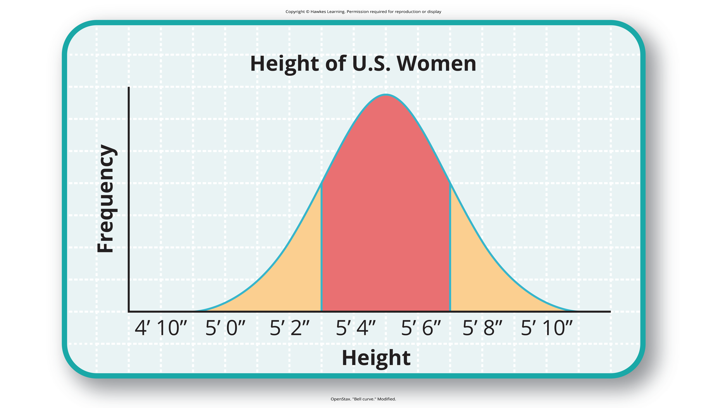
Lesson 6.5 Figure 4
Caption: Are you of below-average, average, or above-average height?

Slide 23
Representative Samples
The trick to finding a bell curve in nature is to use a large sample size.
Without a large sample size, it is less likely that the bell curve will represent the wider population.
A representative sample is a subset of the population that accurately represents the general population.
Example: If you measured the height of the women in your classroom only, you might not actually have a representative sample.

Slide 24
Intelligence Quotient (IQ) Scores
The same principles apply to intelligence tests scores. Individuals earn a score called an intelligence quotient (IQ).
Over the years, different types of IQ tests have evolved, but the way scores are interpreted remains the same. The average IQ score on an IQ test is 100.
Standard deviations describe how data are dispersed in a population and give context to large data sets.
The bell curve uses the standard deviation to show how all scores are dispersed from the average score (Figure 5, next slide).

Slide 25
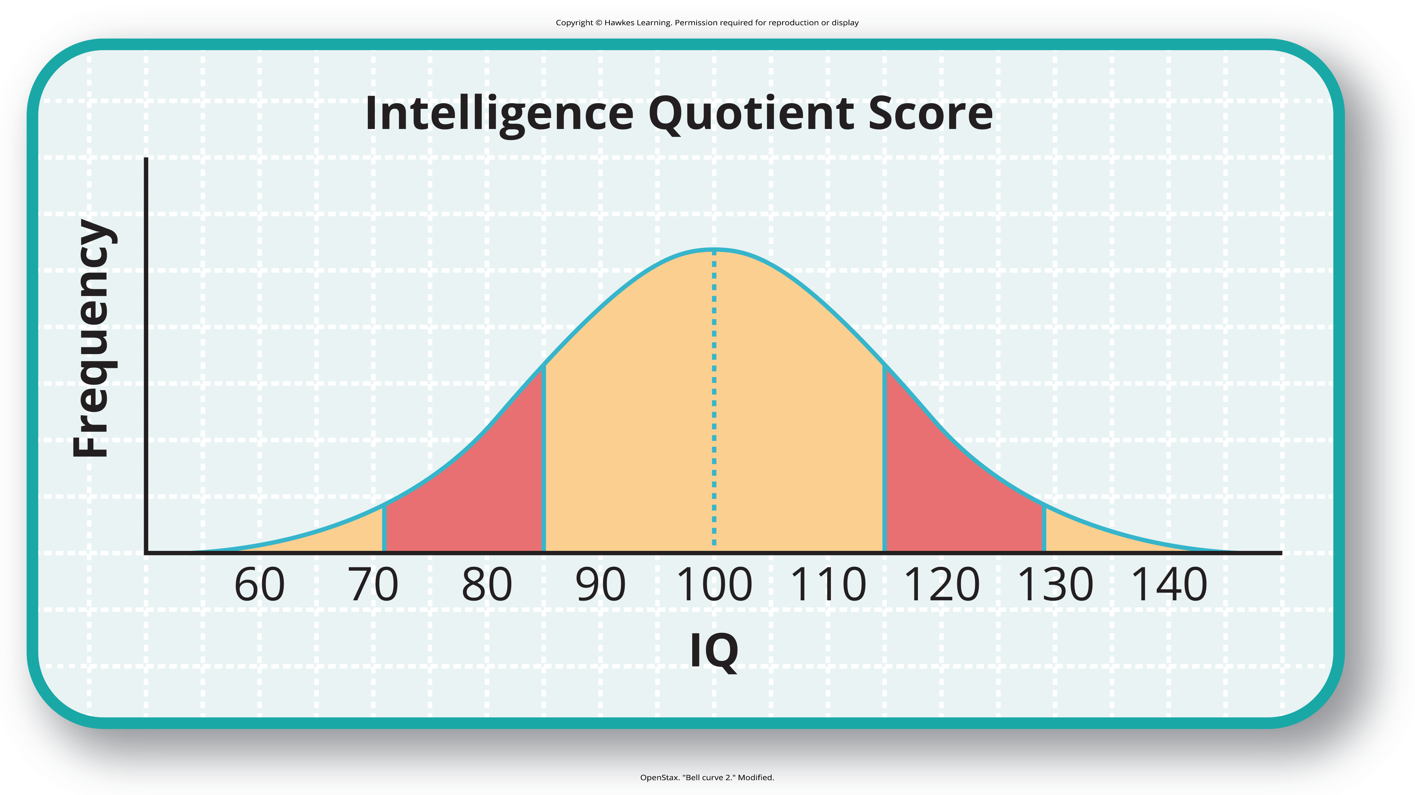
Lesson 6.5 Figure 5
Caption: The majority of people have an IQ score between 85 and 115.

Slide 26
Standard Deviations In IQ Scoring
In modern IQ testing, one standard deviation is 15 points.
So, a score of 85 would be described as "one standard deviation below the mean."
Any IQ score that falls within one standard deviation above and below the mean (between 85 and 115) is considered average, and 68% of the population has IQ scores in this range.
An IQ score of 130 or above is considered a superior level.

Slide 27
IQ Scores Below 70
Only 2.2% of the population has an IQ score below 70 (American Psychiatric Association [APA], 2013).
A score of 70 or below indicates significant cognitive delays, major deficits in adaptive functioning, and difficulty meeting "community standards of personal independence and social responsibility" when compared to same-aged peers (APA, 2013, p. 37).
An individual in this IQ range would be considered to have an intellectual disability and exhibit deficits in intellectual functioning and adaptive behavior (American Association on Intellectual and Developmental Disabilities, n.d.).

Slide 28
Intellectual Developmental Disorder
Formerly known as intellectual disability, the accepted diagnosis now is intellectual developmental disorder, and it has four subtypes:
Mild, moderate, severe, and profound
The Diagnostic and Statistical Manual of Psychological Disorders, fifth edition, text revision lists criteria for each subgroup across three domains: conceptual, social, and practical (APA, 2022).

Slide 29
IQ Scores Above 130
People are considered gifted if they have an IQ score of 130 or higher, or superior intelligence in a particular area.
Consistent with the bell curve, about 2% of the population falls into this category.
Long ago, popular belief suggested that people of high intelligence were maladjusted. This idea was disproven through Lewis Terman’s longitudinal study, begun in 1921.
His findings showed that these children became well-educated, successful adults who were, in fact, well-adjusted (Terman & Oden, 1947).
Additionally, Terman’s study showed that the subjects were above average in physical build and attractiveness, dispelling an earlier popular notion that highly intelligent people were "weaklings."

Slide 30
Why Measure Intelligence?₁
The value of IQ testing is most evident in educational or clinical settings.
Children who seem to be experiencing learning difficulties or severe behavioral problems can be tested to ascertain whether their difficulties may be partly attributed to an IQ score that is significantly different from the mean for their age group.
Without IQ testing—or another measure of intelligence—children and adults needing extra support might not be identified effectively.

Slide 31
Why Measure Intelligence?₂
IQ testing is also used in courts to determine whether a defendant has special or extenuating circumstances that preclude that person from participating in a trial.
People also use IQ testing results to seek disability benefits from the Social Security Administration.
Some organizations use IQ testing as part of the interviewing process to determine whether candidates would be a good fit for open positions.

Slide 32
Summary
Intelligence tests began in earnest with Binet; Wechsler later developed intelligence tests that are still in use today: the WAIS-IV and WISC-V.
The bell curve shows the range of scores that encompass average intelligence as well as standard deviations.

Slide 33
End of Hawkes Learning PowerPoint

