Slide 1
Lesson 6.6
The Source of Intelligence

Slide 2
High Intelligence: Nature Or Nurture?
Is intelligence determined by genetics?
Researchers from the Minnesota Study of Twins Reared Apart found that identical twins raised together and identical twins raised apart exhibit a higher correlation between their IQ scores than siblings or fraternal twins raised together (Bouchard et al., 1990).
The findings from this study suggest that intelligence is partially determined by genetics.
Other studies suggest that although genetics seem to be in control of the level of intelligence, environmental influences help determine if a child reaches their full potential (Bartels et al., 2002; Goriounova & Mansvelder, 2019).

Slide 3
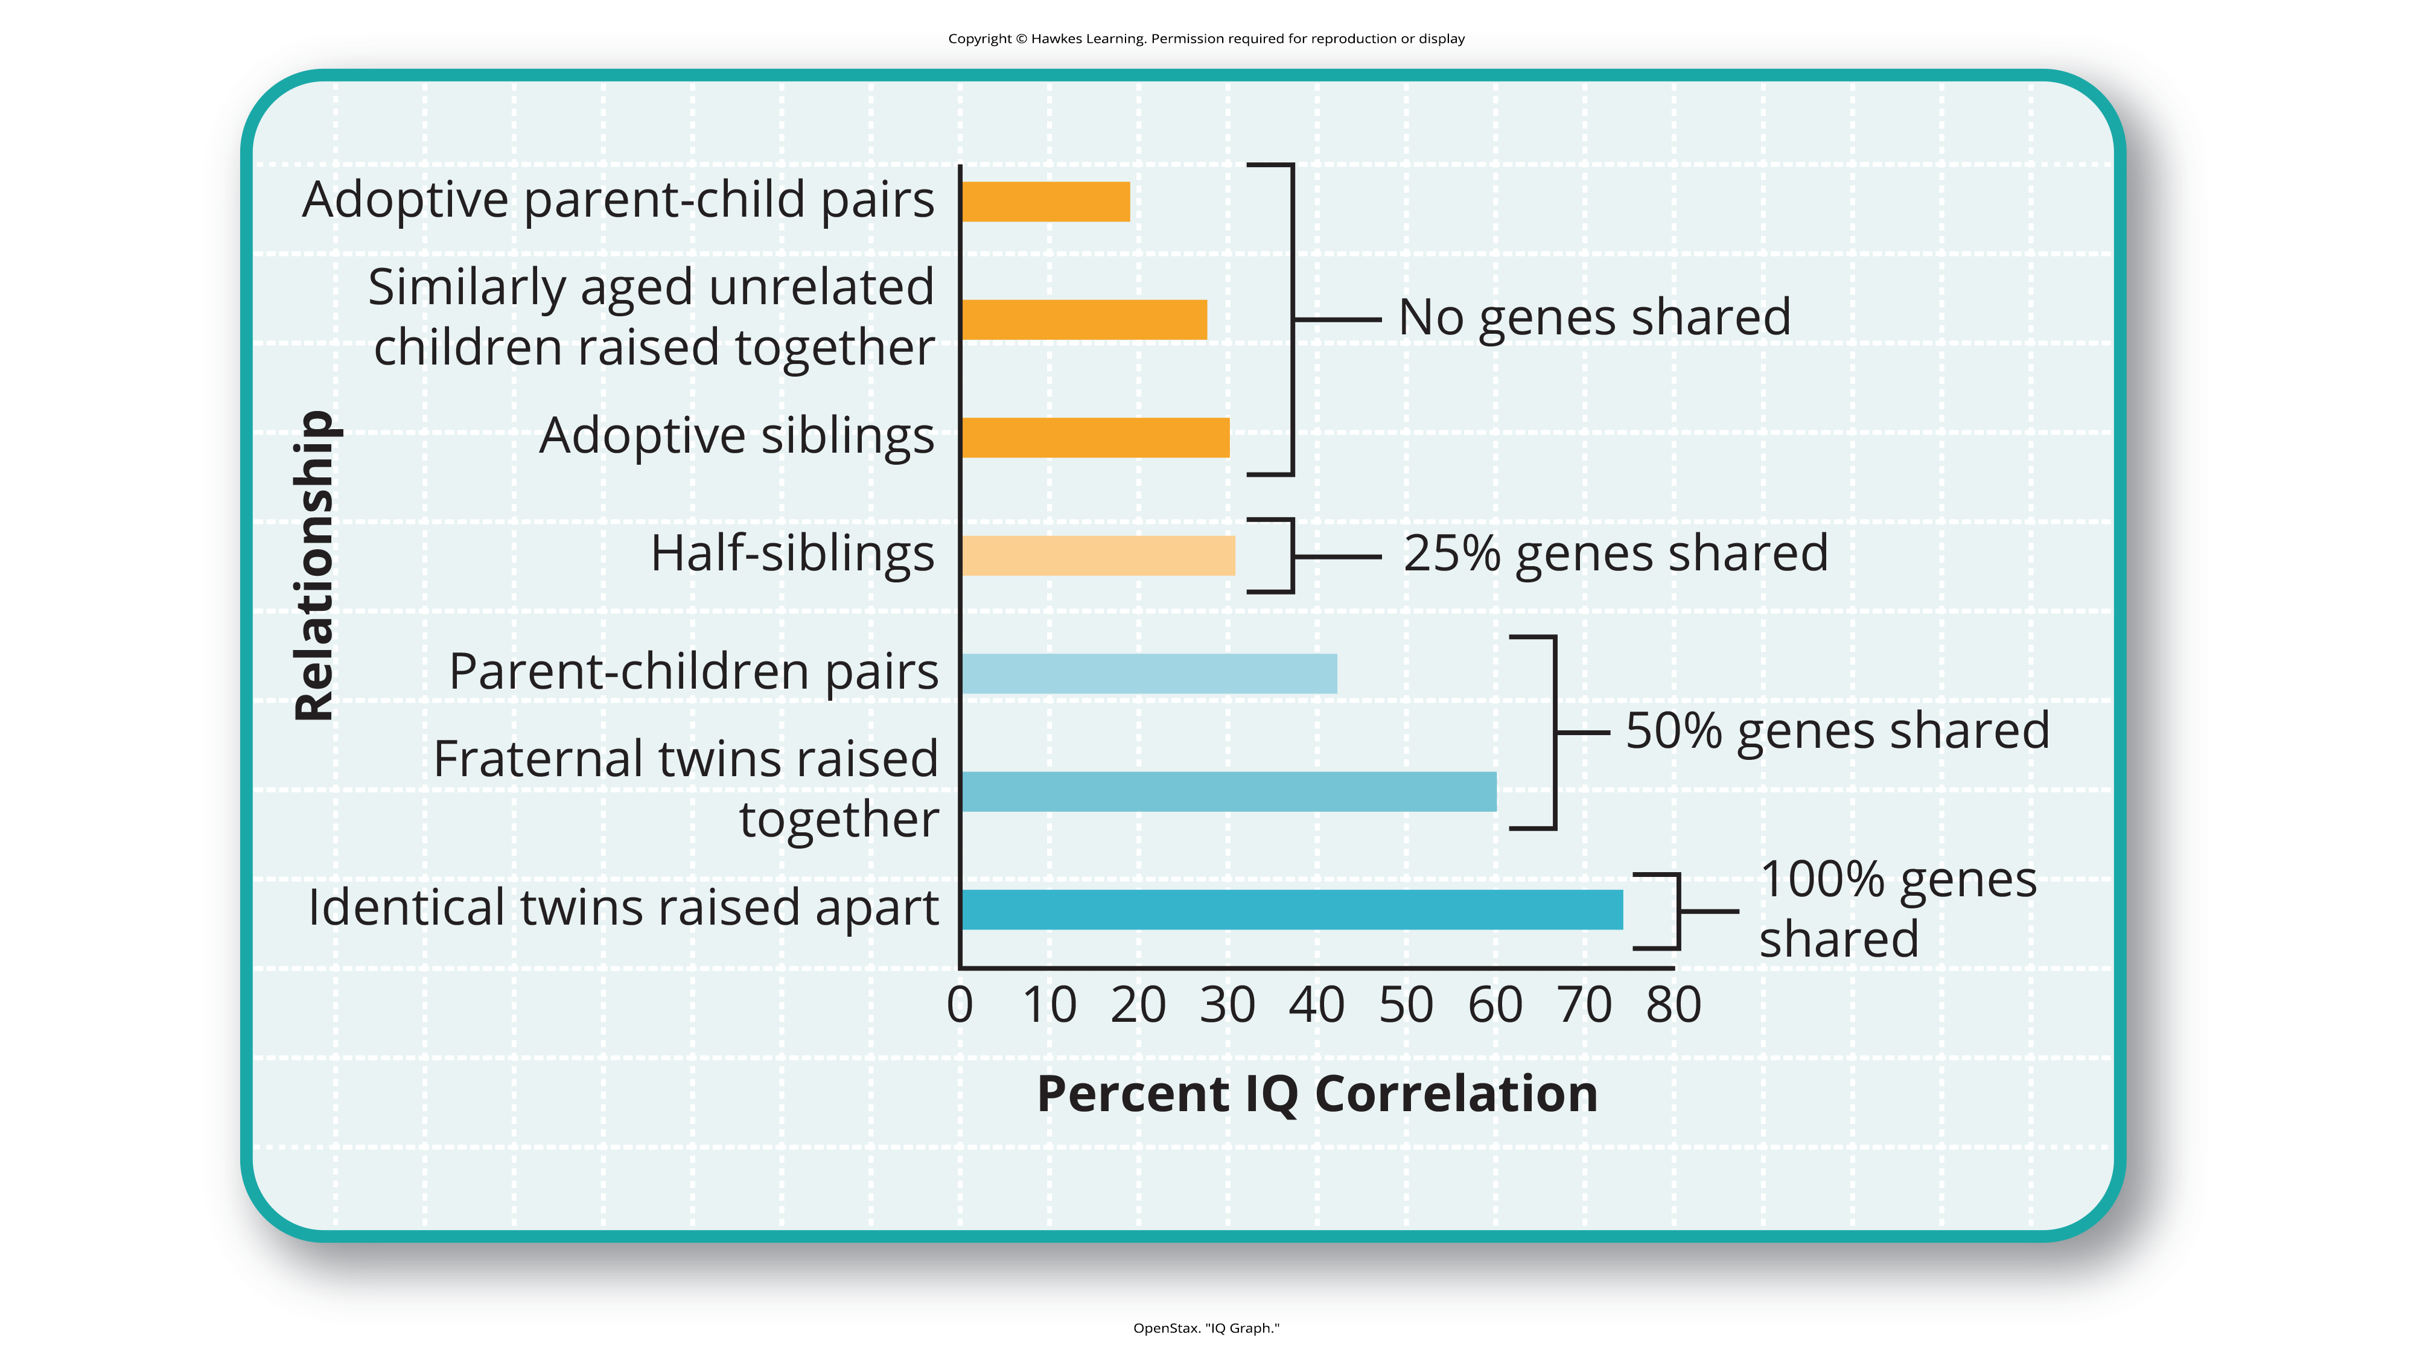
Lesson 6.6 Figure 1
Caption: The correlations of IQs of unrelated versus related persons reared apart or together suggest a genetic component to intelligence.

Slide 4
Reflection Question₁
What about a child's environment do you think is most important for them to achieve their full intellectual potential?

Slide 5
Range Of Reaction
Range of reaction is the theory that each person responds to the environment in a unique way based on their genetic makeup.
According to this idea, your genetic potential is a fixed quantity, but whether you reach your full intellectual potential is dependent upon the environmental stimulation you experience, especially in childhood.

Slide 6
Arthur Jensen's Controversial Theory₁
Children and adults who come from certain minority ethnic groups or come from more impoverished socioeconomic backgrounds tend to have lower IQ scores.
Arthur Jensen made a controversial conclusion that Black Americans had lower conceptual and analytical abilities than White and Asian Americans (Jensen, 1969; Modgil & Modgil, 1987; Williams, 1970).

Slide 7
Arthur Jensen's Controversial Theory₂
Jensen posited that intelligence was made up of two types of abilities: Level I and Level II.
In his theory, Level I is responsible for rote memorization, whereas Level II is responsible for conceptual and analytical abilities.
According to his findings, Level I remains consistent among the human race.
Level II, however, exhibits differences among ethnic groups (Modgil & Modgil, 1987).

Slide 8
Arthur Jensen's Controversial Theory₃
Jensen's most controversial conclusion was that Level II intelligence is most prevalent among Asian Americans and least prevalent among Black Americans, with White Americans falling in the middle.
Robert Williams was among those who called out racial bias in Jensen’s results (Williams, 1970).

Slide 9
Poverty As A Factor In IQ Testing
Recent research has indicated that children growing up in poverty, which includes a higher proportion of Black Americans than White and Asian Americans, do not have their basic needs of safety, food, and shelter met on a consistent basis.
Even when these children do have their needs met, they may frequently worry that they will lose them in the future.
As a result, this excessive worry and stress can impact performance on IQ tests (Kishyama et al., 2009; Jung et al., 2019).

Slide 10
Larry P. v. Riles
Parents of Black American students filed a case against the State of California in 1979 because they believed that the testing method used to identify students with learning disabilities was culturally unfair.
They argued that the tests were normed and standardized using White children (Larry P. v. Riles).
The testing method used by the state disproportionately identified Black American children as intellectually disabled.
These results show the cultural biases that exist with intelligence testing and the importance of cultural sensitivity in the practice of psychological assessment.

Slide 11
Reflection Question₂
What do you think IQ test makers can do to ensure that intelligence tests are unbiased and culturally sensitive?

Slide 12
What Are Learning Disabilities?
Learning disabilities are cognitive disorders that affect different areas of cognition, particularly language or reading.
Learning disabilities are not the same thing as intellectual disabilities.
Learning disabilities are considered specific neurological impairments rather than global intellectual or developmental disabilities.
A person with a language disability has difficulty understanding or using spoken language, whereas someone with a reading disability, such as dyslexia, has difficulty processing what they are reading.

Slide 13
Learning Disabilities And Comorbidity
Learning disabilities tend to exhibit comorbidity with other disorders, like attention-deficit/hyperactivity disorder (ADHD).
Research has found a wide range of comorbid diagnoses between ADHD and learning disorders such as dyslexia and dysgraphia, with reading disabilities being the most common accompanying diagnosis (Langer et al., 2019)
It is important to note that ADHD itself is not considered a learning disability but is classified as a neurodevelopmental disorder (APA, 2022; Gnanavel et al., 2019).

Slide 14
Dysgraphia
Children with dysgraphia have a learning disability that results in a struggle to write legibly.
Dysgraphia can exist independently of intelligence.
A child with an extremely high IQ can still suffer from dysgraphia.
Students with dysgraphia need academic accommodations to help them succeed in school, such as alternative assignment opportunities, such as oral exams (Barton, 2003).

Slide 15
Dyslexia
Dyslexia is the most common learning disability in children.
An individual with dyslexia exhibits an inability to correctly process letters due to the neural mechanism for processing letters not working correctly.
As a result, children with dyslexia may not understand which letter is associated with what sound.

Slide 16
Dyslexia Difficulties
Children with dyslexia are at an extreme disadvantage from their peers because they must learn words by memorizing them because they can’t sound them out.
A child with dyslexia may mix up letters within words and sentences or skip whole words while reading.
Letter reversals, such as those shown in Figure 2 (next slide), are a hallmark of this learning disability (Berninger, 2008; Fischer & Luxembourger, 2021).

Slide 17

Lesson 6.6 Figure 2
Caption: These written words show variations of the word teapot as written by individuals with dyslexia.

Slide 18
On Your Own
Which of the following is not a learning disability?
dysgraphia
dyslexia
bipolar disorder

Slide 19
Summary
Genetics and environment affect intelligence and the challenges of certain learning disabilities.
The intelligence levels of all individuals seem to benefit from rich stimulation in their early environments.
Highly intelligent individuals, however, may have a built-in resiliency that allows them to overcome difficult obstacles in their upbringing.
Learning disabilities can cause major challenges for children who are learning to read and write.
Unlike developmental disabilities, learning disabilities are strictly neurological in nature and are not related to intelligence levels.
Students with dyslexia, for example, may have extreme difficulty learning to read, but their intelligence levels are typically average or above average.

Slide 20
End of Hawkes Learning PowerPoint

