Slide 1
Lesson 7.1
How Memory Functions

Slide 2

Lesson 7.1 Figure 1
Caption: Imagine feeling a sense of confusion as a result of complete memory loss.

Slide 3
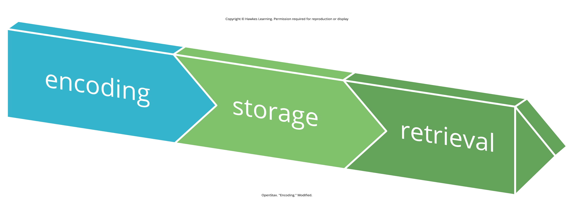
How Memory Functions
Memory: set of processes used to encode, store, and retrieve information over time (Figure 2)
Similar to a computer
Figure 2
Caption: Encoding involves the input of information into the memory system. Storage is the retention of the encoded information. Retrieval, or getting the information out of memory and back into awareness, is the third function.

Slide 4
Encoding₁
Encoding: input of information into the memory system
Involves the labeling or coding of sensory information
Organize information with similar information, connect new concepts to existing ones
Occurs through automatic processing and effortful processing

Slide 5
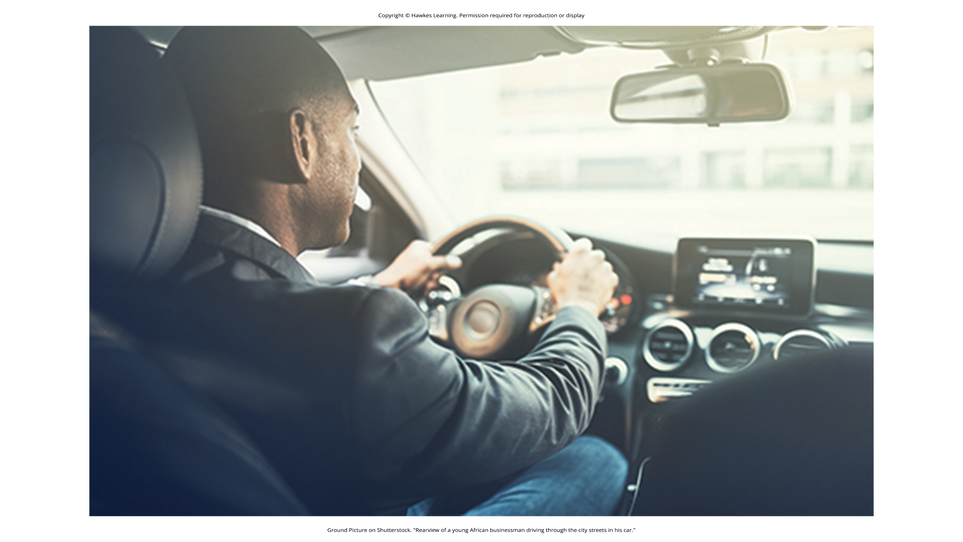
Automatic & Effortful Processing
Automatic processing: encoding of details like time, space, and frequency
Done without conscious awareness
Example: recalling the last time you studied for a test
Effortful processing: encoding of information that requires attention and conscious effort
Example: studying for a test
Figure 3

Slide 6
Encoding₂
Simple sentences are easier to recall when they are meaningful (Anderson, 1984).
Read the following sentences (Bransford & McCarrell, 1974), then look away and count backward from 30, by threes, to zero, then write down the sentences without looking at them again.
The notes were sour because the seams split.
The voyage wasn't delayed because the bottle shattered.
The haystack was important because the cloth ripped.
By themselves, the statements were most likely confusing and difficult to recall.

Slide 7
Encoding₃
Try writing the sentences again, using the following prompts: bagpipe, ship christening, and parachutist.
Count backwards from 40, by fours, then check to see how well you recalled the sentences this time.
The sentences are more memorable because each was placed in context.
Material is better encoded when you make it meaningful.

Slide 8
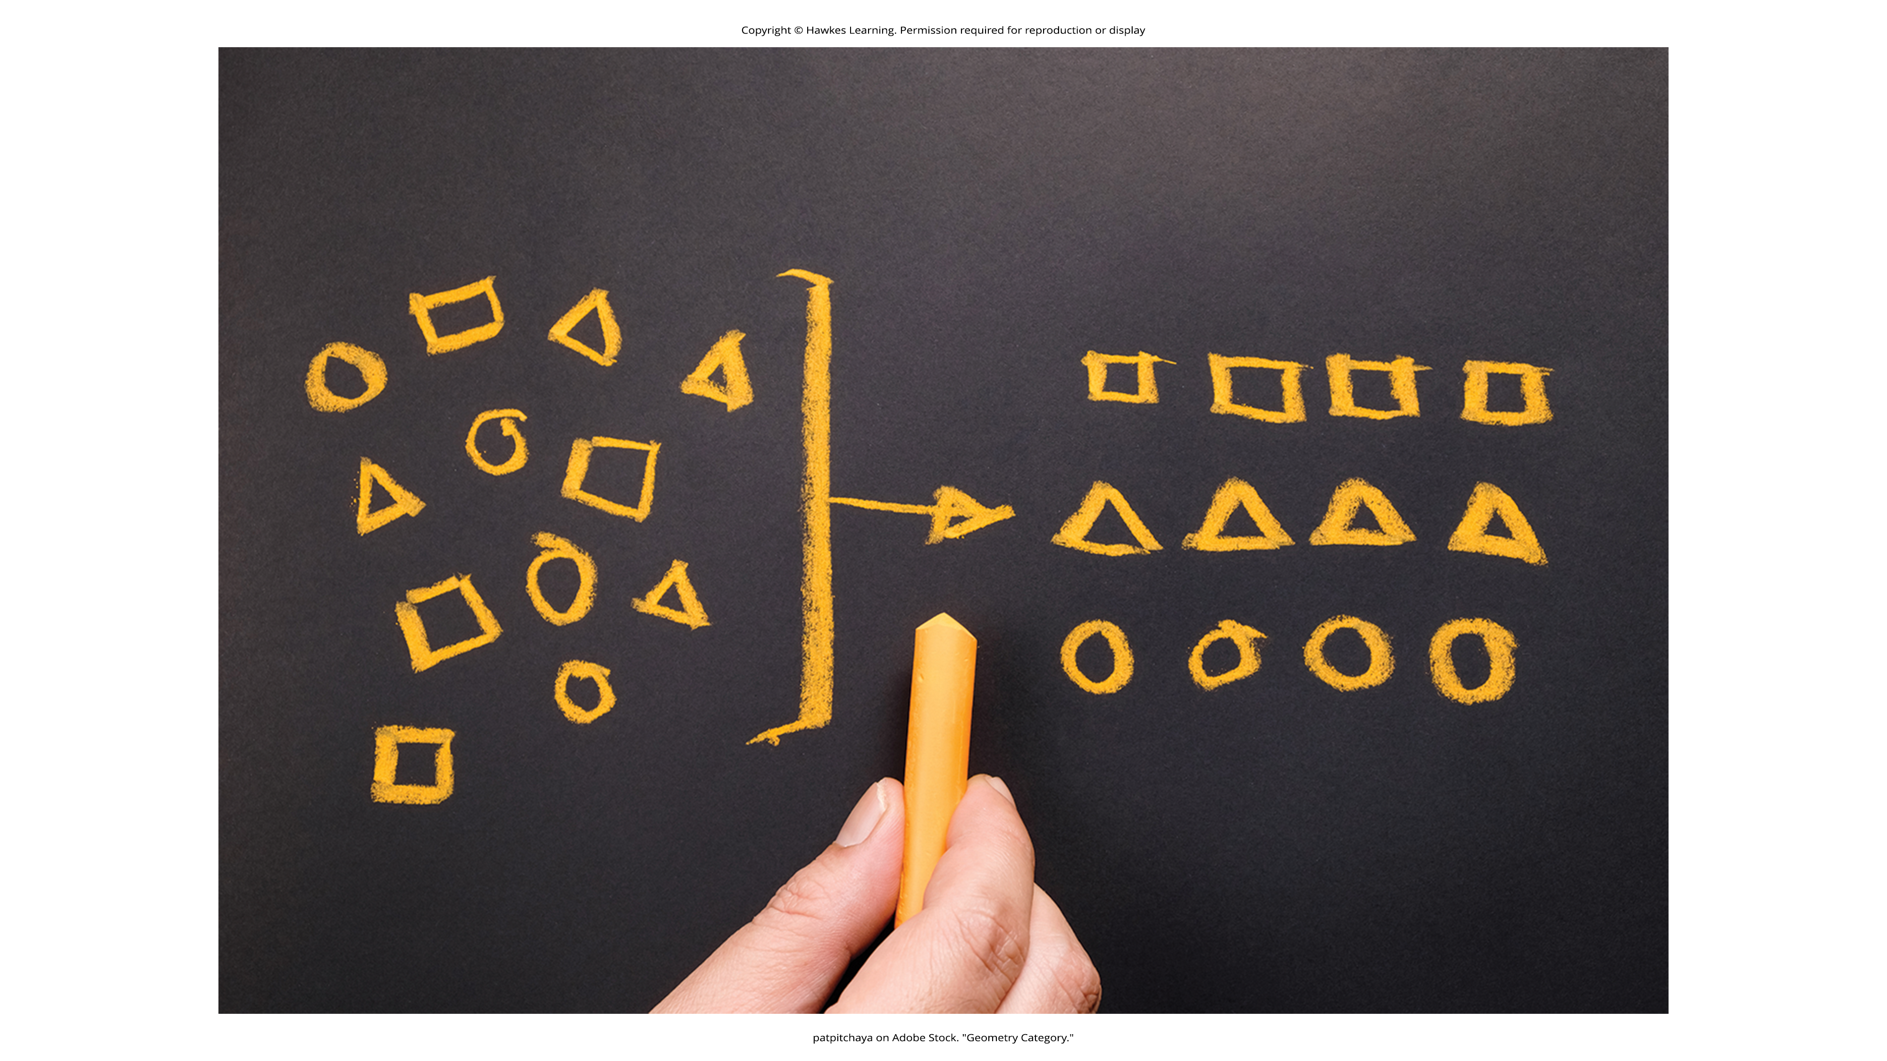
Semantic Encoding
Semantic encoding: encoding of words and their meanings
Often organized through semantic clustering (grouping related items) (Bousfield, 1935)
Figure 4

Slide 9
Visual & Acoustic Encoding
Visual encoding: encoding of images
More effective for high imagery words (e.g., "car," "dog") (Paivio, 1986; Nittono et al., 2002)
Less effective for abstract words (e.g., "level", "truth")
Acoustic encoding: encoding of sounds

Slide 10
Semantic Vs. Visual & Acoustic
Craik and Tulving concluded that we process verbal information best through semantic encoding, especially if we use the self-reference effect.
Self-reference effect: better memory for information related to oneself (Rogers et al., 1977)
Words that had been semantically encoded were better remembered than those visually or acoustically encoded.
Semantic encoding involves a deeper level of processing than visual or acoustic.

Slide 11
Reflection Question₁
What are some ways that you can incorporate semantic encoding and the self-reference effect into the classes you are taking now?

Slide 12
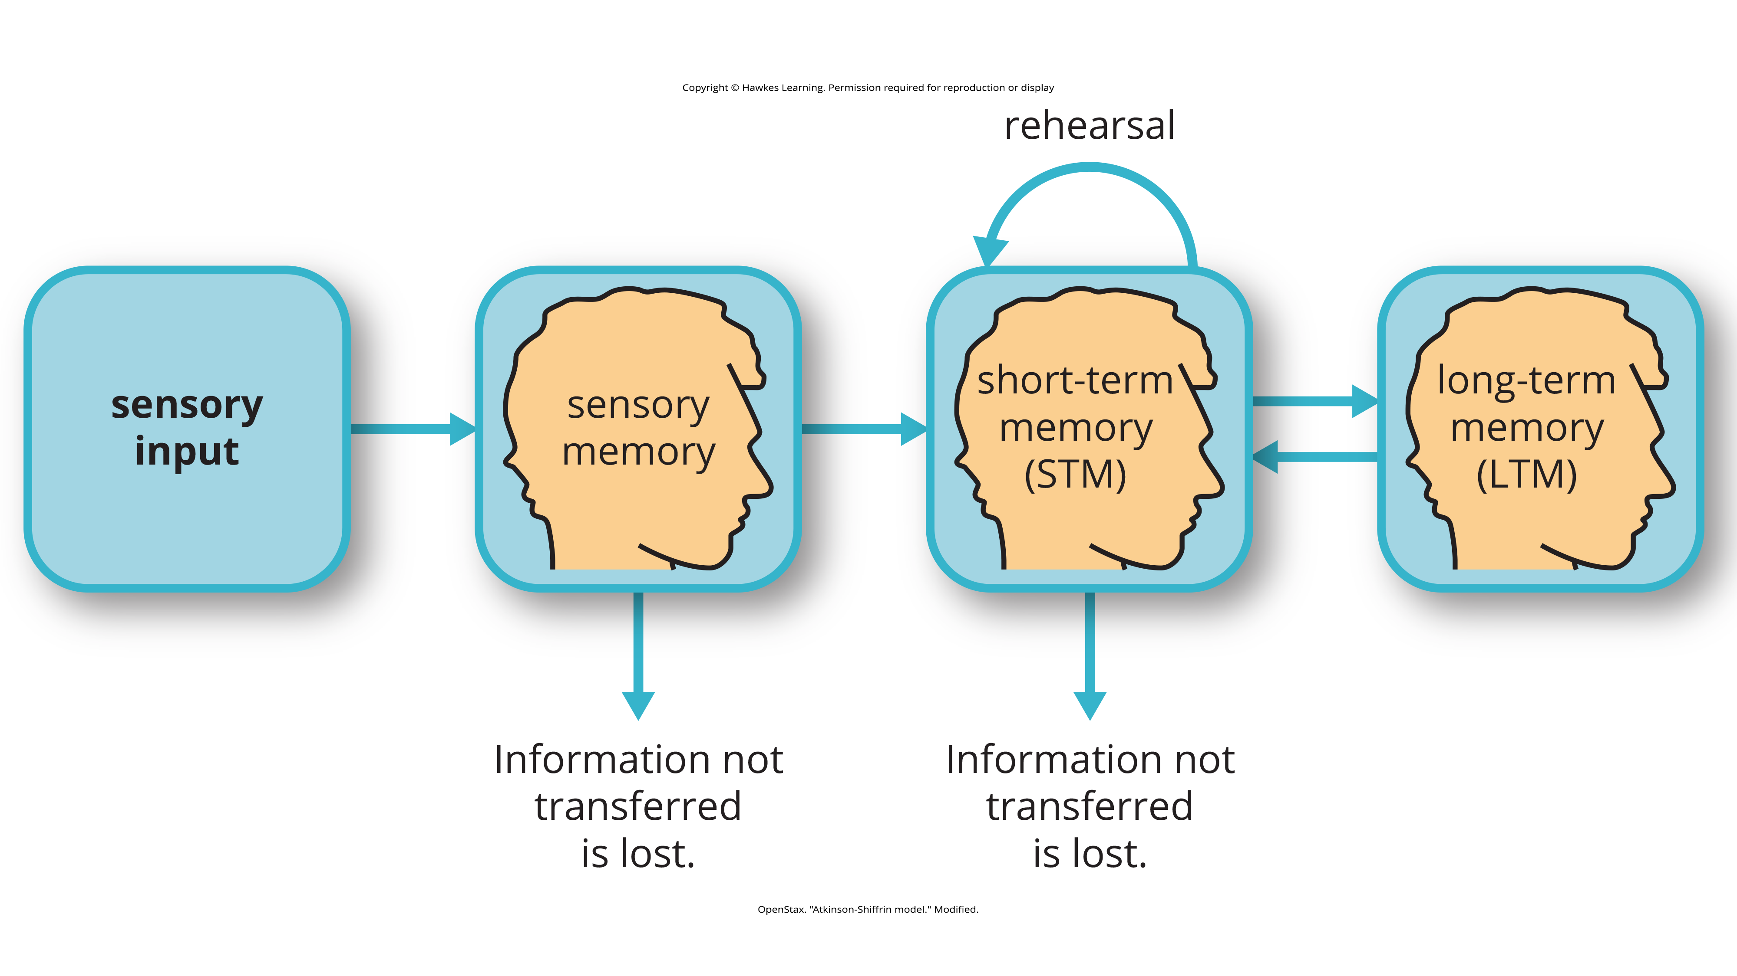
Storage
Storage: creation of a permanent record of information
Atkinson-Shiffrin model: information passes through sensory memory, short-term memory, and long-term memory
Figure 5
Caption: According to the Atkinson-Shiffrin model of memory, information passes through three distinct stages in order for it to be stored in long-term memory.

Slide 13
Baddeley and Hitch Model
Baddeley and Hitch model: short-term memory has multiple forms supervised by a central executive
Forms: visuospatial sketchpad, episodic buffer, phonological loop
Storing memories in short-term similar to opening files on a computer

Slide 14
Sensory Memory
Sensory memory: brief storage of sensory events (sights, sounds, tastes)
Lasts up to a couple of seconds
In Atkinson-Shiffrin model, environmental stimuli first processed here
Stroop effect: demonstrates difficulty in naming the color of a word when the color and word meaning differ

Slide 15
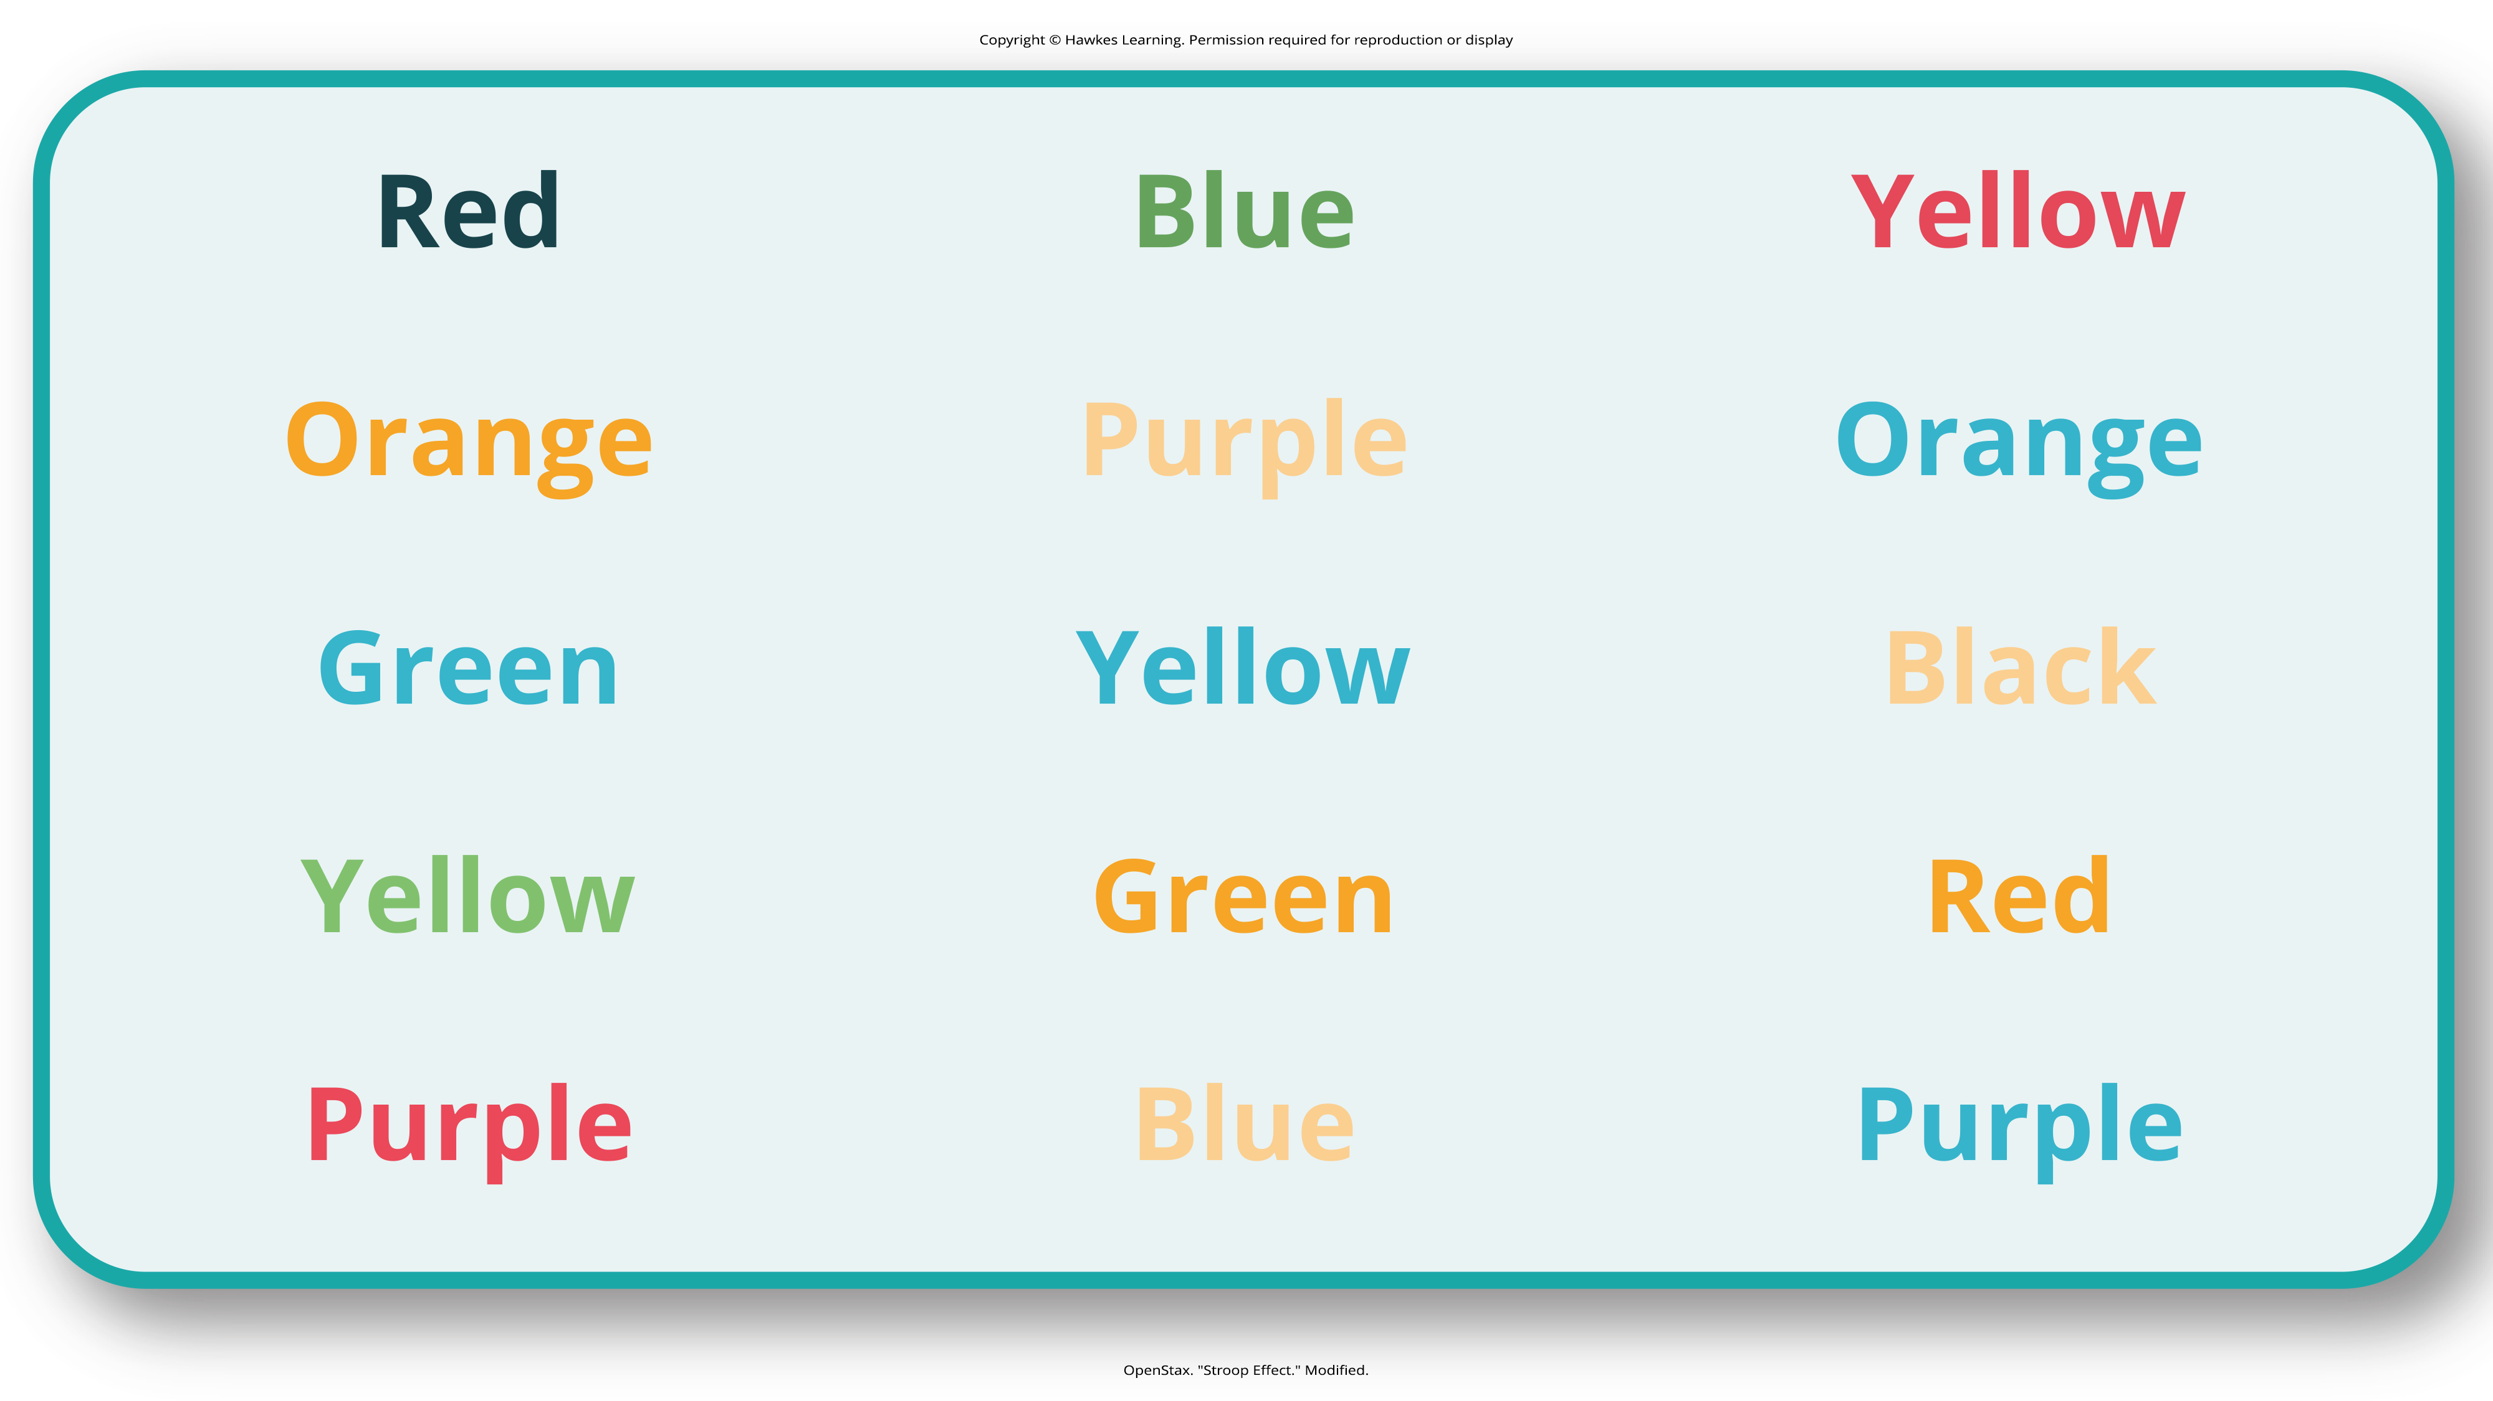
Stroop Effect
Name the colors of the words in Figure 6.
Do not read the words, but say the color the word is printed in.
Figure 6
Caption: The Stroop effect describes why it is difficult for us to name a color when the word and the color of the word are different.

Slide 16
Short-Term Memory
Short-term memory (STM): temporary storage for incoming sensory memory
Sometimes called working memory
Represents everything you are consciously aware of
Average person's STM: 20 seconds
Capacity: typically, 5–9 items (Miller, 1956)
Rehearsal: conscious repetition of information to move it into long-term memory
Memory consolidation: process of storing a short-term memory into long-term memory

Slide 17
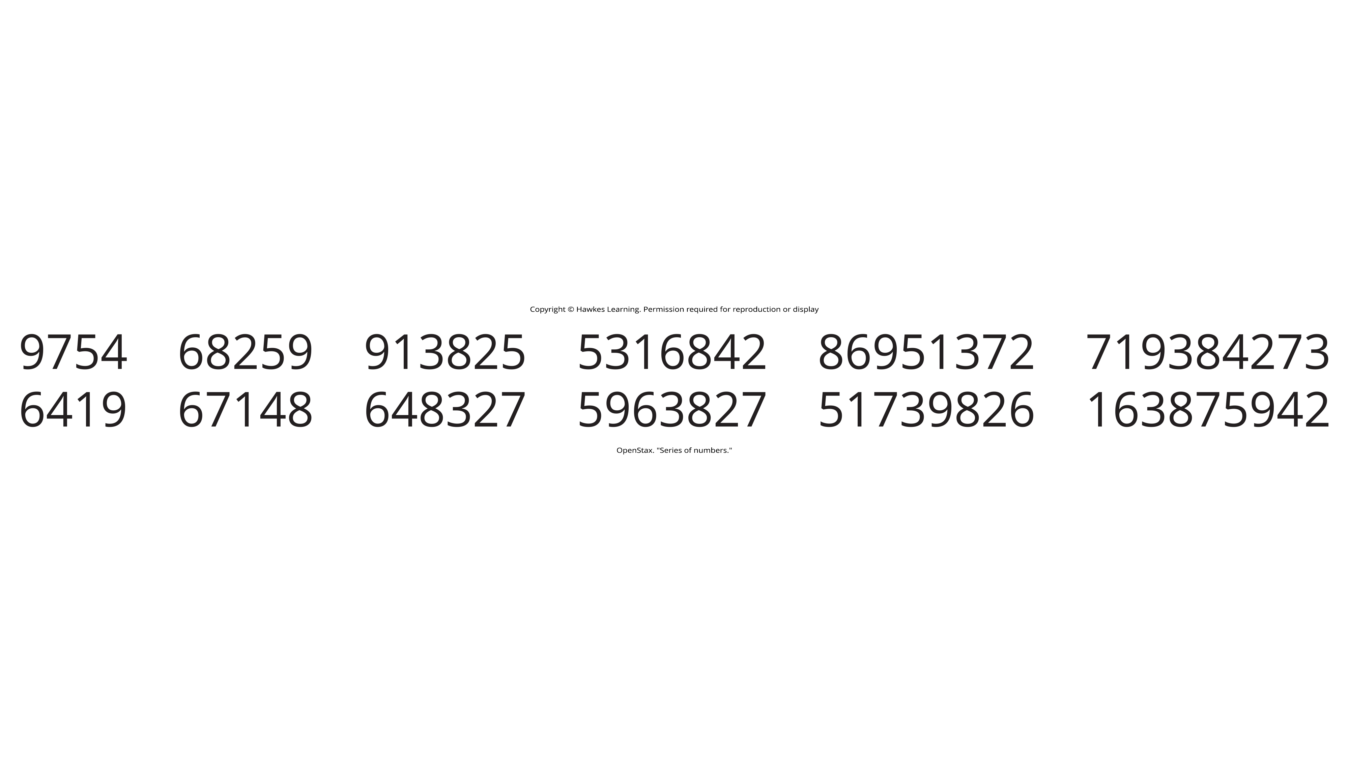
Testing STM Capacity
Have a partner read the strings of random numbers in Figure 7 out loud to you.
Your partner should begin each string by saying, "Ready?" and end each by saying, "Recall."
Try to write down the string of numbers from memory.
Note the longest string at which you got the series correct.
Figure 7

Slide 18
Reflection Question₂
How did you do on the previous exercise? Did it confirm that you had a good, bad, or average short-term memory? Explain.

Slide 19
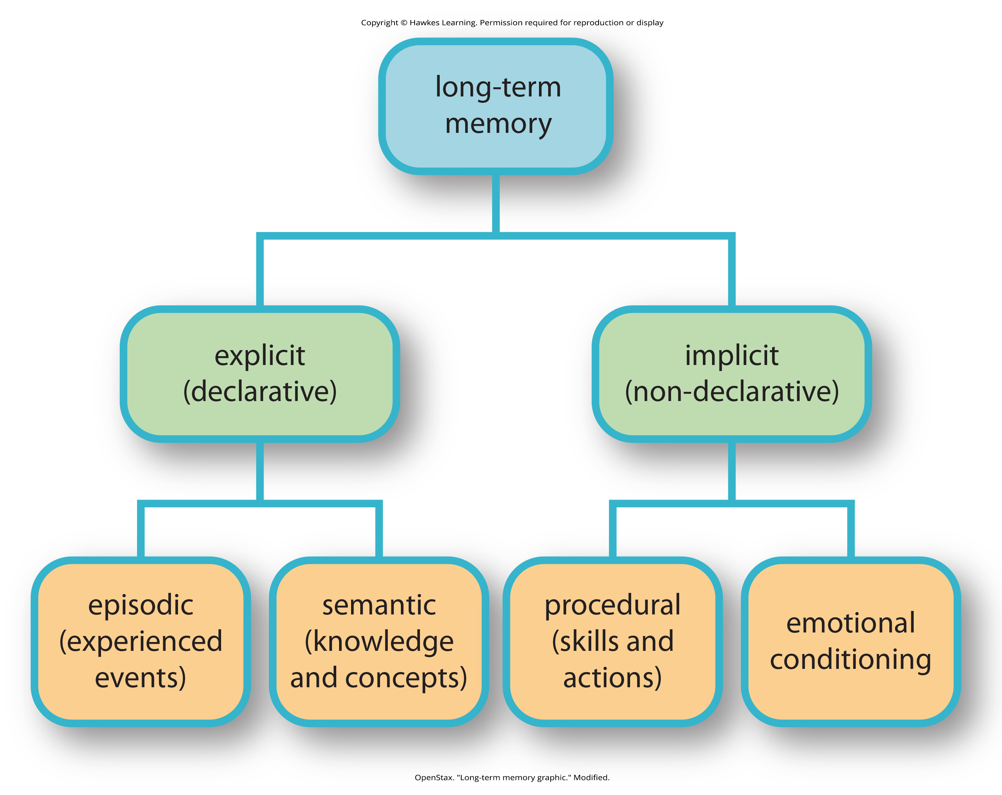
Long-Term Memory
Long-term memory (LTM): continuous storage of memories for everything that has happened in your life
No limits on storage, unlike STM
Divided into explicit and implicit (Figure 8)
Figure 8

Slide 20
Explicit & Implicit Memory₁
Explicit memory: conscious recall of facts and events
Also called declarative memory
Includes semantic memory and episodic memory
Implicit memory: unconscious memory formed by behaviors
Also called non-declarative memory
Includes procedural memory

Slide 21
Explicit & Implicit Memory₂
Procedural memory: type of implicit memory
Stores information about skills and tasks
Example: riding a bike, brushing your teeth
Declarative memory: storage of facts and events personally experienced
Semantic memory: language and facts
Example: historical dates
Episodic memory: personal experiences and events
Example: your last birthday

Slide 22
On Your Own
Give an example of the following types of memory.
Explicit
Implicit
Episodic
Semantic
Procedural

Slide 23
Everyday Connection: Can You Remember Everything You Ever Did or Said?
Most people cannot remember every event in their lives, but Marilu Henner can, due to her HSAM (Figure 9).
Highly superior autobiographical memory (HSAM) is the rare ability to recall vast amounts of personal experiences and details.
Research indicates specific brain structures may be linked to superior memory abilities (LePort et al., 2012).
Lesson 7.1 Figure 9
Caption: Marilu Henner's super autobiographical memory is known as hyperthymesia.

Slide 24
Retrieval
Retrieval: accessing stored information and bringing it into conscious awareness (STM)
Recall: retrieving information without cues
Example: answering an essay question
Recognition: identifying previously learned information when encountered again
Example: multiple-choice questions
Relearning: learning information you previously learned

Slide 25
Reflection Question₃
What type of test would you rather have, an essay or a multiple-choice test? Why? What do you think this says about your preferred method of retrieval?

Slide 26
Summary
Memory: encoding, storage, and retrieval
Atkinson-Shiffrin model: sensory memory to short-term memory to long-term memory
Baddeley and Hitch model: feedback loops between STM and LTM
Long-term memory: divided into explicit (semantic, episodic) and implicit (procedural) memories
Retrieval: recall, recognition, and relearning

Slide 27
End of Hawkes Learning PowerPoint

