Slide 1
Lesson 7.2
Parts of the Brain Involved with Memory

Slide 2
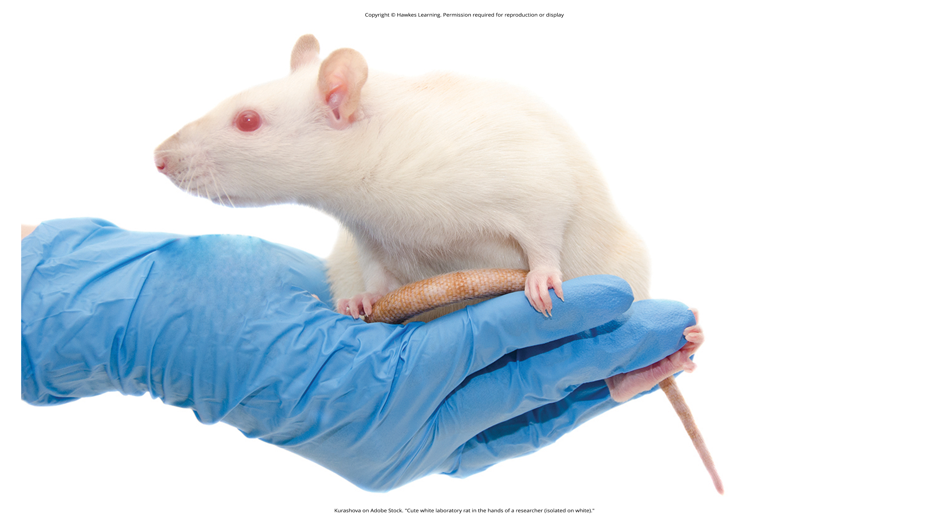
Parts Of The Brain Involved With Memory₁
Karl Lashley attempted to find the engram by creating brain lesions in rats.
  Engram: group of neurons that serve as the "physical representation of memory" (Josselyn, 2010)
Lashley trained rats to find their way through a maze; he used a soldering iron to create lesions in the cerebral cortex.
  Trying to erase the engram (original memory trace) of the maze
The rats were still able to find their way through the maze despite the lesions.
  Equipotentiality hypothesis: if part of one area of the brain involved in memory is damaged, another part of the same area can take over (Lashley 1950)
Figure 1

Slide 3
Parts Of The Brain Involved With Memory₂
Modern psychologists have continued Lashley's work.
  Eric Kandel focused on the synapse's role in memory storage (Mayford et al., 2012).
  Many believe the entire brain is involved in memory.
  Some argue that memory is processed in specific parts of the brain, with specific neurons recognized for their part in memory formation.
Main parts of the brain involved in memory are amygdala, hippocampus, cerebellum, and prefrontal cortex (Figure 2).
  Interactions among these support complex learning and memory (Yavas et al., 2019).

Slide 4
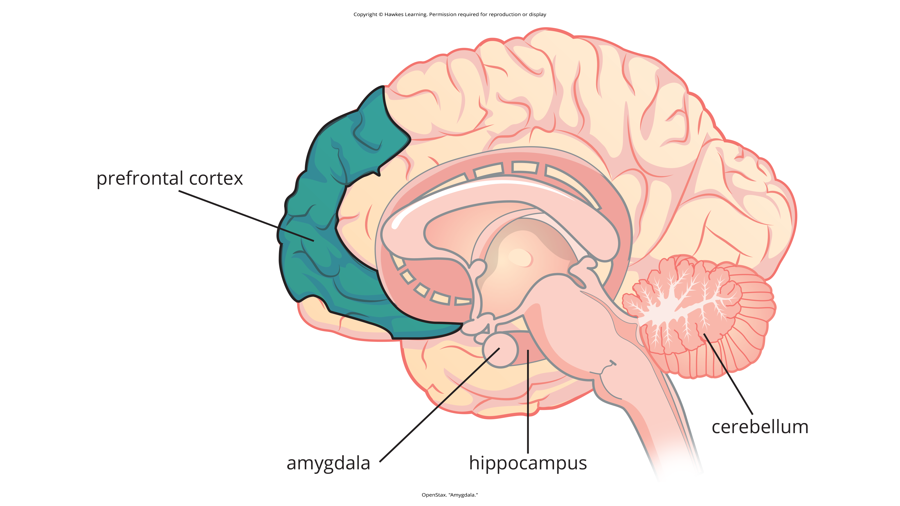
Lesson 7.2 Figure 2
Caption: The amygdala is involved in fear and fear memories. The hippocampus is associated with declarative and episodic memory as well as recognition memory. The cerebellum plays a role in processing procedural memories, such as how to play the piano. The prefrontal cortex appears to be involved in remembering semantic tasks.

Slide 5
The Amygdala
Amygdala: regulates emotions; plays a role in how memories are stored
  Memory storage influenced by stress hormones
Experiment: rats and fear memories (Josselyn, 2010)
  Neutral tone and foot shock produced fear memory.
  After the tone, rats froze, indicating memory for the impending shock.
  Researchers induced cell death in lateral amygdala, showed fading fear memory.
Also involved in memory consolidation (process of transferring new learning to long-term memory)
Facilitates encoding memories at a deeper level when the event is emotionally arousing

Slide 6
Group Activity
In a small group, make a list of ways in which the rats' defensive response of freezing might be adaptive from an evolutionary perspective. Next, discuss and list examples of how the "fight-or-flight" response in humans is adaptive. As a class, share your lists and discuss what they have in common.

Slide 7
The Hippocampus
Experiment: rats and memory processing
  Created lesions in the hippocampi of the rats
  Found that rats demonstrated memory impairment on object recognition, maze running
  Concluded hippocampus involved in memory, specifically normal recognition and spatial memory (Clark et al., 2000)
Connects memories with meaning and other related memories
Also plays a part in memory consolidation

Slide 8
Reflection Question
Do you think it is okay to hurt animals if it is for research purposes? Why or why not?

Slide 9
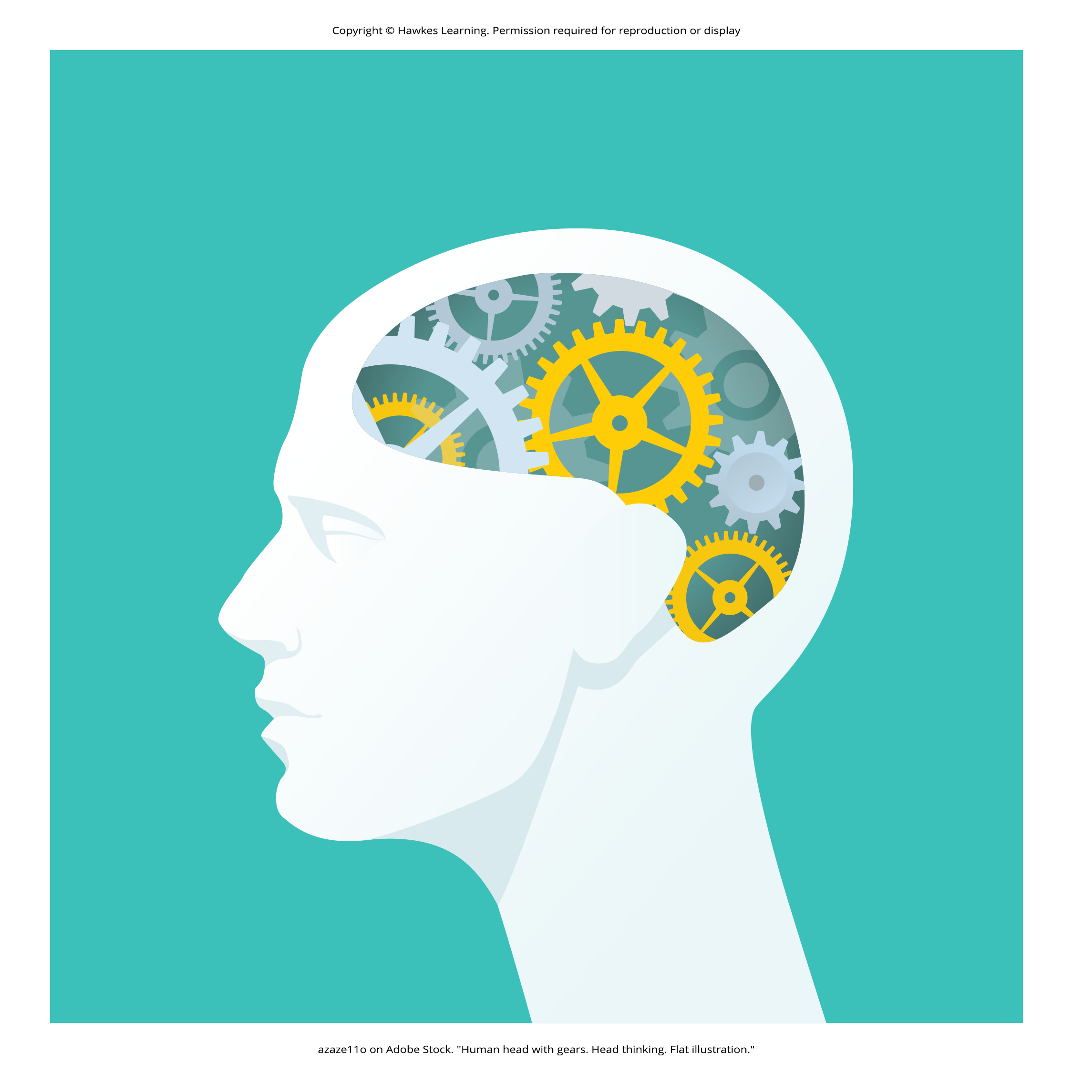
Damage to the Hippocampus
If damaged, leads to impaired ability to form new declarative memories
  Example: H. M. had hippocampi removed to control seizures (Corkin et al., 1997).
    Declarative memory affected, could not form new semantic knowledge
    Lost the ability to form new memories, could still remember information and events
  Can also alter dreaming patterns (Spanò et al., 2020)
Figure 3

Slide 10
The Cerebellum
Cerebellum: processes implicit memories (procedural memory, motor learning, classical conditioning)
  Experiment: accustom subjects to blink when given a puff of air
    Rabbits with damaged cerebellums unable to learn conditioned eye-blink response (Steinmetz, 1999; Green & Woodruff-Pak, 2000)
Attempts to understand learning/memory deficits due to hippocampus impairments in those with Alzheimer's, Parkinson's, Down syndrome, and Pick's disease (Velazquez, 2018)

Slide 11
The Prefrontal Cortex
Prefrontal cortex: involved in memory processing and retention
Experiment: participants look for the letter a in words (perceptual) or categorize a noun as either living or nonliving (semantic) (Kapur et al., 1994)
  Recall better for semantic task than perceptual task
  More activation in left inferior prefrontal cortex for semantic tasks compared to perceptual tasks
Study: encoding associated with left frontal activity, retrieval associated with the right frontal region (Craik et al., 1999)

Slide 12
On Your Own
Identify the four parts of the brain involved in forming and encoding memories and the role each part plays.

Slide 13
Neurotransmitters₁
Epinephrine, dopamine, serotonin, glutamate, and acetylcholine are involved in memory processes (Myhrer, 2003).
  Discussion and debate about which neurotransmitter plays which role (Blokland, 1995)
Neurotransmitter communication among neurons is critical for new memory formation.

Slide 14

Neurotransmitters₂
Arousal theory: strong emotions form strong memories, and weaker emotions form weaker memories (Christianson, 1992)
  Example: strong emotional experiences can release neurotransmitters and hormones, strengthening memory for emotional events
Figure 4

Slide 15
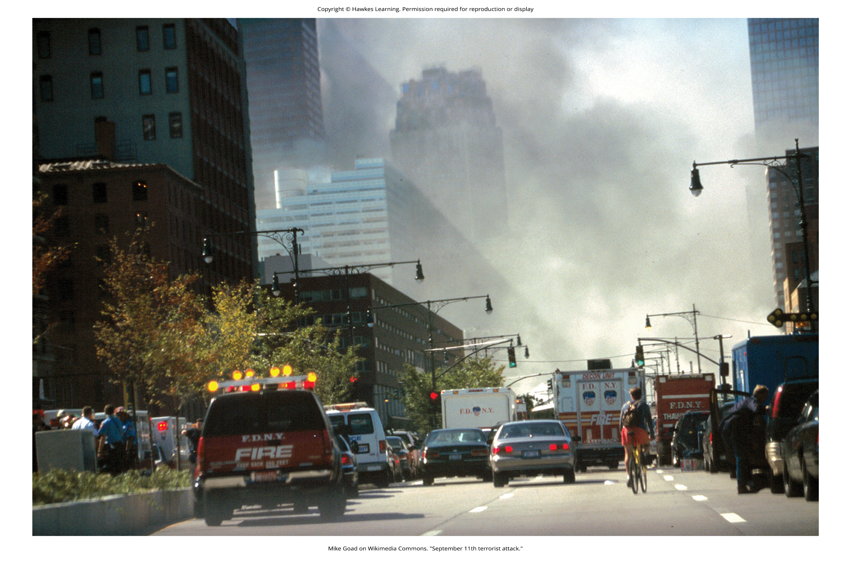
Flashbulb Memory Phenomenon
Stress increases glutamate, aiding in memory formation of stressful events (McGaugh, 2003, 2015).
  Evidenced by flashbulb memory phenomenon: clear recollection of an important event (Figure 5)
  Example: remembering the 9/11 terrorist attacks
Figure 5
Caption: Most people can remember where they were when they first heard about the 9/11 terrorist attacks. This is an example of a flashbulb memory: a record of an atypical and unusual event that has very strong emotional associations.

Slide 16
Dig Deeper: Inaccurate and False Memories
Flashbulb memories can decrease in accuracy over time.
  Example: President Bush's inaccurate recollection of how he heard about the 9/11 attacks (Greenberg, 2004)
Memory can be frail; we can convince a person an event happened even when it did not.
  Study: the word sleep not on a list of sleep-related words, but people recalled hearing the word (Roediger & McDermott, 2000)
    Called the Deese-Roediger-McDermott paradigm

Slide 17
Summary
Lashley's work with the engram led to the hypothesis that several brain areas play significant roles in memory processing and storage.
Cerebellum, hippocampus, and amygdala process different types of memories.
Neurotransmitters and emotions influence the strength of memory formation.
Flashbulb memories can be vivid but inaccurate, and false memories can be created.

Slide 18
End of Hawkes Learning PowerPoint

