Slide 1
Lesson 7.3
Problems with Memory

Slide 2

Problems With Memory
Even individuals with strong memories experience occasional forgetfulness due to various factors.
Memory failures can be frustrating and embarrassing, impacting everyday life.
Figure 1

Slide 3
Amnesia
Amnesia: loss of long-term memory resulting from disease, physical trauma, or psychological trauma
Two types: anterograde and retrograde
Case study: K. C.'s motorcycle incident and resulting severe amnesia
Studied by psychologist Endel Tulving (2002) and colleagues at the University of Toronto
Exhibited profound episodic amnesia, unable to recall any personal life events

Slide 4
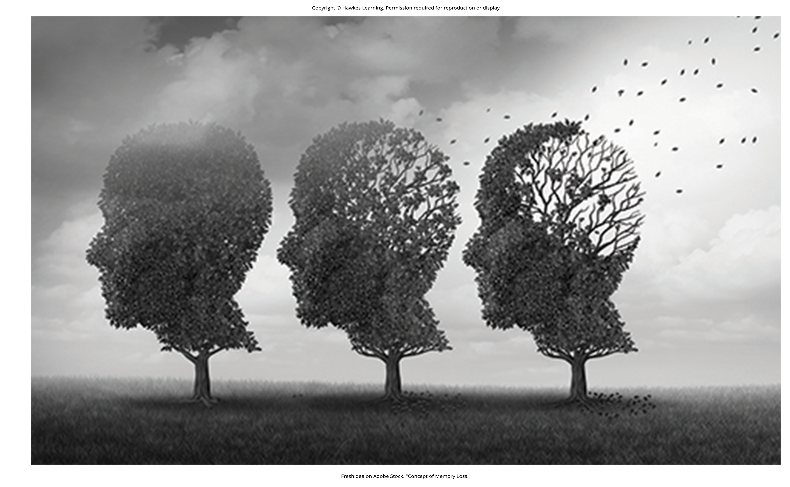
Anterograde Amnesia
Commonly caused by brain trauma
Cannot remember new information
Can remember information and events that happened prior to injury
Hippocampus usually affected (McLeod, 2011)
Inability to transfer information from short-term to long-term memory
Usually unable to form new episodic or semantic memories
Usually able to form new procedural memories (Bayley & Squire, 2002)
Figure 2

Slide 5
Retrograde Amnesia
Retrograde amnesia: loss of memory for events that occurred prior to the trauma
Cannot remember some or all of past events
Difficulty remembering episodic memories
Utilized in movies as a plot device
Example: Garden of Lies (1915), Jason Bourne films
Case study: NFL player Scott Bolzan living with one of the most extreme cases
After head injury, lost 46 years of memories

Slide 6
Anterograde Vs. Retrograde Amnesia
Impact on memory retrieval:
Anterograde: can remember events prior to event that caused amnesia
Retrograde: cannot remember events prior to event that caused amnesia
Impact on memory formation:
Anterograde: cannot form new episodic or semantic but can form new procedural memories
Retrograde: can form new memories

Slide 7
Reflection Question₁
In the movie Eternal Sunshine of the Spotless Mind (2004), Clementine and Joel go through a procedure that removes all memory of their relationship. If you could take a pill or undergo a procedure to erase memories from your past, would you choose to do so? Why or why not?

Slide 8
Memory Construction And Reconstruction
Construction: formation of new memories
Reconstruction: retrieving and potentially altering old memories
Memories easily modified when recalling past events
Can lead to distortions, which happens when we retrieve old memories and combine them with new ones (Roediger and DeSoto, in press)

Slide 9
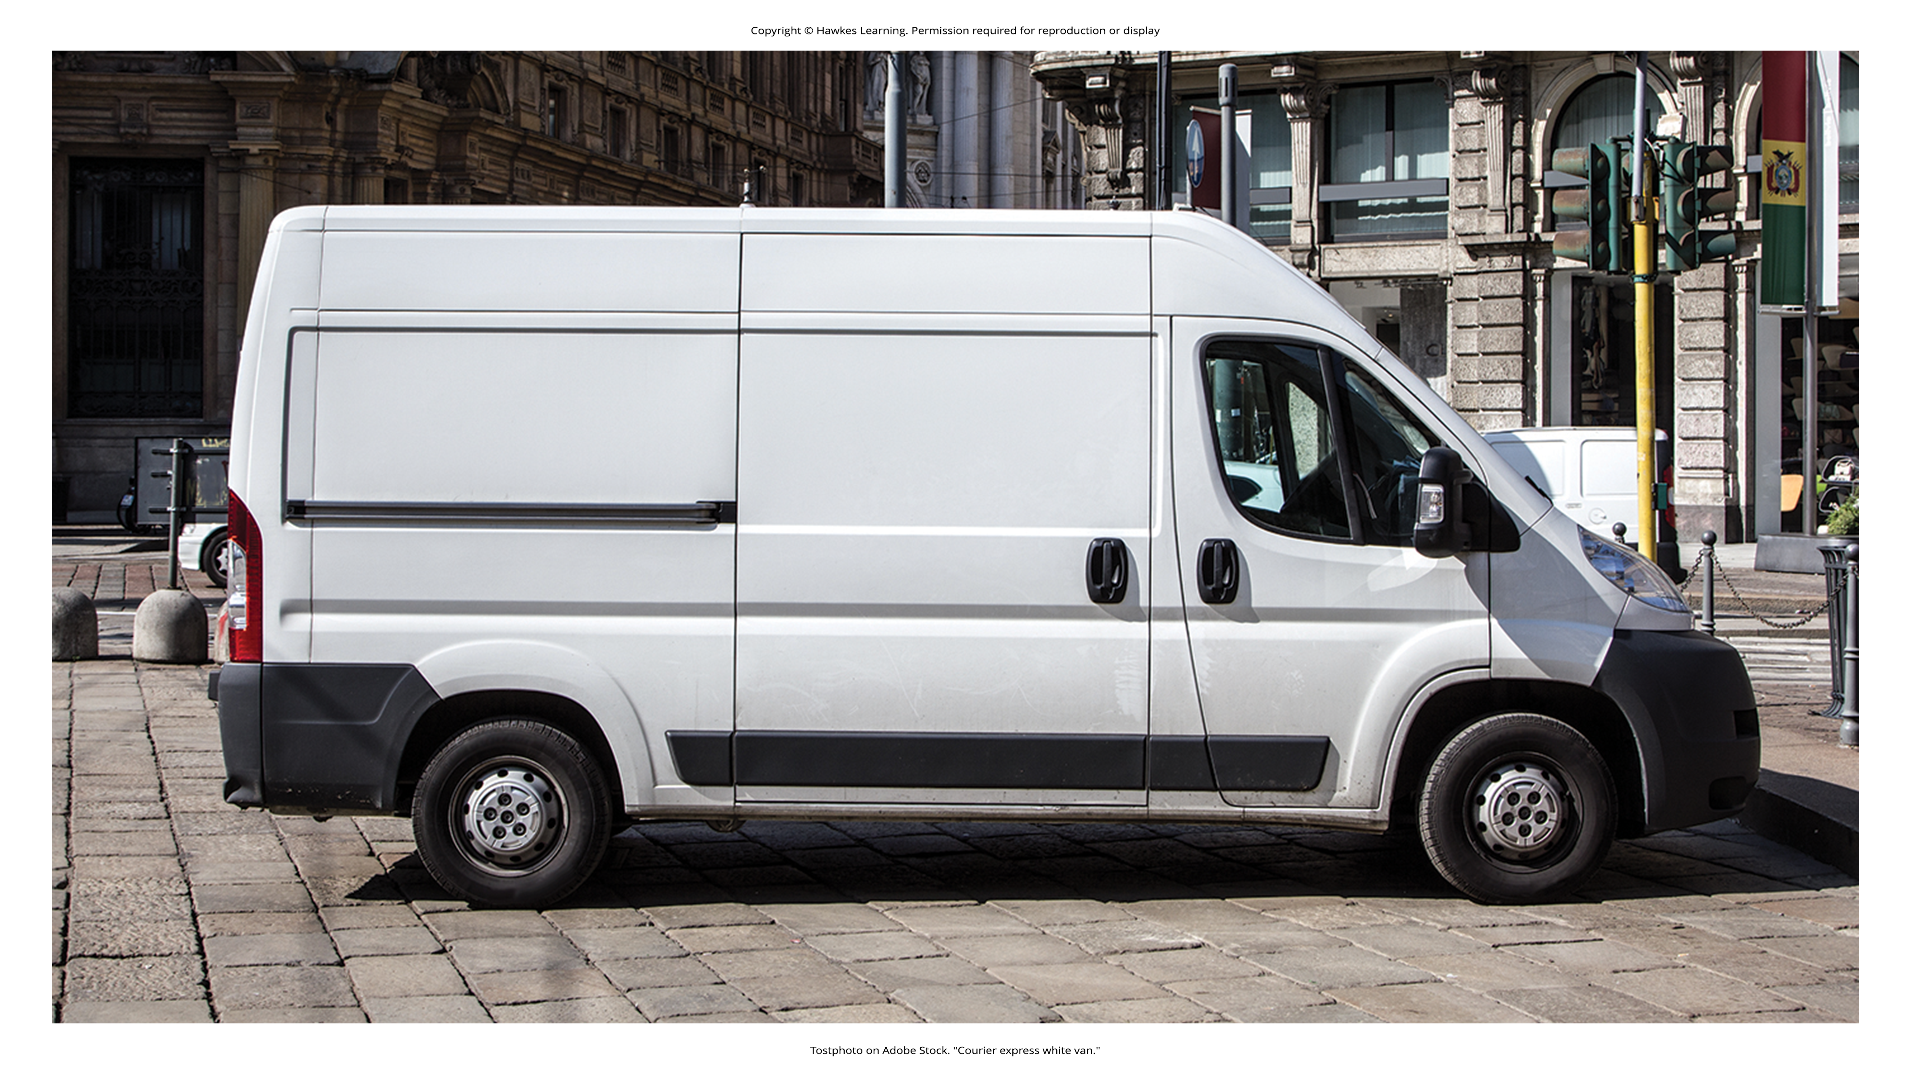
Suggestibility
Suggestibility is the influence of external misinformation on the creation of false memories.
Highlights the vulnerability of memory to external suggestions and misinformation
Witnesses to crimes can be easily misled.
Example: Washington, DC, sniper case where focus on a white van misled investigations
Figure 3
Caption: Do you think you would remember a vehicle present at the scene of a crime?

Slide 10
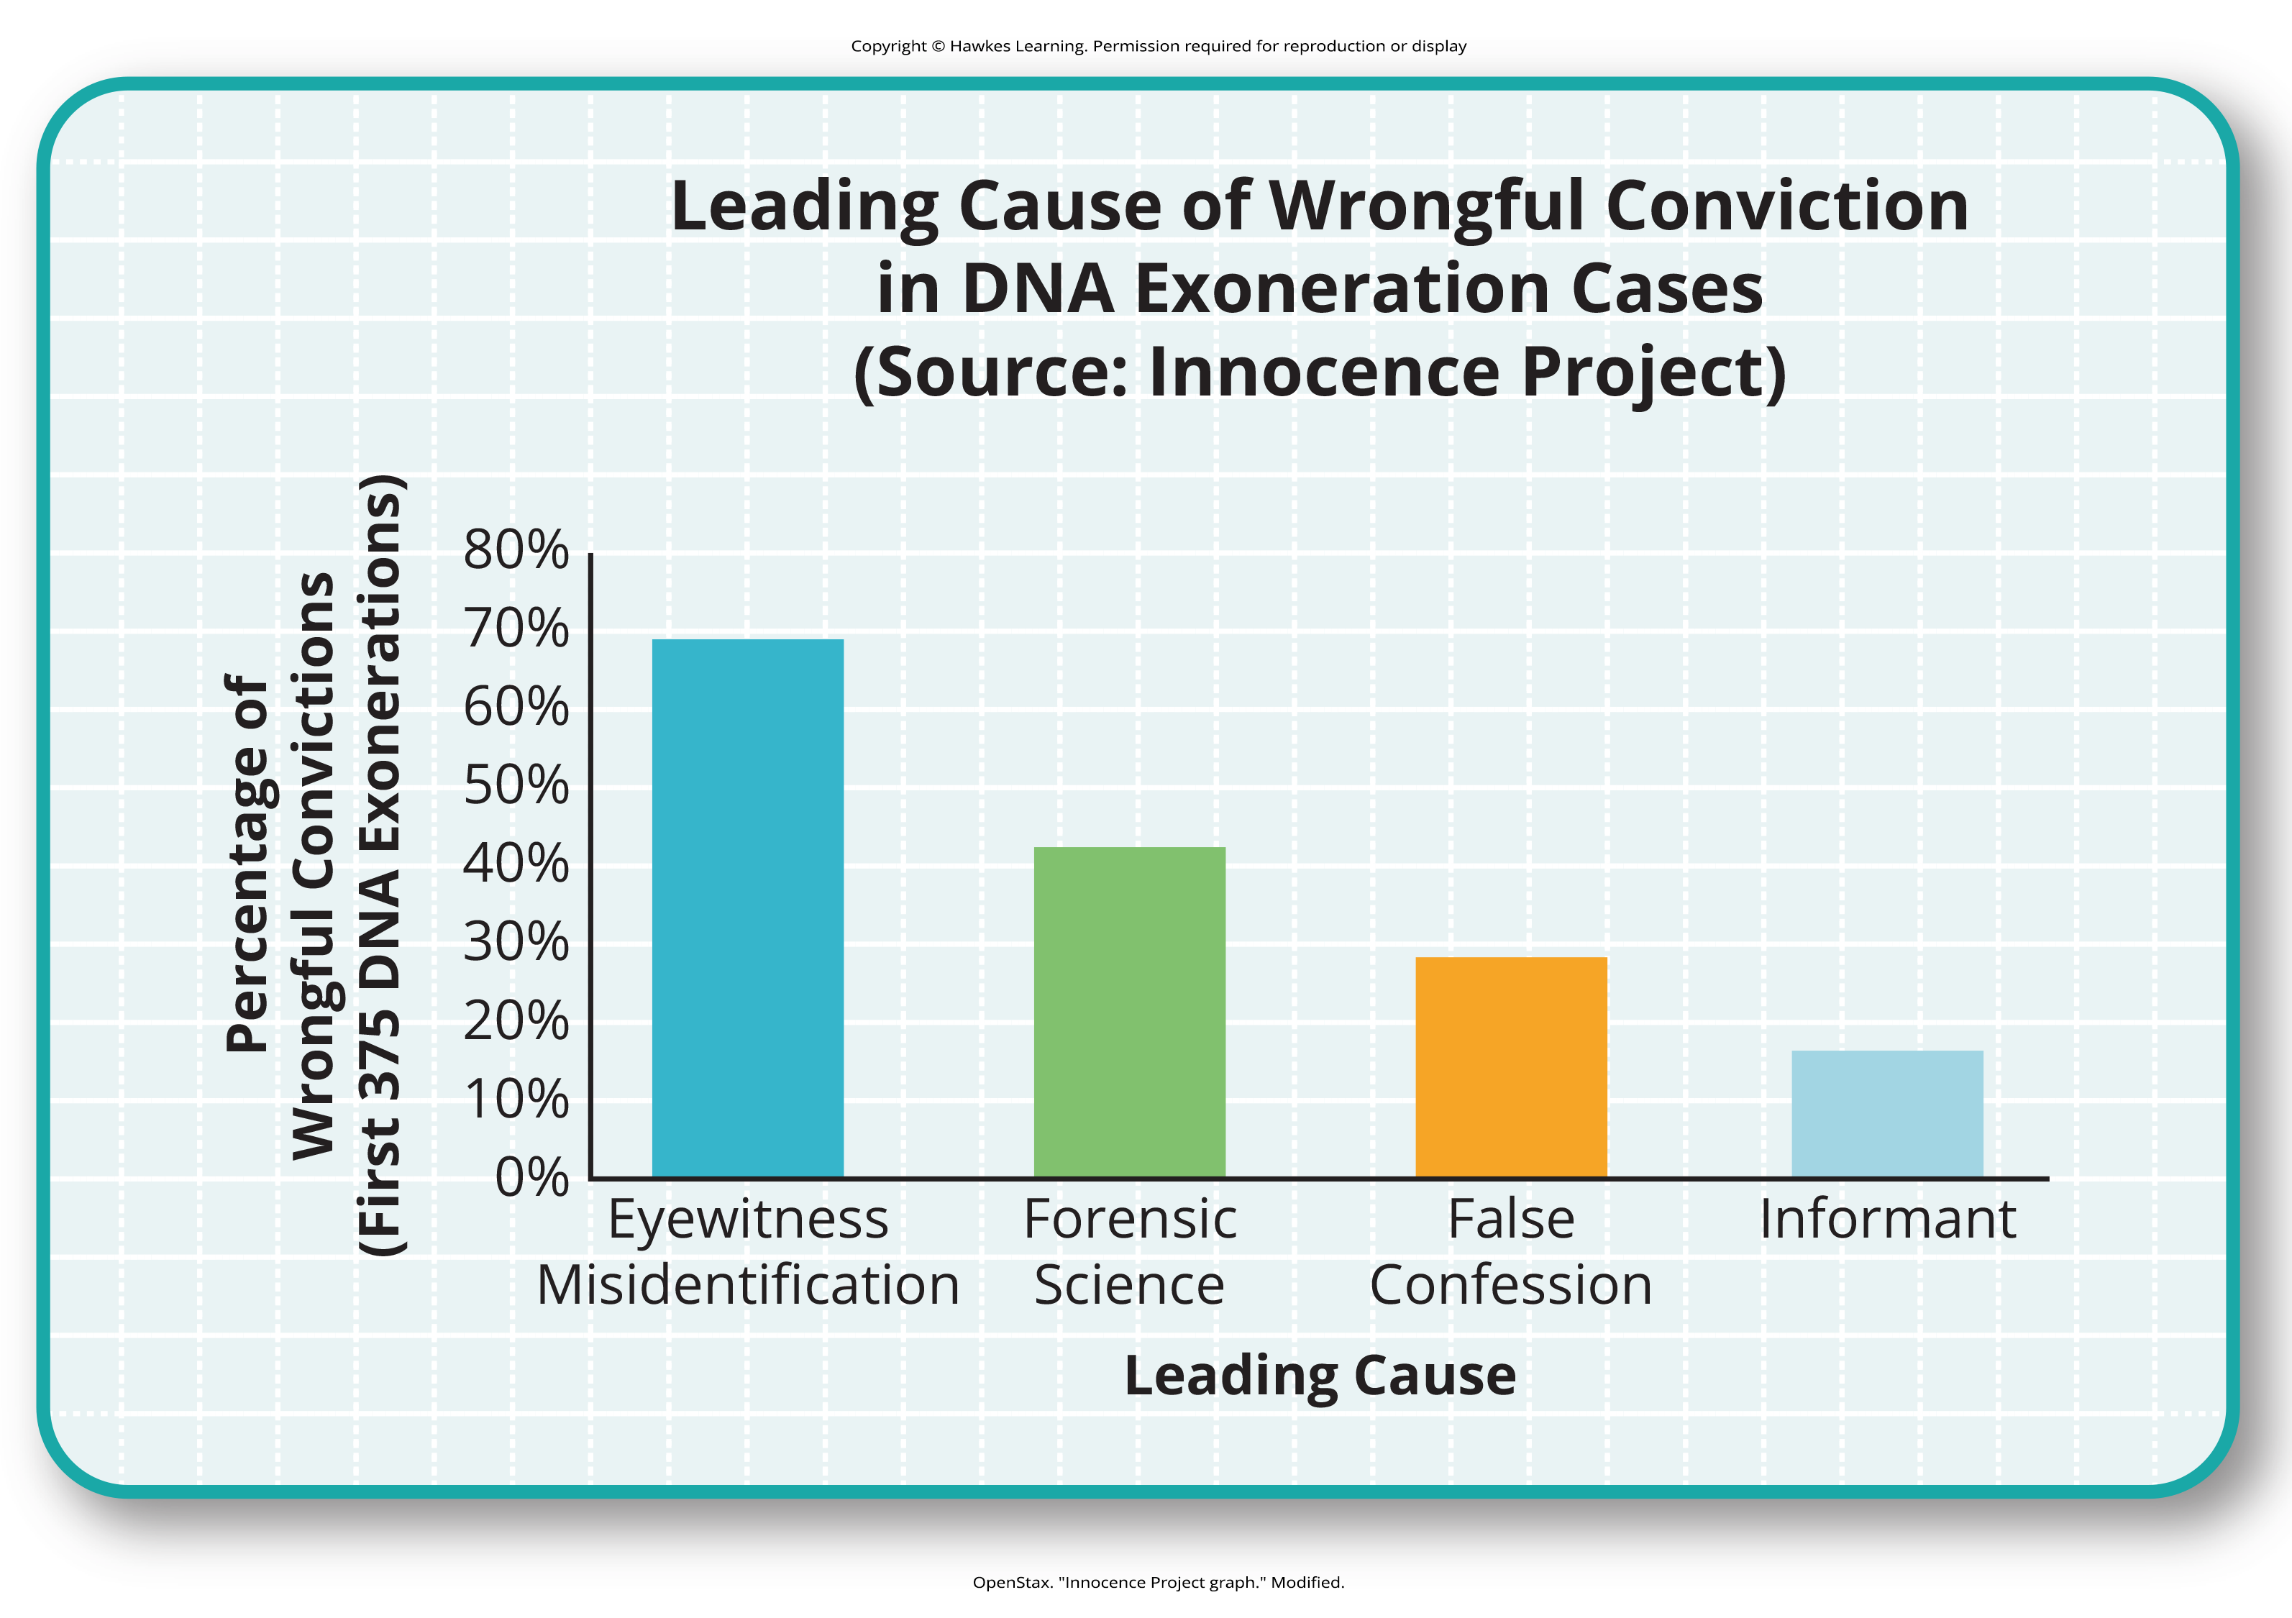
Eyewitness Misidentification₁
Figure 4
Despite its fragility, eyewitness identification and testimony are heavily relied upon in legal proceedings.
Faulty eyewitness identification can lead to wrongful convictions (Figure 4).
Caption: In studying cases where DNA evidence has exonerated people from crimes, the Innocence Project discovered that eyewitness misidentification is the leading cause of wrongful convictions (Innocence Project, 2020).

Slide 11
Eyewitness Misidentification₂
Example: Ronald Cotton's case
Mistakenly identified by Jennifer Thompson due to unintended cues and suggestions by police
Still misidentified during a second trial
Spent over a decade in prison before DNA evidence proved his innocence
Innocence Project: works to exonerate falsely convicted people, including those by eyewitness testimony

Slide 12
Eyewitness Misidentification₃
Loftus's research in the 1970s highlighted flaws in interview practices affecting eyewitness testimony accuracy.
Methods used to collect and preserve evidence impact the integrity of eyewitness identification (Wells et al., 2020).
Steps have been taken to decrease witness suggestibility:
Modify how witnesses are questioned.
Using neutral language improves children's accuracy in recalling events and identifying individuals (Goodman, 2006; Pipe, 1996; Pipe et al., 2004; Brown & Lamb, 2015).
Change how police lineups are conducted.
Blind photo lineups prevent the person showing the lineup from knowing the suspect, reducing the risk of leading cues.
Judges in some states now inform jurors about the possibility of misidentification.
Judges can also suppress eyewitness testimony if they deem it unreliable.

Slide 13
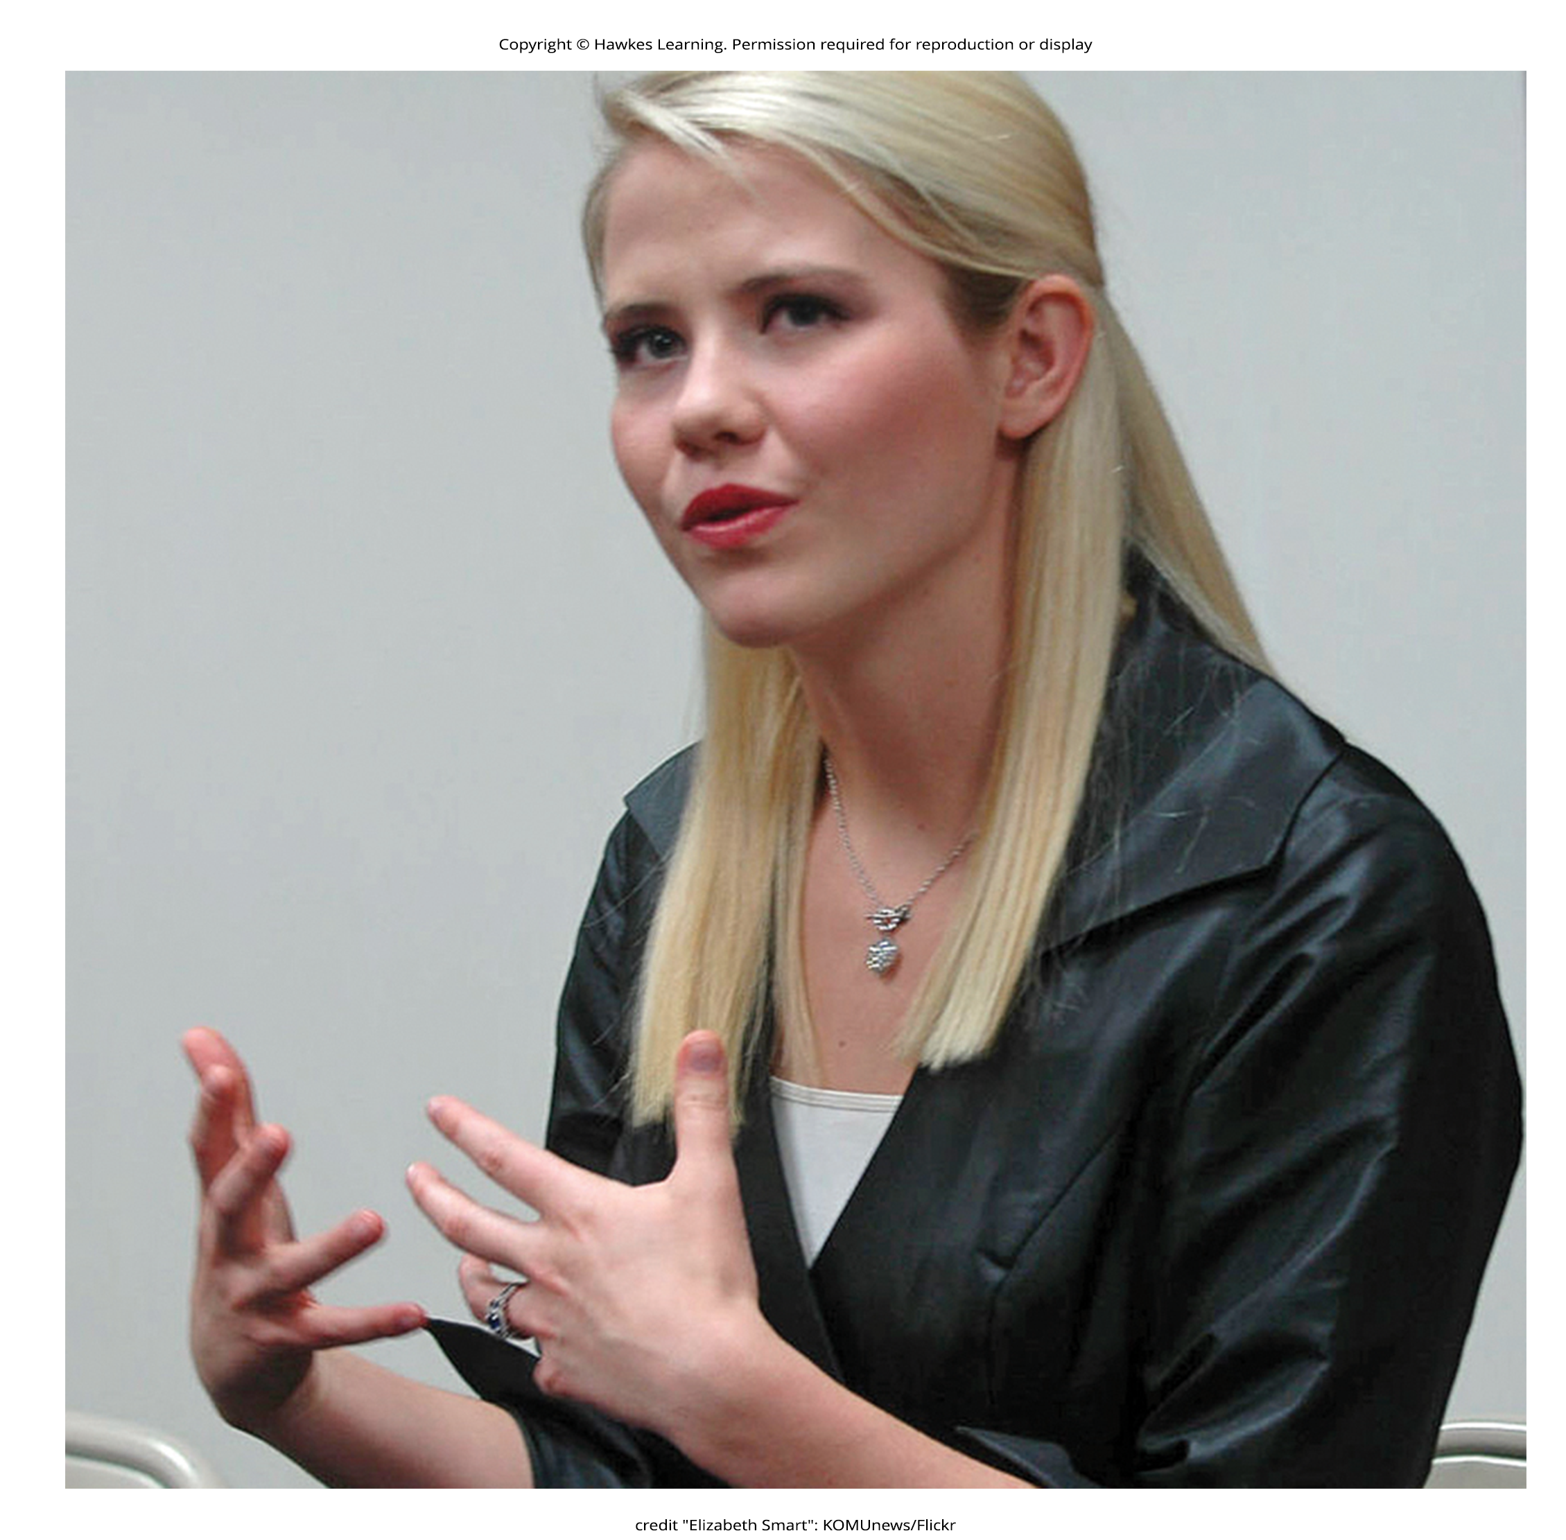
Dig Deeper: Preserving Eyewitness Memory: the Elizabeth Smart Case
Contrasting Cotton's case, the cautious approach in the Elizabeth Smart case prevented false memory implantation.
Mary Katherine Smart, sole eyewitness, was handled with care to avoid corrupting her memory.
Eventually, her accurate recollection led to Elizabeth's rescue and the abductor's capture.
Figure 5

Slide 14
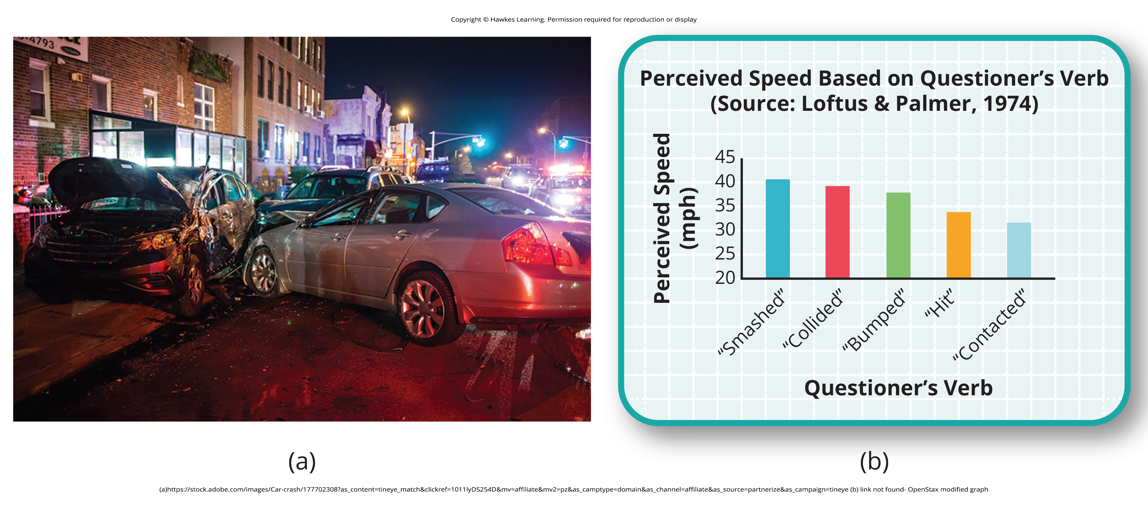
The Misinformation Effect
Misinformation effect paradigm: after exposure to incorrect information, a person may misremember the original event
Eyewitness memory very flexible because of this
Developed by Elizabeth Loftus, who has researched false and recovered memories
Loftus and Palmer's study: 45 college students estimated car speed based on different verbs
Shown films of car accidents, asked about role of the eyewitness
Estimated speed of cars based on verb used in question asked (Figure 6)
Figure 6

Slide 15
Group Activity
How does the Innocence Project decide which cases to take on? Check out this short video in which founder Barry Scheck explains case choice. Then as a group, discuss the following questions:
How does learning about the Innocence Project impact your view of the criminal justice system?
What has this taught you about the role of memory in criminal convictions?
Should eyewitness testimony be allowed in criminal cases?

Slide 16
Controversies Over Repressed And Recovered Memories
Sigmund Freud initially proposed that traumatic memories could be repressed; today, the idea is still debated (Colangelo, 2009; Otgaar et al., 2022).
False memory syndrome involves the recall of false autobiographical memories, often of traumatic events.

Slide 17
The False Memory Debate
Belief in recovered memories
Premise: Trauma in children causes repressed memories.
Treatment: Trauma recalled through hypnosis and guided imagery.
Evidence: 59% of 450 men and women with a history of child abuse did not recall experiences (Briere & Conte, 1993).
Outcome: Recovered Memory Project helps childhood sexual abuse victims recall and start healing (Recovered Memory Project, 2015).
Opponents of recovered memories
Premise: Trauma occurs but repression does not.
Treatment: Questioning by others results in false memories of abuse.
Evidence: 55% of 3-year-old children falsely reported being touched in the genital area during an exam (Ceci & Brooks, 1993, 1995).

Slide 18
Forgetting
Forgetting: loss of information from long-term memory
Affects everyone
Several theories to explain why forgetting happens

Slide 19
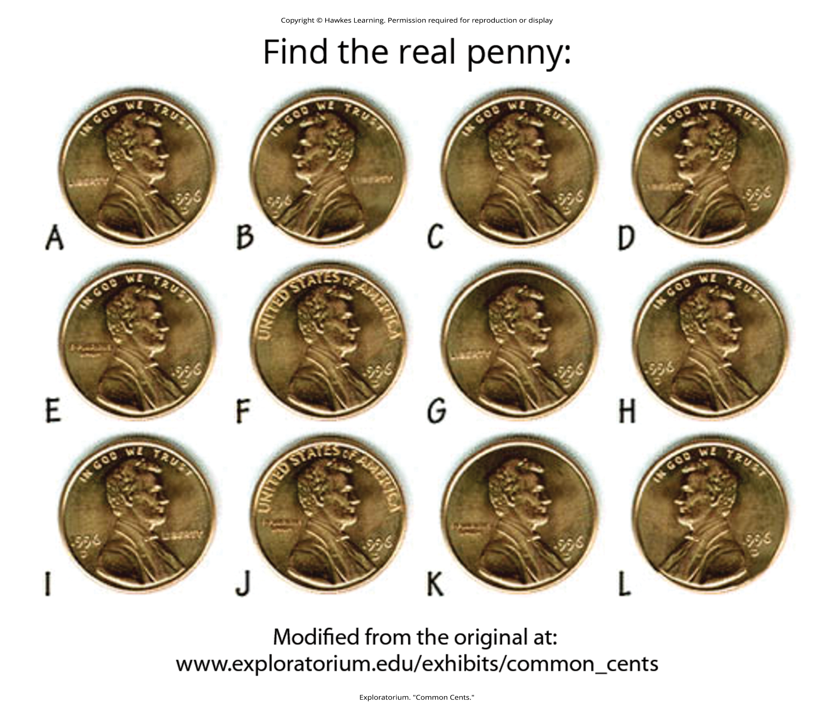
Encoding Failure
Encoding failure: when information is not stored due to lack of attention or processing
Example: can't recall full details of a penny, only distinguishing features (Nickerson & Adams, 1979)
Figure 7

Slide 20
Schachter's Sins Of Memory
Daniel Schacter's seven sins of memory, broken into three categories:
Forgetting: transience, absentmindedness, blocking
Distortion: misattribution, suggestibility, bias
Intrusion: persistence

Slide 21
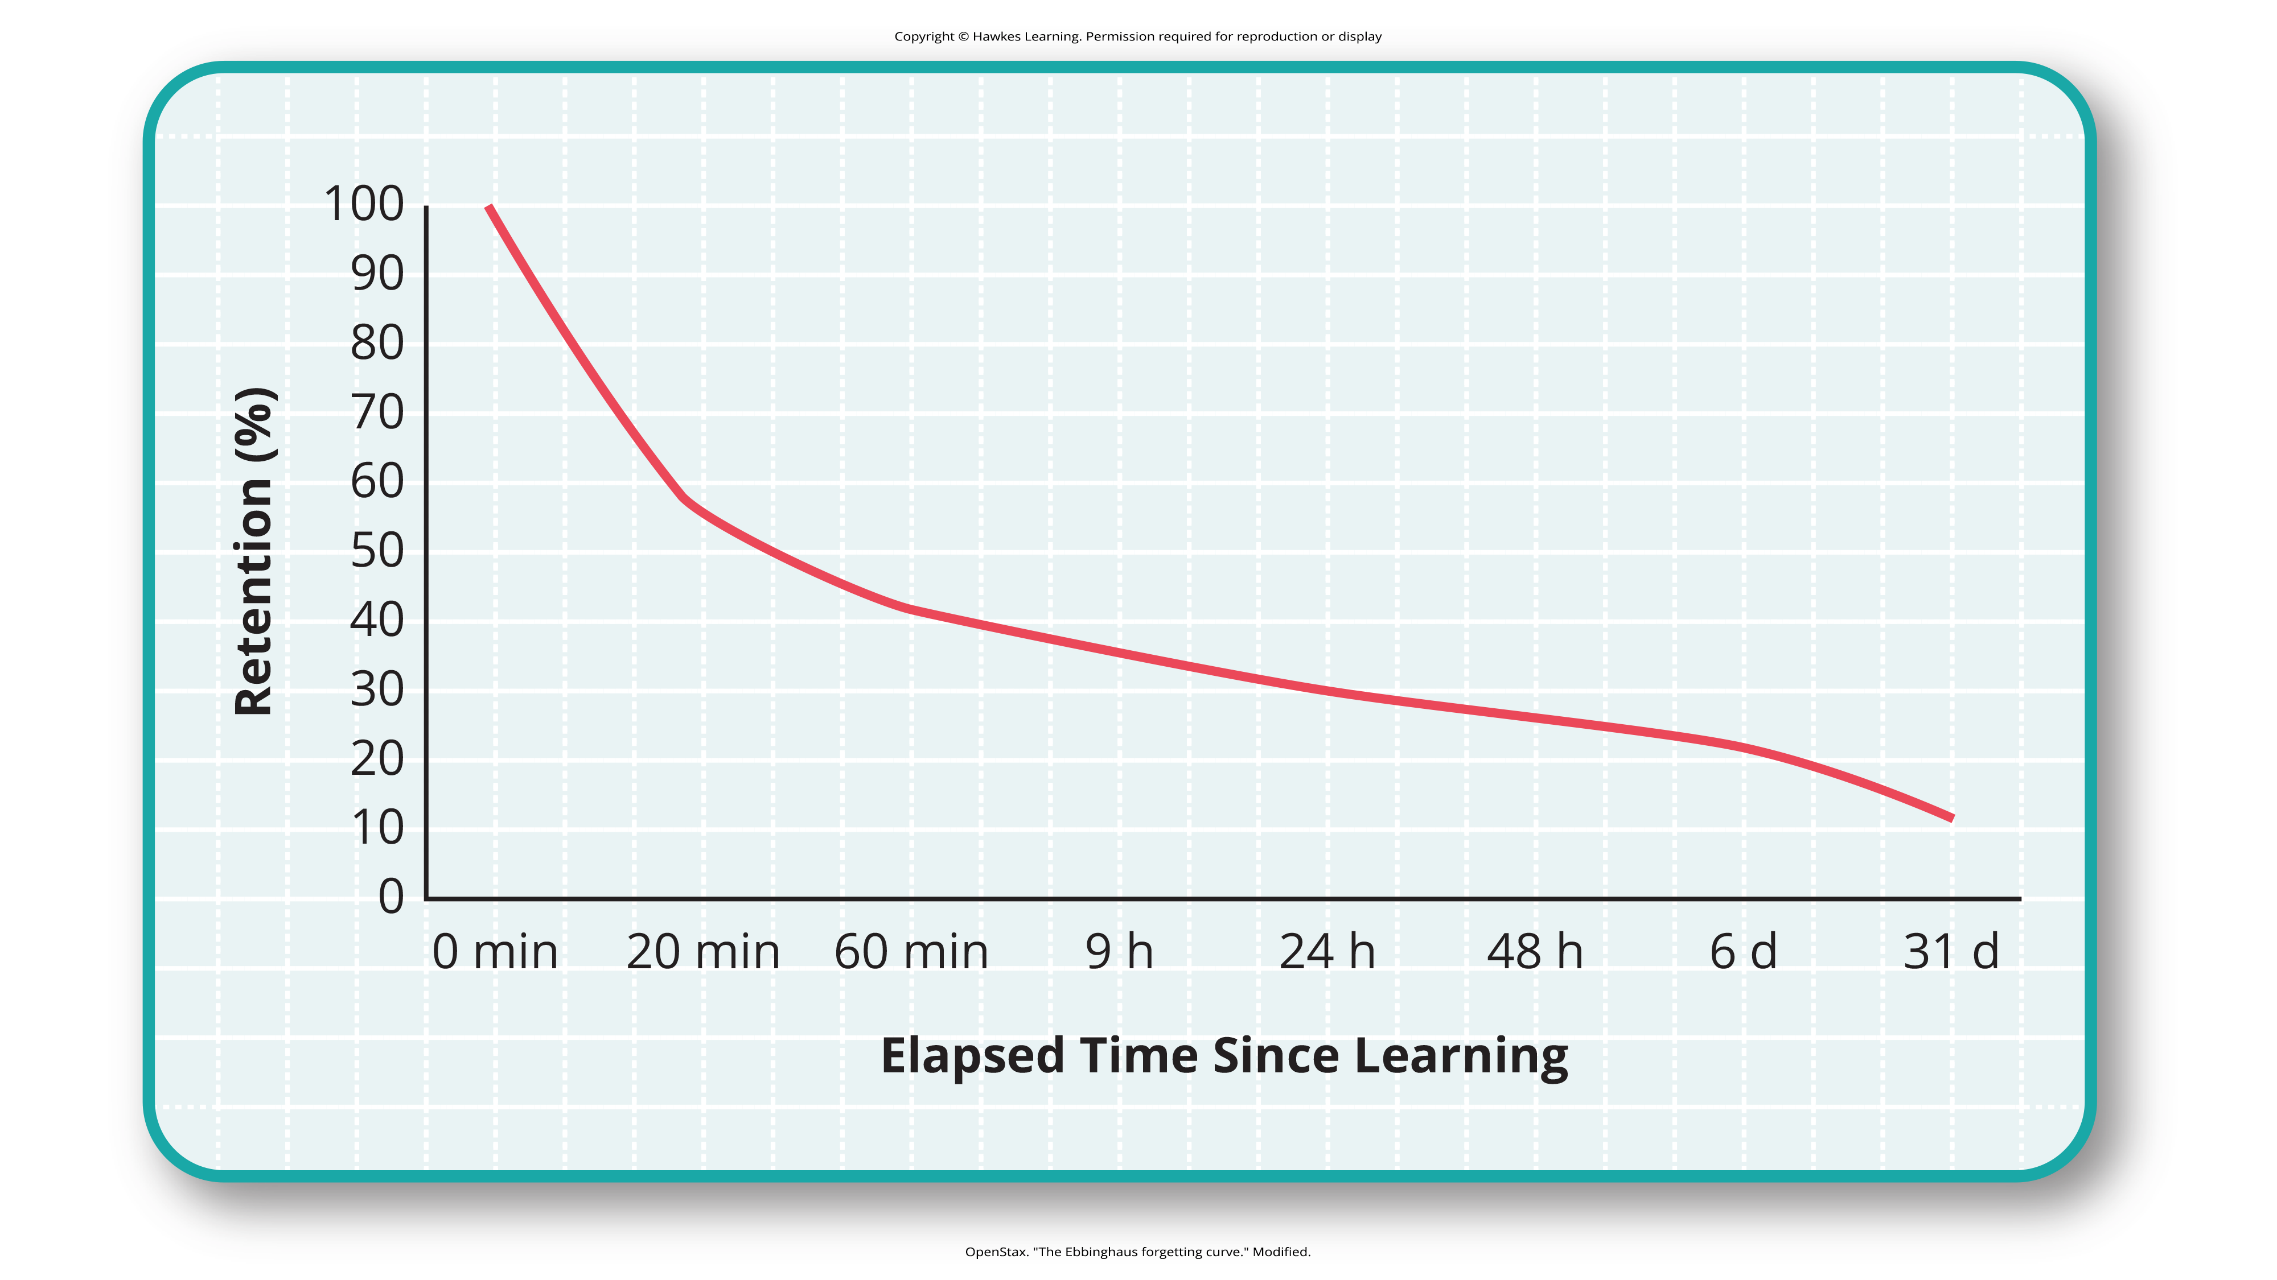
Ebbinghaus's Forgetting Cure
Hermann Ebbinghaus analyzed memorization:
Memorized lists of nonsense syllables
Measured how much he retained when he relearned each list
Tested himself over periods of time from 20 minutes later to 30 days later
His forgetting curve shows rapid initial memory decay, leveling off over time (Figure 8).
Figure 8
Caption: The Ebbinghaus forgetting curve shows how quickly memory for new information decays.

Slide 22

Examples of Memory Errors₁
Transience: forgetting details of a book read long ago due to storage decay
Absentmindedness: forgetting why you entered a room due to a lapse in attention
Blocking: unable to recall a name despite it being on the tip of your tongue (Figure 9)
Figure 9

Slide 23
Examples of Memory Errors₂
Misattribution: confusing the source of information, leading to false memories
Suggestibility: creating false memories based on external suggestions
Bias: distorting memories based on current feelings and worldview
Stereotypical bias: involves racial and gender biases
Egocentric bias: involves enhancing past memories (Payne et al., 2004)
Hindsight bias: involves inevitable outcomes after the fact

Slide 24
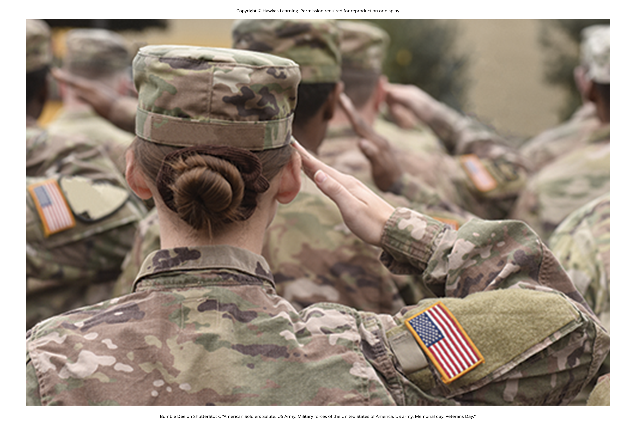
Examples of Memory Errors₃
Persistence: unwanted, intrusive memories that interfere with concentration (Figure 10)
Figure 10

Slide 25
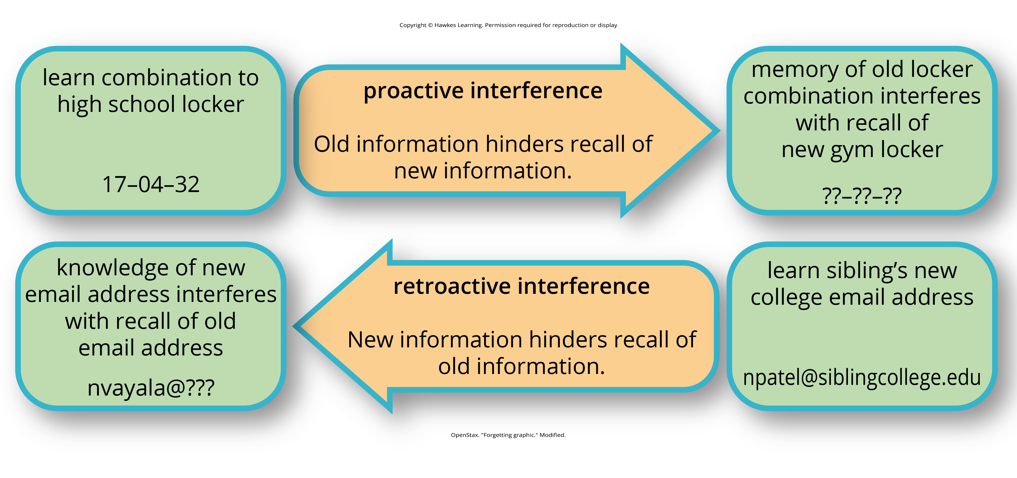
Interference
Two types: proactive and retroactive (Figure 11)
Proactive interference: old memories disrupt new learning
Example: recalling childhood phone number vs. new cell number
Retroactive interference: new information impairs older memories
Example: learning new theories and forgetting earlier ones
Figure 11

Slide 26
Reflection Question₂
Can you remember your house or apartment number from when you were 5 years old? What about your first cell phone number? If you can't, what type(s) of interference is this, or is it a memory error?

Slide 27
Summary
Memory is flexible and prone to errors, impacting the reliability of eyewitness testimony.
Forgetting can result from amnesia, encoding failures, and memory errors.
Schacter's seven memory errors and interference (proactive and retroactive) contribute to forgetting.
Understanding memory's limitations can help mitigate the effects of memory errors and improve memory reliability.

Slide 28
End of Hawkes Learning PowerPoint

