Slide 1
Lesson 7.4
Ways to Enhance Memory

Slide 2

Ways To Enhance Memory
Many people experience memory failures and seek to improve their memory.
Figure 1
Caption: Do you ever wish you could save a hard drive of information to store in your memory?

Slide 3
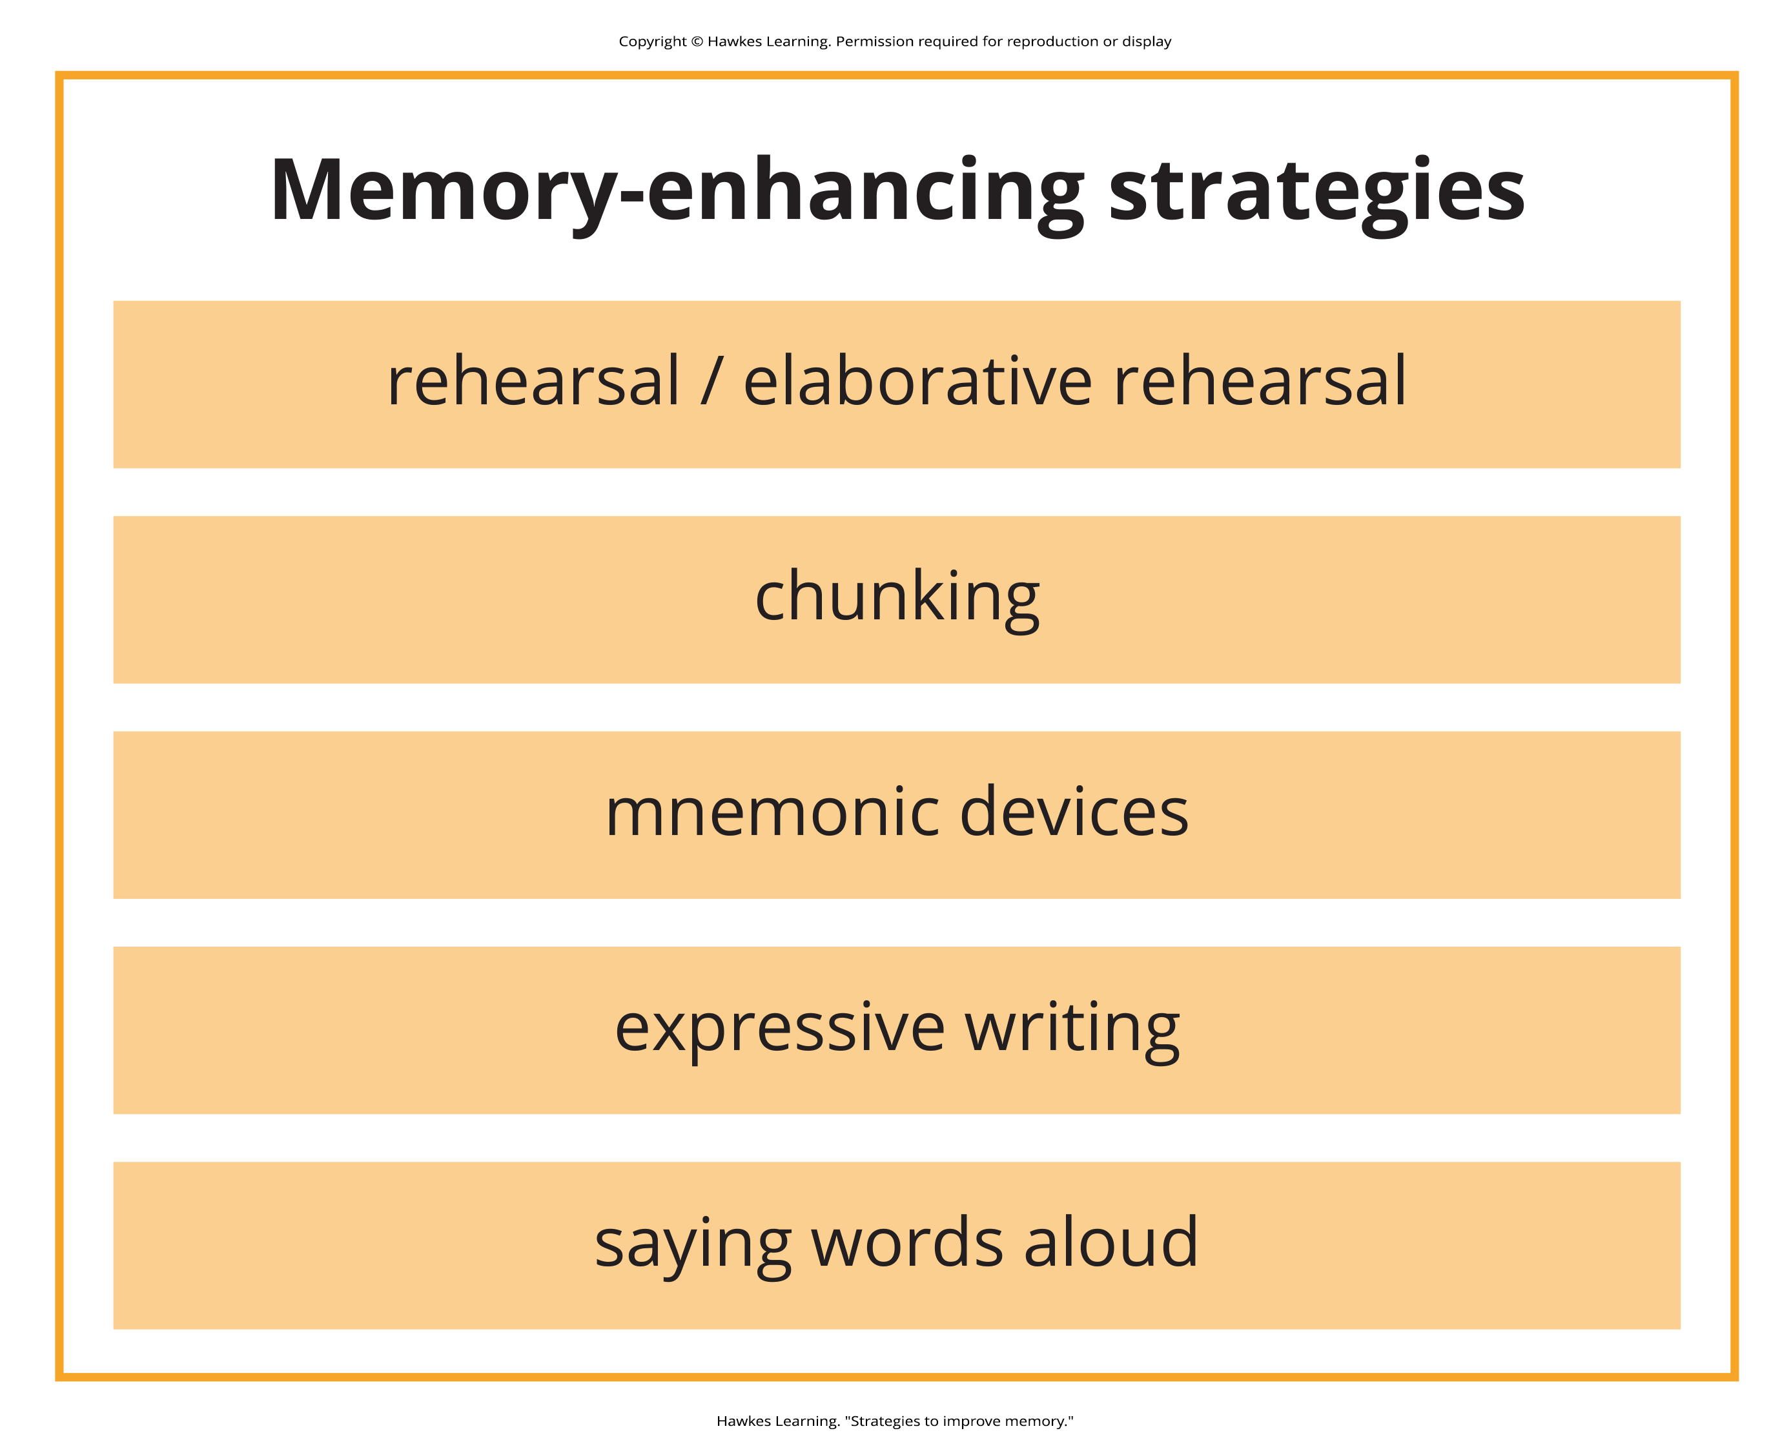
Memory-Enhancing Strategies
Memory-enhancing strategies: help to move information from short-term memory to long-term memory
Figure 2

Slide 4
Rehearsal & Chunking
Rehearsal: conscious repetition of information to be remembered (Craik & Watkins, 1973)
  Example: memorizing multiplication tables
Chunking: organizing information into manageable units or chunks (Bodie et al., 2006)
  Useful for remembering dates, ID numbers, phone numbers

Slide 5
Reflection Question₁
Think of a time when you used chunking to remember information. Why do you suppose chunking works as a memory aid?

Slide 6
Elaborative Rehearsal
Elaborative rehearsal: thinking about the meaning of new information and relating it to existing knowledge (Tigner, 1999)
  Example: remembering an area code and connecting it to a person who lives there
Helps embed new information into long-term memory by creating meaningful connections

Slide 7
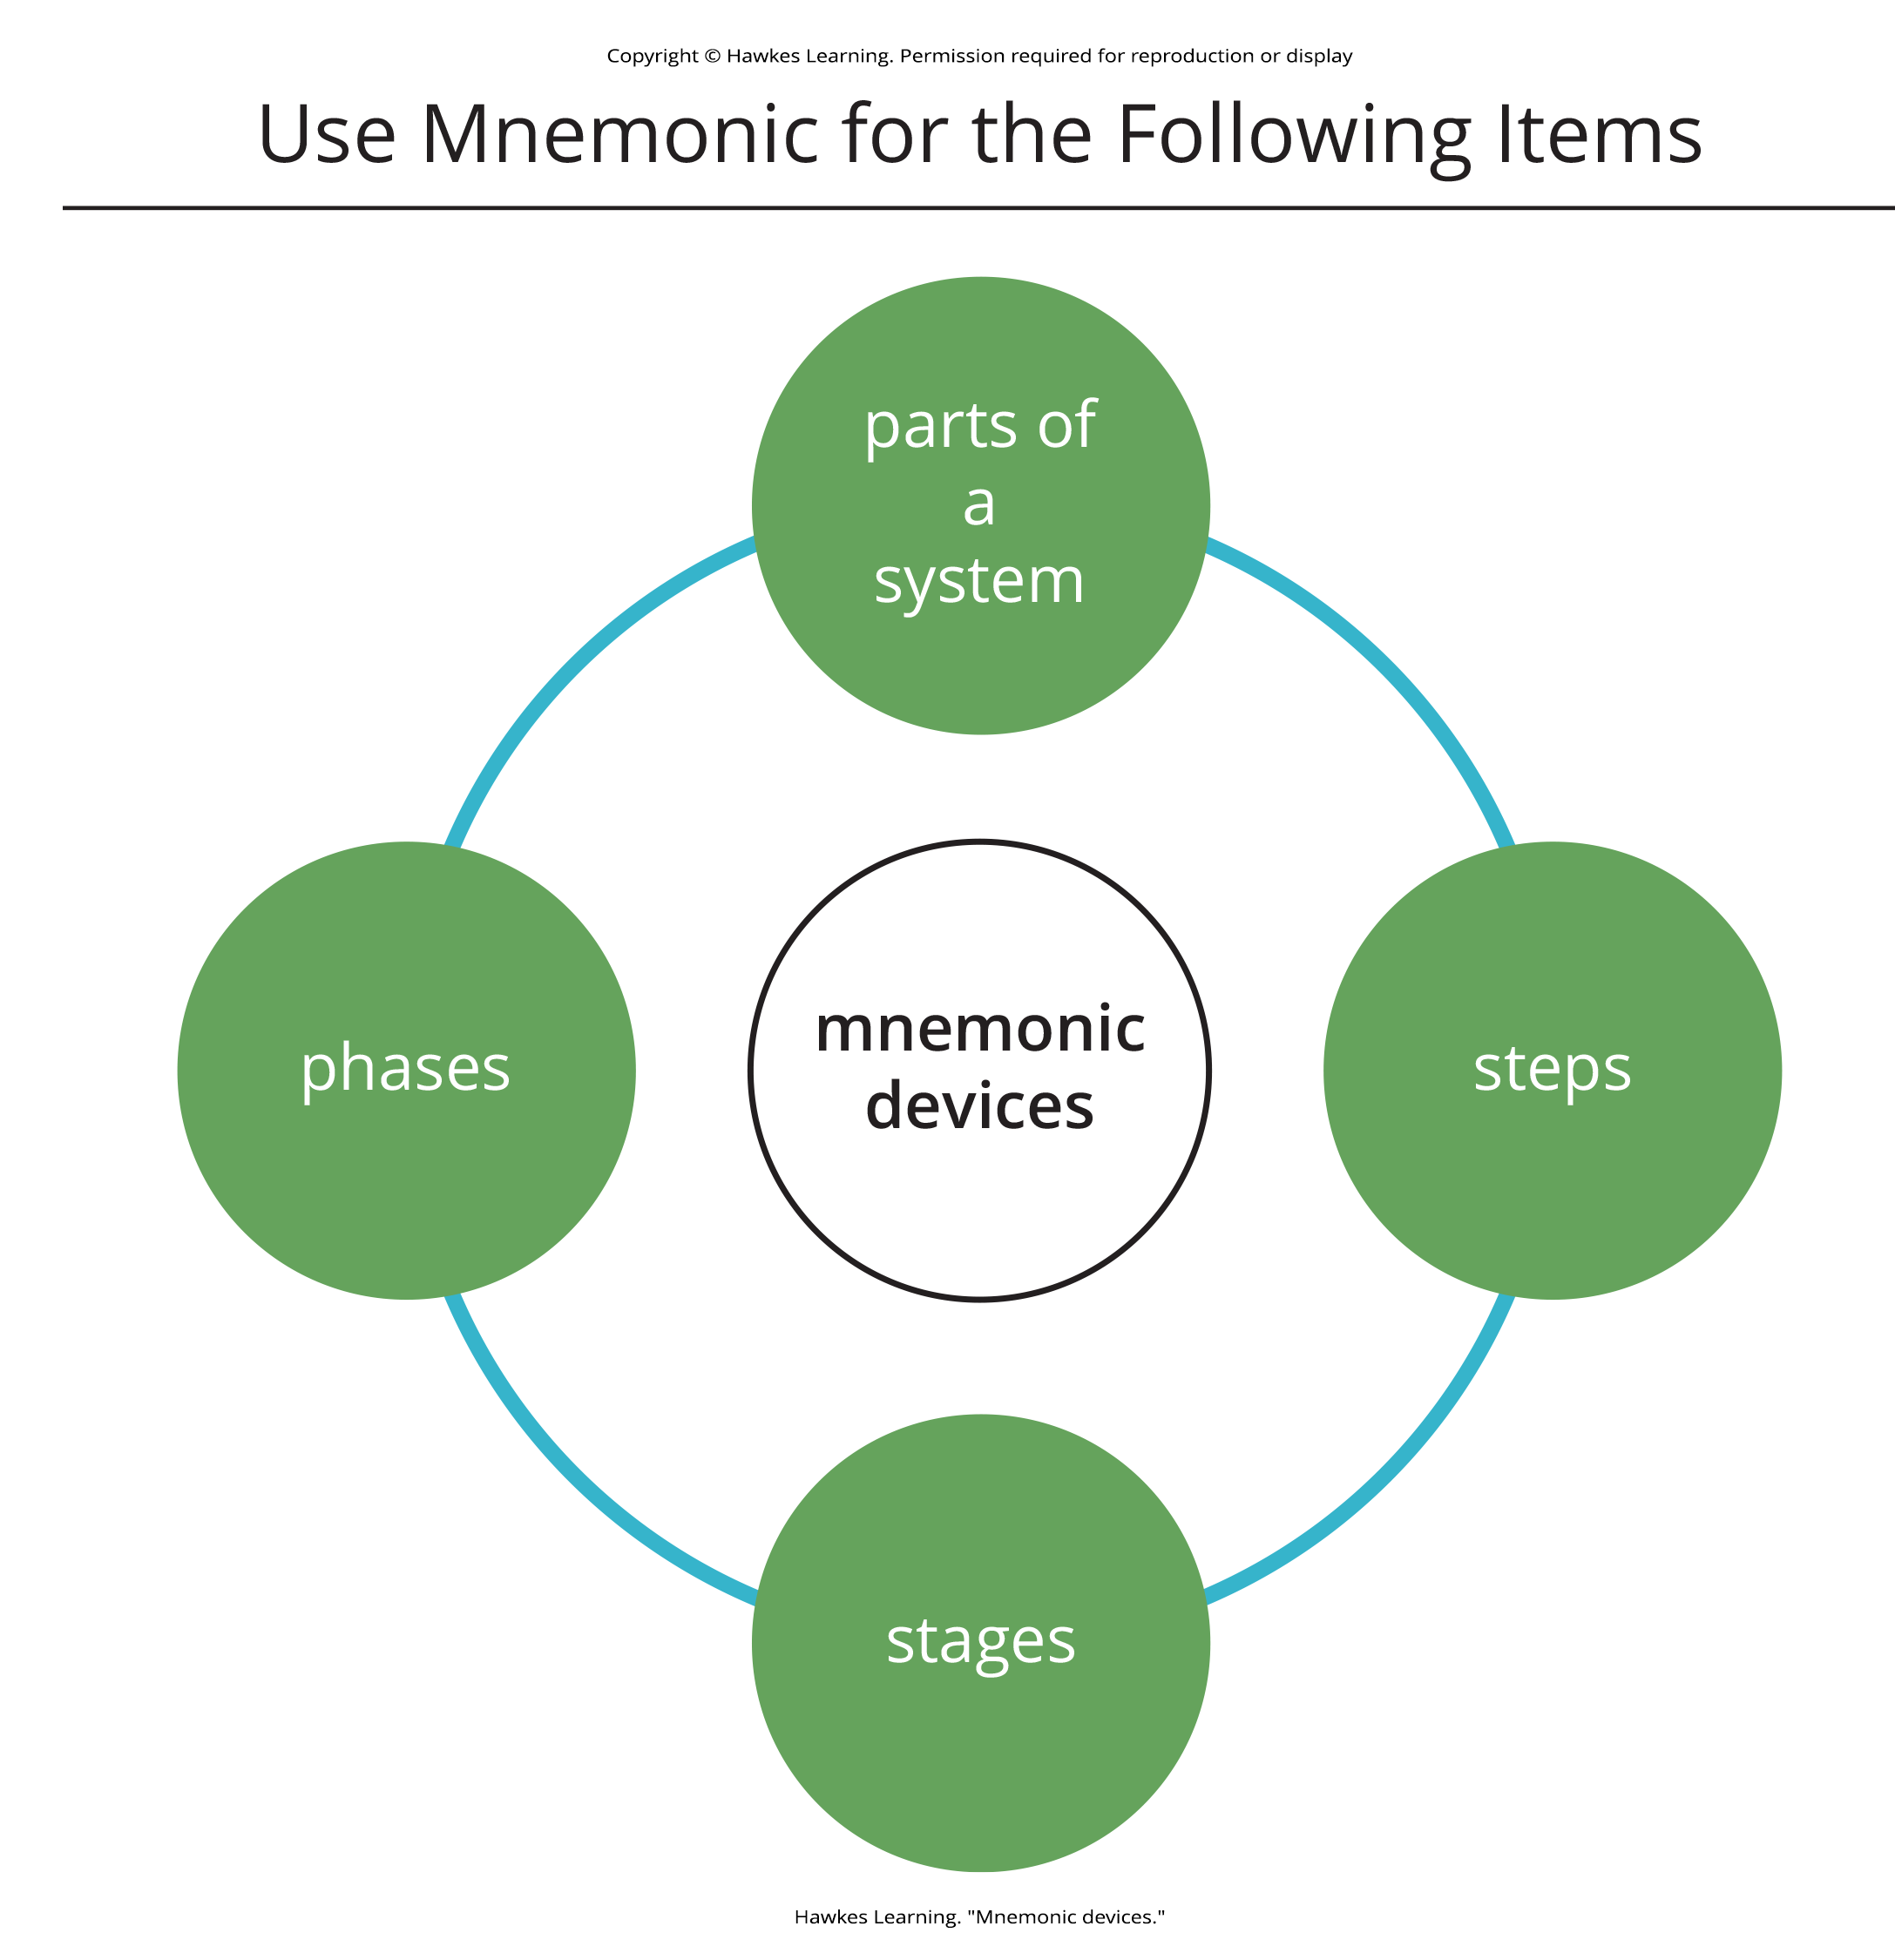
Mnemonic Devices₁
Mnemonic devices: aids that help organize information for encoding (Figure 3)
  Examples: acronyms, vivid associations
Figure 3

Slide 8
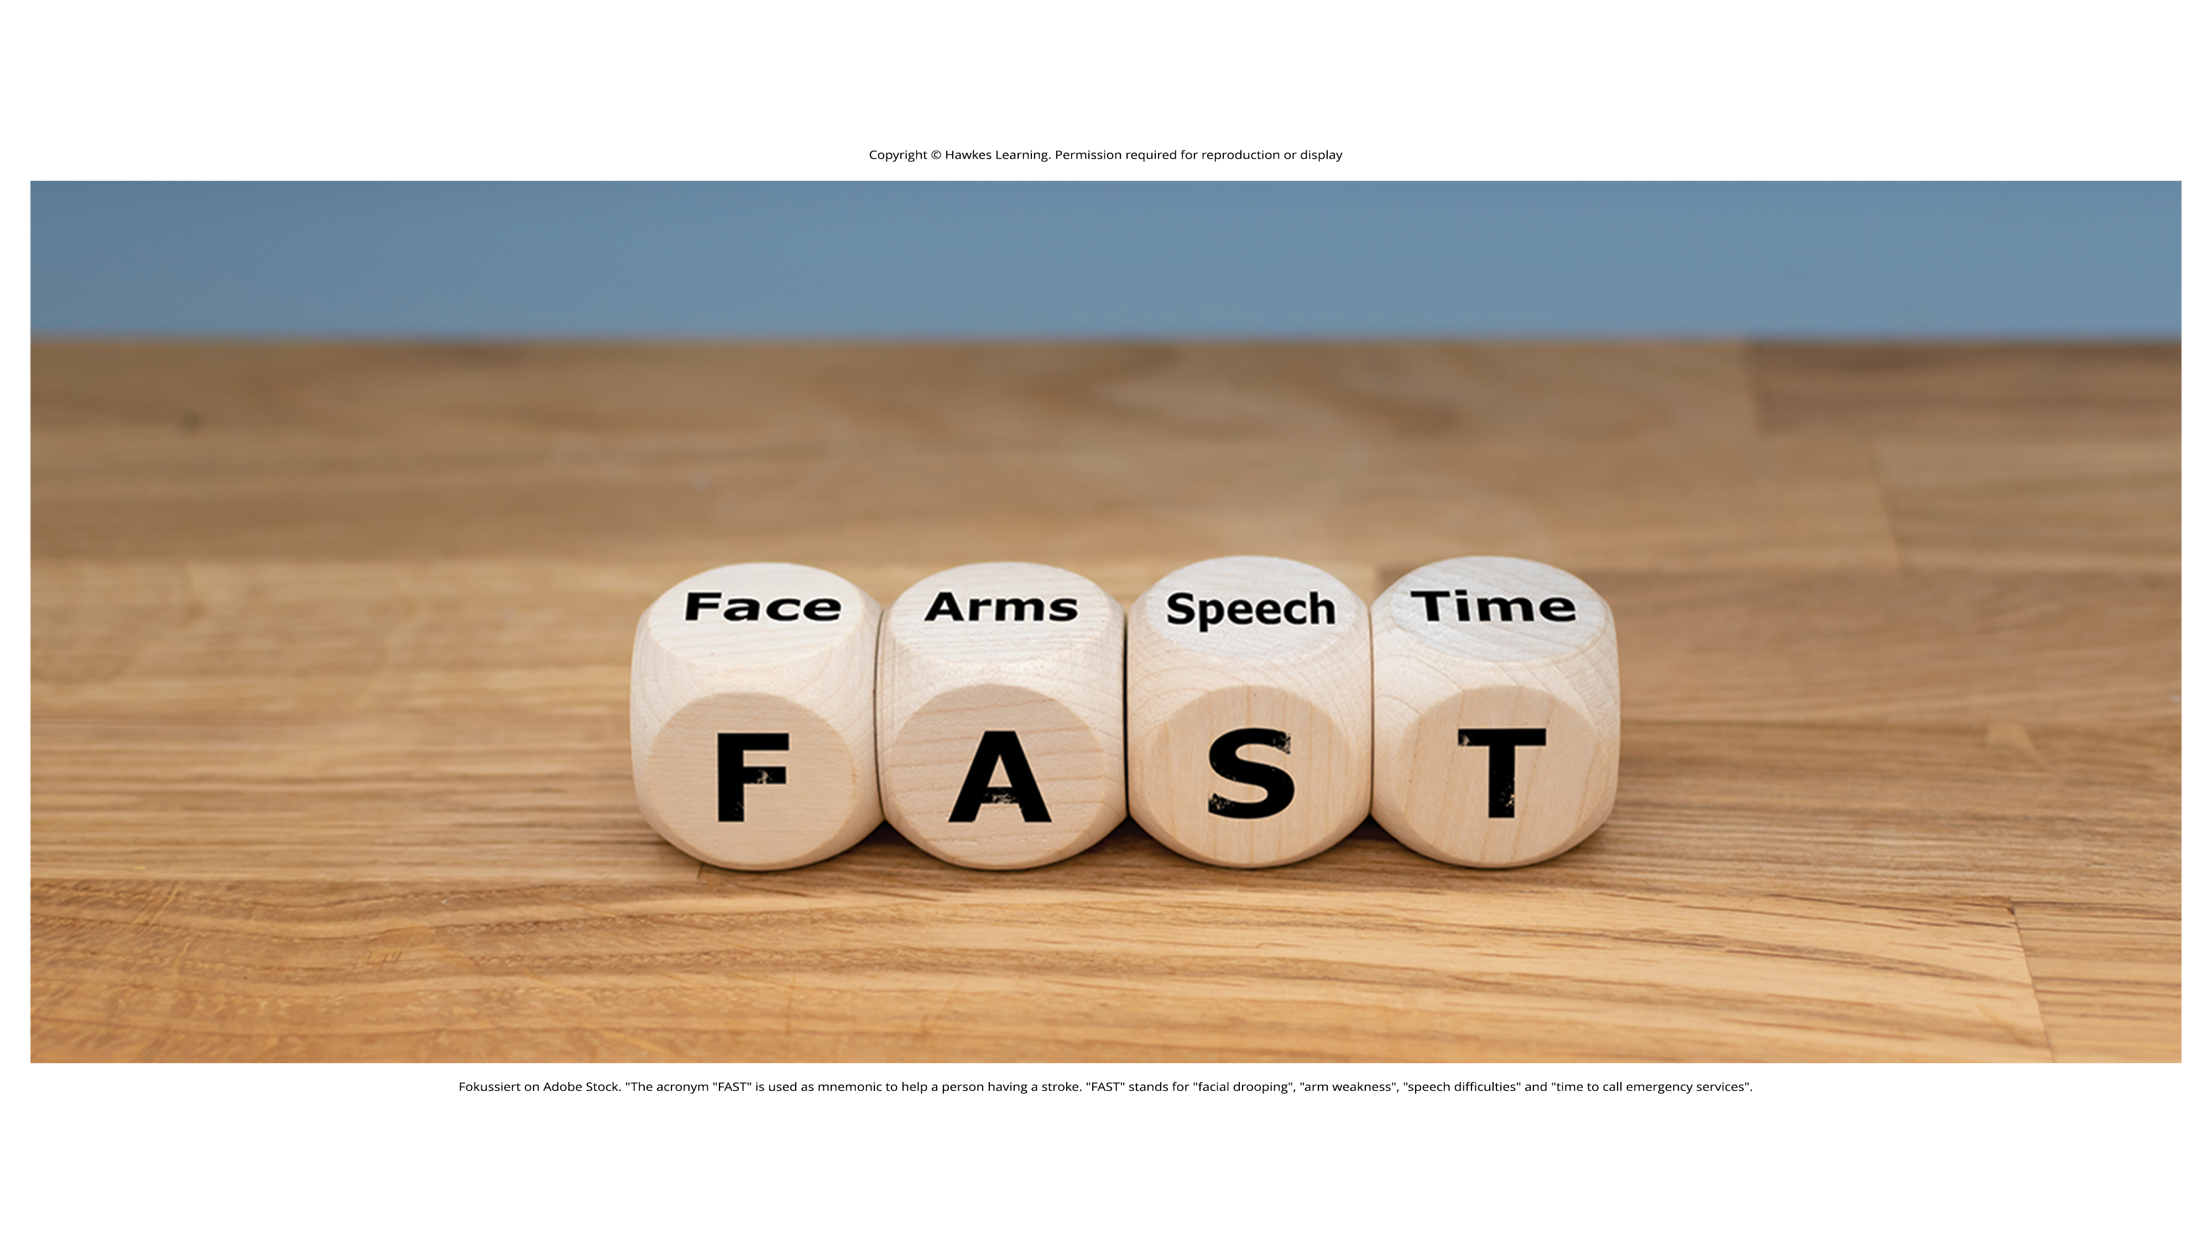
Mnemonic Devices₂
Can help you remember someone's name, a mathematical formula, etc.
More vivid/unusual mnemonics easier to remember
Figure 4
Caption: Mnemonic devices like this one can help us remember how to recognize and respond to emergencies. FAST is used to help a person having a stroke. It stands for "face drooping," "arm weakness," "speech difficulties," and "time to call emergency services."

Slide 9
Reflection Question₂
How can you apply the concepts of elaborative rehearsal, chunking, and mnemonic devices to learning psychology?

Slide 10
Other Strategies
Expressive writing boosts short-term memory capacity (Fartoukh & Chanquoy, 2020).
  Example: Yogo & Fujihara (2008) study where participants wrote for 20-minute intervals a few times a month
    Increased short-term memory after 5 weeks, but only for participants who wrote about traumatic events
Saying words aloud or mouthing increases distinctiveness and memory (MacLeod et al., 2010; Zhou & MacLeod, 2021).

Slide 11
Group Activity₁
In a small group, brainstorm possible reasons that writing about traumatic experiences may improve memory.

Slide 12

How to Study Effectively₁
Elaborative rehearsal: process more deeply, make meaningful links
  Craik and Lockhart (1972) proposed the theory: levels of processing
Self-reference effect: make material personally meaningful
  Example: rewrite in your own words
Don't forget the learning curve: overlearn to prevent storage decay
Figure 5

Slide 13
Group Activity₂
As a group, brainstorm a few psychology terms and some associations you can make to help you process their meanings.

Slide 14
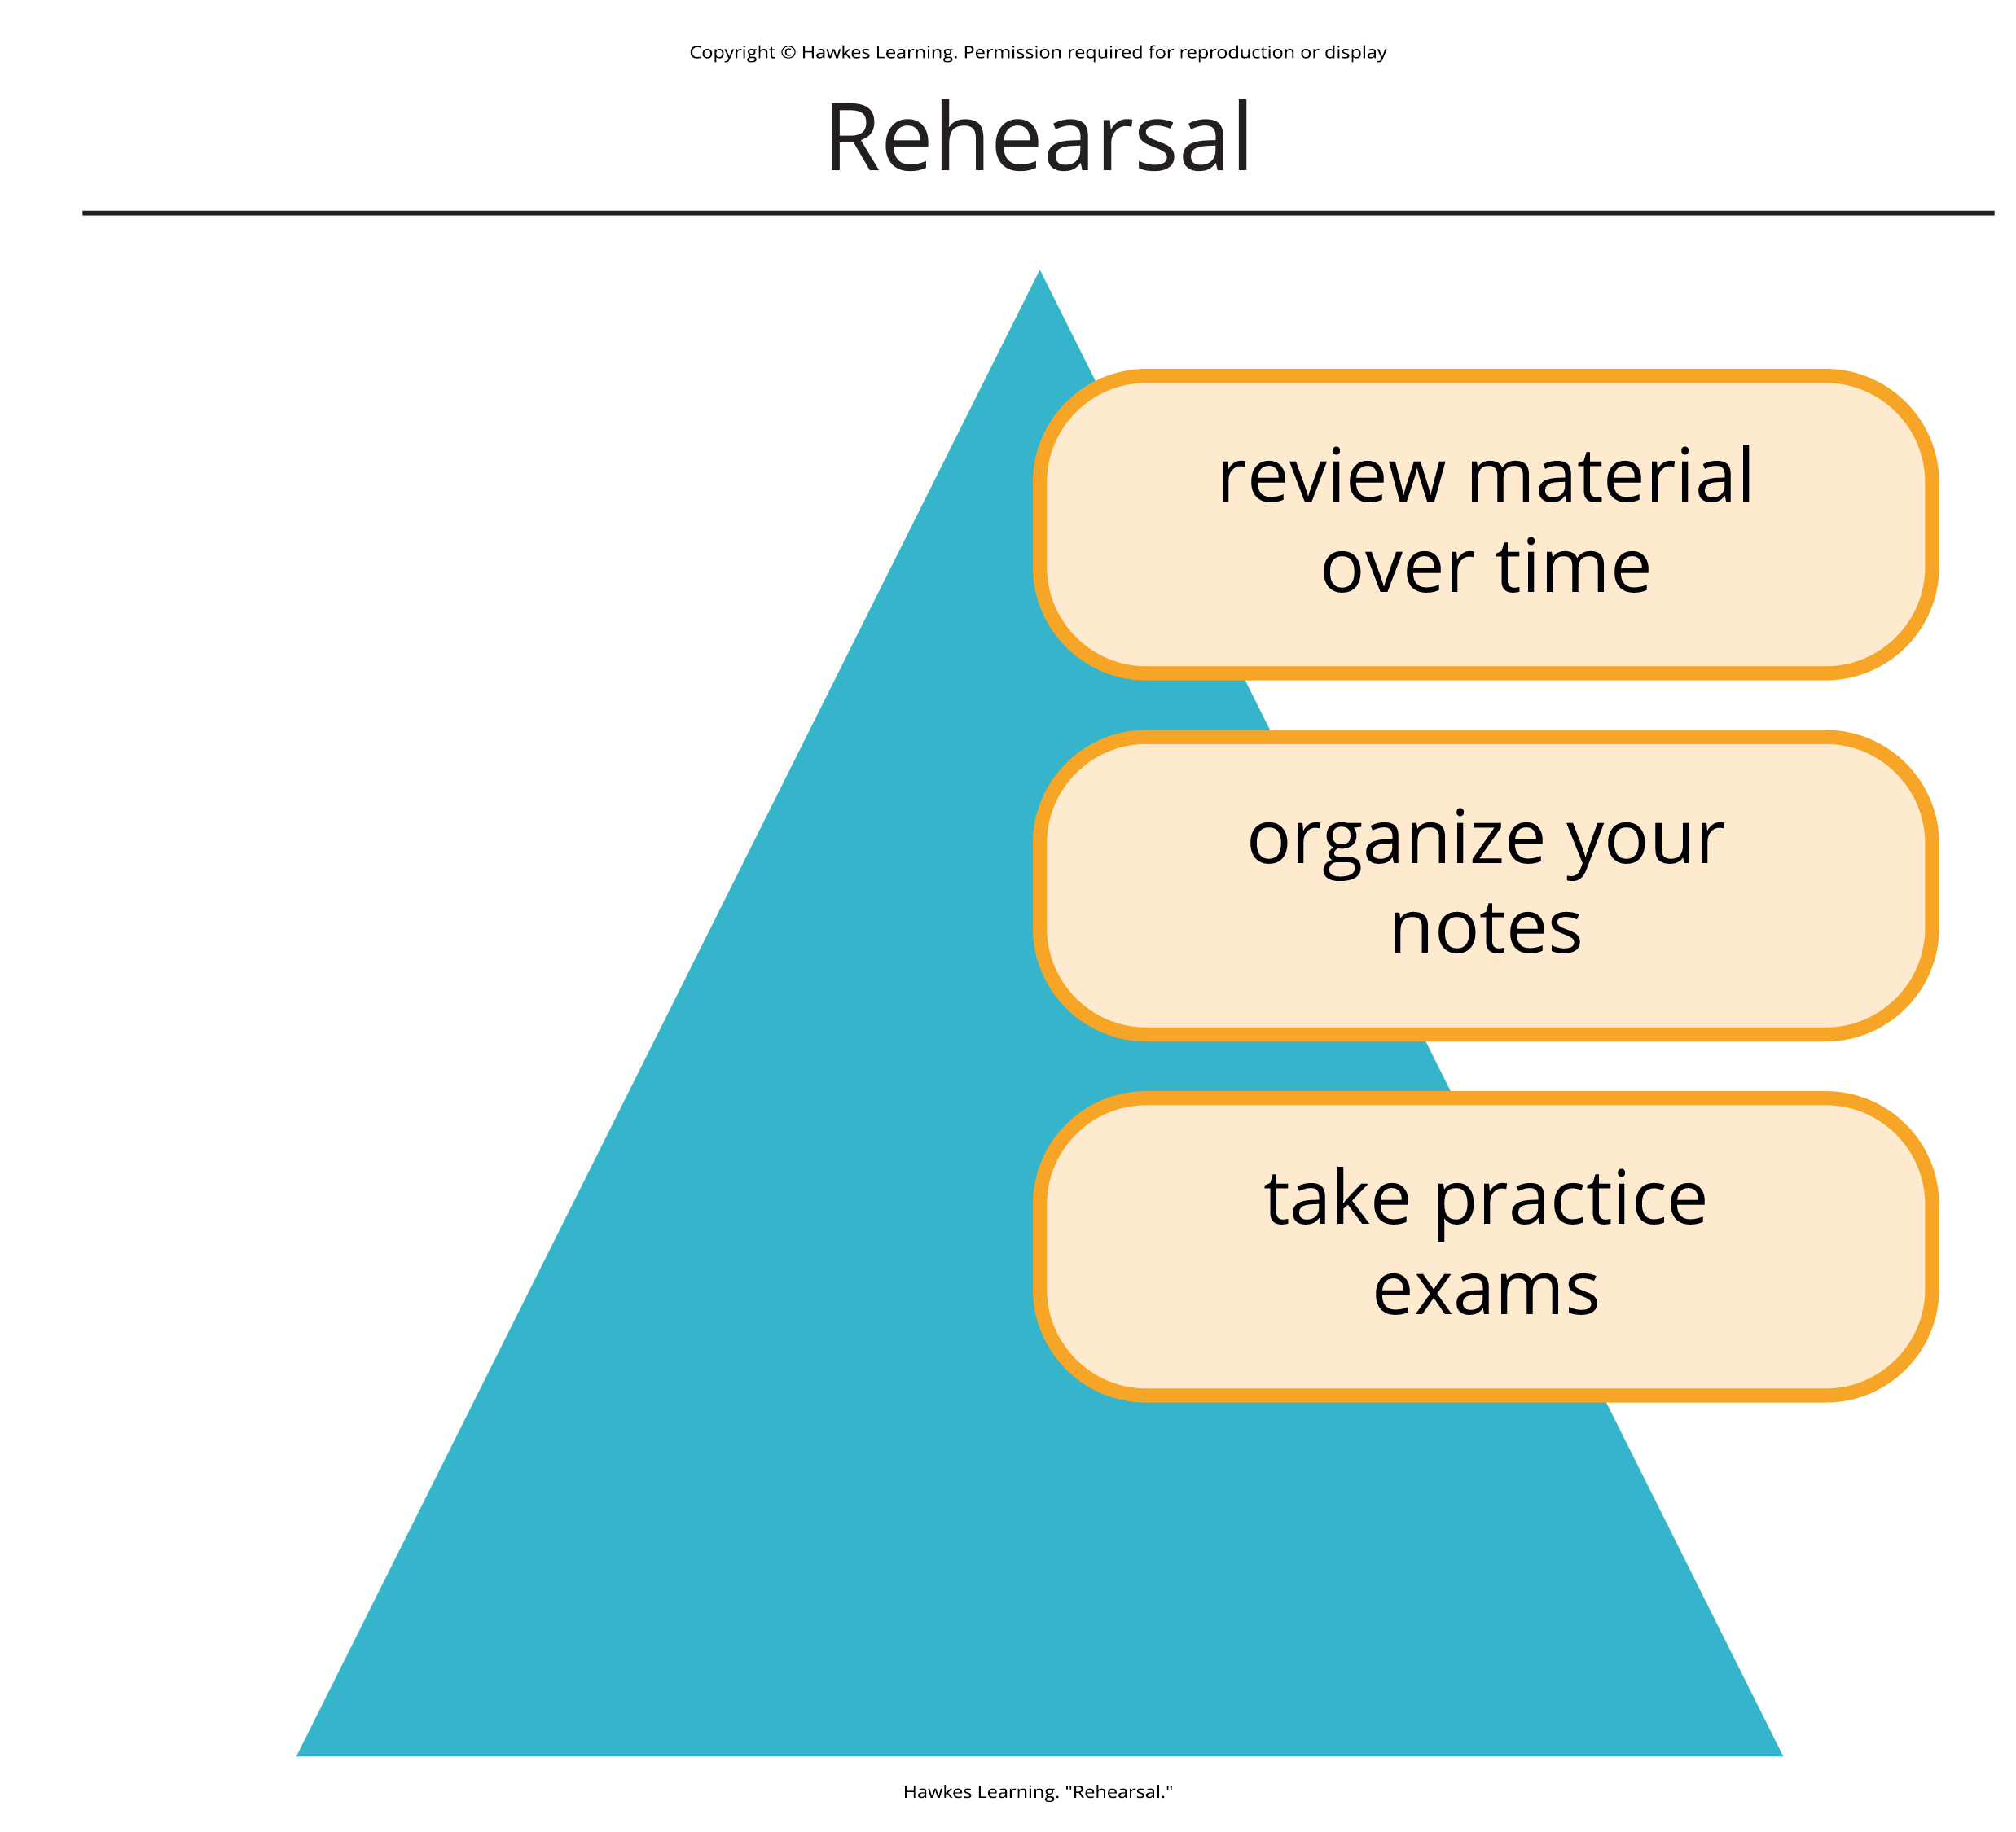
How to Study Effectively₂
Rehearse, rehearse, rehearse: review over time in spaced out, organized study sessions
Be aware of interference: minimize interference from distractions during study
Keep moving: exercise to promote neurogenesis in hippocampus for memory
Get enough sleep: for consolidation of memories (Abel & Bäuml, 2013; Klinzing et al., 2019)
Make use of mnemonic devices: acronyms, acrostics, jingles
Figure 6

Slide 15
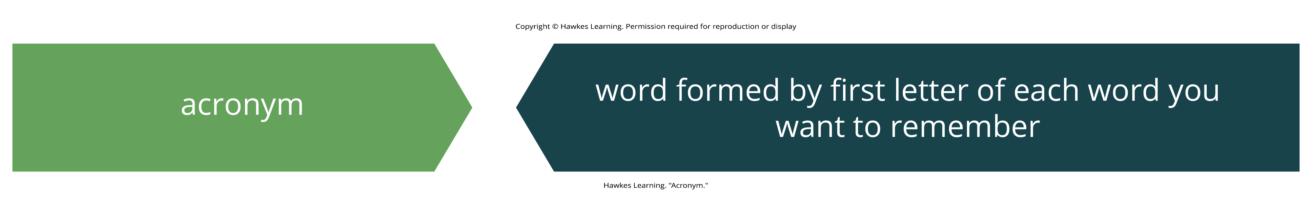
Acronyms
Example: recalling the five Great Lakes
  HOMES: Huron, Ontario, Michigan, Erie, and Superior
Figure 7
Caption: Acronyms are formed by using the first letter in each word you are trying to remember.

Slide 16
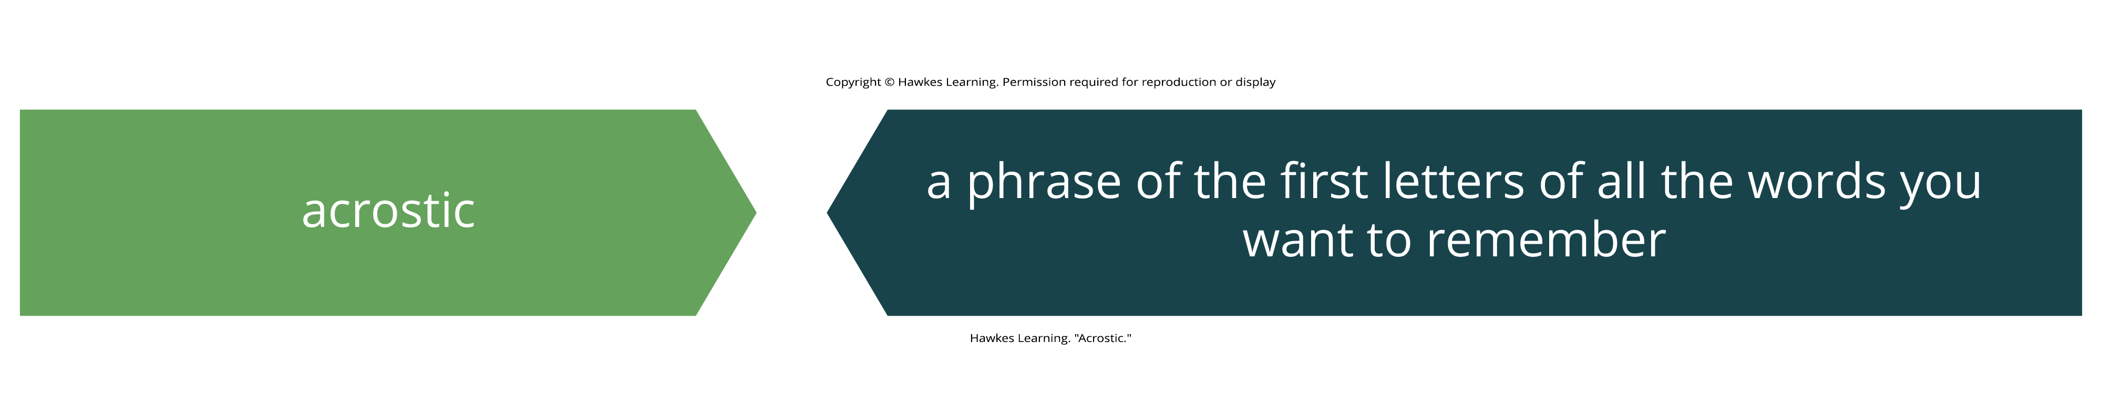
Acrostics
Example: remembering the order of operations
  Please Excuse My Dear Aunt Sally: Parentheses, Exponents, Multiplication, Division, Addition, Subtraction
Figure 8
Caption: An acrostic is like an acronym, but it uses a phrase instead of a single word.

Slide 17
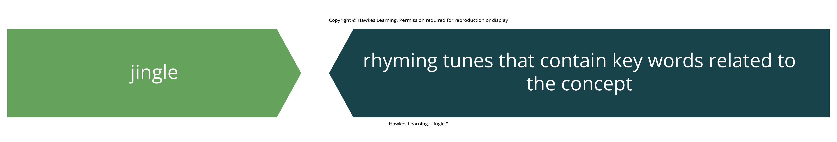
Jingles
Example: remembering grammar rules
  I before e, except after c
Figure 9
Caption: Jingles are a common advertising technique that get you to remember the product long after you are first exposed to it.

Slide 18
Summary
Strategies like mnemonic devices, rehearsal, self-referencing, and adequate sleep can combat memory failures.
These techniques are also effective in enhancing study habits and improving overall memory retention.

Slide 19
End of Hawkes Learning PowerPoint

