Slide 1
Lesson 8.2
Lifespan Theories

Slide 2
Psychosexual Theory Of Development
Sigmund Freud's theory that personality develops through series of childhood stages centered on pleasure-seeking urges.
It is described as a discontinuous progression through oral, anal, phallic, latency, and genital stages based on erogenous zones.
Explains that childhood experiences shape adult personality.
The theory remains disputed by psychologists as a legitimate explanation for personality development.
It highlights the importance of early childhood experiences in shaping individual personalities.

Slide 3
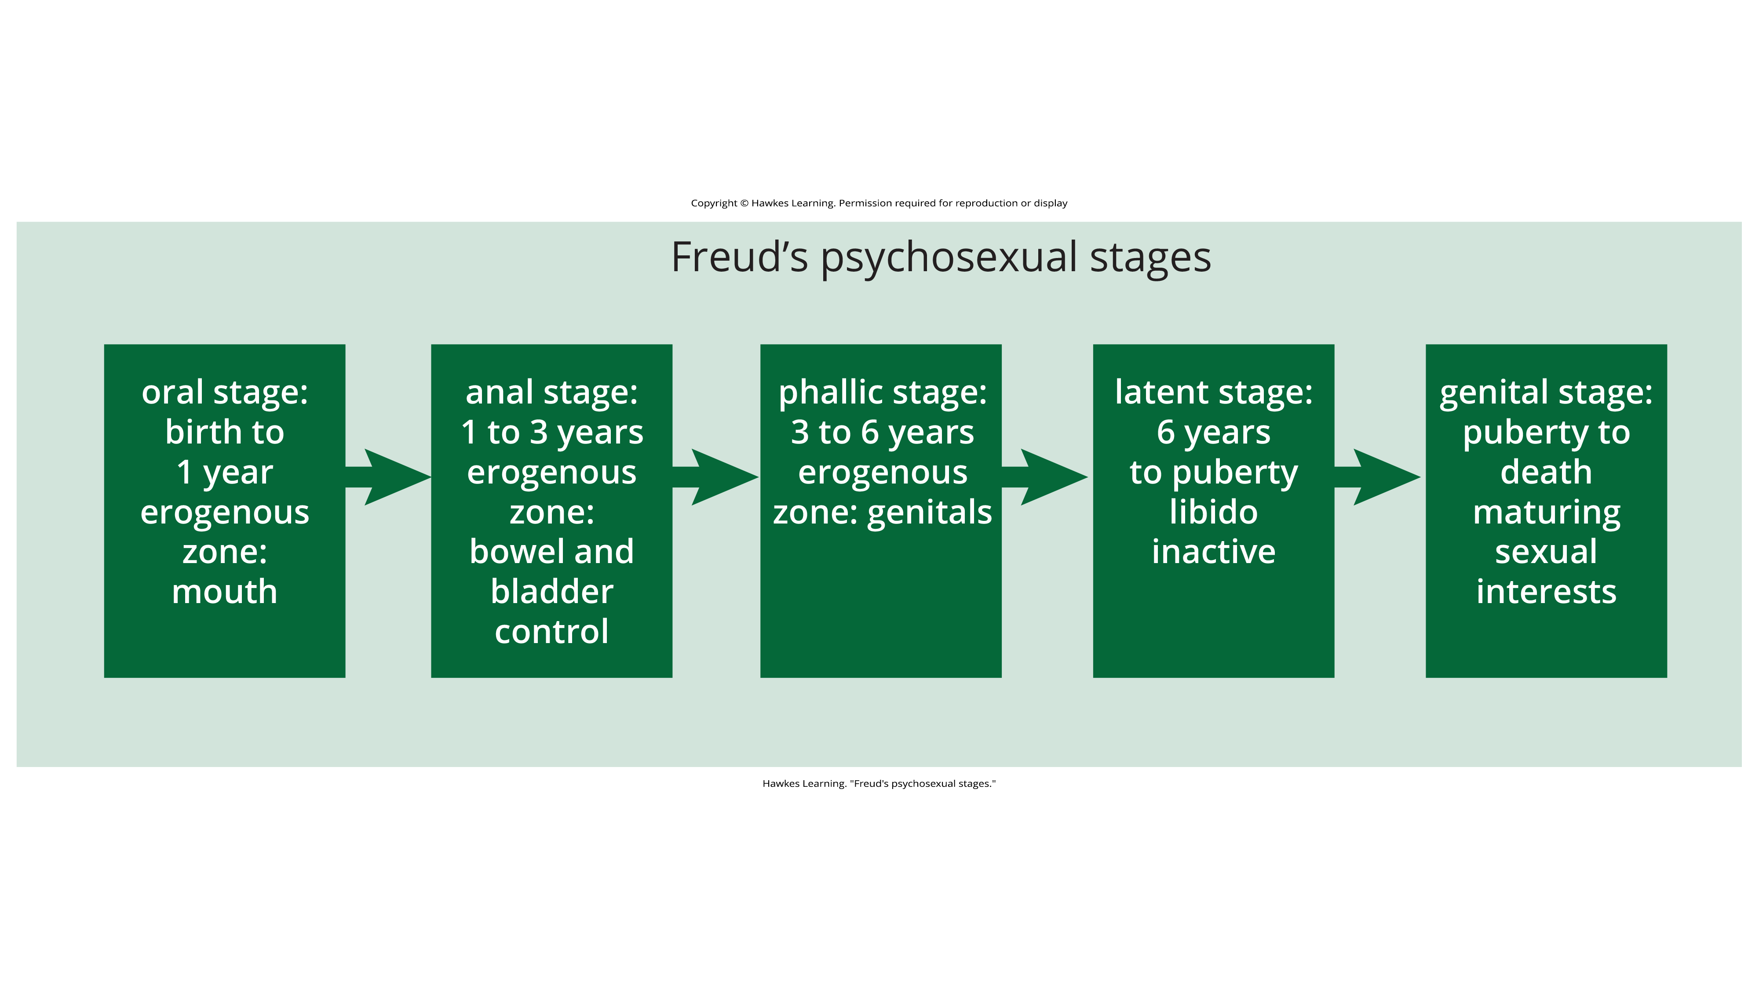
Lesson 8.2 Figure 1
Caption: Freud's theory of psychosexual development includes five stages based on different erogenous zones.

Slide 4
Psychosocial Theory Of Development₁
Erik Erikson's theory that emphasizes social nature of development rather than sexual nature.
Explains that personality development occurs across the lifespan, not just childhood.
Personality is shaped by how we interact with others and develop sense of self or ego identity.
Motivation comes from need to achieve competence in certain life areas.

Slide 5
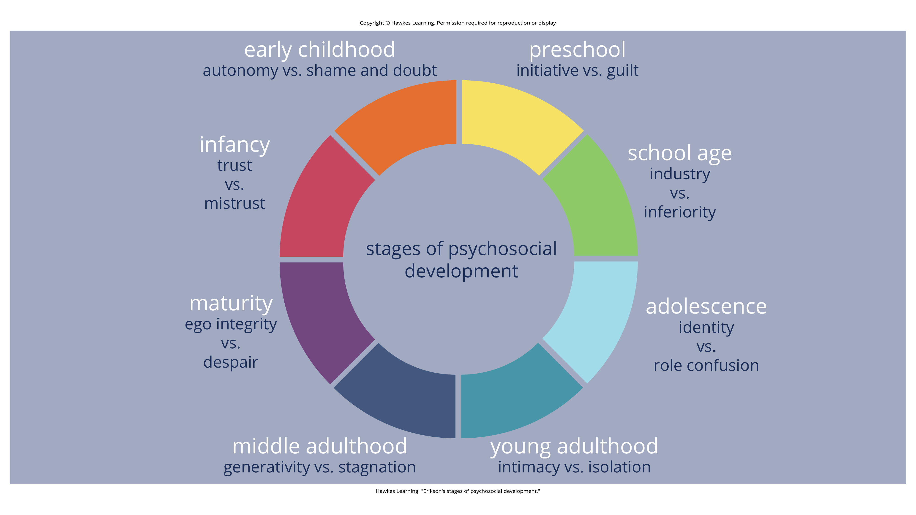
Lesson 8.2 Figure 2
Caption: Erik Erikson proposed the psychosocial theory of development, arguing that personality development takes place throughout the lifespan.

Slide 6
Psychosocial Theory Of Development₂
Eight stages of development from infancy to late adulthood, each with a conflict/task to resolve
Successful resolution leads to sense of competence and healthy personality
Failure leads to feelings of inadequacy

Slide 7
Psychosocial Theory Of Development₃
Stage 1 (Birth-1yr): trust vs. mistrust
  Develop trust through responsive caregiving
Stage 2 (1-3yrs): autonomy vs. shame/doubt
  Establish independence, confidence in abilities
Stage 3 (3-6yrs): initiative vs. guilt
  Plan and achieve goals through social interactions
Stage 4 (6-12yrs): industry vs. inferiority
  Develop sense of pride or inferiority in schoolwork, activities
Stage 5 (12-18yrs): identity vs. role confusion
  Develop sense of self, values and future direction

Slide 8
Reflection Question₁
How might parenting styles impact a child’s initiative?

Slide 9
Reflection Question₂
What are some things parents and teachers can do to help children develop a sense of competence and a belief in themselves and their abilities?

Slide 10
Psychosocial Theory Of Development₄
Stage 6 (Birth-1yr): intimacy vs. isolation
  After developing sense of self in adolescence, ready to share lives with others and develop intimate relationships; failure leads to loneliness, isolation
Stage 7 (1-3yrs): generativity vs. stagnation
  Finding life's work and contributing to others' development through volunteering, mentoring, raising children; failure leads to stagnation, little connection/interest in productivity
Stage 8 (3-6yrs): ego integrity vs. despair
  In late adulthood, reflect on life with sense of satisfaction/integrity or failure/despair; successful feel proud of accomplishments, unsuccessful feel lives wasted focusing on regrets

Slide 11
Reflection Question₃
What stage of Erikson's theory are you in right now? How do you feel like you are progressing through it?

Slide 12

Cognitive Theory Of Development
Jean Piaget (1896–1980) focused on children's cognitive growth.
Piaget's discontinuous theory states that children learn schemata, which are mental models used to help us categorize and interpret information.
  Example: driving a car, naming animals, or getting around campus
Figure 3

Slide 13
Assimilation
Assimilation is taking information from a pre-existing schema and applying it to a new situation.
  Example: If you have children, have worked with children, or are close with young family members or your friend's children, you are likely assimilating the information presented in this lesson.

Slide 14
Accommodation
Accommodation describes when we change our schemata based on new information.
  Example: This may be new information on topics you've never encountered before, and you are likely accommodating the information presented in this lesson.

Slide 15
Stages of Cognitive Development
Piaget proposed a theory of cognitive development that unfolds in four stages:
  Sensorimotor
  Preoperational
  Concrete operational
  Formal operational

Slide 16

Sensorimotor Stage
This stage lasts from birth to about 2 years old.
Children learn about the world through their senses and motor behavior.
  Example: Young children put objects in their mouths to see if the items are edible.
Young infants do not remember an object after it has been removed from sight.
Piaget studied infants' reactions when a toy was first shown to an infant and then hidden under a blanket.
  Infants who had already developed object permanence would reach for the hidden toy, indicating that they knew it still existed.
  Infants who had not developed object permanence would appear confused.
Children usually develop object permanence around 5 to 8 months.
Figure 4

Slide 17
Preoperational Stage
This stage is from approximately 2 to 7 years old.
In this stage children:
  Can use symbols to represent words, images, and ideas, which is why children in this stage engage in pretend play
  Can begin to use language, but they cannot understand adult logic or mentally manipulate information
  Cannot perform mental operations because they have not developed an understanding of conservation
    Conservation: the idea that even if you change the appearance of something, it is still equal in size as long as nothing has been removed or added
Children display egocentrism, which means that the child is not able to take the perspective of others.

Slide 18
Concrete Operational Stage
This stage occurs from about 7 to 11 years old.
In this stage, children can think logically about real (concrete) events
  Example: add, subtract, multiply, and divide
Children master the concept of conservation.
  Conservation: idea that even if you change the appearance of something, it is still equal in size, volume, or number as long as nothing is added or removed
Children understand reversibility.
  Reversibility: principle that objects can be changed but then returned back to their original form or condition.

Slide 19
Formal Operational Stage
This stage is from about age 11 through adulthood.
Individuals in the formal operational stage can deal with abstract ideas and hypothetical situations.
Individuals in this stage can use abstract thinking to problem solve, examine alternative solutions, and test these solutions.
In adolescence, a renewed egocentrism occurs.
In adulthood, we are constantly learning about new situations through exposure and perfecting our problem-solving abilities.
This is another great example of how development is continuous, across the lifespan.

Slide 20
Beyond Formal Operational Thought
Several of Piaget's ideas have come under criticism based on the results of further research.
  Example: researchers suggest that children reach cognitive milestones earlier than Piaget describes (Baillargeon, 2004; de Hevia & Spelke, 2010).
According to Piaget, the highest level of cognitive development is formal operational thought, which begins between 11 and 20 years old.
Adolescents are typically not as good as adults at making decisions that involve emotion and risk taking.
Many developmental psychologists disagree with Piaget, suggesting a possible fifth stage of cognitive development, known as the postformal stage (Basseches, 1984; Commons & Bresette, 2006; Sinnott, 1998).

Slide 21
Reflection Question₄
Do you think that cognitive development stops at age 20, or do you think there is a postformal stage? Why?

Slide 22
Theory of Moral Development₁
Psychologist Lawrence Kohlberg (1927–1987) believed that moral development follows a series of stages.
He proposed hypothetical moral dilemmas to people of all ages.
Kohlberg identified a pattern in how people's reasoning through these types of dilemmas change as they get older, which laid the framework for his stages of moral reasoning (Figure 5).

Slide 23
Reflection Question₅
If you only had two options, to steal a can of baby formula and not steal a can of baby formula, which one would you choose and why?

Slide 24
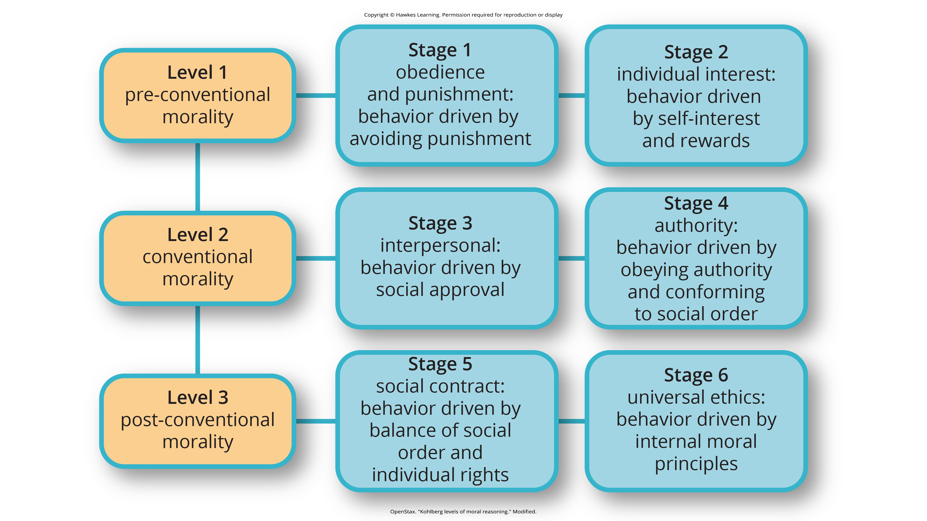
Lesson 8.2 Figure 5
Caption: Kohlberg identified three levels of moral reasoning: pre-conventional, conventional, and post-conventional. Each level is associated with increasingly complex stages of moral development.

Slide 25
Stages of Moral Reasoning
The pre-conventional level involves reasoning that reflects the consequences of the action.
A conventional response reflects the laws and rules of society or maintaining societal norms.
Post-conventional reasoning is a justification that goes beyond the rules and norms to support social cooperation.

Slide 26
Theory of Moral Development₂
Kohlberg (1969) felt that more males than females move past stage four in their moral development.
Carol Gilligan, a research assistant of Kohlberg developed her own ideas of moral development.
In her book, In a Different Voice: Psychological Theory and Women's Development, Gilligan (1982) criticizes her former mentor's theory because it was based only on upper-class White men and boys.
She argues that women would prefer stage three and men would prefer stage four.
Gilligan argues (1982) that these differences represent a difference in orientation between males and females disputing that fact that males are more advanced in moral reasoning than females.

Slide 27
Reflection Question₆
Do you agree with Kohlberg that stage four should be higher than stage three? Explain your response.

Slide 28
Theory of Moral Development₃
Many psychologists agree with Kohlberg's theory of moral development but point out that moral reasoning is very different from moral behavior.
Sometimes what we say we would do in a situation is not what we actually do in that situation.
  Example: people who reason at the post-conventional level also make decisions that are related to the consequence of the behavior

Slide 29
Summary
Sigmund Freud suggested that we pass through a series of psychosexual stages in which our energy is focused on certain erogenous zones on the body.
Eric Erikson said that our social interactions and successful completion of social tasks shape our sense of self.
Jean Piaget proposed a theory of cognitive development that explains how children think and reason as they move through various stages.
Lawrence Kohlberg said that we pass through three levels of moral thinking that build on our cognitive development.

Slide 30
End of Hawkes Learning PowerPoint

