Slide 1
Lesson 8.4
Death and Dying

Slide 2
Death And Dying₁
Our culture and individual backgrounds influence how we view death.
In some cultures, death is embraced as a natural part of life.
Prior to the mid-20th century in the United States, a doctor might not inform someone that they were dying
The majority of deaths occurred in hospitals

Slide 3
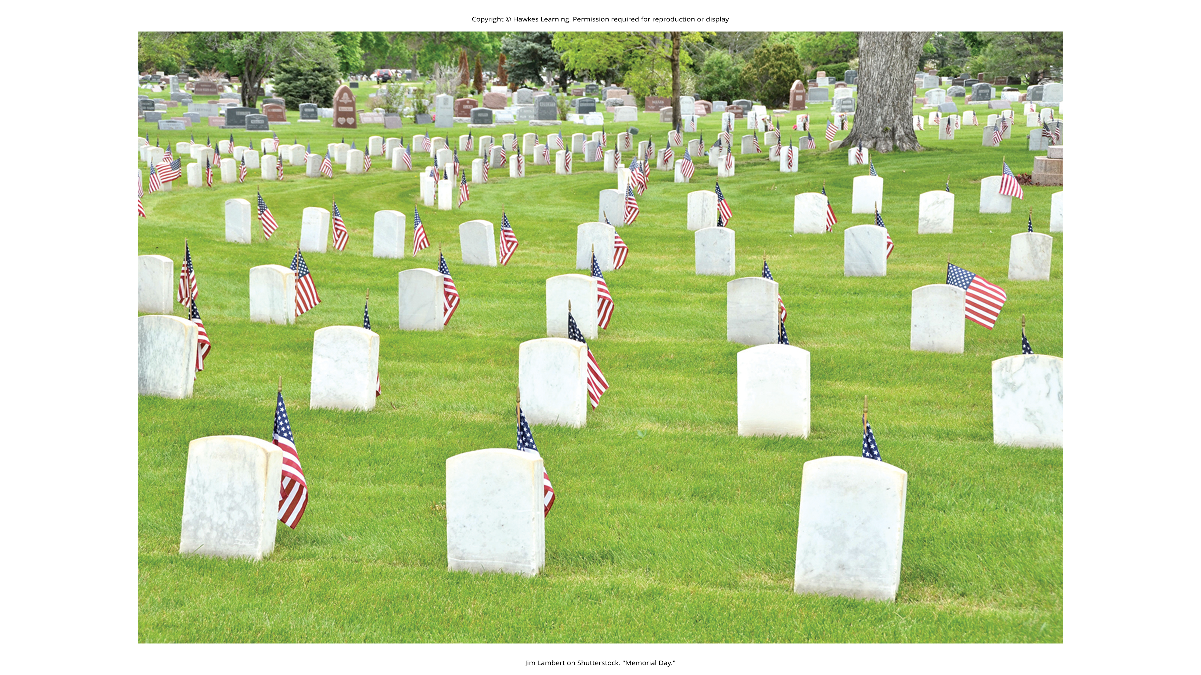
Lesson 8.4 Figure 1
Caption: In some cultures, people's bodies may be buried in a cemetery after death.

Slide 4
Reflection Question
Does it surprise you to learn that it's a fairly recent trend for doctors in the United States to inform their patients if they're dying?
Which approach to this bad news do you agree with more? Why?

Slide 5
Hospice₁
In 1967, Cicely Saunders created the first modern hospice in England.
Hospice: service that provides a death with dignity
Pain management in a human in comfortable environment
Usually occurs outside of a hospital setting
In 1974, Florence Wald founded the first hospice in the United States.
Today, hospice provides care for 1.65 million Americans and their families.

Slide 6
Hospice₂
Research has indicated that hospice care is beneficial for the patient (Brumley et al., 2003; Brumley et al., 2007; Godkin et al., 1984) for the following reasons:
Higher levels of satisfaction
Ability to stay in their homes
Not completely dependent on strangers for care (Brumley et al., 2007)
Longer life expectancy (Connor et al., 2007; Temel et al., 2010)

Slide 7
Stages Of Grief
Elizabeth Kübler-Ross (1969) described the process of an individual accepting their own death.
She proposed five stages of grief:
Denial
Anger
Bargaining
Depression
Acceptance
Most individuals experience these stages, but the stages may occur in different orders, depending on the individual.

Slide 8
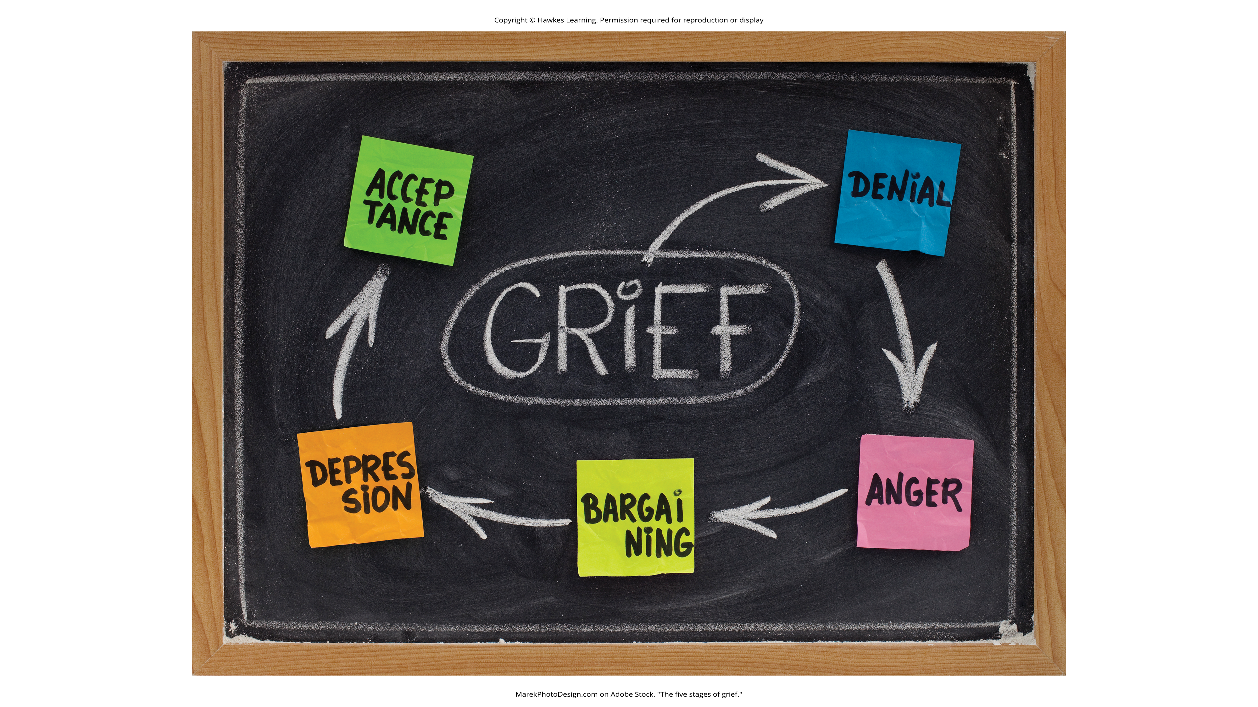
Lesson 8.4 Figure 2
Caption: The five stages of grief can occur in any order.

Slide 9
Death And Dying₂
Living wills/advance directives are legal documents detailing medical interventions a person wants if incapacitated.
A person may include a Do Not Resuscitate (DNR) Order stating no revival attempts if breathing/heartbeat stops.
Individuals can appoint a health care proxy to make medical decisions if they are unable to decide.
Desires for living wills/DNRs are influenced by religion, culture, and upbringing.
These ensure an individual's wishes are known and followed regarding end-of-life care.

Slide 10
Summary
Death marks the endpoint of our lifespan.
There are many ways that we might react when facing death.
Kübler-Ross developed a five-stage model of grief as a way to explain this process.
Many people facing death choose hospice care, which allows their last days to be spent at home in a comfortable, supportive environment.

Slide 11
End of Hawkes Learning PowerPoint

