Slide 1
Lesson 9.1
Motivation

Slide 2

Motivation
Motivation describes the wants and needs that direct behavior.
Why do we act in certain ways?
Why do we feel as we do?
Figure 1

Slide 3
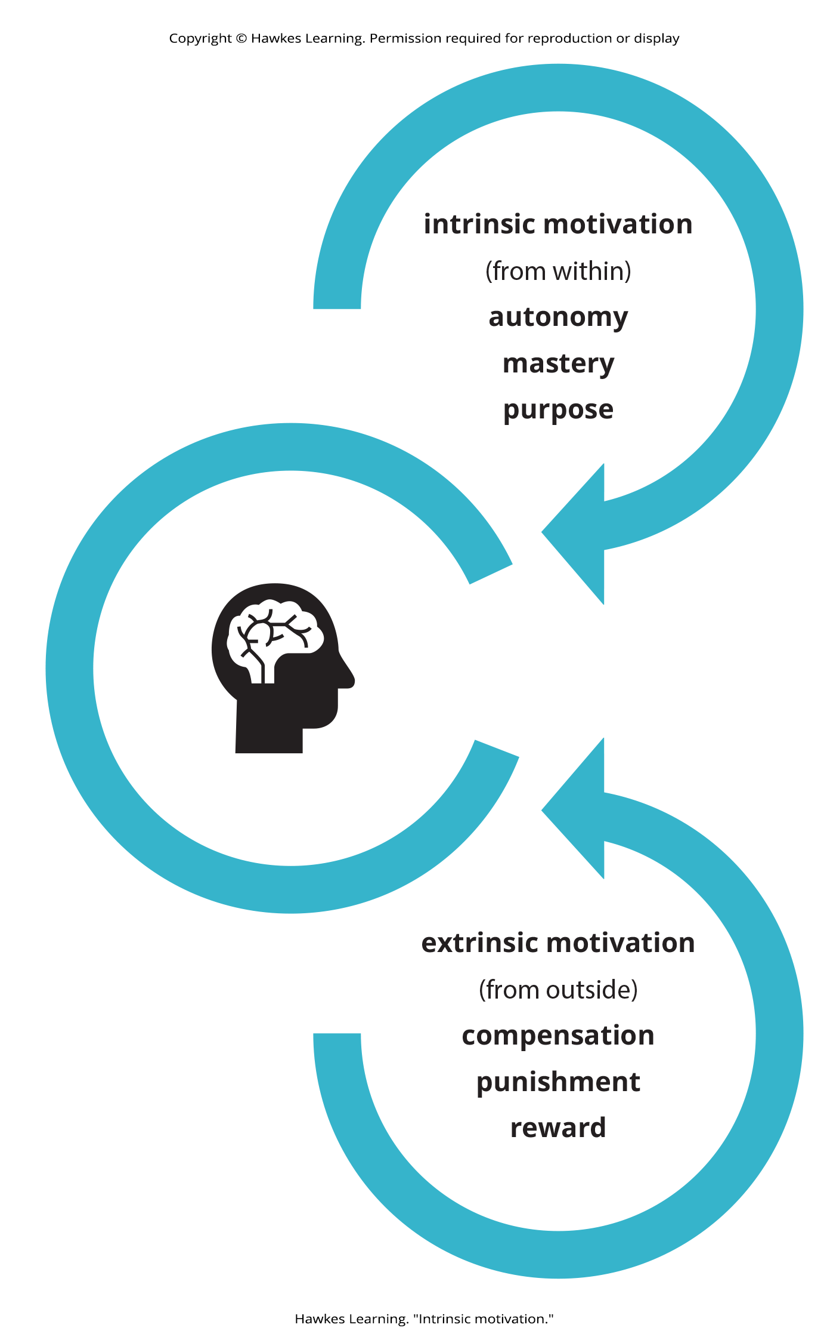
Intrinsic And Extrinsic Motivation₁
Intrinsic motivation - internal factors
Creates a sense of personal satisfaction
Extrinsic motivation - external factors
Performed to receive something from others
Figure 2

Slide 4
On Your Own
What are your intrinsic and extrinsic motivations for being in school?

Slide 5

Intrinsic And Extrinsic Motivation₂
Motivation is often a mix of intrinsic and extrinsic factors.
People who are paid to engage in behaviors they like may result in less personal enjoyment.
Example: Odessa, who loves baking, no longer bakes during free time after being employed as a baker.
Overjustification effect is when intrinsic motivation is diminished when extrinsic rewards are given.
Figure 3

Slide 6
Intrinsic And Extrinsic Motivation₃
Intrinsic motivation may not be vulnerable to effects of extrinsic reinforcements.
Verbal praise might increase intrinsic motivation.
Example: Odessa might still enjoy baking during free time if customers regularly compliment their baking.
Figure 3

Slide 7
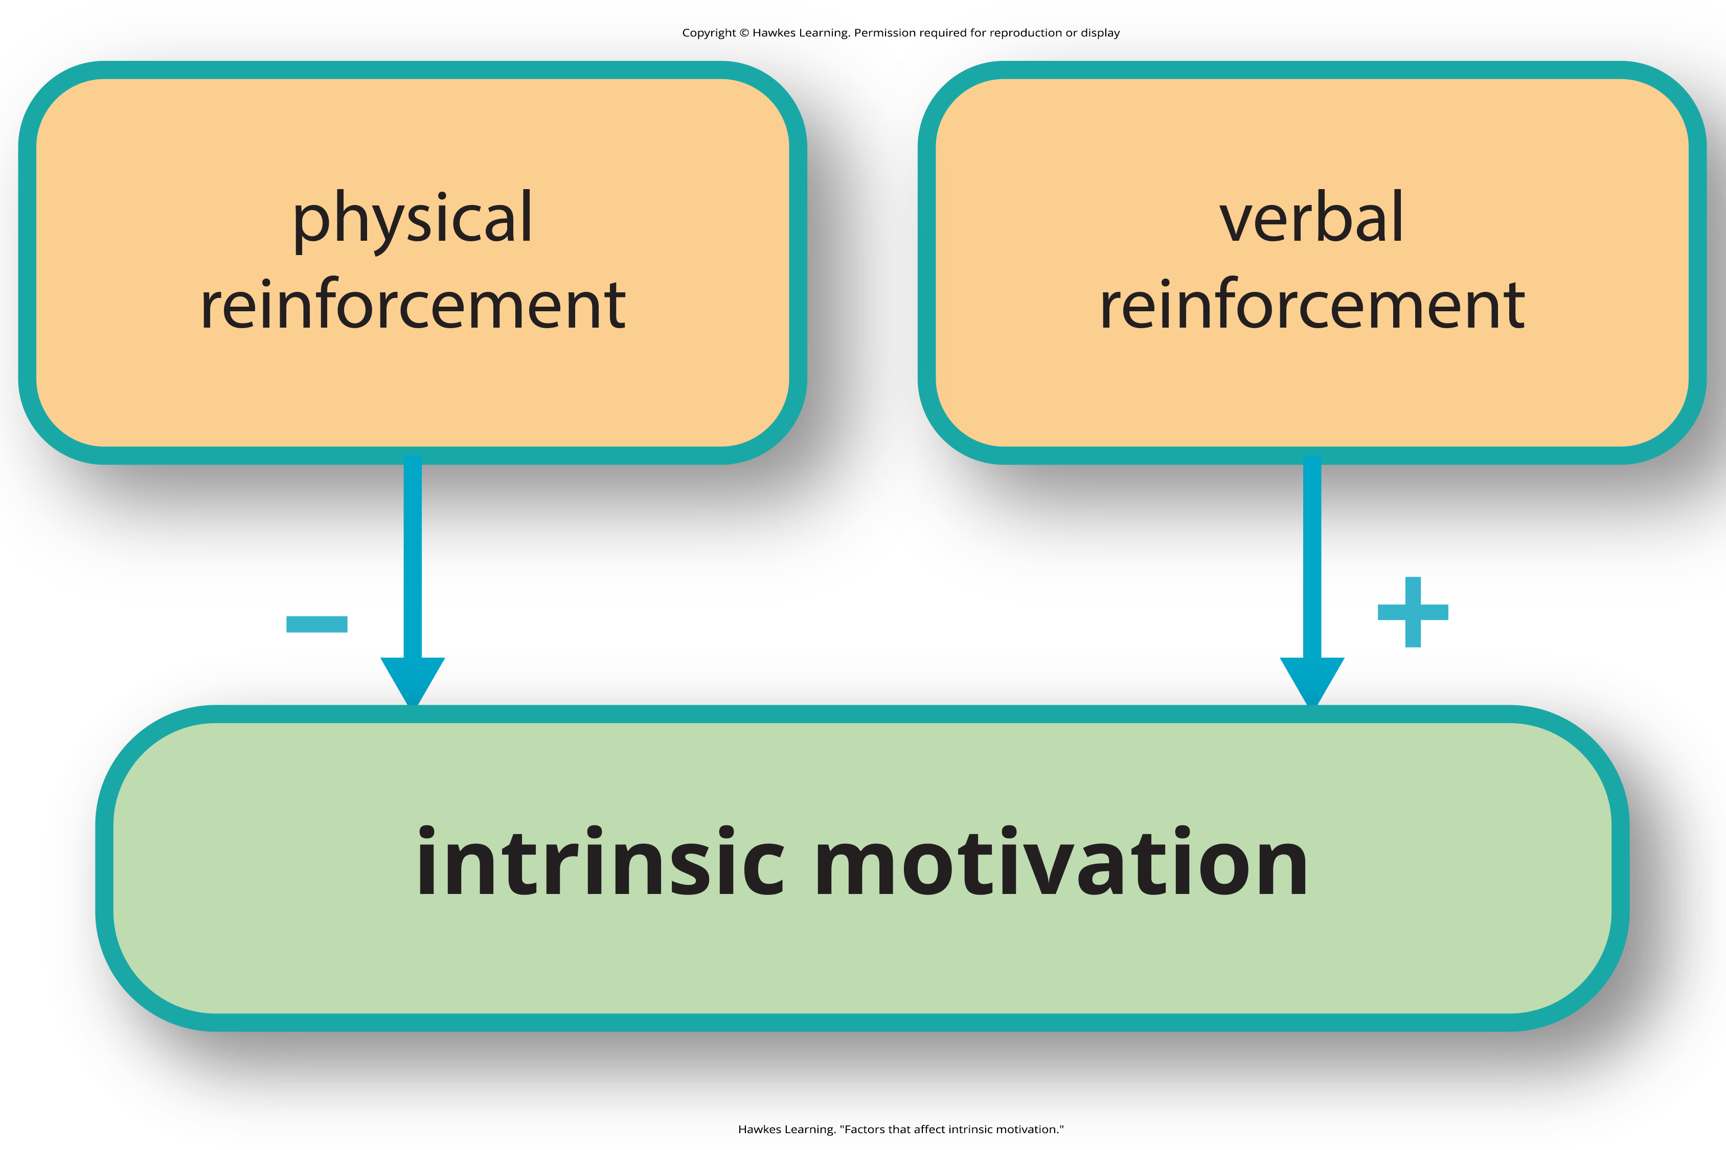
Intrinsic And Extrinsic Motivation₄
If a person expects an extrinsic reward, intrinsic motivation is reduced.
If the extrinsic reward is a surprise, intrinsic motivation persists (Deci et al., 1999).
Figure 4

Slide 8
Increasing Intrinsic Motivation In Educational Settings₁
Students are more likely to experience intrinsic motivation to learn if they feel a sense of belonging and respect.
Internalization of intrinsic motivation is enhanced if evaluative aspects are de-emphasized and if students feel a sense of control over the learning environment.
Providing challenging, yet doable, activities along with a rationale for engaging in activities can also enhance intrinsic motivation.

Slide 9
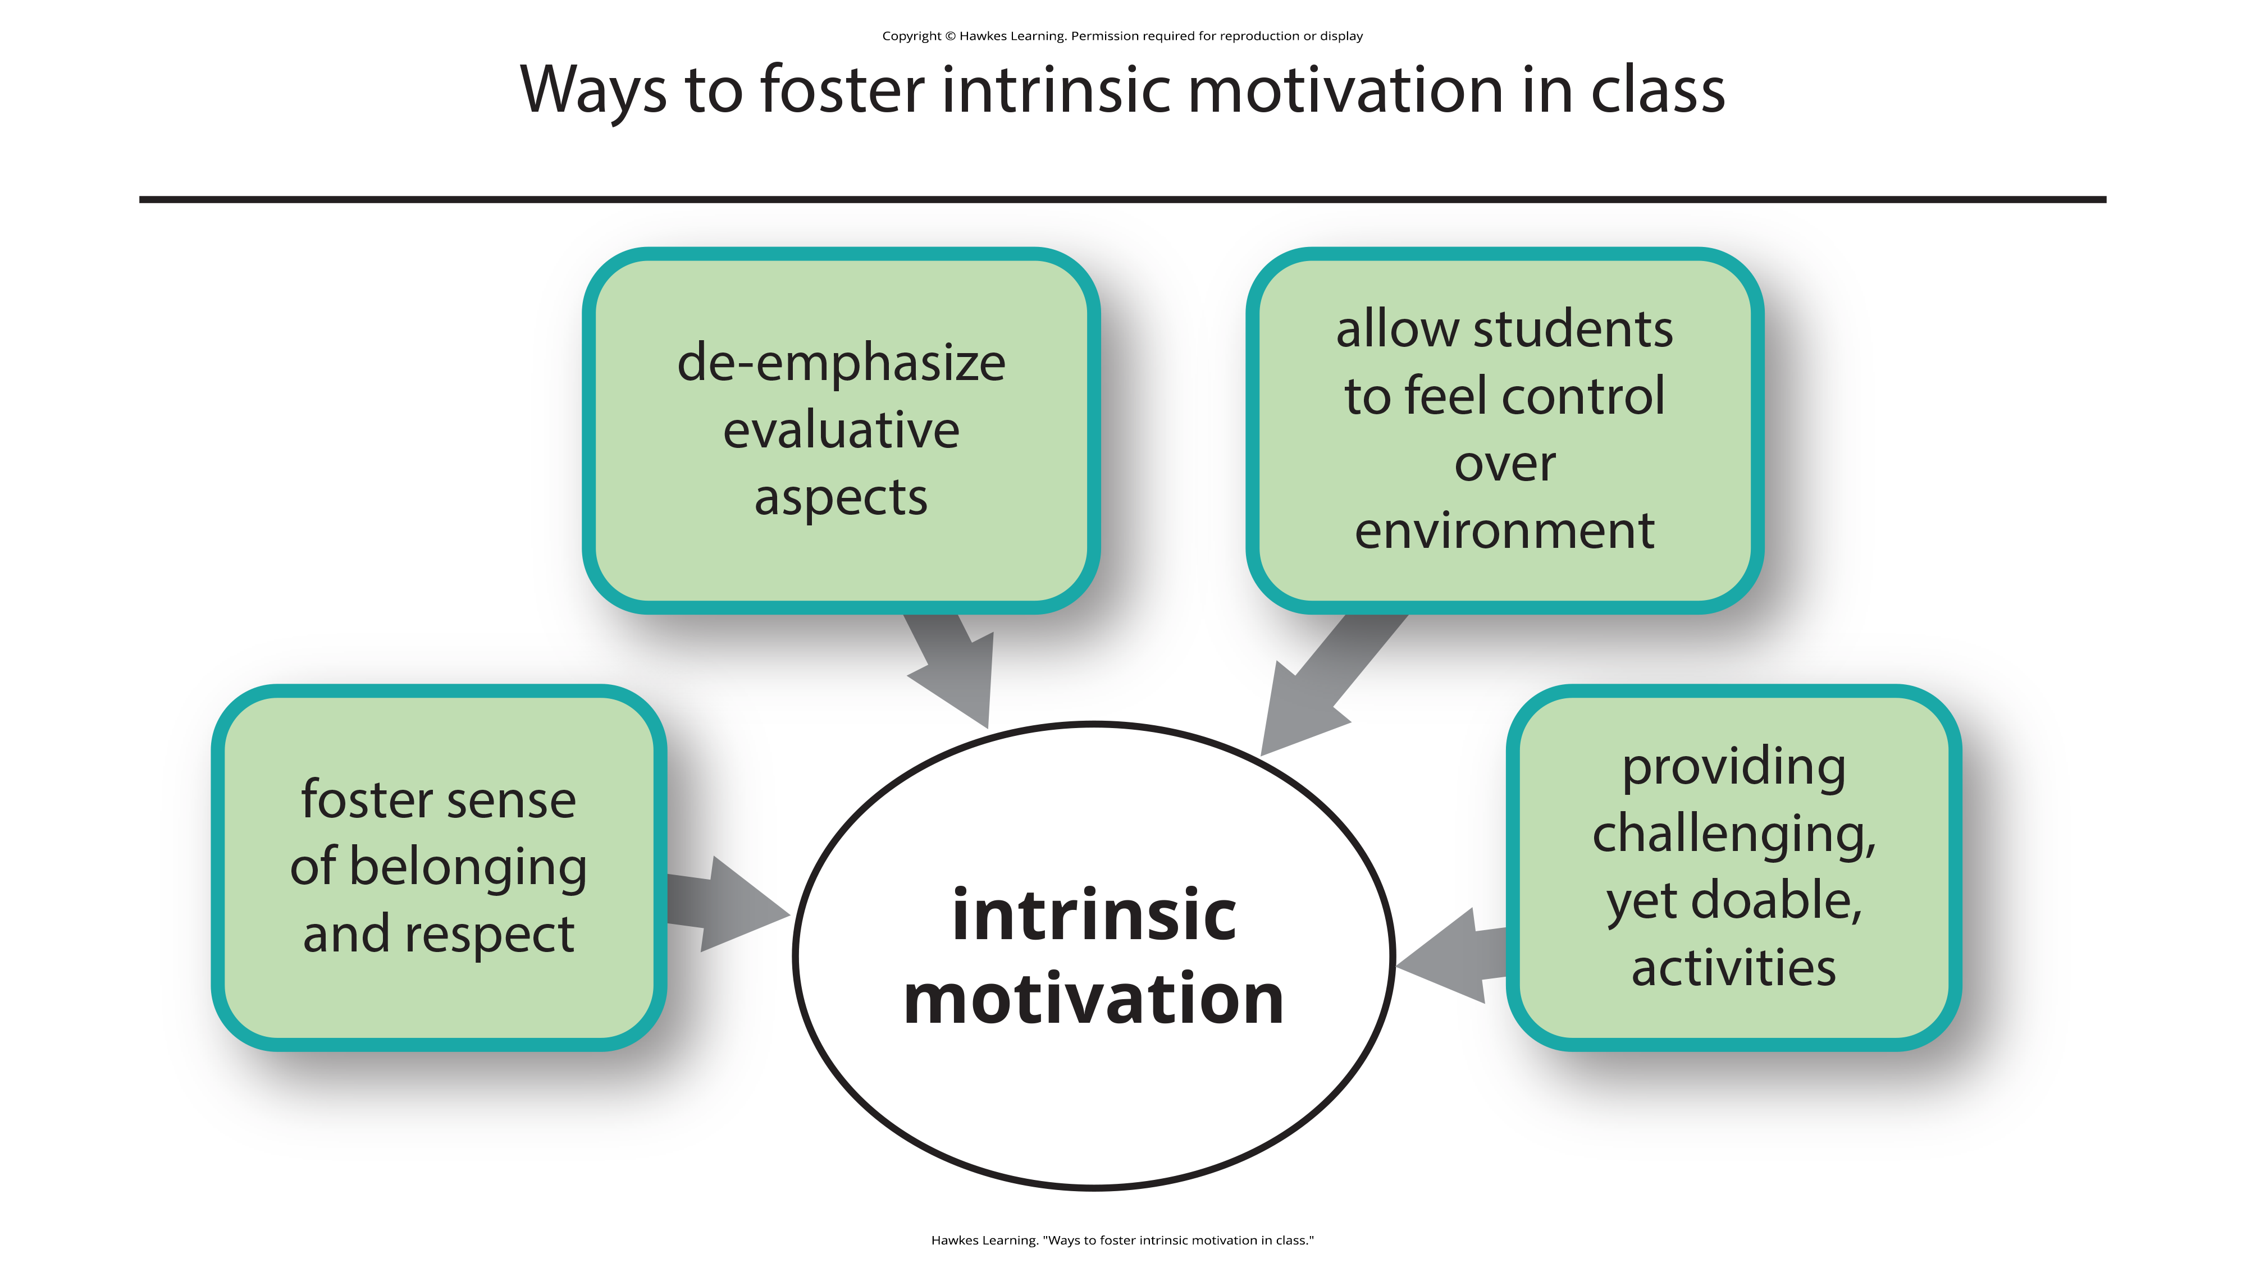
Lesson 9.1 Figure 5
Caption: There are different strategies that are effective for increasing intrinsic motivation in class.

Slide 10
Increasing Intrinsic Motivation In Educational Settings₂
Example:
Hakim is a law student whose professor is intimidating.
The professor puts students on the spot and asks them to answer tough questions.
Students often feel belittled or embarrassed.
Grades are based exclusively on quizzes and exams.
Result: Hakim will feel less intrinsic motivation to learn in this environment.

Slide 11
Increasing Intrinsic Motivation In Educational Settings₃
Example:
Hakim's Criminal Law professor facilitates classroom discussions and respectful debates.
The majority of the course grade is not exam-based but centers on a student-designed research project.
Result: Hakim will feel more intrinsic motivation to learn in this environment.

Slide 12
Reflection Question₁
Have you ever considered what kind of things keep you motivated? Money? Success? Love? Do different things motivate you in different situations?

Slide 13
Theories About Motivation
William James was the father of psychology in the United States.
He theorized behavior was driven by instincts which are species-specific patterns of behavior that are not learned.
This view—that human behavior is driven by instincts—received a fair amount of criticism because of the undeniable role of learning in shaping all sorts of human behavior.

Slide 14
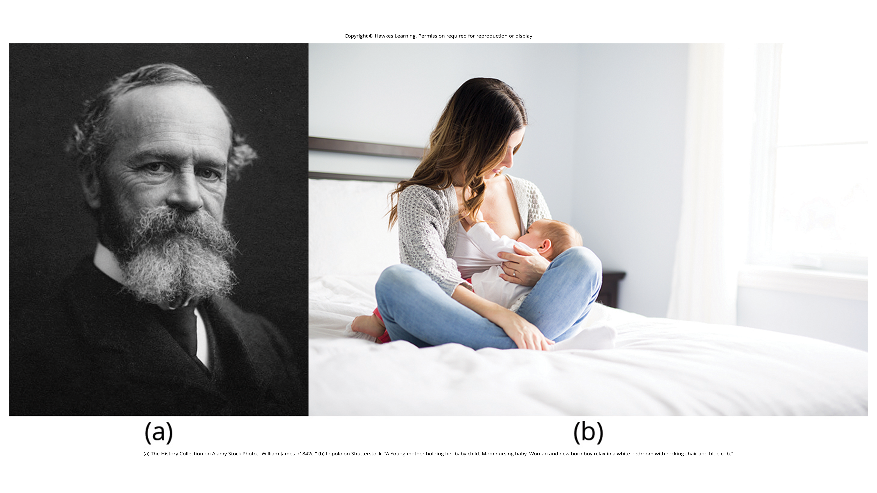
Lesson 9.1 Figure 6
Caption: (a) William James proposed the instinct theory of motivation, asserting that behavior is driven by instincts. (b) In humans, instincts may include behaviors such as an infant’s rooting for a nipple and sucking.

Slide 15
Reflection Question₂
Do humans have instincts that do not differ across individuals? Identify at least five instincts.

Slide 16
Drive Theory Of Motivation₁
Drive theory of motivation
Deviations from homeostasis (tendency to maintain balance, or optimal level, within a biological system) create physiological needs.
Needs become drive states
Drive states direct behavior to meet the needs
Example: Need to eat

Slide 17
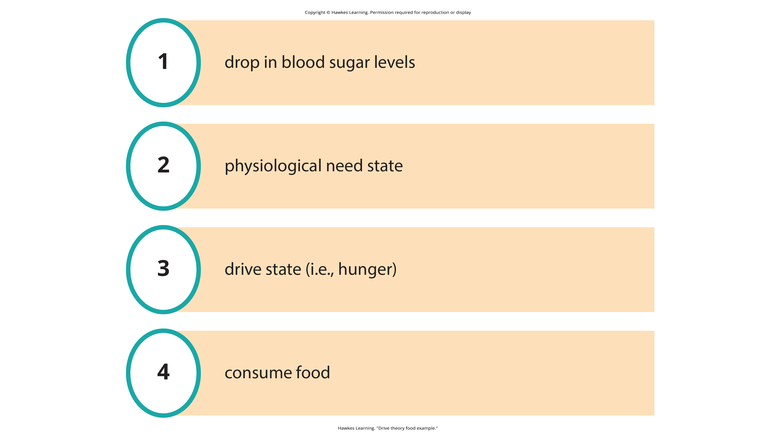
Lesson 9.1 Figure 7
Caption: Going without food causes a specific physiological response that encourages you to eat.

Slide 18

Lesson 9.1 Figure 8
Caption: Hunger and subsequent eating are the result of complex physiological processes that maintain homeostasis.

Slide 19
Drive Theory And Habits
Drive theory emphasizes the role that habits play in behavioral responses.
A habit is a pattern of behavior in which we regularly engage.
Engaging in a behavior that successfully reduces a drive increases the likelihood of that behavior in the future.

Slide 20
Arousal₁
Extensions of drive theory consider levels of arousal.
If a person is underaroused, they become bored and seek out stimulation.
Example: A student feels bored during summer break.
If a person is overaroused, they will engage in behaviors to reduce arousal.
Example: A student is overwhelmed by countless exams and papers.

Slide 21
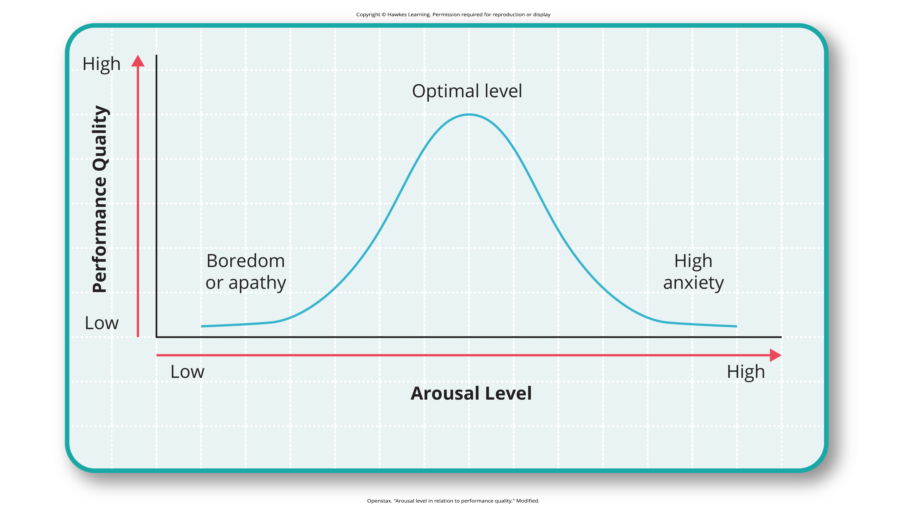
Lesson 9.1 Figure 9
Caption: The concept of optimal arousal in relation to performance on a task is depicted here. Performance is maximized at the optimal level of arousal, and it tapers off during under- and overarousal.

Slide 22
Group Activity
In a small group, discuss your arousal level regarding taking an exam for this class. How does your arousal correlate with your performance?

Slide 23
Arousal₂
Optimal arousal is impacted by the complexity and difficulty of the task.
The Yerkes-Dodson law states that a simple task is performed best when arousal levels are relatively high, and a complex task is best performed when arousal levels are lower.

Slide 24
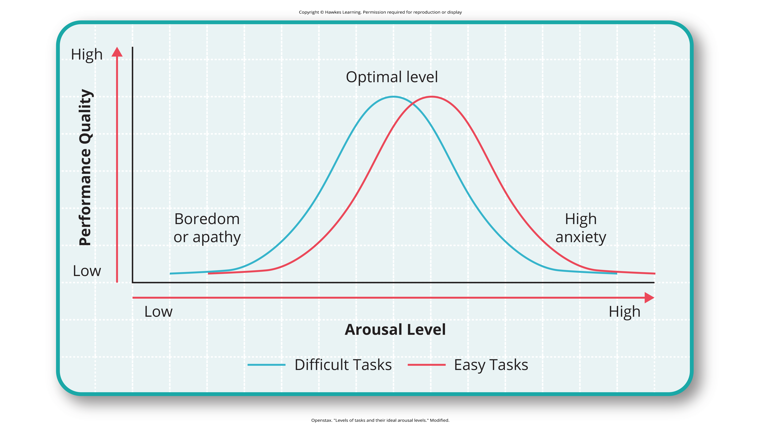
Lesson 9.1 Figure 10
Caption: Task performance is best when arousal levels are in a middle range, with difficult tasks best performed under lower levels of arousal, and simple tasks best performed under higher levels of arousal.

Slide 25
Self-Efficacy
Self-efficacy is an individual's belief in their own ability to complete a task.
A person's sense of self-efficacy plays a pivotal role in motivation (Bandura, 1994).
Motivation comes from expectations we have about the consequences of our behaviors.
Understanding our abilities helps to direct our goals.
Example: If a student believe they can achieve at a high level, they are more likely to take on challenging tasks.

Slide 26
Reflection Question₃
Think back to a recent challenge you faced. Did you approach the problem with high or low self-efficacy?

Slide 27
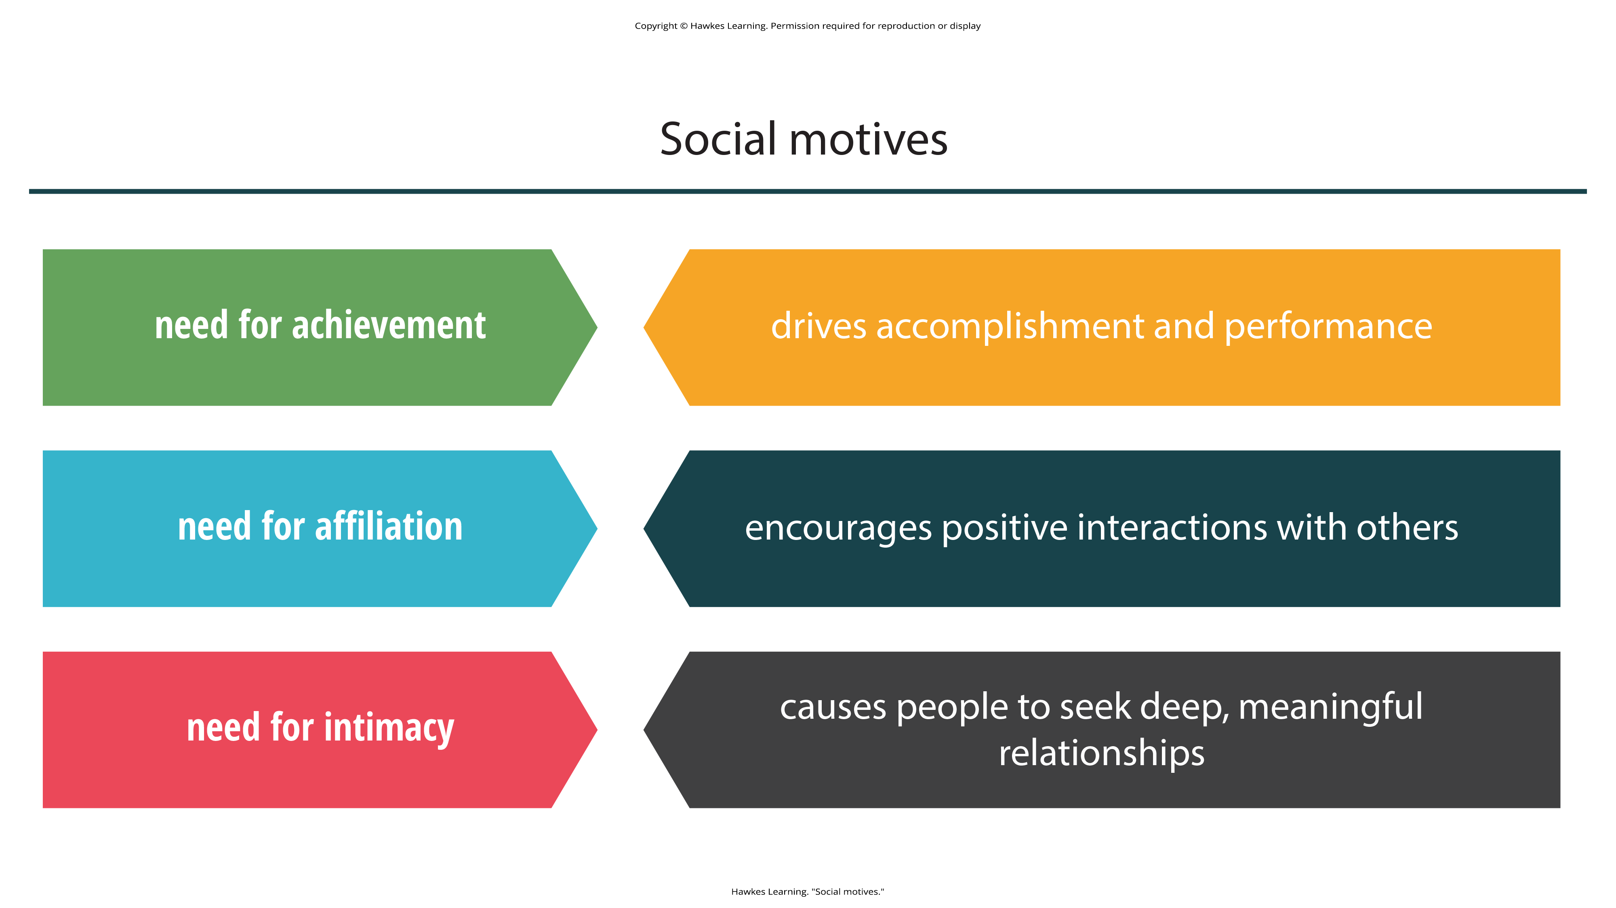
Social Motives
Social motives, including the needs for achievement, affiliation, and intimacy, may also impact behavior.
Figure 11

Slide 28
Maslow's Hierarchy Of Needs₁
The hierarchy of needs spans a spectrum of motives ranging from biological to individual to social (Maslow, 1943).
Physiological needs are necessary for survival.
Security needs refer to feeling safe and secure.
Social needs include feeling loved and having a sense of belonging.
Esteem needs include having self-worth and confidence.
Self-actualization needs equate to achieving one's full potential.

Slide 29
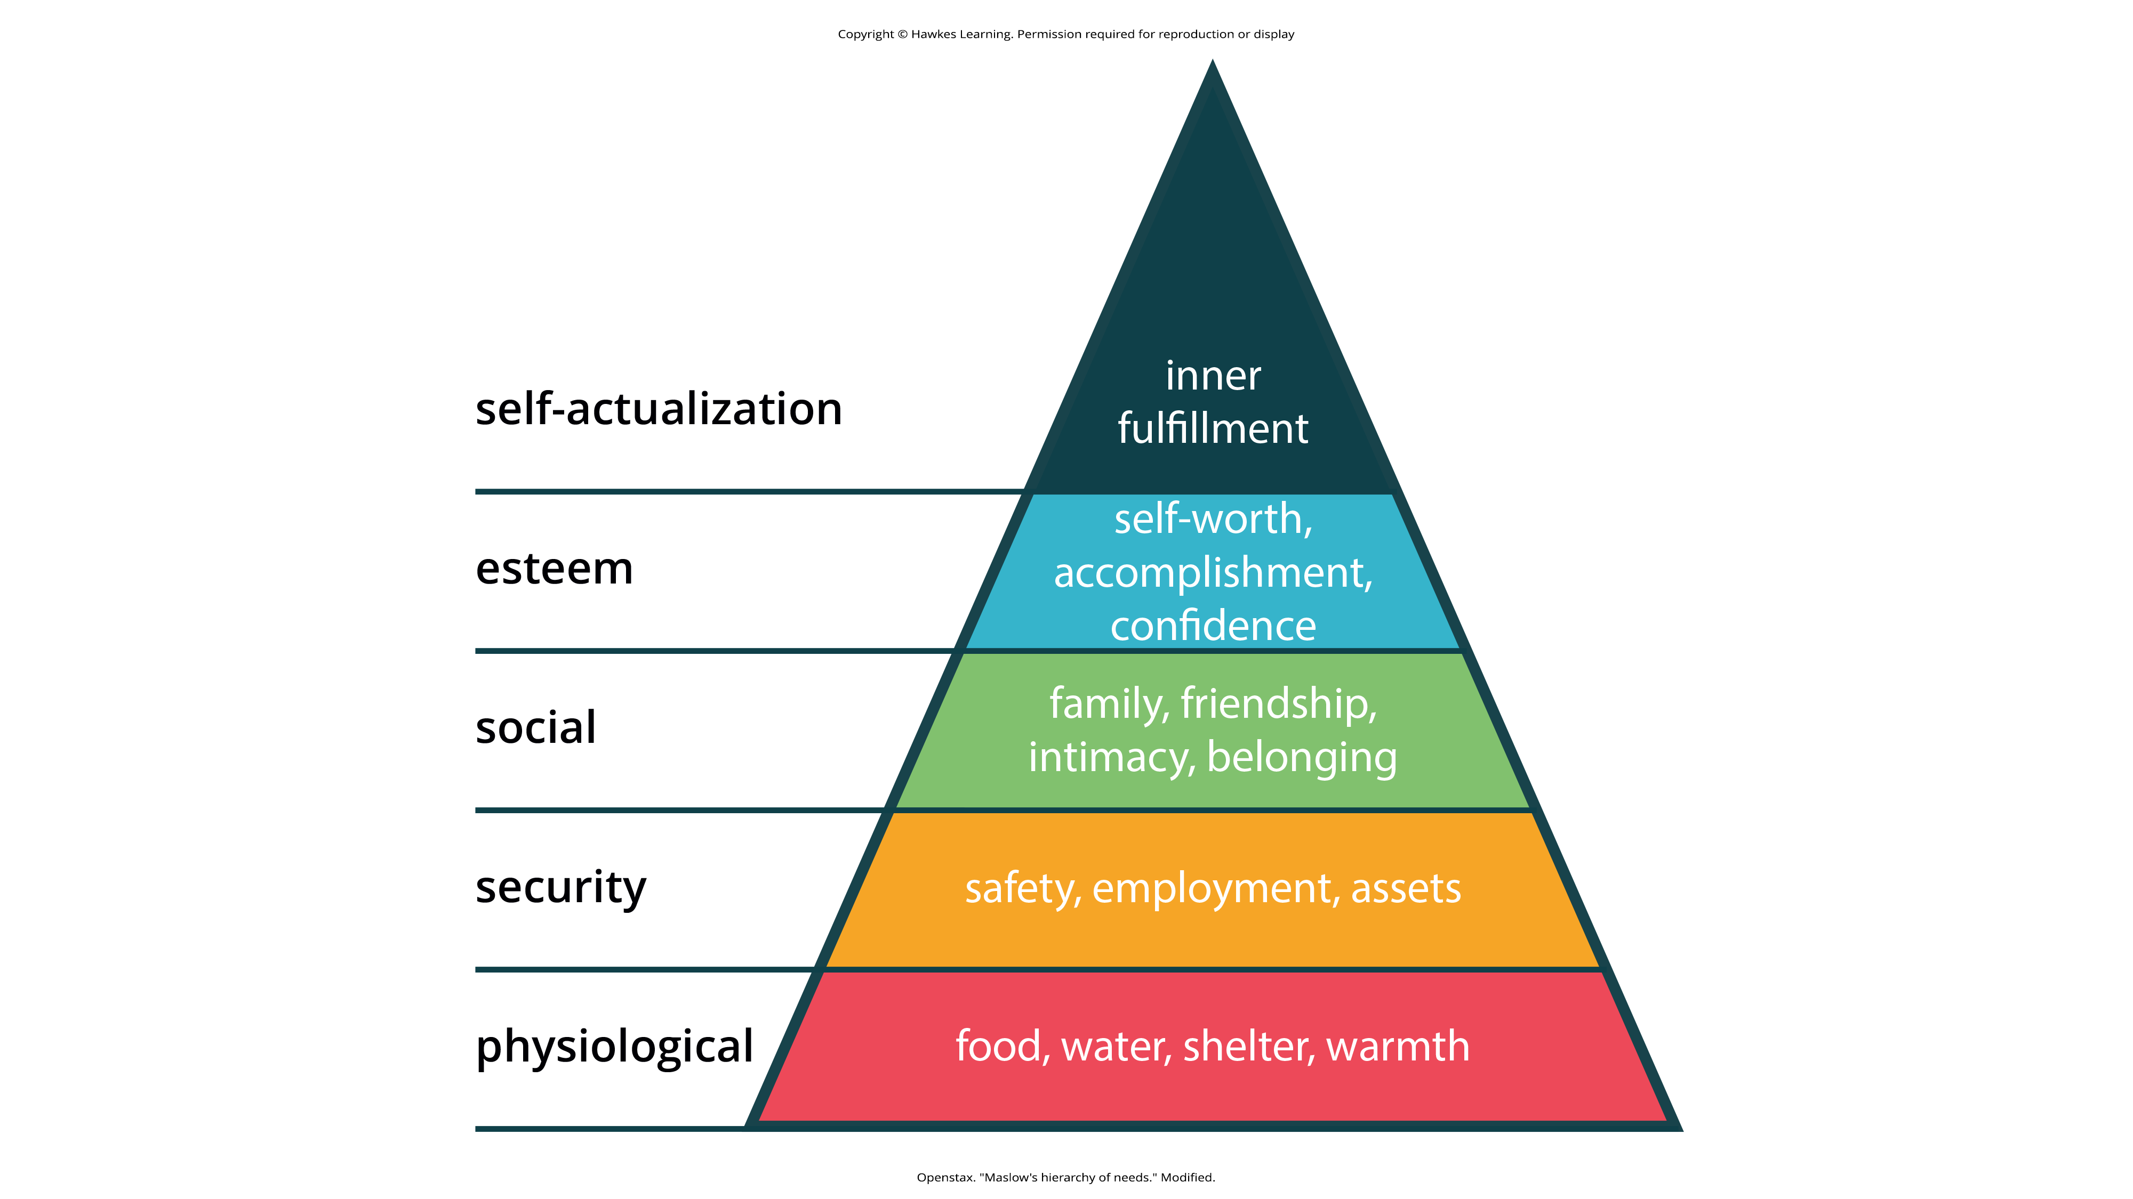
Lesson 9.1 Figure 12
Caption: Maslow’s hierarchy of needs is illustrated here. In some versions of the pyramid, cognitive and aesthetic needs are also included between esteem and self-actualization. Others include another tier at the top of the pyramid for self-transcendence.

Slide 30

Maslow's Hierarchy Of Needs₂
Abraham Maslow felt that one must satisfy lower-level needs before addressing higher-level needs.
Example: A person who is struggling to find food is less likely to worry about their social status.
Example: A person living in an unsafe area will be less concerned about grades.
Figure 13

Slide 31
Maslow's Hierarchy Of Needs₃
Self-transcendence may occur in later life.
This level occurs after self-actualization.
Individuals who reach this level strive for meaning and purpose beyond the concerns for oneself (Koltko-Rivera, 2006).
Example: Mohandas K. Gandhi went on several hunger strikes in protest.

Slide 32
Summary
Motivation may result from internal or external factors.
There are a variety of theories about motivation.
Some theories are biologically-oriented and related to homeostasis and drives.
Bandura theorized that self-efficacy motivates behavior.
Maslow defined motivation in a hierarchy of needs that ranged from low-level physiological needs to high-level self-actualization needs.

Slide 33
End of Hawkes Learning PowerPoint

