Slide 1
Lesson 9.2
Hunger and Eating

Slide 2

Hunger And Eating
Eating is essential for survival.
Drive-like hunger exists to ensure that we seek out sustenance.
Eating and drinking are influenced by physiological mechanisms as well as social, cultural, and economic influences.
Figure 1

Slide 3
Physiological Mechanisms To Initiate Feeding
When the stomach is empty, it contracts, and causes hunger pangs and secretion of chemicals that signal the brain to start feeding behavior.
When blood glucose drops, the pancreas and liver generate chemicals that induce hunger and thus initiate feeding behavior.

Slide 4
Physiological Mechanisms Of Satiation
Satiation is a feeling of fullness and satisfaction that stops eating behavior.
As blood glucose levels increase, the pancreas and liver send signals to stop eating behavior.
Food’s passage through the gastrointestinal tract provides satiety signals to the brain.
Fat cells release a satiety hormone called leptin.

Slide 5
Reflection Question₁
When your body tells you that you've eaten enough food, do you generally listen to it?
How often do you ignore this message and choose to overeat?

Slide 6
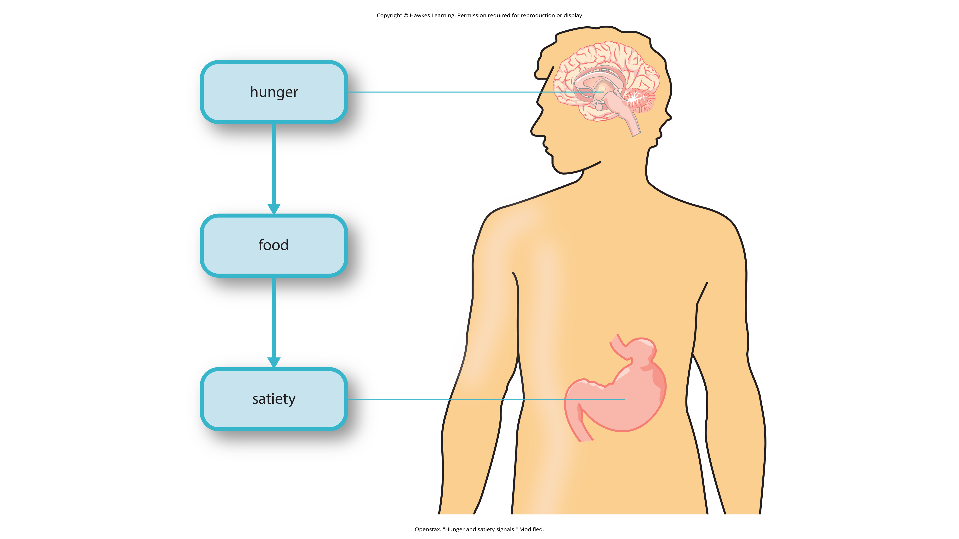
Physiological Mechanisms For Eating
The various signals that regulate eating are integrated in the brain, specifically areas of the hypothalamus and the hindbrain.
Figure 2

Slide 7
Metabolism And Body Weight
Body weight is influenced by several factors, such as genetics, environment, and the number of calories we consume and burn daily.
If we take in more calories than we burn, our bodies store excess energy as fat.
A person's metabolic rate is the amount of energy that is expended over a given time.
People with high rates of metabolism can burn off calories more easily than those with lower rates.

Slide 8
Set-Point Theory
The set-point theory argues that when a person diets and exercises, their metabolic rate will slow down to keep that person at their same ideal body weight.
However, a study indicated that metabolic rates did not change in individuals who had lost weight (Weinsier et al., 2000).

Slide 9
Reflection Question₂
Do you agree with the set-point theory, or do you think body weight over time is influenced mostly by diet or exercise?

Slide 10
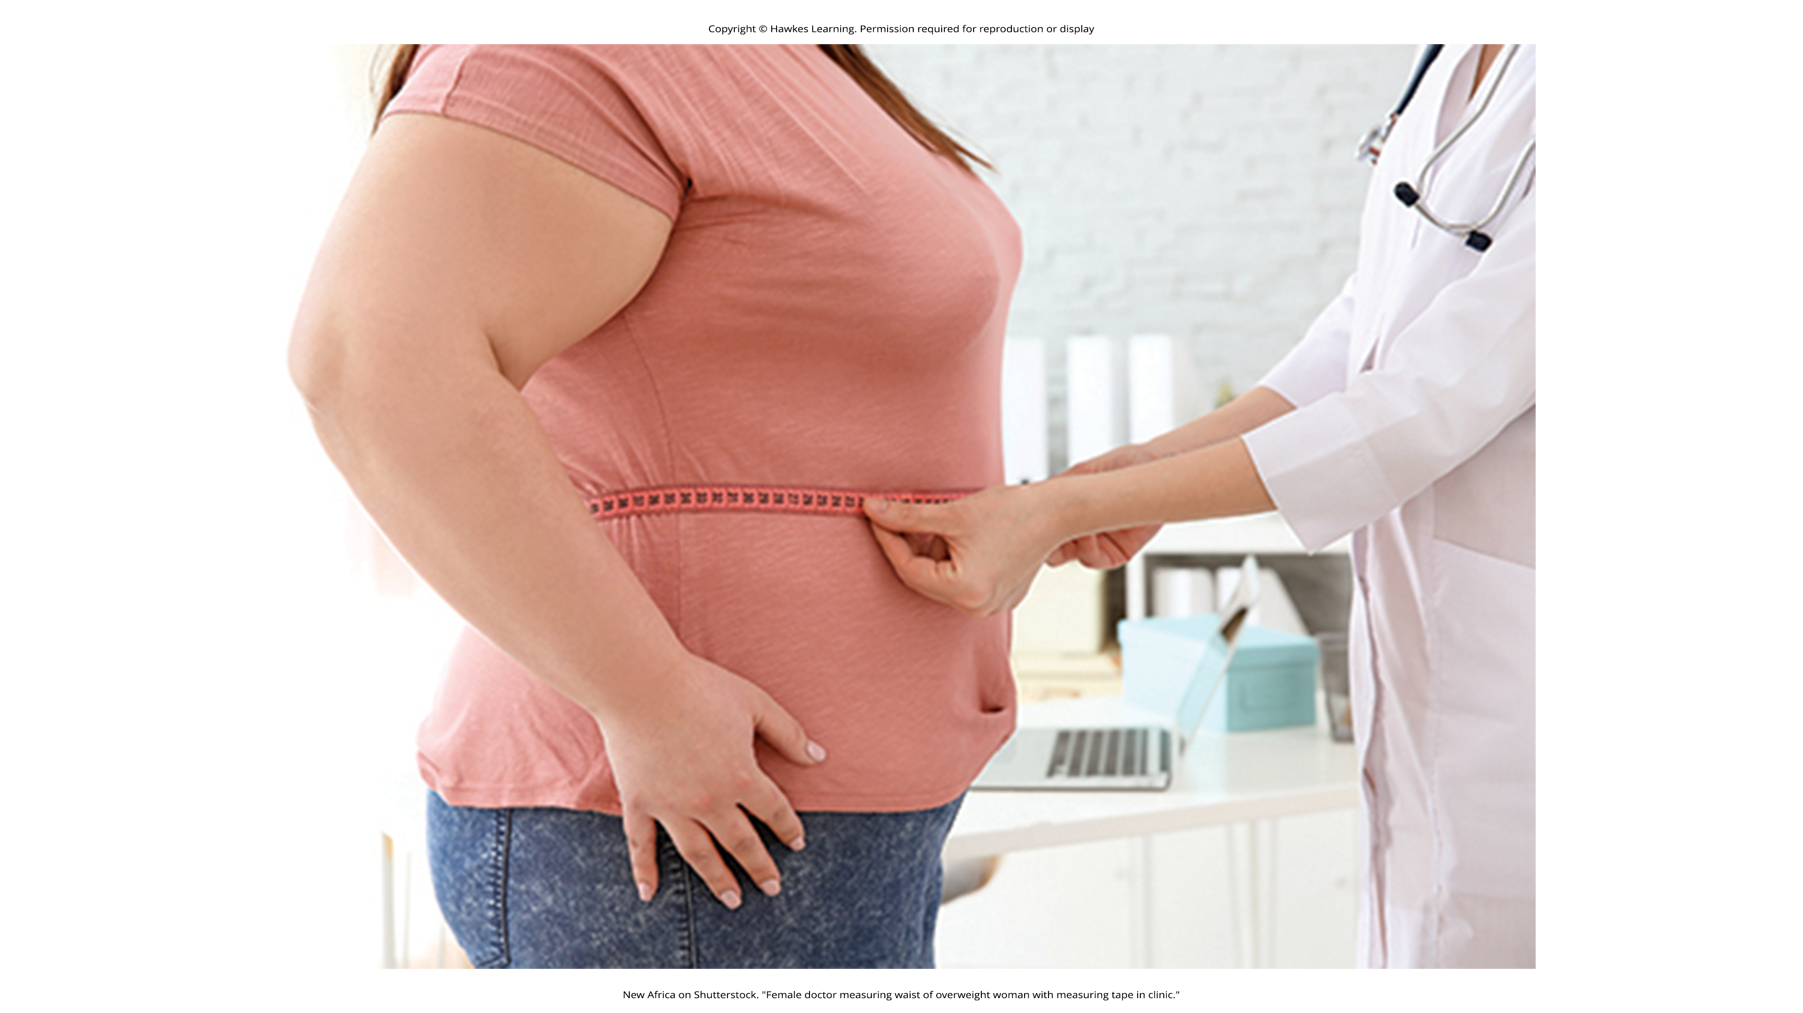
Obesity
Nearly 42% of adults and approximately 20% of children are classified as overweight or obese (CDC, 2021).
Excess weight increases one's risk for type 2 diabetes, sleep apnea, colon cancer, breast cancer, infertility, and arthritis.
Figure 3

Slide 11
Body Mass Index (BMI)
A body mass index (BMI) is calculated by dividing a person's weight by their height.
A body mass index between 25 and 29.9 is considered overweight; 30 or higher is considered obese, and over 40 is considered morbidly obese.
BMI does not distinguish percentage of fat and muscle in a person's weight.
Genetics, socioeconomic status, and physical environment contribute to obesity.

Slide 12
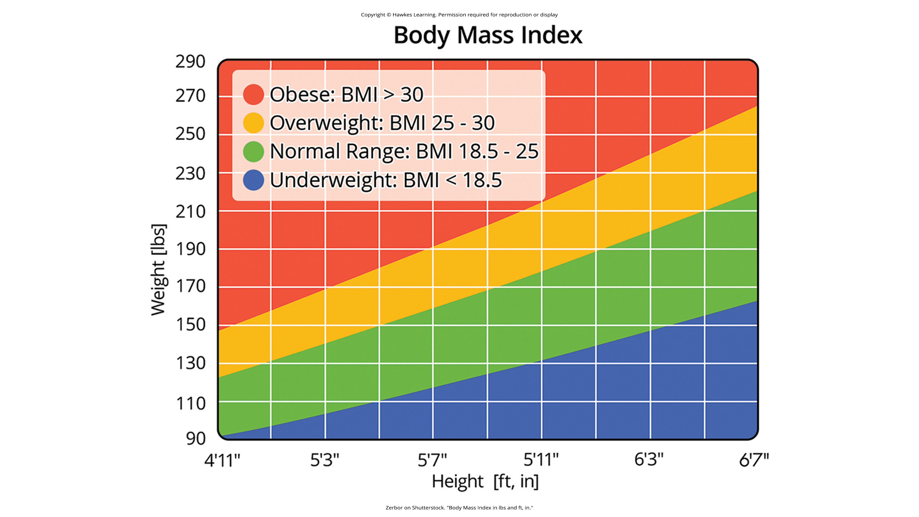
Lesson 9.2 Figure 4
Caption: This chart shows how adult BMI is calculated. Individuals find their height on the x-axis and their weight on the y-axis to determine their BMI.

Slide 13
Reflection Question₃
Why do you think socioeconomic status might be related to obesity?

Slide 14
Bariatric Surgery
Bariatric surgery is a type of surgery specifically aimed at weight reduction by modifying the gastrointestinal system to reduce the amount of food that can be eaten or limit the amount of digested food that can be absorbed.
A meta-analysis suggests bariatric surgery is more effective than nonsurgical treatment for obesity in the 2 years immediately following the procedure (Gloy et al., 2013).

Slide 15
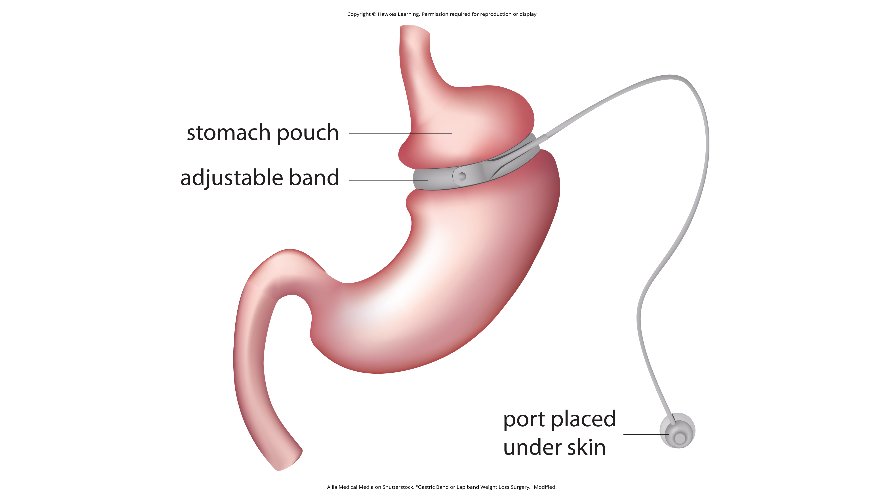
Lesson 9.2 Figure 5
Caption: Gastric banding surgery creates a small pouch of stomach, reducing the size of the stomach that can be used for digestion.

Slide 16
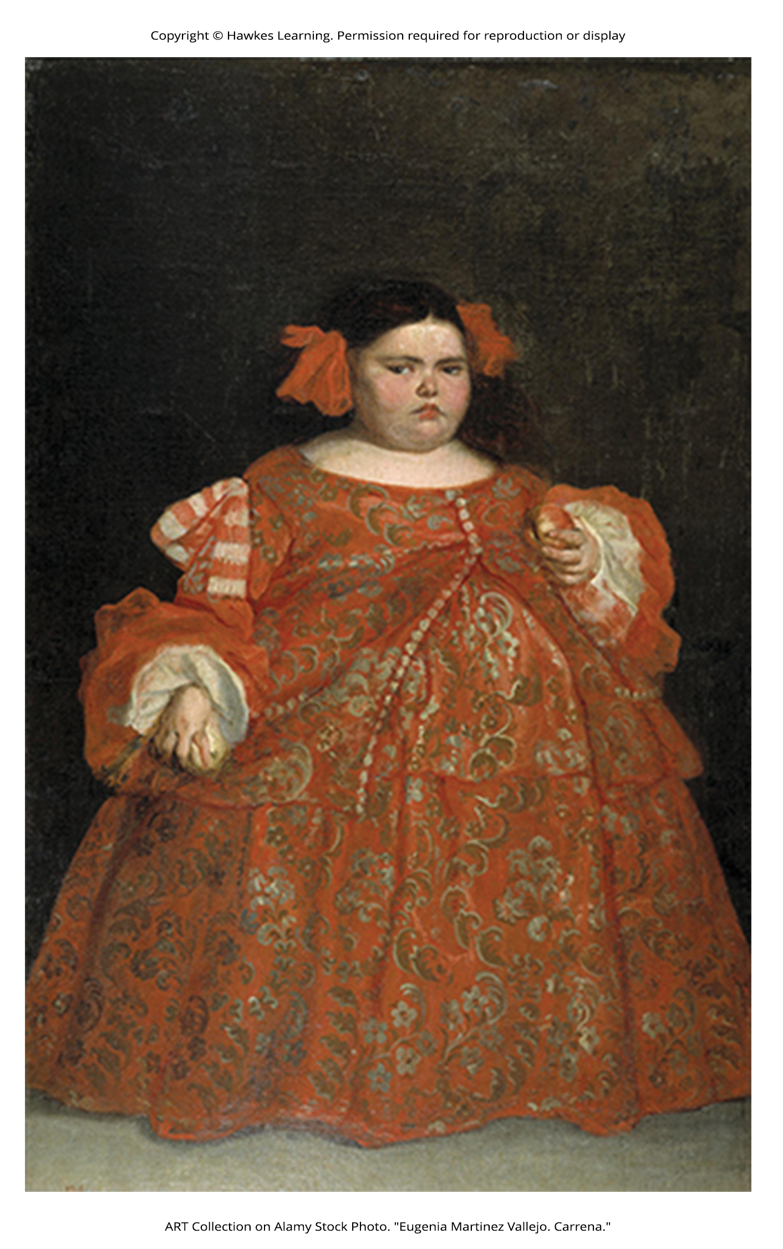
Prader-Willi Syndrome₁
Prader-Willi Syndrome (PWS) is a genetic disorder that results in persistent feelings of intense hunger and reduced metabolism rates.
Affected children are monitored to ensure they do not eat excessively.
Currently, PWS is the leading cause of morbid obesity in children.
Figure 6

Slide 17
Prader-Willi Syndrome₂
Lack of muscle tone and poor sucking behavior from birth to 2 years might be early warning signs.
Developmental delays between ages 6 to 12 and excessive eating and cognitive deficits are associated with later PWS onset.
People with PWS have hypothalamic abnormalities.
There is no current treatment or cure for PWS, but controlling weight can increase life expectancy.

Slide 18
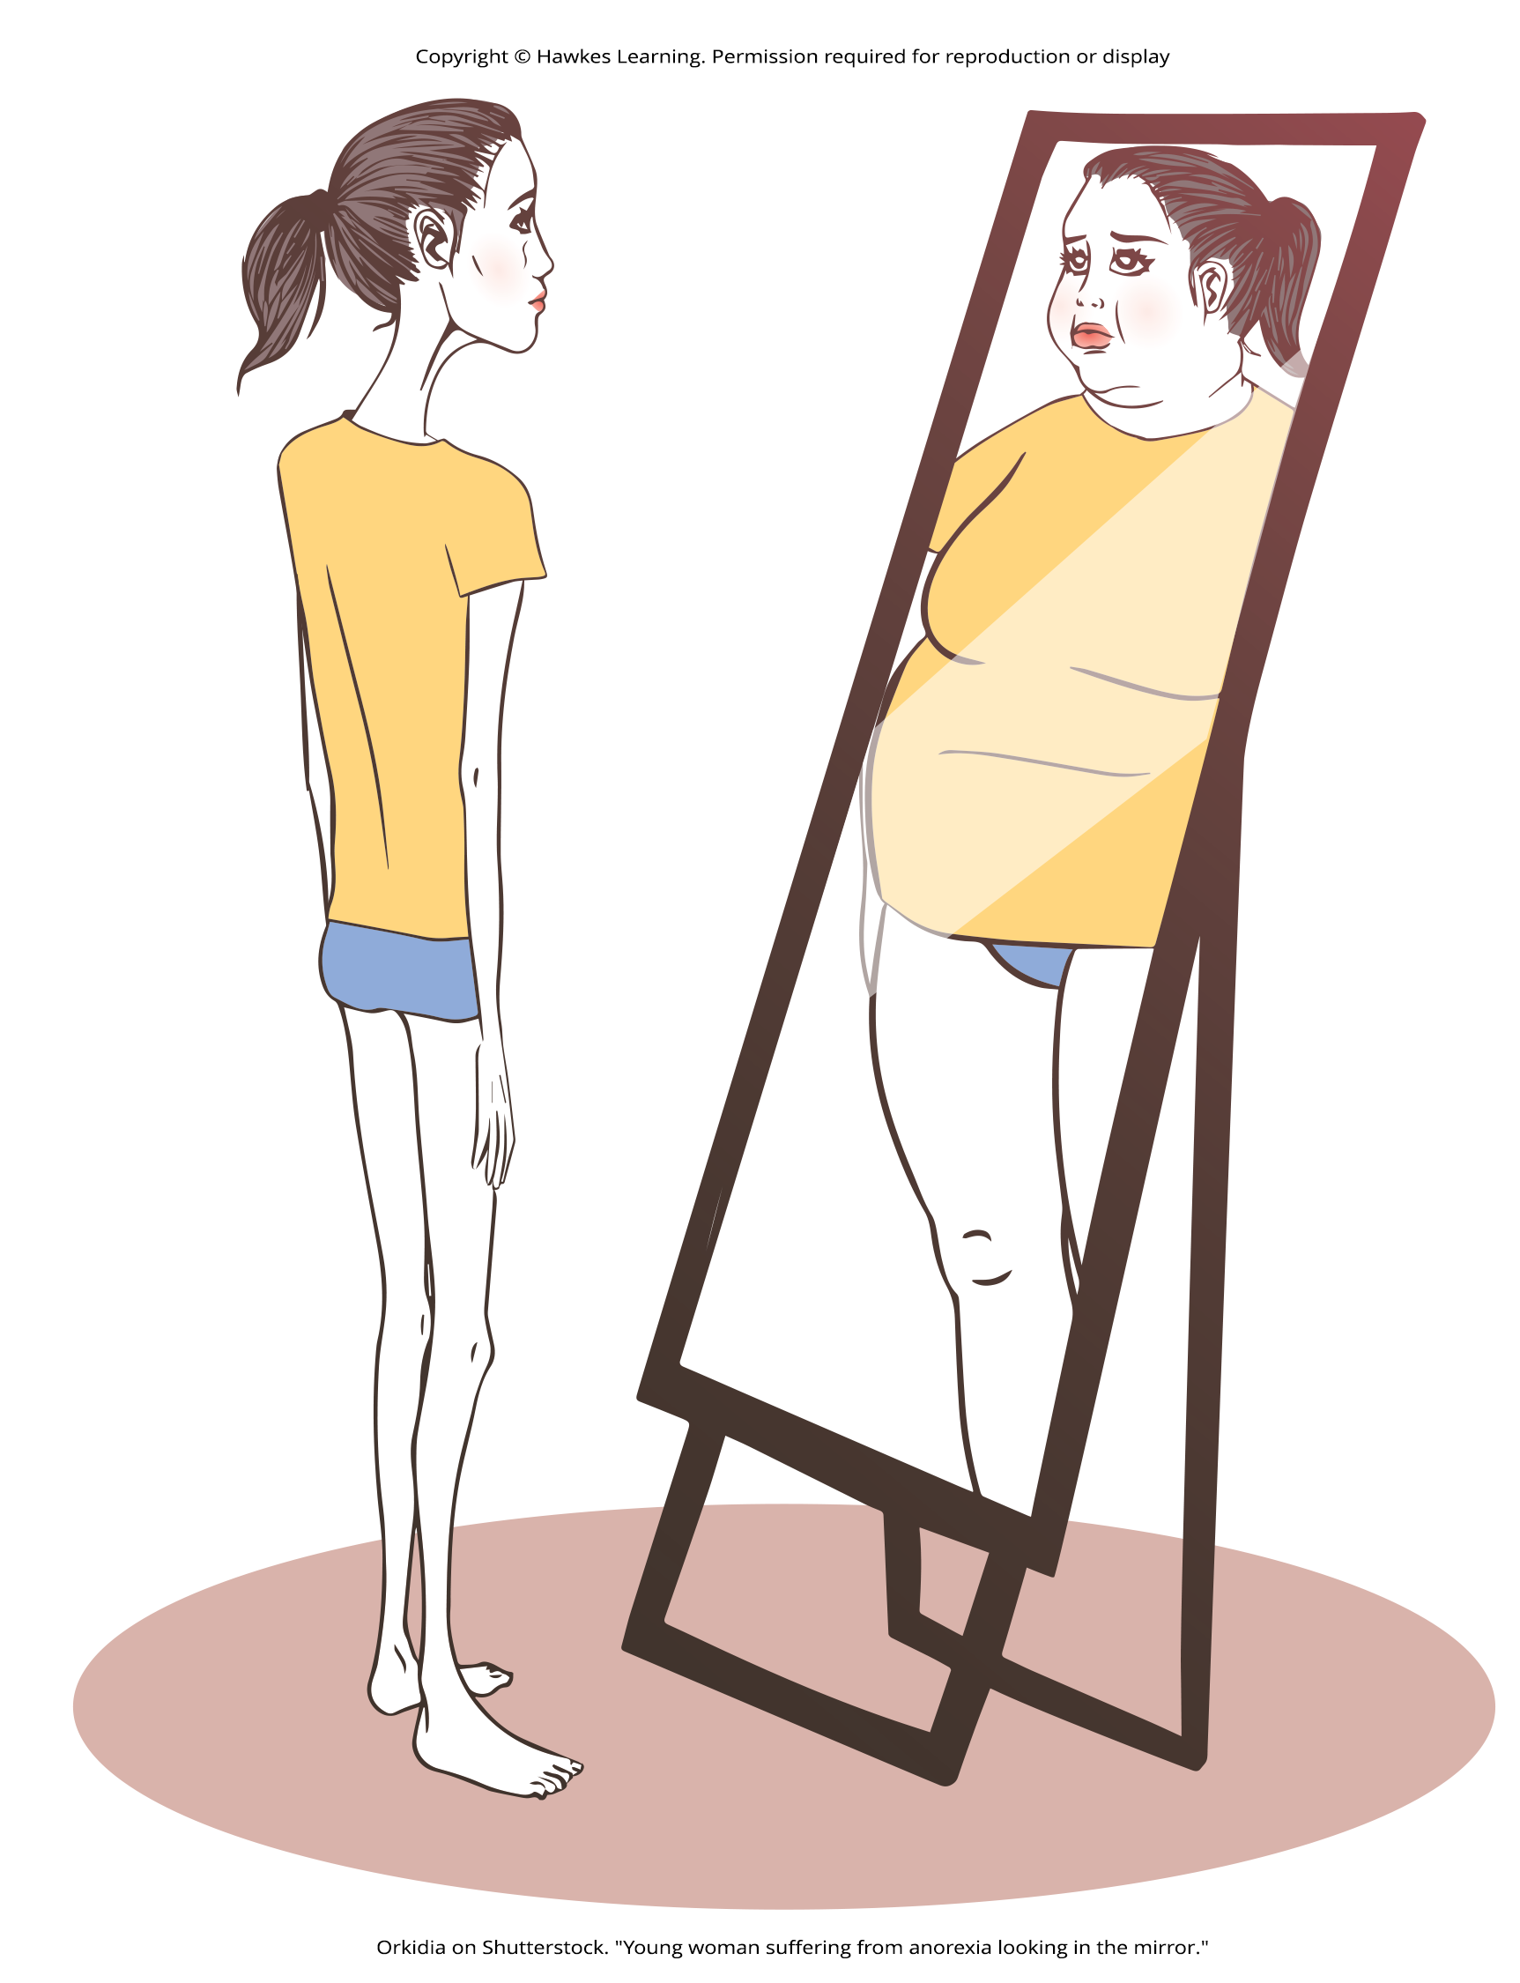
Eating Disorders
A small, but significant, portion of the population has eating disorders that typically result in being normal weight or underweight.
These people are often fearful of gaining weight.
Figure 7

Slide 19
Eating Disorders: Bulimia Nervosa
People suffering from bulimia nervosa engage in binge eating behavior that is followed by an attempt to compensate for the large amount of food consumed.
  People may purge by inducing vomiting, using laxatives, or engaging in excessive exercise.
Some possible impacts of bulimia are kidney failure, heart failure, tooth decay, anxiety, depression, and increased risk of substance abuse.
Lifetime prevalence for bulimia nervosa is around 1% for women and less than 0.5% for men.

Slide 20
Eating Disorders: Binge Eating Disorder
Binge eating disorder is a disorder in which individuals eat large amount of food but do not purge afterwards.
These individuals feel distressed about the binge behavior which distinguishes binge eating disorder from overeating.

Slide 21
Eating Disorders: Anorexia Nervosa₁
Anorexia nervosa is characterized by maintenance of body weight well below average through starvation and/or excessive exercise.
People with this disorder often have a distorted body image, or a type of body dysmorphia, where they view themselves as overweight when they are not.

Slide 22
Eating Disorders: Anorexia Nervosa₂
Some possible impacts of anorexia are bone loss, heart failure, kidney failure, amenorrhea, reduced gonadal function, anxiety and mood disorders, increased risk of substance abuse, and death.
The prevalence of anorexia nervosa is 4% for women and 0.3% for men (van Eeden et al., 2021).

Slide 23

Cultural Influences
White females from Western societies between the ages of 15 and 19 years are most at-risk for anorexia and bulimia nervosa.
These eating disorders may be related to the messages of beauty standard of a thin ideal that is often portrayed in popular media.
Figure 8

Slide 24
Reflection Question₄
Why do you think eating disorders are more common in the United States than other areas of the world?

Slide 25
Summary
Hunger and satiety are highly regulated processes that result in a person maintaining a stable weight.
When more calories are consumed than burned, a person will store excess energy as fat.
Being overweight can pose potential health issues, including increased risk of type 2 diabetes.
Sociocultural factors that emphasize thinness may contribute to the development of eating disorders.

Slide 26
End of Hawkes Learning PowerPoint

