Slide 1
Lesson 9.3
Emotion

Slide 2
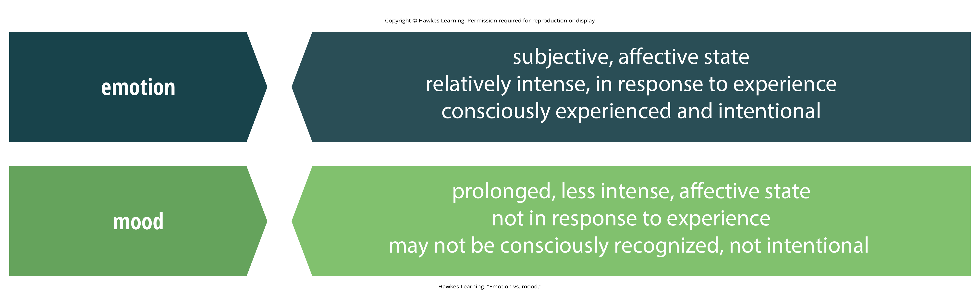
Emotion
Emotion is a subjective state of being that we often describe as our feelings.
  The words emotion and mood are sometimes used interchangeably, but psychologists use these words to refer to two different things.
Mood is a prolonged, less intense, affective state.
Figure 1

Slide 3
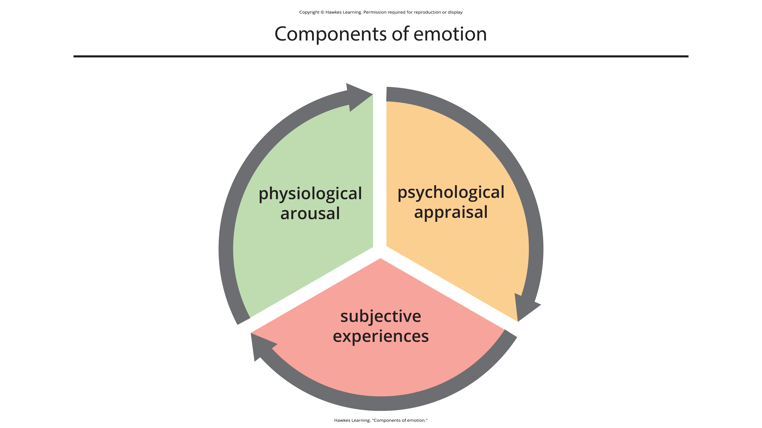
Theories Of Emotion₁
The components of emotion include physiological arousal, psychological appraisal, and subjective experiences.
Figure 3

Slide 4

Theories Of Emotion₂
Emotional appraisals are informed by experiences, backgrounds, and cultures.
People may have different emotional experiences when faced with similar circumstances.
Figure 2

Slide 5
The James-Lange Theory Of Emotion
The James-Lange theory of emotion states that emotions arise from physiological arousal.
  Example: Encountering a venomous snake in your backyard would result in your sympathetic nervous system causing physiological arousal, such as your heart racing and increased breathing.
The James-Lange theory says you will only experience fear after this physiological arousal has taken place.

Slide 6

Lesson 9.3 Figure 4
Caption: How would you react coming face to face with something like this?

Slide 7
Reflection Question₁
Think about a time when your body reacted in fear before you had a chance to even consciously experience that you were afraid.

Slide 8
The Cannon-Bard Theory Of Emotion
The Cannon-Bard theory states that physiological arousal and emotional experience occur simultaneously, yet independently.
  Example: Seeing the venomous snake results in feeling fear while the fight-or-flight response kicks in at the same time.
The emotional reaction of fear is separate and independent from the physiological arousal.

Slide 9
Empirical Support
The James-Lange and Cannon-Bard theories have some empirical support.
  People with spinal cord injuries who had less awareness of their physiological arousal reported less intense emotions (Chwalisz et al., 1988).
  Suppression of facial expression of emotion lowered the intensity of some emotions (Davis et al., 2009; Dzokoto et al., 2014).
  Arousal appears involved in the intensity of emotion.

Slide 10
Reflection Question₂
Imagine a situation in which you feel fear, but you do not experience the physiological component of fear—no heart racing, no sweaty palms. Would you feel as afraid in this situation?

Slide 11
The Schachter-Singer Two-Factory Theory₁
The Schachter-Singer two-factory theory states that physiological arousal is interpreted in context to produce the emotional experience.
  Example: Seeing a venomous snake will elicit sympathetic nervous system activation that is labeled fear and then we experience that fear.

Slide 12
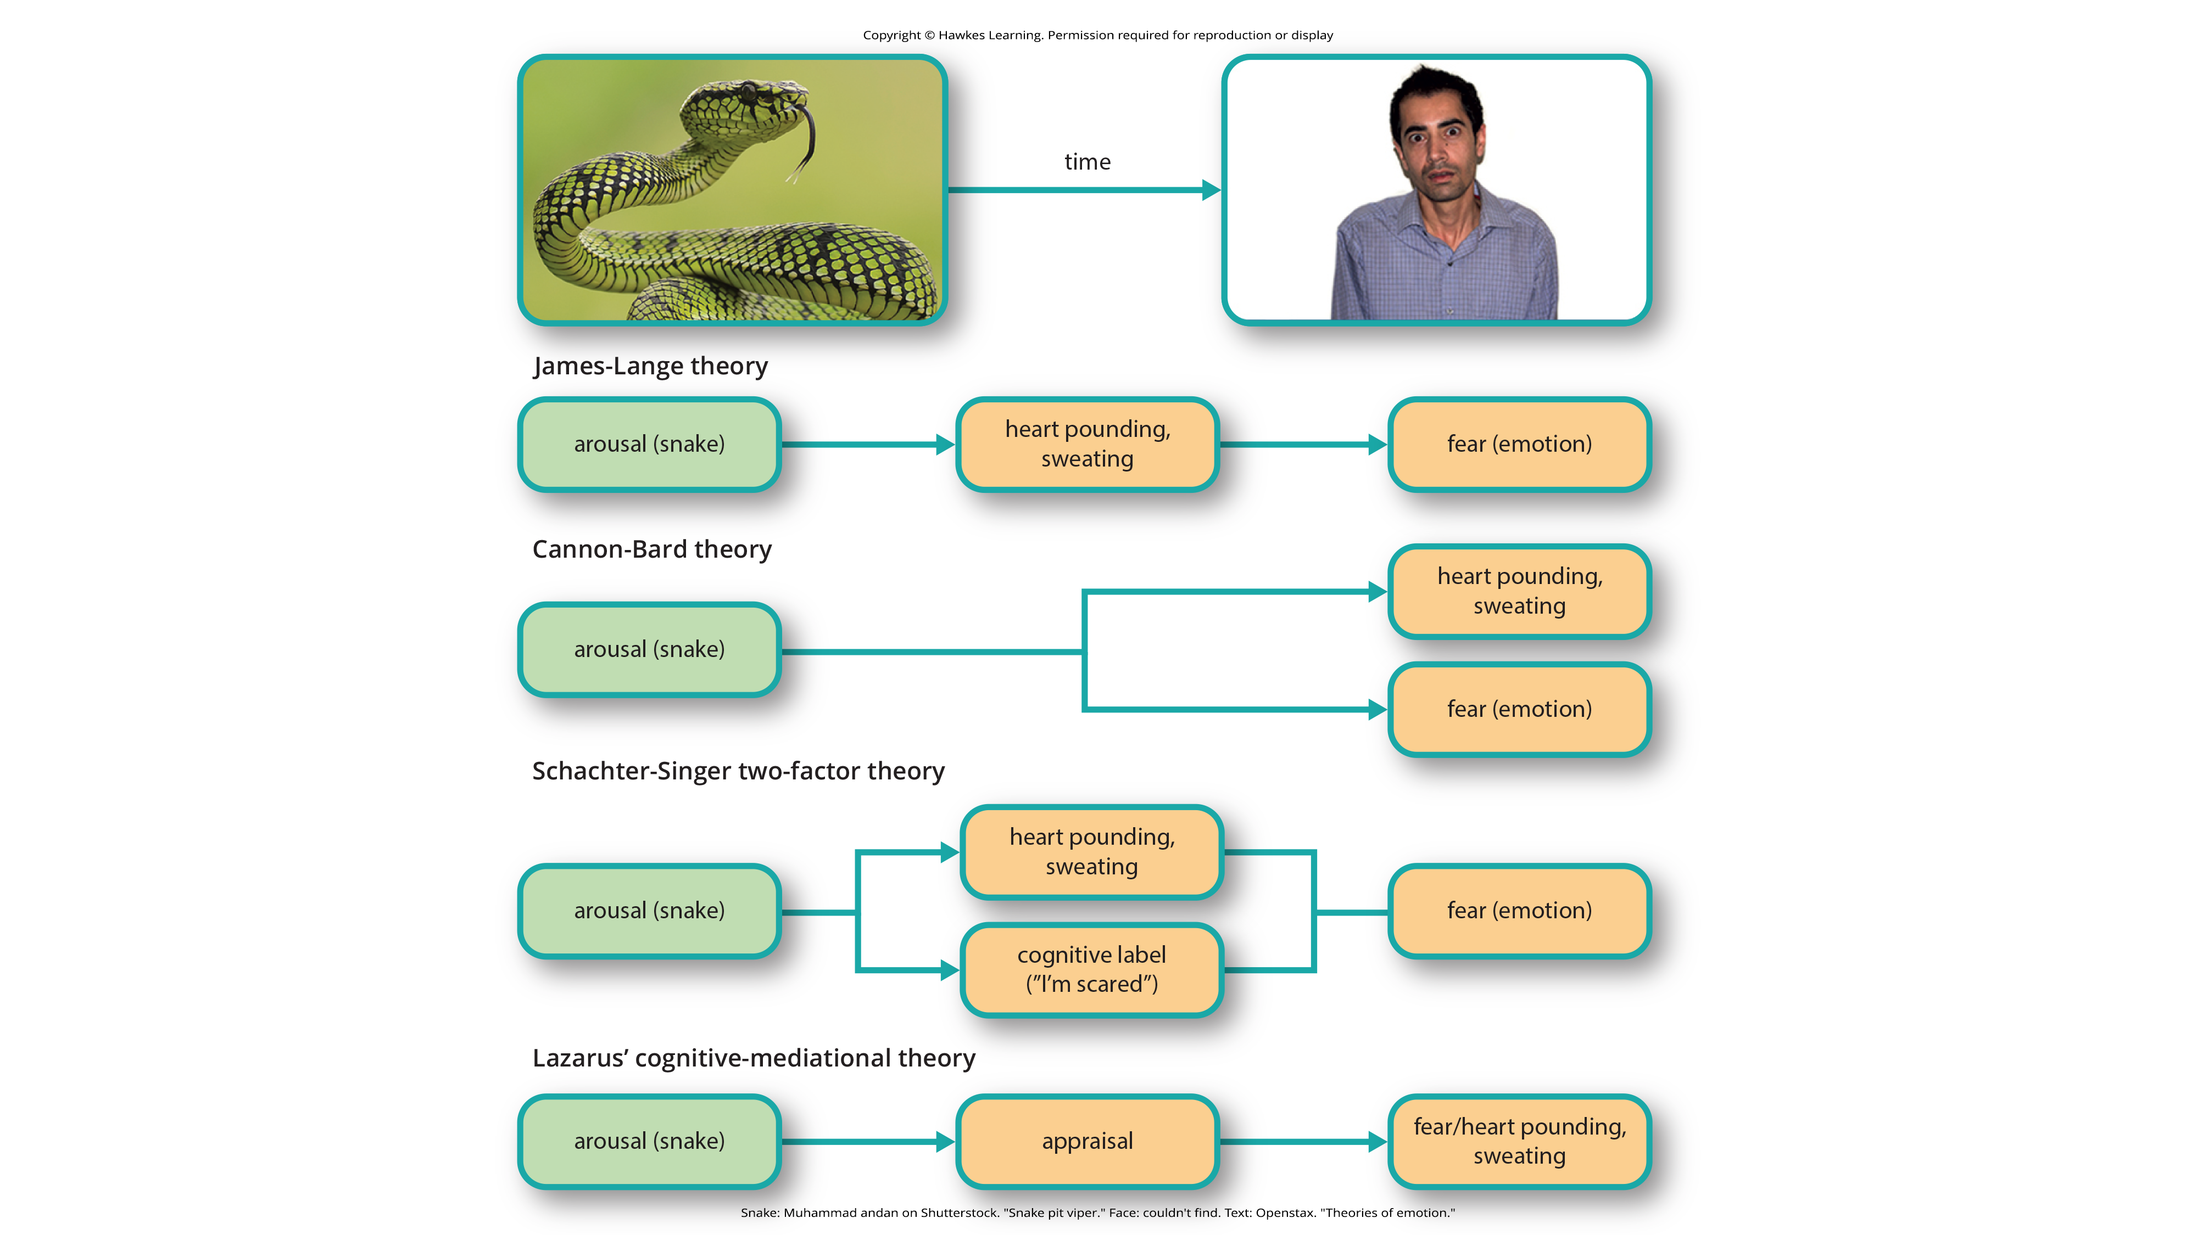
Lesson 9.3 Figure 5
Caption: This figure illustrates the major assertions of the James-Lange, Cannon-Bard, Lazarus' cognitive-mediational, and Schachter-Singer two-factor theories of emotion.

Slide 13
The Schachter-Singer Two-Factory Theory₂
Schachter and Singer believed that physiological arousal was similar across different types of emotion.
They felt that the cognitive appraisal was critical to the actual emotion that is experienced.

Slide 14
The Schachter-Singer Experiment₁
Male participants received an injection of epinephrine.
Some were told to expect these physiological side effects whereas others were not told.
Participants were placed in a waiting room with another subject who was a research confederate who acted in scripted ways to either show euphoric or angry behavior.

Slide 15
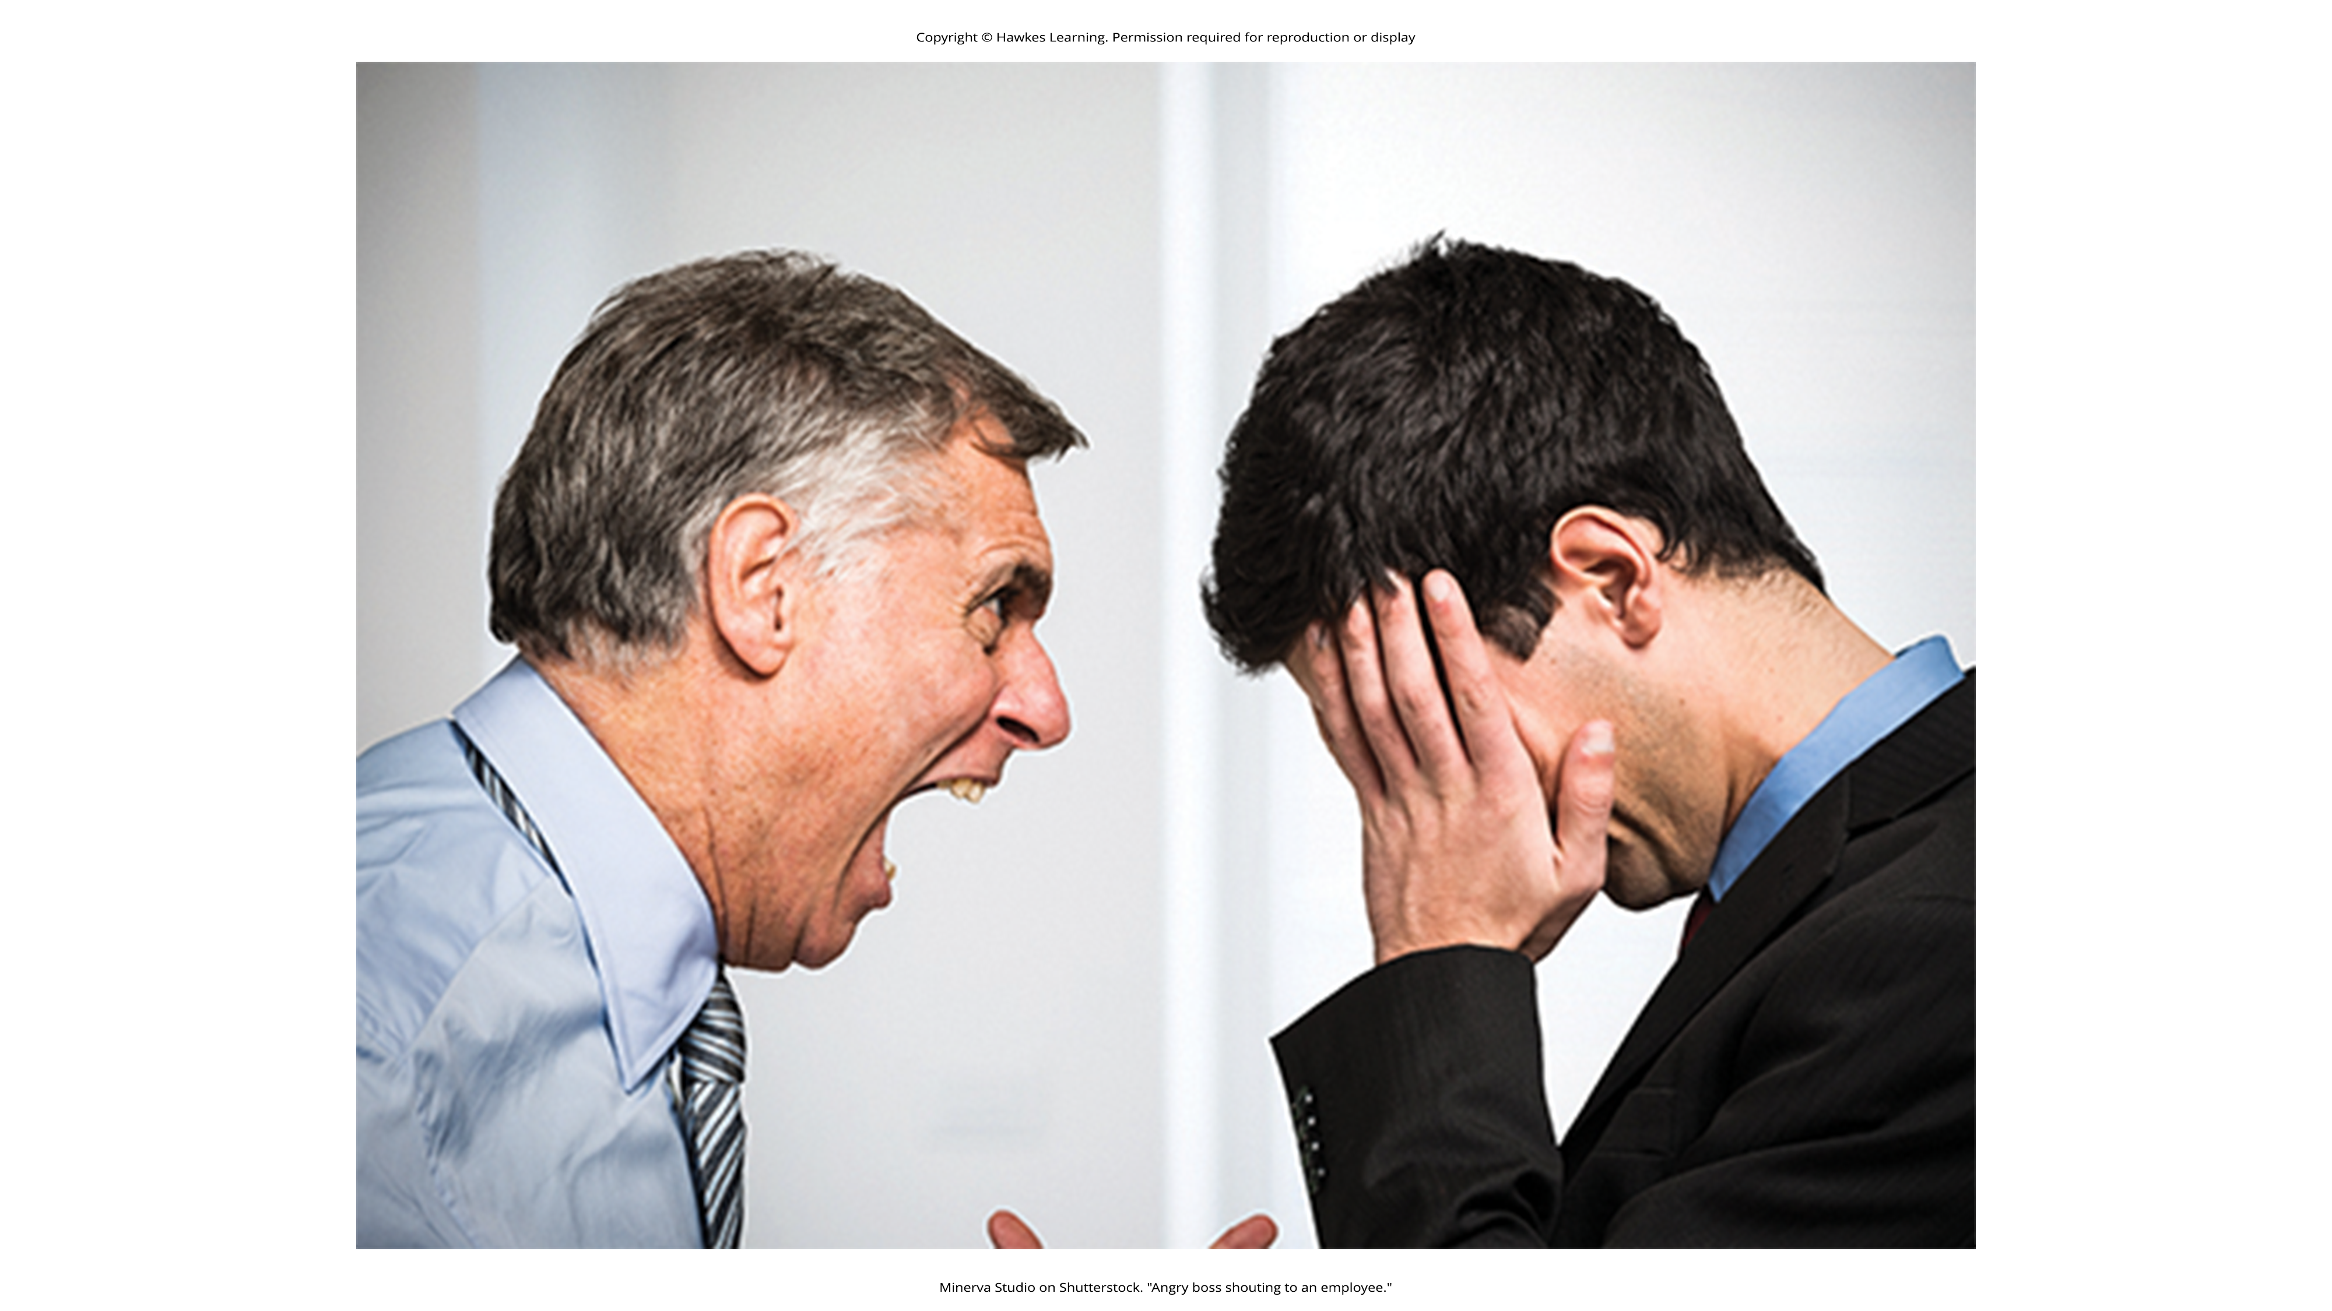
Lesson 9.3 Figure 6
Caption: Imagine how you would feel if someone unexpectedly starting showcasing anger after this experiment.

Slide 16
The Schachter-Singer Experiment²
Participants who knew to expect side effects indicated they did not experience emotional changes in the waiting room.
Participants who were not expecting side effects reported feeling euphoria or anger as a function of their assigned confederate’s behavior.
Everyone experienced the same physiological arousal from the epinephrine; however, only those not expecting the arousal used context to interpret the arousal as a change in emotional state.

Slide 17
Physiological Arousal
Strong emotional responses are associated with physiological arousal, such as increased heart rate, increased respiration rate, and sweating.
The changes may be measured to determine if someone is telling the truth or not.
A polygraph, or a lie detector test, measures the physiological arousal of an individual responding to a series of questions.
Increased levels of arousal could be signs that the respondent may have been dishonest on those answers.
  The validity and accuracy of these tests are highly questionable.

Slide 18
Group Activity₁
Partner up with a few other students and generate a list of pros and cons for using a polygraph test to determine if an individual is telling the truth. What problems might there be with polygraphs? Should polygraphs be admissible (allowed) in court?

Slide 19
The Cognitive-Mediational Theory
The cognitive-mediational theory asserts that our emotions are determined by our appraisal of the stimulus.
This appraisal mediates between the stimulus and the emotional response, and it is immediate and often unconscious.
The appraisal precedes the cognitive label.

Slide 20
Reflection Question₃
Think about an experience where your appraisal might differ from others', resulting in a different experience of emotion for you than most people.
For example, a person who has owned a pet tarantula is less likely to react with fear when confronted with a spider due to the difference in cognitive appraisal of the stimulus.

Slide 21
Other Theories Of Emotion
Zajonc asserted that some emotions occur separately from or prior to our cognitive interpretation of them.
  Example: A person feels fear in response to an unexpected loud noise.
LeDoux believed some emotions completely bypass cognitive interpretation.
  A fear stimulus can be processed through the cortex which involved interpretation.
  Alternatively, a fear stimulus can be processed more directly through the amygdala where interpretation is bypassed.

Slide 22
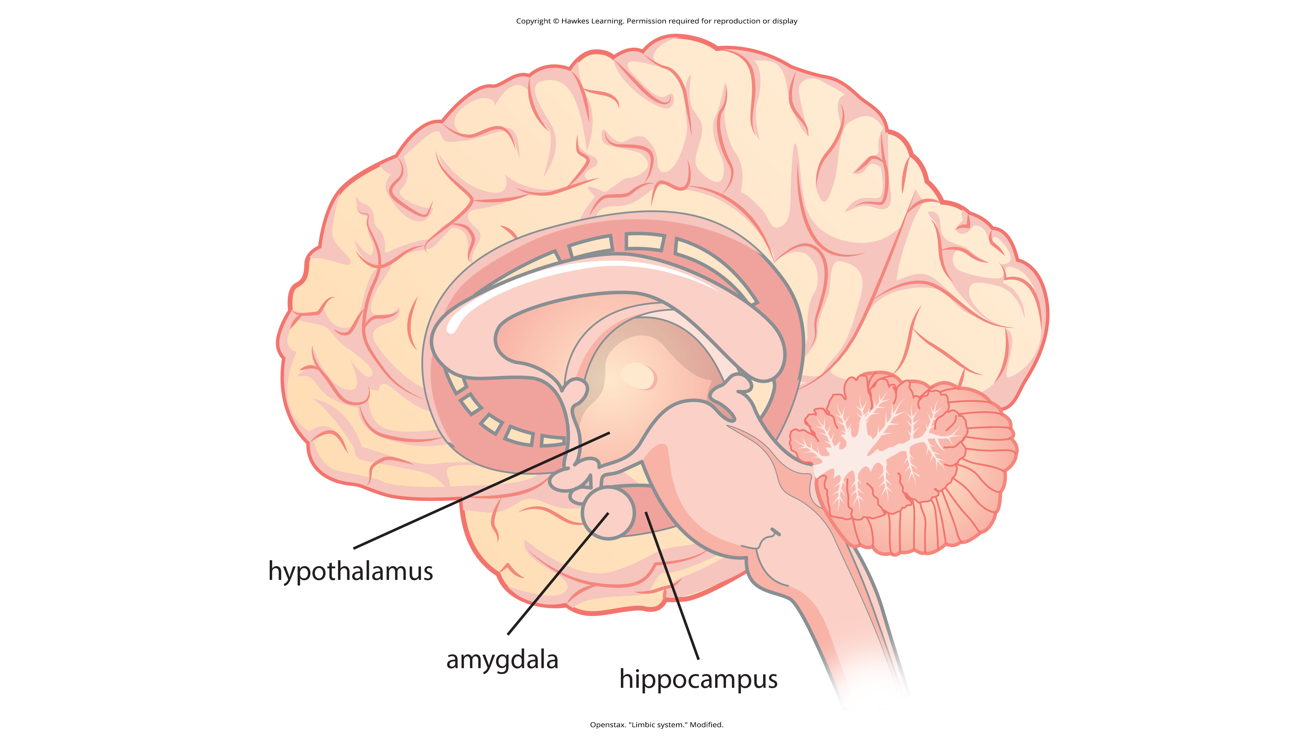
The Biology Of Emotions
Each part of the limbic system is involved in mediating emotional response and memory.
Figure 7

Slide 23
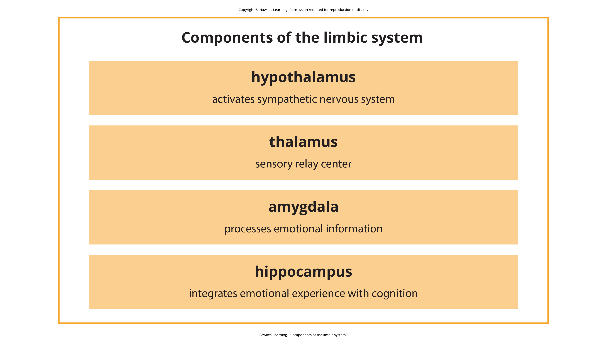
Lesson 9.3 Figure 8
Caption: Each part of the limbic system has a specialized job in mediating emotions.

Slide 24
Subnuclei Of The Amygdala
The amygdala is composed of various subnuclei.
  The basolateral complex has dense connections with a variety of sensory areas of the brain.
    This area is critical for classical conditioning and for attaching emotional value to learning and memory.
  The central nucleus plays a role in attention.
    It has connections with the hypothalamus and brainstem areas to regulate the autonomic and endocrine systems' activity.

Slide 25
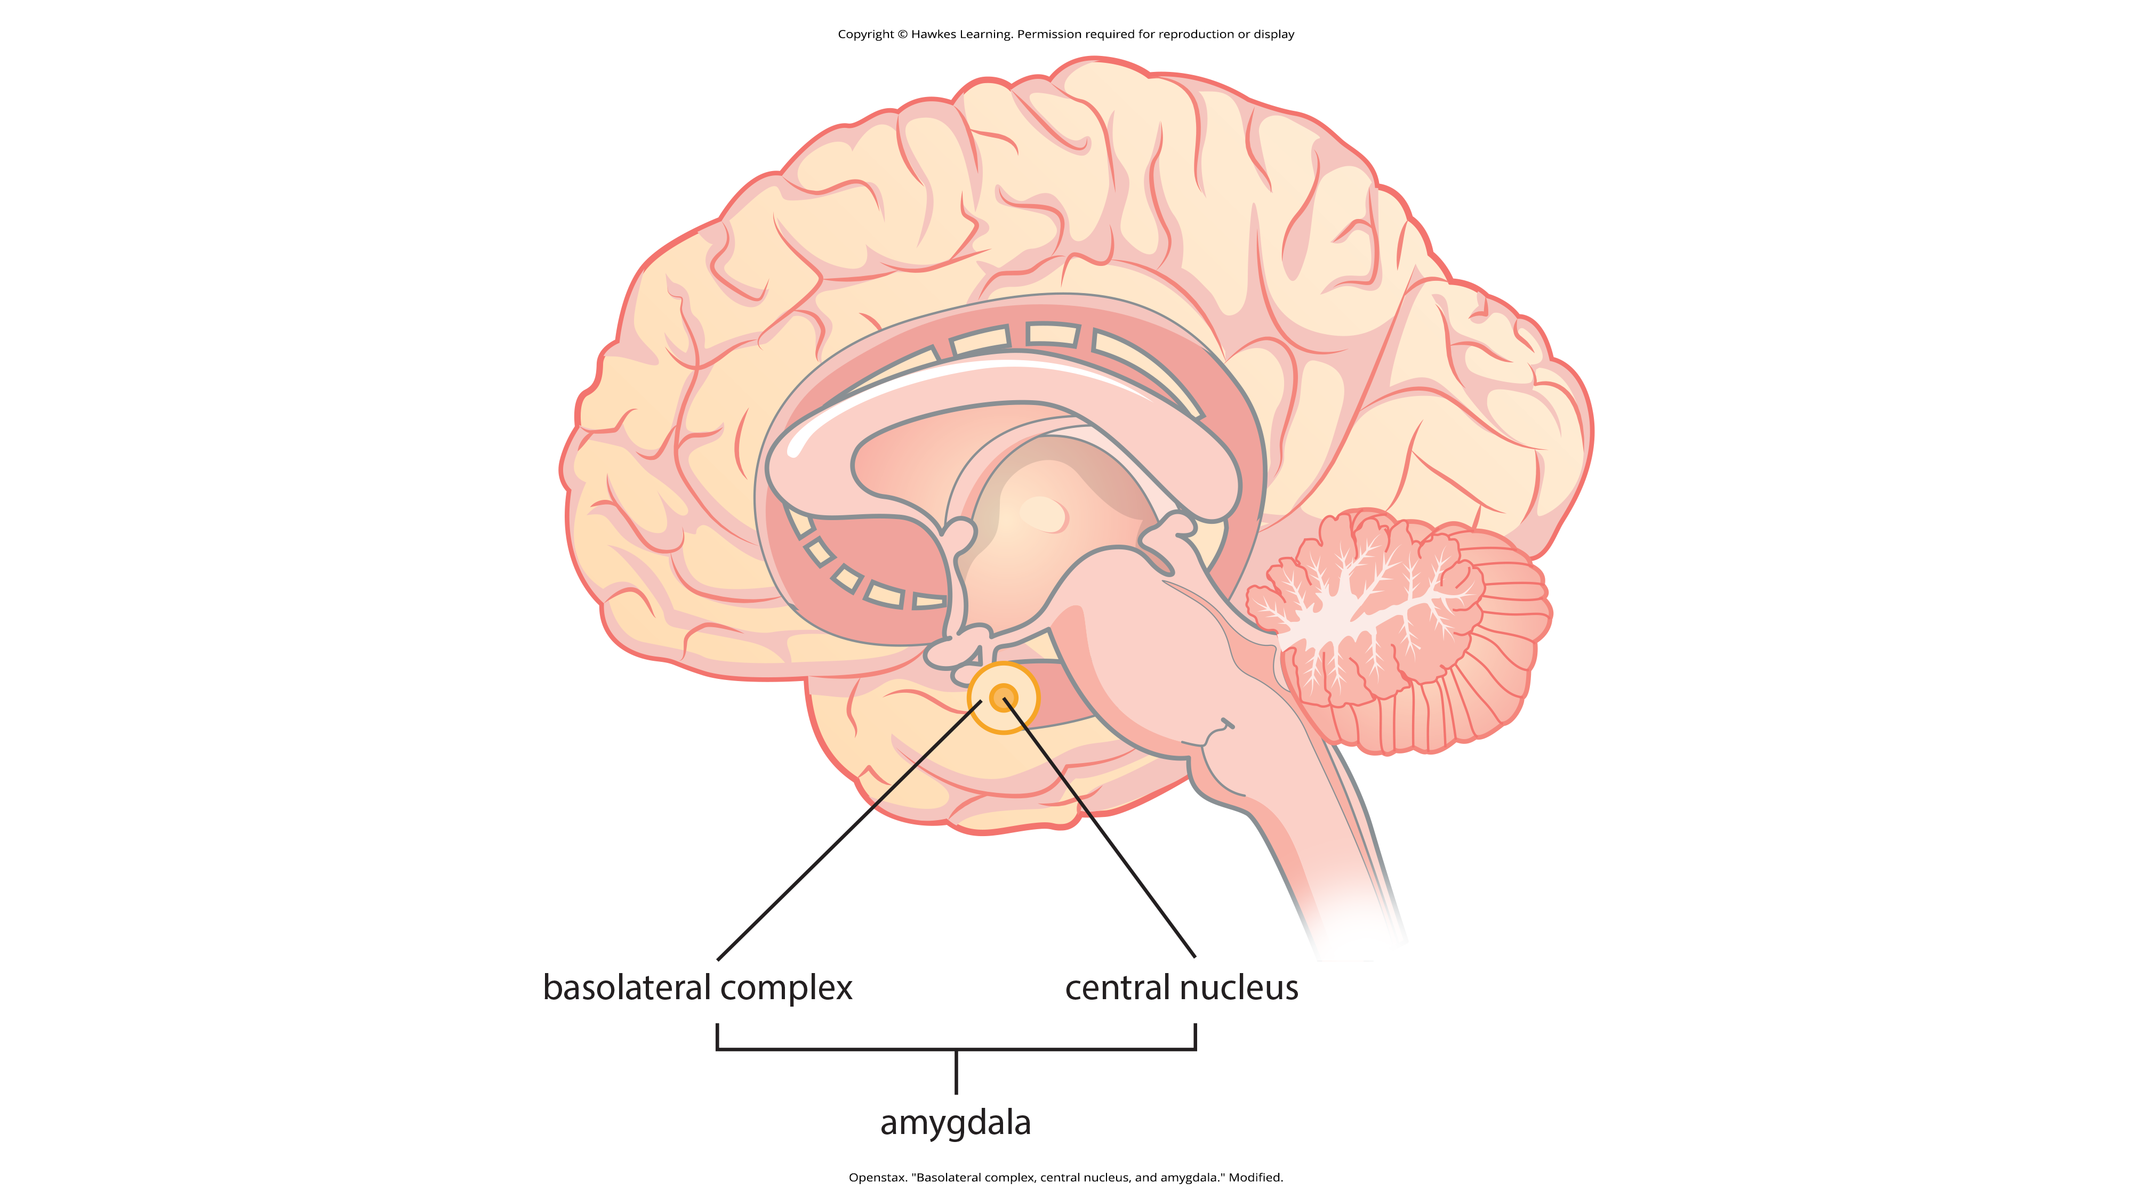
Lesson 9.3 Figure 9
Caption: The anatomy of the basolateral complex and central nucleus of the amygdala are illustrated in this diagram.

Slide 26
Amygdala Research: Animals₁
Animal research has shown that there is increased activation of the amygdala in rat pups that have odor cues paired with electrical shock when their mother is absent.
When the mother is absent, the rat pups then show aversion to the odor cue.
When the mother is present, the pups show preference for the odor cue despite its pairing with shock.
The amygdala responds differently depending on context (the presence or absence of the mother).

Slide 27
Amygdala Research: Animals₂
In rats, negative early life experiences could alter the function of the amygdala (Raineki et al., 2012).
Rat pups either received abusive or normal treatment during postnatal days 8 through 12.
  One group had abusive treatment of insufficient bedding which resulted in the mother rat being away for more time.
  One group had abusive treatment of the odor cue paired with electrical shock when the mother was absent.
  A control group had sufficient bedding and were left undisturbed.

Slide 28
Amygdala Research: Animals₃
The rat pups that experienced abuse were more likely to exhibit depressive-like symptoms during adolescence.
These behaviors were associated with increased activation of the amygdala.

Slide 29
Group Activity₂
Partner up with a few other students and discuss the implications of the Raineki et al. (2012) study for humans. Can we apply research with rats to humans when it comes to complex emotional development?

Slide 30
Amygdala Research: Humans
Human research shows a relationship between the amygdala and psychological disorders of mood or anxiety.
Changes in amygdala structure and function have been demonstrated in adolescents who are either at-risk or have been diagnosed with various mood and/or anxiety disorders.

Slide 31
Hippocampus₁
The hippocampus is involved in emotional processing.
Hippocampal structure and function are linked to a variety of mood and anxiety disorders.
In people with posttraumatic stress disorder (PTSD), they show marked reductions in the volume of parts of the hippocampus.
These changes may result from decreased levels of neurogenesis and dendritic branching.

Slide 32

Hippocampus₂
Studies have shown behavioral improvements and hippocampal volume increases after either pharmacological or cognitive-behavioral therapy in those with PTSD.
Figure 10

Slide 33
Cultural Display Rules Of Emotional Expression₁
A cultural display rule is one of a collection of culturally specific standards that govern the types and frequencies of displays of emotions that are acceptable.
  Example: People from the United States express negative emotions, like fear and anger, both alone and around others.
  Example: People from Japan express these same negative emotions only when alone.

Slide 34
Cultural Display Rules Of Emotional Expression₂
People from more socially cohesive cultures may be more likely to engage in suppression of emotional reaction.
There may be gender differences involved in emotional processing.

Slide 35
Reflection Question₄
What constraints do you have on how you can express your emotions?
Are they culture-based? Gender-based? Something else?

Slide 36
Facial Expression And Recognition Of Emotions
Our ability to recognize and produce facial expressions of emotion appears to be universal.
Even people who are congenitally blind produce the same facial expressions despite having never seen them.
There is substantial evidence for seven universal emotions that are associated with distinct facial expressions.

Slide 37
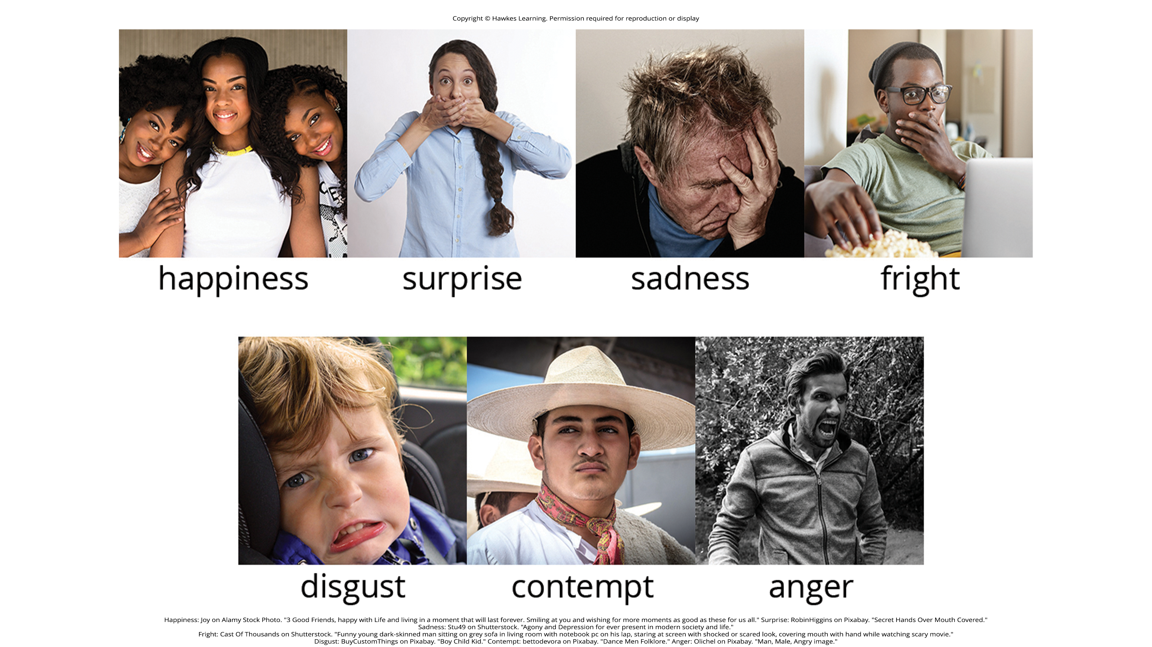
Lesson 9.3 Figure 11
Caption: The seven universal facial expressions of emotion are shown.

Slide 38
Reflection Question₅
Does smiling make you happy? Or does being happy make you smile? Or could both be true? Why do you think so?

Slide 39
Facial Feedback And Body Language
The facial feedback hypothesis asserts that facial expressions can influence our emotions.
  Example: Smiling could make a person feel happier.
Body language is the expression of emotion in terms of body position and movement.
Research shows we are sensitive to emotional information communicated through body language, even if we are not consciously aware of it.

Slide 40

Autism Spectrum Disorder And Expressions of Emotions
Autism spectrum disorder (ASD) is a neurodevelopmental disorders characterized by deficits in social communication and interaction.
  Individuals have difficulty recognizing the emotional states of others.
  There may be an inability to distinguish nonverbal expressions of emotion from one another.
  Individuals also have difficulty expressing emotions through tone of voice and facial expressions.
Figure 12

Slide 41
Summary₁
Emotions are subjective experiences that consist of physiological arousal and cognitive appraisal.
The James-Lange theory states that emotions arise as a function of physiological arousal.
The Cannon-Bard theory states that emotional experience occurs simultaneously with physiological arousal.
The Schachter-Singer two-factory theory includes cognitive labels as a function of context that help to form our emotional experience.

Slide 42
Summary₂
The limbic system, which includes the amygdala and hippocampus, is the brain’s emotional circuit.
Increased amygdala activity is associated with learning to fear and is seen in those with mood disorders.
The volume of the hippocampus has been shown to be reduced in individuals with posttraumatic stress disorder.
The ability to produce and recognize facial expressions of emotions seems to be universal regardless of cultural background.

Slide 43
End of Hawkes Learning PowerPoint

