Slide 1
HAWKES LEARNING
What is Psychology?
Notes:
Many people may wonder what, exactly, is psychology?

Slide 2



Psychology
Scientific study of the mind and behavior
HAWKES LEARNING
Notes:
The term itself means the scientific study of the mind and behavior. For example, you may wonder why people fall in love or what characteristics make a good parent.

Slide 3




Scientific Method
Hypothesis
Tentative explanation of a phenomenon.
Theory
Larger framework.
Broad explanation for some aspect of natural world.
Observation
Behavioral observations
Experiments
Publication
HAWKES LEARNING
Notes:
To answer these questions and more, psychologists use the scientific method. In this process, researchers begin with a question about how or why something happens.

Slide 4
Hypothesis
Hypothesis
Tentative explanation of a phenomenon
HAWKES LEARNING
Notes:
They will then propose a hypothesis, or tentative explanation, for the phenomenon. For instance, perhaps people fall in love due to attractive physical characteristics.

Slide 5
Theory
Theory
Larger framework
Broad explanation for some aspect of natural world
HAWKES LEARNING
Notes:
These hypotheses should fit into a larger framework, or theory, which is a broad explanation for some aspect of the natural world.

Slide 6
Observation
Observation
Behavioral observations
Experiments
HAWKES LEARNING
Notes:
Researchers then make observations or conduct experiments to test the validity of their hypotheses. In this case, perhaps researchers gather photographs of various people ranging in levels of attractiveness and ask people which partners they would be interested in pursuing.

Slide 7
Scientific Method
Publication
HAWKES LEARNING
Notes:
After the observation or experiment, researchers publish the results so that others can check the results or build upon them.

Slide 8



Constructs
Operational definitions
HAWKES LEARNING
Notes:
As in the example, psychologists need to determine the best ways to measure psychological constructs. Measuring the size of an object is easy, but how does one measure attraction or anxiety? In these cases, psychologists need to operationally define each construct. For example, what, exactly, is love?

Slide 9



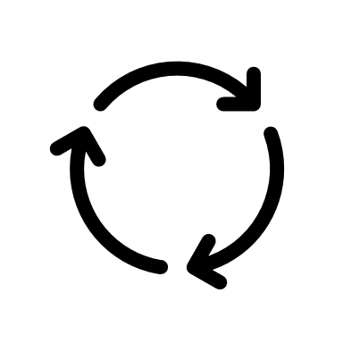
Why Study Psychology?
Critical Thinking Skills
Diversity
Environment
Biology
Experiences
HAWKES LEARNING
Notes:
Some people may wonder why study psychology? Studying psychology actually has multiple benefits including the development of critical thinking skills which allow individuals to evaluation information and make educated decisions.

Slide 10
History of Psychology
Early History of Psychology
Wilhem Wundt
German psychology laboratory (1879)
Introspection
Freud and Psychoanalysis
Unconscious feelings and urges
Gestalt Psychology
Behaviorism
Observable, measurable behavior
Ivan Pavlov
Classical conditioning
John Watson
Famous behaviorist
Only observable behavior worth studying
B.F. Skinner
Operant conditioning
Skinner Box
Humanistic Psychology
Potential for good
Abraham Maslow
Hierarchy of needs
Carl Rogers
Potential for good
Client-centered therapy
Unconditional positive regard
Genuineness
Empathy
Cognitive Revolution
New perspectives
Renewed interest in the mind
William James
American psychologist
Study function of behavior in the world
Women Psychologists
Mary Whiton Calkins
Margaret Floy Washburn
HAWKES LEARNING
Notes:
Psychology also teaches the delicate interplay between biology, the environment, and experiences that all come together to shape the individual and how the individual behaves. Psychology also helps to increase understanding of and respect for diversity.

Slide 11



Early History of Psychology
Wilhelm Wundt
German scientist
William James
American psychologist
Study function of behavior in the world
Women Psychologists
Mary Whiton Calkins
Margaret Floy Washburn
First psychology laboratory (1879)
Introspection
Structuralism
Functionalism
HAWKES LEARNING
Notes:
Historically, psychology was initially considered a component of both philosophy and biology.
In the late 1800s, however, it became its own academic discipline, thanks to Wilhelm Wundt and Williams James.

Slide 12


Wilhelm Wundt
Structuralism
German scientist
First psychology laboratory (1879)
Introspection
HAWKES LEARNING
Notes:
Wilhelm Wundt was a German scientist who established one of the first psychology laboratories in 1879. In this lab, he studied the structure of the human mind (a pursuit known as structuralism) using introspection. For instance, a person may be isolated in a room and exposed to a light. This individual would then be asked to process the experience objectively. As you could imagine, the introspective process was highly subjective and there was little agreement between individuals.

Slide 13

William James
Functionalism
American psychologist
Study function of behavior in the world
HAWKES LEARNING
Notes:
In contrast, Williams James was an American psychologist who believed that psychology should be used to study the function of behavior in the world. This belief was the core of functionalism, a focus on how mental activities helped an organism adapt to its environment.

Slide 14


Women Psychologists
Mary Whiton Calkins
Margaret Floy Washburn
HAWKES LEARNING
Notes:
Early psychology also featured several prominent woman psychologists, including Mary Whiton Calkins and Margaret Floy Washburn, both of whom went on to be president of APA in later years.

Slide 15



Freud and Psychoanalysis
Unconscious feelings and urges
Dreams
Narratives
HAWKES LEARNING
Notes:
Even people who are not overly familiar with psychology will have heard of Sigmund Freud. Freud believed that individuals had unconscious feelings and urges which were the key to understanding human behavior and treating psychological illness. Through psychoanalysis, he would analyze dreams or the narratives of his patients to uncover these unconscious influences. He was also a firm believer in childhood experiences having an impact on adult behavior.

Slide 16


Gestalt Psychology
BARK!
HAWKES LEARNING
Notes:
Another early area of psychology was Gestalt psychology, developed by Max Wertheimer, Kurt Koffka, and Wolfgang Kohler. The major emphasis of Gestalt psychology is the idea that individuals usually perceive sensory information as a whole rather than its individual pieces. For example, when touching a barking dog, you do not experience the bark and the tactile sensation in isolation. Instead, you experience the “whole” dog.

Slide 17
Behaviorism
Observable, measurable behavior
Ivan Pavlov
Classical conditioning
John Watson
Famous behaviorist
B.F. Skinner
Operant conditioning
Only observable behavior worth studying
HAWKES LEARNING
Notes:
Thus far, most of the early work in psychology focused on internal experiences. However, behaviorism, which focused on the idea that only behavior was observable and measurable, soon took over psychology.

Slide 18




Ivan Pavlov
Classical conditioning
HAWKES LEARNING
Notes:
One notable researcher, Ivan Pavlov, discovered the principle of classical conditioning. Essentially, dogs would learn to salivate to the sound of a metronome if it had been previously paired with the presentation of meat powder.

Slide 19
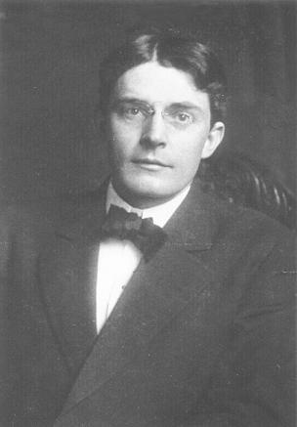



John Watson
Famous behaviorist
Only observable worth studying
This Photo by Unknown Author is licensed under CC BY-SA
HAWKES LEARNING
Notes:
John B. Watson was another famous behaviorist who believed that only measurable behavior was worth studying within the realm of psychology.

Slide 20
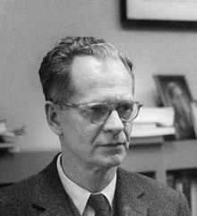


B.F. Skinner
Operant conditioning
Skinner box
This Photo by Unknown Author is licensed under CC BY-SA
Reinforcement
Punishment
HAWKES LEARNING
Notes:
B. F. Skinner also concentrated on observable behavior and developed the concept of operant conditioning. He believed that behavior was increased or decreased depending on whether an individual or animal received a reinforcement or a punishment.

Slide 21
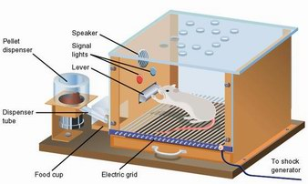
Skinner Box
This Photo by Unknown Author is licensed under CC BY-SA-NC
HAWKES LEARNING
Notes:
To test these ideas, he developed a testing chamber called a Skinner box in which animals would be rewarded or punished for different behaviors to determine the likelihood of those behaviors occurring in the future.

Slide 22
Humanistic Psychology
Potential for good
Abraham Maslow
Hierarchy of needs
Carl Rogers
Potential for good
Client-centered therapy
HAWKES LEARNING
Notes:
There were several psychologists who objected to psychoanalysis and behaviorism. Instead, they proposed the idea of humanism which is the perspective in psychology that emphasizes the potential for good that is innate to all humans.

Slide 23
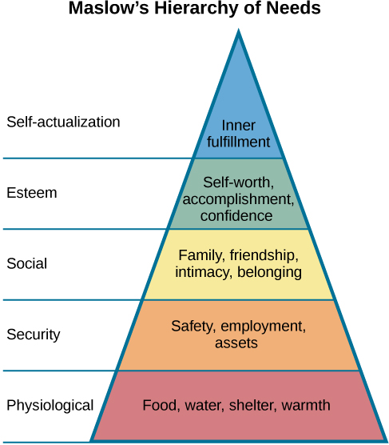
Abraham Maslow
This Photo by Unknown Author is licensed under CC BY
HAWKES LEARNING
Notes:
Abraham Maslow is best known for proposing the hierarchy of needs in motivating behavior. In short, Maslow felt the individuals could be motivated by higher-level needs if basic needs had been met. According to Maslow, the highest-level need was self-actualization, a process by which people work to achieve their full potential.

Slide 24
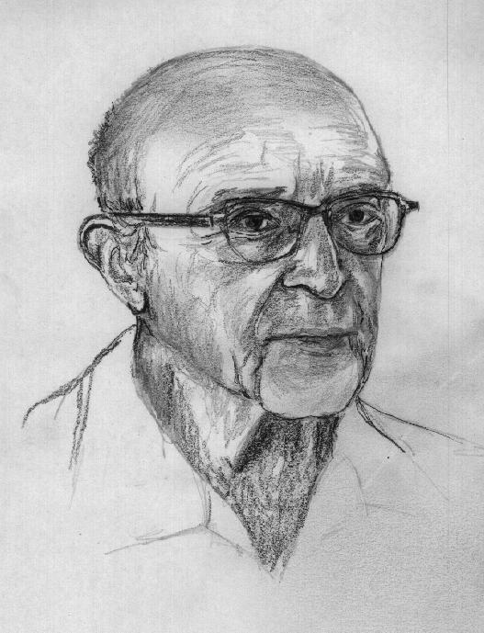



Carl Rogers
Potential for good
Client-centered therapy
Unconditional positive regard
Empathy
Genuineness
This Photo by Unknown Author is licensed under CC BY-SA
HAWKES LEARNING
Notes:
Carl Rogers emphasized the potential for good to exist in all people. In addition, he used client-centered therapy to help his clients cope with problematic issues. Rogers felt that a clinician should possess unconditional positive regard (the idea that a therapist will accept the client no matter what is said), genuineness, and empathy.

Slide 25

Cognitive Revolution
New perspectives
Renewed interest in the mind
HAWKES LEARNING
Notes:
By the 1950s, new perspectives in linguistics, neuroscience, and computer science were emerging and helped to revive interest in the inner workings of the mind. This shift in focus was the basis of the cognitive revolution in which research could, once again, focus on the mysteries of the mind.

Slide 26


Current Day
Francis Cecil Summer
George Sanchez
Diverse
Inclusive
HAWKES LEARNING
Notes:
Psychology has not been exempt from barriers that prevented people from entering the field based on race or gender. However, many pioneering individuals, such as Francis Cecil Sumner and George Sanchez, helped to define the impact of culture on social psychology and issues of social justice. As a result, the modern realm of psychology is both more representative and inclusive.

Slide 27




HAWKES LEARNING

