Slide 1
HAWKES LEARNING
Analyzing Findings

Slide 2


Correlations
Variable 1
Variable 2
HAWKES LEARNING
Notes:
When it comes to research, people typically conduct either correlations or experiments. A correlation means there is a relationship between two or more variables. When two variables are correlated, it means that as one variable changes, the other changes as well. For example, when ice cream sales increase, so do incidents of aggression. Why are these variables correlated?

Slide 3

Correlations
HAWKES LEARNING
Notes:
Summer! Heat makes people irritable. Similarly, more people buy ice cream in the summer. Just because two variables are correlated, we cannot assume that one causes the other. In fact, correlation does not mean causation.

Slide 4
Positive Correlation
Variable 1
Variable 2
HAWKES LEARNING
Notes:
There are different types of correlations. A positive correlation means that the variables move in the same direction. When one variable increases, the other variable increases. In our example of ice cream and drowning, this is a positive correlation.

Slide 5



Negative Correlation
Variable 1
Variable 2
HAWKES LEARNING
Notes:
In contrast, a negative correlation means that the variables move in opposite directions. Here, a decrease in one variable is associated with an increase in the other one. For example, the more alcohol you drink, the slower your reaction time.

Slide 6
Correlation Coefficient
-1
+1
Negative
Positive
HAWKES LEARNING
Notes:
In order to know the strength and direction of your correlation, you need to know the correlation coefficient. This value ranges from -1 to +1 and it tells you two things. The first is whether the correlation is positive or negative, as evidenced by the sign of the correlation coefficient.

Slide 7
Correlation Coefficient
Stronger correlation
-1
+1
0
Weaker correlation
-0.6 = +0.6
HAWKES LEARNING
Notes:
The second is the strength of the correlation, denoted by the numerical value. The closer the number is to 0, the weaker the correlation. The closer to 1, the stronger the correlation. It is important to note that a -.6 is the same strength as a +.6. The sign only indicates the directions that the two variables move.

Slide 8
Correlations
HAWKES LEARNING
Notes:
Correlations are limited because they tell us little about cause and effect. Sometimes a third or confounding variable is causing the difference. Thinking back to our ice cream and drowning example, the confounding variable is temperature.

Slide 9




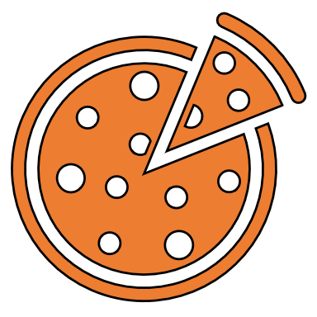
No Causation
HAWKES LEARNING
Notes:
Unfortunately, people mistakenly make claims of causation as a function of correlations all the time. For example, there is a correlation between eating oatmeal and lower cholesterol. Therefore, oatmeal is considered a heart healthy food. But what else might cause this result? Maybe it is more directly related to what isn’t eaten. If you are eating oatmeal, you aren’t eating sausage and bacon or other foods.

Slide 10


Illusory Correlations
HAWKES LEARNING
Notes:
With correlations, people also tend to make the mistake of illusory correlations, or false correlations, that occur when people believe that relationships exist between two variables when no such relationship exists.
For example, many people believe that there is a correlation between lunar phase and human behavior. Over 40 studies, however, have consistently shown this relationship does not exist. Although we may pay more attention to odd behavior during a full moon, the rates of odd behavior remain constant throughout the lunar cycle.

Slide 11




Experiments
Controlled settings and conditions
Begins with hypothesis
HAWKES LEARNING
Notes:
To truly be able to make causal statements, one must conduct scientific experiments because they use controlled settings and conditions. An experiment begins with an hypothesis which is then tested. For example, you may believe violent programming causes children to be more violent. You could then set up an experiment to test this hypothesis.

Slide 12
Experiments
Experimental
Control
Violent
Non-Violent
HAWKES LEARNING
Notes:
The most basic experimental design involves two groups: the experimental group and the control group. The experimental group gets the experimental manipulation whereas the control group does not. In our example about violent television programming, we have the experimental group watch violent programming for 30 minutes. The control group watches non-violent television for the same amount of time.

Slide 13


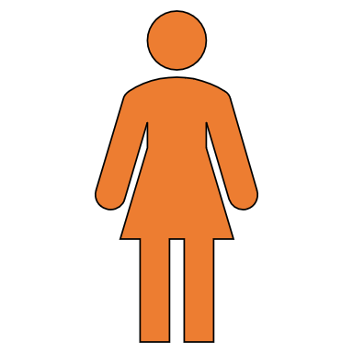

Experiments
Operationally define
HAWKES LEARNING
Notes:
After exposing the children to the television programming, we might observe their behavior on the playground for 60 minutes. We would operationally define the behaviors we were looking for, such as hitting or kicking or even verbal violence.

Slide 14

Considerations
Random Assignment
Notes:
There are a few considerations to keep in mind for an experiment. First, random assignment to the experimental and control group ensure the groups are similar. In addition, it is important that the groups are unaware of their group assignment; this is referred to as a single blind study. In fact, it would be even better if the observing experimenter was unaware of the participant’s group assignment, which is a double blind study.

Slide 15


Placebo Effect
This Photo by Unknown Author is licensed under CC BY-NC-ND
HAWKES LEARNING
Notes:
These controls are important to guard against the placebo effect which occurs when people’s beliefs influence their experience. For example, a sugar pill could have the unintended result of making someone feel better if that person thinks he is receiving an actual medication.

Slide 16

Variables
Independent Variable
Dependent Variable
Controls
Did IV influence?
HAWKES LEARNING
Notes:
Whenever a researcher is designing an experiment, the independent and dependent variables must be determined. An independent variable is the variable that is controlled by the experimenter. In contrast, the dependent variable is what is measured to determine if the independent variable made an impact. In our example of violent television programming, the independent variable would be the different types of TV programming and the dependent measure would be the children’s behavior on the playground.

Slide 17



Variables
Control
HAWKES LEARNING
Notes:
True experiments require the experimenter to manipulate the independent variable. Some aspects, however, are outside of control. For example, you may be interested in the difference in aggression between boys and girls. However, you cannot assign a person to being a boy or a girl for the purposes of research. In this case, the experiment would be a quasi-experiment as the independent variable cannot, truly, be controlled.

Slide 18

Ethics
Not Ethical!
HAWKES LEARNING
Notes:
Experiments are also limited by ethical considerations. If you were interested in the effects of spanking on personality development, you could not ethically assigned a group of parents to routinely physically punish their children. It would be unethical to do so.

Slide 19


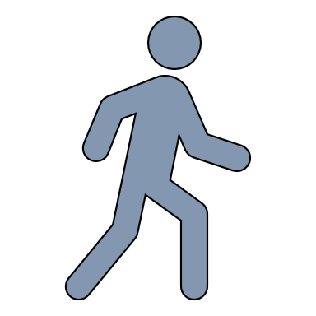
Journals
HAWKES LEARNING
Notes:
After research has been completed, researchers submit their findings for peer reviewed journals. After an article is sent in, other experts in the field read the articles for flaws and make suggestions to improve the research. Some of the flaws may be related to reliability and validity.

Slide 20

Reliability
Monday
Friday
HAWKES LEARNING
Notes:
A reliable finding is one that is consistent. If you took a driving test on Monday but failed it on Friday with similar effort, the test wouldn’t be considered reliable.

Slide 21
Validity
HAWKES LEARNING
Notes:
A valid study is one that measures what it was supposed to measure. For validity – which is a better measure of driving skill? A written test or a driving test? In this case, the driving test would be considered more valid.

Slide 22




HAWKES LEARNING
Notes:
In sum, there are a variety of different aspects that researchers must keep in mind as they engage in correlational or experimental research.

