Slide 1
HAWKES LEARNING
Freud and the Psychodynamic Perspective
Introduction to Psychology
Notes:
This lesson will focus on Sigmund Freud and the psychodynamic perspective. Freud was the first to develop a comprehensive theory regarding personality development.

Slide 2
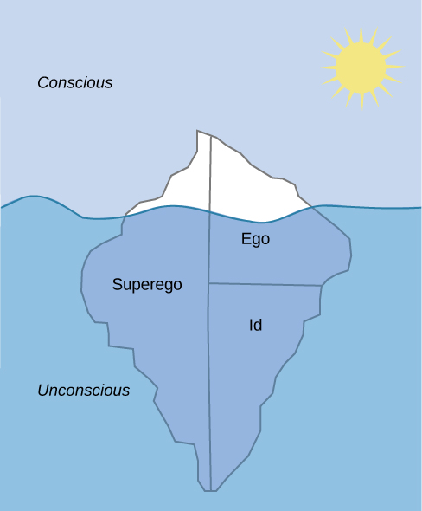
The Unconscious
Unacceptable urges
Unacceptable desires
Notes:
Freud compared the mind to an iceberg, where much of the mind is unconscious, and only a small portion was conscious. This unconscious mind held unacceptable urges and desires that direct a person’s behaviors.

Slide 3


Personality Development
Biological
Socialized Control
Id
Superego
Ego
Notes:
According to Freud, our personality develops from a conflict between two forces: our biological aggressive and pleasure-seeking drives versus our internal socialized control over these drives. Specifically, Freud felt that there is continuous conflict between the id, ego, and superego.

Slide 4
Id
Unconscious
Primitive
Pleasure-principle
Notes:
The id is the unconscious, primitive drives or urges that are present from birth. This force operates on the pleasure principle: if it feels good, do it.

Slide 5
Superego
Conscience
Moral compass
Perfection
Notes:
The superego is the opposite; it acts as our conscience and moral compass. It strives for perfection, something that isn’t often achievable.

Slide 6


Ego
Id
Superego
Notes:
Finally, the ego mediates between the id and the superego and takes into account the reality principle. Perhaps the id has the urge to have ice cream for dinner. The superego may counter with the perfect ideal of never breaking away from the diet. The ego may mediate between these and allow a scoop of ice cream after a well-balanced dinner.

Slide 7
Defense Mechanisms
Unacceptable Urges
Anxiety
Notes:
Freud also believed that we develop a variety of defense mechanisms to help us cope with these internal, unacceptable, conflicts. These mechanisms serve to help reduce our anxiety that we feel due to these unconscious urges.

Slide 8




Defense Mechanism: Denial
Refusing real events
No!
Notes:
Denial involves refusing to accept real events that are unpleasant. For example, someone with a drug or alcohol addiction may vehemently deny this reality.

Slide 9




Defense Mechanism: Displacement
Notes:
In displacement, people take out frustrations on someone other than the actual target because the actual target is too threatening. People often go home and yell at their families when they are upset with their boss or coworker instead.

Slide 10
Defense Mechanism: Projection
He cheats!
Cheater
Notes:
Projection refers to attributing your own unacceptable desires to others. For example, you may see someone else as a cheater when you, in fact, are the cheater.

Slide 11
Defense Mechanism: Rationalization
Justifications
If he hadn’t . . .
Notes:
Rationalization involves the justifications we often tell ourselves for our behaviors. Instead of admitting we made a mistake, we tend to blame it on something else. Children often engage in this behavior: “I hit him because he looked at me funny.” The focus is on explaining away the behavior rather than taking responsibility.

Slide 12



Defense Mechanism: Reaction Formation
Notes:
Reaction formation involves reacting in a way contrary to how you feel. For example, the guilt at being upset with your mother is so great that you bring her flowers!

Slide 13


Defense Mechanism: Regression
Notes:
Regression involves reverting back to a childlike state. Children often return to bedwetting or thumb-sucking when their parents are having marital issues.

Slide 14


Defense Mechanism: Repression
Notes:
Repression involves blocking negative memories, such as blocking out abuse.

Slide 15

Defense Mechanism: Sublimation
Unacceptable desires
Acceptable channels
Notes:
Sublimation involves redirecting unacceptable desires through socially acceptable channels. An example here might be an aggressive urge to hurt sex offenders, which becomes volunteer activity to help with tracking of sex offenders in the local area. We often engage in at least some of these behaviors to help protect ourselves from internal anxiety.

Slide 16
Psychosexual Stages
Oral Stage
Anal Stage
Phallic Stage
Latency Stage
Genital Stage
Notes:
Freud believed that personality developed across several psychosexual stages in early childhood. In each stage, the child has pleasure-seeking urges from different erogenous zones.

Slide 17





Oral Stage
Notes:
In the oral stage, from birth to one year, the pleasure is focused on the mouth. In fact, young babies seem to put everything in their mouths. When weaned, this can create conflict. Freud theorized that adults who smoke or overeat had an unsuccessfully resolved conflict at the end of the oral stage, resulting in an oral fixation.

Slide 18

Anal Stage
Anal retentive
Anal expulsive
Notes:
In the anal stage, 1 to 3 years of age, the child is learning to toiler train. Again, how this stage is handled could result in fixation at this stage. Freud theorized that people could become anal retentive (perfectionists, stingy, stubborn) or anal expulsive (messy, careless, disorganized).

Slide 19

Phallic Stage
Notes:
In the phallic stage, 3 to 6 years, the child becomes interested in his or her own body. Conflict arises when the child feels a desire for the opposite-sex parent and jealousy towards the same-sex parent. This Oedipus or Electra complex should be successfully resolved so that the child has a secure identity.

Slide 20



Latency Stage
Notes:
The latency period occurs until puberty. Freud felt that sexual feelings were dormant in these children, and they instead focused on friends, school, and relationships.

Slide 21


Genital Stage
Notes:
In the final stage, the genital stage, Freud described individuals as fully developed and able to direct their urges to socially acceptable partners. According to Freud, individuals who successfully navigated the other stages until this point would be well-balanced, healthy adults.

Slide 22




HAWKES LEARNING

