Slide 1
HAWKES LEARNING
Trait Theorists
Introduction to Psychology
Notes:
Trait theorists believe that personality is composed of different traits or ways of behaving.

Slide 2
Gordon Allport
Cardinal Traits
Central Traits
Secondary Traits
Notes:
Gordon Allport organized personality traits into three categories. Cardinal traits dominate the personality, central traits are those that make up our personalities, and secondary traits are present in certain circumstances.

Slide 3
Raymond Cattell
Stability
Warmth
Sensitivity
Reasoning
Openness
Vigilance
Self-reliance
Perfectionism
Notes:
Raymond Cattell identified 16 factors of personality; some of which included warmth, reasoning, emotional stability, sensitivity, vigilance, openness, self-reliance, and perfectionism. Each dimension can be scored on a continuum, which means the person is either high or low in each trait.

Slide 4




Hans and Sybil Eysenck
Extroversion
Neuroticism
Notes:
Hans and Sybil Eysenck focused on temperament, specifically extroversion and neuroticism. Those high in extroversion are outgoing and social. Those high in introversion like to be alone. High neuroticism results in anxiety, and low neuroticism refers to emotional stability.

Slide 5
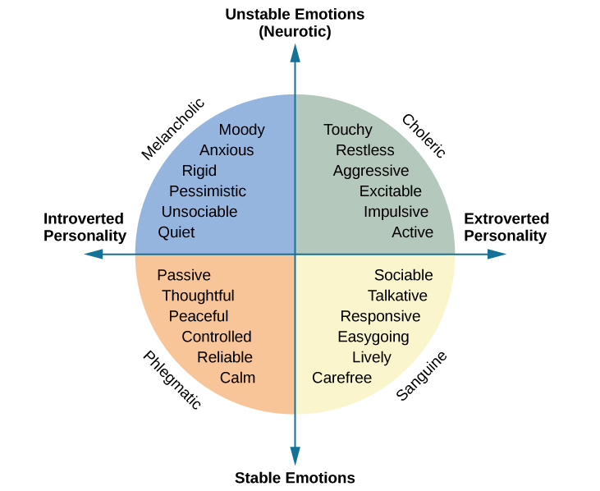
Personality
Notes:
These traits of extroversion and neuroticism were used to create four personality dimensions: melancholic, choleric, sanguine, and phlegmatic.

Slide 6


Additional Dimension
Psychoticism
Superego Control
Notes:
The Eysencks later added another dimension—psychoticism and superego control. Those high in psychoticism tend to be independent thinkers who are cold and nonconformist. In contrast, those high in superego control tend to be more altruistic and cooperative.

Slide 7






Five Factors
A+
Notes:
The Five Factor Model of personality includes openness, which includes imagination and curiosity; conscientiousness, which is characterized by competence; self-discipline and achievement; extroversion, which is the degree of sociability; agreeableness, which is the degree to which a person is pleasant, cooperative, and good-natured; and finally, neuroticism, which is the tendency to experience negative emotions.

Slide 8




HAWKES LEARNING
Notes:
Taken together, these traits may explain, in part, our personalities.

