Slide 1
HAWKES LEARNING
Cultural Understandings of Personality
Introduction to Psychology
Notes:
A cultural understanding of personality is important because culture is one of the most influential environmental factors that shape us.

Slide 2

Culture
Beliefs
Customs
Art
Traditions
Notes:
Culture refers to all of the beliefs, customs, art, and traditions of a particular society.

Slide 3



Culture
Universal
Culture-specific
Notes:
Given that these beliefs are passed down through language and observational learning, researchers have investigated whether personality traits are the same across cultures. There does appear to be some universal and some culture-specific aspects.

Slide 4

Big 5 Factors
Notes:
Traits of the Big 5 can vary across cultures. For example, Asian cultures are less extroverted. Ventral and South American individuals tend to be more open to experience, whereas Europeans are higher on neuroticism.

Slide 5
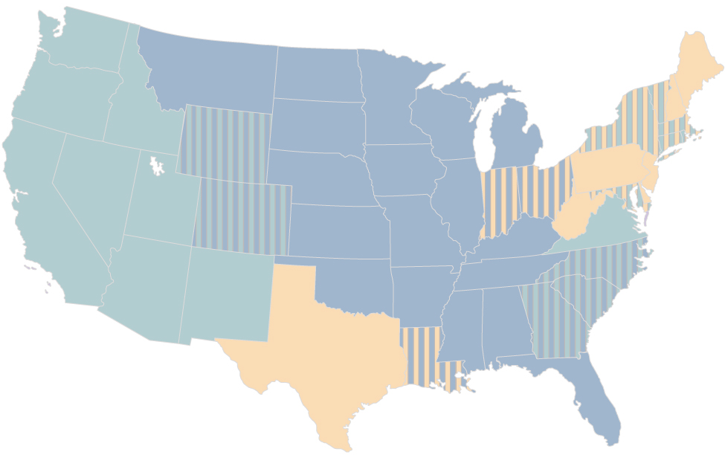

Cerebral Cortex
Notes:
There are even cultural differences within different regions of the United States. The first group is the Upper Midwest and Deep South, which contain “friendly and conventional” people. The West is dominated by calm, emotionally stable individuals. Finally, the Northeast is more stressed, irritable, and depressed.

Slide 6







Culture
Individualistic
Collectivistic
Notes:
Cultures are typically individualistic, valuing independence and personal achievement, or collectivistic, valuing social harmony and group needs. These cultural influences can impact personality with those from collectivistic cultures being more socially oriented, and those from individualistic cultures being more individually oriented.

Slide 7
Studying Culture
Cultural-comparative
Indigenous
Cross-cultural
Notes:
There are different approaches to studying personality in a cultural context. The cultural-comparative approach seeks to test Western ideas about personality in other cultures to determine their generalizability. The indigenous approach uses personality constructs that are relevant to the culture being studied, rather than a Western comparison. Finally, cross-cultural studies combine these approaches.

Slide 8




HAWKES LEARNING

