Slide 1
HAWKES LEARNING
Personality Assessment
Introduction to Psychology
Notes:
Personality assessment is often used in employment decisions, in criminal cases, and to assess psychological disorders.

Slide 2
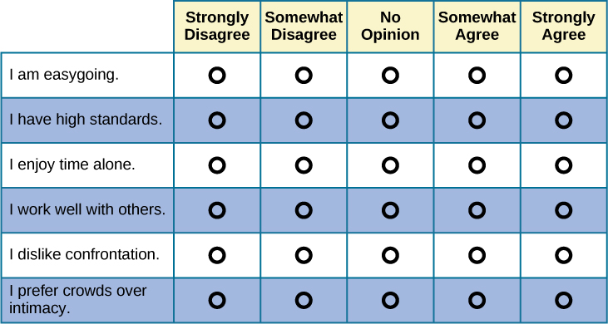
Self-Report Inventories
Notes:
A self-report inventory is a multiple-choice type questionnaire that typically uses a Likert scale, such as a range of answers from Strongly Disagree to Strongly Agree. One such example, the Minnesota Multiphasic Personality Inventory (MMPI), measures a variety of factors including depression and paranoia.

Slide 3


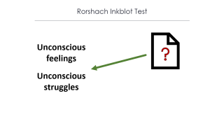
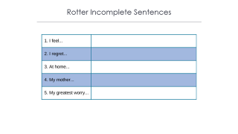
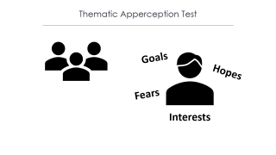
Projective Tests
Personality
Notes:
Projective tests ask individuals to interpret meaning from a series of ambiguous pictures. These tests are supposed to tap into Freud’s idea of projection where the individual projects his or her feelings onto the card and, thereby, shares information about his or her personality.

Slide 4

Rorshach Inkblot Test
Unconscious feelings
Unconscious struggles
Notes:
The Rorshach Inkblot test is a series of inkblots in which the client must identify what is seen. The answers given represent unconscious feelings and struggles.

Slide 5


Thematic Apperception Test
Goals
Hopes
Fears
Interests
Notes:
The Thematic Apperception Test includes 8 to 12 ambiguous pictures, and the client must tell a story about each picture. These stories give insight into the person’s hopes, fears, interests, and goals.

Slide 6
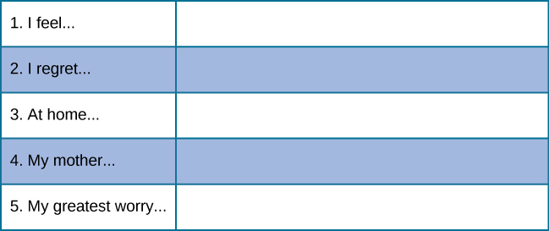
Rotter Incomplete Sentences
Notes:
The Rotter Incomplete Sentence Bank includes 40 incomplete sentences that people are asked to complete as quickly as possible.

Slide 7

Culturally Specific Personality Tests
Contemporized-Themes Concerning Blacks Test
Tell Me a Story Multicultural Thematic Apperception Test
Notes:
There are also culturally specific projective tests, such as the Contemporized-Themes Concerning Blacks Test, which contains 20 color images that show scenes of African-American lifestyles. The Tell Me a Story Multicultural Thematic Apperception Test uses images and storytelling cues that relate to minority culture.

Slide 8




HAWKES LEARNING

