Slide 1
HAWKES LEARNING
Conformity, Compliance, and Obedience
Notes:
Researchers have often been interested in conformity, compliance, and obedience.

Slide 2
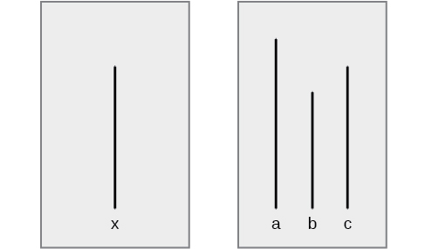
Conformity
This Photo by Unknown Author is licensed under CC BY
HAWKES LEARNING
Notes:
In the Asch Line Experiment, a single participant was in the room with several confederates and was asked to indicate which line – A, B, or C matched with x. The confederates would give the wrong answer, and then the participant would have to answer last. Results showed the majority of participants went along with the group.

Slide 3
Asch Line Experiment
Large majority
Group was unanimous
Responses public
Voices of dissent
Private answers
HAWKES LEARNING
Notes:
The Asch effect can be increased if the majority is big, if the group was unanimous, and if responses were public. If there were other voices of dissent or if the answer could be given privately, they were less likely to conform.

Slide 4



Motivation
Normative Social Influence
Informational Social Influence
HAWKES LEARNING
Notes:
Motivation to confirm falls into two groups: normative social influence involves conforming in order to feel accepted or to fit in. Informational social influence involves conforming because the group is thought to be competent and correct.

Slide 5


Obedience to Authority
HAWKES LEARNING
Notes:
Another form of social influence is obedience to authority. Obedience is the change of an individual’s behavior to comply with a demand by an authority figure.

Slide 6



Milgram Study
Participant
Confederate
HAWKES LEARNING
Notes:
A classic experiment by Stanley Milgram demonstrated the power of obedience. In this case, a participant was paired with a confederate. The participant was to shock the confederate if he or she answered a question incorrectly.

Slide 7


Milgram Study
?
HAWKES LEARNING
Notes:
For each incorrect answer, the voltage of the shock was increased. When confederates appeared upset, cried, or protested, participants continued to shock them when the researcher prompted them to continue. In fact, 65% of people continued to apply the shocks to the point that the learner no longer responded.

Slide 8






Groupthink
HAWKES LEARNING
Notes:
Another type of conformity occurs when groups get together. Groupthink occurs when people modify their opinions to fit with the group. In these cases, people want to maintain group harmony and avoid disagreeing with the leader.

Slide 9
Group Polarization
Pro-diversity
HAWKES LEARNING
Notes:
Group polarization occurs when the original group attitude becomes stronger as group members are allowed to discuss their views. For example, individuals who are moderately pro-diversity will become more pro-diversity as they communicate.

Slide 10



Social Facilitation
HAWKES LEARNING
Notes:
Social facilitation occurs when an individual performs better when an audience is watching than when performing alone. This phenomenon usually occurs in sports.

Slide 11




Social Loafing
HAWKES LEARNING
Notes:
Everyone has probably had experience with a social loafer in their lives. These are individuals who, when given group work, do not contribute, knowing the others will pick up their slack. This situation is especially common for easy tasks when individual effort is not known.

Slide 12




HAWKES LEARNING

