Slide 1
HAWKES LEARNING
Prejudice and Discrimination
Notes:
Prejudice and discrimination are often the root causes of human conflict.

Slide 2






Social Groups
HAWKES LEARNING
Notes:
The social groups we belong to often help to form our identities but they can also form the basis for group differences that can lead to prejudice and discrimination. Prejudice is a negative attitude about an individual based on his or her group membership.

Slide 3







Social Groups
HAWKES LEARNING
Notes:
Social groups include many facts including gender, race, nationality, social class, religion, and more. Any of these can become the foundation for prejudicial beliefs.

Slide 4





Stereotypes
HAWKES LEARNING
Notes:
Prejudice often begins with stereotypes – specific beliefs about people based on their group membership that may not be true of the individual. Old people are often seen as incompetent, but that is certainly not true of even the majority of older people. It isn’t true that blondes are dumb. All women are not bad drivers. There are countless others.

Slide 5

Discrimination
HAWKES LEARNING
Notes:
Sometimes people will act on these prejudiced attitudes and commit discrimination. Discrimination is a negative action toward an individual as a result of one’s membership in a group. For example, choosing not to hire someone of a particular group would be an example of discrimination.

Slide 6

Prejudice and Discrimination
HAWKES LEARNING
Notes:
There are a variety of types of prejudice and discrimination.

Slide 7



Racism
HAWKES LEARNING
Notes:
Racism involves prejudice and discrimination against individuals based on their racial group membership. These attitudes then result in different treatment for individuals. For example, many people have often heard of the idea of “Driving while black” which refers to the fact that Black people are pulled over more often than White people are.

Slide 8







Sexism
HAWKES LEARNING
Notes:
Sexism is another relatively common prejudice and discrimination in which people are targeted based on their sex. Gender role expectations, such as expecting women to be nurturing and men to be dominant, are included in sexism.

Slide 9



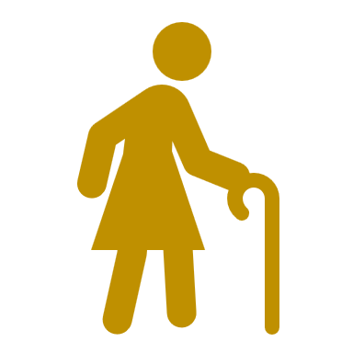


Ageism
HAWKES LEARNING
Notes:
Ageism refers to prejudice and discrimination based on a person’s age. Typically, ageism occurs with older adults but younger adults can also be affected. Older adults are seen as incompetent and treated as children simply due to their age. Similarly, young adults are sometimes not given opportunities due to the belief that they are too young to handle them.

Slide 10

Homophobia
This Photo by Unknown Author is licensed under CC BY-SA
HAWKES LEARNING
Notes:
Homophobia is another prejudice based on someone’s sexual orientation. Individuals who are part of the LGBT community are often discriminated against based on their orientation.

Slide 11

Prejudice and Discrimination
HAWKES LEARNING
Notes:
Prejudice and discrimination are perpetuated by our psychology. For example, when we hold a stereotype about a person, we have expectations that the person will fill that expectation. Therefore, we look for the person to confirm our beliefs. If you believe all blondes are bad drivers, you will surely notice when your blonde friend makes a mistake behind the wheel. In addition, your friend may know your belief about blonde drivers. Therefore, the person gets nervous when you are in the car, resulting in making an error that may not have otherwise occurred.

Slide 12
Self-fulfilling Prophecy
HAWKES LEARNING
Notes:
Another aspect that keeps stereotypes alive is the fact that we have an in-group bias. We have a natural tendency to like people similar to ourselves. This increased the likelihood that we will not like perceived outsiders.

Slide 13
In-Group Bias
HAWKES LEARNING
Notes:
To promote harmony between groups, empathy is key. We are all individuals with diverse backgrounds but we are likely more similar than one might think.

Slide 14




HAWKES LEARNING

