Slide 1
HAWKES LEARNING
Prosocial Behavior
Introduction to Psychology
Notes:
In this section, we will discuss prosocial behavior: voluntary behavior with the intent to help others.

Slide 2



Altruism
Notes:
Why do we help others? Altruism may be one reason; it is our desire to help others even if the costs outweigh the benefits of helping. A person running into a burning building would be an example of an altruistic action. This action may result in the individual’s death.

Slide 3


Altruism cont’d
Empathy
Notes:
Some researchers believe that altruism operates on empathy, which is the capacity to understand another person’s perspective, to feel what the other person feels. There is a controversy over whether altruism is motivated by the desire to feel good about oneself. Some say we are too self-centered to be truly altruistic. Others say this boost in self-perception is not the cause of such behavior.

Slide 4


Relationships
Notes:
Another focus in prosocial behavior is why we form relationships with certain people. It turns out that the people we tend to choose as friends or partners are those whom we come into contact with frequently. Similarity is another factor; we tend to gravitate towards those that share our interests, background, and lifestyle.

Slide 5

Reciprocity
Notes:
Relationships succeed when there is reciprocity: the give and take that all relationships should have. Self-disclosure is a component of this give and take: we share more information with each other as we become better friends or more invested partners.

Slide 6


Attraction
Notes:
What is the basis of attraction? We tend to look for physical attractiveness, but that gauge can vary widely. For women, some universally attractive features include large eyes, high cheekbones, and a slender build. For men, being tall with broad shoulders and narrow waist are universally desired.

Slide 7
Social Traits
Warmth
Achievement
Affection
Leadership
Social skills
Job skills
Notes:
Some social traits are also preferred over others. For instance, warmth, affection, and social skills are prized in women, whereas achievement, leadership, and job skills are valued in men.

Slide 8
Attraction cont’d
Notes:
While we may be attracted to people with certain physical features, we often pursue those that we perceive on a similar level of attractiveness to ourselves. This matching hypothesis explains why some individuals will not pursue those they deem as “out of their league.”

Slide 9
Sternberg’s Theory of Love
Intimacy
Passion
Commitment
Notes:
The type of love we feel for people can also vary. In Sternberg’s triangular theory of love, he postulated that there were three components of love. Intimacy was the sharing of details and intimate thoughts and emotions. Passion was physical attraction. Finally, commitment was sticking by the person.

Slide 10
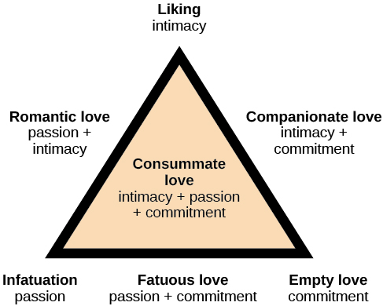
Sternberg’s Theory of Love cont’d
Notes:
These three factors could be combined to create 7 different types of love, ranging from only liking a person (intimacy only) to having romantic love (with both passion and intimacy) to the pinnacle of all love, consummate love, where the individuals have all three components.

Slide 11
Social Exchange Theory
Costs
Benefits
Notes:
Finally, social exchange theory determines the degree to which we are satisfied in relationships. The idea here is that we keep tabs on the costs and benefits of the relationship. As in all things, we are often driven to increase benefits while minimizing costs. Here, if a relationship is perceived as costly, we are more likely to let it go.

Slide 12




HAWKES LEARNING

