Slide 1
HAWKES LEARNING
What Is Industrial and Organizational Psychology?
Introduction to Psychology
Notes:
Industrial organizational psychology is a branch of psychology that studies how human behavior and psychology affect work and how individuals are affected by work.

Slide 2
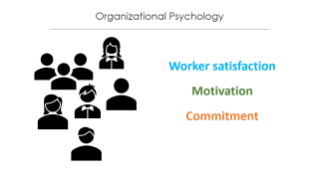
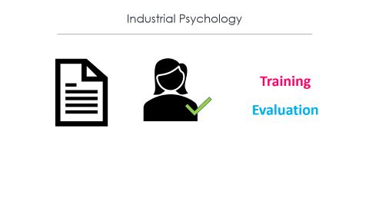

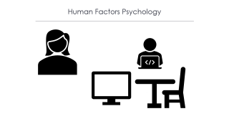

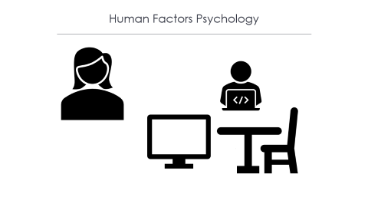
Industrial and Organizational Psychology
Notes:
This focus can be divided into three different sub-divisions.

Slide 3



Industrial Psychology
Training
Evaluation
Notes:
Industrial psychology describes job requirements and assesses an individual’s ability to meet those requirements. Employee training and evaluations are also important.

Slide 4





Organizational Psychology
Worker satisfaction
Motivation
Commitment
Notes:
Organizational psychology is about relationships between employees. Worker satisfaction, motivation, and commitment, among other aspects, are important.

Slide 5

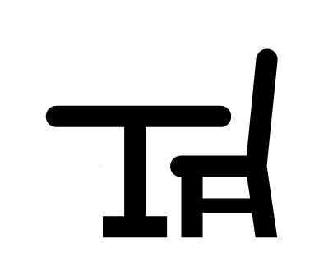

Human Factors Psychology
Notes:
Finally, human factors psychology is the study of how workers interact with the tools of work and how to design these tools to optimize productivity, safety, and health. Desks, chairs, and computer design can all be considerations.

Slide 6


Historical Beginnings
James Cattell
Walter Dill Scott
Notes:
Some historical beginnings of industrial organizational psychology include James Cattell, who set up a psychological consulting company, and Walter Dill Scott, who applied psychology to advertising, management, and personnel selection.

Slide 7
Historical Beginnings
World War I
Enlisted
Officers
Notes:
World War I was a facilitator of the development of this branch of psychology. Specifically, the military wanted to screen and select men best suited to serve. It was also important to select those best suited to be officers.

Slide 8

Historical Beginnings
Elton Mayo
Hawthorne effect
Notes:
Elton Mayo focused on how social and psychological factors impact performance, such as how supervisory style impacts productivity. This research led to the term the Hawthorne effect, which is the increase in performance that occurs when people are noticed, watched, and paid attention to.

Slide 9
Historical Beginnings
Kurt Lewin
Frederick Taylor
Lillian Gilbreth
Notes:
Other developments included Kurt Lewin’s focus on leadership styles, team structure, and team dynamics. Frederick Taylor redesigned workspaces to increase productivity. Lillian Gilbreth focused on reducing the number of moves workers had to perform on the job. These investigations into employee fatigue and time management stress helped to improve the workplace.

Slide 10




HAWKES LEARNING

