Slide 1
HAWKES LEARNING
Industrial Psychology: Selecting and Evaluating Employees
Introduction to Psychology
Notes:
Industrial psychology involves selecting and evaluating employees.

Slide 2
Job Analysis
Task
Worker
Frequency
Difficulty
Importance
Knowledge
Skills
Abilities
Notes:
One way to select an employee would be to perform a job analysis in which the job or person bested suited to the job is described. A job analysis can be approached in two ways. One is task-oriented in which the task is described in terms of frequency, difficulty, and importance. The second is worker-oriented, which describes the knowledge, skills, and abilities necessary for the job.

Slide 3





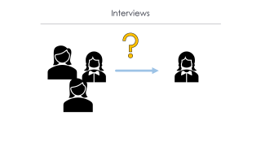
Selection
Notes:
Potential candidates then need to be narrowed down, and this process can involve testing, interviews, or work samples. Essentially, the goal is to find the right person for the specific job.

Slide 4

Interviews
Notes:
One way to determine fit is through interviews. Unstructured interviews include questions that were not predetermined, whereas a structured interview does use predetermined questions. Standardized questions are scored for each candidate, so the best person can be selected.

Slide 5

Training
Notes:
Once employees are selected, they usually undergo training to orient individuals to the new workplace and job requirements. In some cases, individuals will receive mentoring in which an experienced employee guides the work of the new employee. Mentoring can have positive benefits for both the one mentoring and the one being mentored.

Slide 6

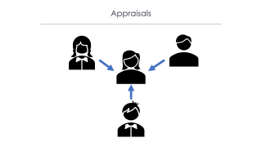
Appraisal
Perform better
Job-person match
Training needs
Notes:
I/O psychologists develop performance appraisal systems, so corporations can determine the degree to which employees are meeting their job requirements. Fairly evaluated work helps employees perform better, improves the likelihood of job-person match, and identifies training needs.

Slide 7
Appraisals
Notes:
Performance appraisals involve documenting work behaviors and a face-to-face meeting with a supervisor regarding performance. One approach is the 360-degree feedback appraisal in which the employee’s ratings derive from supervisors, peers, employees that are under the target employee, and from the employee him/herself.

Slide 8



Employment Laws
Religion
Notes:
There are a variety of safeguards in place when it comes to hiring individuals. The U.S. Equal Employment Opportunity Commission is responsible for enforcing federal laws that make it illegal to discriminate against a job applicant due to race, color, religion, sex, national origin, age, or disability.

Slide 9


Employment Law
Notes:
Some specific laws include the Equal Pay Act, which requires men and women to earn the same amount if performing the same job. Title VII of the Civil Rights Act requires equal treatment for individuals of differing race. Federal legislation does not currently protect individuals for differing sexual orientation or gender identity; this protection has been left up to the states.

Slide 10


Employment Law
Notes:
The Americans with Disabilities Act states people may not be discriminated against due to the nature of their disability—both physical and mental. If a disability is disclosed, an employer must make reasonable accommodations for the employee. In some cases, jobs may have specific requirements for age or sex if that attribute is absolutely necessary to the job. For example, there is an age requirement for pilots for safety reasons.

Slide 11




HAWKES LEARNING

